Slide 1
Performance and Scalability
By Vaisali Namburi
Vasantha Gundeti

Slide 2
Scalability
Scalability is the capability of a system, network, or process to handle a growing amount of work or its potential to be enlarged in order to accommodate that growth.

Slide 3
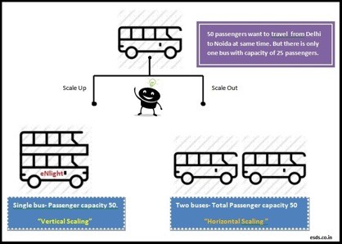
Different ways to Scale a Database
Horizontal Scaling - It is the ability to increase the capacity of existing hardware or software by adding resources.
Vertical Scaling - Vertical scaling is limited by the fact that you can only get as big as the size of the server.

Slide 4
Horizontal Scaling
Lots of smaller servers.
You can upgrade by adding a new server(often called by a node).
Nodes can either self contained whole of the application or separate functional nodes.

Slide 5
Vertical Scaling
Few larger servers.
You can upgrade the application environment by adding more individual resource: more RAM faster disk etc.
The classic method of writing web apps relies on this(one server or a simple cluster).

Slide 6
Performance
Database performance can be defined as the optimization of the resource use to increase the throughput and minimize contention, enabling the largest possible workload to be processed.

Slide 7
Key Factors
System resources
Work Load Throughput Contention

Slide 8
Database Tuning
Database tuning is activity of making a database application run more quickly, usually means higher throughput though it may mean lower response time for time critical applications.
The main aim is to maximize the use of system resources to perform work as efficiently as possible.

Slide 9
Query Optimization
Query optimization is a function of many relational database management systems.
The query optimizer attempts to determine the most efficient way to execute a given query by considering the possible query plans.

Slide 10
Scaling Up Vs Scaling Out
•
Scale-up typically refers to architectures that use a single, fixed resource controller for all processing. To add capacity, you attach disk-shelves up to the maximum for which the controller is rated.
Scale-out typically refers to architectures that scale performance and capacity separately by not relying on a single controller, but instead provide processing power with each unit of disk.

Slide 11
Database Partitioning
A partition is a division of a logical database or its constituent elements into distinct independent parts.
Database partitioning is normally done for manageability, performance or availability reasons.

Slide 12
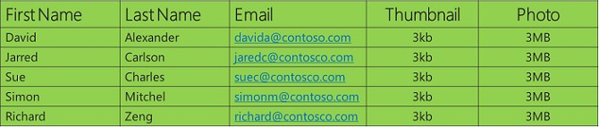
Partitioning Methods
The partitioning can be done by either building separate smaller databases or by splitting selected elements, for example just one table.
➢Horizontal partitioning
➢Vertical partitioning

Slide 13
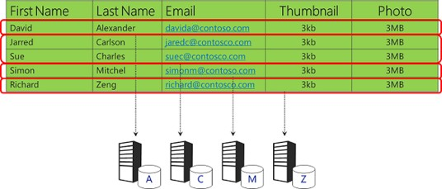
Horizontal Partitioning
Horizontal partitioning involves putting different rows into different tables.
Customers with ZIP codes less than 50000 are stored in CustomersEast, while customers with ZIP codes greater than or equal to 50000 are stored in CustomersWest.

Slide 14
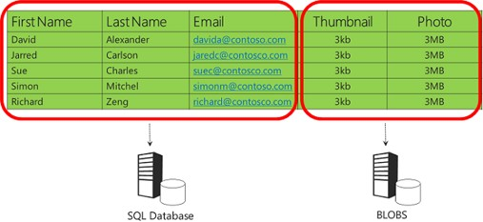
Vertical Partitioning
Vertical partitioning involves creating tables with fewer columns and using additional tables to store the remaining columns.
Normalization also involves this splitting of columns across tables, but vertical partitioning goes beyond that and partitions columns even when already normalized.

Slide 15
Advantages of Partitioning
Each partition may be spread over multiple nodes, and users at the node can perform local transactions on the partition.
This increases performance for sites that have regular transactions involving certain views of data.

Slide 16
Clustering
Clustering refers to the ability of several servers or instances to connect to a single database.
An instance is the collection of memory and processes that interacts with a database, which is the set of physical files that actually store data.
Shared-Nothing Architecture
Shared-Disk Architecture

Slide 17
Advantages
Fault tolerance: Because there is more than one server or instance for users to connect to, clustering offers an alternative, in the event of individual server failure.
Load balancing: The clustering feature is usually set up to allow users to be automatically allocated to the server with the least load.

Slide 18
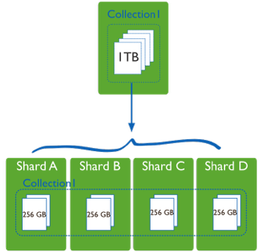
Sharding
•Sharding is a type of database partitioning that separates very large databases the into smaller, faster, more easily managed parts called data shards. The word shard means a small part of a whole.
•There are four types of sharding
Vertical Based Sharding
Range Based Sharding
Hash Key Based Sharding
Directory Based Sharding

Slide 19
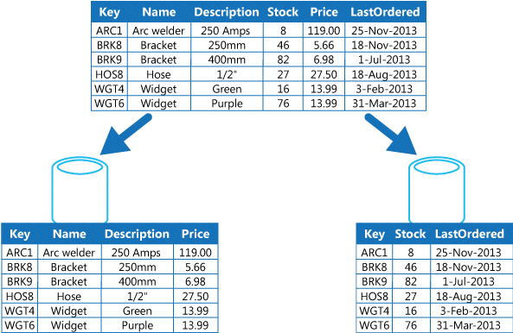
Vertical Based Sharding

Slide 20
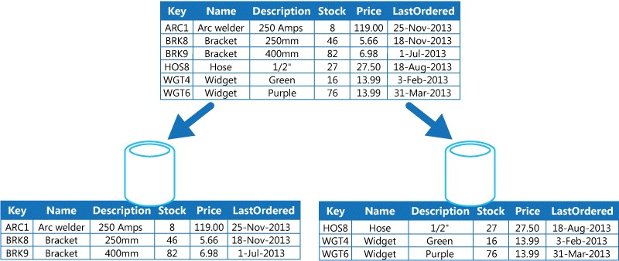
Range Based Sharding

Slide 21
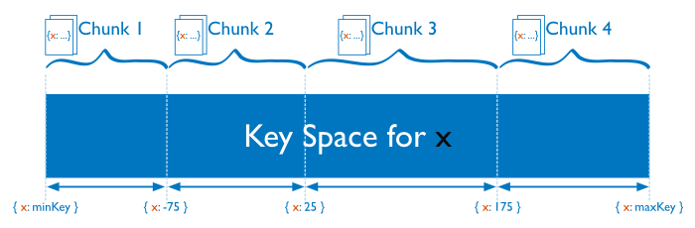
Hash-Key Based Sharding

Slide 22
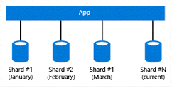
Directory Based Sharding

Slide 23
Data Retrieval
Un-wrapper
Segregator Execution Formatter Responder

Slide 24
Clustering Vs Sharding
Clustering - Using multiple application servers to access the same database. Used for computation intensive, parallelized, analytical applications that work on non volatile data.
Sharding - Splitting up a large table of data horizontally. Sharding is done to spread load and improve access speed.

Slide 25
Sharding Vs Mysql Cluster
Differences in intention
Architecture differences
SQL operations
Horizontal partitioning
Rebalancing data and Backup Strategies

Slide 26
Differences in Intension
Sharding is designed for
Quick Scalability
Handling high write/read ratios
MySQL Clusters are designed for
Fast Responses
Always on 99.999% reliability
Handling high read/write ratios

Slide 27
Architectural Differences
MySQL Clusters are geared to handle fast fail overs automatically.
This is ensured by replicating the data in several database nodes to handle random node failures.
While any number of shards can be added to the system as long as the network supports, the number of nodes in a MySQL Cluster is limited.

Slide 28
SQL Operations
On Shards, joins are inherently impossible. MySQL Clusters support joins but they are much slower than on traditional databases as it has to be run against data on different nodes

Slide 29
Horizontal Partitioning
On Shards the partitioning logic can be defined by the user. So essentially any logic can be employed.
As of MySQL Cluster 5.1.6, all Cluster tables are by default partitioned by KEY using the table's primary key as the partitioning key.

Slide 30
Rebalancing Data and Backup Strategies
In shard, These features have been custom implemented currently. There are some libraries that are coming up to assist the same.
On a MySQL Cluster these are implemented and require least work.

Slide 31
Shard-Query
A GRID, or "Group of Redundant Independent Databases" is a collection of nodes that represent one large "virtual schema". Each node in the grid is uniquely identified by a hostname, a port and a schema name.
Shard-Query supports multiple different virtual schema, each with a unique sharding setup.

Slide 32
Shard-Query(cont..)
Shard-Query requires that one node be designated for the configuration repository.
Shard-Query stores data in storage nodes. All storage nodes must contain identical schema in order for Shard- Query to work properly.
Storage nodes contain both sharded and unsharded tables.

Slide 33
Sharded-Tables
When setting up Shard-Query, a "shard key" is selected. This column, when present in a row, identifies the table as being “sharded”.
This means that the data in the table will depend on the value of the "shard key" column in each row.

Slide 34
UnSharded-Tables
Shard-Query supports un-sharded tables. Un-sharded tables are tables which do not contain the "shard key". Insertions into un-sharded tables go to all shards. When a query does not reference any sharded tables, then the query is sent to only a single shard to prevent duplication of data.

Slide 35
Requirements
At least one server for data storage
A database schema for storing the Shard-Query configuration
MySQL 5.1+ (5.6 STRONGLY suggested!) Apache
PHP
gearmand (get it from epel, or compile from gearman.org)
php-mysql

Slide 36
Parallel-Query
It allows one to break a given SQL statement so that its parts can run simultaneously on different processors in a multi-processor machine.
Parallel query divide the workload of a SQL statement.
Parallel Query can improve performance of certain types of operations dramatically and is commonly used in Decision Support and Data Warehousing applications.

Slide 37
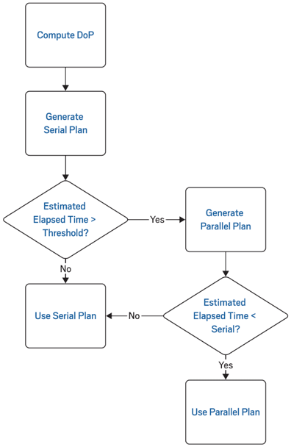
Decision Tree for Query Parallelization

Slide 38
Overview
Scalability
Performance Partitioning Clustering
Sharding Shard Query
Parallel Query

Slide 39
THANK YOU

