Slide 1
RDBMS vs. NOSQL
By
Anusha Kondapalli,
Shilpa Poloju

Slide 2
RDBMS
Relational database management system.
Based on relational model.
This model is based on tables, rows and columns and the manipulation of data stored within.
Relational database is a collection of these tables.
It has overtaken Hierarchical and Network models.
Single database can be spread across several tables.
Examples: Sybase, Oracle, IBM’s DB2, MySQL & Microsoft Access.

Slide 3
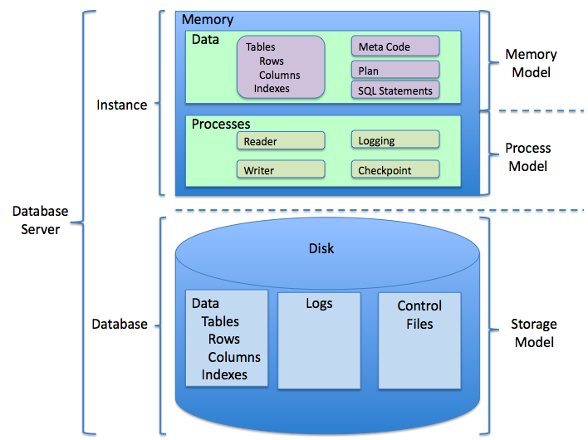
General structure of RDBMS

Slide 4
RDBMS Storage Method
There are some special data structures allowing to efficiently store a large sorted data on a block storage device.
Indexing(File Structure)
record block
database
secondary storage

Slide 5
Each record is stored in one block of secondary storage.
Two methods of storage: spanned and unspanned.
Indexing : used to make search faster.
For each record there is a pointer/index.
Index points Record stored in secondary storage(blocks)
index file
Index+record points

Slide 6
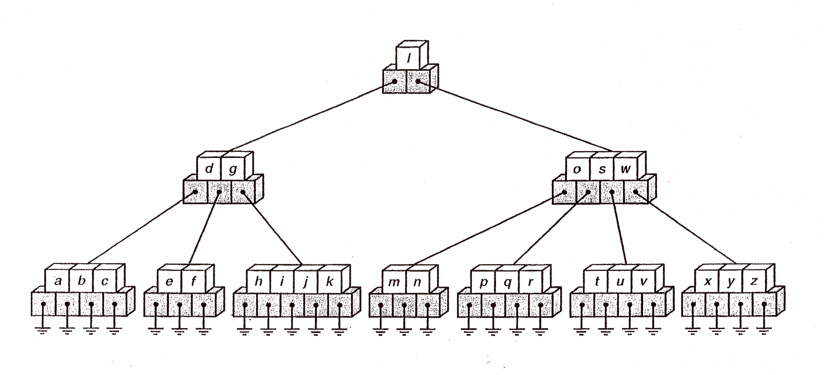
Btree

Slide 7
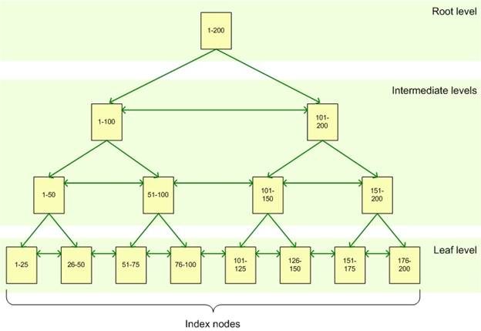
B+ tree

Slide 8
ISAM
An early technology for fast retrieval of individual records and maintained sorted data.
It is about how the data is mapped to the physical data storage device.
ISAM files are generally an integrated storage structure.
Clustered.
Each index entry contains an entire row.
A node contains F keys and F+1 pointers.

Slide 9
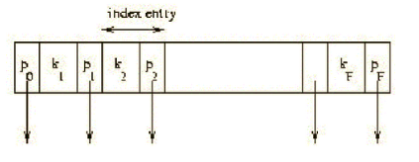
This node structure is a generalization of a binary search tree node.
Separator entry = (k_{i} , p_{i}) where k_{i} is a search key value and pi is a pointer to a lower level page.
F is determined by the index or primary key size of the data, s, plus 4 bytes for pointers.

Slide 10
Advantages of RDBMS
Data is only stored once.
Complex queries can be carried out.
Better security.
Cater for future requirements.
Ease of use.
Flexibility.
Precision.

Slide 11
Disadvantages
Performance.
Physical storage consumption.
Slow extraction of meaning from data.
Data complexity.
Broken keys and records.
Developer expertise.
Hardware.

Slide 12
NOSQL
“Not only SQL”.
Organizes data into objects, key-value pairs.
Distributed, fault-tolerant architecture.
No fixed schema.
No joins
- expensive operation for combining records from two or more tables into one set.
- joins require strong consistency and fixed schemas.
It is not a replacement for a RDBMS but compliments it.
Mostly open source.
Running well on clusters.

Slide 13
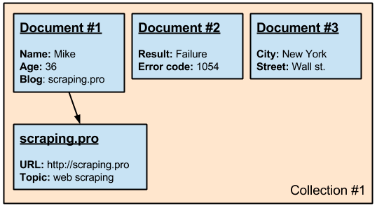
Types of NoSQL
Document oriented database: semi structured data.
Data is represented in formats similar to JSON.
Each document has set of properties that may differ from others.
e.g.: mongo database, couch database.
Practical examples: linked-In, Dropbox.

Slide 14
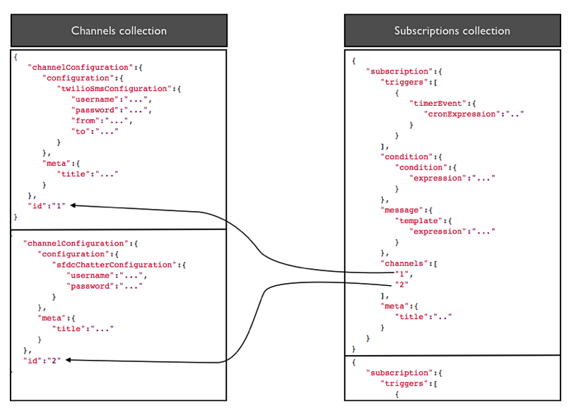
Document oriented database

Slide 15
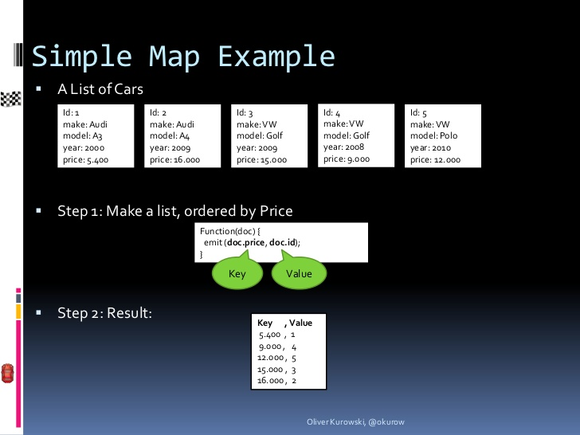
Couch db: map function

Slide 16
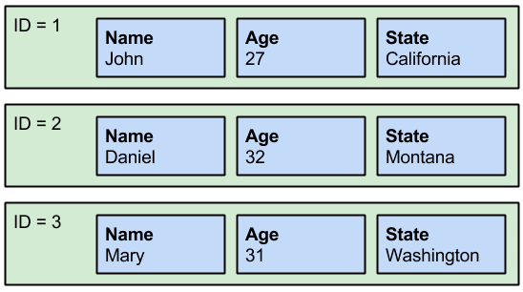
Columnar database- distributed peer stores.
Designed to handle huge amount of data distributes over many servers.
Uses keys
e.g. : Cassandra, Dynamo databases.
Practical applications e.g. : Google earth, Ebay.

Slide 17
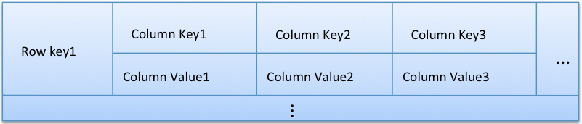
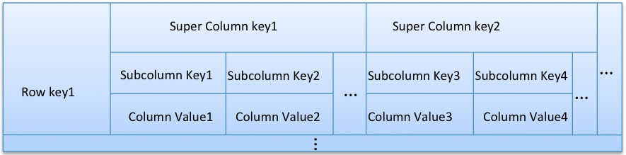
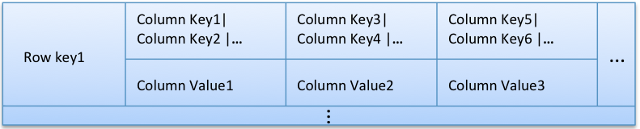

Slide 18
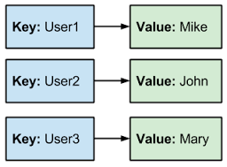
Key value database
Allows to store data in an unstructured manner.
The stored data contains key and the actual data.
Key value stores keep data by keys.
e.g.: REDIS, Amazon Dynamo.

Slide 19
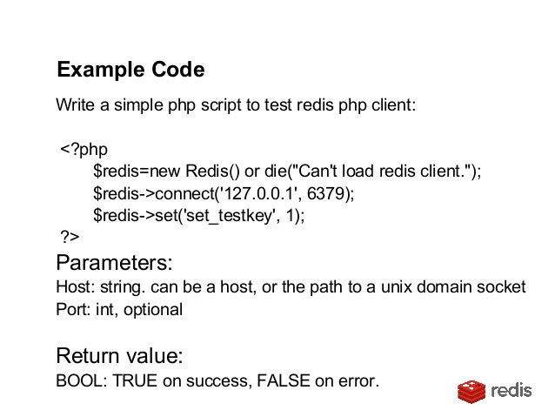
Simplest to implement.
Works for complex data that is difficult to model.
Applies in situations where write performance is prioritize.
Practical applications: Amazon shopping cart, Mozilla Test Pilot.
Redis example:

Slide 20
Graph database
Keeps data in forms of nodes, properties and edges.
Fits for any application that requires managing relationships among objects like social networks.
e.g.: Neo4j, Infinite Graph, InfoGrid
Practical applications: Polymap, Neoclipse, Neosocial which connects Facebook.

Slide 21
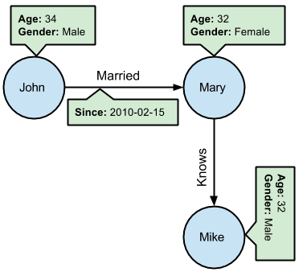

Slide 22
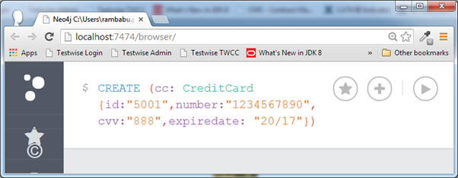
Neo4j

Slide 23
Advantages of NoSQL
Massive scalability.
High availability.
Lower cost.
Predictable elasticity.
Schema flexibility, sparse & semi-structured data.

Slide 24
Disadvantages
Limited query capabilities.
Eventual consistency
- makes client applications more complicated
No standardization
Insufficient access control.

Slide 25
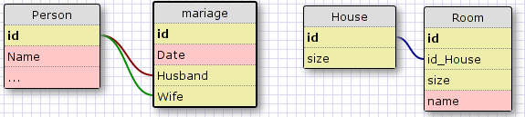
RDBMS Vs NoSQL
When and why should choose RDBMS
Some unique features:
Table based.
Relations between distinct table entities and rows.
Referential integrity.
ACID Transactions.
Arbitrary Queries and joins.

Slide 26
Why RDBMS might not right?
Features like data model, storage, data retrieval and administration are at the price of complexity.
Does not provide good persistent and consistency where as key value store is perfect.
In hierarchical application objects and query capability then any NoSQL solution is better.

Slide 27
RDBMS does not support large trees or networks where as Graph data base suits best.
For distributed DB for durability and availability Dynamo and big table were used.
For large data to be processed on a single machine than Hadoop .

Slide 28
Why an RDBMS does not scale and many NoSQL solutions do
Problem with RDBMS is horizontal distribution of large data.
RDBMS cannot easily achieve automatic data sharding.

Slide 29
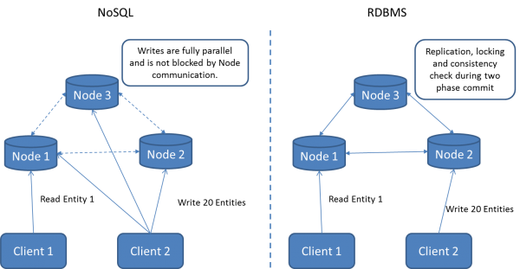

Slide 30
What about application performance?
Depends to a very large degree on choosing the right implementation for your use case.
Both application performance and scalability depends heavily on data itself, especially on database cluster.
looking at the end-to-end application performance it can handle the different NoSQL solutions just like any other database.

Slide 31
References
http://apmblog.dynatrace.com/2011/10/05/nosql-or-rdbms-are-we-asking-the-right-questions/
http://www.ebaytechblog.com/2014/10/10/nosql-data-modeling/
https://www.thoughtworks.com/insights/blog/nosql-databases-overview
http://scraping.pro/where-nosql-practically-used/
https://www.youtube.com/watch?v=gXVeBpww3x0

Slide 32


