Slide 1
SQLite
by Majesh and Naveen

Slide 2
Contents
RDMS
Storage Mechanism
Transactions in RDBMS
Introduction to SQLite
Data Storage
WAL mode
Pages
Storage Classes and Type Affinity
Limits in SQLite
Appropriate Uses for SQLite
Architecture and Virtual File System
Advantages and Disadvantages

Slide 3
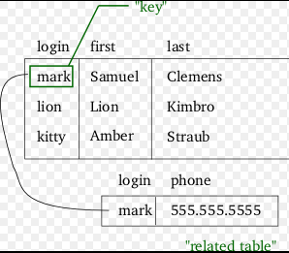
RDBMS
Relation Database Management System.
Based on Relational Model.
Invented by E. F. Codd.
Present the data to the user as tables.
Provide relational operators to manipulate the data.

Slide 4
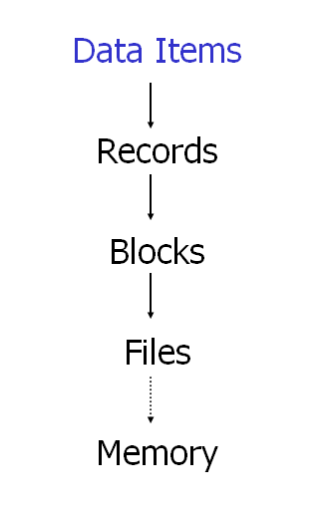
Storage Mechanism
Data items are stored in records.
Records are placed in blocks in two ways, Spanned and Un-spanned.
Spanned : Records may be split between the blocks.
Un-spanned : Records must be within one block.
These blocks are stored as files on disks.

Slide 5
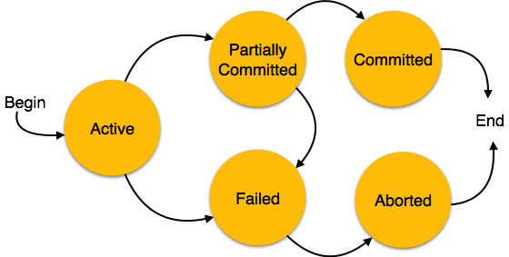
Transactions In RDBMS
A unit of work performed with in the database.
ACID(Atomicity, Consistency, Isolation, Durability) are the four primary attributes ensured to transaction.
Every transaction can be in one of the following states
Active
Partially Committed
Failed
Aborted
Committed

Slide 6
Introduction to SQLite
SQLite is an RDBMS that implements
Self-contained
Serverless
Zero-configuration
Transactional
The code is in public domain and is free for commercial or private purpose.
It is the most widely deployed database.
Single user applications.
Reads and writes directly to disk.
Database file format is cross-platform.

Slide 7
Data Storage
The complete state of an SQLite database is usually contained a single file on disk called the “main database file”.
During a transaction, SQLite stores additional information in a second file called the “rollback journal”.
If the SQLite is in WAL mode it stores in write-ahead log file.
These files are used to restore the data when the system crashes before the completion of the transaction.

Slide 8
WAL mode(Write-Ahead Logging)
The WAL inverts the Rollback Approach.
Changes are made in WAL file while the original database is unchanged.
WAL is significantly faster in more scenarios.
WAL provides more concurrency.
WAL might be slightly slower(perhaps 1% or 2%) than the traditional Rollback approach.

Slide 9
Pages
Main database file consists of one or more pages.
Size of the page is power of 2 between 512 and 65536.
Pages within the same database are of same size.
Page size for the database is determined by a 2-byte integer.
Pages are numbered from 1 to maximum of 2147483646(2^31-2).
Minimum size of SQLite database is 512-byte and the maximum size would be approximately 140 terabytes.

Slide 10
Storage Classes
Each Value stored SQLite has one of the following storage classes.
Null
Integer
Real
Text
BLOB
SQLite does not have a separate Boolean storage class. Instead, Boolean values are stored as integers 0 (false) and 1 (true).
SQLite supports the concept of type affinity on columns and hence it is dynamic type system.

Slide 11
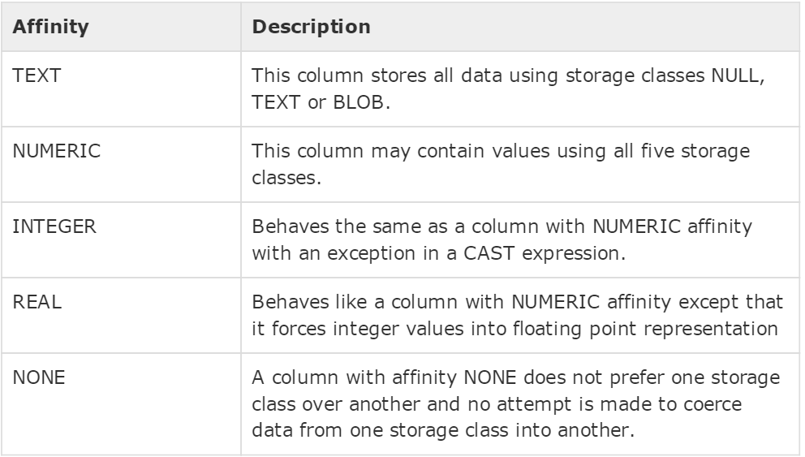
Type Affinity
Any column can still store any type of data but the preferred storage class for a column is called its affinity.

Slide 12
Limits in SQLite
Max Length of string or BLOB:
Maximum number of bytes in a string or BLOB in SQLite is defined by the preprocessor macro SQLITE_MAX_LENGTH.
The default value of this macro is 1 billion.
The current version support a string or BLOB length up to 2³¹-1.
Maximum Number of columns:
The default setting for SQLITE_MAX_COLUMN is 2000.
This can be altered during compile time up to 32767.
Maximum Length of SQL statement
SQLITE_MAX_SQL_LENGTH which defaults to 1000000.
Can change up to 1073741824.

Slide 13
Limits in SQLite
Maximum Number of Tables in a Join:
Support Joins for 64 tables.
Maximum Number Of Rows in a Table:
2^64(theoretically)
This limit is unreachable since the maximum database size of 140 terabytes will be reached first.
Maximum Number of Tables in a Schema:
2147483646 (a little over 2 billion).

Slide 14
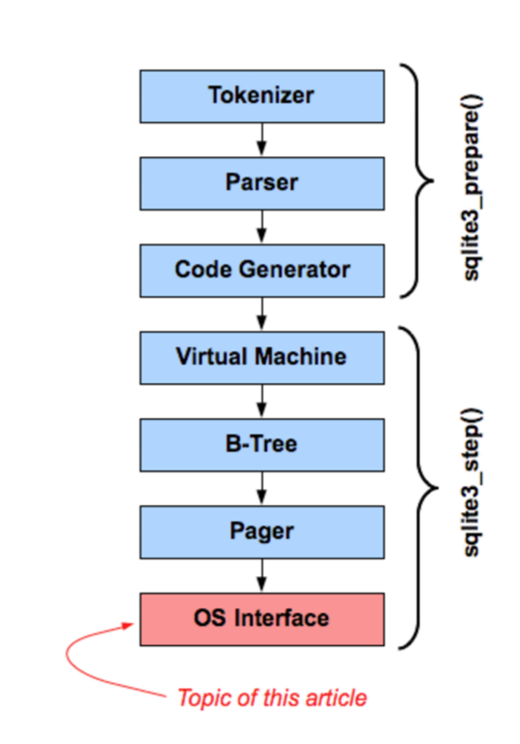
Architecture

Slide 15
VFS-Virtual File System
A virtual file system (VFS) is an sqlite3_vfs object that SQLite uses to interact with the underlying operating system.
Whenever any of the other modules in SQLite needs to communicate with the operating system, they invoke methods in the VFS.
The VFS then invokes the operating-specific code needed to satisfy the request.
Hence, porting SQLite to a new operating system is simply a matter of writing a new OS interface layer or "VFS".

Slide 16
Appropriate Uses For SQLite
Embedded devices and Internet of Things
Websites
Cache for enterprise data
Server side database
Data Analysis
Education and Training

Slide 17
Appropriate Uses For SQLite
SQLite works great as the database engine for most low to medium traffic websites.
The amount of web traffic that SQLite can handle depends on how heavily the website uses its database.
Any site that gets fewer than 100K hits/day should work fine with SQLite.
The SQLite website (https://www.sqlite.org/) uses SQLite itself.
It handles about 400K to 500K HTTP requests per day.
Many applications use SQLite as a cache of relevant content from an enterprise RDBMS.

Slide 18

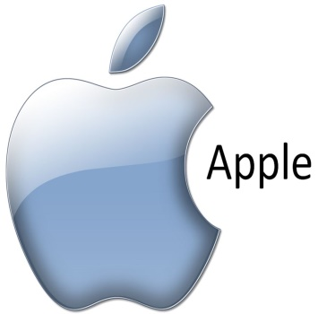







Applications using SQLite

Slide 19
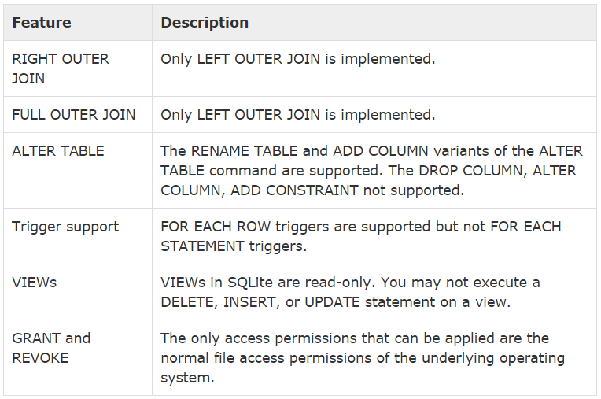
SQLite Limitations
There are few unsupported features of SQL in SQLite.

Slide 20
Advantages
Zero Configuration
Serverless
Single database File
Cross-platform Database file
Compact
Manifest Typing
Variable length records
Public Domain

Slide 21
Disadvantages
Locks whole file while writing.
Not fully SQL92 compliant.
Not very scalable.
Multiple users can not simultaneously modify a database.

Slide 22
SQLite vs Berkeley DB
 | Berkeley DB | SQLite
Database model | Key-value store | Relational DBMS
Schema | Schema-Free | yes
Typing | no | yes
Sever | Server oriented | Server-less
Programming Languages | C, C#, C++, Java | Almost all Languages
Triggers | no | yes
License | Commercial license available | Public domain

Slide 23
SQLite vs Couchbase
 | Couchbase | SQLite
Database model | Key-value store | Relational DBMS
Query language | Java Script | SQL
Map and Reduce | yes | no
Integrity model | MVCC | ACID
Value size max. | 20MB | 140TB

Slide 24
SQLite vs Couchbase
 | Couchbase | SQLite
Operating systems | Ubuntu Touch Red Hat Windows Mac OS X | Cross-platform
Multi-User system | Yes | No

Slide 25
References
https://www.sqlite.org/
https://en.wikipedia.org/wiki/Database
http://www.tutorialspoint.com/sqlite/
http://vschart.com/compare/couchbase/vs/sqlite
http://db-engines.com/en/system/Berkeley+DB%3BSQLite

Slide 26
Thank You

