Slide 1
Spatial Extensions in RDBMS
Presenters –
Shweta Zutshi
Sudha Mallavarapu

Slide 2
Definitions
DBMS
A database management system is a set of programs in an operating system that creates and maintains a database.
RDBMS
Maintains data in tables and relationships which are created and maintained across and among the data and tables.
SDBMS
Spatial extensions are features added to a traditional RDBMS that is optimized to store and query data that represents objects defined in geometric space.

Slide 3
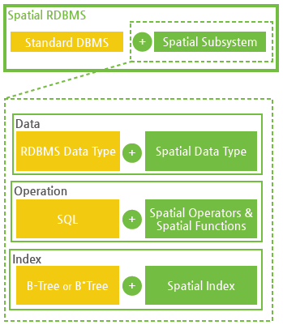
How is Spatial Database Different?
Spatial databases provides the capabilities of a traditional DBMS while allowing special storage and handling of Spatial data.
It adds following to the traditional RDBMS
Data types specific to spatial data
Additional functions
Additional operators

Slide 4
Extensions required to a standard DBMS architecture
Spatial data types and Operations
Spatial index structures
Filter and refine techniques
Different query language
Spatial join algorithms

Slide 5
Uses of Spatial Database
Professionals from all walks of life have to deal with spatial data.
Mobile phone companies tracking phone usage
Doctor comparing MRI’s
Transportation agency tracking their vehicles
Emergency response determining quickest route to victim
Example of Apps which uses Spatial DB are:
Google Maps, Circle of Six etc.

Slide 6
Spatial Operations
Spatial Measurements : computes line length, polygon area, etc
Spatial Functions : intersecting features, etc
Spatial Predicates : allows true/false queries about spatial relationships between geometries
Geometry constructors : creates new geometries
Observer Functions : returns specific information

Slide 7
Additional Data Types
Point
LineString
Polygon
Curve
MultiPoint
MultiLinestring
MultiPolygon

Slide 8
Additional Functions
Few examples are;
Equals
Disjoint
Intersects
Touches
Crosses
Within
Contains
Distance
Buffer

Slide 9
Additional Operators
Few examples are;
A @ B
A ~ B
A && B
A ~= B
A = B
A << B
A >> B

Slide 10
Spatial Queries
Nearness queries request objects that lie near a specified location.
Nearest neighbour queries, given a point or an object, find the nearest object that satisfies given conditions.
Region queries deal with spatial regions. e.g., ask for objects that lie partially or fully inside a specified region.
Queries that compute intersections or unions of regions.

Slide 11
Spatial Query Language Operations
Spatial data is typically queried using a graphical query language; results are also displayed in a graphical manner.
Graphical interface constitutes the front-end
Extensions of SQL with abstract data types, such as lines, polygons and bit maps, have been proposed to interface with back-end.
allows relational databases to store and retrieve spatial information
Queries can use spatial conditions (e.g. contains or overlaps).
queries can mix spatial and non spatial conditions

Slide 12
Spatial Query Language
Spatial query language
Spatial data types, e.g. point, linestring, polygon, …
Spatial operations, e.g. overlap, distance, nearest neighbor, …
Callable from a query language (e.g. SQL3) of underlying DBMS
SELECT S.name
FROM Senator S
WHERE S.district.Area() > 300
Standards
SQL3 (a.k.a. SQL 1999) is a standard for query languages
OGIS is a standard for spatial data types and operators
Both standards enjoy wide support in industry

Slide 13
Query Example
Find all senators who serve a district of area greater than 300 square miles and who own a business within the district
Spatial join example
SELECT S.name FROM Senator S, Business B
WHERE S.district.Area() > 300 AND Within(B.location, S.district)

Slide 14
Indexing of Spatial data
Regular indexing for RDBMS does not work with spatial data.
Different spatial indexing techniques are there to retrieve data efficiently.
Many spatial indexing techniques are implemented in spatial databases.
Examples: Quad trees
R- Trees
R+ - Trees
k-d Trees
Oct- Trees

Slide 15
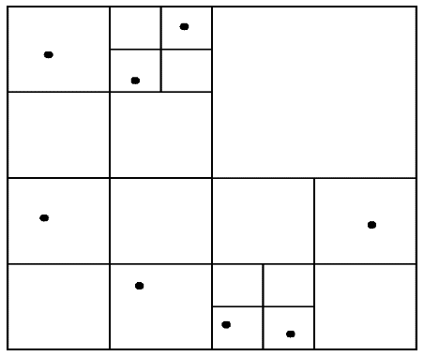
Quadtrees
Quadtrees
Each node of a quadtree is associated with a rectangular region of space; the top node is associated with the entire target space.
Each non-leaf node divides its region into four equal sized quadrants
correspondingly each such node has four child nodes corresponding to the four quadrants and so on
Leaf nodes have between zero and some fixed maximum number of points (set to 1 in example).

Slide 16
K-d tree
k-d tree - early structure used for indexing in multiple dimensions.
Each level of a k-d tree partitions the space into two.
choose one dimension for partitioning at the root level of the tree.
choose another dimensions for partitioning in nodes at the next level and so on, cycling through the dimensions.
In each node, approximately half of the points stored in the sub-tree fall on one side and half on the other.
Partitioning stops when a node has less than a given maximum number of points.
The k-d-B tree extends the k-d tree to allow multiple child nodes for each internal node; well-suited for secondary storage.

Slide 17
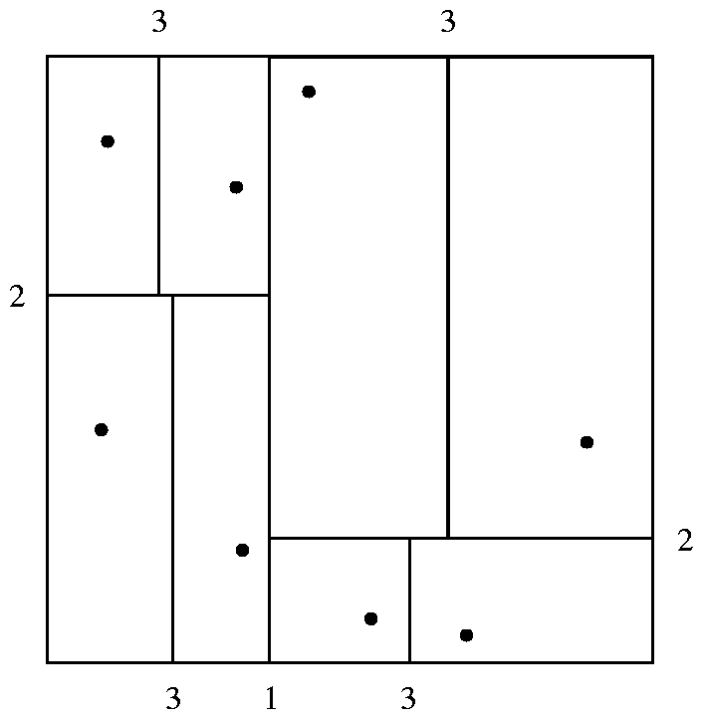
Division of Space by a K-d Tree
Each line in the figure (other than the outside box) corresponds to a node in the k-d tree. The maximum number of points in a leaf node has been set to 1.

Slide 18
R-Trees
R-trees are a N-dimensional extension of B⁺-trees, useful for indexing sets of rectangles and other polygons.
Supported in many modern database systems
Basic idea: generalize the notion of a one-dimensional interval associated with each B+ -tree node to an N-dimensional interval, that is, an N-dimensional rectangle.
Will consider only the two-dimensional case (N = 2)
generalization for N > 2 is straightforward

Slide 19
Suppose we have a cluster of points in 2-D space we can build a “box” around points. The smallest box (which is axis parallel) that contains all the points is called a Minimum Bounding Rectangle (MBR). MBR is also known as minimum bounding box
Bounding Rectangle
MBR = {(L.x,L.y)(U.x,U.y)}
Note that we only need two points to describe an MBR, we typically use lower left, and upper right.

Slide 20
Clustering points
We can group clusters of data points into MBRs
Can also handle line-segments, rectangles, polygons, in addition to points
We can further recursively group MBRs into larger MBRs….
R1
R4
R2
R5
R3
R6
R9
R7
R8

Slide 21
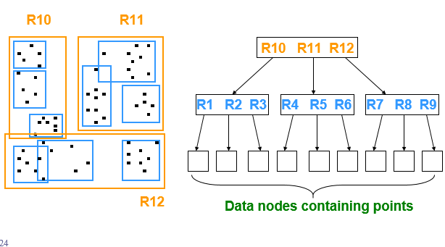
R-tree Structure
Nested MBRs are organized as a tree

Slide 22
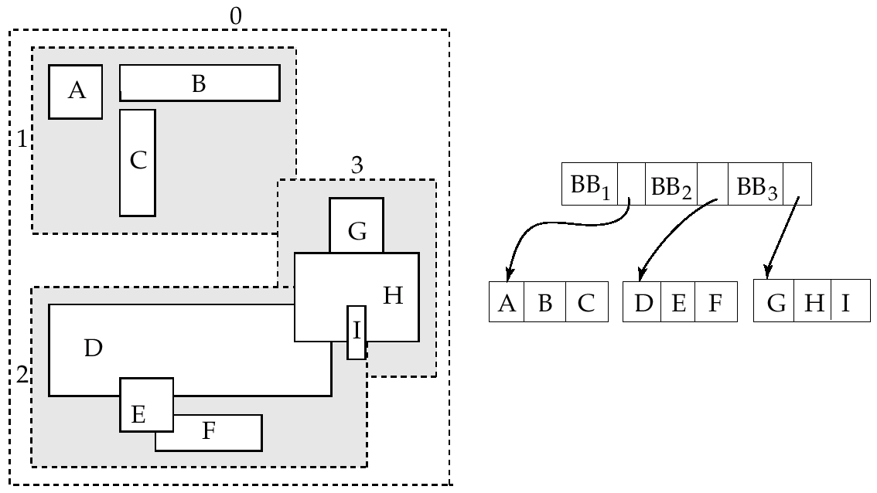
Example R – Tree Structure
A set of rectangles (solid line) and the bounding boxes (dashed line) of the nodes of an R-tree for the rectangles. The R-tree is shown on the right.
<number>
Notes:
<number>

Slide 23
NoSQL in Spatial Data Environment
NoSQL does not require fixed table structures and avoids joins.
Are good at dealing with lots of reading/writing tasks coming in at once, that slows down RDBMS.
3 companies using NoSQL – Facebook, eBay, Google.
Support spatial data natively or through an extension
NoSQL databases using spatial data – MongoDB, BigTable, Cassandra, CouchDB.
Who’s using NoSQL for spatial tasks?
- FourSquare : MongoDB
- SimpleGeo : Cassandra
- GoogleEarth : Google Big Table

Slide 24
Summary
Introduction to SDBMS
Additional Features (Data types, operators, functions)
Performance with spatial queries
Indexing of spatial data
Few Indexing techniques (R-trees, Quad Trees)
NoSQL in Spatial Data Environment

Slide 25
References
http://www.cubrid.org/blog/dev-platform/20-minutes-to-understanding-spatial-database/
http://postgis.net/docs/manual-1.3/ch06.html#id439526
https://dev.mysql.com/doc/refman/5.0/en/opengis-geometry-model.html

Slide 26
Thank You…..

