Slide 1
Theory Construction and Statistical Modeling Factor analysis Welcome!

Slide 2
Factor Analysis
Exploratory Factor Analysis (EFA) and Principal Components Analysis (PCA)
Two related techniques
Both often described as types of factor analysis
In R: use the package “psych”
install.packages(“psych”); library(psych)
Functions: principal()and fa()
Controversy discussed in Preacher & McCallum
Confirmatory Factor Analysis (CFA) next week

Slide 3
EFA and PCA
Statistical techniques in which researchers want to know, very generally:
Given a set of observed variables, how can I transform them to make a smaller set, while still retaining as much information as possible
As much as possible, similar variables in my original set should relate to the same variable in my new set
E.g. If I have 10, 50 or 100 variables, how can I make 2, 3 or 4 variables that capture as much as possible
Data-driven approaches!

Slide 4
When is it useful?
Develop measurement tools or tests for latent variables
Personality, Intelligence, Depression
Investigate the dimensions of test items
Data reduction
Also called “dimension reduction”
E.g., solves multicollinearity in linear regression

Slide 5
When is it useful?
Develop measurement tools or tests for latent variables
Personality, Intelligence, Depression
Investigate the dimensions of test items
Data reduction
Also called “dimension reduction”
E.g., solves multicollinearity in linear regression

Slide 6
In Practice: Developing a measurement scale
Create a questionnaire with a very large number of items about a topic of interest
Student aptitude: school history, family history, health, personality, previous grades
Give questionnaire to random sample
Derive factors
E.g. Intelligence, Work ethic, Independence
Delete or add items depending on factor loadings
Repeat steps 2 to 4
Test validity of factors
E.g. predict future grades

Slide 7
Difference between PCA and EFA
Goal:
PCA: reduce correlated observed variables to a smaller set of independent composite variables.
Data reduction!
Components describe the total variance in the dataset
(E)FA: assume or wish to test a theoretical model of latent factors causing observed variables.
Model says that observed variables covary because all variables are caused by an unobserved factor
Don’t know exactly how many factors or which factors cause which variables – Exploratory Factor Analysis (EFA)
Strong theory on latent structure that you want to confirm/disconfirm – Confirmatory Factor analysis
PCA rotates axes to explain as much variance as possible, EFA models the covariance matrix.

Slide 8


Variance and Covariance
PCA analyzes variance
EFA analyzes covariance
PCA
EFA

Slide 9

Variance and Covariance
$$Y_{1}$$

Slide 10
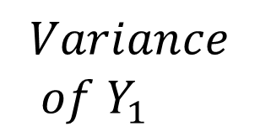
Variance and Covariance
$$Y_{1}$$
$$Variance \\ of Y_{1}$$

Slide 11


Variance and Covariance
$$Y_{1}$$
$$Y_{2}$$

Slide 12
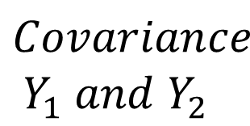
Variance and Covariance
$$Y_{1}$$
$$Y_{2}$$
$$Covariance \\ Y_{1} and Y_{2}$$

Slide 13
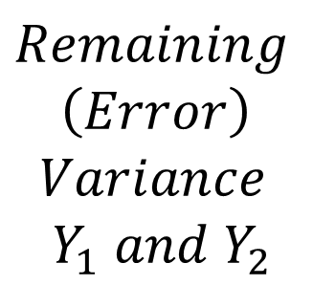
Variance and Covariance
$$Y_{1}$$
$$Y_{2}$$
$$Covariance \\ Y_{1} and Y_{2}$$
$$Remaining$$
$$\left(Error\right)$$
$$Variance \\ Y_{1} and Y_{2}$$

Slide 14
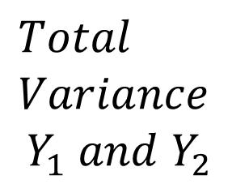
Variance and Covariance
$$Y_{1}$$
$$Y_{2}$$
$$Total \\ Variance$$
$$Y_{1} and Y_{2}$$

Slide 15
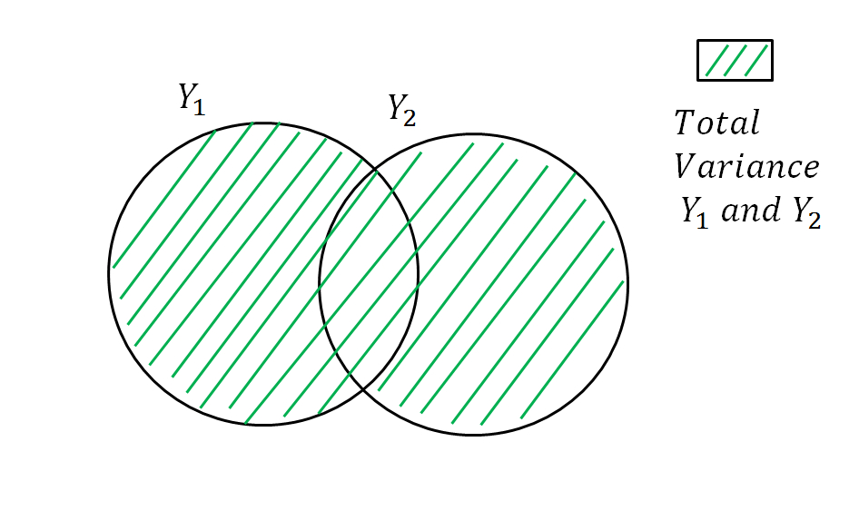
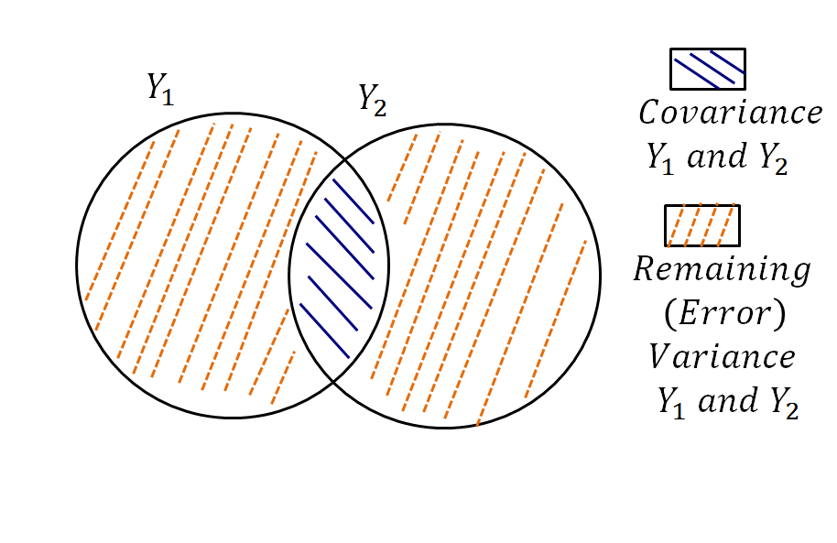
Exploratory Factor Analysis
Principal Components Analysis

Slide 16
PCA : Summarize variance
For n variables, you obtain n components
The first component explains most variance, second explains second-most, etc.
Each component is uncorrelated with all others (but see Rotation)
Usually we retain the first few components that eplain most variance: Data reduction

Slide 17
PCA - Visual example
http://setosa.io/ev/principal-component-analysis/

Slide 18
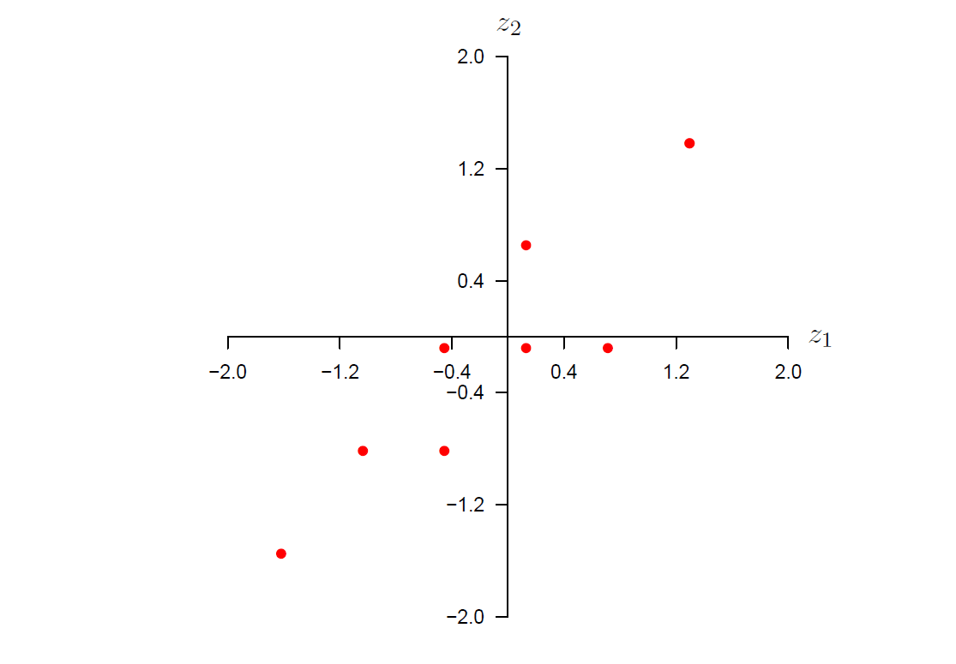


PCA
$$Y_{1}$$
$$Y_{2}$$

Slide 19
PCA
$$Y_{1}$$
$$Y_{2}$$

Slide 20
PCA
$$Y_{1}$$
$$Y_{2}$$

Slide 21
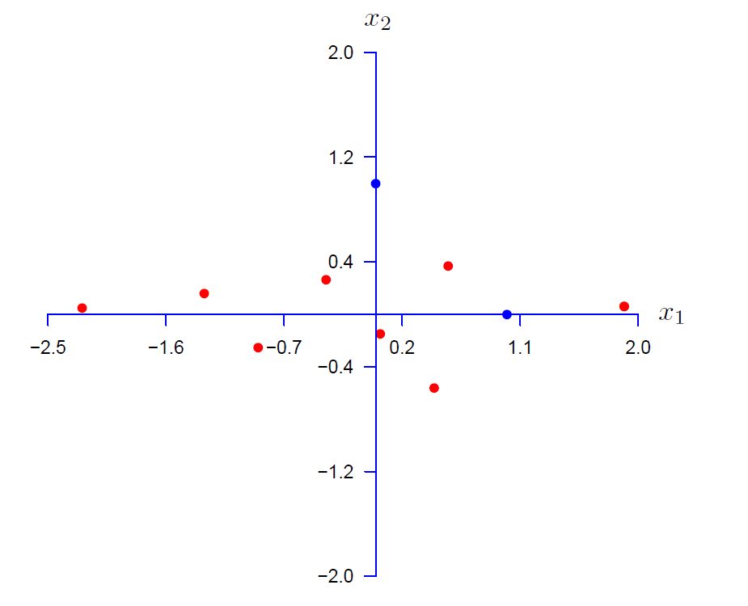


PCA
$$C_{1}$$
$$C_{2}$$

Slide 22
EFA : Explaining covariance
For n variables, estimate max n new factors
Usually less than n
I create these so that:
The first factor explains most covariance, the second explains second-most, etc.
Each factor is uncorrelated with other factors ** (see Rotation)
As much as possible each observed variable only relates to one factor

Slide 23






PCA and EFA
$$Y_{2}$$
$$Y_{4}$$
$$Y_{1}$$
$$Y_{5}$$
$$Y_{3}$$
$$Y_{6}$$

Slide 24

PCA: Analyse Variance
$$Y_{1}$$
$$Y_{2}$$
$$Y_{4}$$
$$Y_{5}$$
$$Y_{3}$$
$$Y_{6}$$

Slide 25

EFA: Analyse Co-variance
$$Y_{1}$$
$$Y_{2}$$
$$Y_{4}$$
$$Y_{5}$$
$$Y_{3}$$
$$Y_{6}$$

Slide 26
PCA –Example 2
I always wear a seatbelt
I do not think before I act
I would never make a long journey in a sailing boat
I am an impulsive person
I would like to jump out of an airplane with a parachute

Slide 27
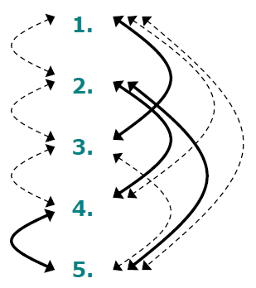
Example
Five questions
We observe these correlations

Slide 28
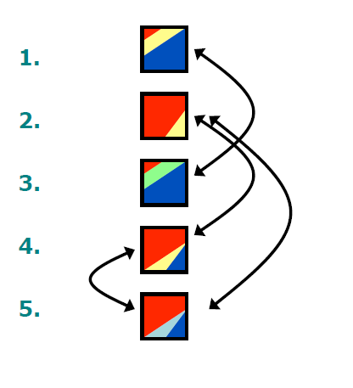
Example

Slide 29
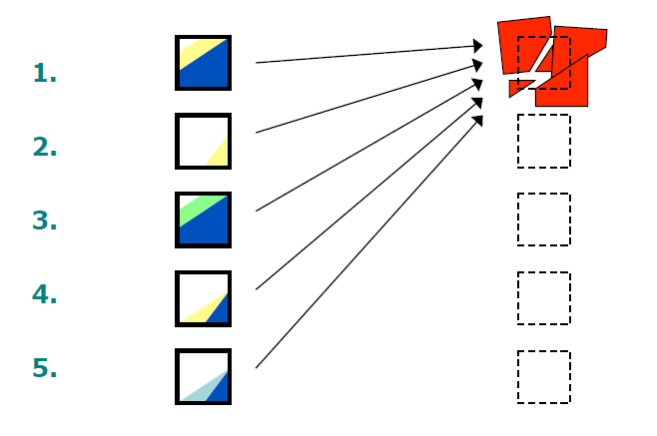
Example

Slide 30
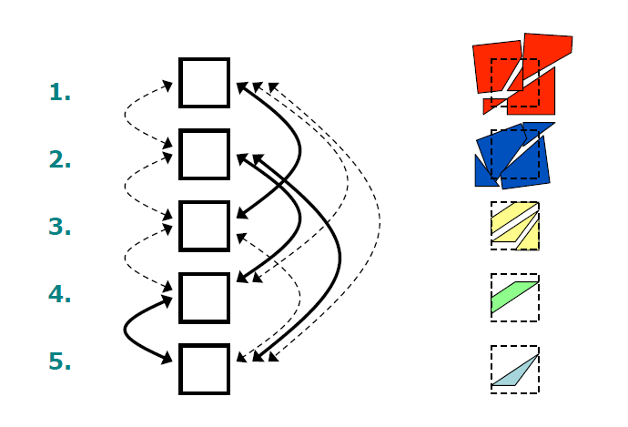
Example

Slide 31
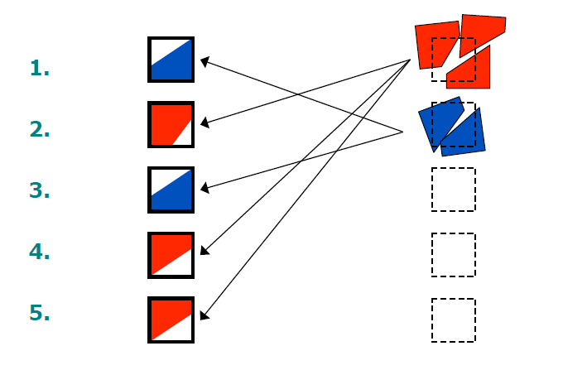
Example

Slide 32
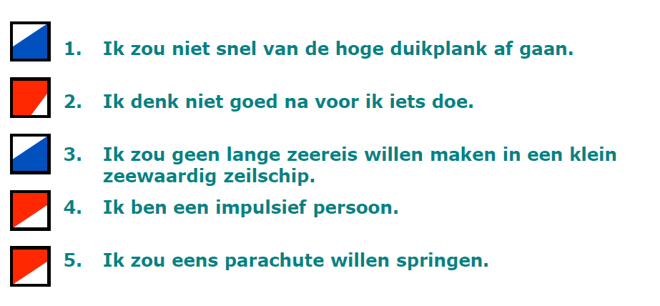
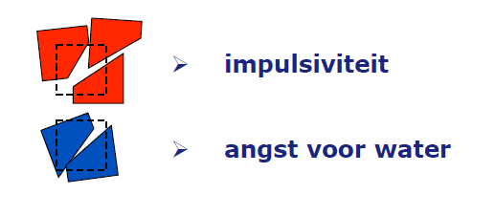
Example
I always wear a seatbelt
I do not think before I act
I would never make a long journey in a sailing boat
I am an impulsive person
I would like to jump out of an airplane with a parachute
Impulsive
Safety-Conscious

Slide 33
BOX DIAGRAMS OF PCA AND FA

Slide 34
Quick Revision: Path Diagrams
Observed variable
(or Indicator)
Latent (unmeasured) variable
(or Factor)
Regression (Theoretical) Causal effect * Direct Effect *
Covariance
(no causal hypothesis)
34
Notes:
9/6/2020
34

Slide 35
Quick Revision: Interpretation of parameters
Direct effects, b, (X→ Y) as regression coefficients
If X goes up with 1 point, y is expected to go up with b points (controlling for other predictors).
If X goes up with 1 SD, y is expected to go up with b SD (controlling for other predictors).
Factor loadings are direct effects from a factor to an indicator
Covariances (unstandardized) and correlations (standardized)
Variances and residual variances

Slide 36
PCA
C₁
I₁
C₂
I₂
C₃
I₃
C₄
I₄

Slide 37
EFA
F₁
I₁
e₁
F₂
I₂
e₂
F₃
I₃
e₃
F₄
I₄
e₄

Slide 38
EFA
I₁
e₁
F₁
I₂
e₂
I₃
e₃
F₂
I₄
e₄

Slide 39
EFA
I₁
e₁
I₂
e₂
F
I₃
e₃
I₄
e₄

Slide 40
Summary PCA vs. EFA
Principal Components Analysis (PCA) | Exploratory Factor Analysis (EFA)
Components Summarize Variance | Factors explain Covariance
Not really a model: Transformation of the data No Model Fit | Model: Some variance is interesting (covariance), some is error Fit indices possible
Dimension Reduction | Scale construction
library(psych) principal(data, nfactors = n) | library(psych) fa(data, nfactors = n)
Extraction method: Principal Components | Extraction method: OLS, can also do “ml” (which SPSS uses)
In large samples, with large number of correlated variables, practical differences are often small

Slide 41

Break

Slide 42
Steps to take
Analysis requires decisions
1.Extraction method
PCA = “Principal Components”
EFA = “OLS/Maximum Likelihood”
2.Number of factors
3.Rotation method
4.(Factor scores)

Slide 43
Example
Six observed variables (intelligence tests)
visual perception, cubes, lozenges,
paragraph, sentence, word meaning
2 factors
Simulated data

Slide 44
1. Components or Factors?
principal(df, nfactors = 2)
RC1 RC2 h2 u2 com
visperc 0.81 0.08 0.66 0.34 1.0
cubes 0.77 0.07 0.59 0.41 1.0
lozenges 0.78 0.13 0.62 0.38 1.1
paragrap 0.17 0.79 0.64 0.36 1.1
sentence 0.11 0.78 0.62 0.38 1.0
wordmean 0.07 0.74 0.56 0.44 1.0
RC1 RC2
SS loadings 1.90 1.80
Proportion Var 0.32 0.30
Cumulative Var 0.32 0.62
Proportion Explained 0.51 0.49
Cumulative Proportion 0.51 1.00

Slide 45
1. Components or Factors?
fa(df, nfactors = 2)
MR1 MR2 h2 u2 com
visperc 0.74 -0.03 0.53 0.47 1
cubes 0.60 0.01 0.36 0.64 1
lozenges 0.65 0.04 0.44 0.56 1
paragrap 0.01 0.72 0.52 0.48 1
sentence 0.01 0.65 0.42 0.58 1
wordmean 0.00 0.55 0.31 0.69 1
MR1 MR2
SS loadings 1.33 1.25
Proportion Var 0.22 0.21
Cumulative Var 0.22 0.43
Proportion Explained 0.52 0.48
Cumulative Proportion 0.52 1.00
With factor correlations of
MR1 MR2
MR1 1.00 0.38
MR2 0.38 1.00

Slide 46
2. EFA: How Many Factors?
If (proto) theory predicts k factors, try k factors
Parallel analysis
Guttman-Kaiser criterion (Eigenvalue ≥1) best with small number of reliable variables
Scree plot best with large number of unreliable variables
Pick the solution that makes most interpretative sense

Slide 47

2. EFA: How Many Factors?
Guttman-Kaiser criterion (Eigenvalue ≥1) best with small number of reliable variables
Eigenvalues relate to how much of the total variance each component/factor accounts for
First explains most, second explains second-most, etc.
$\frac{Eigenvalue}{Total Number observed items}=Variance explained by factor$
> res <- principal(df, nfactors = 5) > res$values [1] 2.34 1.35 0.67 0.60 0.53 0.48 > res$values > 1 [1] TRUE TRUE FALSE FALSE FALSE FALSE
>

Slide 48
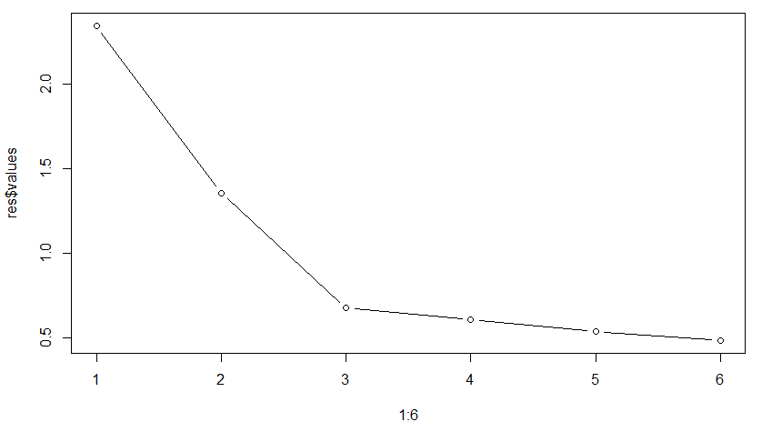
2. EFA: How Many Factors?
Scree plot best with large number of unreliable variables
Pick the number of factors “above the elbow”
> plot(1:6, res$values, type = "b")

Slide 49
2. EFA: How Many Factors?
Scree plot best with large number of unreliable variables
Pick the number of factors “above the elbow”
> plot(1:6, res$values, type = "b")

Slide 50
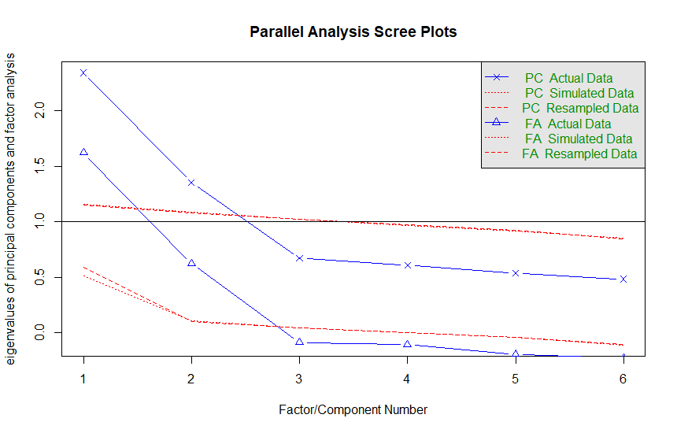
2. EFA: How Many Factors?
Parallel Analysis (Horn, 1965)
> fa.parallel(df) Parallel analysis suggests that the number of factors = 2 and the number of components = 2

Slide 51
2. EFA: How Many Factors?
Pick the solution that makes most sense wrt interpretation
If theory predicts k factors, try k factors
Try out different numbers of factor solutions
Sometimes different rules-of-thumb give different solutions
Look at the factor loadings
Pick the solution which gives you meaningful factors/components

Slide 52
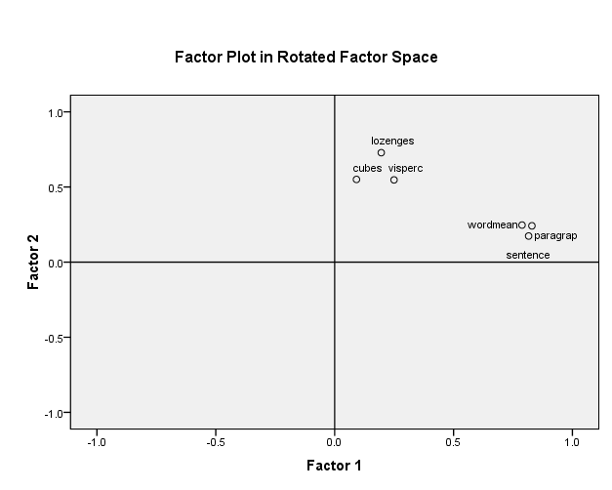
3. Factor Rotation
Orthogonal rotation:
Factors rotate, but ‘angle’ is always 90 degrees. Factors are not correlated!
Oblique rotation: factors rotate to minimize distance between items and factor (oblique)
Factors are correlated!
Reading question 5: what is the purpose of factor rotation?
The procedure of rotating the factor axes makes sure items load as much on only one factor as possible. There are two methods: Orthogonal rotation, in which two latent factors are not allowed to correlate (i.e. the axes describe a 90 degree angle), and oblique (oblimin or promax) rotation, in which the factors are allowed to correlate.

Slide 53
Orthogonal Rotation 1
$$Y_{1}$$
$$Y_{2}$$

Slide 54
Orthogonal Rotation 2
$$C_{1}$$
$$C_{2}$$

Slide 55
Oblique Rotation 1
$$Y_{1}$$
$$Y_{2}$$

Slide 56
Oblique rotation 2
$$Y_{1}$$
$$Y_{2}$$

Slide 57
3. Factor rotation
Orthogonal: uncorrelated factors
Varimax
Simple
Interpretation may be easier
Factor loadings show up in the Factor Matrix
Oblique: correlated factors
Promax, Oblimin
More realistic
Easier to get items to load on only one factor
Factor loadings show up in the Pattern Matrix

Slide 58
Varimax vs promax

Slide 59
4. Factor scores
Useful to save the factor scores:
fa(df, nfactors = 2,
scores = “regression”)
Multiplication of item scores:
sum(individual itemscore * factor loading)
Three ways: “regression”, “Anderson” or “Bartlett”
Small difference
Use these factors as observed variables in your analysis
Ignores measurement error
Not needed if you continue with SEM!

Slide 60
4. Factor scores
> res <- fa(df, nfactors = 2, scores = "Bartlett") > head(res$scores) MR1 MR2 [1,] -0.5609899 -0.03047855 [2,] 0.5132644 1.29435355 [3,] 0.2444246 -1.19983489 [4,] -0.8724184 1.30067344 [5,] -0.1687548 1.02015701 [6,] 1.1181263 -0.51572749

Slide 61
EFA: Optimal decisions and defaults
Decision about | Optimal | Default
Extraction | Theory: Factors Data reduction: Components | fa(): Factors principal(): Components
# Factors | Theory Parallel analysis
Rotation | Oblique | fa(): oblimin principal(): Varimax
Factor scores | Bartlett | fa(): scores = “regression” principal(): method = “regression”

Slide 62


Example EFA
Allen & Mayers (1996) three part model of commitment
Affective commitment
5 items
Continuance commitment
5 items
Normative commitment
4 items

Slide 63
Example
Think about (and report)
Extraction method
Number of factors
Rotation method

Slide 64
Number of factors
> res <- fa(df, nfactors = 6) > res Factor Analysis using method = minres
Call: fa(r = df, nfactors = 6)
Standardized loadings (pattern matrix) based upon correlation matrix
…
MR1 MR2 MR5 MR4 MR3 MR6
SS loadings 2.87 1.64 1.37 1.26 1.28 0.65
Proportion Var 0.20 0.12 0.10 0.09 0.09 0.05
Cumulative Var 0.20 0.32 0.42 0.51 0.60 0.65
Proportion Explained 0.32 0.18 0.15 0.14 0.14 0.07
Cumulative Proportion 0.32 0.50 0.65 0.79 0.93 1.00 > res$values
[1] 4.21663707 2.23703890 1.23475959 0.49065841 0.44348134 0.44266071 0.11342196 0.05770514 0.03241050
[10] 0.01736304 -0.01664042 -0.03138805 -0.06975776 -0.10589982

Slide 65
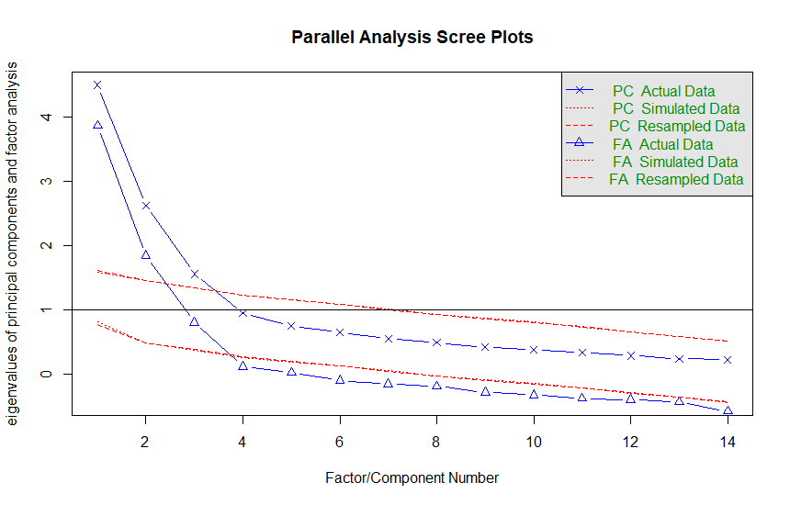
Number of factors
> fa.parallel(df) Parallel analysis suggests that the number of factors = 3 and the number of components = 3

Slide 66
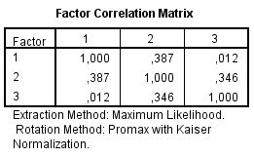
Rotated factor loadings
> res <- fa(df, nfactors = 3)
> res
Factor Analysis using method = minres
Call: fa(r = df, nfactors = 3)
Standardized loadings (pattern matrix) based upon correlation matrix
MR1 MR3 MR2 h2 u2 com
A1 0.51 0.19 0.03 0.36 0.64 1.3
A2 0.77 0.06 -0.21 0.67 0.33 1.2
A3 0.86 -0.01 0.01 0.73 0.27 1.0
A4 0.72 0.11 -0.08 0.59 0.41 1.1
A5 0.85 -0.09 0.17 0.69 0.31 1.1
C1 0.06 0.31 0.60 0.56 0.44 1.5
C2 0.08 0.12 0.52 0.32 0.68 1.2
C3 -0.17 -0.06 0.72 0.54 0.46 1.1
C4 0.19 -0.02 0.32 0.13 0.87 1.7
C5 0.08 -0.04 0.65 0.42 0.58 1.0
N1 0.16 0.65 0.05 0.55 0.45 1.1
N2 0.09 0.67 0.00 0.50 0.50 1.0
N3 -0.12 0.90 0.00 0.75 0.25 1.0
N4 0.08 0.71 0.04 0.57 0.43 1.0 With factor correlations of
MR1 MR3 MR2
MR1 1.00 0.34 -0.03
MR3 0.34 1.00 0.25
MR2 -0.03 0.25 1.00

Slide 67
Typical step-by-step procedure for assessing quality of measurement?
1. check data -> outliers, missing data etc.
2. check correlations
3. More than 1 factor/component?
4. include only those items that form a scale
5. compute reliability (Cronbach’s alpha) of indicators for every factor using psych::alpha()

Slide 68
Additional Reading
Andy Field is a useful reference
DO NOT use Edition 3 or earlier
Mixes up PCA and EFA
See instead Edition 4 onwards

Slide 69

See you Thursday!

