Slide 1
PSYCH 403/505:
Matlab for Vision Research

Slide 2
Programming
Different languages …
… one basic skill.
Key: Being as simple-minded as…
… your computer.

Slide 3
Computers are
Tame and stubborn.
So, don’t be afraid…
just talk to it differently.
And never throw it out the window! (better and safer results are achieved with regular hammers)

Slide 4
Computers are
Hardware + Software
Hardware:
  What you’ll ruin with a brick, a hammer, a screwdriver (of both solid and liquid kind), or even a third-floor window …

Slide 5
Computers are
Hardware + Software
Hardware:
  Memory:
    dead (hard drive or solid state) or alive (RAM)
    in a stick (flash) or in a disk (CD, DVD)
  Monitor and graphics card (VRAM)
  Speakers (and sound card, integrated)
  Various peripherals:
    Mouse, keyboard, eye tracker, EEG stuff.
  ONE (or a few)
  ALL-MIGHTY microprocessor CPU
    Central Processing Unit
    MHz: clock cycle/speed.
      1GHz = 1 billion operations /second (1 gigaflop)
      (brain anyone? 1 exaflop)
      http://www.futuremark.com/hardware/cpu/Intel+Core+i7-5960X/review
      http://www.newegg.com/Product/Product.aspx?Item=N82E16819117404

Slide 6
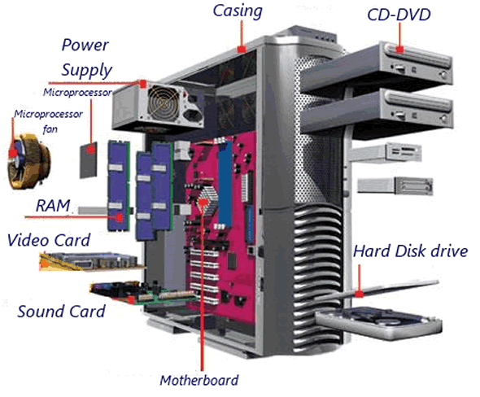

Slide 7
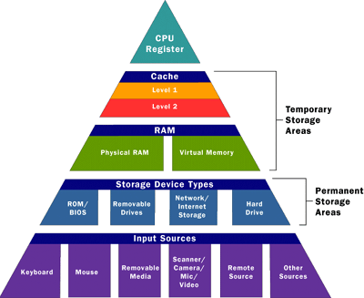
Pyramid!

Slide 8
(D)RAM and CACHE
Dynamic Random Access Memory
  Yummy.
  bit size of CPU = size of simultaneous memory read from RAM.
    32-bit CPU = 4 bytes
    64-bit CPU = 8 bytes
  RAM speed: typically much slower than CPU! So, the fastest the better for you! (up to the speed of CPU and the bus)
  http://computer.howstuffworks.com/ram.htm
  Link.

Slide 9
(D) RAM summary
Get a TON!
This will make you (and Matlab) happier.

Slide 10
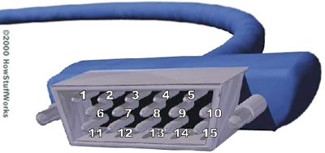
CRT Monitors and VGA
Analog ergo the video/graphics adapter
Red, Green,
and Blue
Phosphor dots
Phosphor decay?
Link
1: Red out
6: Red return (ground)
11: Monitor ID 0 in
2: Green out
7: Green return (ground)
12: Monitor ID 1 in
or data from display
3: Blue out
8: Blue return (ground)
13: Horizontal Sync out
4: Unused
9: Unused
14: Vertical Sync
5: Ground
10: Sync return (ground)
15: Monitor ID 3 in
or data clock

Slide 11
LCD Monitors
Digital
  Faster, perhaps better?
  No need to translate to digital signal.
  DVI: digital video interface
  Do not support VGA standards.
  BE CAREFUL WHEN USING (light differences too).
  DIFFERENCE: LCD dynamically maximizes bandwidth between computer and monitor. PLUS: LINK!

Slide 12
So... software
a.k.a. programs
  Catalog of “behavioral” instructions.
Programs are written in “programming languages”.
CANNOT HARM your computer.
So, feel free to crash your computer as much as you’d like!

Slide 13
Aha! Programming
Tell the machine what to do.
You’ll need:
  A language to communicate with the CPU’s binary world (bits & bytes)
  and
  Lots of patience.

Slide 14
MATLAB
MATrix LABoratory:
  High-level language
    slow to interpret by machine
    easy to understand by humans
  I will teach you “syntax”
    Algorithm based
  Our vocabulary will be MATRICES.
  MATLAB is optimized for matrix-based calculations

Slide 15
ALGORITHMS
Describe in a piece of paper, the instructions required to achieve the following goal:
  I want to stack these three boxes on top of each other.
How would these instructions change if we wanted a stable structure?
How would these instructions change if we had an indeterminate amount of boxes of different sizes?

Slide 16
ALGORITHMS
Describe in a piece of paper, the instructions required to achieve the following goal:
  I want to hang my Klimt, Monet, and VanGogh paintings on my wall.
K
VG
M

Slide 17
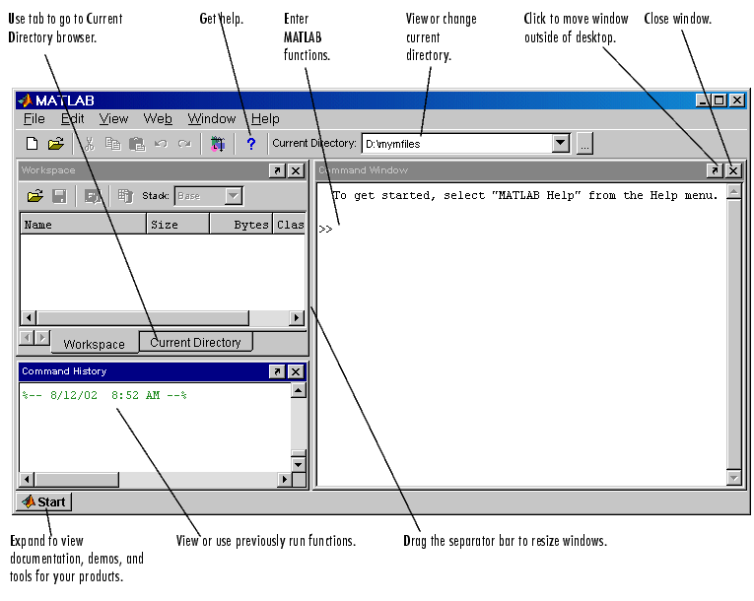
START MATLAB!

Slide 18
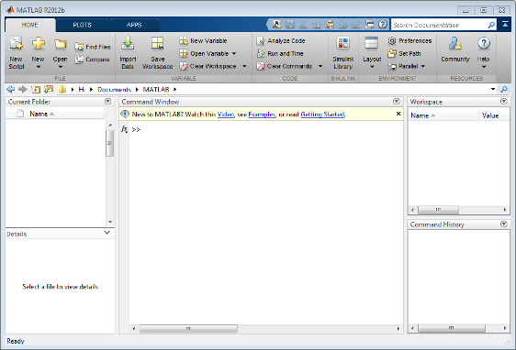
START MATLAB!

Slide 19
A few important things
Create a directory where you will save your Matlab work
SET PATH!
  Window or in command line:
  Setting the path in your code:
  >p=path;
  >path(p,‘o:\MatlabCourse’);

Slide 20
A few important commands
pwd: Where are you?
cd: Change Directory
dir: lists contents of folder
mkdir: makes a new directory
who: lists of variables in workspace
whos: who + size of variables
clear X: erases X
clear all: erases all.

Slide 21
The most important commands
help topic
lookfor string
edit nameoffile

Slide 22
Intro to Matrices
Vector:
  Orderly array of stuff
  Stuff = numbers, letters, words, bits
  [1 2 3 4 5 6] is a 6 element vector of digits
  [‘cat’ ‘dog’] is a 2 element vector of words (strings)
  [c a t d o g]is a 6 element vector of characters
  [0 1 0 1 1 1] is a 6 element vector of bits (binary digit)
  MATRIX = “VECTOR” Of Vectors

Slide 23
Matrices
Simple matrices will look like this: (horizontally stacked vectors)
  [1 2 3 4
  1 2 3 5
  1 2 3 6]
  This is a 3 rows by 4 column matrix referred to as a 3-by-4 matrix.
  First mentioned dimension is ALWAYS the number of rows
  Second dimension = number of columns
What is the (2,3) element in the matrix?

Slide 24
Matrices
Matrices can have as many dimensions as you’d like.
  Vectors have 1 dimension
    Third element in vector V: V(3)
  Most algebraic Matrices have 2 (one for the rows, and for the columns)
    Third row, fourth column of M: M(3,4).
  Matrices can be (m-by-n-by-o-by-p)
    Elements are then referenced (i,j,k,l),
    One index for each dimension.

Slide 25
What can I put in a matrix?
A note on memory allocation
and types of values:
  1 bit codes 0 or 1
  8 bits code 8 possible combinations of 0 and 1. 2^8=256
  8 bits = 1 byte.
  1 ASCII character = 1 byte
  (8 bits)
  ASCII codes!

Slide 26
What can I put in a matrix?
A note on memory allocation
and types of values:
  numbers (int, double)
  or letters (char)
  or strings of letters (strings)
  A matrix with a combination of different kinds of values is called a STRUCTURE (later in the semester) or a TABLE.
  A matrix with different types of things in each cell is called a “cell array” (later)

Slide 27
What can I put in a matrix?
Size of different variable types:
double 64 bits (8 bytes)
int8 2^8 = 256 integers
uint8 unsigned integers
int16, uint16 2^16 = 65536 integers
int32, uint 32 2^32 = 65536^2 = 4000 million
int64, uint64 2^64 = millions of gazillions
1 char = 2 bytes (more than ASCII)

Slide 28
What can I put in a matrix?
A variable is a piece of memory that holds whichever value you specify. In Matlab, a variable will hold the values of an entire matrix or structure.
A pointer is the address in memory of a piece of memory holding whichever value you specified.

Slide 29
Quick word on variables
  A variable NAME has at least one letter + any number of letters, digits and underscores.
  myage = [29]
  myname = ‘alejo’
  What happens when I do?
  myname = alejo

Slide 30
A WARNING on variables
  Matlab is smart
  --> no preallocation necessary
  Dangerous!
  Besides, it is slow:
  The #1 slow-down factor of Matlab code is dynamic preallocation.

Slide 31
How does Matlab put information in memory?
1
2

Slide 32
How does Matlab put information in memory?
1
2
1
2

Slide 33
How does Matlab put information in memory?
1
2
3
1
2

Slide 34
How does Matlab put information in memory?
1
2
3

Slide 35
How does Matlab put information in memory?
1
2
3

Slide 36
How does Matlab put information in memory?
1
2
3

Slide 37
How does Matlab put information in memory?
1
2
3

Slide 38
How does Matlab put information in memory?
1
2
3
And this repeats EVERY time you modify the SIZE of a variable.
1
2
3
THE POWER OF MATLAB RESIDES IN THE SEQUENTIAL ADDRESS OF ORDERED INFORMATION IN MEMORY.

Slide 39
Back to Matlab!
Name your matrices always lowercase (because…)
Create variable a:
> a = [ 1 2 3 4];
Create matrix b:
> b = [ 1 2 3
4 5 6];
Or:
> c = [1,2,3;4,5,6];
, delimitates elements
within a row
; delimitates rows
c(i,j) is element i,j of c

Slide 40
Back to Matlab!
Create a vector of characters:
> d = ‘Hello world’;
What is d(4)? d(5)? d(6)?
Create a matrix of characters:
> e = [‘Hello’;’world’]
Select some of the elements in the Matrix using ‘:’
> f = e(:,5) %all elements of 5th column of e
> g = e(2,2:4) %elements 2, 3 and 4 of 2nd row.

Slide 41
Exploring…
Question: what do empty brackets do in the expression?
> e(:,4)=[]

Slide 42
Exploring…
Question: without typing on Matlab, what happens in the next series of commands?
> m = e(2,:);
e(2,:) = e(1,:);
> e(1,:) = m;

Slide 43
What we learned…
--> to swap the values of 2 variables…
…you need 3 variables.

Slide 44
Exploring…
Question: can I simply use numbers, like in? (that is, without brackets)
> age = 29;
Type
> age
> age(1)
> age(2)

Slide 45
Exploring…
Question: what do you think would happen if I did the following?
> t = e(7);
Values are stacked!
e(1) = e(1,1)
e(2) = e(2,1)
e(7) = ‘o’

Slide 46
How to use a matrix: sum.
Add two vectors: C = A + B:
  A = [ 1 0 3]
  B = [-1 4 2]
  C = [ 0 4 5]
  Corresponding elements are added in each cell.
  Therefore, you cannot add vectors (or matrices) of different dimensions!

Slide 47
How to use a matrix: sum.
  Type:
  D = A + 4 % what happened?

Slide 48
How to use a matrix: multiplication.
There are three important forms of multiplication:
  * which multiplies all the values of a matrix by the same number.
  Type:
  > clear all;
  > a = [ 1 1 2; 3 4 5]
  2as = a*2; % 2*a also works
  And .* which does element by element multiplication
  a= [1 2 3]
  b= [0 2 6]
  a.*b=[0 4 18]

Slide 49
How to use a matrix: multiplication.
There are two important forms of multiplication:
  * which multiplies two matrices together. Hard math. To multiply A times B (A*B), A needs to have the same number of columns as B has rows.
  Try:
  >C = A * A %what happened?
  >B = A’ %what happened?
  >D = A * B

Slide 50
Other stuff.
  But you can also subtract, divide (both ./ and /, though matrix division is OUT of our league).
  ^ is expontential (for numbers)

Slide 51
What is a script file?
Files of the type “.m” are simply a collection of orderly command- line instructions
(scripting language)
type:
> edit moo.m
and save it in your matlab directory.

Slide 52
script files
Inside moo.m type the following sequence of commands:
>str=’this is my first program’;
Save your file, close it and on the command line, execute it by typing:
>moo

Slide 53
script files
What happened? Why?
Allow your program to show you its output and run it again.

Slide 54
script files
Change your program to this:
str=’this is my first program’;
disp(str);
Run moo
Differences?

