Slide 1
Week 5 – Images 1.

Slide 2
IMAGES (1)
The philosophy:
Any two dimensional matrix can be easily transformed into an image.
If matrix is 40 x 40
--> 40 x 40 picture.
matrix(i,j) --> pixel(y,x)
where y=ith pixel on y scale
and x=jth pixel on x scale

Slide 3
IMAGES (1)
Example:
br = [ 0 0 0 0 0
1 1 1 1 1
0 0 0 0 0
1 1 1 1 1]

Slide 4
IMAGES (1)
Example:
br = [ 0 0 0 0 0
1 1 1 1 1
0 0 0 0 0
1 1 1 1 1]

Slide 5
IMAGES (1)
Example:
br = [ 0 0 0 0 0
1 1 1 1 1
0 0 0 0 0
1 1 1 1 1]
elements of br:
br(2,3) = 1

Slide 6
IMAGES (1)
Example:
br = [ 0 0 0 0 0
1 1 1 1 1
0 0 0 0 0
1 1 1 1 1]
x axis
y axis
elements of br:
br(2,3) = 1

Slide 7
IMAGES (1)
Example:
br = [ 0 0 0 0 0
1 1 1 1 1
0 0 0 0 0
1 1 1 1 1]
x axis
y axis
elements of br:
br(2,3) = 1
br(2,3) has coordinates
x=3
y=2

Slide 8
IMAGES (1)
Example:
br = [ 0 0 0 0 0
1 1 1 1 1
0 0 0 0 0
1 1 1 1 1]

Slide 9
IMAGES (1)
Example:
br = [ 0 0 0 0 0
1 1 1 1 1
0 0 0 0 0
1 1 1 1 1]
0
0
0
0
0
1
1
1
1
1
0
0
0
0
0
1
1
1
1
1

Slide 10
IMAGES (1)
Example:
br = [ 0 0 0 0 0
1 1 1 1 1
0 0 0 0 0
1 1 1 1 1]
say…
0 = black
1 = red
0
0
0
0
0
1
1
1
1
1
0
0
0
0
0
1
1
1
1
1

Slide 11
IMAGES (1) p. 22
Let's play with Matlab's demo:
Type:
> clear all
> load durer %check workspace.
> image(X) %what happened?
> colormap(map) %ruminate on this…
> axis equal
> axis image %same as equal, but image fits tightly
> axis off %turns off tick marks

Slide 12
IMAGES (1) p. 22
Try:
> X(1,1)
> max(max(X)) %returns largest value in matrix
> min(min(X)) %returns smallest value in matrix
so we have values between 1 and 128, each translated into a color through a colormap (aka Color Look Up Table).
what are the dimensions of the variable map?

Slide 13
COLORMAPS p. 22
“A colormap consists of a set of entries defining color values. The colormap associated with a window is used to display the contents of the window; each pixel value indexes the colormap to produce an RGB value that drives the guns of a monitor. Depending on hardware limitations, one or more colormaps can be installed at one time so that windows associated with those maps display with true colors.”

Slide 14
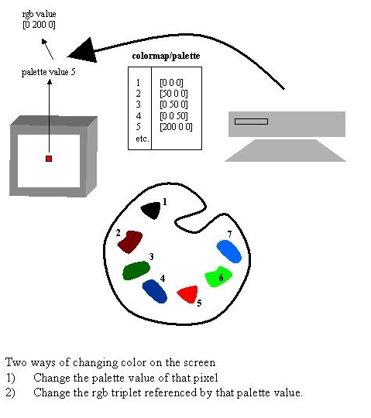
COLORMAPS p. 22
RGB value
[200 0 0]

Slide 15
COLORMAPS p. 22
= SHORTCUTS to your 'kinda colors'.
How many colors in my computer?
- 8 bit color = 256 colors. (GIFs)
- 24 bit color = 8 bits/gun.
256^3 = 16.7 million
- 36 bit color = 12 bits/gun.
(2^12)^3 = 68 billion.
Most today are:
32 bit: 8 bits per gun, plus 8 bits of transparency…

Slide 16
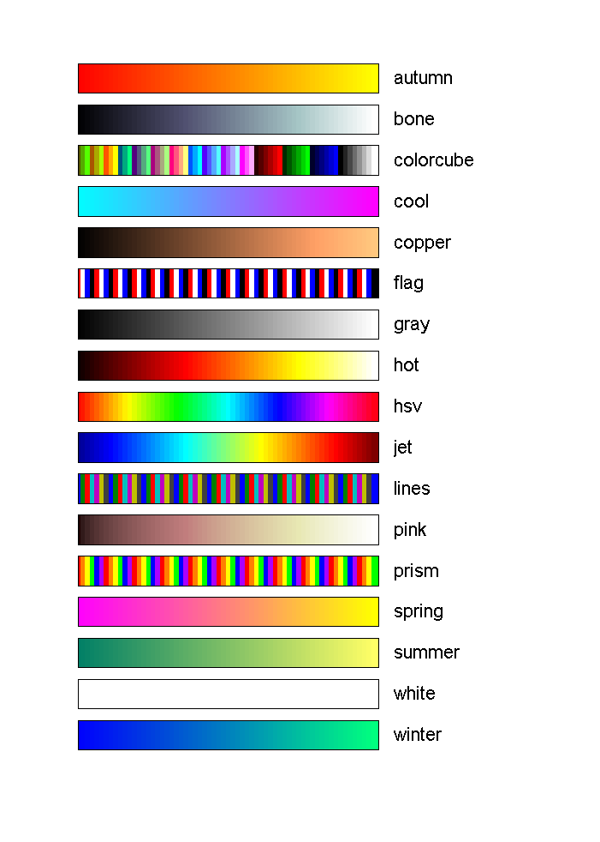
CLUTs
Matlab native colormaps (you can make your own):
hsv - Hue-saturation-value color map.
hot - Black-red-yellow-white color map.
gray - Linear gray-scale color map.
bone - Gray-scale with tinge of blue color map.
copper - Linear copper-tone color map.
pink - Pastel shades of pink color map.
white - All white color map.
flag - Alternating red, white, blue, and black color map.
lines - Color map with the line colors.
colorcube - Enhanced color-cube color map.
vga - Windows colormap for 16 colors.
jet - Variant of HSV.
prism - Prism color map.
cool - Shades of cyan and magenta color map.
autumn - Shades of red and yellow color map.
spring - Shades of magenta and yellow color map.
winter - Shades of blue and green color map.
summer - Shades of green and yellow color map.

Slide 17
Exercise
Look at map. What do you notice?
Display Durer's etching in all shades of red.
>map(:,2)=0;
>map(:,3)=0;
>colormap(map)

Slide 18
Other types of images
You can load TIFF, JPEG, BMP… with
imread
[X,map] = imread(filename,ext);
for indexed images. (like GIF)
MxN matrices of color indeces
or
X = imread(filename,ext);
for non-indexed images (like JPG)
MxNx3 matrices with rgb triplets at m x n
for more options do 'help imread'

Slide 19
demos…
write a script named classdemo.m
That's where will be working today.
go to the webpage:
http://internal.psychology.illinois.edu/~alleras/courseImages.htm

Slide 20
Other types of images
Examples:
go to webpage:
http://internal.psychology.illinois.edu/~alleras/courseImages.htm
indexed image: type this on classdemo
[x,map]=imread('VisionLab','gif')
image(x);
axis off;
axis equal;
input('click key when ready');
colormap(map);
input('click key when ready');
colormap(hot);
CHECK OUT 'map'. These are customized color values needed to reproduce THIS image.

Slide 21
Other types of images
non-indexed image:
[x,map]=imread('VisionLab','jpg')
what's map?
%what are the dimensions of x?
image(x);
axis off;
axis equal;
input('click key when ready');
colormap(cool);
.

Slide 22
Write images to files
Let's make and save a random b/w mask image.
imwrite(matrix,'nameoffile','ext')
%imwrite(matrix,colormap,'nof','ext') for indexed images
> mask = rand(400,400);
> imwrite(mask,'mask.bmp','bmp');
> clear all
> input('click key when ready');
> [X,map] = imread('mask','bmp');
> image(X);
> input('click key when ready');
> colormap(map); %default map is grayscale

Slide 23
Write images to files
Let's make and save a random color-noise mask image -unindexed
> mask2 = rand(400,400,3); %why 3?
> imwrite(mask2,'mask2','jpg');
> clear all;
> input('click key when ready');
> X = imread('mask2','jpg');
> image(X);
> colormap(gray);
> input('click key when ready');
> colormap(hot);

Slide 24

Exercise
Display to the Figure window an image of a horizontal grayscale (size 256 x 200) (all colors of grayscale(256))
grate = zeros(256,200);
for n=1:256
grate(n,:) = n;
end;
colormap(gray(256));
image(grate);
axis off;
axis equal;

Slide 25
Other demo
Display to the Figure window an image of a grayscale horizontal sinusoidal grating (size 200 x 200)
grate = zeros(200,200);
for n=1:200
grate(n,:) = 256 * (abs(sin(2*pi*n/200)));
end;
colormap(gray(256));
image(grate);
axis off;
axis equal;

Slide 26
In class exercise (1)
Display the durer image on a background of white and red stripes. Each background stripe should be 24 pixels.
load durer
newmap1 = colormap(gray(128));
newmap2 = newmap1;
newmap2(:,2) = 0;
newmap2(:,3) = 0;
newmap = [newmap1;newmap2];

Slide 27
In class exercise (1)
with a for loop, every 24 lines, you add 128 to color index
image has 27 'bands'
create a matrix with these bands
width_of_X = size(X,2);
zer = zeros(24,width_of_X);
one = ones(24,width_of_X);
conc = [zer;one];
newX = repmat(conc,13,1);
newX = [newX;zer];
newX = newX .*128; % 1 -> 128, 0 stay!
newX = newX + X; %done! “moved” %indeces to lower part of CLUT!
image(newX);
colormap(newmap);

