Slide 1
Last time
Psychophysics Toolbox
-Synchronizing images with monitors
-Getting responses from Kb

Slide 2
TODAY
More Psychophysics Toolbox
- Balance your design
Mouse
Sounds!
Prioritizing your code
Exercises
Putting it all together

Slide 3
Name of Keys: if you ever forget, use KbDemo!
a=0;
while KbCheck end;
while ~a
[a,b,keyCode] = KbCheck;
end;
resp = KbName(keyCode)
CODES of keys change, but NOT their names, across OS...

Slide 4
%TOJ.m
rand('state',sum(100*clock)); %Resets the random generator to a different
%state each time. Important for Experiments!!
warning off MATLAB:DeprecatedLogicalAPI
[window,rect]=Screen('OpenWindow',0,[0 0 0]);
refresh=Screen('GetFlipInterval',windowPtr);
slack=refresh./2;
dotradius = 20;
rect4dot = [0 0 dotradius*2 dotradius*2];
Xright = rect(3);
Ybottom = rect(4);
Xcenter=Xright/2;
Ycenter=Ybottom/2;
white = [255 255 255];
fixtime = 30; %500ms at 60Hz
ontime = 6; %100ms at 60HZ
left_dot = kbName('left');
right_dot = kbName('right');
%***************************************************************
% design
%***************************************************************
TimeCond = floor(rand(1)*3); %1=left appears first, 2=right, 0 both
TempOffsets = [1 2 4]; % different wait categories refreshes to wait
TempOff = TempOffsets(ceil(rand(1)*3)); %actual number of refreshes we'll wait

Slide 5
TOJ.m
%*********************************************
% draw things
%*********************************************
X=imread('white_circle.jpg');
Y=imread('white_rect.jpg');
circle=Screen('MakeTexture',windowPtr,X);
rect1=Screen('MakeTexture',windowPtr,Y); %Makes rectangle
%% or you can use Screen(‘FillRect’, ‘DrawDots’, ‘FillOval’
Screen('TextFont',windowPtr,'Times New Roman')
%

Slide 6
TOJ.m
%-------------------
%Run "trial"
%-------------------
while KbCheck end; %purges kb
Screen(‘Flip’,window);
Screen(‘DrawLine’,window,[255 255 255], [Xcenter Ycenter-10 Xcenter Ycenter+10;Xcenter-10 Ycenter Xcenter+10 Ycenter]); %draws fixation Cross
vbl=Screen(‘Flip’,window,[],1);
switch TimeCond
case 0 %both appear at the same time!!!
Screen('DrawTexture',windowPtr,circle,[],[Xcenter-100 Ycenter-25 Xcenter-50 Ycenter-+25]);
Screen('DrawTexture',windowPtr,circle,[],[Xcenter+50 Ycenter-25 Xcenter+100 Ycenter-+25]);
vbl=Screen('Flip',window,vbl+fixtime*refresh-slack,1,1);
case 1 %left first
Screen('DrawTexture',windowPtr,circle,[],[Xcenter-100 Ycenter-25 Xcenter-50 Ycenter-+25]);
vbl=Screen('Flip',window,vbl+fixtime*refresh-slack,1,1);
Screen('DrawTexture',windowPtr,circle,[],[Xcenter+50 Ycenter-25 Xcenter+100 Ycenter-+25]);
vbl=Screen('Flip',window,vbl+TempOff*refresh-slack,1,1);
case 2 %right first
Screen('DrawTexture',windowPtr,circle,[],[Xcenter+50 Ycenter-25 Xcenter+100 Ycenter-+25]);
vbl=Screen('Flip',window,vbl+fixtime*refresh-slack,1,1);
Screen('DrawTexture',windowPtr,circle,[],[Xcenter-100 Ycenter-25 Xcenter-50 Ycenter-+25]);
vbl=Screen('Flip',window,vbl+TempOff*refresh-slack,1,1);
end; %switch

Slide 7
TOJ.m
%-------------------
%Run "trial"
%-------------------
while KbCheck end; %purges kb
Screen(‘Flip’,window);
Screen(‘DrawLine’,window,[255 255 255], [Xcenter Ycenter-10 Xcenter Ycenter+10;Xcenter-10 Ycenter Xcenter+10 Ycenter]); %draws fixation Cross
vbl=Screen(‘Flip’,window,[],1);
A BIG advantage of commands like DrawDots or DrawLine is that you can pass a list of dots or lines to draw in one single command!! Here the list is:
[ Xcenter Ycenter-10 Xcenter Ycenter+10;
Xcenter-10 Ycenter Xcenter+10 Ycenter];
[startx1 starty1 endx1 endy1;
startx2 startu2 endx2 endy2]

Slide 8
TOJ.m
%-------------------
%Run "trial"
%-------------------
...
vbl=Screen(‘Flip’,window,[],1);
switch TimeCond
case 0 %both appear at the same time!!!
Screen('DrawTexture',windowPtr,circle,[],[Xcenter-100 Ycenter-25 Xcenter-50 Ycenter+25]);
Screen('DrawTexture',windowPtr,circle,[],[Xcenter+50 Ycenter-25 Xcenter+100 Ycenter+25]);
vbl=Screen('Flip',window,vbl+fixtime*refresh-slack,1,1); %%QUESTION WHAT IS vbl+fixtim*refresh-slack?
case 1 %left first
Screen('DrawTexture',windowPtr,circle,[],[Xcenter-100 Ycenter-25 Xcenter-50 Ycenter+25]);
vbl=Screen('Flip',window,vbl+fixtime*refresh-slack,1,1);
Screen('DrawTexture',windowPtr,circle,[],[Xcenter+50 Ycenter-25 Xcenter+100 Ycenter+25]);
vbl=Screen('Flip',window,vbl+TempOff*refresh-slack,1,1); %%WHAT IS vbl+TempOff*refresh-slack?
case 2 %right first
Screen('DrawTexture',windowPtr,circle,[],[Xcenter+50 Ycenter-25 Xcenter+100 Ycenter+25]);
vbl=Screen('Flip',window,vbl+fixtime*refresh-slack,1,1);
Screen('DrawTexture',windowPtr,circle,[],[Xcenter-100 Ycenter-25 Xcenter-50 Ycenter+25]);
vbl=Screen('Flip',window,vbl+TempOff*refresh-slack,1,1);
end; %switch

Slide 9
TOJ.m
%-------------------
%Getting responses
%-------------------
touch = 0;
while ~touch
[touch, secs, keyCode] = KbCheck;
end
correct =0;
if (keyCode(right_dot) & TimeCond==2)
correct =1;
elseif(keyCode(left_dot) & TimeCond==1)
correct =1;
else
correct=0; %this is redundant!
end;
correct %print to commandwindow
%record_confidence

Slide 10
TOJ.m
%-------------------
%record confidence
%-------------------
WaitSecs(1);
boxsize= 50;
spacing = 10;
for count=1:5
Screen('FillRect',window,[150 150 150], [(XRight/3+count*(boxsize+spacing)) YBottom/2
(XRight/3+count*(boxsize+spacing)+boxsize) (YBottom/2+boxsize)]);
Screen(‘DrawText’,window,int2str(count),
XRight/3+count*(boxsize+spacing)) YBottom/2, [0 0 0]);
end;
Screen(‘Flip’,window,[],1); %% don’t clear to keep the squares visible
while KbCheck end;

Slide 11
TOJ.m
touch =0;
while ~touch
[touch, secs, keyCode] = KbCheck;
end
selected = str2double(KbName(keyCode))
%%%if you use the number keypad this transforms the name of the key ‘1’, %%%‘2’, etc into the number 1 or 2, etc
color=[255 0 0];
Screen('FillRect',window,color,...
[(XRight/3+selected*(boxsize+spacing)) YBottom/2...
(XRight/3+selected*(boxsize+spacing +boxsize)) (YBottom/2+boxsize)]);
Screen(‘DrawText’,window,int2str(selected), XRight/3+selected*(boxsize+spacing)) YBottom/2, [0 0 0]);
Screen(‘Flip’,window);
WaitSecs(1);
Screen('CloseAll');
clear all;

Slide 12
Balancing your Design
Multiple conditions/factors:
-> decide what is to be RANDOM and what is to be pseudo-Random.
Ex: in a visual search location of items can be random (as long as non-overlapping)…
whereas target-distractor similarity or setsize on any given trial should be pseudo-random (so that we have same/comparable number of observations per condition.

Slide 13
Balancing your Design
Construct your DATA structure:
Data = repmat(struct('trial',1,'setsize',1, 'tgtdistsim',0, 'rt',-1, 'resp',-1),1,60);
%assume 3 setsizes: 4, 8, 16
%two levels of tgtdistsim
%balance!

Slide 14
Balancing your Design
Construct your DATA structure:
Data = repmat(struct('trial',1,'setsize',1, 'tgtdistsim',0, 'rt',-1, 'resp',-1),1,T_TRIALS);
%assume 3 setsizes: 4, 8, 16
%two levels of tgtdistsim
%balance!
%!!!!T_TRIALS MUST BE A MULTIPLE OF your number of %conditions
for i=1:T_TRIALS
Data(i).trial=i;
Data(i).setsize=mod(i,3);
Data(i).tgtdistsim=mod(i,2);
end
%THIS only works because 3 and 2 are relative primes.
%PST: ALWAYS PRINT YOUR DESIGN AND CHECK IT!!!
%So, do that!

Slide 15
Balancing your Design
%PST: ALWAYS PRINT YOUR DESIGN AND CHECK IT!!!
%So, do that!
for trial=1:T_TRIALS
fprintf('Trial:%3d ss:%2d targetDistSim:%d\n', Data(trial).trial, Data(trial).setsize, Data(trial).tgtdistsim);
pause;
end
%Once you verify your design,
%THEN you randomize the order of trials
% Go Ahead!!

Slide 16
Balancing your Design
%THEN you randomize the order of trials
% Go Ahead!!
Dummy=Data;
sequence = randperm(T_TRIALS);
Data = Dummy(sequence);
%Problem??
%Data.trial is not in order…
%You can start without declaring .trial and then add it (or
% just change it:
for i=1:T_TRIALS
Data(i).trial = i;
end

Slide 17
Balancing your Design
Exercise: Balance a Design that has three factors:
TargetID: 1 or 2
TargetLoc: 1 or 2
CueValidity: 1 (70%), 0 (30%)

Slide 18
Balancing your Design
Exercise: Balance a Design that has three factors:
TargetID: 1 or 2
TargetLoc: 1 or 2
CueValidity: 1 (70%), 0 (30%)
T_TRIALS=80;
Data = repmat(struct('trial',1,'tgtID',1, 'tgtLoc',0,'CueVal',1, 'rt',-1, 'resp',-1),1,T_TRIALS);
count=0;
for rep=1:2
for id=1:2
for loc=1:2
for val=1:10
count=count+1;
Data(count).tgtID = id;
Data(count).tgtLoc = loc;
if (val<8)
Data(count).CueVal=1;
else
Data(count).CueVal=0;
end;
end;
end;
end;
end;

Slide 19
MOUSE Management
List of useful functions:
HideCursor
ShowCursor
GetClicks
GetMouse
SetMouse

Slide 20
MOUSE Management
List of useful functions:
HideCursor
ShowCursor
Self_explanatory
ShowCursor allows you to pick your own cursor!!
Let’s look at them!

Slide 21
AllMice.m
%Screen start
[w,rect]=Screen('OpenWindow',2,1);
KbWait;
for i=0:5
ShowCursor(i);
WaitSecs(0.5);
HideCursor;
WaitSecs(0.1);
end
%%%some have names:’Arrow’,’CrossHair’,
%%%’Hand’,’SandClock’
KbWait;
sca;
clear all;

Slide 22
MOUSE Management
[x,y,buttons]=GetMouse([windowPtr]);
-gives x,y location of mouse
-the state of buttons:
1 x Number of buttons
(1 for button down).
NOTE: If you use GetMouse to wait for clicks, don't forget to wait for the user to release the mouse button, ending the current click, before you begin waiting for the next mouse press.

Slide 23
MOUSE Management
Test your mouse:
[x,y,buttons] = GetMouse;
% Test if any mouse button is pressed.
if any(buttons)
fprintf('Someone''s pressing a button.\n');
end
% Test if the first mouse button is pressed.
if buttons(1)
fprintf('Someone''s pressing the first button!\n');
end
% Test if the second mouse button is pressed.
if length(buttons)>=2 & buttons(2)
fprintf('Someone''s pressing the second button!\n');
end

Slide 24
MOUSE Management
More usage:
fprintf('Please click the mouse now.\n');
[x,y,buttons] = GetMouse;
while any(buttons) % if already down, wait for release
[x,y,buttons] = GetMouse;
end
while ~any(buttons) % wait for press
[x,y,buttons] = GetMouse;
end
while any(buttons) % wait for release
[x,y,buttons] = GetMouse;
end
fprintf('You clicked! Thanks.\n');

Slide 25
MOUSE Management
GetClicks
[clicks,x,y,whichbutton] = GetClicks([windowPtr],[interclickSecs]);
returns number of clicks within inter-click interval (OS) and returns x,y coordinates
if interclickSecs=0: as soon as mouse click detected, x,y is returned.
Try it! Try doubleclicking: GetClicks
Then try: GetClicks([],0.1);
GetClicks([],0.2);
fun, eh?

Slide 26
MOUSE Management
SetMouse:
SetMouse(x,y) duh!

Slide 27
Exercise
Write a program that:
puts the mouse cursor at the center of the screen
When the user starts moving the cursor, it starts counting time.
draws a dot at the current location of the mouse, at every display refresh for one second
then waits for the a key to be pushed to end the program

Slide 28
%% draw dots for one second
warning off MATLAB:DeprecatedLogicalAPI;
[window,rect]=screen('OpenWindow',2 ,255);
refreshFlip=Screen('GetFlipInterval',window);
HideCursor;
ShowCursor('CrossHair');
Xcenter=rect(3)/2;
Ycenter=rect(4)/2;
SetMouse(Xcenter,Ycenter);
[x,y,buttons]=GetMouse(window);
while (x==Xcenter) && (y==Ycenter)
[x,y,buttons]=GetMouse(window);
end;
t1=GetSecs;
while (GetSecs - t1 < 1)
Screen('DrawDots', window, [x y], 1, [0 0 0]);
Screen('Flip',window,[],1,1);
[x,y,buttons]=GetMouse(window);
end;
HideCursor;
KbWait;
Screen('CloseAll');

Slide 29
CHANGE THE PROGRAM SO THAT MATLAB FIRST RECORDS YOUR MOUSE MOVEMENTS AND THEN DRAWS THEM AFTER YOUR DONE MOVING!!
First option: sample the mouse with at each Flip
    Second option: sample mouse every millisecond.

Slide 30
CHANGE THE PROGRAM SO THAT MATLAB FIRST RECORDS YOUR MOUSE MOVEMENTS AND THEN DRAWS THEM AFTER YOUR DONE MOVING!!
First option: sample the mouse with at each Flip
    Second option: sample mouse every millisecond. (on your own)
X(1)=Xcenter;
Y(1)=Ycenter;
while (GetSecs - t1 < 1)
Screen('Flip',window);
[x,y,buttons]=GetMouse(window);
X=[X x];
Y=[Y y];
end;
boo=[X;Y];
Screen('DrawDots', window, boo, 1, [0 0 0]);
Screen('Flip',window);

Slide 31
Now: Change the program so that it RE-ANIMATES your actions for you.
This time: record while the mouse is moving and draw as soon as the mouse stops.
%% RECORD:
while (moving)
Screen('Flip',window);
[x,y,buttons]=GetMouse(window);
X=[X x];
Y=[Y y];
if (X(end)==X(end-1) && Y(end)==Y(end-1)...
&& X(end)==X(end-2) && Y(end) ==Y(end-2) )
moving=0;
beep;
end;
end;
HideCursor;

Slide 32
Now: Change the program so that it RE-ANIMATES your actions for you.
This time: record while the mouse is moving and draw as soon as the mouse stops.
%% DRAW
for i=1:length(X)
Screen('DrawDots', window, [X(i) ; Y(i)], 3,...
[0 0 0]);
Screen('Flip',window,[],1);
end;
KbWait;
Screen('CloseAll');

Slide 33
Movies!
% Movie and multimedia playback functions:
[ moviePtr [duration] [fps] [width] [height] [count]]=Screen('OpenMovie', windowPtr, moviefile [, async=0] [, preloadSecs=1]);
Screen('CloseMovie', moviePtr);
[ texturePtr [timeindex]]=Screen('GetMovieImage', windowPtr, moviePtr, [waitForImage], [fortimeindex], [specialFlags = 0] [, specialFlags2 = 0]);
[droppedframes] = Screen('PlayMovie', moviePtr, rate, [loop], [soundvolume]);
timeindex = Screen('GetMovieTimeIndex', moviePtr);
[oldtimeindex] = Screen('SetMovieTimeIndex', moviePtr, timeindex [, indexIsFrames=0]);
moviePtr = Screen('CreateMovie', windowPtr, movieFile [, width][, height][, frameRate=30][, movieOptions]);
Screen('FinalizeMovie', moviePtr);
Screen('AddFrameToMovie', windowPtr [,rect] [,bufferName] [,moviePtr=0] [,frameduration=1])

Slide 34
Movies!
% Video capture functions:
devices = Screen('VideoCaptureDevices' [, engineId]);
videoPtr =Screen('OpenVideoCapture', windowPtr [, deviceIndex] [,roirectangle] [, pixeldepth] [, numbuffers] [, allowfallback] [, targetmoviename] [, recordingflags] [, captureEngineType]);
Screen('CloseVideoCapture', capturePtr);
[fps starttime] = Screen('StartVideoCapture', capturePtr [, captureRateFPS] [, dropframes=0] [, startAt]);
droppedframes = Screen('StopVideoCapture', capturePtr);
[ texturePtr [capturetimestamp] [droppedcount] [summed_intensityOrRawImageMatrix]]=Screen('GetCapturedImage', windowPtr, capturePtr [, waitForImage=1] [,oldTexture] [,specialmode] [,targetmemptr]);
oldvalue = Screen('SetVideoCaptureParameter', capturePtr, 'parameterName' [, value]);

Slide 35
Beeps and Wav sounds
Matlab can play wav sounds and beeps WHILE doing something else (nice for experiments).
Just like we 'Open' a window, we need to 'Open' a sound channel:
Snd('Open');
and 'close' it when you are done:
Snd('Close');
WARNING: Snd is not a reliable function... we prefer the new PsychPortAudio functions (soon). But useful for feedback and simple audio.

Slide 36
Beeps
  You can create beeps with MakeBeep, which creates a vector that will be interpreted by your sound card (just like a matrix of numbers is interpreted by your graphics card as an image).
  beep = MakeBeep(frequency,duration,[samplingrate]);
  Then you can play that beep:
  Snd('Play',beep,samplingrate);

Slide 37
PsychPortAudio
Requires download of a special driver to your computer
http://psychtoolbox.org/wikka.php?wakka=PsychPortAudio
High performance, high precision, low latency sound control for experimental purposes!

Slide 38
PsychPortAudio
% Perform basic initialization of the sound driver:
InitializePsychSound;
%PsychPortAudioTimingTest is a test to check
% audio-visual synchronization
pahandle = PsychPortAudio('Open', [], [], 0, freq, nrchannels);
% Open the default audio device [], with default mode [] (==Only playback),and a required latencyclass of zero 0 == no low-latency mode, as well as a frequency of freq and nrchannels sound channels. This returns a handle (like fid) to the audio device. It’s just like [win,rect]=Screen(‘OpenWindow’,[],[])
PsychPortAudio('FillBuffer', pahandle, wavedata);
% Fill the audio playback buffer with the audio data 'wavedata‘. This is just like Screen(‘DrawTexture’,window,textureptr)
t1 = PsychPortAudio('Start', pahandle, repetitions, 0, 1);
% Start audio playback for 'repetitions' repetitions of the sound data, start it immediately (0) and wait for the playback to start, return onset timestamp.

Slide 39
PsychPortAudio
% Query current playback status and print it to the Matlab window:
s = PsychPortAudio('GetStatus', pahandle);
% Stop playback:
PsychPortAudio('Stop', pahandle);
% Close the audio device: (DON”T FORGET! Like Screen(‘Close’,window);
PsychPortAudio('Close', pahandle);

Slide 40
Example
InitializePsychSound;
minusnamecell={'minusone2';'minustwo1';'minusthree1';'minusfour1';'minusfive1'};
WaitForOnset=0; %How long do we wait before starting to play sound. It’s like %%scheduling a Flip ahead of time.
pahandle = PsychPortAudio('Open', [], [], 0, 44100, 1);
for i=1:5
pickname=minusnamecell{i};
[wavedata,freq,bits,opt_ck] = wavread(pickname);
PsychPortAudio('FillBuffer', pahandle, wavedata');
t2=GetSecs;
t1= PsychPortAudio('Start',pahandle,1,WaitForOnset,1);%1repetition,telltime
t4=GetSecs;
flag=1;
while flag
status=PsychPortAudio('GetStatus',pahandle);
flag=status.Active;
end;
t3=GetSecs;
TimeToStartSound=t4-t2
TimeToFinishPlayingSound=t3-t4
WholeThing=t3-t2
end;
PsychPortAudio('Close', pahandle);

Slide 41
PsychPortAudio
RECORDING:
freq = 44100;
pahandle = PsychPortAudio('Open', [], 2, 0, freq, 2);
% Open the default audio device [], with mode 2 (== Only audio capture),and a required latencyclass of zero 0 == no low-latency mode, as well as a frequency of 44100 Hz and 2 sound channels for stereo capture. This returns a handle to the audio device
PsychPortAudio('GetAudioData', pahandle, 10);
% Preallocate an internal audio recording buffer with a capacity of 10 seconds
PsychPortAudio('Start', pahandle, 0, 0, 1);
% Start audio capture immediately and wait for the capture to start before returning control to Matlab. We set the number of 'repetitions' to zero,
% i.e. record until recording is manually stopped.

Slide 42
Voice Trigger Example
Voice Trigger:
if voicetrigger > 0
% Yes. Fetch audio data and check against threshold:
level = 0;
% Repeat as long as below trigger-threshold:
while level < voicetrigger
% Fetch current audiodata:
[audiodata offset overflow tCaptureStart] = PsychPortAudio('GetAudioData', pahandle);
% Compute maximum signal amplitude in this chunk of data:
if ~isempty(audiodata)
level = max(abs(audiodata(1,:)));
else
level = 0;
end
% Below trigger-threshold?
if level < voicetrigger
% Wait for a millisecond before next scan:
WaitSecs(0.0001);
end
end

Slide 43
PsychPortAudio
Voice Trigger:
% Ok, last fetched chunk was above threshold!
% Find exact location of first above threshold sample.
idx = min(find(abs(audiodata(1,:)) >= voicetrigger)); %#ok<MXFND>
% Initialize our recordedaudio vector with captured data starting from
% triggersample:
recordedaudio = audiodata(:, idx:end);
% For the fun of it, calculate signal onset time in the GetSecs time:
% Caution: For accurate and reliable results, you should
% PsychPortAudio('Open',...); the device in low-latency mode.
% See
% PsychPortAudioTimingTest and AudioFeedbackLatencyTest for how to
% setup low-latency high precision mode.
tOnset = tCaptureStart + ((offset + idx - 1) / freq);
fprintf('Estimated signal onset time is %f secs, this is %f msecs after start of capture.\n', tOnset, (tOnset - tCaptureStart)*1000);
else
% Start with empty sound vector:
recordedaudio = [];
end

Slide 44
Rushing code
So, we not always have instant access to the processor (other tasks in the waiting cue).
-> Close any windows programs while running your experiments
-> You can also "rush“ or “prioritize” the thread of your code.

Slide 45
Rushing your code
Different operations have different priorities in your computer.
-> checking status of Kb.
-> make sure to be on time for display refresh…
“Priority” allows us to alter the priority of a piece of code.

Slide 46
Rushing your code
Windows process priorities:
0: like any other task…
1: high priority level:
2: real time priority level.
process priority + Thread priority = real priority.
"Round Robin" fashion: low priorities get the crumbs…
(OSX has 9 priority levels)

Slide 47
Rushing your code
About high priority:
-Blocks Time Manager: Microseconds function (used in GetSecs) advances at coarser steps 0.3ms (rather than 0.02ms) and might overflow…
Though my personal tests have failed to show that: in XP, as many as 2000000 GetSecs failed to overflow.

Slide 48
Rushing your code
About real time priority:
-blocks keyboard input (no Ctr-Alt-Delete!)
-but keystrokes (and mouse clicks) are sent to the Kb queue (and event queue), so can be read by KbCheck, GetClicks IF THESE functions ARE also RUN AT PRIORITY 2!

Slide 49
Priority
call:Priority(newpriority)
[window,rect]=Screen('OpenWindow',2,0);
refresh=Screen('GetFlipInterval',window);
load durer;
durer=Screen('MakeTexture',window,X);
Priority(2);
vbl=Screen('Flip',window); %synchronizing to retrace.
for i=1:36
Screen('DrawTexture',window,durer,[],[],10*i);
vbl=Screen('Flip',window , vbl + (3-0.5)*refresh,[],1);
end;
Priority(0);
KbCheck;
Screen('CloseAll');

Slide 50
MaxPriority
Allows you to determine the Maximum priority level that will allow your functions to execute properly!
Call:
priorityLevel = MaxPriority(windowPtr, [‘Flip'],[‘MakeTexture'],...
['BlankingInterrupt'],['SetClut'],['ClutMovie'],...
['SND'],['sound'],['speak'],[‘DrawTexture’],...
['GetSecs'],['WaitSecs'],['cputime'],...
['KbCheck'],['KbWait'],['CharAvail'],['GetChar'],...
['EventAvail'],['GetClicks'],['GetMouse'],['GetTicks']);

Slide 51
MaxPriority
load durer;
durer=Screen('MakeTexture',window,X);
Priority(MaxPriority(‘DrawTexture’,’Flip’));
vbl=Screen('Flip',window); %synchronizing to retrace.
for i=1:36
Screen('DrawTexture',window,durer,[],[],10*i);
vbl=Screen('Flip',window, vbl + (3-0.5)*refresh,[],1);
end;
Priority(0);
KbCheck;
Screen('CloseAll');

Slide 52
Putting it all together
So, how do I run a program?
-> Use your experiment program as 1 or several blocks of trials (when possible).
-> Call your m-file from another script.
-> Create m-files for routine procedures (like getting subject information, or drawing repeated stimuli).

Slide 53
start_toj.m
iddef % next slide: a script that gets the subject number and whether practice is required
inst toj %somewhere an instruction file toj.txt
if (strcmp(Prac,'y'))
toj_expt %would have a conditional: inside of toj_expt.m
% will talk about it in a few slides.
load tempSbjID
Prac = 'd'; % 'd' for done.
save tempSbjID SbjID Prac;
end
for blocks=1:endblock
inst startblock
toj_expt
if (abort == 1)
break;
end;
end;
showcursor;
clc;
fprintf('You are done! Thank you.\n');

Slide 54
iddef.m
SbjID=input('Subject ID : ','s');
Prac=input('Practice (y/n):','s');
lr=mod(str2num(SbjID),2);
%in case you need to counterbalance color assignements or key locations…
save tempSbjID SbjID Prac lr;

Slide 55
start_toj.m
iddef % next slide: a script that gets the subject number and whether practice is required
inst toj %somewhere an instruction file toj.txt
if (strcmp(Prac,'y'))
toj_expt %would have a conditional: inside of toj_expt.m
% will talk about it in a few slides.
load tempSbjID
Prac = 'd'; % 'd' for done.
save tempSbjID SbjID Prac;
end
for blocks=1:endblock
inst startblock
toj_expt
if (abort == 1)
break;
end;
end;
showcursor;
clc;
fprintf('You are done! Thank you.\n');

Slide 56
inst.m
function inst(filename);
%***************************************************************
% inst.m
%***************************************************************
if nargin < 1; error('??? specify file name'); end
warning off MATLAB:DeprecatedLogicalAPI; % in Mac, comment this line out
[window,rect]=screen('OpenWindow',0,255);
r=screen(window,'Rect');
XLeft=rect(RectLeft); XRight=rect(RectRight);
YTop=rect(RectTop); YBottom=rect(RectBottom);
Xcentre=XRight./2; Ycentre=YBottom./2;
white=[255,255,255];
black=[0,0,0];
gray=(white+black)/2;
escapeKey = KbName('esc');
spaceKey = kbName('space');
fid=fopen(['inst' char(filename) '.txt'],'rt')
if(fid==-1)
clear all
error('File not found.');
end

Slide 57
inst.m
y=10;
while 1
comment=fgetl(fid);
if ~ischar(comment)
break;
end
screen(window,'DrawText',comment,10,y,[0,0,0]);
y=y+20;
end
fclose(fid);
Screen(‘Flip’,window);
waitsecs(3);
while (1) % pressing spacebar
[a,b,keyCode]=kbCheck;
if keyCode(spaceKey);
break;
end
end
clear y, a, b, keyCode, fid, comment, escapeKey, spaceKey, window, rect;
screen('CloseAll');

Slide 58
At start of toj_expt.m
At the very top of program:
%Don’t forget to save the current value of blocks (if determined by the controlling script (same for practice, Subject ID, etc...).
fprintf(fid, 'Subject Block Trial Asynchrony DotFirst Correct Confidence\n');
for count=1:1 %T_TRIALS
fprintf(fid, ...
'%-8s %2d %3d %2d %2d %2d %2d\n', ...
num2str(SbjID), blocks, data(count).trial, ...
data(count).TempOff, data(count).DotCond, ...
data(count).correct, data(count).confidence);
end
fclose(fid);
.

Slide 59
start_toj.m
iddef % next slide: a script that gets the subject number and whether practice is required
inst toj %somewhere an instruction file toj.txt
if (strcmp(Prac,'y'))
toj_expt %would have a conditional: inside of toj_expt.m
% will talk about it in a few slides.
load tempSbjID
Prac = 'd'; % 'd' for done.
save tempSbjID SbjID Prac;
end
for blocks=1:endblock
inst startblock
toj_expt
if (abort == 1)
break;
end;
end;
showcursor;
clc;
fprintf('You are done! Thank you.\n');

Slide 60
conditional in toj_expt.m
To only run a few trials of practice, right before the trial for loop
P_TRIALS=10; % this is added at the declaration stage
%-------------------
% Run trials
%-------------------
HideCursor;
for trial=1:T_trials
% for loop
Turns into:
if (strcmp(Prac,'y')) % Prac
T_TRIALS=P_TRIALS; % Prac
end % Prac
for trial=1:T_trials
%for loop

Slide 61
start_toj.m
iddef % next slide: a script that gets the subject number and whether practice is required
inst toj %somewhere an instruction file toj.txt
if (strcmp(Prac,'y'))
toj_expt %would have a conditional: inside of toj_expt.m
% will talk about it in a few slides.
load tempSbjID
Prac = 'd'; % 'd' for done.
save tempSbjID SbjID Prac;
end
for blocks=1:endblock
inst startblock
toj_expt
%load abort
if (abort == 1) %if you have a clear all at the end of your experiment, move %it to the end of this script or save the abort value and %load it back here
break;
end;
end;
showcursor;
clc;
clear all;
fprintf('You are done! Thank you.\n');

Slide 62
aborting the experiment
When categorizing responses:
elseif keyCode(escapeKey)
fprintf('ESC\n');
screen('CloseAll');
fprintf('Program Aborted');
break;
Now you add:
elseif keyCode(escapeKey)
fprintf('ESC\n');
abort =1;
screen('CloseAll');
fprintf('Program Aborted');
break;
and at the end of the program you save that value:
save abort abort;
so it can be read by your start_toj program

Slide 63
Advantages
Why to do it this way?
-> Simplicity inside the experiment code itself
-> for loop for blocks can be cumbersome
-> You can CLEAN memory between blocks!
(helps keep our machine mean and slim)
-> Can customize inter-block breaks with ease.
-> Can easily block conditions
-> Can easily calculate performance feedback.
Disadvantage: a bit cumbersome

Slide 64
Repeated Stimuli
Create functions to draw complex or OFTEN REPEATED stimuli to make code more readable, and decrease the chances of errors.
Ex: function to draw a diamond with a missing corner:

Slide 65
function diamond(wp,rl,col,x,y);
%wp=window pointer=which image to draw diamond on
%rl=specificies missing corner location
%col=color
diam=20;
if(rl==1) % left
xlist=[0; -diam; 0; diam/3*2; diam/3*2]*-1;
ylist=[-diam; 0; diam; diam/3; -diam/3];
elseif(rl==2) % right
xlist=[0; -diam; 0; diam/3*2; diam/3*2];
ylist=[-diam; 0; diam; diam/3; -diam/3];
end
if(col==1)
colvalue=[255, 0, 0];
elseif(col==2)
colvalue=[0, 255, 0];
end
pointlist=[xlist,ylist];
dlocx=ones(numel(xlist),1)*x;
dlocy=ones(numel(xlist),1)*y;
dloc=[dlocx,dlocy];
screen('FillPoly',window,colvalue, pointlist+dloc);

Slide 66
EXCEL: Download data:
https://netfiles.uiuc.edu/alleras/www/

Slide 67
Analyzing Data:
1. Matlab:
Done: You can easily export/import the vector with RTs and operate on it in any possible mathematical way.
I do concatenate my data on Matlab.
2. Today, Excel:
Why: Quick, reliable, graphics…

Slide 68
Analyzing Data:
1. On Matlab:
Run Concat_nozero.m to Concatenate the 6 data files (all in same directory).
2. Open overall file with Excel.
2.1 Click on column label A
2.2 Data -> Text_to_Columns
2.3 Space as delimiter.
3. Now you are ready!

Slide 69
Navigating cells:
Select the top cell with data.
-HOLDING Ctrl key down, push the down arrow key, right arrow key, etc…
-> takes you to the end of CONTIGUOUS cells.
-HOLDING Shift key down: selects cells
-Push both together to select the WHOLE set of DATA!!!

Slide 70
Sorting DATA
-Data-> Sort: select the order by which to organize your data.
Examples:
-Eliminate practice trials (block =-1).
-Eliminate first three trials of every block (warm-up trials).

Slide 71
Pivot Tables
Let's calculate accuracy in this task, per condition, per subject.
-Go to overall data.
-Select it all (Ctrl+Shit: down and left).
-Data -> Pivot Table
Select first option.
Next
Layout:

Slide 72
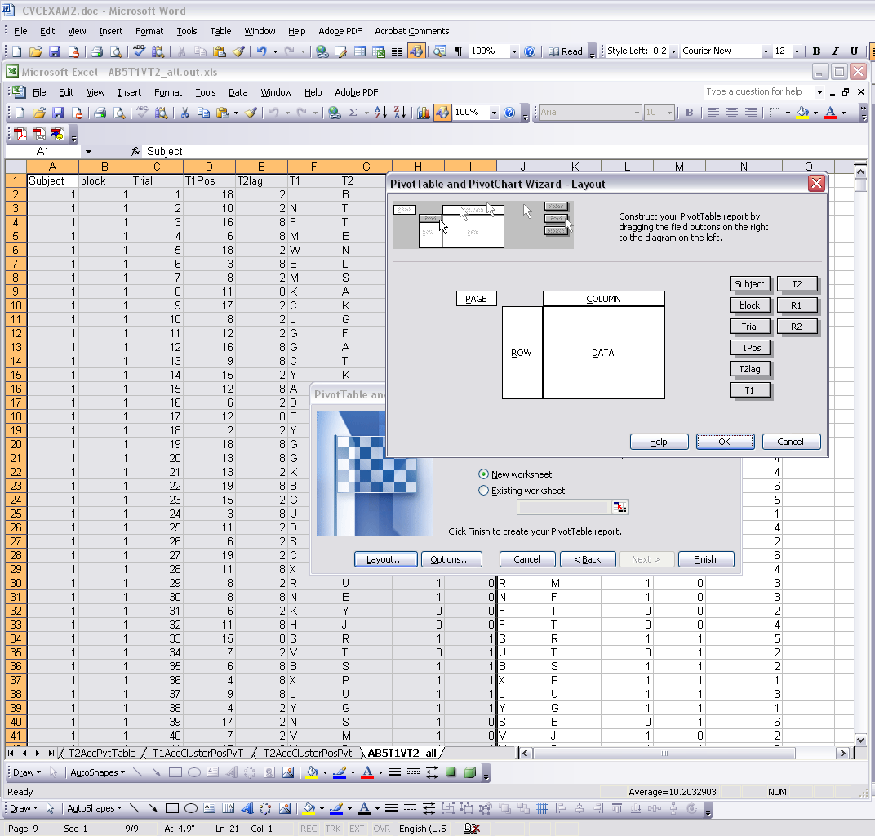
Pivot Tables
Let's calculate accuracy in this task, per condition, per subject.
-Go to overall data.
-Select it all.
-Data -> Pivot Table
Select first option.
Next
Layout:

Slide 73
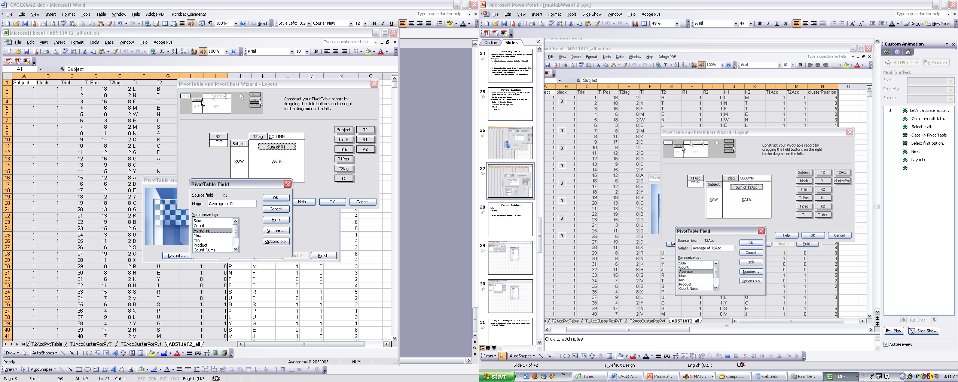
Pivot Tables
OK.
Finish.
Tada! Ready to export to SPSS!!

Slide 74
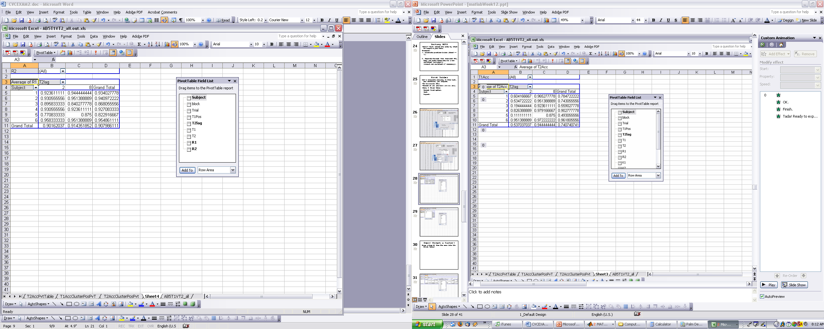
Pivot Tables
OK.
Finish.
Tada! Ready to export to SPSS!!

Slide 75
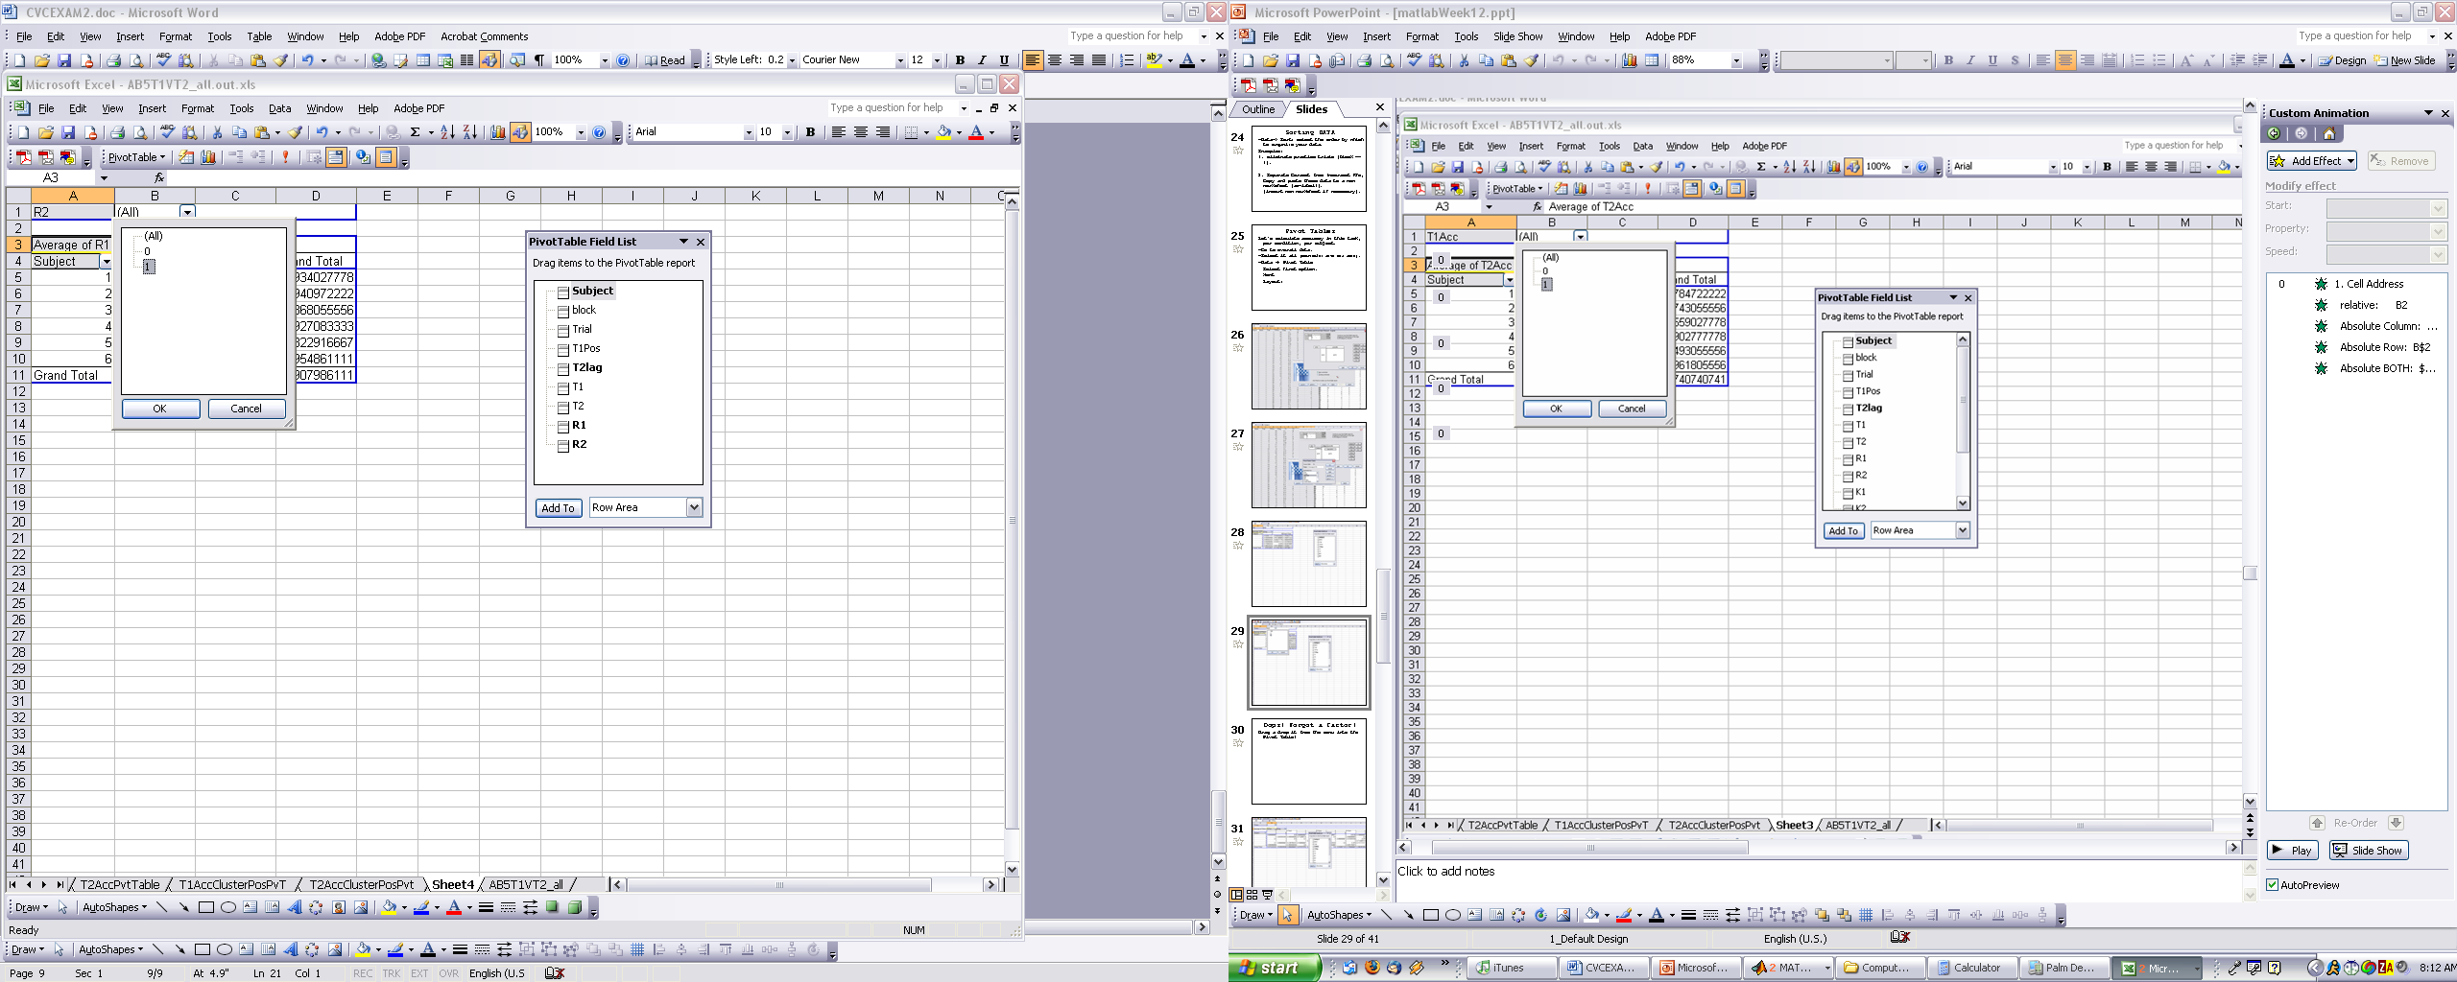
FORMULAS in Excel
1. Cell Address
relative: B2
Absolute Column: $B2
Absolute Row: B$2
Absolute BOTH: $B$2

Slide 76
Oops! Forgot a factor!
Drag and drop it from the menu into the Pivot Table!

Slide 77
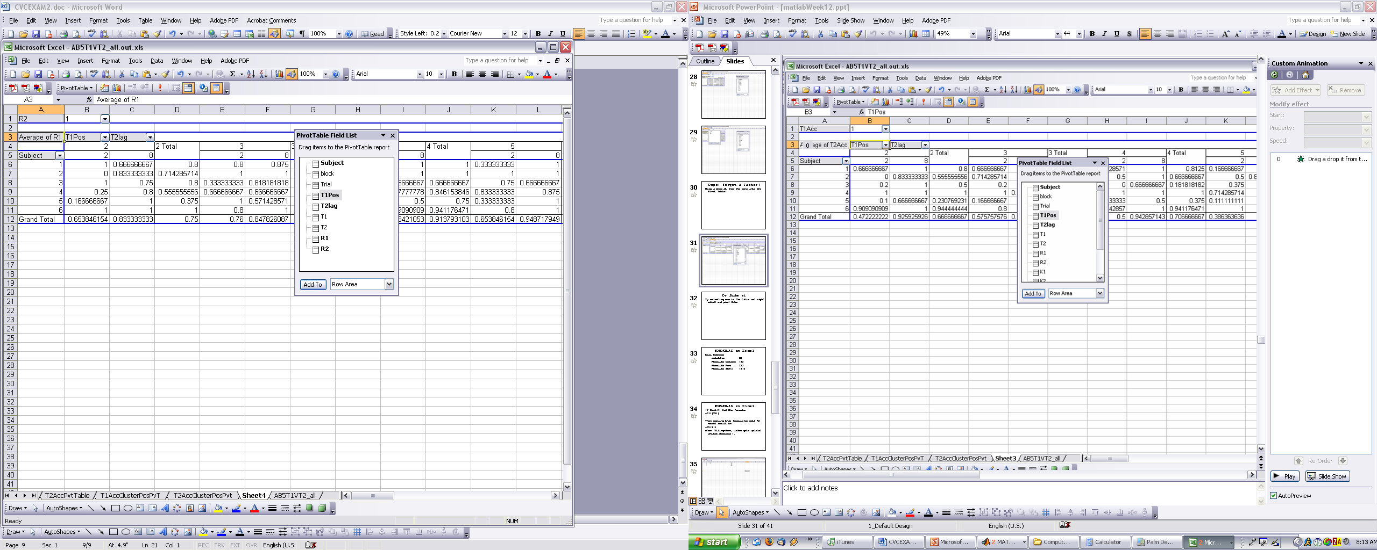
Or Hide it
By selecting one in the table and right click and pick Hide.

Slide 78
BEWARE OF MEANS in Pivot Tables
The mean “across subjects” is really “ignoring” subjects as a factor. So, never take your “means” from a pivot table.
Particularly dangerous with unequal Ns.

Slide 79
FORMULAS in Excel
Cell Address
relative: B2
Absolute Column: $B2
Absolute Row: B$2
Absolute BOTH: $B$2

Slide 80
FORMULAS in Excel
If Cell A1 had the formula:
=G1/(B$1)
Then copying this formula to cell A2 would result in:
=G2/B$1
when filling-down, index gets updated UNLESS absolute $.

Slide 81
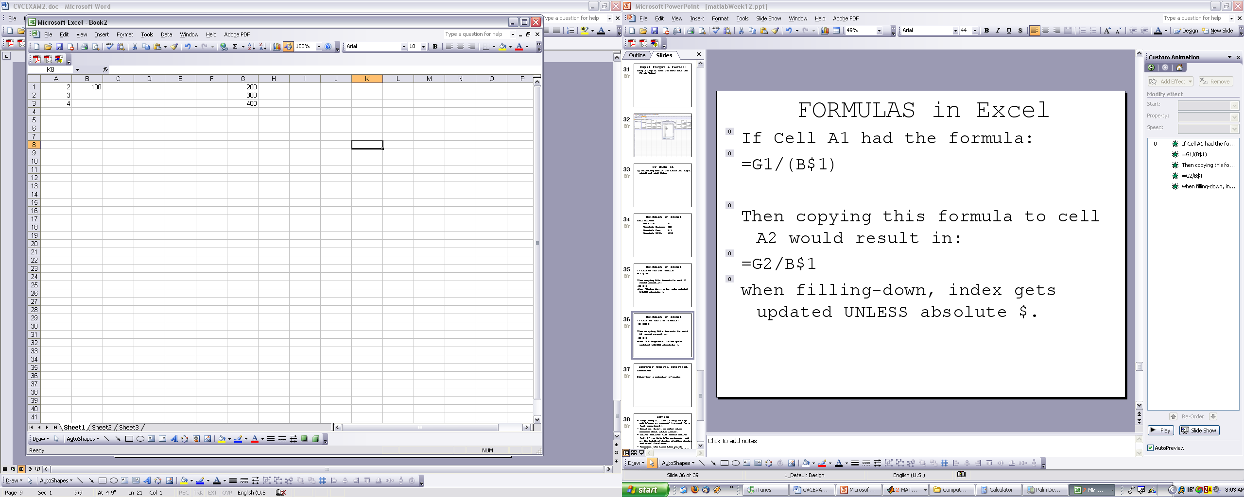
FORMULAS in Excel
If Cell A1 had the formula:
=G1/(B$1)
Then copying this formula to cell A2 would result in:
=G2/B$1
when filling-down, index gets updated UNLESS absolute $.

Slide 82
FORMULAS in Excel
If Cell A1 had the formula:
=A5/($A8)
Then copying this formula to cell B1 would result in:
=B5/$A8
when moving rightwards, LETTER gets updated UNLESS absolute $.

Slide 83
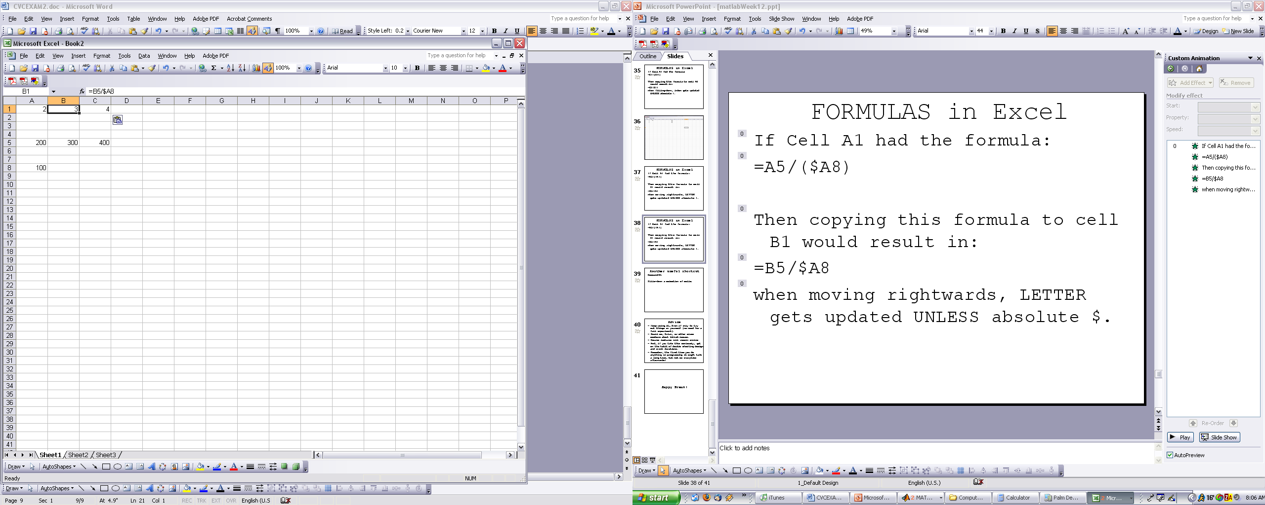
FORMULAS in Excel
If Cell A1 had the formula:
=A5/($A8)
Then copying this formula to cell B1 would result in:
=B5/$A8
when moving rightwards, LETTER gets updated UNLESS absolute $.

Slide 84
Another useful shortcut
Command-D:
Fills-down a selection of cells.

Slide 85
Exercise:
Accuracy is miscalculated in the file. Response to T1 is correct if EITHER K1 or K2 is equal to T1. Let's recalculate T1acc.
-New Column: T1Acc
cell L2 =IF(J2=F2,1,IF(K2=F2,1,0))

Slide 86
Exercise:
Accuracy is miscalculated in the file. Response to T1 is correct if EITHER K1 or K2 is equal to T1. Let's recalculate T1acc.
-New Column: T1Acc
cell L2 =IF(J2=F2,1,IF(K2=F2,1,0))
- Go to BOTTOM of cells: (on a filled cell, push Ctrl Down-Key)
- Holding Ctrl+Shift Key, push Up ARROW in L column.

Slide 87
Exercise:
Holding Ctrl+Shift Key, push Up ARROW in L column.
- You should have all cells selected.
- Now, "Ctrl D" to fill down.
- Tada!
- At home: try to redo T2Acc, and redo Pivot Table.

Slide 88
Two more things:
Working simultaneously on more than one Worksheet.
Macros.

Slide 89
Multi-tasking!
Open file Exercise RT.
-Divide data into three worksheets:
full set, correct RT, incorrect RTs and delete trial code =3.
Now you are ready to multitask:
- Go to worksheet with correct RTs
- While holding Ctrl key down, select the worksheet with incorrect RTs.
--> until you unselect the second worksheet, everything you do on one sheet will be repeated on the second (third, fourth…) worksheet!

Slide 90
Macros:
Your own customized instructions to Excel.
-> Tools-> Macro->Record

Slide 91
Advice
- Keep programming! Even if only to try out things on yourself (no need for a full experiment).
- Email me, Hengqing, or other class members about Matlab issues.
- Course lectures will remain online
- And, get on the habit of double checking design and event durations.
- Remember, the first time you do anything in programming it might take a long time, but not so every time afterwards!

Slide 92
Homework:TOJ_Expt
Turn TOJ.m into a proper experiment program, with the following characteristics:
-20% chance of SOA = -4
-20% chance of SOA = -2
-30% chance of SOA = -1
-30% chance of SOA = 0.
For each SOA condition, there must be an equal number of first_left, first_right dot conditions. The experiment should have at least 5 trials per SOA x Dot_First condition.
The data should be saved in one file, with the following information:
Subject number, Trial number, SOA condition, Dot_First condition, response, confidence. A header at the top of the file with the name of each column should be included.
Extra Credit (+1): Add a condition where a brief cue is presented 50 ms prior to the first dot, with no location validity.
Extra Credit (+2): Observers use the mouse and click on the relevant box. And record that response and highlight the box.

