Slide 1

Predicting sale price of homes in Ames, Iowa
by Kyle Jones
Ames, Iowa

Slide 2
Dataset
2,919 property sales records in Ames, Iowa between 2006 - 2010
Train Set: 1,460 records
Test Set: 1,459 records
Response Variable: recorded sale price
Predictors: 80 variables that describe quality and quantity of physical attributes of property.
I have only explored a handful of these variables thus far. I plan to explore more and include that information in the final written report.

Slide 3
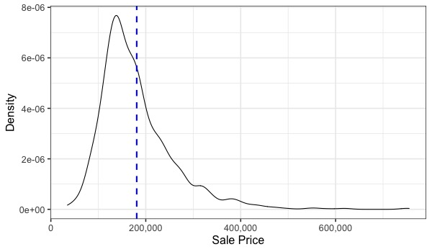
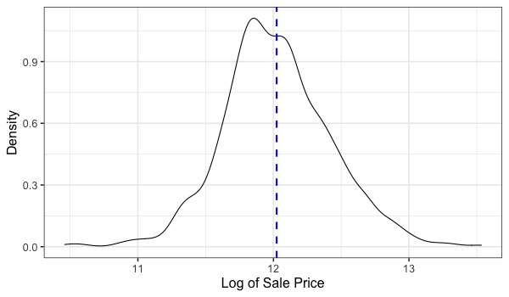
Goal of project
Primary goal of this project was to construct the “best” predictive model possible of sale price.
“best fit” evaluated by RMSE between the logarithm of the predicted sale price and the logarithm of the actual price.
taking logarithm of sale price ensured that errors on ”cheap” and “expensive” houses had equal weight.
also resulted in more normally distributed response variable (see below).
Sale price was log transformed

Slide 4
Exploratory Analysis
Variables found to be associated with sale price (so far). These were all significant in a linear regression model.
Square Footage of home
Condition of Sale
Normal sale
Abnormal sale (trade, foreclosure, short sale)
Family (sale between family members)
Partial (home not completed when last assessed)
Neighborhood (25 unique neighborhoods in dataset)
Year of remodel
Total Bathrooms
Number of Cars that can fit in garage
Near Park
Near Railroad
Fence with good privacy
direction of association
and
depending on neighborhood

Slide 5
Model Selection
Four types of models tested (so far). All predictors from prior slide included.
Linear Regression
Lasso Regression
Ridge Regression
Random Forest Regression
100-fold Monte Carlo cross validation used on train set (due to small sample size) to determine best model based on RMSE.
Within each Monte Carlo fold, optimal hyperparameters for lasso, ridge, and random forest were determined using 5-fold cross validation.
Lasso and ridge hyperparameter: lambda
Random Forest hyperparameters: tree size, and number of predictors considered
Final model chosen based on lowest Monte Carlo test error had hyperparameters retuned using entire train set before making predictions on test set.

Slide 6
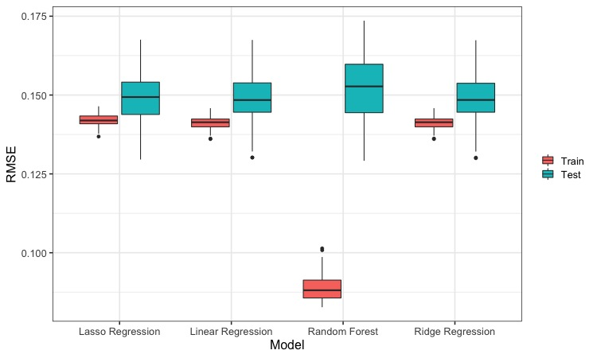
Monte Carlo Cross Validation Results
Lowest median
test RMSE
0.152
0.1489
0.1484
0.1483

Slide 7
Prediction results on test set
 | N | Log RMSE | Average Percentage Error* (Prediction - SalePrice)/SalePrice
Full Train Set after cross validation | 1,460 | 0.142 | +/- 10.65%
Test Set | 1,459 | 0.172 | Unknown
Average Percentage Error: I transformed the predicted log sale price to the predicted sale price to get the average percentage error on the train set. This is easier to understand than RMSE in my opinion. For an actual sale price of $265,000, a 10.65% error equates to +/- $28,222.50
* I couldn’t calculate an average percentage error for the test set, since they don’t provide the sale price for the test data on Kaggle. Based on the higher RMSE on the test set relative to the train set, the percent error is clearly higher than 10.65% on average.

Slide 8
Conclusions
Linear models performed better than nonlinear Random Forest model.
This is indicative of linear associations between the predicting variables and the response variable.
RMSE was noticeably poorer on the test set relative to train set, indicative of an overfit of the train set.
This was surprising considering ridge regression didn’t show signs of overfitting in the Monte Carlo cross validation analysis on the train set.
Predicted sale price was 10.6% worse than actual sale price on average.
Probably not good enough for a real estate website.
Ranked in the bottom third of the Kaggle submissions.
Hoping to improve performance for final submission by including other relevant predictors.

