Slide 1

Predicting sale price of homes in Ames, Iowa
by Kyle Jones
Ames, Iowa

Slide 2
Dataset
2,919 property sales records in Ames, Iowa between 2006 - 2010
Train Set: 1,460 records
Test Set: 1,459 records
Response Variable: recorded sale price
Predictors: 80 variables that describe quality and quantity of physical attributes of property.
I have only explored a handful of these variables thus far. I plan to explore more and include that information in the final written report.

Slide 3
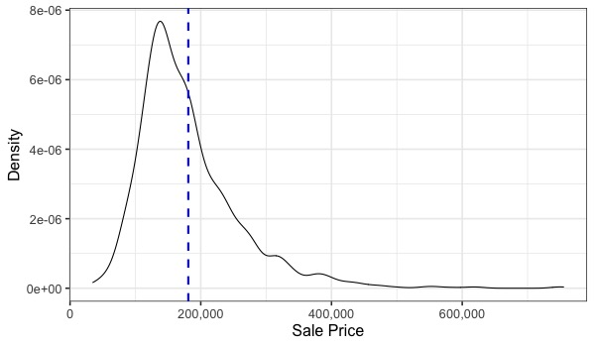
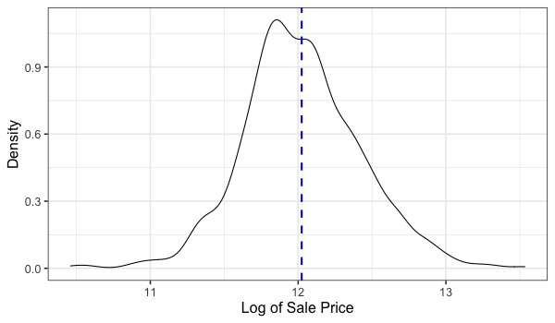
Goal of project
Primary goal of this project was to construct the “best” predictive model possible of sale price.
“best fit” evaluated by RMSE between the logarithm of the predicted sale price and the logarithm of the actual price.
taking logarithm of sale price ensured that errors on ”cheap” and “expensive” houses had equal weight.
also resulted in more normally distributed response variable (see below).
Sale price was log transformed

Slide 4
Exploratory Analysis
Variables found to be associated with sale price (so far). These were all significant in a linear regression model.
Square Footage of home
Condition of Sale
Normal sale
Abnormal sale (trade, foreclosure, short sale)
Family (sale between family members)
Partial (home not completed when last assessed)
Neighborhood (25 unique neighborhoods in dataset)
Year of remodel
Total Bathrooms
Number of Cars that can fit in garage
Near Park
Near Railroad
Fence with good privacy
direction of association
and
depending on neighborhood

Slide 5
Model Selection
Four types of models tested (so far)
Linear Regression
Lasso Regression
Ridge Regression
Random Forest Regression
100-fold Monte Carlo cross validation used on train set (due to small sample size) to determine best model based on RMSE.
Within each Monte Carlo fold, optimal hyperparameters for lasso, ridge, and random forest were determined using 5-fold cross validation.
Lasso and ridge hyperparameter: lambda
Random Forest hyperparameters: tree size, and number of predictors considered
Final model chosen based on lowest Monte Carlo test error had hyperparameters retuned using entire train set before making predictions on test set.

Slide 6
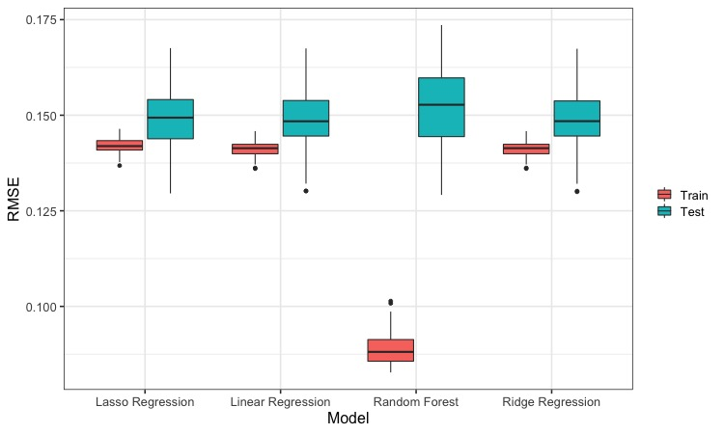
Monte Carlo Cross Validation Results
Lowest median
test RMSE
0.152
0.1489
0.1484
0.1483

Slide 7
Prediction results on test set

Slide 8
Conclusions

