Slide 1

Machine Learning applied to
Multispectral Optoacoustic Tomography unmixing
Kyle Jones

Slide 2

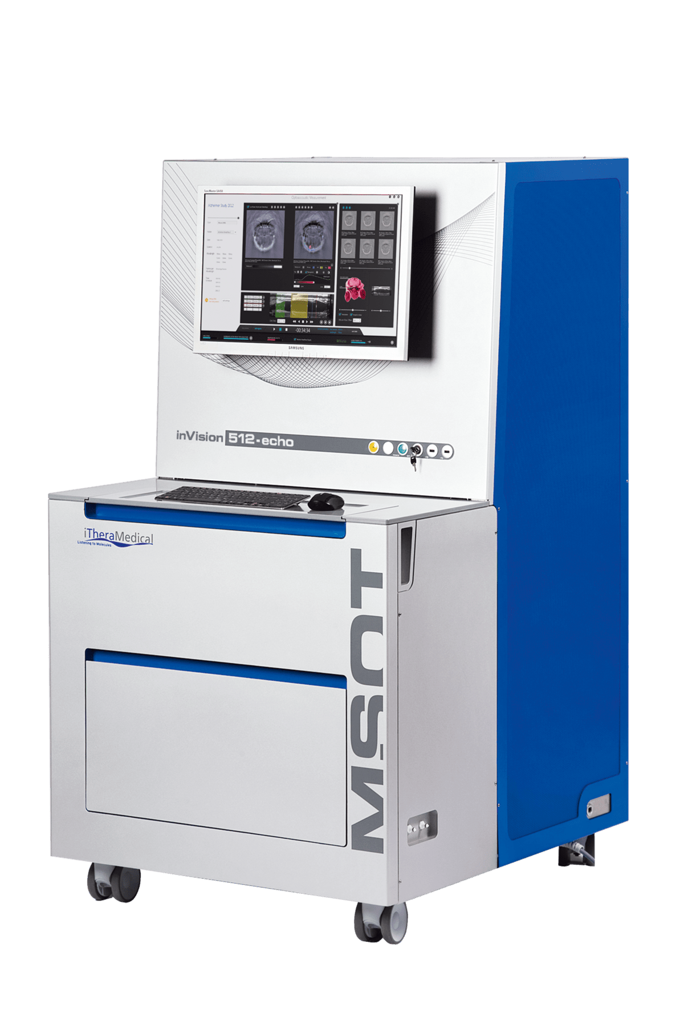
Background
MSOT inVision
Multispectral Optoacoustic Tomography (MSOT): a non-invasive molecular imaging method that can be used to diagnose tumors and monitor treatment response.
E.g., MSOT can be used to measure tumor oxygenation levels and degree of vascular perfusion.

Slide 3
Example: Oxygen Enhanced MSOT

Slide 4
Opportunity for improvement
The multiple signals within an MSOT spectrum can be decomposed using a simple unmixing method (slide 7).
Works well with clean spectra, but poorly under noisy conditions.
Machine learning algorithms may perform better when SNR is low.

Slide 5
Goals for Project
Goal 1: compare the accuracy of MSOT decomposition between the traditional unmixing method and machine learning methods.
Comparisons will be done under low and high SNR conditions.
Goal 2: determine the optimal wavelength components when acquiring an MSOT spectrum
Under most experimental conditions, it’s not realistic to acquire densely sampled spectra
E.g., What 6 wavelengths should we acquire images at if we only have time to acquire 6 images?
Do machine learning methods work better than the traditional unmixing method when the MSOT spectrum is sparse?

Slide 6
What has been done so far?

Slide 7
Coded the traditional unmixing method in Python
Dataset
Y (experimental MSOT signal) | Hb (known 100% Hb spectrum) | HbO2 (known 100% HbO2 spectrum)
1 | 1 | 1
0.8 | 0.9 | 0.7
0.72 | 0.8 | 0.5
…
0.11 | .2 | .8
n
experimental MSOT signal at n wavelengths
known 100% Hb MSOT signal at n wavelengths
known 100% HbO2 MSOT signal at n wavelengths
Spectral Unmixing Method
Y = B1 x Hb + B2 x HbO2
estimate B1 and B2 using linear regression with nonnegative least squares, to ensure you don’t get negative fractional components.
estimated Hb fraction in Y
estimated HbO2 fraction in Y

Slide 8
Developed machine learning alternative
Dataset
Y1 (Hb fraction) | Y2 (HbO2 fraction) | X1 | X2
1 | 0 | 0.38 | 0.67
0.9 | 0.1 | 0.22 | 0.89
0.8 | 0.2 | 0.01 | 0.96
0.7 | 0.3 | 0.57 | 0.37
0.6 | 0.4 | 0.82 | 0.85
0.5 | 0.5 | 0.86 | 0.93
Xp
0.45
1.00
0.47
0.66
0.28
0.93
p wavelengths, where each wavelength is a predictor.
…
…
0 | 1 | 0.34 | 0.29
0.16
n
number of data points
y
X
There are machine learning algorithms that support multioutput predictions (e.g., linear regression, k-nearest neighbor, decision tree, etc.).
https://machinelearningmastery.com/multi-output-regression-models-with-python

Slide 9
Developed data collection plan
Acquire high SNR MSOT spectra at 1 mm wavelength steps between 680 nm to 900 nm.
MSOT spectra will be collected of blood samples with various levels of O2.
Data will be collected by March 7th

Slide 10
Discovered resource to read MSOT images into Python
https://ithera-medical.com/login

Slide 11
Plans after data is collected?

Slide 12
Machine learning vs. traditional method
Measure Hb and HbO2 fractions using traditional unmixing method and machine learning alternatives under low and high SNR conditions.
Densely sampled spectrum will be used for this part of analysis.
Data collected will be very clean (high SNR)
“Noisy” spectra will by simulated by adding gaussian noise to clean spectra.
Quantify accuracy (RMSE) of each methods’ estimate of Hb and HbO2.
Cross-Validation performance will be used to compare methods.
Is the best method the same under varying levels of noise?

Slide 13
Optimize wavelengths to collect using best unmixing method
Identify unmixing method that performs best with densely sampled spectra.
Using best method, determine which X wavelengths result in most accurate Hb and HbO2 estimation?
Is the answer the same under varying levels of noise?

