Slide 1

Machine Learning applied to the Analysis of
Multispectral Optoacoustic Tomography
Midterm Project Report
Kyle Jones

Slide 2

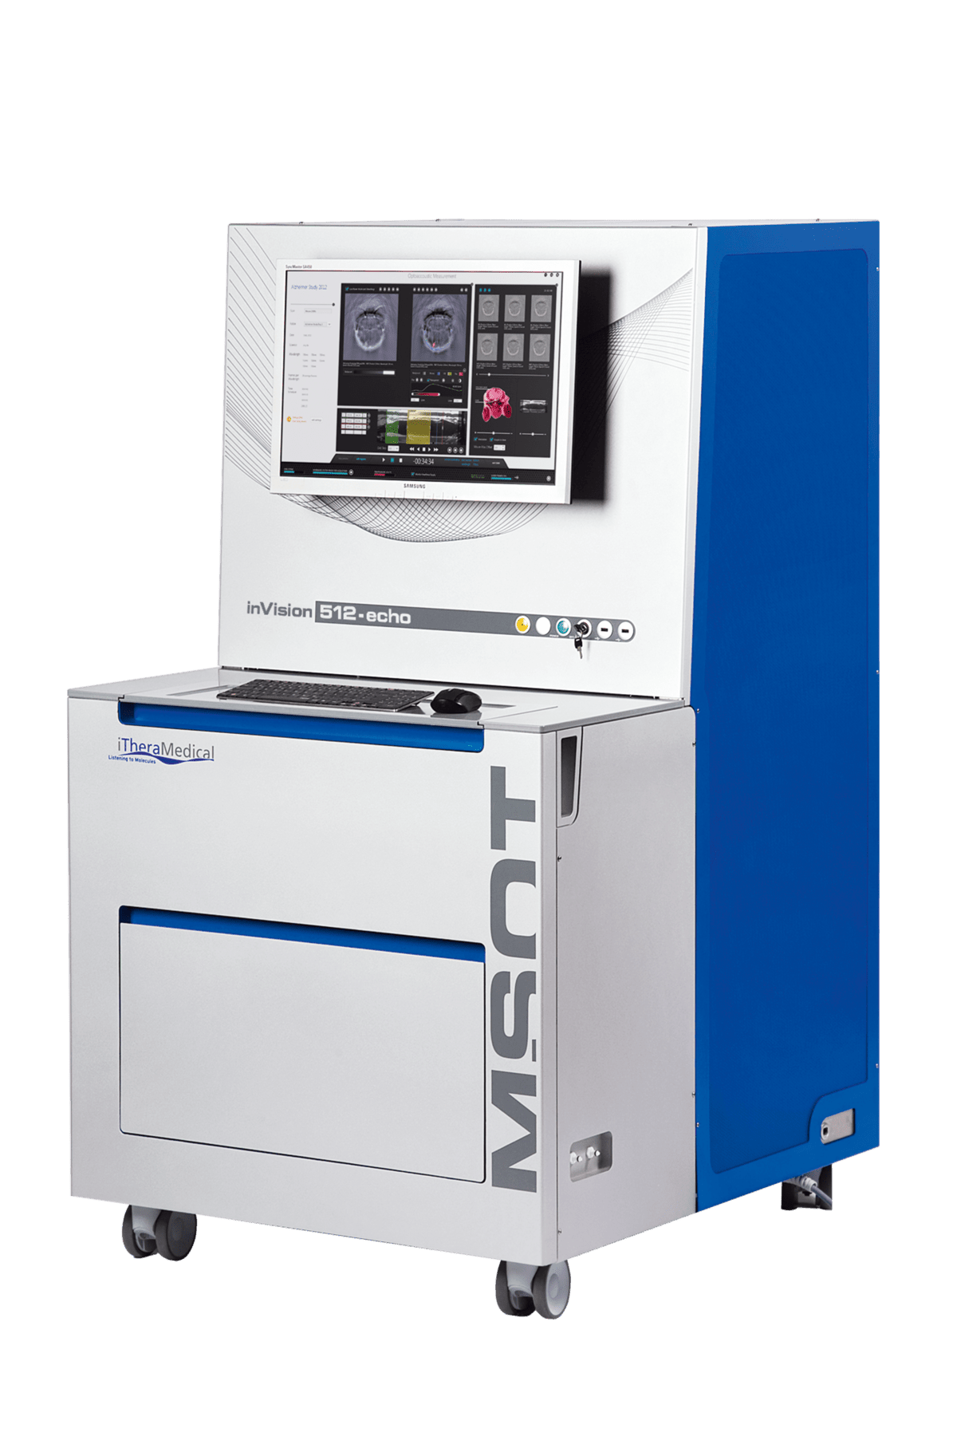
Background
MSOT inVision
Multispectral Optoacoustic Tomography (MSOT): a non-invasive molecular imaging method that can be used to diagnose tumors and monitor treatment response
E.g., MSOT can be used to measure tumor oxygenation levels and degree of vascular perfusion

Slide 3
Example: Oxygen Enhanced MSOT

Slide 4
Opportunity for improvement
The multiple signals within an MSOT spectrum can be decomposed using a simple unmixing method (slide 7).
Works well with clean spectra, but poorly under noisy conditions.
Machine learning algorithms may perform better when SNR is low.

Slide 5
Goals for Project
Goal 1: compare the accuracy of MSOT decomposition between the traditional unmixing method and machine learning methods
Comparisons will be done under low and high SNR conditions
Goal 2: determine the optimal wavelength components when acquiring an MSOT spectrum
E.g., What 6 wavelengths should we acquire images at if we only have time to acquire 6 images?
Do machine learning methods work better than the traditional unmixing method when the MSOT spectrum is sparse?

Slide 6
What has been done so far?

Slide 7
Coded the traditional unmixing method in Python
Dataset
Y (experimental MSOT signal) | Hb (known 100% Hb spectrum) | HbO₂ (known 100% HbO₂ spectrum)
1 | 1 | 1
0.8 | 0.9 | 0.7
0.72 | 0.8 | 0.5
…
0.11 | .2 | .8
n
experimental MSOT signal at n wavelengths
known 100% Hb MSOT signal at n wavelengths
known 100% HbO₂ MSOT signal at n wavelengths
Spectral Unmixing Method
Y = B1 x Hb + B2 x HbO₂
estimate B1 and B2 using linear regression with nonnegative least squares, to ensure estimated fractional components are positive
estimated Hb fraction in Y
estimated HbO₂ fraction in Y

Slide 8
Conceptualized machine learning alternative
Dataset
p wavelengths, where the signal at each wavelength is a predictor of Y1 and Y2.
Y1 (Hb fraction) | Y2 (HbO₂ fraction) | X1 signal | X2 signal
1 | 0 | 0.38 | 0.67
0.9 | 0.1 | 0.22 | 0.89
0.8 | 0.2 | 0.01 | 0.96
0.7 | 0.3 | 0.57 | 0.37
0.6 | 0.4 | 0.82 | 0.85
0.5 | 0.5 | 0.86 | 0.93
Xp signal
0.45
1.00
0.47
0.66
0.28
0.93
…
…
0 | 1 | 0.34 | 0.29
0.16
n
number of data points
y
X
There are machine learning algorithms that support multioutput predictions (e.g., linear regression, k-nearest neighbor, decision tree, etc.).
https://machinelearningmastery.com/multi-output-regression-models-with-python

Slide 9
Discovered resource to read MSOT images into Python
https://ithera-medical.com/login

Slide 10
Developed data collection plan
Acquire high SNR MSOT spectra at 1 mm wavelength steps between 680 nm to 900 nm.
MSOT spectra will be collected on blood samples with varying levels of O₂.
Data will be collected by March 7th

Slide 11
Plans after data is collected?

Slide 12
Machine learning vs. traditional method
Measure Hb and HbO₂ fractions using traditional unmixing method and machine learning alternatives under low and high SNR conditions.
Densely sampled spectra will be used for this part of analysis.
Data collected will be very clean (high SNR)
“Noisy” spectra will be simulated by adding gaussian noise to clean spectra.
Quantify accuracy (RMSE) of each methods’ estimate of Hb and HbO₂.
Cross-Validation performance will be used to compare machine learning methods.
Is the best method the same under varying levels of noise?

Slide 13
Optimize wavelengths to collect using best method
Identify analytic method that performs best with densely sampled spectra.
Using best method, determine which X wavelengths result in most accurate Hb and HbO₂ estimation?
Is the answer the same under varying levels of noise?

