Slide 1
Predicting factors for a Lower Interest Rate Loan Using a Tree Model Machine Learning
Kyle Myat
Dominic Cinco
Pasindu Senaratne
Koi Tran
Alpha Osita
Marie Francois

Slide 2
Project Objective
Train a model to predict loan interest rates a user would receive based on various features.
Tools used: SQL, Python Pandas, & JavaScript Postgres

Slide 3


Project Process
Locate and review different datasets for project (validity)
Data Review
Finalize project objective, select model along with algorithm – including data optimization
Database in SQL
JavaScript Plotly Dashboard

Slide 4
Tree-Based Model in Machine Learning
Tree-based model is a type of supervised Machine Learning which performs classification and regression analysis. For our project, reduction in variance was the type of algorithm used.
We set out to predict numerical values that are continuous to show a range of interest rates that a user would receive.

Slide 5
Data Review
Two datasets were reviewed. One set was dropped due to validity concerns.
From the selected dataset:
Index(['loan_amnt', 'funded_amnt', 'funded_amnt_inv', 'term', 'int_rate', 'installment', 'emp_length', 'home_ownership', 'annual_inc', 'verification_status', 'loan_status', 'purpose', 'title', 'dti', 'delinq_2yrs', 'inq_last_6mths', 'open_acc', 'pub_rec', 'revol_bal', 'revol_util', 'total_acc']

Slide 6
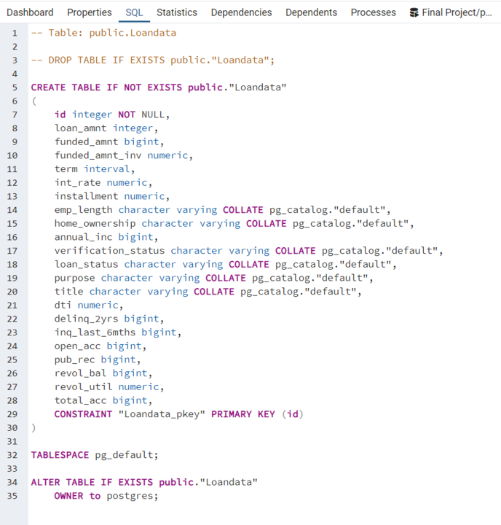
Block Code
SQL

Slide 7
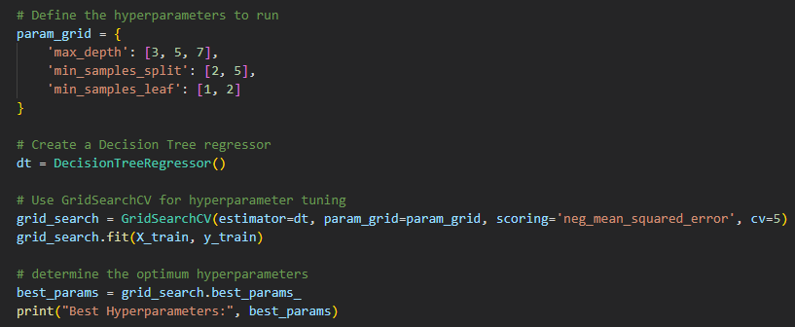
Block Code
Get Dummies
Hyperparameters

Slide 8
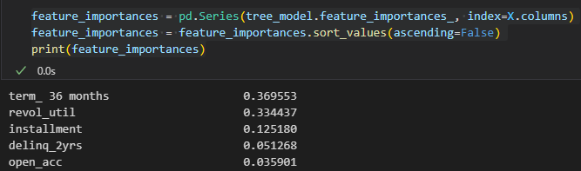
Block Code
Defining Features

Slide 9
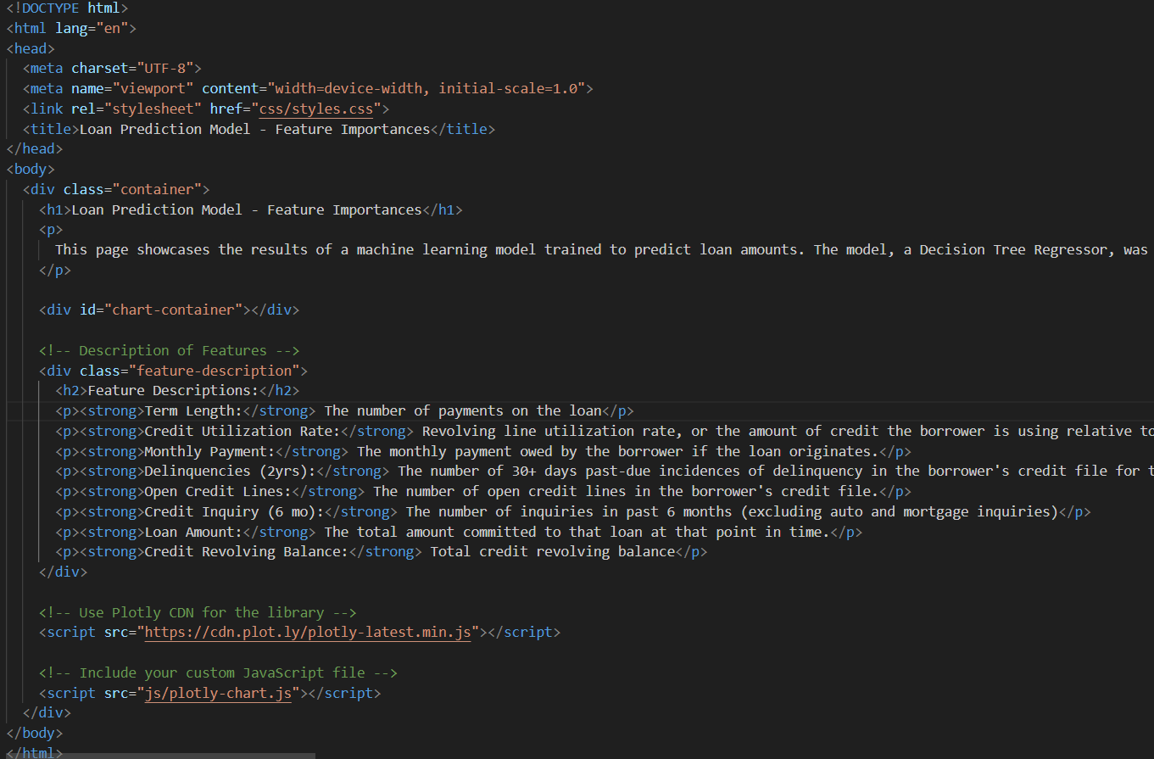
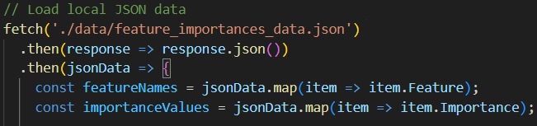
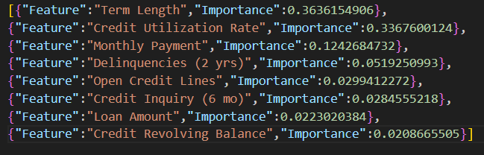
Block Code
JavaScript Plotly

Slide 10
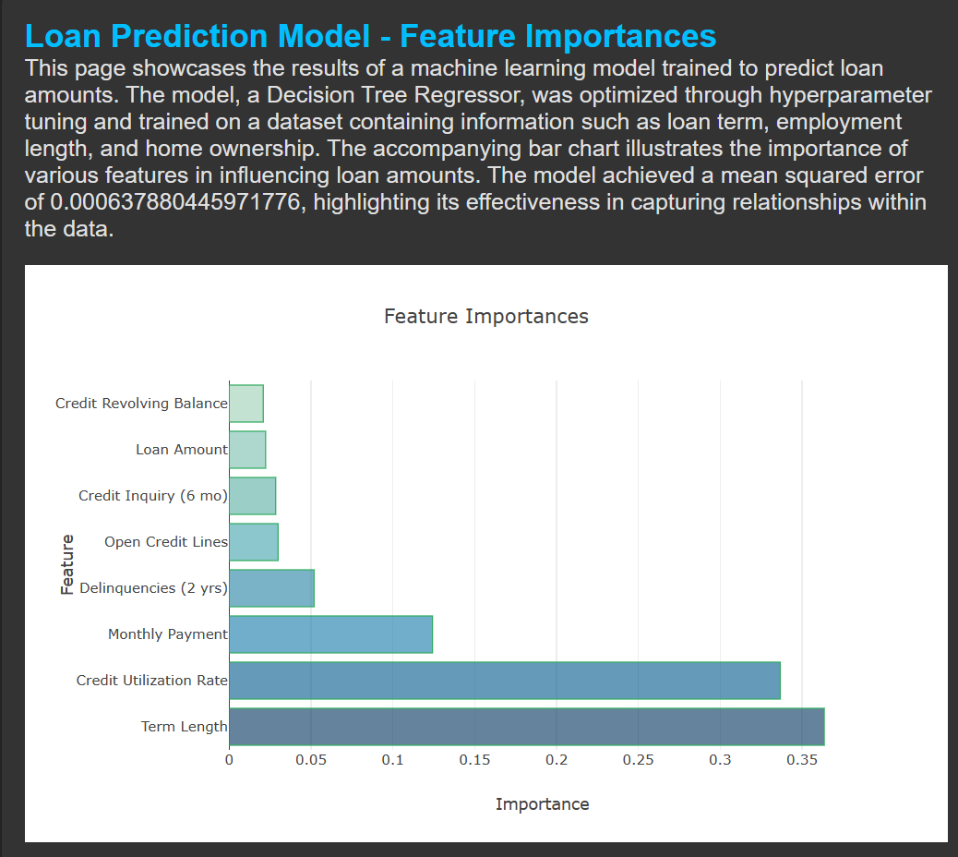
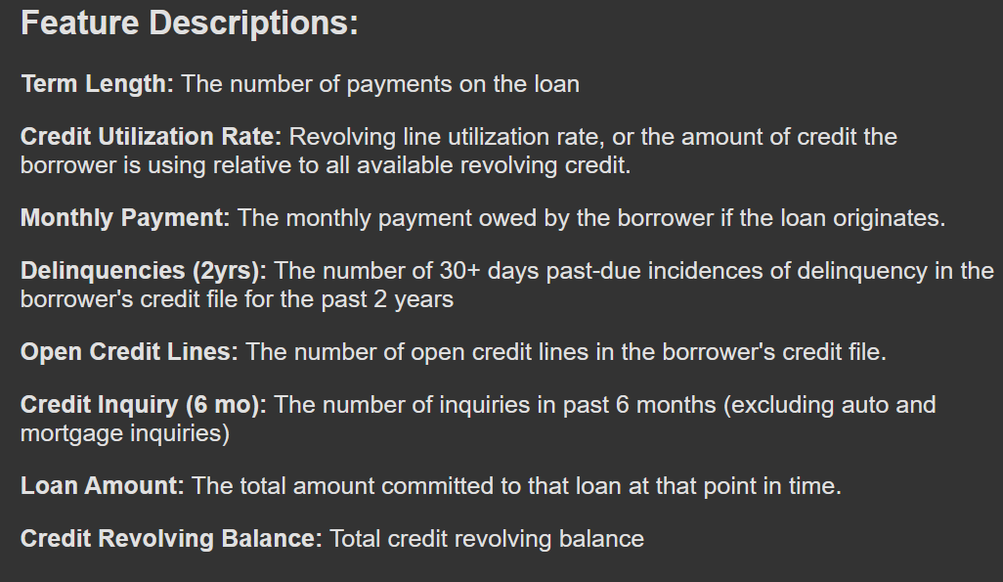

Slide 11
Conclusion
Model was efficient for predicting interest rates with a low mean squared error:
Mean Squared Error on Test Set: 0.0006433274724282495
Predicting Features
0.369553 – Term – Length of Loan
0.334437 – Credit Utilization - Amount of credit the borrower is using relative to all available revolving credit
0.125180 – Installment – Monthly Payment
0.051268 – Delinquency in 2 Years – 30+ days past-due for the past 2 years
0.035901 – Open Accounts – The number of open lines of credit

