Slide 1
Predicting factors for a Lower Interest Rate Loan Using a Tree Model Machine Learning
Kyle Myat
Dominic Cinco
Pasindu Senaratne
Koi Tran
Alpha Osita
Marie Francois

Slide 2
Project Objective
Train a model to predict loan interest rates a user would receive based on various features.
Tools used: SQL, Python Pandas, & JavaScript Postgres

Slide 3


Project Process
Locate and review different datasets for project (validity)
Data Review
Finalize project objective, select model along with algorithm – including data optimization
Database in SQL
Python Pandas
JavaScript Plotly Dashboard

Slide 4
Tree-Based Model in Machine Learning
Tree-based model is a type of supervised Machine Learning which performs classification and regression analysis.
We set out to predict numerical values that are continuous.

Slide 5
Data Review
Two datasets were reviewed. One set was dropped due to validity concerns.
From the selected dataset:
Index(['loan_amnt', 'funded_amnt', 'funded_amnt_inv', 'term', 'int_rate', 'installment', 'emp_length', 'home_ownership', 'annual_inc', 'verification_status', 'loan_status', 'purpose', 'title', 'dti', 'delinq_2yrs', 'inq_last_6mths', 'open_acc', 'pub_rec', 'revol_bal', 'revol_util', 'total_acc']

Slide 6
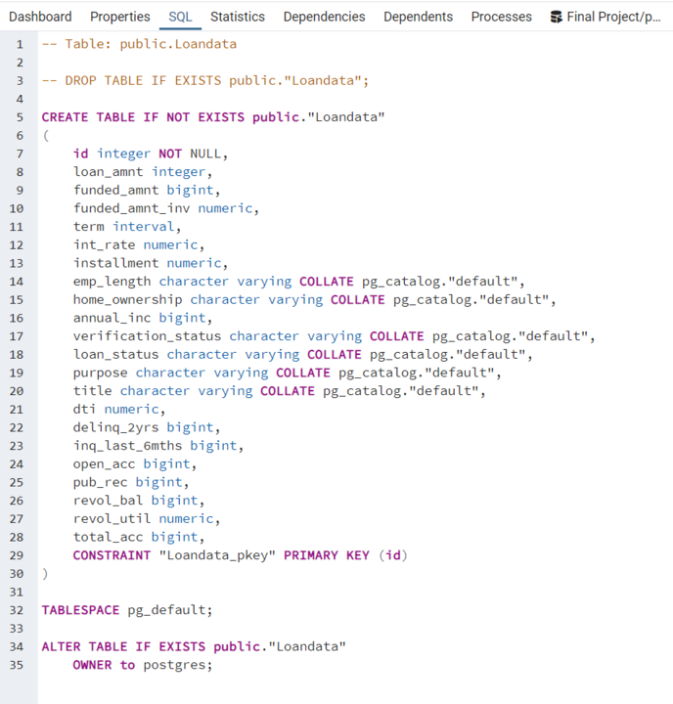
Block Code
SQL

Slide 7
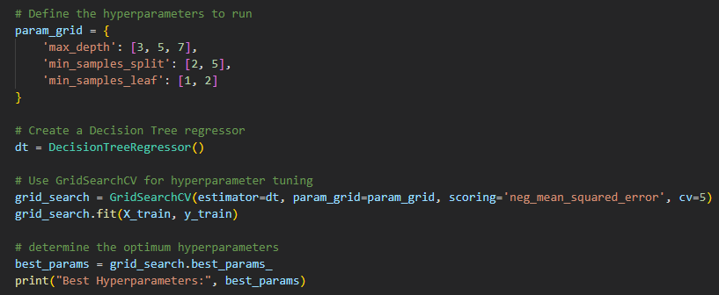
Block Code
Get Dummies
Hyperparameters

Slide 8
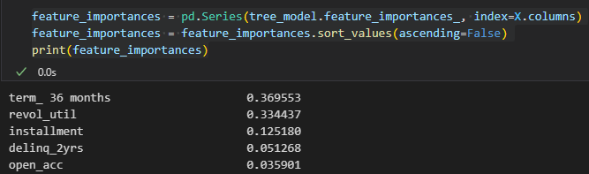
Block Code
Defining Features

Slide 9
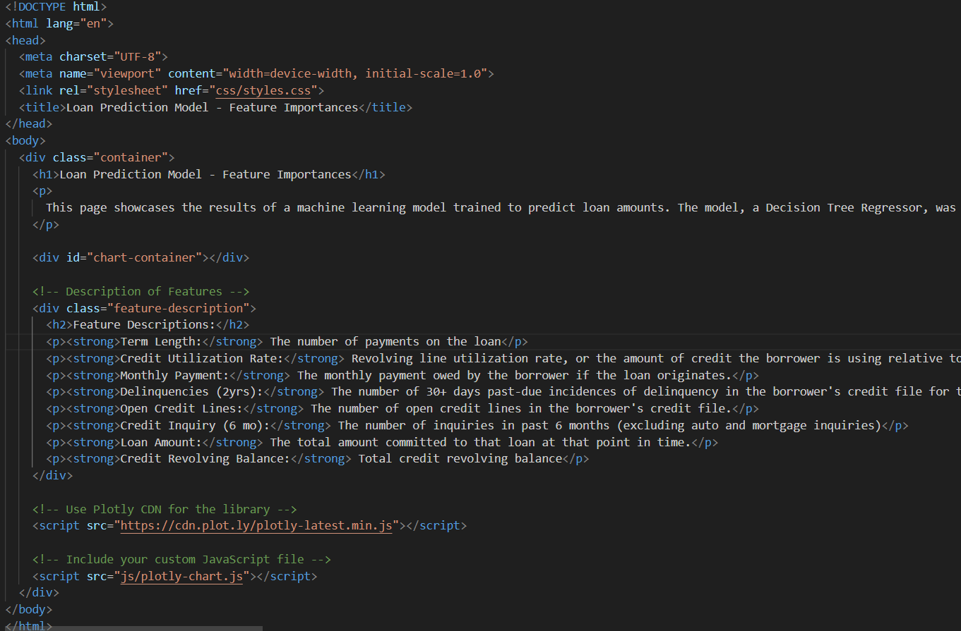
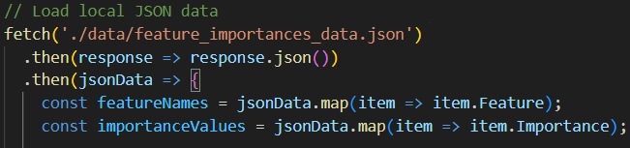
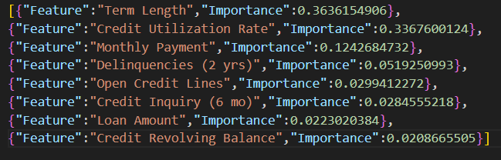
Block Code
JavaScript Plotly

Slide 10
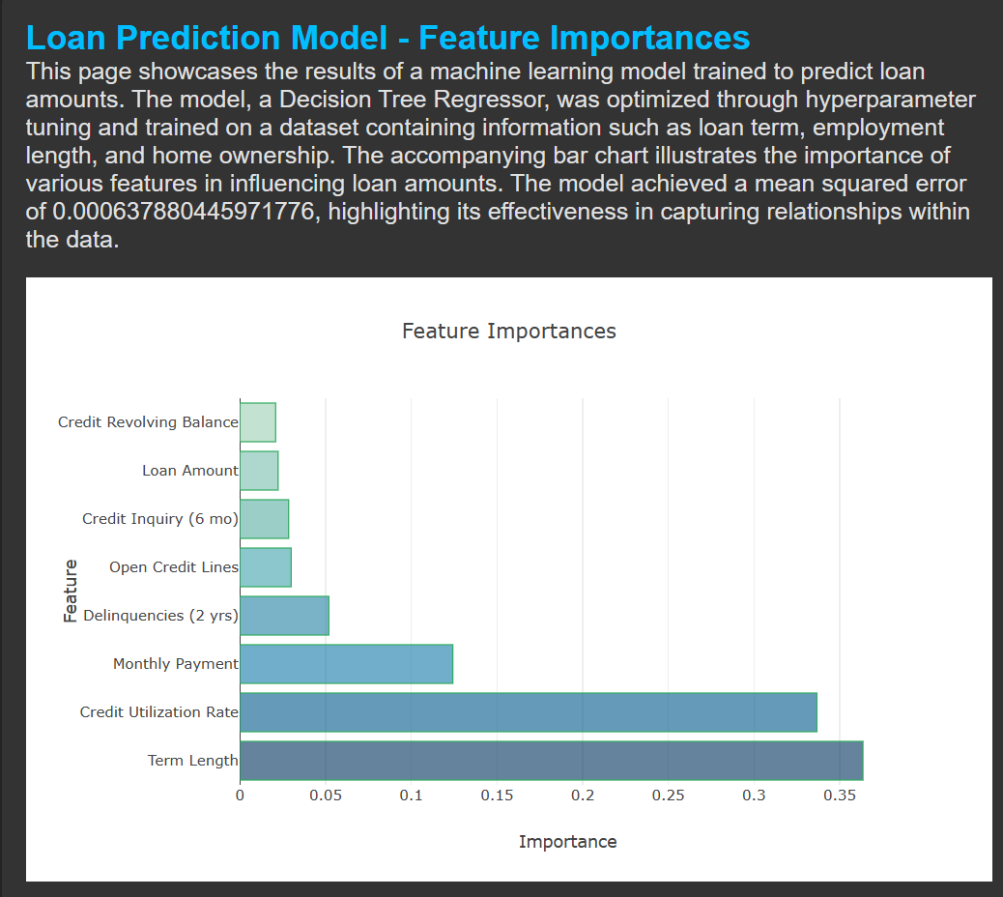
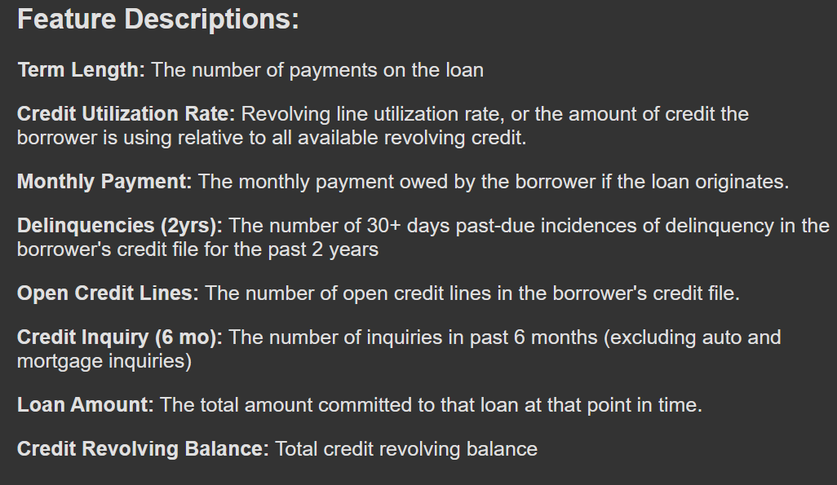
JavaScript Plotly

Slide 11
Conclusion
Model was efficient for predicting interest rates with a low mean squared error:
Mean Squared Error on Test Set: 0.0006433274724282495
Predicting Features
0.369553 – Term – Length of Loan
0.334437 – Credit Utilization - Amount of credit the borrower is using relative to all available revolving credit
0.125180 – Installment – Monthly Payment
0.051268 – Delinquency in 2 Years – 30+ days past-due for the past 2 years
0.035901 – Open Accounts – The number of open lines of credit

