Slide 1
Cuesta College Drone Program Advisory Committee Meeting
August 12, 2026

Slide 2
Agenda
Introductions
Program overview
Vote to recommend program

Slide 3
Introductions

Slide 4

Skilled Trades and Technology Programs
Drone program will fall under Skilled Trades and Technology Division at Cuesta
Focus is on providing real world training for in demand jobs

Slide 5
Target Students
Existing professionals looking to add skills within their domain
Job seekers looking to boost CV or enter drone specific domains
Not hobbyists or the drone curious
Expectation is that students plan to use drones in commercial applications

Slide 6
Program Structure
Core Program
Supplemental Courses
Drone Infrastructure Inspection
Advanced Drone Mapping
Agricultural Spraying
Independent Study
Public Safety
AERO 100
Basic UAV Operator
Part 108
BVLOS
. . .

Slide 7
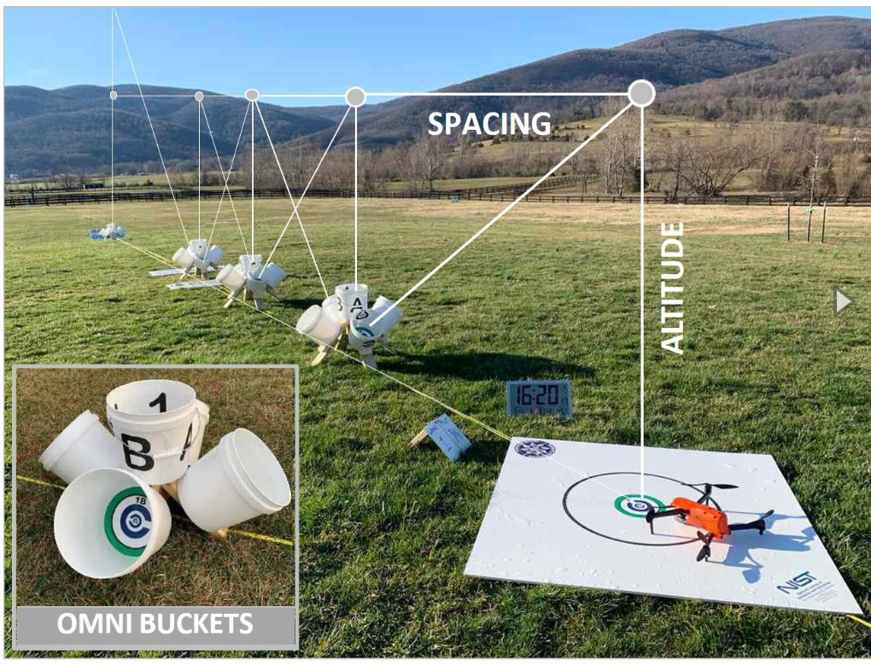
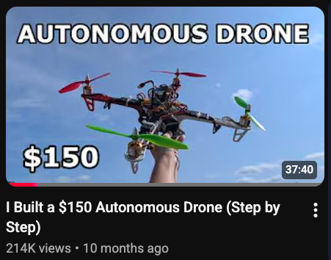
AERO 100: Basic UAV Operator
Three goals:
Acquire Part 107
Demonstrate flight competency
Understand drone fundamentals
2 lecture 3 lab hours per week
NIST level 1-3 open test lane for flight competency
Explore concepts of drones with curated DIY build
@hoardersam10

Slide 8
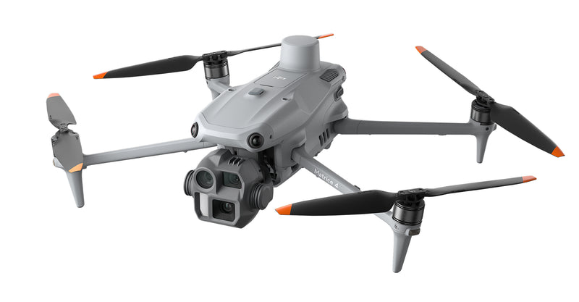
Advanced Drone Mapping
Goal: Prepare students to create high-quality spatial data
Primarily focused on color orthomosaics
flexiblity to include multi-spec and guest LiDAR labs
Flight planning, data collection, GCPs, processing, quality assurance, delivery
Opportunities to collaborate with local entities
Not a GIS course
DJI Matrice 4E
Questions:
NDAA compliant drones?
Best mapping and processing software to teach?
Lecture/lab time?

Slide 9
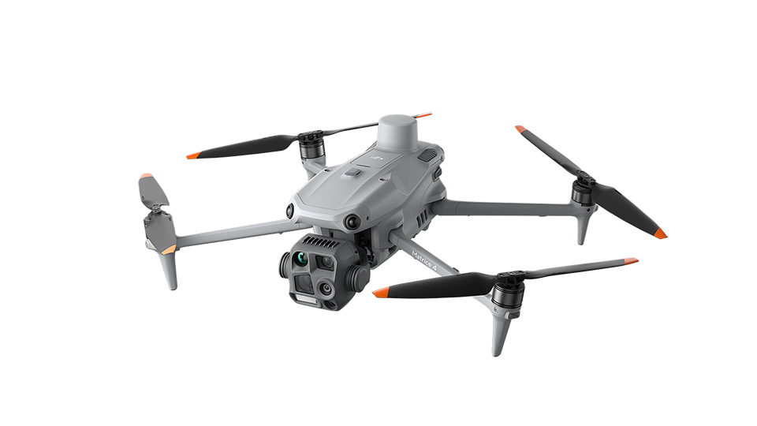
Infrastructure Inspection
Goals:
Prepare students for utility and infrastructure inspection
Prepare students for Level 1 Thermography certification
Focus on how to fly safely near energized equipment and what to look for
Primarily targeted at energy sector, like PG&E
DJI Matrice 4T
Questions:
NDAA Compliance?
Do you know anyone who can advise?

Slide 10
Certificates of Specialization
Shorter, focused credential for specific occupational roles
UAV Mapping (9.0 units)
Basic UAV Operator
Introduction to Geographic Information Systems
Advanced Drone Mapping
UAV Inspection (6.0 units)
Basic UAV Operator
Drone Infrastructure Inspection
UAV Videography (9.0 units)
Basic UAV Operator
Digital Photography I
Single Camera TV Production and Editing
UAV Crop Monitoring (9.0 units)
Basic UAV Operator
Advanced Drone Mapping
Introduction to Plant Science
UAV Spray Operations (9.0 units)
Basic UAV Operator
Introduction to Plant Science
Agricultural Spraying

Slide 11
Certificate of Achievement (UAV Technology)
State-recognized credential for a more comprehensive program of study
Requirements
AERO 100
Two AERO electives
Mapping, inspection, etc.
Two support courses
One AERO supplemental class
16 units total
Supported outside courses
Introduction to Geographic Information Systems
Advanced Geographic Information Systems
Web Applications in GIS
Data Acquisition and Management in GIS
Introduction to Remote Sensing
Physical Geography
Plane Surveying
Introduction to Plant Science
Introduction to Viticulture
Digital Photography I
Digital Photography II
Single Camera TV Production and Editing

Slide 12
Recommendation Vote

