Slide 1
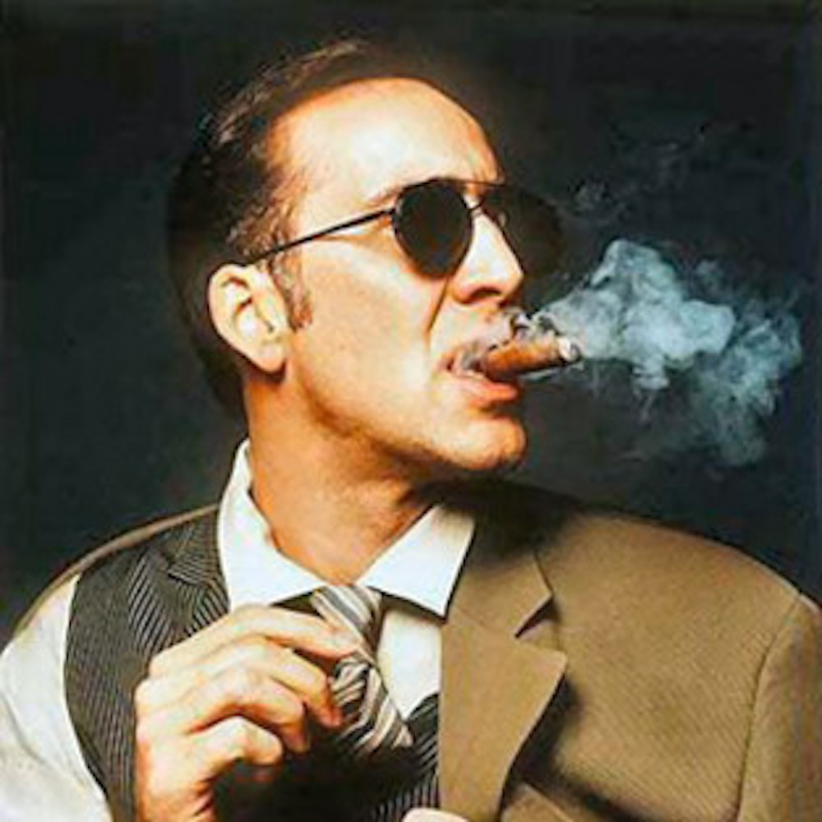
Nicolas Cage Galore
Kyle Nicola, Nam Nguyen, Stephen Ridings

Slide 2
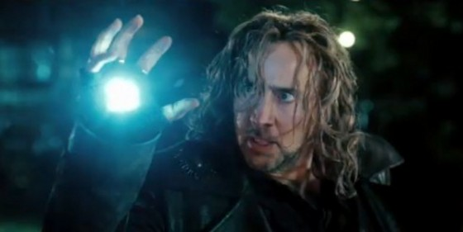
Our Goal
To create a source of pure entertainment, hilarity and appreciation for one of our favorite actors, known to make the most out of both very very good and also very very bad movies.
To experiment with different forms of media (video, sound, image and controls effects), along with integrating the native hardware (accelerometer), and software (keystroke timing) on the Android mobile platform

Slide 3
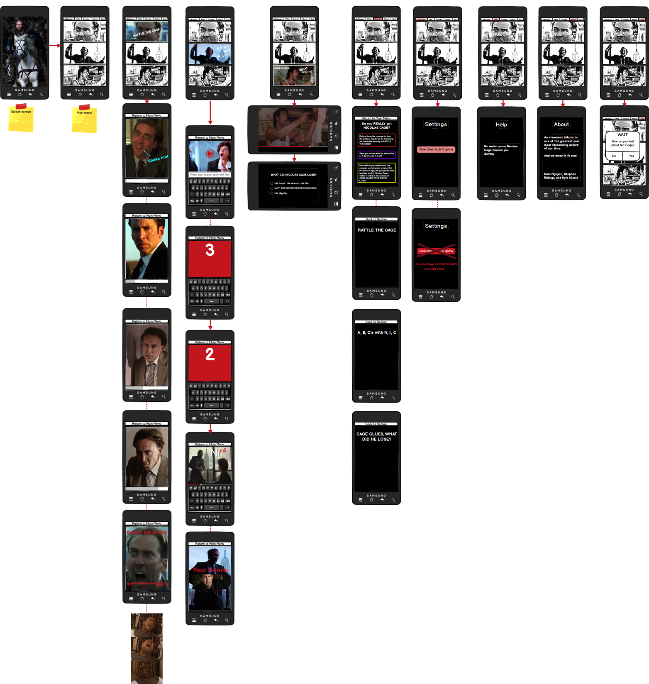

Slide 4
Challenges

Slide 5
Demo Time!

