Slide 1

Tuesday Webinars
AUDITORS CAN CODE

Slide 2

Ice breaker: where are you now?
Let us know in the chat where you are based

Slide 3
Why this Webclass?
What happens when the data set is larger than 1,048,576 records and you can’t use Excel?
Move from sampling to full population testing.
Build programmatic thinking and add a new tool to your tool built.
Get a foothold to make progress on continuous auditing.
Auditors can code!
+ 1 hour free CPE!

Slide 4

Ice Breaker
What do we have in common?
Poll
Python for Auditors
Why is Python an ideal tool for auditors?
Approachable
Open Source
Extensible
Does not require specialty hardware
Same tools used by Data Scientists
Most companies make Python available
Please use the Zoom polls feature to select your answer.
Pick more than one answer – if you wish!
Other good reasons to use Python? Let us know in the chat!

Slide 5

INTRODUCTIONS

Slide 6




Our guest speaker
Today!
Experience
Former Management Consultant
Six years as chief technical audit executive Fortune 500
CEO of an AI/ML software startup
Credentials
Certified Internal Auditor
Certificate in Advanced Cybersecurity
Certified Cryptocurrency Auditor
Interests:
Coded a 10-player online game in Python to play over Zoom during the pandemic
Blockchain and Cryptocurrency Enthusiast
Kyle Pott
Senior Managing Partner and Co-Founder
Decise.io
Notes:
Crop headshot into circle:
https://crop-circle.imageonline.co/

Slide 7

Ground Rules and Goals
AUDIT SPECIFIC
NO CODING EXPERIENCE
NO FLUFF
Concepts, code snippets, and specifics you can apply on your next audit.
Approachable and inclusive session, coding experience and an engineering background is not expected
No coding theory, no system administration, just applied learnings

Slide 8
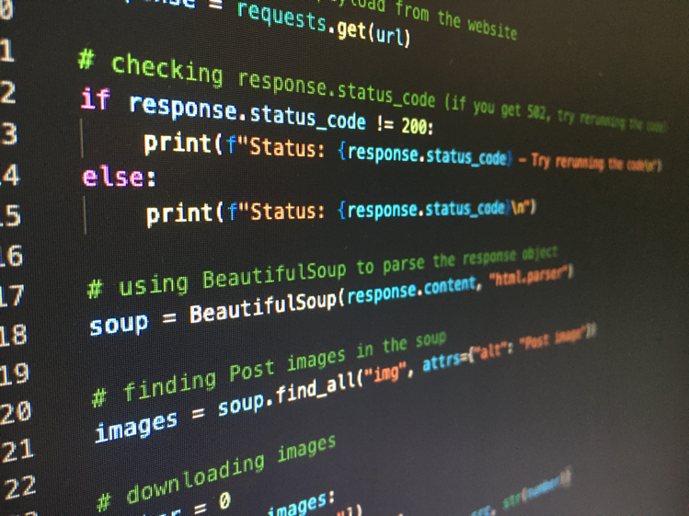
Agenda
All code demonstrated in today’s session will be available at github.com/kylepott/python-for-auditors
The Case for Python
Getting Started
Creating Work Papers
Importing Data
Analyzing Data
Graphing and Visualizations
10M+ Structured Data Examples
Q&A

Slide 9
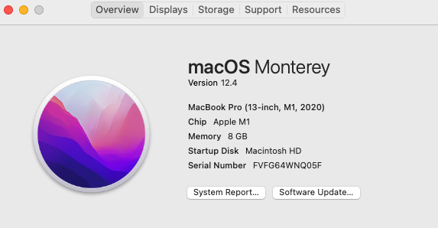
The Case for Python
What happens when the data set is larger than 1,048,576 records?
Approachable for non-engineers
Beginner friendly
Free, open-source
Same tools used by enterprise data scientists
Usually accessible inside enterprise open-source governance programs
Extremely extensible with libraries
Powerful for structured and unstructured use cases
Quick analysis, easy visualizations
Does not require super computers

Slide 10

Outcomes Unlocked
"The spread of computers and the Internet will put jobs in two categories," Andreessen says. "People who tell computers what to do, and people who are told by computers what to do."
Extend advanced tool sets beyond Excel
Work with extremely large data sets
Test full populations instead of samples
Automated control testing and continuous auditing become possible
Analyze structured and unstructured data
Visualize data
Begin to work toward data science solutions

Slide 11
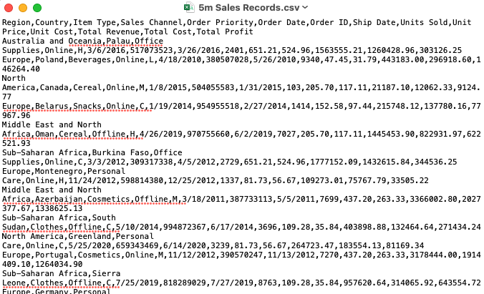
Let’s Go
Install Python and Jupyter Notebook [Windows] [Mac]
Get a great data set – push yourself to use big data [link] (we’ll use 10M records today)

Slide 12
Closing
Course Content:
https://github.com/kylepott/python-for-auditors
Masterclass:
https://decise.thinkific.com/ → DATA50 to save 50%
Email: kyle@decise.io
Decise LLC
222 S. Riverside Plaza – 28th Floor
Chicago, IL 60606

Slide 13
Q&A
For any questions, please contact:
cjw@aufinia.com

Slide 14

Thanks for coming!
Join our Data Leaders in Internal Audit group
for free Tuesday Webclasses

