Slide 1
Cost Effective Quantum Moves a Step Closer
Kyle Romero
204747283
Laboratory 7: Zhaowei Tan

Slide 2
What is quantum computing?
A branch of computer science that utilizes quantum-mechanical phenomena to complete data operations

Slide 3
How does quantum computing differ from classical computing?
Data
Operations
Networking
Instead of using bits, quantum computers use superposition to store information in qubits (quantum bits).
Instead of logic gates, quantum computers use quantum gates to perform operations on quantum bits.
Allows for the transmission of qubits between physically separate quantum processors
Quantum Supremacy
The term quantum supremacy refers to the hypothetical speedup advantage that a quantum computer would have over a classical computer. [1]

Slide 4
Quantum Key Distribution (QKD)
A method of performing a quantum cryptographic task that involves producing a shared, random key that can be used to encrypt and decrypt messages

Slide 5
Quantum Key Distribution Procedure
3. Encoding
The information is encoded using the key generated and a different encryption algorithm
03
1. Key Generation
Quantum phenomena are used to generate a secret, shared key
01
02
2. Key Distribution
This key is shared between parties on the quantum network

Slide 6
How does QKD handle eavesdropping?
Any attempt by Eve to measure the key will inherently affect the quantum system and alert Alice and Bob that someone is eavesdropping.
Eve
Bob
Alice
Notes:
Any attempt to measure the quantum mechanical system to eavesdrop the key will inherently affect that system and alert Alice and Bob to the eavesdropping.

Slide 7
This all sounds great...so then what’s the problem?

Slide 8
QKD is still vulnerable to quantum hacking...
The equipment used to generate the key could be targeted:
Random Number Generator Attack
Trojan Horse Attack
My article announces the development of a cost-effective measurement-device-independent quantum key distribution system.

Slide 9
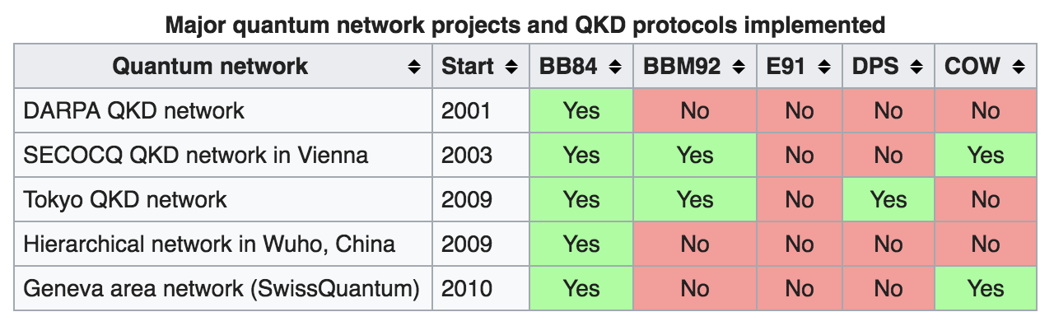
Related QKD Networks
Source: https://en.wikipedia.org/wiki/Quantum_network
To date, there is no network connecting quantum processors that exists outside of the lab.[2]
Different protocols take advantage of different properties of quantum mechanics to accomplish the same general objective

Slide 10
Related Devices
Vulnerabilities in quantum key distribution systems have been recognized for awhile and potential solutions were found in:
Potential solutions were found in:
  Device-Independent QKD
  Semi-Device Independent QKD
  One-Sided Device Independent QKD
The best balance of practicality and performance was realized in measurement-device-independent QKD

Slide 11
A cost-effective measurement-device-independent quantum key distribution system for quantum networks
Published in Quantum Science and Technology, Volume 2, Number 4
Main Idea: This measurement-device-independent QKD system relies on commercially available hardware such as distributed feedback lasers and field-programmable gate arrays.

Slide 12
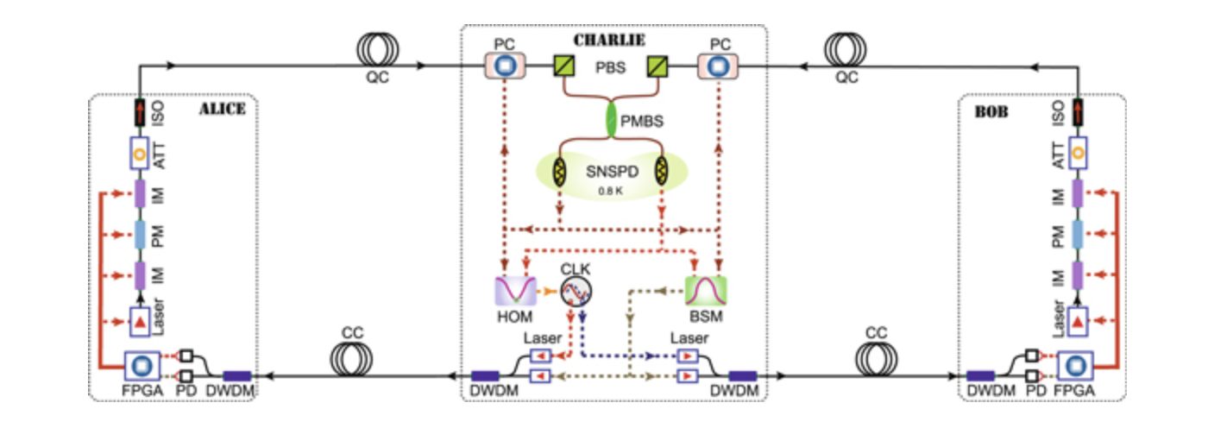
Components
Qubit preparation module
Control Modules
3. BSM Module
4. Time-tagging modules

Slide 13
Qubit Preparation Module
Uses random values on FPGA board to produce laser bursts that are modified by the phase modulator (PM) and intensity modulator (IM) to generate qubits
Several protections against potential quantum hacking:
  Optic Isolator on laser protects against Trojan Horse Attack
  Phase modulation protects against unambiguous state discrimination

Slide 14
Control Modules
In order for Charlie to function properly, we need stabilization of photons emitted by the lasers in all degrees of freedom (spatial, temporal, polarization, and spectral degrees)
Feedback module allows for efficient key distribution, since they are not distributed at the same time that the feedback happens

Slide 15
BSM Module
The two photons are combined at the polarization maintaining beam splitter (PMBS)
Produces a key based on projections onto a specific bases used in quantum mechanics called the Bell State

Slide 16
Time-tagging Modules
Records Alice and Bob’s qubit preparations and outputs from the BSM Module
Knowing this information allows us to discern the properties of the two photons that were combined in the PMBS
Detects eavesdropping and/or secure key generation

Slide 17
Goals and Challenges
Goals:
A QKD that is secure from most forms of quantum hacking
Provide a cost-effective system without sacrificing performance
Ability to perform accurately over long distances
Challenges:
Multitudes of quantum hacking strategies already exist and are quite robust
Physical systems are less ideal than theoretical systems
Quantum mechanics is HARD

Slide 18
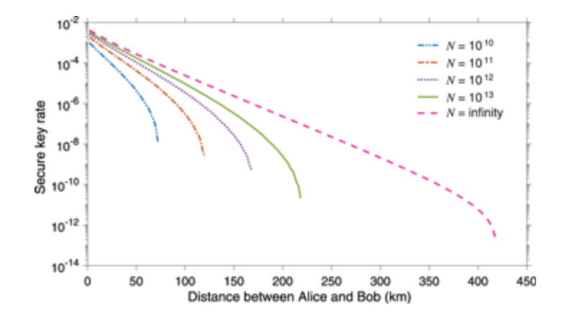
Results
N = # of pairs of qubits emitted by Alice and Bob
We can see that the secure key rate is very low; however, this clock runs at 20MHz so it takes ~1.4 hours for N=10^13 at a distance of close to 200km
Researchers note that advancements in quantum processing could increase this speed by over 100x if the clock speed could be increased to 2 GHz

Slide 19
Implications
Specific:
Demonstrated cost-effective implementation of quantum key distribution system, that works over long distances
Shown minimal impact on performance from using readily available components
Broad:
Reliable quantum key distribution systems could provide secure information transfer for financial transactions, nuclear launch codes, medical records, etc.

Slide 20
Impressions
Reiterate: Quantum computing is HARD; Chemistry is scary
I mainly found the cryptographic aspects more interesting than the quantum computing
Applications are widespread—privacy is important to everyone
I’m excited to see where this new technology heads in the future
I would consider studying cryptography and quantum computing in the future

Slide 21
Sources
[1] “Quantum key distribution.” Wikipedia, Wikimedia Foundation, 26 Oct. 2017, en.wikipedia.org/wiki/Quantum_key_distribution.
[2] “Quantum network.” Wikipedia, Wikimedia Foundation, 29 Oct. 2017, en.wikipedia.org/wiki/Quantum_network.
[3] IOPPublishing. “Cost effective quantum moves a step closer.” EurekAlert!, www.eurekalert.org/pub_releases/2017-09/ip-ceq091817.php.
[4] Raju Valivarthi et al 2017 Quantum Sci. Technol. 2 04LT01

