Slide 1

Congress’s Tweets by Party
By Kyle Schmoyer

Slide 2
Introduction
Twitter’s important role in political climate
Large party divide
Can I predict a user’s party by their tweets, specifically lawmakers and government figures?

Slide 3
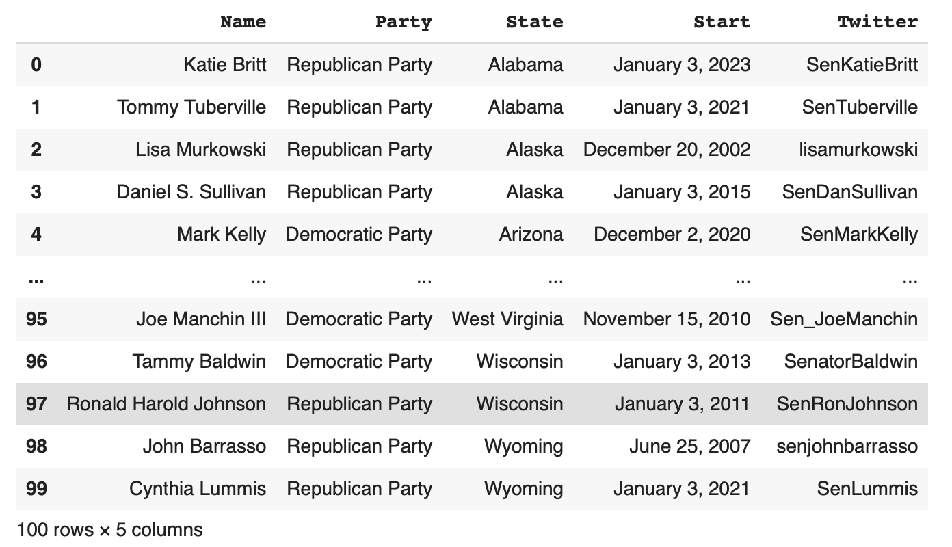
Data collection
Scraped Ballotpedia
Gathered data on senators and representatives

Slide 4
Twitter Issues
Trouble getting authenticated
Twitter API not an option
Instead used python library snscrape

Slide 5
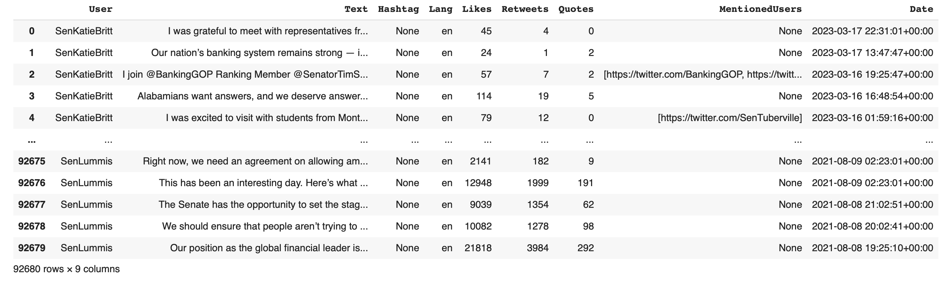

Slide 6
Data Cleaning
Quote Tweets
Links
Bernie Sanders

Slide 7
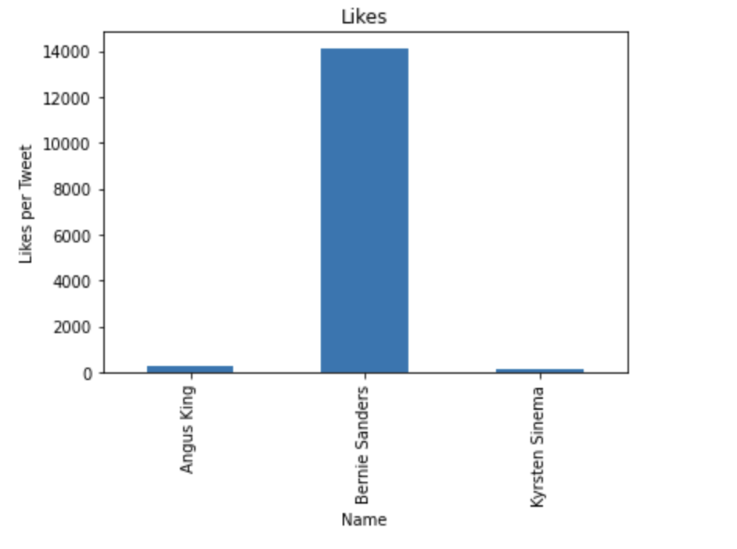
Visualizations
Issues by with by Party
Bernie does too well on Twitter
Focused on two-party system from now on

Slide 8
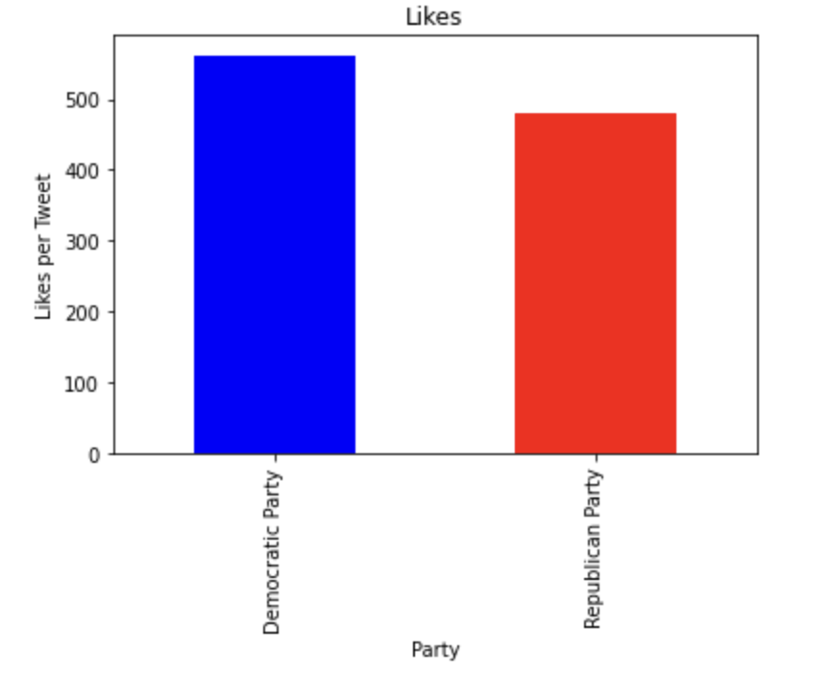
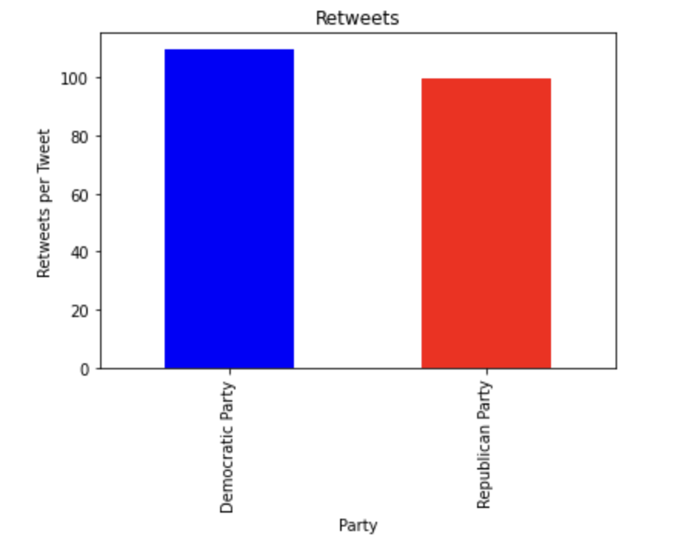
Tweet Stats

Slide 9
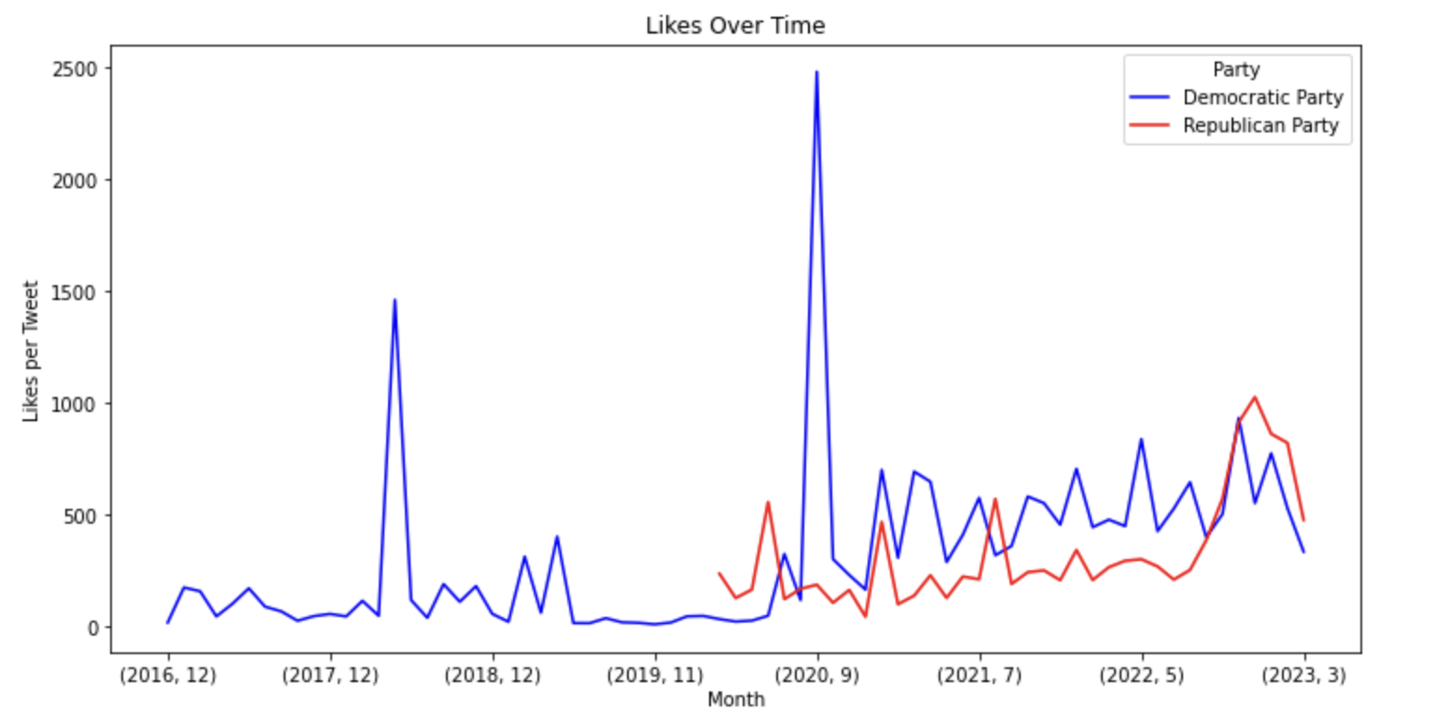

Slide 10
What and When
Word Cloud
Calendar Heatmap
Top 200 words
Removed words present in opposing party’s
Sized by frequency
Weight - Frequency per year
Separated by Party

Slide 11
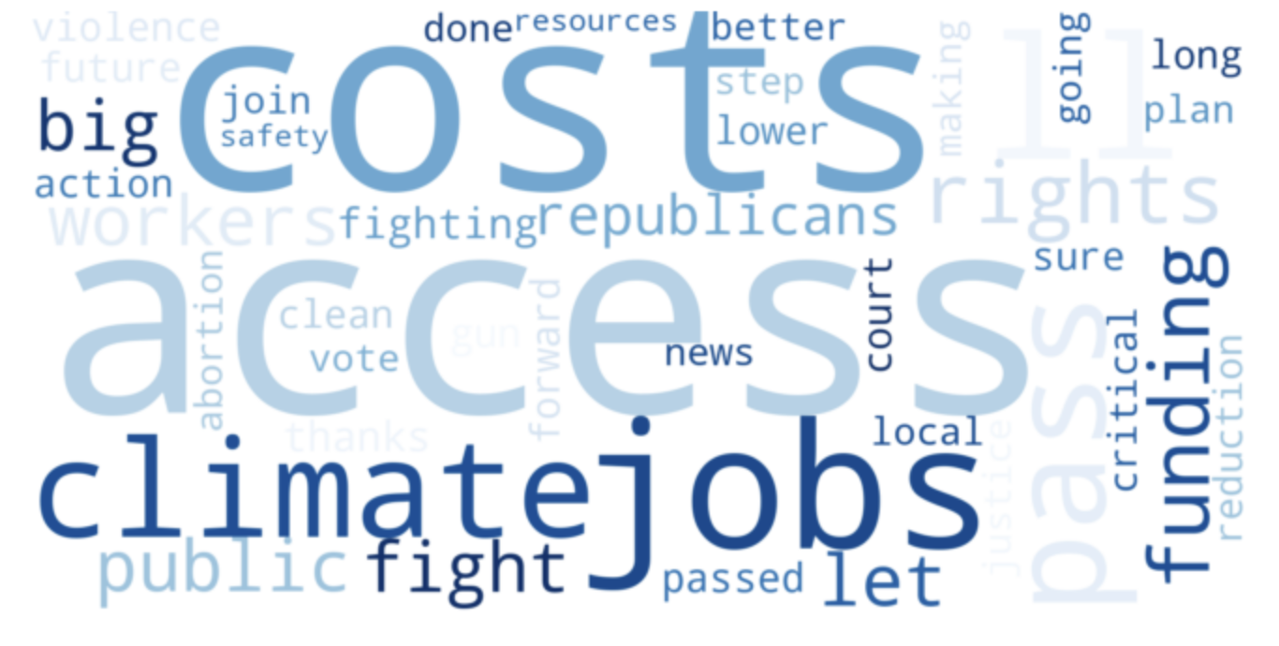
Democrats

Slide 12
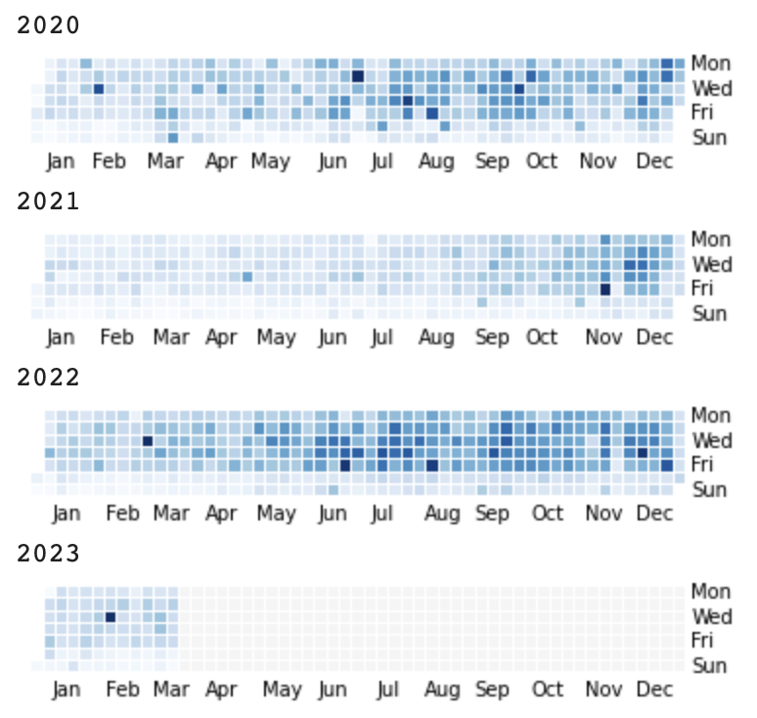

Slide 13
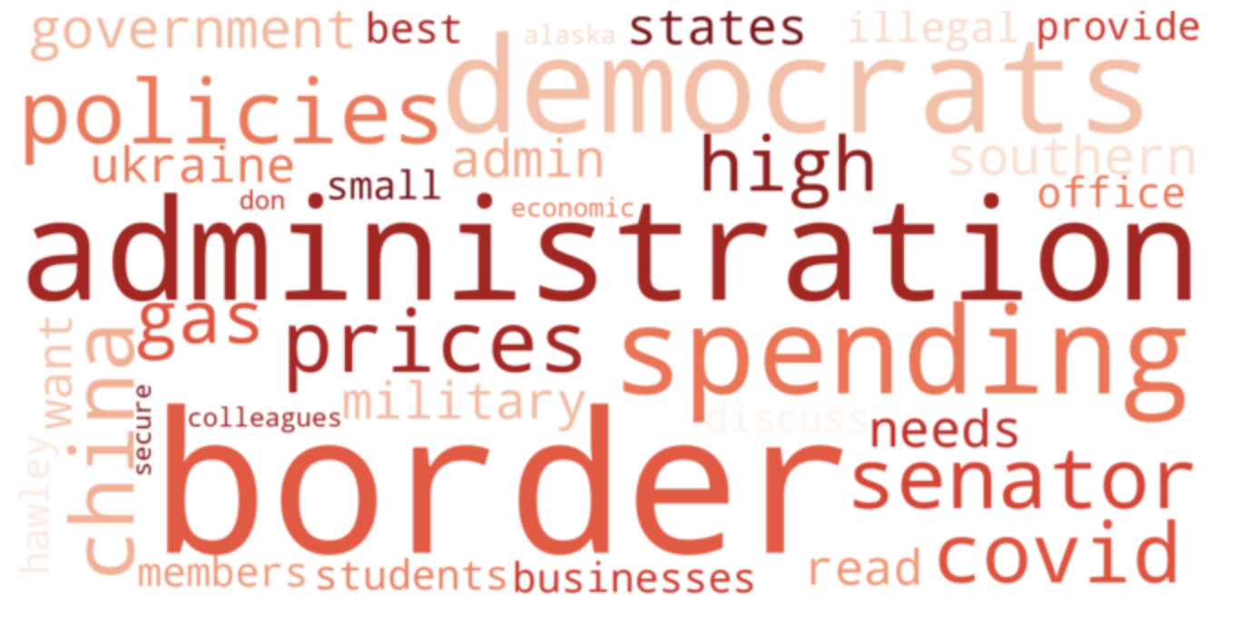
Republicans

Slide 14
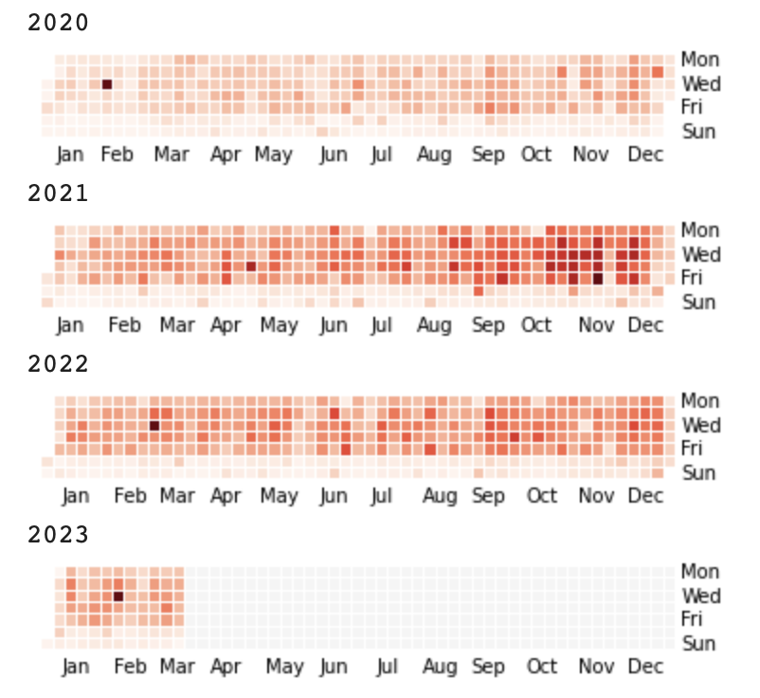

Slide 15
Likes per tweet by state

Slide 16
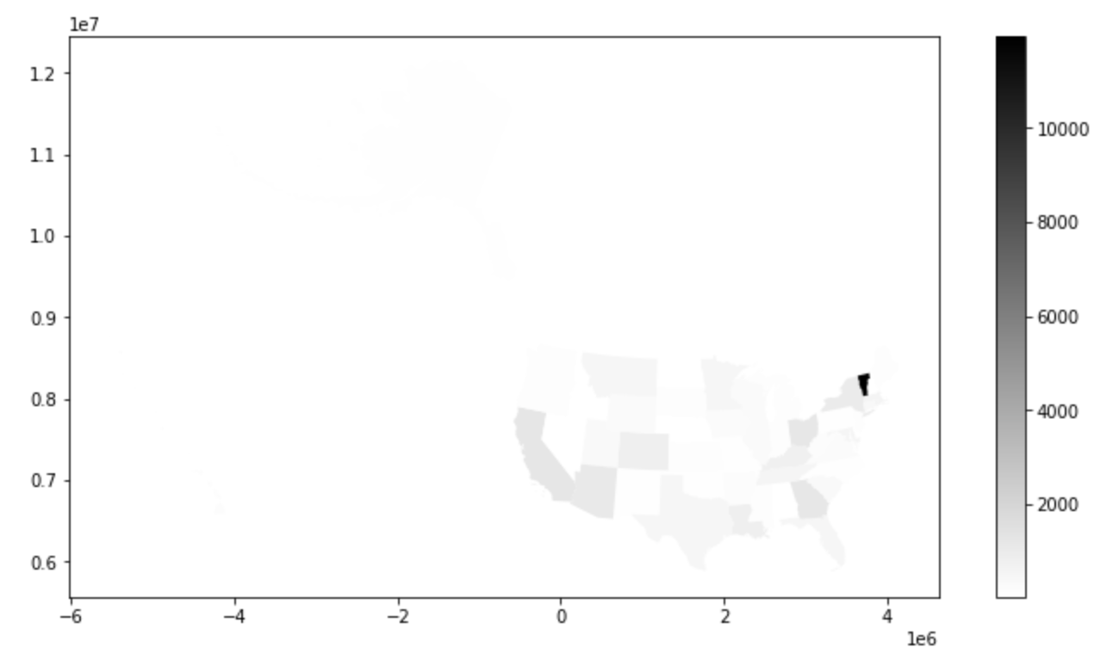

Slide 17
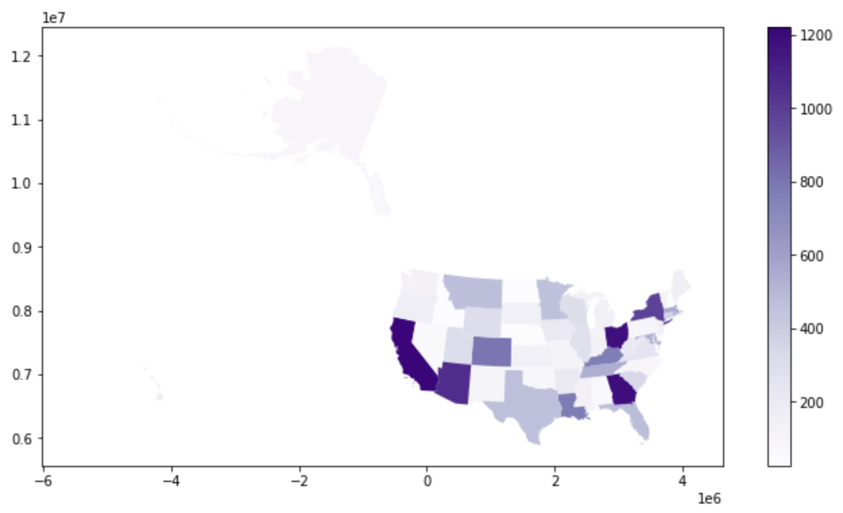

Slide 18
Machine Learning
Focused on Text
Stop-words
N-gram range of 1 is best

Slide 19
KNN Classifier
k of 75 optimal
Euclidian Distance
f1_macro score of about 0.79

Slide 20
Multinomial Naive Bayes
Tried different hyperparameters
Found alpha of. 0.14
F1-macro of 0.81

Slide 21

Ensemble Methods
Score was lowered for portions of the data
Very slow
Use Multinomial Naive Bayes

Slide 22
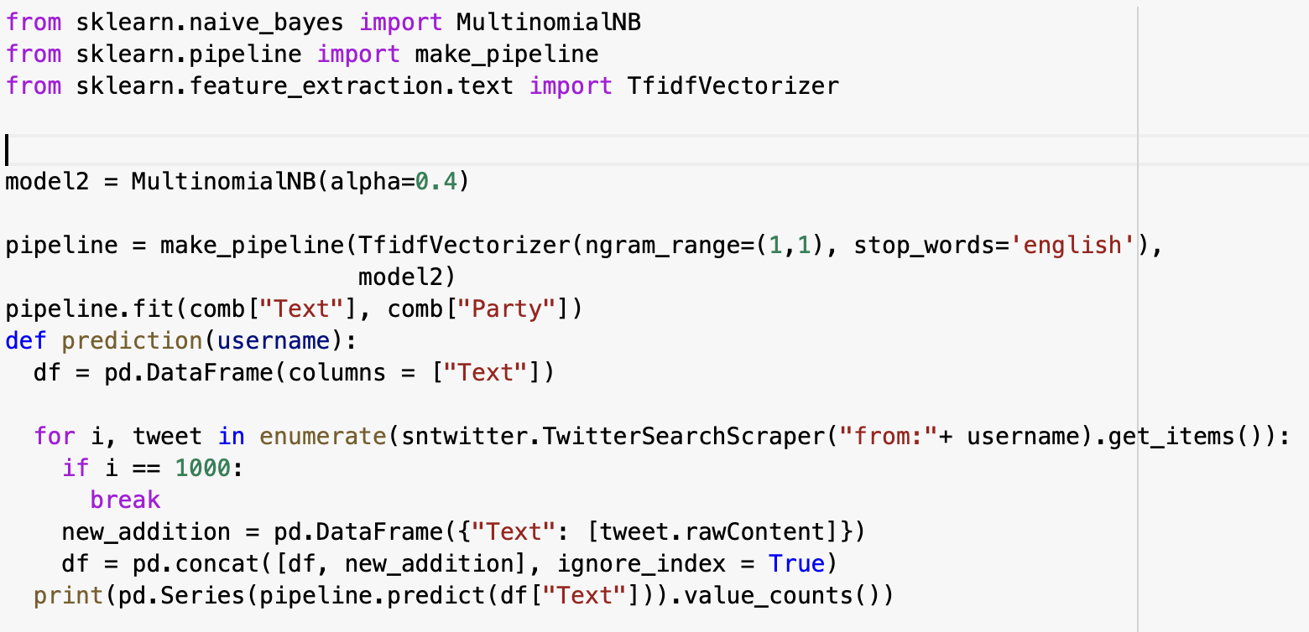
Function
Function to predict by username
Scrapes twitter
Predicts tweet by tweet

Slide 23
