Slide 1


Disaggregated RAID Storage in Modern Datacenters
Junyi Shu, Ruidong Zhu, Yun Ma, Gang Huang
Hong Mei, Xuanzhe Liu, Xin Jin
Notes:
Hi, everyone. I‘m Junyi Shu from Peking University.
Today, I’ll talk about our work Disaggregated RAID Storage in Modern Datacenters, dRAID, which allows you to build a scalable and reliable block device with disaggregated storage.

Slide 2
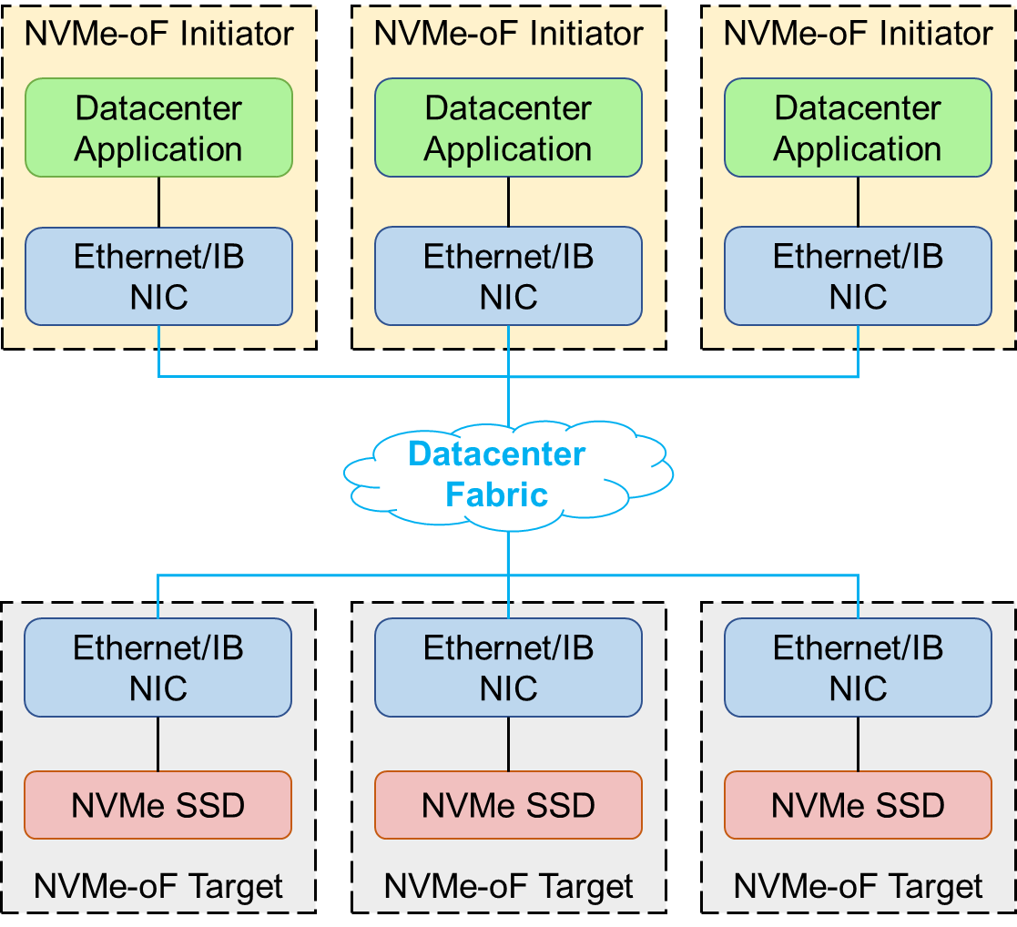
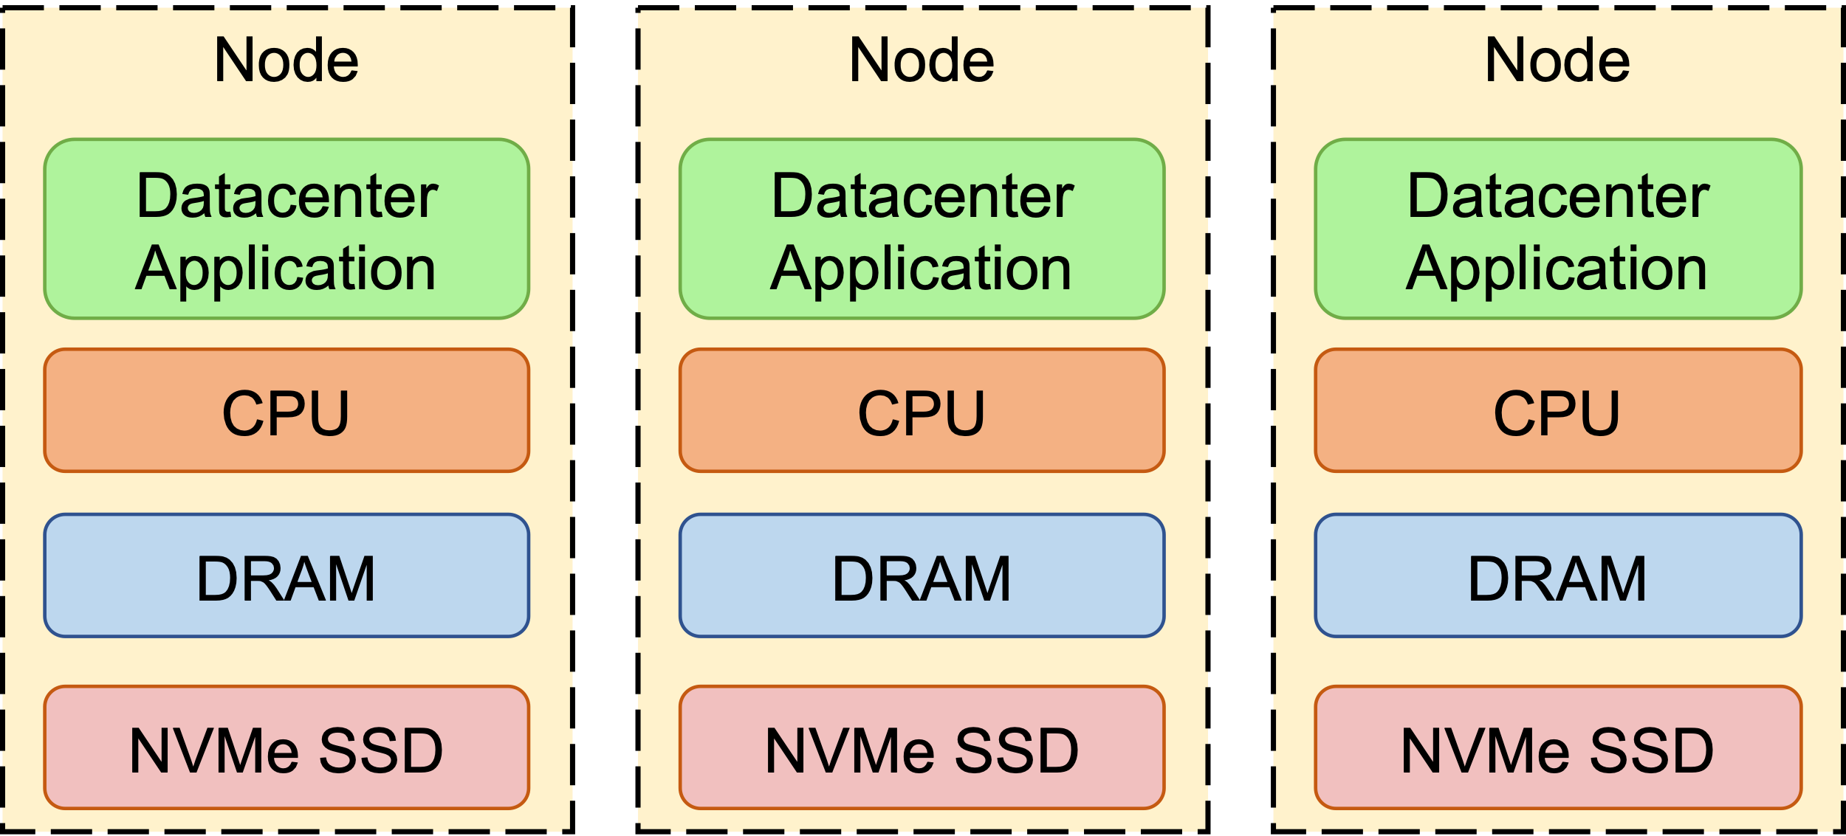
Disaggregated Storage
Datacenter network is evolving fast
Bandwidth doubles every generation
Latency cut in half every generation (for now)
Disaggregated storage becomes popular
Decouple compute & storage
Higher resource utilization
InfiniBand RoadMap
Diskless
Compute
Nodes
10,000
GDR
XDR
4.8T
NDR
2.4T
Bandwidth (Gb/s)
1,000
HDR
1.6T
1.2T
EDR
600G
800G
800G
12X
QDR
300G
400G
400G
400G
QDR
200G
200G
200G
100
168G
2X
4X
100G
100G
100G
56G
50G
Storage
Nodes
with
Wimpy CPUs
1X
25G
Monolithic Architecture
10
14G
Year
InfiniBand Roadmap (https://www.infinibandta.org/infiniband-roadmap/)
NVMe-oF Initiator
NVMe-oF Initiator
NVMe-oF Initiator
Datacenter
Application
Datacenter
Application
Datacenter
Application
Ethernet/IB NIC
Ethernet/IB NIC
Ethernet/IB NIC
Node
Node
Node
Datacenter
Application
Datacenter
Application
Datacenter
Application
Datacenter
Fabric
CPU
CPU
CPU
DRAM
DRAM
DRAM
NVMe-oF Target
NVMe-oF Target
NVMe-oF Target
NVMe SSD
NVMe SSD
NVMe SSD
Ethernet/IB NIC
Ethernet/IB NIC
Ethernet/IB NIC
NVMe SSD
NVMe SSD
NVMe SSD
Notes:
Modern datacenter fabric is evolving towards higher bandwidth and lower latency. Different components in a computer used to be interconnected with local bus. Now, we can also access a remote device with enough bandwidth and acceptable latency. (Click)
Disaggregated storage becomes popular in cloud datacenters. It decouples resources into diskless compute clusters and storage clusters with limited compute power. It is very attractive to both cloud platforms and their users, because compute and storage can now scale independently, which leads to higher resource utilization and lower cost.

Slide 3
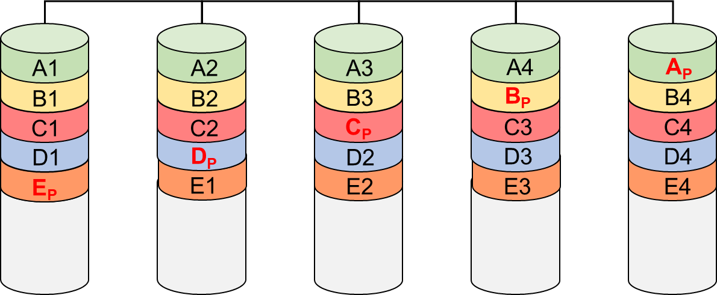
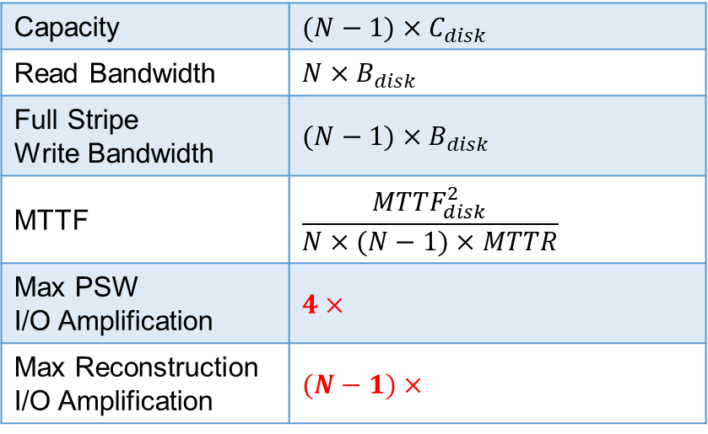
Parity-based RAID
A classic solution for building
A virtual block device with high BW/capacity
While achieving high reliability (MTTF↑ ↑)
Can lead to severe I/O amplification
Partial stripe write
Data reconstruction
RAID-5 with 5 disks
Capacity | $${(N−1)×C}_{disk}$$
Read Bandwidth | $$N×B_{disk}$$
Full Stripe Write Bandwidth | $$(N−1)×B_{disk}$$
MTTF | $$\frac{MTTF_{disk}^{2}}{N×(N−1)×MTTR}$$
Max PSW I/O Amplification | $$4×$$
Max Reconstruction I/O Amplification | $$(N−1)×$$
A1
A2
A3
A4
A_{P}
B1
B2
B3
B_{P}
B4
C1
C2
C_{P}
C3
C4
D1
D_{P}
D2
D3
D4
E_{P}
E1
E2
E3
E4
Notes:
On the other hand, redundant array of independent disks, especially parity-based RAID is a key building block for realizing a virtual block device with bandwidth and capacity beyond what a single drive can offer. It also achieves high reliability by storing extra parity chunks. (Click)
However, it is a well-known problem that partial stripe write and data reconstruction of parity-based RAID can lead to severe I/O amplification.

Slide 4



Parity-Based RAID over Disaggregated Storage
RAID controller & drives on the same machine
Lose flexibility of choosing drives from the pool
Create a single point of failure
RAID controller & drives decoupled
Easier/cheaper to add/replace a drive
Better tolerance of storage server faults
Client
Host
Client
Host
RAID Controller
Network
RAID Controller
PCIe
Storage Server
Storage Servers
Notes:
There are basically two approaches to build RAID over disaggregated storage. One is to disaggregate the RAID controller to a storage server, and uses drives from the same machine. The other is to decouple the RAID controller and the drives. (Click)
Let’s first consider a single-drive failure. (Click) For the single machine approach, you have to find another available drive on the same server. (Click) But for the decoupled approach, you can use any drive from the entire storage pool. (Click)
As for a server failure, if you take the single machine approach, the entire array becomes unavailable to client, and you may lose the data forever. (Click) But if you carefully choose the member drives with the decoupled approach, your array is still available, and the data can be reconstructed from other drives. (Click) For these two reasons, we believe the decoupled approach is preferred in most cases.

Slide 5
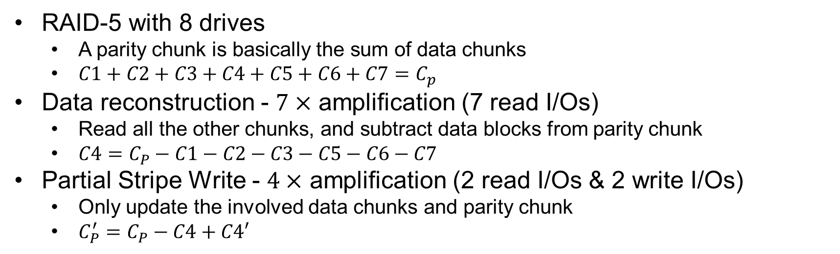

An Example of RAID I/O Amplification
RAID-5 with 8 drives
A parity chunk is basically the sum of data chunks
$C1+C2+C3+C4+C5+C6+C7=C_{p}$
Data reconstruction - $7×$ amplification (7 read I/Os)
Read all the other chunks, and subtract data blocks from parity chunk
$C4=C_{P}−C1−C2−C3−C5−C6−C7$
Partial Stripe Write - $4×$ amplification (2 read I/Os & 2 write I/Os)
Only update the involved data chunks and parity chunk
$C_{P}^{′}=C_{P}−C4+C4′$
C4’
C_{P}’
All reads and writes go through host NIC!
Stripe $i$
C1
C2
C3
C4
C5
C6
C7
C_{P}
Notes:
But how I/O amplification impacts a disaggregated RAID? Assume we have a RAID-5 array with 8 drives. The parity chunk is basically the sum of the data chunks in the same stripe. (Click)
We first look at data reconstruction. For a normal read I/O, we only need to touch one chunk. (Click) But if chunk C4 becomes unavailable, we’ll have to read all the other chunks to reconstruct C4, which creates 7 times amplification. (Click)
For partial stripe write, say we only update C4 to C4 prime in a stripe. (Click) An naive approach is to retrieve the unmodified chunks and recalculate the parity. (Click) Then we update C4 prime and CP prime. (Click) A smarter way in practice is to retrieve C4 and CP instead, you can derive CP prime from that. In total, it requires 2 reads and 2 writes, which incurs 4 times amplification. (Click) It is still a problem because the amplified I/Os all go through the host NIC!

Slide 6
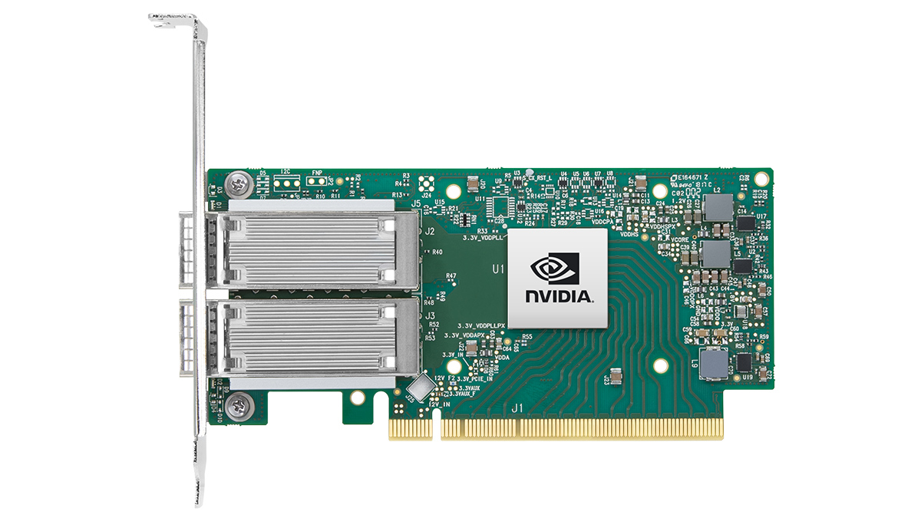

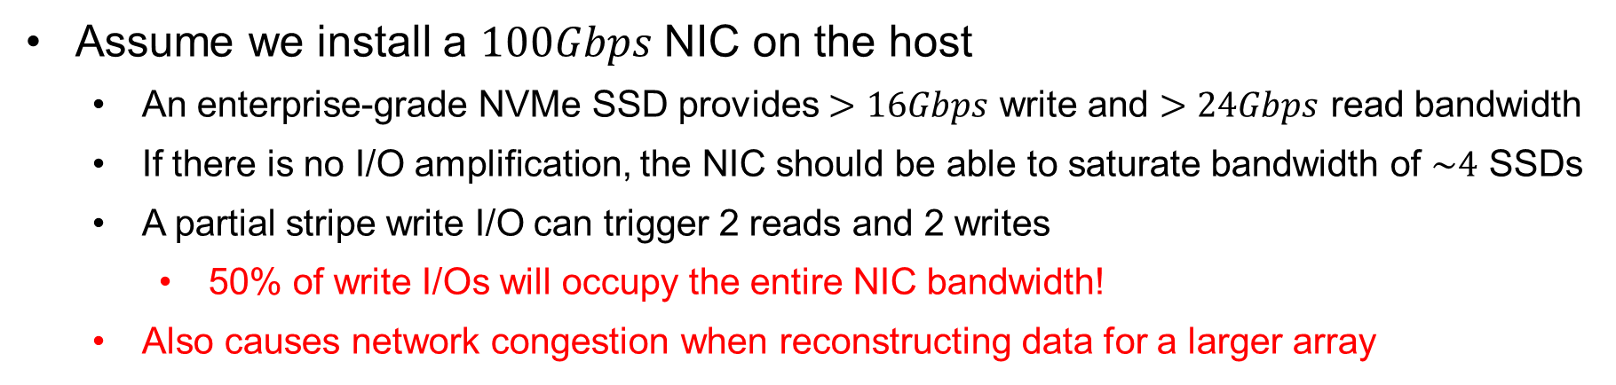
New bottleneck at Host NIC
Assume we install a $100Gbps$ NIC on the host
An enterprise-grade NVMe SSD provides $>16Gbps$ write and $>24Gbps$ read bandwidth
If there is no I/O amplification, the NIC should be able to saturate bandwidth of $\sim 4$ SSDs
A partial stripe write I/O can trigger 2 reads and 2 writes
50% of write I/Os will occupy the entire NIC bandwidth!
Also causes network congestion when reconstructing data for a larger array
Notes:
We can do some simple math to see why this becomes a problem. Let’s assume we have a 100Gbps NIC on the host. (Click)
An enterprise-grade NVMe SSD provides more than 16Gbps write and 24Gbps read bandwidth. (Click)
If we use each drive separately and have no I/O amplification, the NIC can saturate bandwidth of about 4 SSDs. (Click)
Recall a partial stripe write can trigger 2 reads and 2 writes, that pretty much means half of the write traffic will occupy the entire NIC. (Click)
And things could be worse for data reconstruction on a larger array.

Slide 7
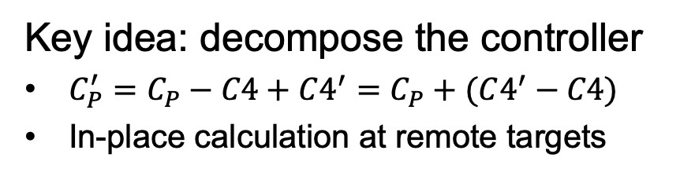
Our Key Insight: Extra Network I/Os Are Avoidable
Root cause of the extra network I/Os
The centralized RAID controller!
Processes everything except drive I/Os
Key idea: decompose the controller
$C_{P}^{′}=C_{P}−C4+C4^{′}=C_{P}+(C4^{′}−C4)$
In-place calculation at remote targets
Client
C4’
Host
Host
C4’
RAID Controller
Network
C1
C2
C3
C4’
C4
C4
C5
C6
C7
C_{P}’
C_{P}
C_{P}
C4’- C4
C4’- C4
C_{P}+(C4’- C4)
C_{P}+(C4’- C4)
Storage Servers
Notes:
So where do the extra network I/Os come from? The source of extra I/Os is the centralized RAID controller. It does everything except for drive I/O processing. (Click)
So the key idea here is to decompose the controller. The formula to calculate CP prime here can be expressed in a different way. (Click) We first calculate C4 prime minus C4, (Click) then we add CP on top of that, (Click) we now have CP prime, and we persist it. The calculations are in-place at each remote target, so the network overhead is minimized.

Slide 8
dRAID Overview
What architectural changes do we need to make?
Client-server -> peer-to-peer-access
What protocol changes do we need to make?
Extends NVMe-oF protocol
How do we design the system to maximize parallelism?
Non-blocking multi-stage write
Pipelined I/O processing
Bandwidth-aware reconstruction
Notes:
To apply this idea to the real world, we ask ourselves three questions: (Click)
What architectural changes do we need to make? (Click)
What protocol changes do we need to make? (Click)
How do we design the system to maximize parallelism?
We will answer them in next few slides.

Slide 9
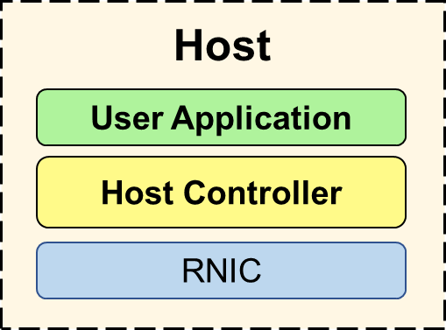
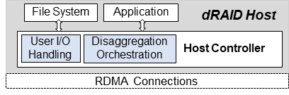
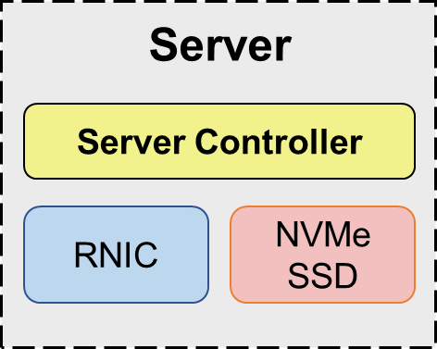
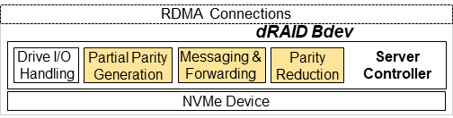
dRAID Architecture
Host component
Exposes a user interface
Orchestrates the read/write workflow
Server component
Does most of computation & data transfer
Does not control the behaviors itself
Host
Server
File System
Application
dRAID Host
User Application
Server Controller
User I/O Handling
Disaggregation
Orchestration
Host Controller
RDMA Connections
Host Controller
RNIC
NVMe SSD
RDMA Connections
dRAID Bdev
RNIC
Drive I/O
Handling
Partial Parity
Generation
Messaging &
Forwarding
Parity
Reduction
Server
Controller
NVMe Device
Notes:
Here, every data access between servers must go through the host. (Click)
To enable peer-to-peer data access, we must create a connection between each pair of servers. (Click)
The host controller exposes a user interface and orchestrates each read and write workflow. (Click)
In contrast, the server component does whatever the host asks it to do, including parity calculation and data transfer.

Slide 10
dRAID Protocol
NVMe-oF (NVMe-over-Fabric)
A popular disaggregated storage protocol
90% of it is the same as NVMe protocol
Supports basic behaviors (read/write…)
dRAID extends NVMe-oF
Supports disaggregated operations
Includes necessary parameters
Supports both RAID-5 & RAID-6
NVMe-oF Command Capsule
dRAID Command Capsule
Command ID
Optional Command Data
Command
ID
Opcode
NSID
Buffer
Address
Command
Parameters
Other
Data
Opcode
Read
Write
+
PartialWrite
Parity
Reconstruction
Peer
offset
sg-list
length
next-dest2
NSID
num-sge
data-idx
subtype
num-sge2
Buffer Address
fwd-offset
sg-list2
fwd-length
Command Parameters
next-dest
wait-num
Notes:
But how does the host control the behaviors of the server controllers? NVMe-oF is a widely used disaggregated storage protocol. But NVMe-oF only supports a few basic commands such as read and write. (Click)
We create dRAID protocol by extending NVMe-oF protocol. (Click) It supports host-to-server commands partial write, parity, and reconstruction, and also peer command between servers. (Click) It includes necessary parameters for these commands, (Click) and it supports both RAID-5 and RAID-6.

Slide 11
Maximize Inter-node Parallelism
Host-side Controller
Stage 1: Broadcast
Stage 2: Reduce
Stage 3: Callback
D1’
D1’
D2’
D2’
Msg:PartialWrite
Msg:PartialWrite
Msg:Parity
Msg:Peer
Msg:Peer
Msg:Callback
D1’
D2’
P1’
P1’
P2’
P2’
P’
……
What if Parity command arrives late?
Reduction is blocked!
DRAM
DRAM
DRAM
P
D1
P
D1
D2
NVMe
D2
NVMe
NVMe
Server 1
Server 2
Server P
Notes:
Now let’s see how dRAID uses the protocol to support partial stripe write. Here, we want to update D1 to D1 prime, D2 to D2 prime. We can conceptually divide the workflow into 3 phases. (Click)
In broadcast phase, we first send commands to the involved servers. (Click) Upon receiving the commands, data server fetches the new data, and parity server retrieves the old parity. (Click) Data server also needs to retrieve its old data. (Click) Now, each data server can calculate the partial parity. (Click) And then persist the new data. (Click)
In reduce phase, each data server notifies parity server with a peer command, (Click) which lets parity server fetch the partial parity (Click) and eventually generate the new parity and (Click) persist it. (Click)
The last step is to notify the host the final result. (Click) The problem here is, the entire reduce phase relies on the parity command to arrive and provide necessary parameters. If it arrives late, reduce phase is blocked.

Slide 12
Non-blocking Multi-stage Write
Enforcing Parity command to arrive before reduction starts with barrier incurs expensive synchronization
Parity reduction is basically addition/subtraction which does not require any specific order
Solution: does not require Parity command to arrive until the last step
Does not know how many partial results are expected
Msg:Parity wait_num:2
P2’+P1’
P2’+P1’+P
P1’
P1’
P2’
……
P2’
P
Server 1
Server 2
Server P
Notes:
An easy way to address this problem is to use a barrier, which we try to avoid when possible. (Click)
Parity reduction is basically addition and subtraction which does not require a specific order. (Click)
So we can just allow the reduce phase to proceed, and only make sure Parity command has arrived before we persist the new parity. (Click)
We will have a few available buffers on parity server, (Click) we can keep reducing the partial parities. (Click) And we eventually see the Parity command. (Click) We now know we are waiting for 2 partial parities and they are all here. So we are done!

Slide 13

Maximize Intra-node Parallelism
Interface | # of queues | Queue depth
SATA | 1 | 32
SAS | 1 | 256
NVMe | 65,535 | 65,536
Modern NICs and NVMe SSDs are asynchronous I/O devices that can support many concurrent I/Os
Recv ParitialWrite Cmd
NIC
Recv WRITE Cmd
NIC
Fetch new data
NIC
Read old data
NVMe
Fetch new data
Miss the opportunity of
pipelining!
NVMe-oF
WRITE
NIC
dRAID
PartialWrite
Generate Parity
Write new data
NVMe
CPU
Write new data
NVMe
Send SUCCESS
NIC
Send Peer
NIC
Send SUCCESS
NIC
Notes:
Non-blocking multi-stage write allows more parallelism across servers. But are there any opportunities within a node? Modern NICs and NVMe SSDs can support many concurrent I/Os, which we should take advantage of. (Click)
This is the execution workflow of NVMe-oF Write, each action depends on the previous one. (Click) But for dRAID partial stripe write, the dependency graph suggests there is an opportunity to parallelize the actions across the devices. (Click) Why not pipeline them?

Slide 14
Pipelined I/O Processing
Takes the unique opportunity in dRAID to parallelize multiple I/Os
Enqueue I/Os to NVMe SSDs and NICs ASAP to maximize utilization of their internal parallelism
Poll CMD
CMD 1
CMD 2
CMD 3
Fetch
Remote
Fetch 1
Fetch 2
Fetch 3
Read
Read 1
Read 2
Read 3
Write
Write 1
Write 2
Write 3
Partial Parity
Parity 1
Parity 2
Parity 3
Callback
CB 1
CB 2
CB 3
Notes:
We take advantage of this unique opportunity and apply pipeline parallelism. (Click) We enqueue the I/Os to NVMe SSD or NIC as soon as possible, and let them do the rest for us.

Slide 15
Accelerate Data Reconstruction
First try: randomly choose a reducer to avoid overwhelming the host
Reality: different remote targets may have uneven available bandwidth
Goal: balance the available bandwidth
Our approach: Choose a reducer based on a probabilistic model calculated from current available bandwidth
Notes:
Don’t forget another source of I/O amplification is data reconstruction. (Click) A straightforward approach is to randomly select a reducer to reconstruct the data for the host every time. (Click) But it does not work well when each server has different available bandwidth at a time, which is the reality. (Click) What we want to do is to balance the available bandwidth. (Click) So a better way is to choose a reducer based on probability calculated from current available bandwidth.

Slide 16
Evaluation
Implementation: ~9,800 lines of C++ code
Built on top of a customized version of SPDK 21.10
Testbed
19 CloudLab Utah c6525-100g instances
AMD EPYC 7402P processor, 128 GB memory, 1.6 TB NVMe SSD, ConnectX-5 Ex 100Gbps NIC, and ConnectX-5 25 Gbps NIC
Comparison Schemes
Linux MD driver and SPDK RAID-5/6 POC
Workload
FIO
YCSB on RocksDB and a light-weight object store
Notes:
We implemented dRAID on top of SPDK, a user-space storage framework. (Click) We use the publicly available platform CloudLab as the testbed.

Slide 17
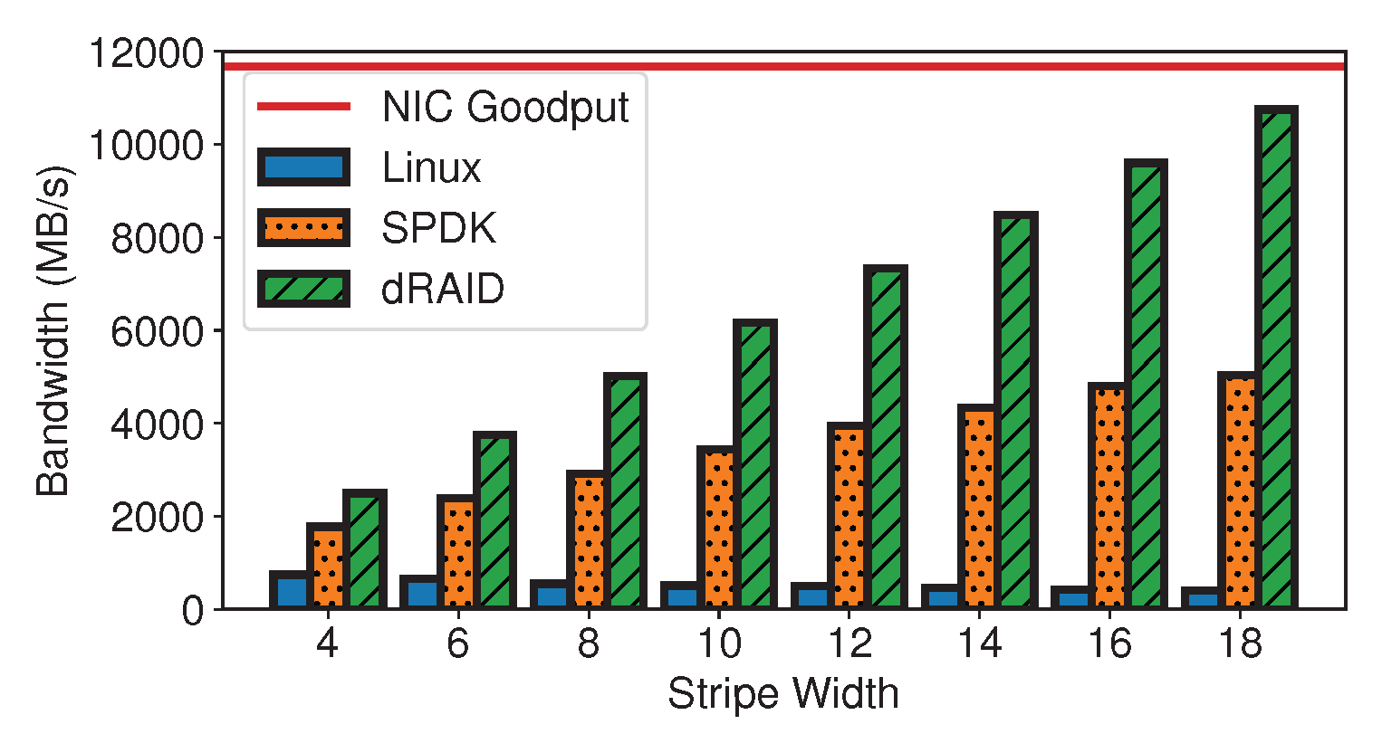
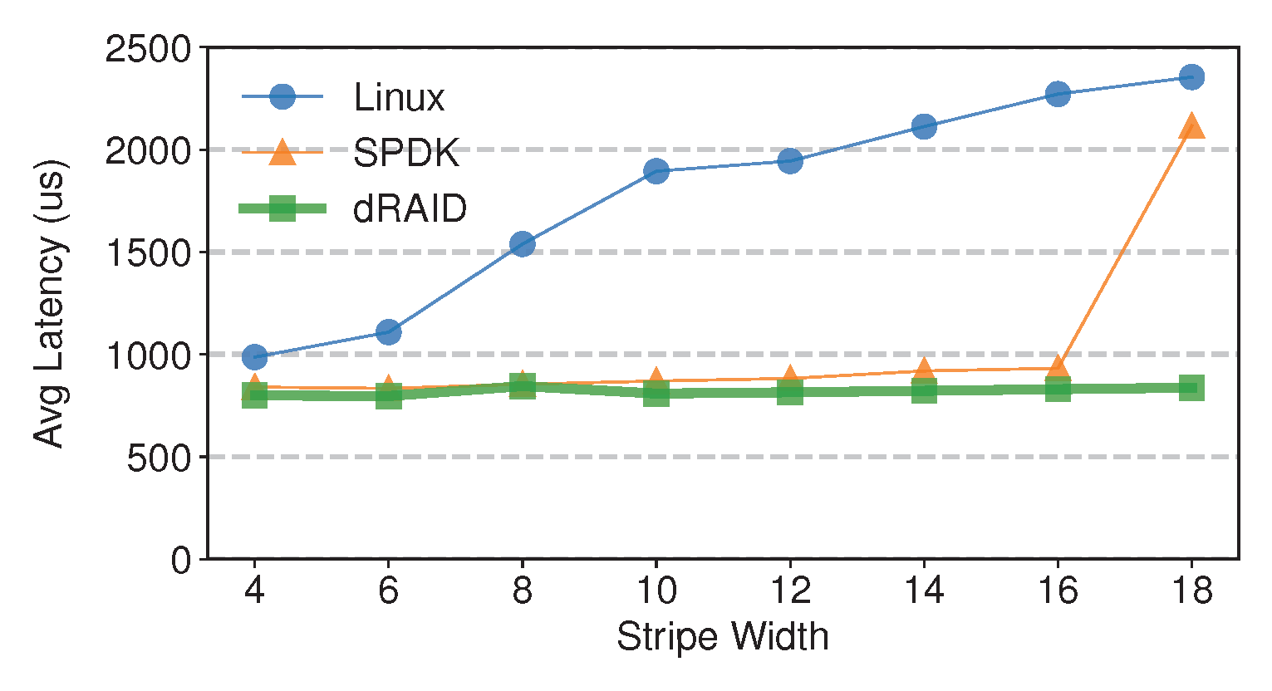
Node Scalability on Write
dRAID scales linearly towards NIC goodput
SPDK scales to half of NIC goodput
dRAID shows low latency consistently
Notes:
We examined node scalability of dRAID. Overall, it’s linearly scalable. For write scalability, dRAID shows very consistent latency and scales towards the NIC goodput.

Slide 18
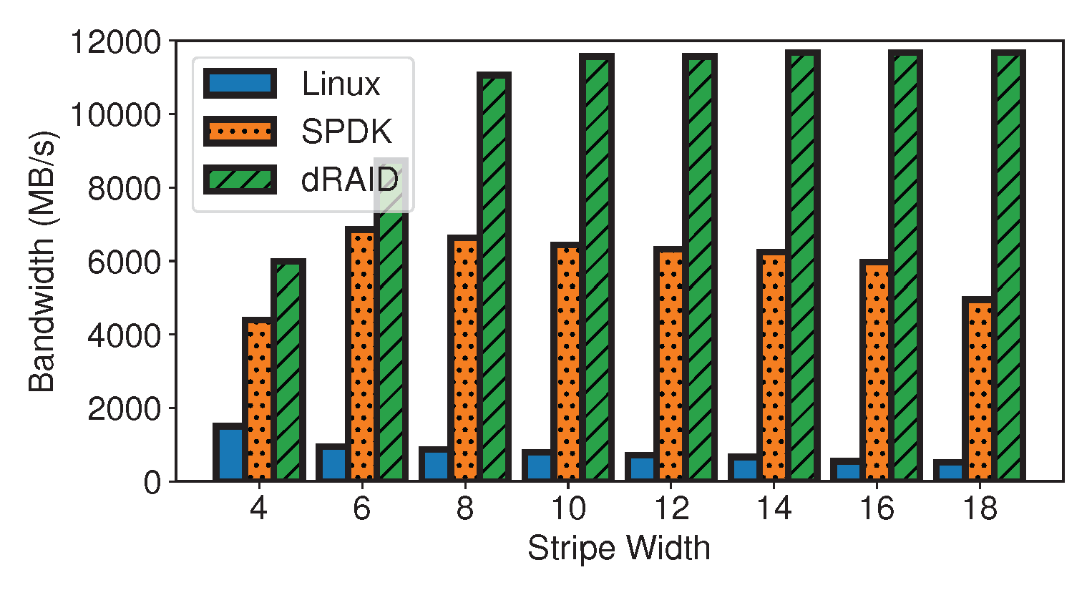
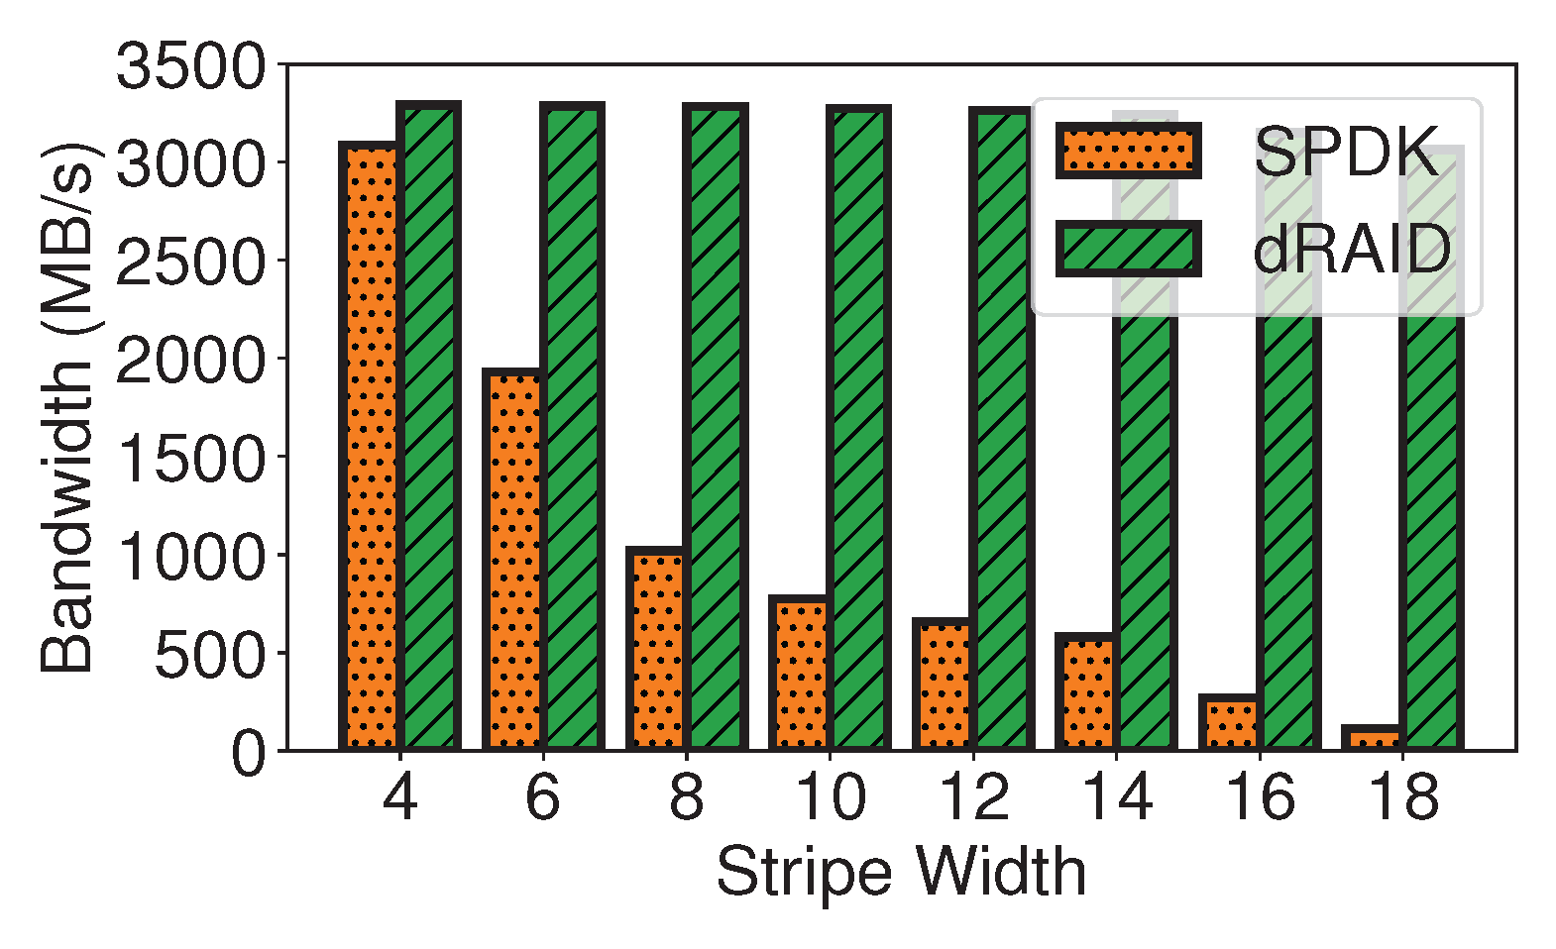
Node Scalability on Degraded Read
Degraded Read
dRAID achieves near-normal performance
SPDK performance drops with more nodes added
Reconstruction
dRAID achieves relatively steady performance
SPDK performance drops quickly as more nodes added
Normal read performance
Degraded Read
Reconstruction
Notes:
For degraded read, dRAID is very close to normal state read, while SPDK becomes overwhelmed due to host NIC congestion. (Click) If we only have reconstruction, SPDK becomes even worse.

Slide 19
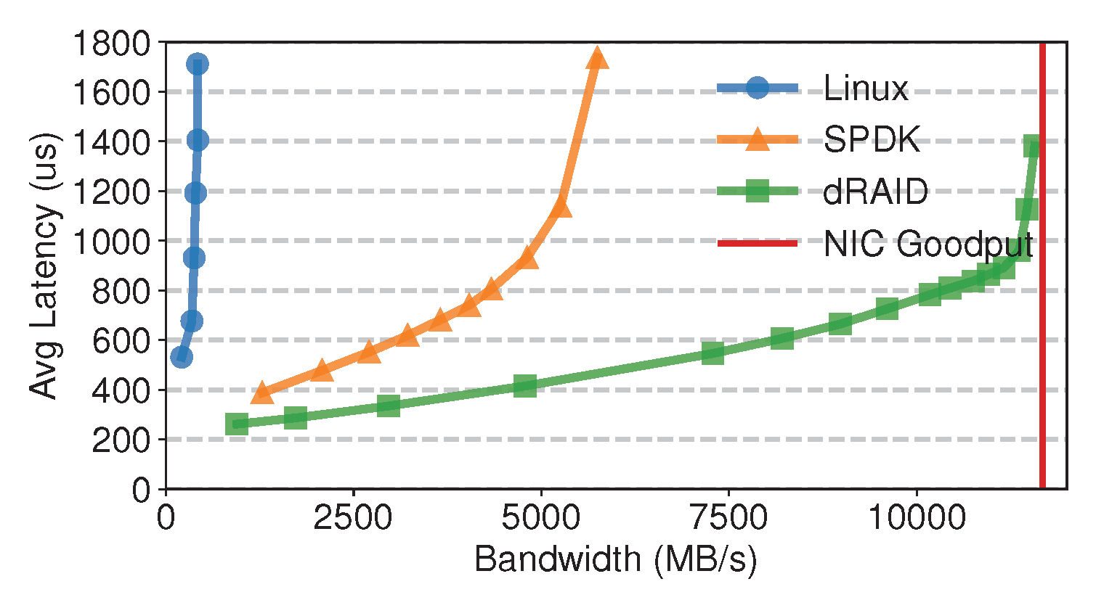
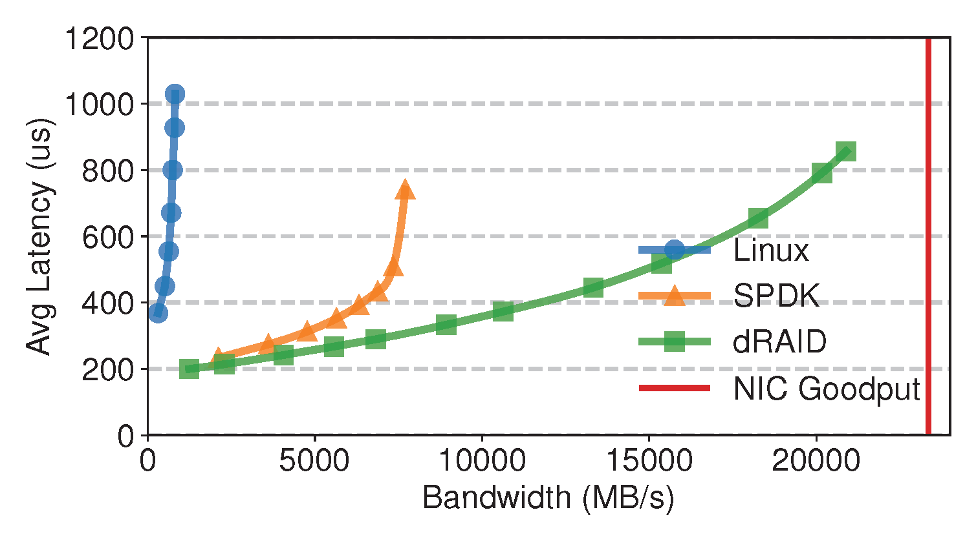
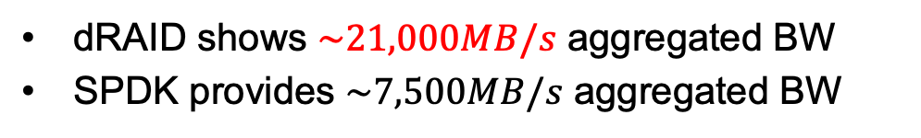


I/O Scalability
dRAID approaches NIC goodput
SPDK can achieve half of NIC goodput
dRAID shows $\sim 21,000MB/s$ aggregated BW
SPDK provides $\sim 7,500MB/s$ aggregated BW
$$2×$$
$$3×$$
Write
50% Read + 50% Write
Notes:
dRAID also scales with number of concurrent I/Os. dRAID outperforms SPDK by 2 times on write-only workload, (Click) and 3 times on read-write workload. This is very close to the theoretical improvement.

Slide 20
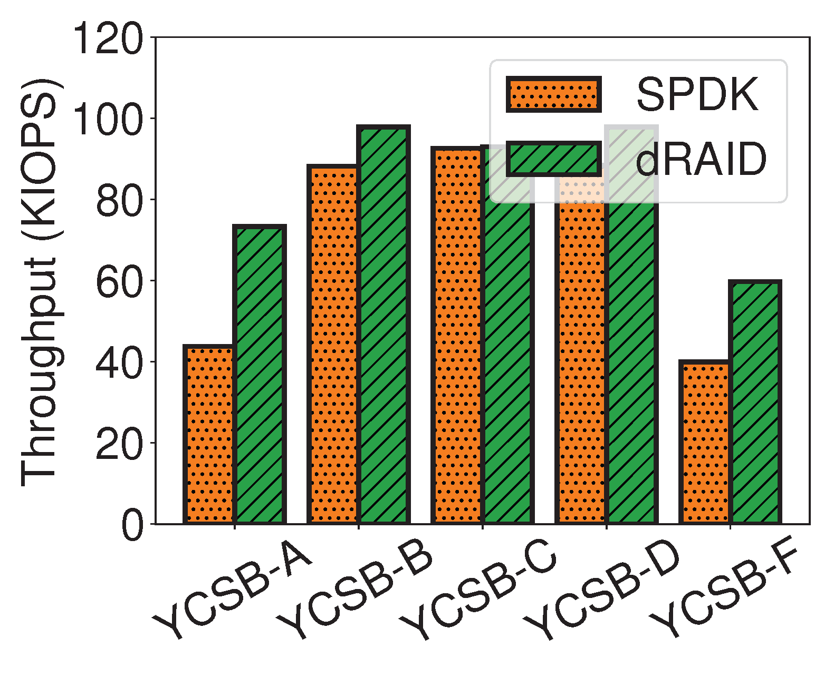
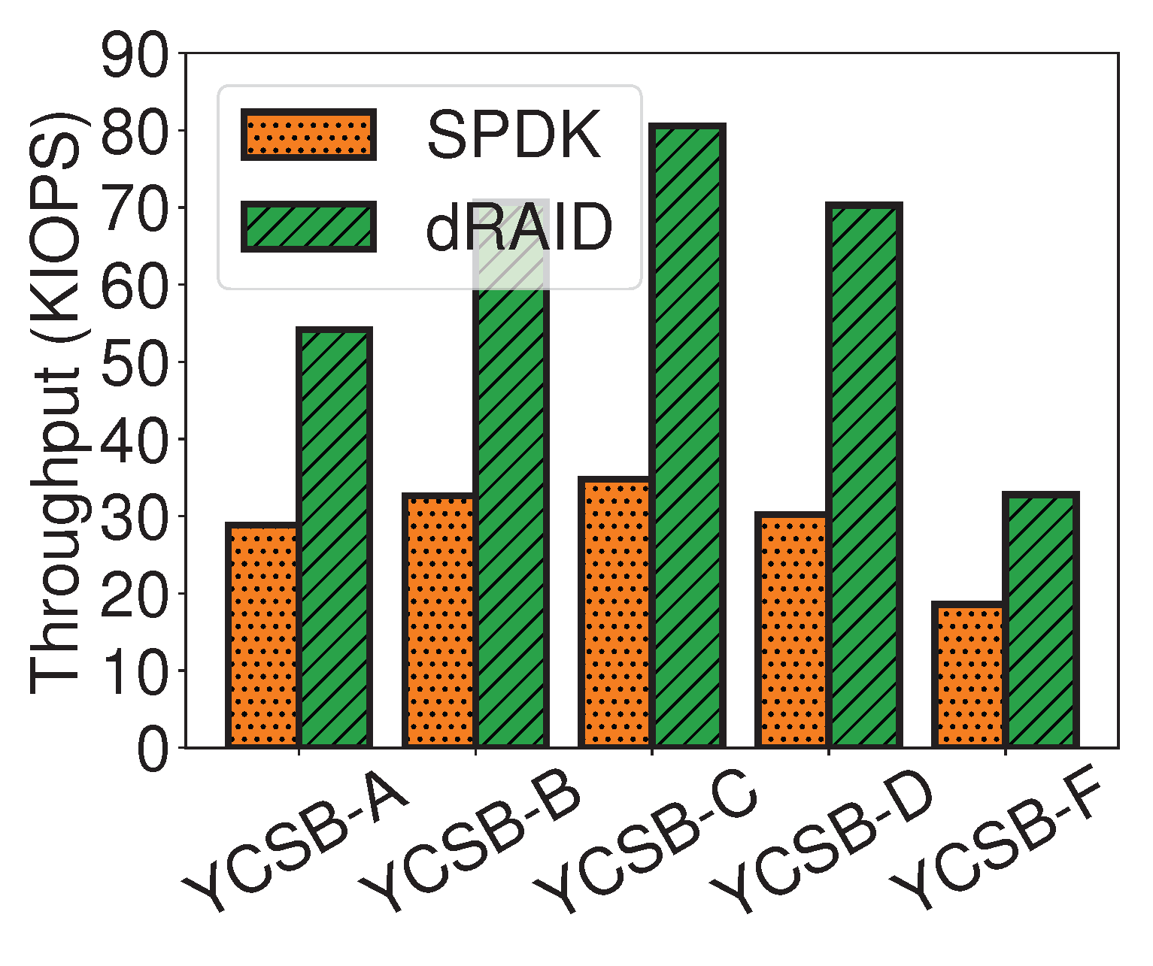

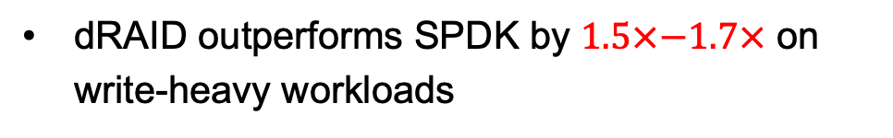

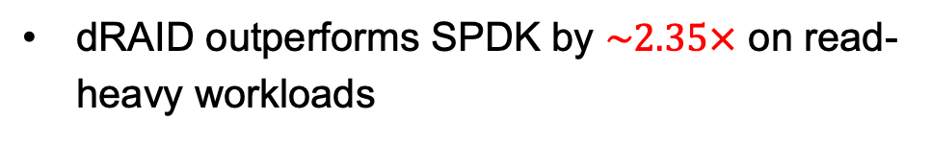
Application Performance
dRAID outperforms SPDK by $1.5×−1.7×$ on write-heavy workloads
dRAID outperforms SPDK by $\sim 2.35×$ on read-heavy workloads
$$2.35×$$
$$1.7×$$
Normal State
Degraded State
Notes:
We implemented a lightweight key-value store, and run YCSB against it. Under normal state, improvement of dRAID is mostly on write-heavy workloads A and F. (Click) And the improvement is more significant under degraded state across all workloads because dRAID improves both read and write.

Slide 21
More Experiments in Our Paper
Results of RAID-6 evaluation
Performance on different parameters/configurations
Chunk size, I/O size, read/write ratio
Normal state vs. degraded state
Impact of bandwidth-aware reconstruction
…
Notes:
For more experiment results, please read our paper.

Slide 22
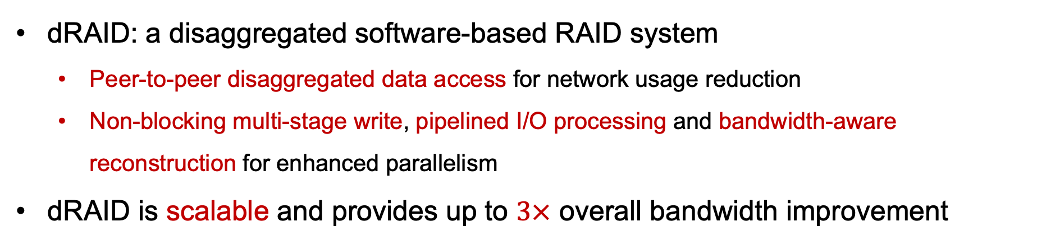
Conclusion
dRAID: a disaggregated software-based RAID system
Peer-to-peer disaggregated data access for network usage reduction
Non-blocking multi-stage write, pipelined I/O processing and bandwidth-aware reconstruction for enhanced parallelism
dRAID is scalable and provides up to $3×$ overall bandwidth improvement
Open-sourced at https://github.com/pkusys/dRAID
shujunyi@pku.edu.cn
Thanks!
Notes:
To conclude, dRAID is a disaggregated software-based RAID system. It exploits peer-to-peer disaggregated data access to reduce network usage, and applies system techniques targeting modern hardware to maximize parallelism. We show that dRAID is scalable and provides up to 3 times overall bandwidth improvement. (Click)
Thanks for listening. And I’m ready to take any questions.

