Slide 1



Burstable Cloud Block Storage with Data Processing Units
Junyi Shu, Kun Qian, Ennan Zhai, Xuanzhe Liu, Xin Jin
Notes:
Hi, everyone. I‘m Junyi Shu from Peking University.
Today, I’ll talk about our work BurstCBS, an I/O scheduling system that allows burst while limiting tenant interference.
This is a joint work with Kun and Ennan from Alibaba Cloud, Xuanzhe and Xin from Peking University.

Slide 2




Cloud block storage
……
VM
VM
……
VD
VD
VD
VD
VD
Storage Agent (SA)
Three-layer disaggregated architecture
Adopted by Alibaba (SIGCOMM ’22), Azure (NSDI ’23) and others
Enhanced availability & elasticity
A compute node serves user VMs and virtual disks (VDs)
The partitioning cluster handles CBS-specific logic
The persistence cluster is a DFS that stores data for many services
……
Compute
Cluster
Proprietary
Protocol
……
Partitioning
Cluster
Proprietary
Protocol
……
Persistence
Cluster
Notes:
Cloud block storage is a key building block for cloud computing. At public clouds like Alibaba and Azure, cloud block storage is disaggregated into three layers. (Click) At the compute layer, a storage agent abstracts the backend storage as virtual disks for user VMs. (Click) The persistence cluster provides a generalized distributed storage for different services including block storage, object storage and file storage. (Click) And block storage specific logic, such as segment management, is built into the partitioning layer. This three layer architecture allows fast failover and flexible resource provisioning compared to local disks.

Slide 3
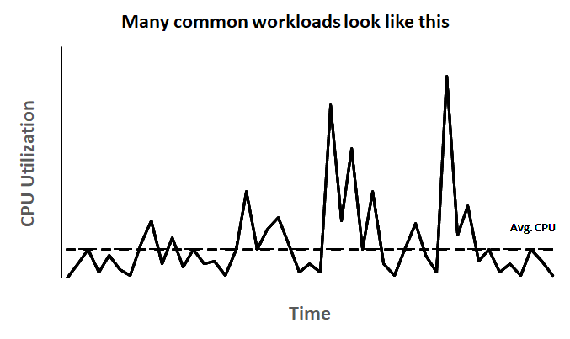
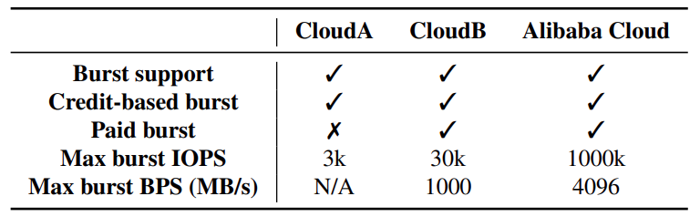
Beyond elasticity: burst at anytime
Burstable VM instance
Provide a base-level CPU performance
Able to burst above it anytime
Suitable for fluctuated workload
Burstable virtual disk
Provide a base-level IOPS/bandwidth
Able to saturate more I/Os when bursting
I/O utilization is also fluctuated
Notes:
Yet we always strive to provide more elasticity, not only when you provision your VMs and disks, but also at runtime. Burstable VM becomes attractive these days. In addition to the guaranteed resource provisioning like normal VMs, it allows you to use additional vCPUs when needed. If you have a workload that has many unpredictable CPU usage spikes, burstable VM is a great choice. (Click) There are also a lot of I/O-bound tasks which share a similar pattern. Therefore, many cloud providers, including us, also provide burstable virtual disks which can burst to a higher IOPS and bandwidth than your provisioning.

Slide 4
How is provisionable IOPS/bandwidth determined?
Various workloads
Small I/Os
Max IOPS
Max BPS (bits-per-second)
Large I/Os
……
Compute
Node
Lots of VDs
Small I/Os
Large I/Os
Max IOPS
Max BPS (bits-per-second)
……
Partitioning
Cluster
Lots of segments
Small I/Os
Max IOPS
Max BPS (bits-per-second)
Large I/Os
……
Persistence
Cluster
Lots of chunks
Notes:
Before we move onto burstable IOPS and bandwidth support, let’s first look at how the maximum provisionable IOPS and bandwidth is determined at Alibaba Cloud. (Click) We take each individual component, and measure them with various workloads. (Click) We derive the maximum IOPS and BPS from the results, and make sure we don’t provision IOPS and BPS beyond that.

Slide 5
Do we have the IOPS/bandwidth to support burst?
……
Compute
Cluster
Proprietary
Protocol
Supporting burst requires spare IOPS/bandwidth at each layer
……
Partitioning
Cluster
Do we need to provision additional resources just for supporting burst?
Proprietary
Protocol
……
Persistence
Cluster
Notes:
Then it comes to next question. Apparently, saturating burst requires extra resources. Do we have enough IOPS and BPS at each layer to support burstable virtual disks? Do we need to provision more resources? Or we already have spare resources there?

Slide 6
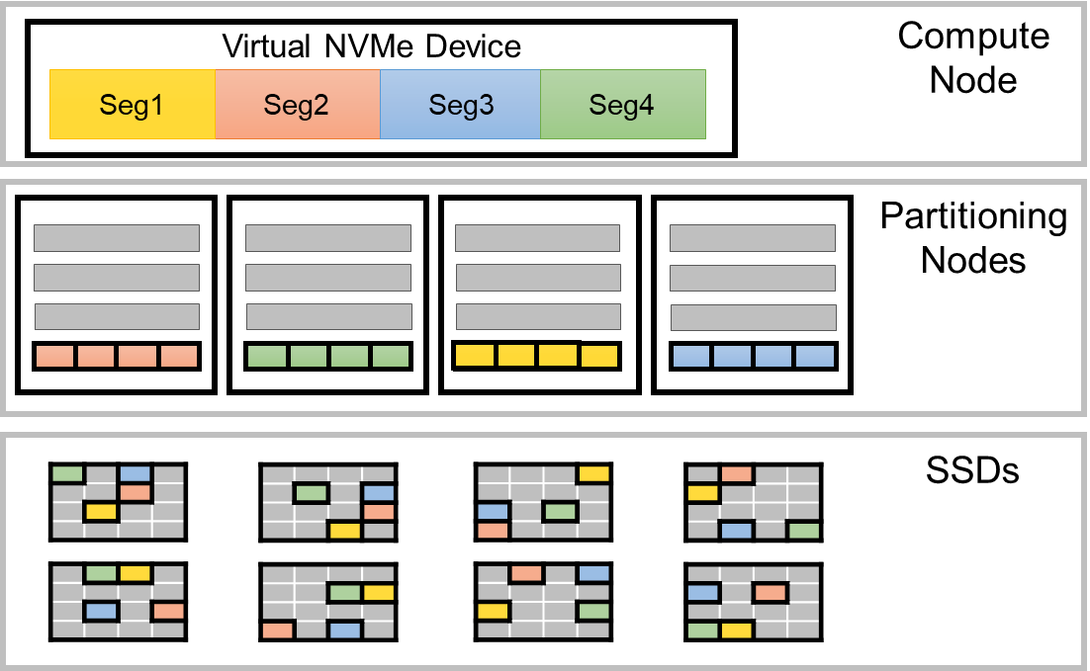
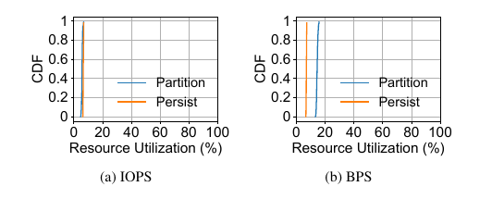
Insight 1: low utilization of backend clusters
IOPS/BPS usage is low
~78% disk capacity is used
<20% IOPS/BPS is used
Vertical CDF -> well balanced load
Virtual NVMe Device
Compute
Node
Seg1
Seg2
Seg3
Seg4
Partitioning
Nodes
SSDs
Notes:
Starting from the persistence layer and partitioning layer. Our first insight is although 78% disk capacity is used, IOPS and BPS utilization is extremely low and the CDFs are almost vertical lines. (Click) This is because our data placement strategy balances the load at both layers. So we conclude that we have plenty of resources available at the backend layers.

Slide 7
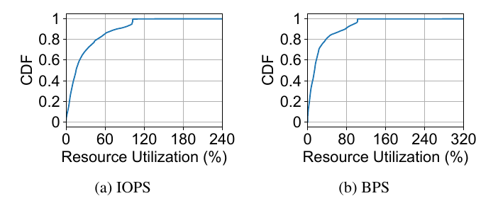
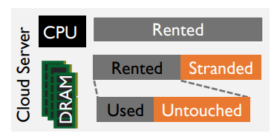
Insight 2: diverse utilization of compute clusters
IOPS/BPS distribution of all tenants in a compute cluster
Over 80% of the tenants use only <50% of their provisioned IOPS/BPS
Overprovisioning tendency is common in public clouds
Long tail on the need for bursting
Pond [ASPLOS ’23]
Notes:
In contrast, IOPS and BPS usage on the compute nodes is very diverse. (Click) Over 80% of the tenants use only <50% of their provisioned IOPS/BPS. (Click) This is kind of expected because resource overprovisioning by cloud users is common. (Click) But we also observe the long tail on bursts.

Slide 8
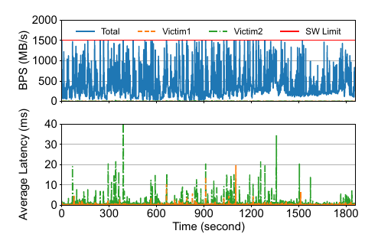

What if we just allow tenants to burst in the wild?
The base-level tenants suffer high latency
The traffic created by Victim1 and Victim2 is negligible
Overall BPS utilization reaches 100% frequently
Victims experience >10ms average latency (norm is sub-millisecond)
Why?
Notes:
So can we just let burst tenants use those idle resources? This is a 30-minute trace when some tenants were bursting. (Click) Although the resource utilization of the victims is extremely low, (Click) we still observe unacceptable high average latency on them. (Click) How did that happen?

Slide 9

Key component of a compute node: xDPU
I/O workflow
T0: NVMe control command arrives
T1: data moves to DPU
T1: control thread polls I/O metadata
T2: control thread finish header encapsulation and send signal
T3: send I/O when both header and data are ready
xDPU
Control Path
Wimpy CPUs
Data Path
SA Control
Thread
SA Control
Thread
SA Control
Thread
User VM
poll
control
NIC
FPGA
SA
DMA
/dev/nvme1n1
/dev/nvme2n1
Dataplane
NVMe Driver
Bottlenecks
Wimpy CPUs
Interconnects: PCIe + NIC
Backend
Cluster
PCIe Bus
Notes:
Storage virtualization is handled by xDPU on the compute node to save powerful host CPUs for VM usage. xDPU is an SoC which has wimpy CPU cores, NIC, and FPGA. We take NVMe Write as an example to explain how it works. (Click) After NVMe command arrives at FPGA, (Click) FPGA starts copying data assisted by DMA engine, (Click) at the same time, A control thread running on a wimpy CPU polls I/O metadata. (Click) And when it finishes header encapsulation, it notifies the dataplane. (Click) When both header and data are ready, the packets are dispatched to the backend. (Click) In this workflow, each component on xDPU can become congested.

Slide 10

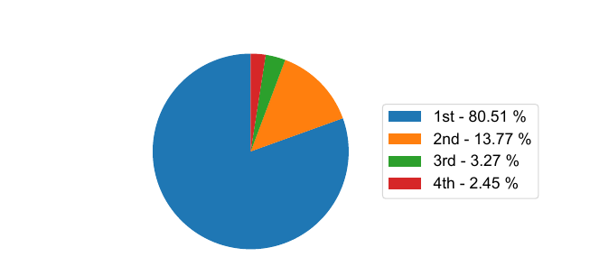
Insight 3: load imbalance on xDPU
An illustrative example of load imbalance
User VM1
User VM2
vCPUs are not evenly used
>80% of the I/Os are processed by the busiest core on 4-core VMs.
CPU
1-1
CPU
1-2
CPU
1-3
CPU
1-4
CPU
2-1
CPU
2-2
CPU
2-3
CPU
2-4
NVMe Device 1
NVMe Device 2
IMPACTED
BURST
PCIe Bus
SA Control
Thread 1
SA Control
Thread 2
SA Control
Thread 3
SA Control
Thread 4
SA Control Plane
Notes:
The major source of congestion comes from load imbalance. In this example, I/Os from CPU 1-1 and 2-2 are both mapped to control thread 1, (Click) when CPU 1-1 starts bursting, (Click) I/Os from CPU 2-2 are impacted. (Click) And based on our observation, load among vCPUs can be very skewed.

Slide 11
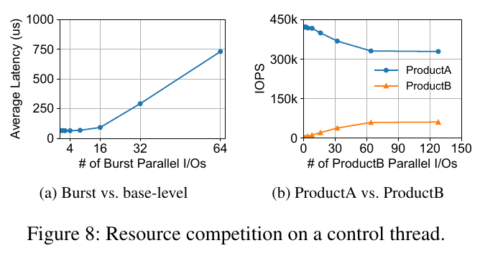
Insight 4: resource competition on xDPU
Case 1: victim latency at burst
Within a thread, higher burst results in latency increase of victims
Case 2: different products
Different products vary in their ability to compete for resources
Notes:
Even without load imbalance, interference also happens when multiple tenants competing for resources. On the left side, we increase the I/O parallelism of a neighbor tenant, average latency quickly increases after a certain point. On the right side, We have two generations of virtual disks running on the same compute node, we keep increasing the I/O parallelism of ProductB disk while keeping ProductA disk parallelism unchanged. Apparently, ProductB is at a disadvantage when competing with ProductA.

Slide 12
Opportunity, challenges, and goal
Non-bottleneck: low backend resource utilization
Opportunity: diverse utilization on compute nodes
Challenge 1: load imbalance among threads
Challenge 2: undesired resource allocation within a thread
We need to design an I/O scheduling system on xDPU that:
1) keeps the load balanced among threads to avoid congestion;
2) and allocates resources with a thread to support burst and limit tenant interference.
Notes:
With these findings, to provide burst capability with interference minimized, (Click) we need an I/O scheduling system on xDPU to keep load balanced among threads and also allocate resources for tenants within a thread.

Slide 13
BurstCBS Overview
SA Control Plane
SA Control
Thread
High-Perf
Queue Scaling
Inter-thread load balance
SA Control
Thread
FPGA
SA Data Plane
Burstable I/O Scheduler
SA Control
Thread
Intra-thread
scheduling
Vectorized I/O
Cost Estimator
SA Control
Thread
Notes:
Our system BurstCBS consists of three parts, (Click) high-performance queue scaling for efficient load balancing, (Click) and burstable I/O scheduler with vectorized I/O cost estimator for intra-thread scheduling.

Slide 14
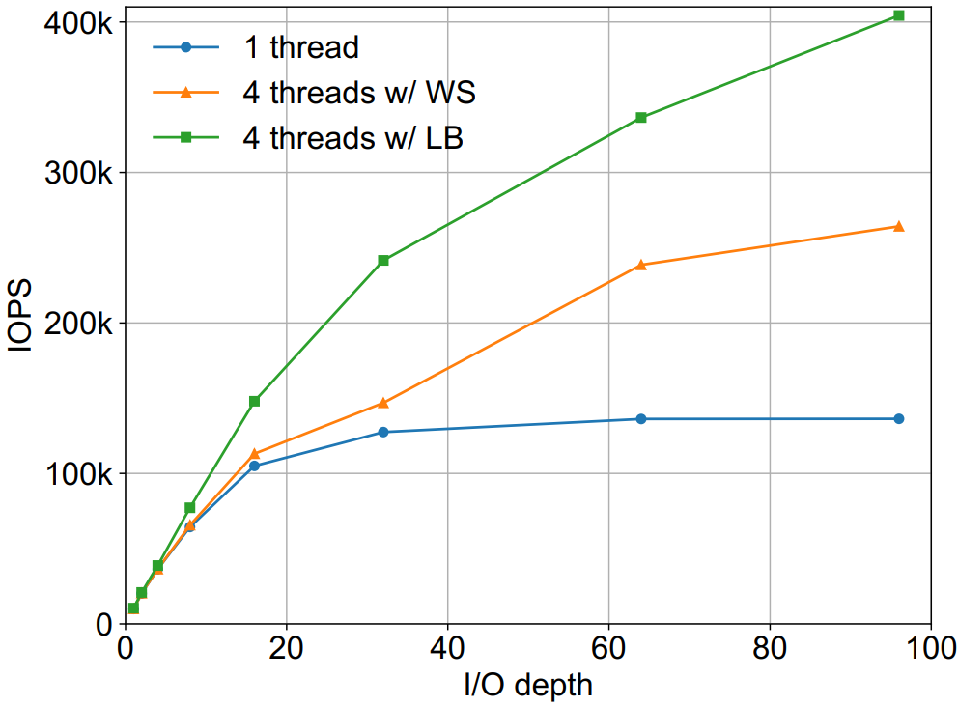
FPGA-assisted inter-thread load-balancing
1-to-1 mapping
Causes load imbalance when a vCPU starts bursting
Work stealing can alleviate load imbalance
~35% throughput loss
1-to-N mapping
Always load balanced
At line rate with no throughput loss
Consumes more FPGA resources
wimpy core
wimpy core
wimpy core
wimpy core
SA Control
Thread 1
SA Control
Thread 2
SA Control
Thread 1
SA Control
Thread 2
Egress
Queue
1
Egress
Queue
3
Egress
Queue
2
Egress
Queue
4
Egress
Queue
1-1
Egress
Queue
2-1
Egress
Queue
1-2
Egress
Queue
2-2
Ingress
Queue 1
Ingress
Queue 2
Ingress
Queue 3
Ingress
Queue 4
Ingress
Queue 1
Ingress
Queue 2
vCPU
vCPU
vCPU
vCPU
vCPU
vCPU
Notes:
On xDPU, FPGA acts as a switch. With limited FPGA resource, xDPU only has one egress queue per ingress queue. (Click) When a vCPU bursts, load imbalance happens. (Click) A common approach to mitigate load imbalance is work stealing. (Click) However, in our current setup, it incurs about 35% throughput loss. (Click) To achieve load balancing at line rate, we added more FPGA resource for our newest version of xDPU to support more egress queues per ingress queue, so I/Os from one egress queue can be evenly distributed to the threads at line rate.

Slide 15
Efficient tiered memory pooling
I/O memory buffer lifecycle
Main goal is to avoid slow & heavy operations on the critical path
VM/VD/IOQ metadata prefilling becomes non-trivial for supporting 1m+ IOPS
Two-tier memory pool to avoid prefilling while supporting more I/Os
Memory allocation
Infrequent path
Prefill metadata
Memory allocation
Memory allocation
Critical path
Critical path
Retrieve from global memory pool
Add to global memory pool
Add to memory pool
Retrieve from memory pool
Add to memory pool
Retrieve from memory pool
Prefill metadata
Critical path
I/O queue ↑ ↑ ↑
# of I/Os per queue ↓ ↓ ↓
Add to IOQ memory pool
Retrieve from IOQ memory pool
I/O processing
Prefill metadata
I/O processing
I/O processing
Global memory pool
I/O Queue dedicated memory pool
Notes:
However, this approach creates pressure on memory management. The main goal of memory management is to avoid memory allocation on the critical path. So we used to keep a shared memory pool at initialization. (Click) When we attempt to support millions of IOPS on a single node, we discover that prefilling VM, Virtual Disk, or I/O queue related information also impacts the performance, therefore we separate the shared pool into I/O queue dedicated pools, so we can prefill buffers only once. (Click) With more queues added, we have fewer memory buffers per queue, which limits number of parallel I/Os we can support. (Click) To combine the benefits of both solutions, we adopt a two-tier memory pool. Prefilling only happens when buffers are moved from the global pool to a per-queue pool.

Slide 16
Existing systems for intra-thread scheduling
BaseCBS
Isolated performance
Does not support burst
WildCBS
Support maximum burst
Latency increase on base-level tenants
VM1
I/O Loop
VM1
I/O Loop
VM2
VM2
VM3
VM3
Assume I/O queue of VM2 is always full
Notes:
With load imbalance addressed, we move onto scheduling inside a thread. There are two existing approaches at Alibaba. BaseCBS gives each tenant a fix amount of resource per loop. (Click) If a tenant does not use its resource allocation, (Click) then it‘s wasted. (Click) WildCBS instead allows burst by allowing using resources of other tenants. (Click) The problem arises when low-usage tenants and burst tenants co-exist. (Click) Because the I/O loop is quickly occupied by burst tenants, I/Os from low-usage tenants always have to wait for at least one loop to get processed.

Slide 17
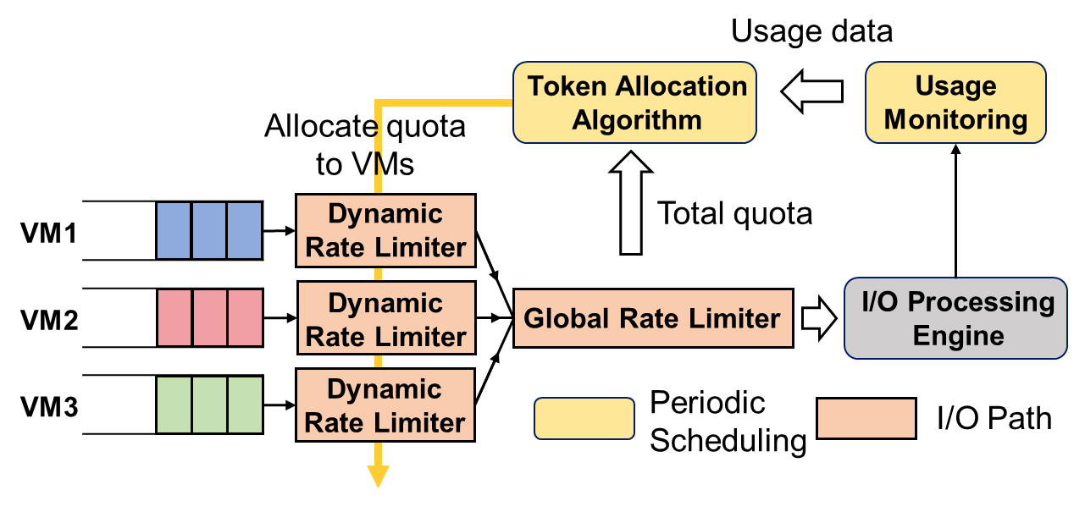
Burstable I/O scheduler
Supports burst while protecting base-level tenants
Predicts usage of next window based on statistics of last N windows
Leverages unused provisioned resources for bursting
Provide fallback mechanisms for base-level tenants protection
burst
burst
burst
burst
base
base
base
base
Shared token pool
Usage data
Token Allocation
Algorithm
Usage
Monitoring
Allocate quota to VMs
Dynamic Rate Limiter
Total quota
VM1
VM2
Dynamic Rate Limiter
Global Rate Limiter
I/O Processing
Engine
VM3
Dynamic Rate Limiter
Periodic
Scheduling
I/O Path
Notes:
To support burst while protecting performance of base-level tenants, we propose burstable I/O scheduler. Burstable I/O scheduler predicts usage of next window based on historical stats. (Click) If a tenant uses less resource than its base-level provisioning, (Click) we try to reduce its allocation; The idle resources are then allocated to burst tenants. (Click) We repeat it for every scheduling window. (Click) To protect base-level tenants, they are allowed to steal resources from burst tenants. (Click) And we keep a shared resource pool for base-level tenants to fallback to. We intentionally choose a heuristic-based approach so that it only takes linear time to run each scheduling cycle and constant time to process an I/O. This is important as wimpy CPU cores of xDPU have limited processing power, a complex algorithm results in both high tail latency and lower peak throughput on a compute node.

Slide 18
Vectorized cost estimator
SSD cost estimation
SSD as a black-box
Scalar cost with linear estimation: ReFlex [ASPLOS ’17], IOCost [ASPLOS ’22]
Heterogeneity in consumed resources on xDPU
Small I/Os are bottlenecked on CPU time
Large I/Os are bottlenecked on NIC bandwidth
Scalar
Vector
I/O type | CPU time | Data egress | Admittable # of I/Os per ms (100Gb NIC) | Admittable # of I/Os per ms (CPU)
4KB write | 1.16us | 4KB | 3276 | 862
128KB write | 6.18us | 128KB | 102 | 161
Wasted
resources
Cost = max(2, 1)
Cost = <2, 1>
Notes:
But how do we describe how much resource an I/O consumes? For SSD cost estimation, as vendors provide very limited information, existing work adopts a scalar cost model with linear estimation. However, xDPU and its software are more transparent to us. We identify that different I/O patterns have different bottlenecks. (Click) If we use the the most consumed resource as the cost, (Click) there will be a significant amount of wasted resources. (Click) But if we describe cost as a vector of different resources, (Click) the overall resource utilization can be improved without causing congestion.

Slide 19
Evaluation
Setup
One compute node equipped with the newest version of xDPU
Baselines
BaseCBS & WildCBS
Workload
BPS-intensive: 4-128KB, which are the most common I/O sizes
IOPS-intensive: 4-16KB, which resembles many transactional DBs
Notes:
We conducted a comprehensive evaluation to show BurstCBS achieves the desired benefits. For all of the experiments, we use a compute node which has the newest version of xDPU. We compare with both BaseCBS and WildCBS, on different types of I/O patterns.

Slide 20
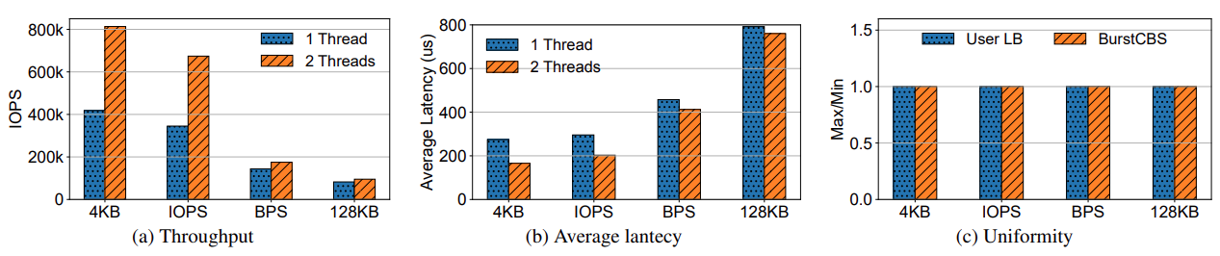
Is load balanced among multiple threads?
Linear scaling & near-perfect load balancing
Linear throughput scaling when adding more control threads
Load is balanced among all the threads
1.94x
Max/Min≈1
Notes:
BurstCBS is able to distribute I/Os from multiple control threads (Click) with near linear scaling.
And our load balancer is nearly equivalent (Click) to dispatching the same amount of I/Os from each vCPU.

Slide 21
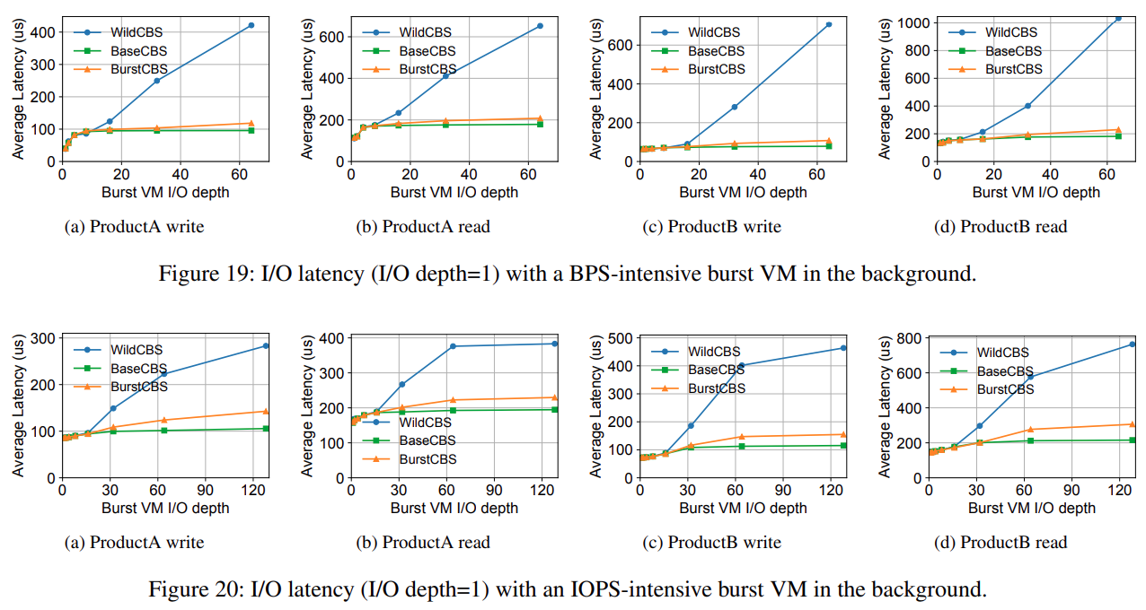
How does a burst tenant impact its neighbors?
Achieves near-ideal performance isolation
Up to 85% latency reduction
85%
IOPS-intensive workload
BPS-intensive workload
Notes:
With BurstCBS, tenant interference is also significantly reduced. When there is a burst tenant in the background, BurstCBS is able to reduce average latency by (Click) up to 85% and is very close to BaseCBS.

Slide 22
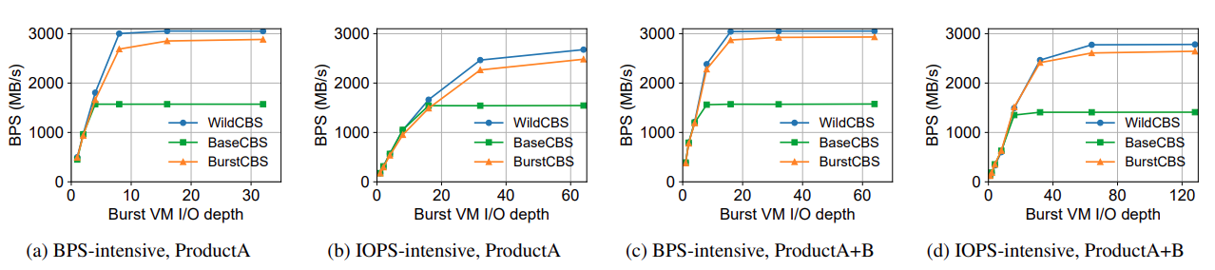
What is the maximum burst capability?
Supports similar level of burst to WildCBS
Only 5%-8% throughput loss due to global shared resource pool
Notes:
And at what cost do we achieve the performance isolation? The maximum burst capability only drops by 5-8%, which is primarily due to the shared resource pool we reserve.

Slide 23
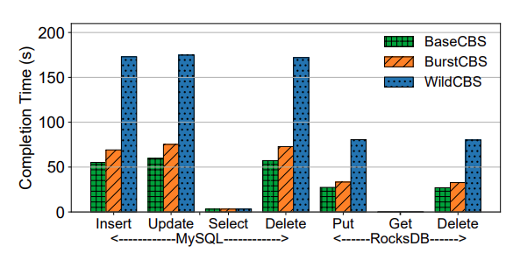
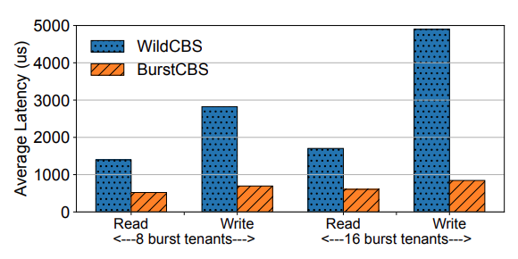
Application performance improvement
Effectively reduces latency of transactional databases
~60% latency reduction on MySQL and RocksDB write operations
Up to 83% latency reduction on our internal relational database service
Notes:
We also verify that application actually benefits from BurstCBS. We evaluated both open-source database systems MySQL and RocksDB, and our managed database service RDS. And we observe latency reduction during bursts for both cases.

Slide 24
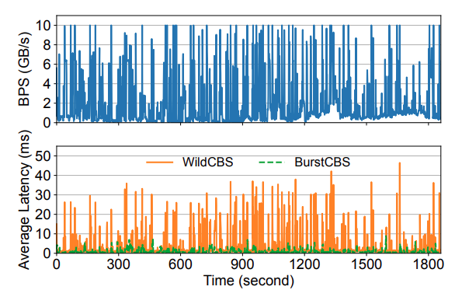
Application performance improvement (cont.)
Benefits for our internal relational database service
Average query latency: up to 47ms -> less than 10ms
Notes:
We also reproduced amplified production trace, and successfully reduce average SQL query latency from up to 47ms to less than 10ms during a 30-minute period.

Slide 25
More details in our paper
Handling of I/O cost mis-estimation
Scheduler scalability
Responsiveness to sudden tenant activation
…
Notes:
For more details, please refer to our paper.

Slide 26
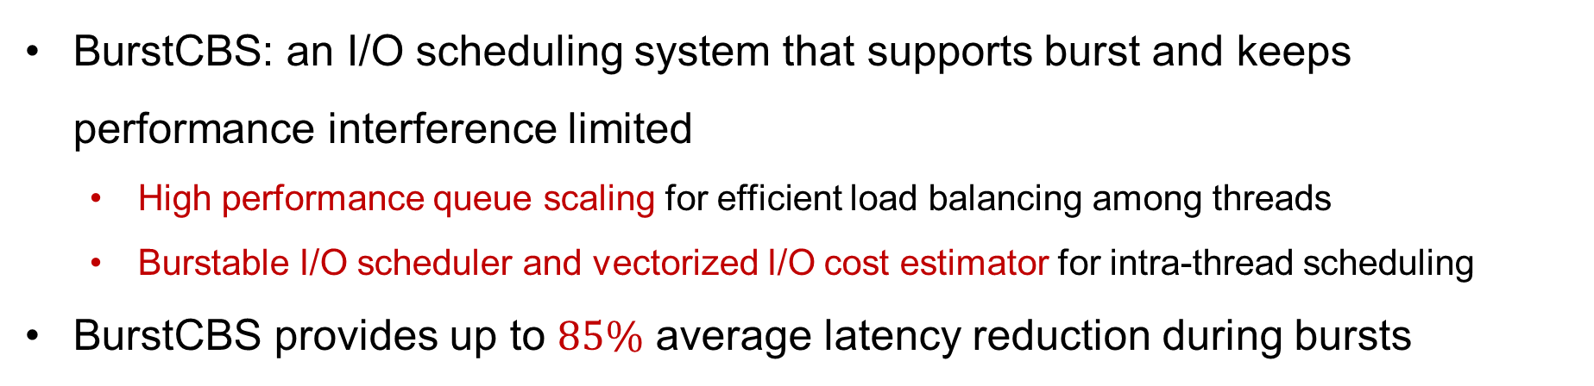
Conclusion
BurstCBS: an I/O scheduling system that supports burst and keeps performance interference limited
High performance queue scaling for efficient load balancing among threads
Burstable I/O scheduler and vectorized I/O cost estimator for intra-thread scheduling
BurstCBS provides up to $85\%$ average latency reduction during bursts
shujunyi@pku.edu.cn
Thanks!
Notes:
To summarize, BurstCBS is an I/O scheduling system that supports burst and keeps performance interference limited with low overheads. It employs high performance queue scaling for efficient load balancing, burstable I/O scheduler with vectorized I/O cost estimator for intra-thread scheduling. It provides up to 85% average latency reduction during bursts. (Click) Thanks for listening and I’m ready to take questions.

