Slide 1
Energy Generating Bikes
By: Kyle Stanevich

Slide 2
Introduction
Renewable energy
Cardio respiratory endurance
Motivations
Building the bike

Slide 3
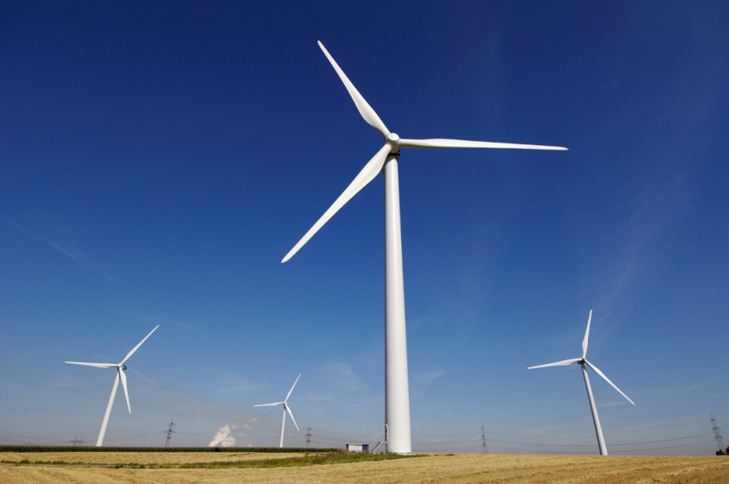
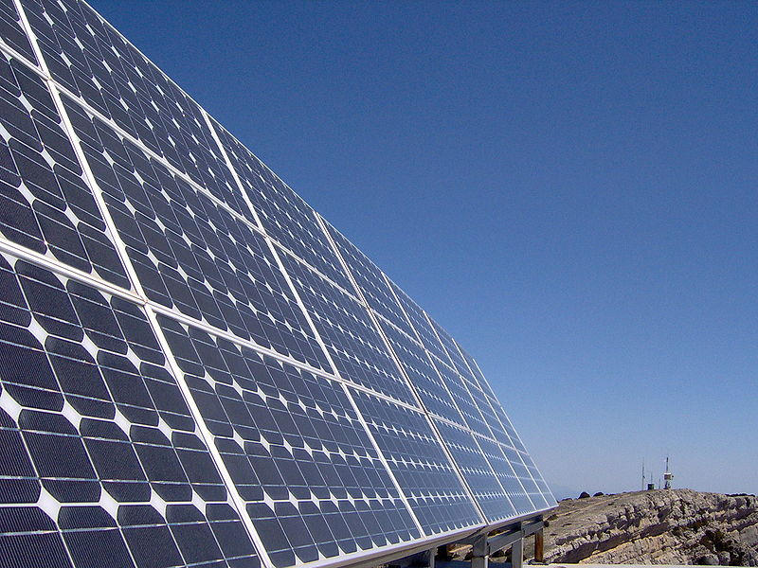
Renewable Energy
Part of the future
“Go Green” movement
New technology

Slide 4
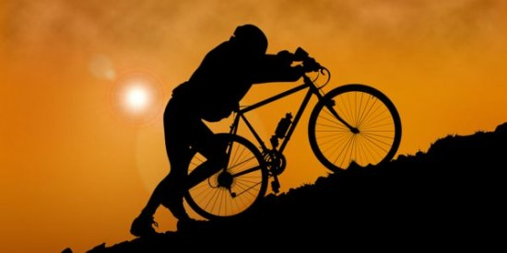
Motivations
Preform CRE exercise
Go green
Effect of the bike

Slide 5
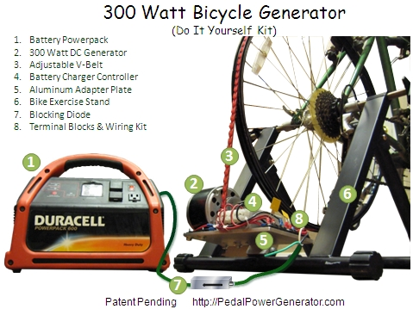
Building the Bike

Slide 6
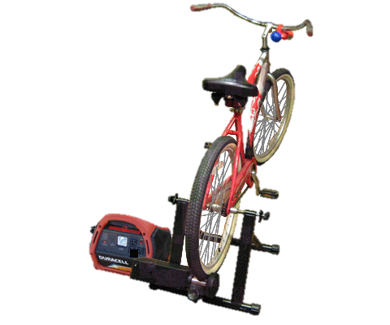

The Bike

Slide 7
Materials and Methods
Created energy generating bike
Made motivations survey
Ran Wilcoxon paired-samples test and chi-squared goodness of fit test

Slide 8
Survey Results
How motivated are you perform Cardio Respiratory Endurance (CRE) workouts?
8 | 8 | 9 | 5 | 15 | 14 | 13 | 13 | 6 | 9
How motivated are you to be "Green" in everyday life?
7 | 1 | 10 | 5 | 11 | 18 | 14 | 17 | 9 | 7
How often do you work out using CRE Machines?
12 | 15 | 19 | 10 | 5 | 11 | 12 | 8 | 4 | 2
Given opportunities daily to go green, how often do you chose these options?
0 | 1 | 7 | 9 | 12 | 10 | 15 | 24 | 13 | 8
If there was an energy generating bike for your use, how often would you use it?
5 | 4 | 8 | 13 | 15 | 15 | 11 | 12 | 6 | 9
How motivated would you be to preform CRE workouts if you could utilize an energy generating bike?
7 | 3 | 7 | 11 | 10 | 15 | 13 | 8 | 11 | 12
How motivated would you be to go green if an energy generating bike existed in the IMSA fitness center?
6 | 3 | 8 | 9 | 15 | 12 | 14 | 17 | 6 | 7
How often would you use this bike if it could charge your phone, computer, iPod, and other items for your daily use and convenience?
5 | 3 | 4 | 6 | 10 | 13 | 11 | 19 | 8 | 19
How often would you use this bike if it was used to power the needs of IMSA campus?
5 | 4 | 2 | 7 | 10 | 13 | 18 | 18 | 9 | 12
How important is the similarity of this bike compared to the non-energy producing bikes in reference to the feel of riding?
7 | 1 | 4 | 7 | 14 | 15 | 8 | 19 | 13 | 11

Slide 9
Go Green Results
No significant difference
T+=14.5, T-=13.5, n=10, .10<P<.20

Slide 10
CRE Results
No significant difference
T+=24, T-=23, n=10, P>.5

Slide 11
Discussion
Adding the bike had no apparent effect on the motivations.
Not expected
Because:
  No bike to actually use
  Bike has disadvantages

Slide 12
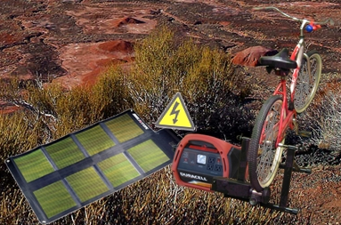
Future Studies
Complete building the bike
Optimizing the bike
Economic advantages for energy generating bikes

Slide 13
Acknowledgments
Mr. Gentzler
Mr. Lawrence
SIR staff
Students who took my survey
Any question?

