Slide 1

Analyzing Factors that Affect Sleep Duration
By: Kyle Tam & Andre Smith

Slide 2
Project Overview
Problem Statement
Why It Matters
This project examines how demographic, behavioral, and health-related factors such as age, physical activity, stress level, and BMI affect sleep duration. The objective is to identify which variables are most impactful in order to better understand patterns associated with healthy sleep.
Sleep plays an important role in physical health, mental health, and daily performance.
Understanding the factors that influence sleep can help identify healthier lifestyle choices.

Slide 3









Dataset Overview
Age
Gender
Physical Activity
Patient age in Years
Male / Female
Daily activity level
Stress Level
BMI
Blood Pressure
Self reported 1-10
Body Mass Index
Systolic / Diastolic
Stress Level
Heart Rate
Daily Steps
Sleep Disorder
Beats per minute
Steps walked per day
None / Insomnia / Apnea

Slide 4
Data Cleaning & Preprocessing
01
02
Data Cleaning
Preprocessing
Removed duplicate rows
Replacing inconsistent BMI labels
Filled missing values for sleep disorder
Split blood pressure into systolic and diastolic values
Encoded gender as numerical values (0 and 1)
One-hot encoded BMI categories
One-hot encoded sleep disorder categories
Standardized numerical variables
Performed train / test split

Slide 5
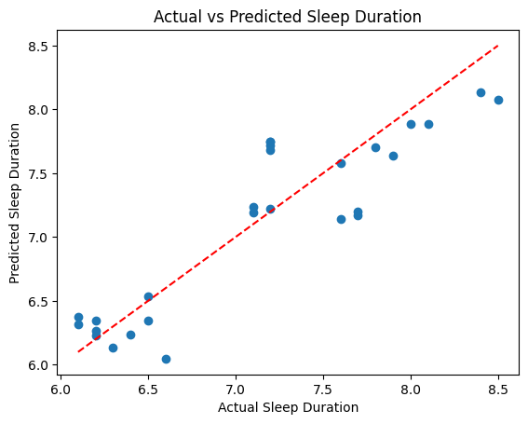
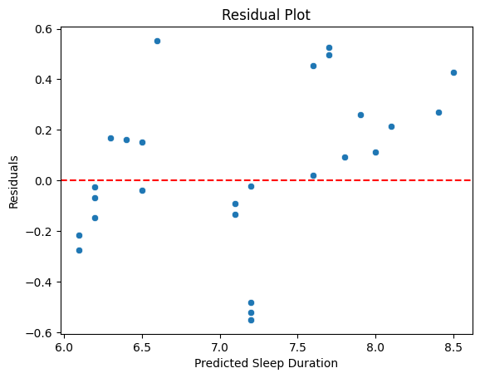
Multivariable Linear Regression
Model Performance
R² = 0.806
RMSE = 0.322
Top Coefficient
BMI Overweight: -0.608
Stress Level: -0.384
Physical Activity: 0.265

Slide 6
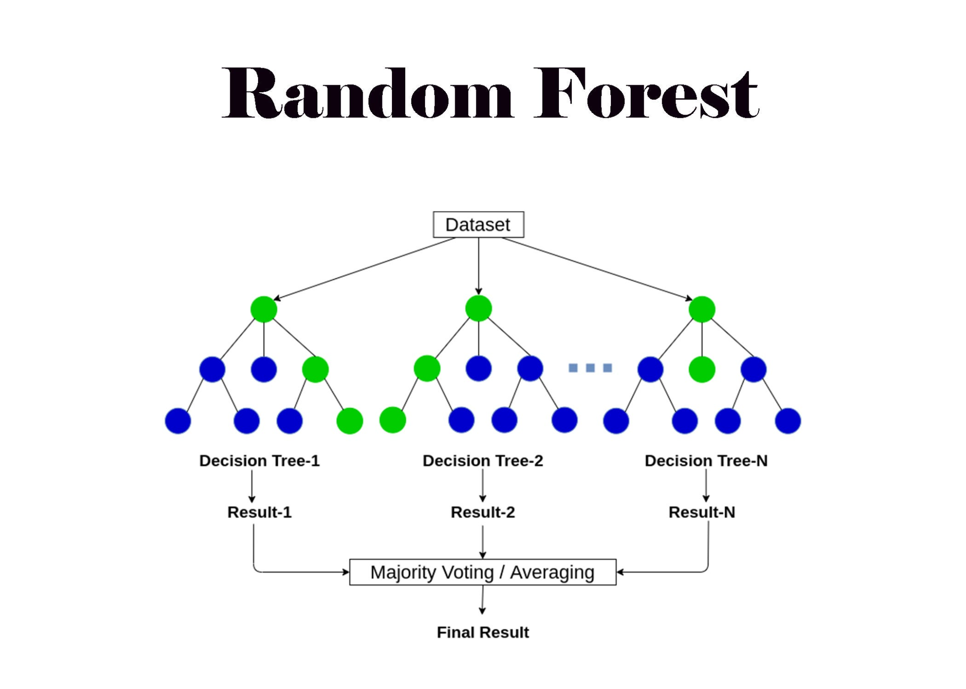
What is Random Forest?
What is it?
A machine learning model made up of many decision trees
How does it work?
Each tree learns patterns from the data
Each tree makes a prediction
The final prediction is the average of all trees
Why use it?
More accurate than simple models
Captures complex relationships between variables

Slide 7
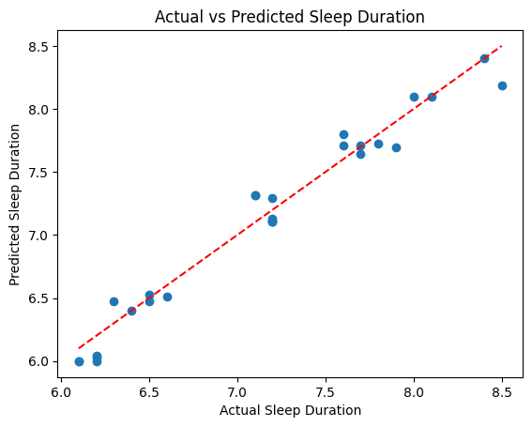
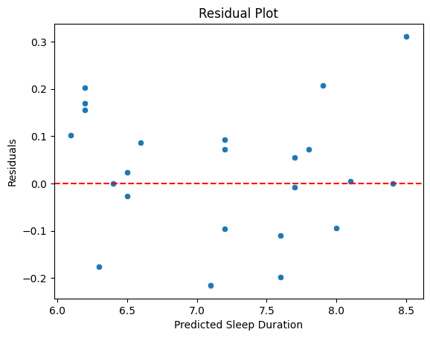
Random Forest Model
Model Performance
R² = 0.965
RMSE = 0.136
Top Importance
Stress Level: 0.711
Physical Activity: 0.135
Age: 0.081

Slide 8
Model Comparison
Model Performance
R² = 0.806
RMSE = 0.322
Linear Regression
Model Performance
R² = 0.965
RMSE = 0.136
Random Forest
Interpretation
Random Forest achieved higher predictive accuracy
Lower RMSE indicates smaller prediction errors
Suggests nonlinear relationship exist in the dataset
The Random Forest model captures more complex relationships than linear regression.

Slide 9


Conclusion
Strongest Positive Factors
Strongest Negative Factors
Weakest Factors
Physical Activity Level
Age
Stress Level
BMI (Overweight)
Sleep disorder
Heart Rate
Overall, stress level and physical activity were the most influential predictors of sleep duration across both models.

Slide 10




Future Work
1
2
3
Larger Dataset
Additional Variables
Sleep Quality
Using a larger and more diverse dataset could improve the model’s reliability and generalizability.
Incorporate additional variables that may influence sleep, such as lifestyle habits and living conditions, to better understand their impact.
Future studies could focus on predicting sleep quality in addition to sleep duration to get a more complete understanding of sleep health.

Slide 11
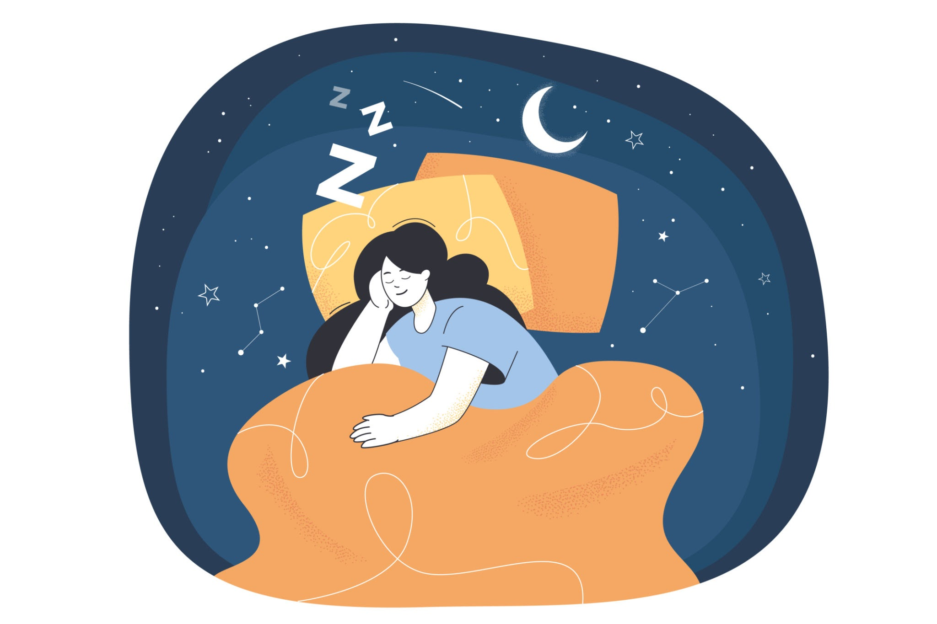
Thank You
Questions?

