Slide 1
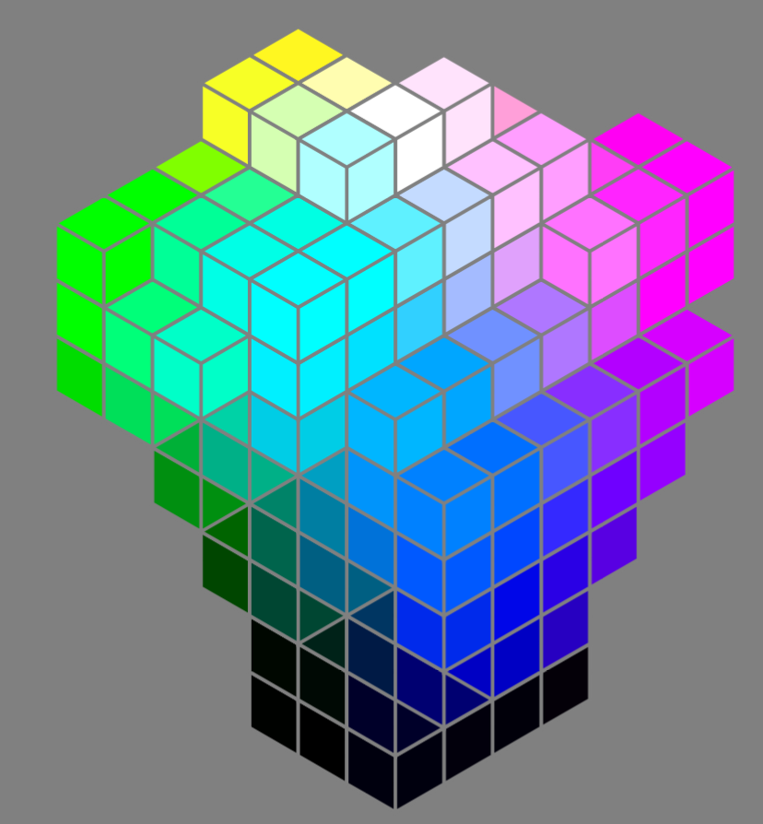
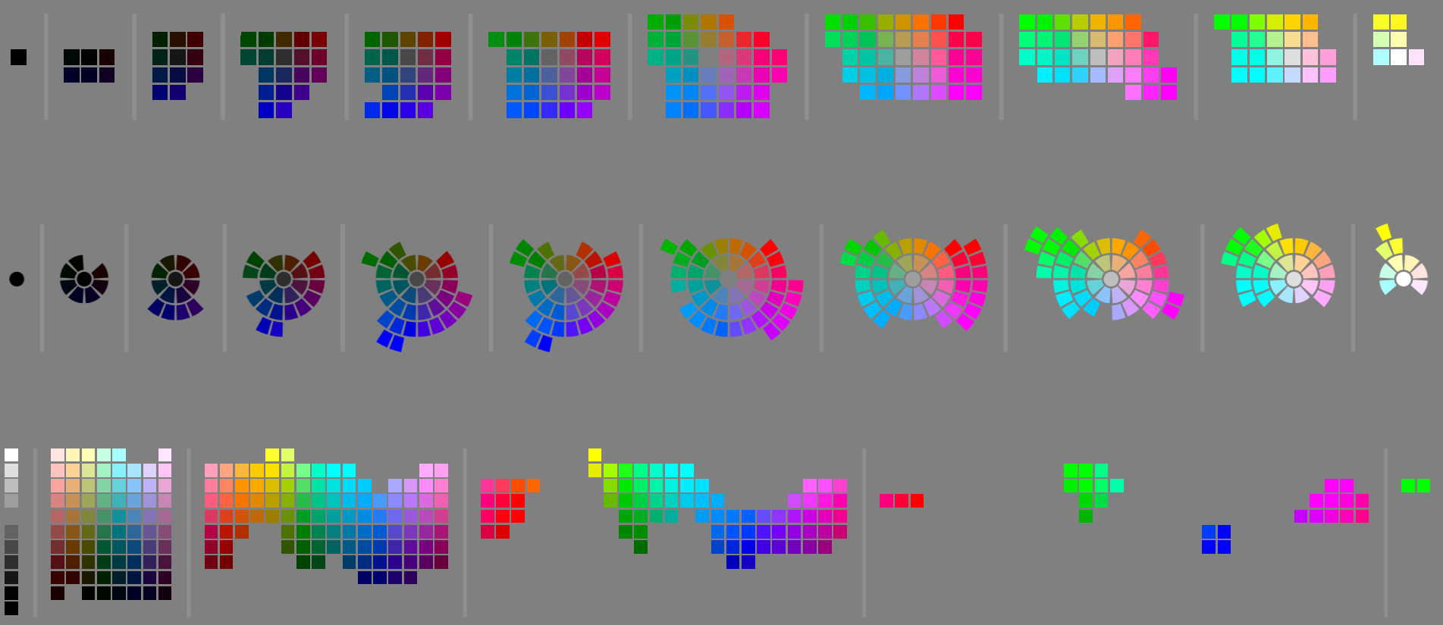
Oklab bins
b
L
a
b
a
L=0
L=0.1
L=0.2
L=0.3
L=0.4
L=0.5
L=0.6
L=0.7
L=0.8
L=0.9
L=1
h
b
Oklch bins
c
a
L=0
L=0.1
L=0.2
L=0.3
L=0.4
L=0.5
L=0.6
L=0.7
L=0.8
L=0.9
L=1
L
L
b
a
h
L
h
c
c=0
c=0.1
c=0.2
c=0.3
c=0.4
c=0.5

Slide 2

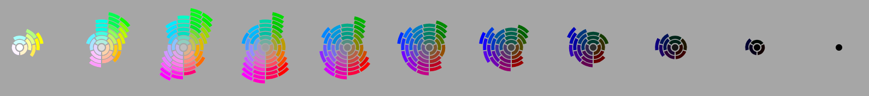
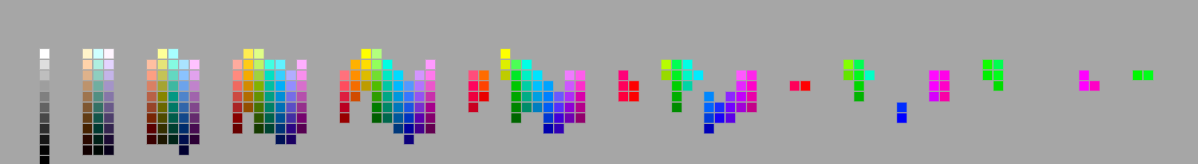
HDR rec2020 colors in Oklab and Oklch space
Oklab space – bins are l,a,b .1x.1x.1 cubes
a
L=1
b
L=0
Oklab space – spatially equal size bins (following h,c arcs)
a
L=1
b
L=0
Oklch –same bins as above, but shown in Oklch space
L
h
c=.475
c=0

