Slide 1


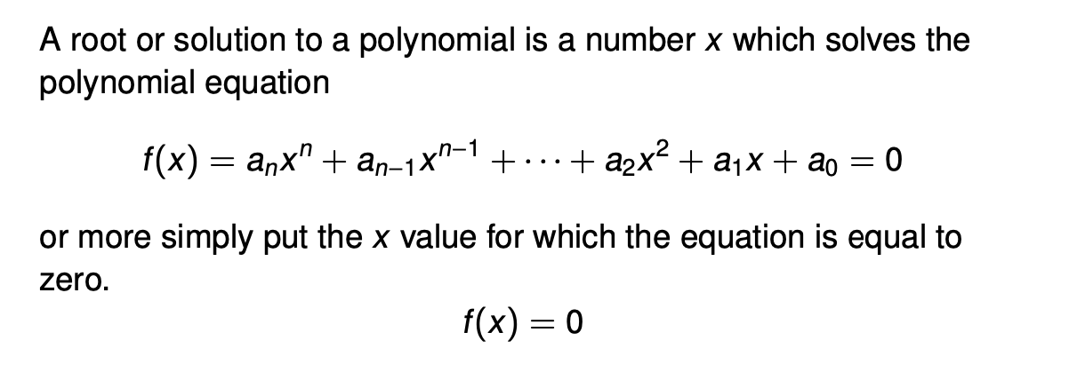
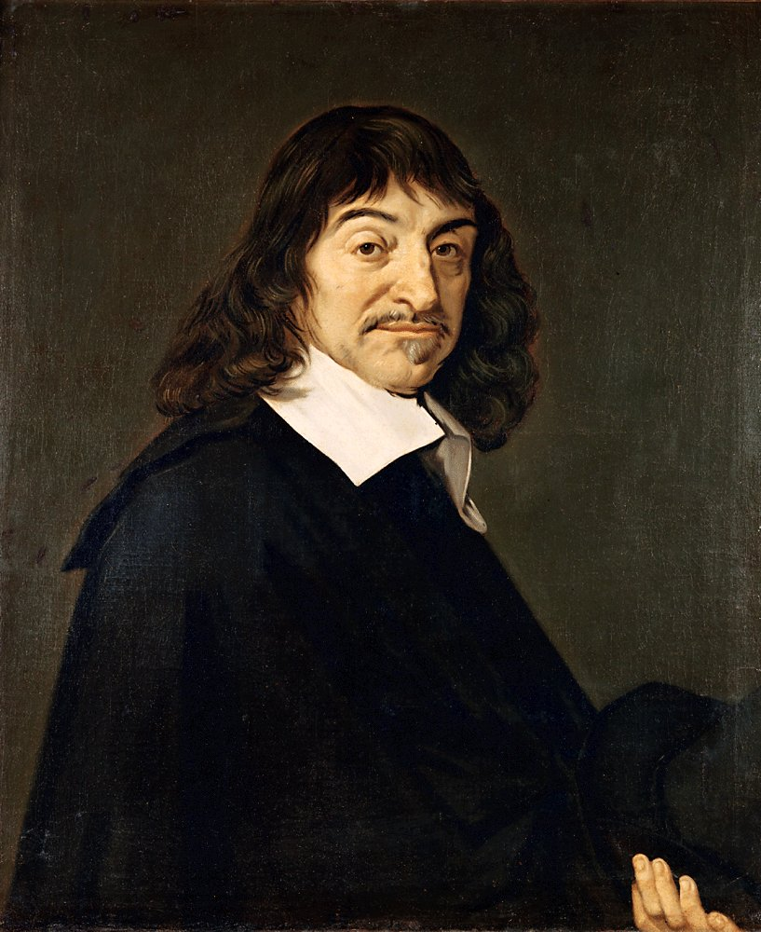
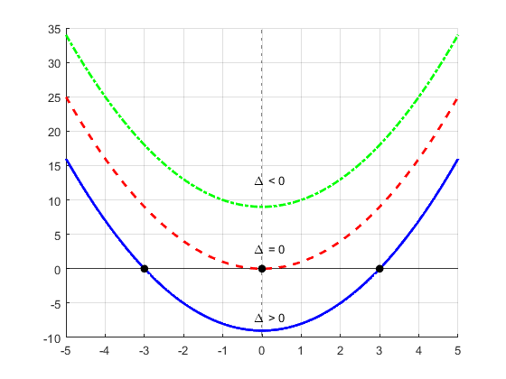
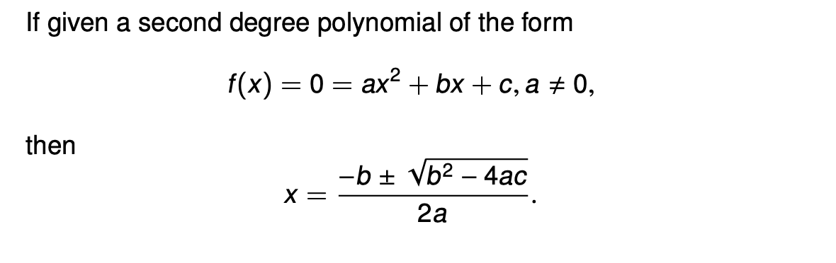
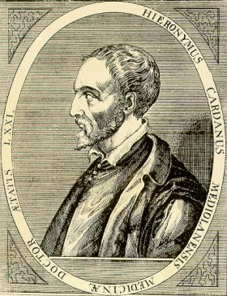
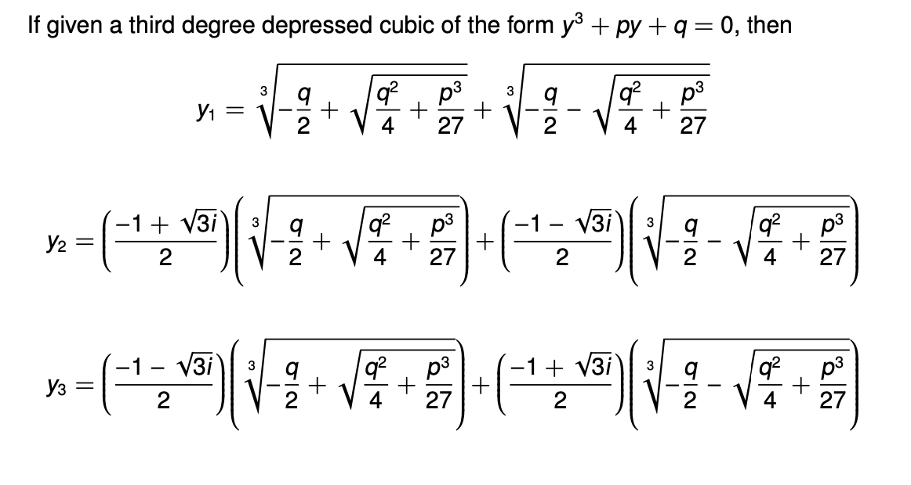
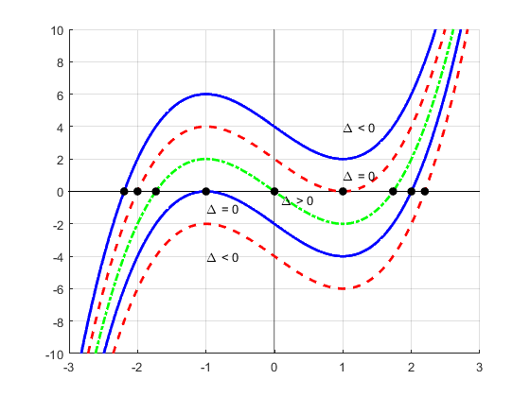

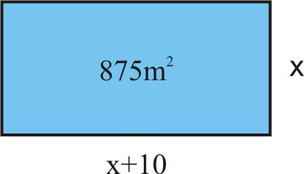
Roots of Polynomials and Computational
Speed of Resulting Algorithms
Kyle Thibodeaux
Endicott College, School of Arts and Sciences, Mathematical Department
Background
Definition of a Polynomial
Computational Speed Testing
Brahmagupta was an Indian mathematician and astronomer who lived in the seventh century. Brahmagupta also was one of the first mathematicians to recognize negative numbers as well, which later helped him point out that quadratic equations can have two solutions if one of the solutions was a negative number. He was also credited as being the first person to discover a general solution to a quadratic equation.
Quadratic Formula
René Descartes is a French mathematician who published the well known version of the Quadratic Formula in La Géométrie. Descartes lived in the seventeenth century and was regarded as one of the most integral mathematicians in combining both geometry and algebra. Descartes was the first mathematician to represent the horizontal direction on a plane as x and the vertical direction on a plane as y.
Conclusion
Gerolamo Cardano was credited with the discovery of the Cubic Formula and the Quartic Formula both published in Ars Magna, however he was not the discoverer of either of the formulas. The general solution for a cubic equation was apparently discovered by Scipione del Ferro in the late 1400's, who never published his findings. The solution found its way through word of mouth through several other mathematicians before Cardano, who eventually published the solution.
Cardano’s Formula
Real World Applications
History
Quadratics are some of the most common equations that are found in real world settings. Quadratics were originally thought to be first solved around 2000 B.C. by the Egyptian, Chinese and Babylonian engineers. The story goes that these engineers when considering what they were building they knew what the total area of their design needed to be.
Acknowledgements
I would like to thank Dr. Christopher McDaniel his guidance and knowledge helping me navigate this topic. I would also like to thank the rest of the Mathematics and Computer Science department for helping me complete a successful four years at Endicott!
They also know what proportions their side lengths needed to be as well; however, they did not know hat size of the lengths of the side would be required to satisfy these designs. Therefore, the need to find the lengths of sides to satisfy certain design was thought to be the first example of a quadratic function.

