Slide 1
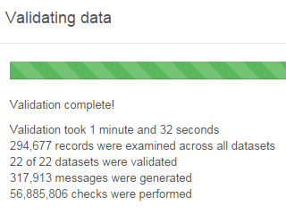
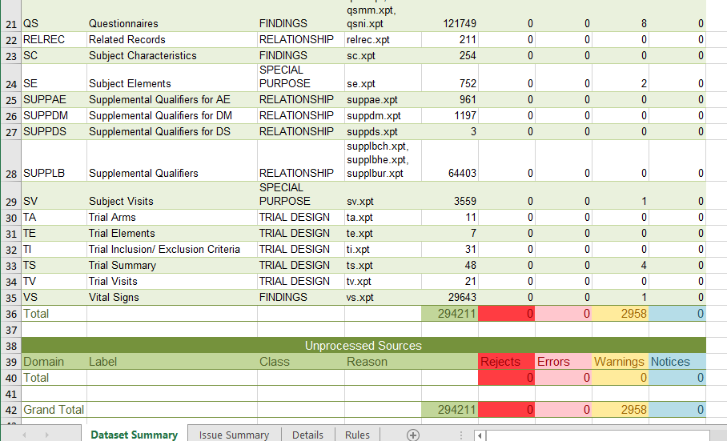
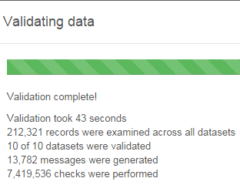
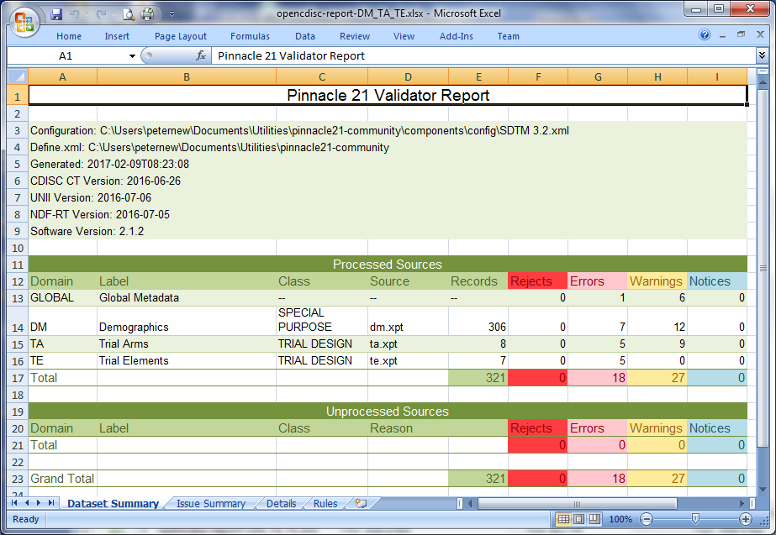
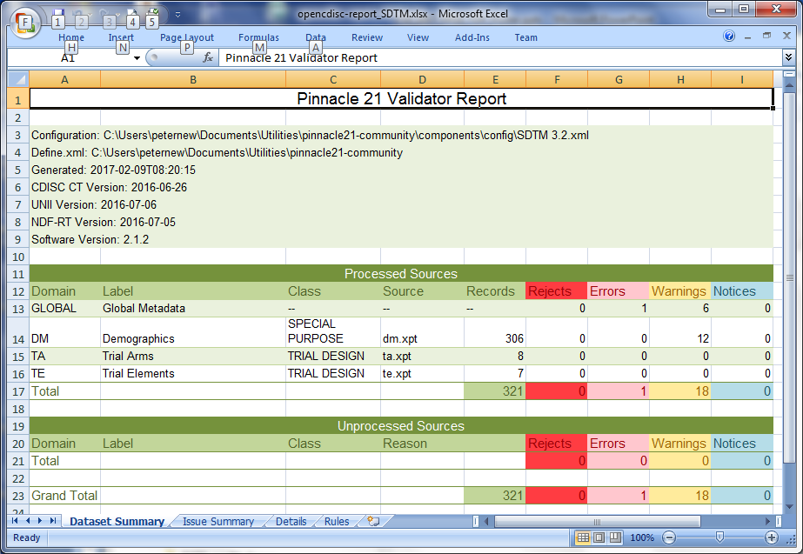
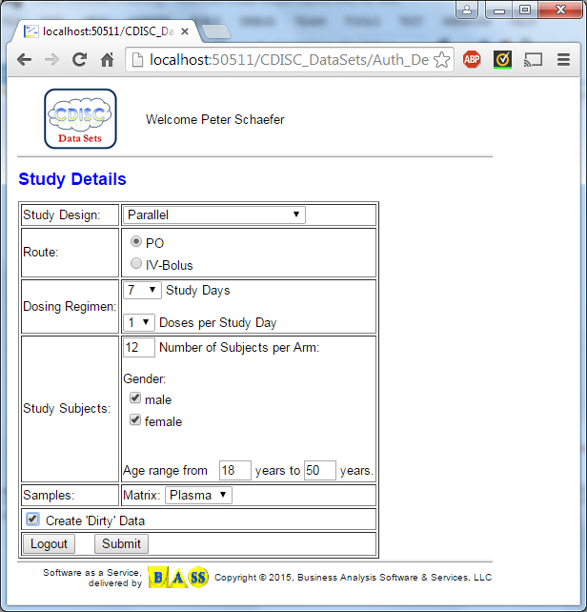

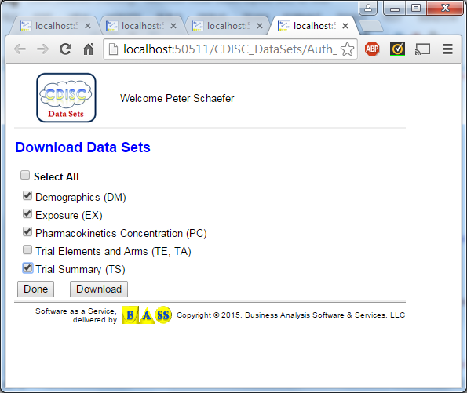
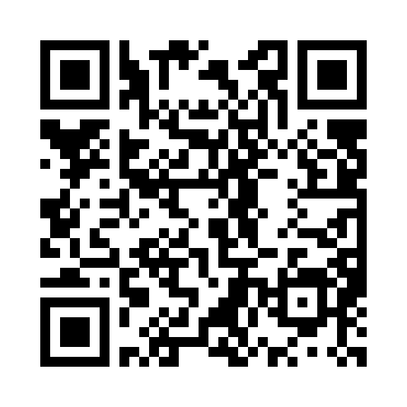
One Year Later – Results of the Test Data Factory (TDF) Project
Peter Schaefer (VCA-Plus) and the TDF Team
The Test Data Factory project is part of the “Standard Analyses and Code Sharing” Working Group. With this project, the working group has acknowledged that testing with appropriate test data is an essential part of any solution development. The objective of the TDF team is to provide test datasets including appropriate documentation of deviations from the standard specification that can be used by anyone for their testing effort. To produce some usable test datasets quickly, the project team decided to start with updating the CDISC Pilot datasets to comply with current versions of the CDISC standards.
At this point, the project team has nearly completed the update of the SDTM and ADaM datasets of the CDISC pilot and some insights into what has been done are provided below. In addition, the poster will outline a vision for provisioning test datasets based on simulation of medical research studies and the creation of datasets based on user input about the test datasets to be created.
Updating the CDISC Pilot Datasets
More than 10 years ago the CDISCPILOT01 study was created – a de-identified study provided by a large pharmaceutical company to test the then current versions of SDTM and ADaM for their usefulness in submitting and reviewing study data. Even now, in many cases the CDISC Pilot02 study is still a reference and starting point when CDISC-based processes and systems are developed and tested.
But are the datasets in the CDISC Pilot really good for testing?
BEFORE Validation of CDISC Pilot study datasets created many errors and warnings.
AFTER
The goal:
Update datasets to pass validation using Pinnacle 21 Community Edition.
Explain remaining validation warnings
Publish datasets and documentation in Github
SDTM
ADaM
These are just ‘formal’ validation errors
Many are rather easy to fix
We also found ‘content’ errors; these will require us to generate additional data
Typical issues:
Trim variable length
Add or correct Controlled Terminology
Correct variable labels
Add missing variables
Status of the CDISC Pilot Update
Achievements and ToDo’s:
22 SDTM datasets were updated and documented, including define.xml
Most of the 10 ADaM datasets were updated
Need to finalize define.xml and documentation
Available at https://github.com/phuse-org/phuse-scripts/tree/master/data/sdtm/updated_cdiscpilot
Out-of-scope:
Update of CRF, protocol
Creation of additional datasets
The Team This Poster
Nancy Brucken, Syneos Health Scan this to download
Jessica Dai, Vertex a copy of this poster.
Cynthia Stroupe, UCB
J. J. Hantsch, Biorasi
Tania Walton
Peter Schaefer, VCA-Plus
What’s Next: Our Vision for the TDF Project
What if we could create tools that allow a user to describe what kind of test datasets are required and have the tools create these datasets? SDTM domains that are requested, with consistent observations and optional features like ‘dirty’ data? And even the resulting ADaM datasets?
Creating CDISC test datasets is the idea of the interactive “PhUSE Test Data Factory”, which is essentially the longer-term vision of the TDF project:
User enters details of the study specification in a web browser UI
Cloud-based applications are executed to generate the study data based on this input
CDISC datasets are created as xpt files and can be downloaded to the user’s desktop
Need to create data sets and use for testing
start “PhUSE TDF”
System settings should be user-defined in a production release
enter study specification
“SUBMIT”
“PhUSE TDF” creates domain data sets
Should be SAS Transport (xpt) files in a production release
download data sets and use for testing
We believe it’s time to start working on this!!!
Summary
The TDF team exists to provide CDISC test datasets as an important contribution to the development and deployment of CDISC-based solutions. Updating the CDISC Pilot datasets might not seem like a big step, but we wanted to walk before we run and contribute useful results quickly.
Certainly, the idea of a software tool that enables users to ‘generate’ test datasets – a really interactive “Test Data Factory” – is somewhat of a dream. However, because the technology is available and similar concepts have been used in other application areas we will be working on this and to see can be achieved.
Contact: Peter Schaefer, pschaefer@vca-plus.com

