Slide 1
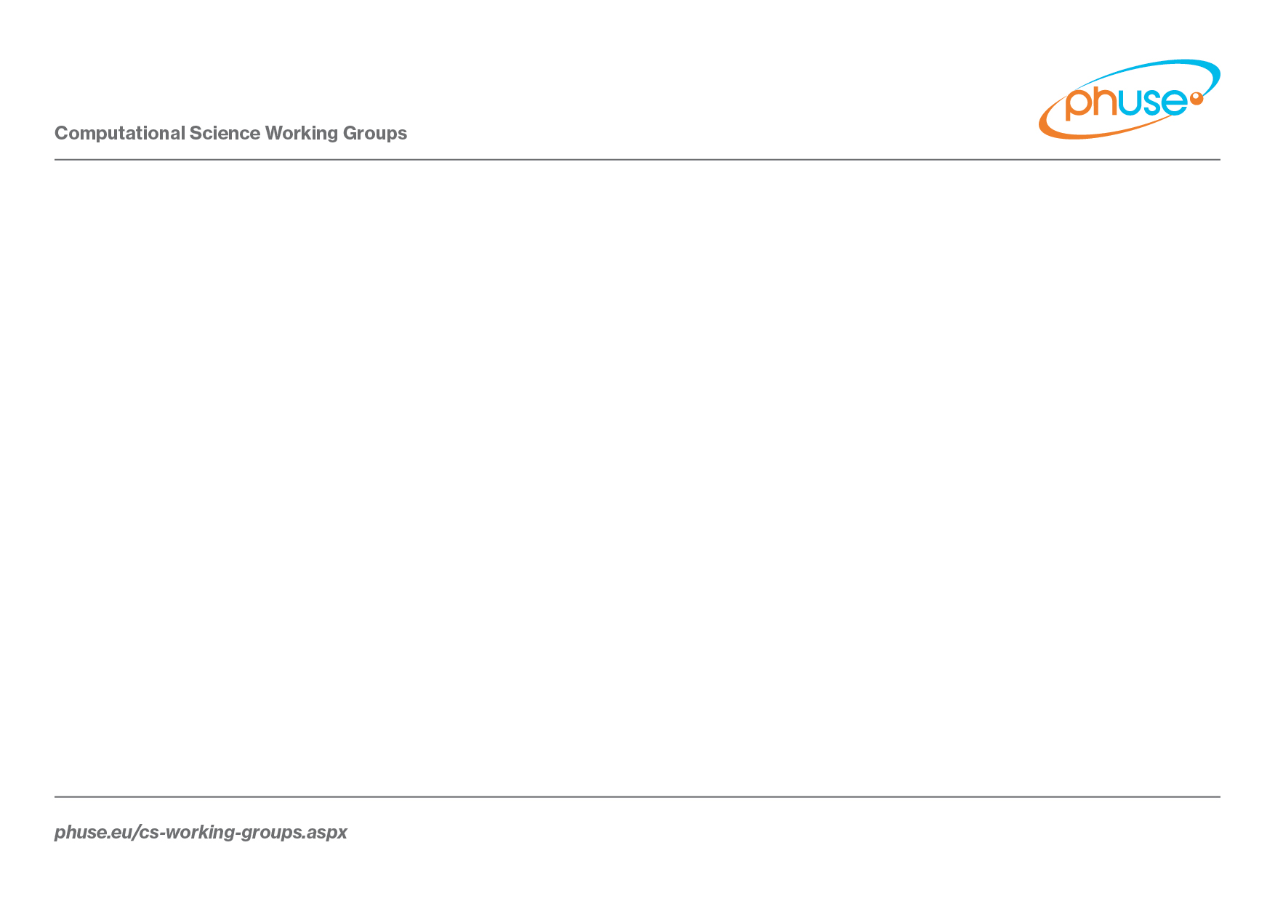
Standard Analyses & Code Sharing
Test Data Factory Project
Peter Schaefer

Slide 2
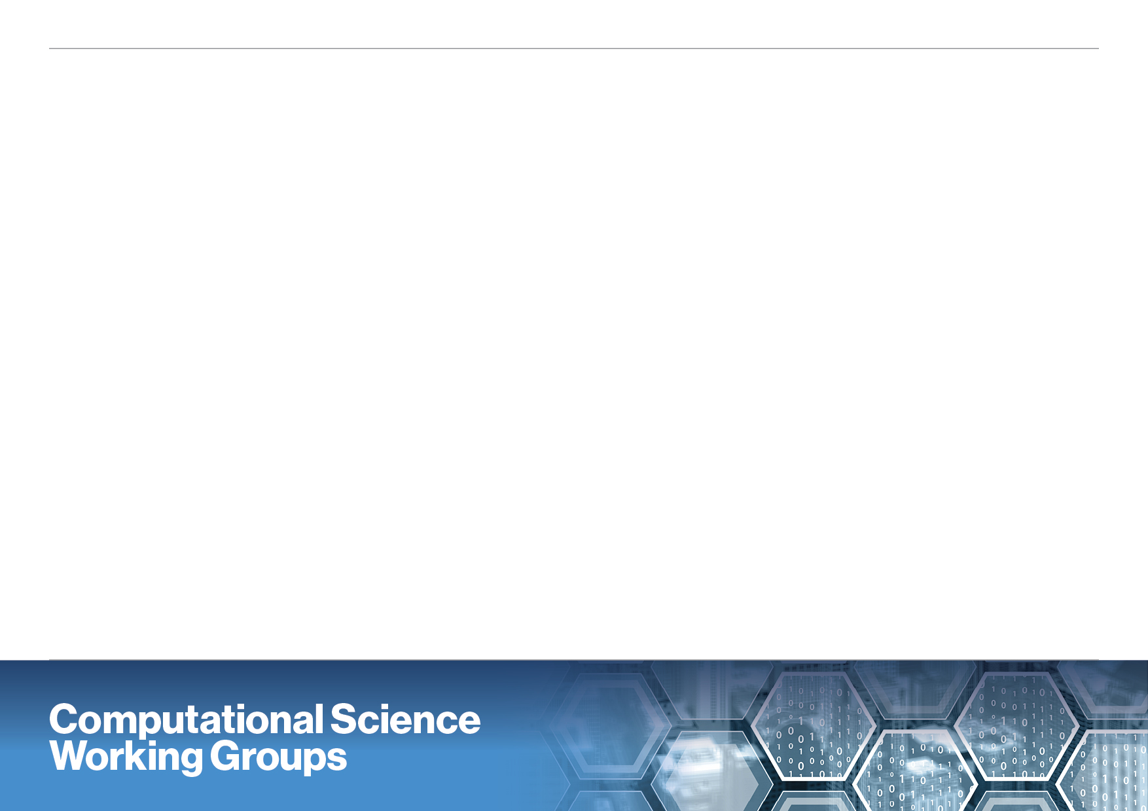
Background
Several PhUSE projects develop scripts or concepts that need to be tested with CDISC datasets
When implementing CDISC-based systems or processes you’ll need to data for testing.
Use of CDISC pilot (outdated) and sanitized datasets (from team members) for testing is considered unsystematic and not sufficient in many cases

Slide 3
Project Approach
Determine test dataset requirements
Create, document, and publish test datasets
Short versus long term approach:
Create test data sets from existing study data
Create ‘simulated’ SDTM and/or ADaM test data sets using scripts

Slide 4
Accomplishments
CDISC Pilot Datasets
Updated to be consistent with current SDTM standards
Documented remaining warnings
Can be found at
https://github.com/phuse-org/phuse-scripts/tree/master/data/sdtm/updated_cdiscpilot
ADaM dataset updates close to be finished
Team Members
Nancy Brucken, Jessica Dai, Cynthia Stroupe, J.J. Hantsch, Tania Walton, Peter Schaefer

Slide 5
Plan for Next Steps
Get back to the original idea: “Create simulated datasets“
Demo of the concept
Need feedback and some brainstorming about details

Slide 6
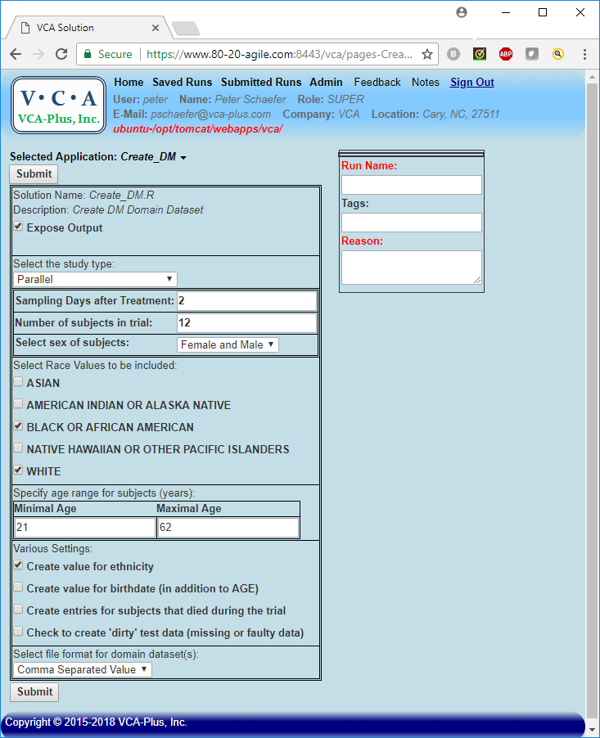
TDF Concept
User enters study parameters
Scripts create datasets
User can download test datasets

Slide 7


Slide 8
TDF Concept
User enters study parameters
Scripts create datasets
User can download test datasets

Slide 9
TDF Brainstorming about Next Steps
TDF project wants to “Create simulated datasets“
SDTM and / or ADaM?
Prioritize domains
List of input parameters

