Slide 2
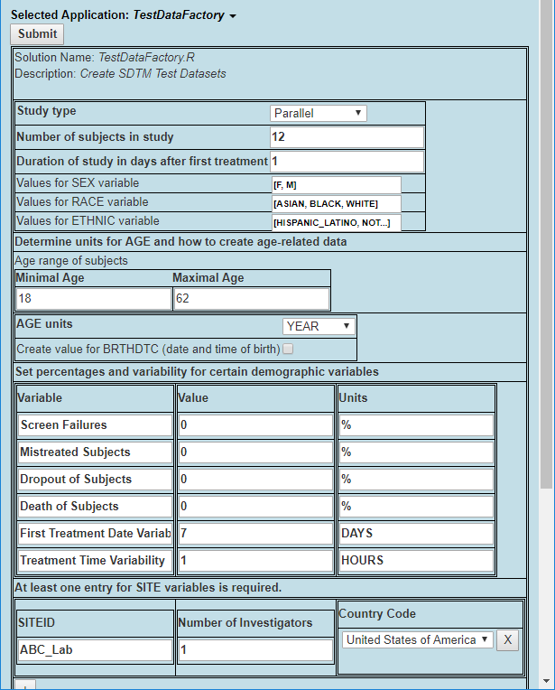
My Original Workflow Idea
Collect User Input
Create DM Domain
Create LB Domain
Create EX Domain
Create … Domain
Test Data Spec. (Excel)
TDF Domain Datasets
EX Domain (xpt, csv, Excel)
DM Domain (xpt, csv, Excel)
LB Domain (xpt, csv, Excel)
… Domain (xpt, csv, Excel)

Slide 3
Simulation Workflow Idea
Collect User Input
Study Setup
Visit 1: …
Visit 2: …
Visit 3: …
For each subject:
Test Data Spec. (Excel)
Create DM Records
Create LB Records
Create EX Records
Create … Records
TDF Domain Datasets
DM Domain (xpt, csv, Excel)
LB Domain (xpt, csv, Excel)
EX Domain (xpt, csv, Excel)
… Domain (xpt, csv, Excel)

