Slide 1
Similar Techniques For Molecular Sequencing and Network Security
Doug Madory
27 APR 05
Big Picture
Protein Structure
Sequencing using Profile HMM

Slide 2
Big Picture
PQS for Network Security (Us)
  Design HMM for network event
  Find event within linear stream of observed network events
Q: Did an event happen?
Sequencing using Profile HMM (Bioinformatics)
  Train HMM using known information about subsequence
  Find subsequence within linear protein / genome sequence
Q: If it exists, where is sequence?

Slide 3
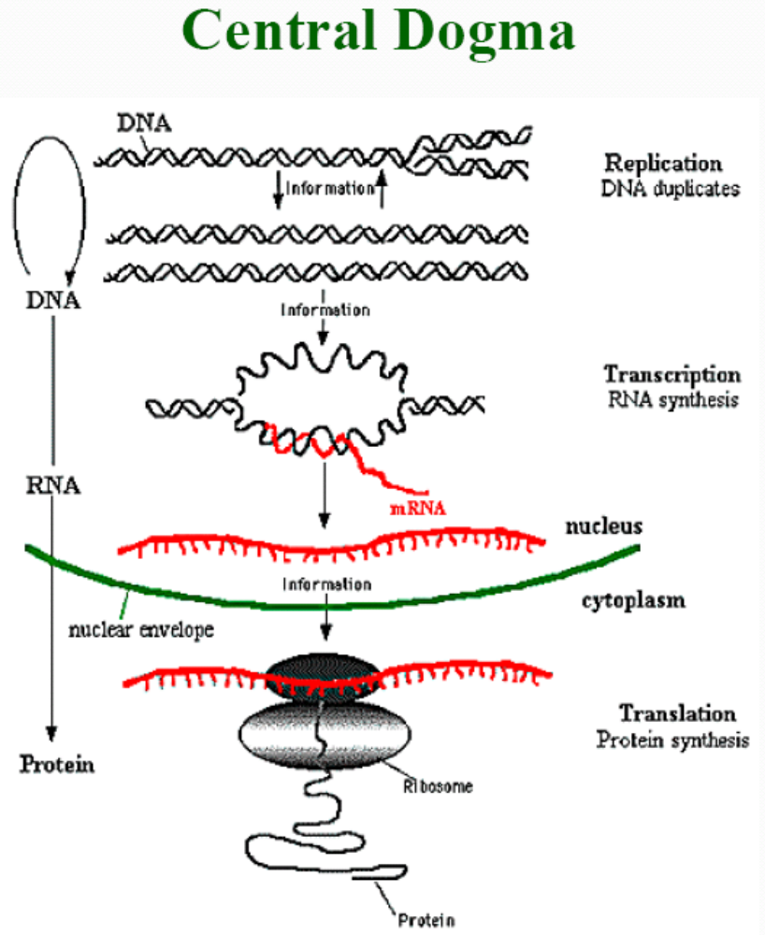

Slide 4
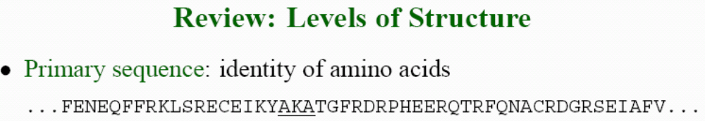
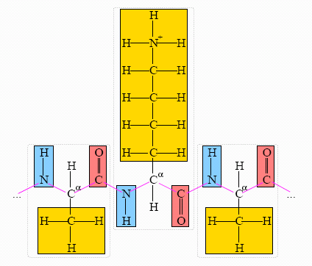
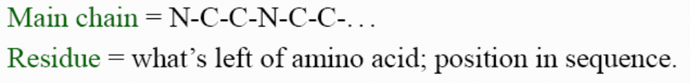

Slide 5
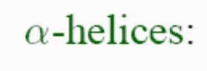


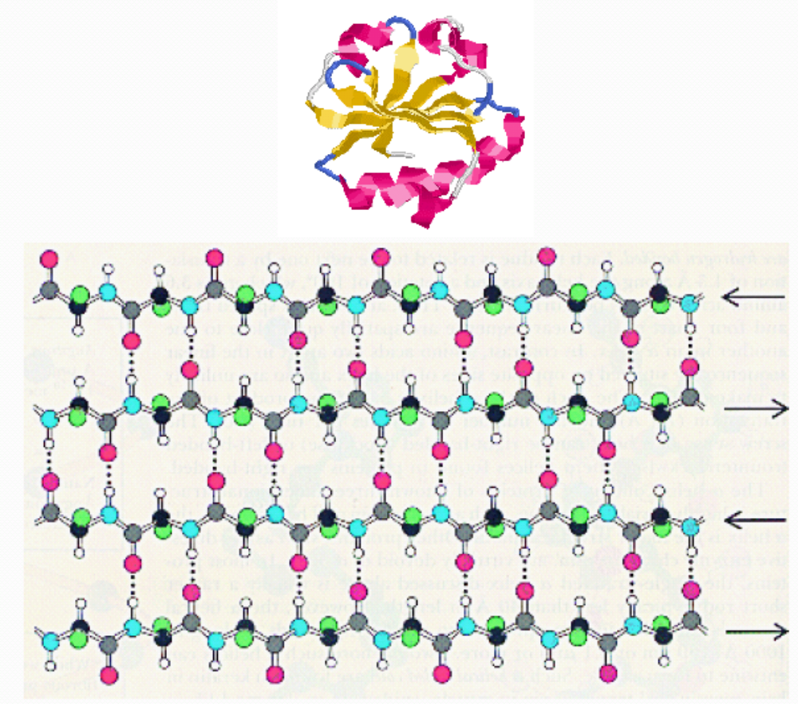
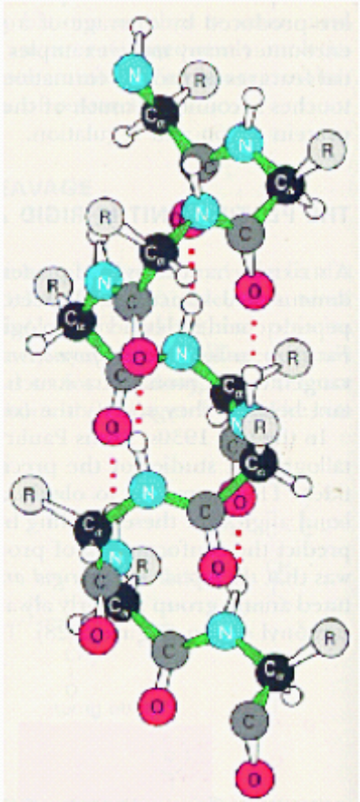

Slide 6
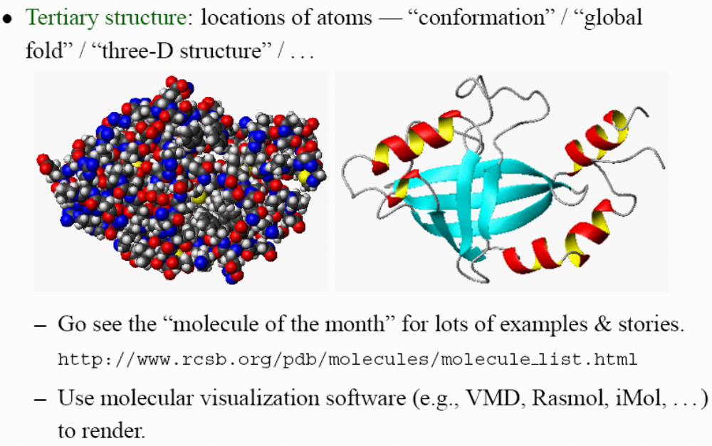

Slide 7
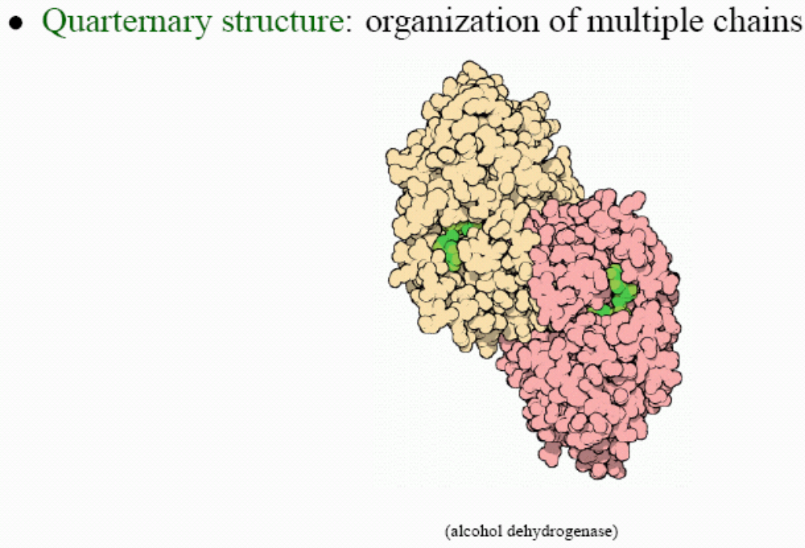

Slide 8
Profile HMM - Simple Case
Train HMM
Viterbi Scoring
Backtrace Viterbi
Query: A-, AA, TA
DB: ATA

Slide 9
HMM Training
D₁
D₂
I₀
I₁
I₂
Begin
A
C
G
T
A
C
G
T
End
Build HMM with 2 M states because there are 2 columns in query
M₁ M₂

Slide 10
HMM Training
D₁
1
D₂
1
1
1
1
1
1
1
1
1
I₀
I₁
I₂
1
1
1
1
1
1
1
Begin
1
A 1
C 1
G 1
T 1
1
A 1
C 1
G 1
T 1
1
End
Step 1 – add pseudocount to each transition and emission
M₁ M₂

Slide 11
HMM Training
D₁
1
D₂
1
1
1
1
1
2
1
1
1
I₀
I₁
I₂
1
1
1
2
1
1
1
Begin
2
A 2
C 1
G 1
T 1
1
A 1
C 1
G 1
T 1
1
End
Step 2 – train with A-
M₁ M₂

Slide 12
HMM Training
D₁
1
D₂
1
1
1
1
1
2
1
1
1
I₀
I₁
I₂
1
1
1
2
1
1
1
Begin
3
A 3
C 1
G 1
T 1
2
A 2
C 1
G 1
T 1
2
End
Step 3 – train with AA
M₁ M₂

Slide 13
HMM Training
D₁
1
D₂
1
1
1
1
1
2
1
1
1
I₀
I₁
I₂
1
1
1
2
1
1
1
Begin
4
A 3
C 1
G 1
T 2
3
A 3
C 1
G 1
T 1
3
End
Step 4 – train with TA
M₁ M₂

Slide 14
HMM Training
D₁
1
D₂
1
1
1
1
1
2
1
1
1
I₀
I₁
I₂
1
1
1
2
1
1
1
Begin
4
A 3
C 1
G 1
T 2
3
A 3
C 1
G 1
T 1
3
End
Fully trained HMM
M₁ M₂

Slide 15
Viterbi Scoring
Moves
Insert
Match
Delete
Illegal Moves
Observations
 | X | A | T | A
B/I₀ | V^{B}=0
M₁
I₁
D₁
M₂
I₂
D₂
E
V^{I}₀(1) = log a_{B-I0}
V^{M}₁(0) = 0
V^{I}₁(0) = 0
States
V^{D}₁(0) = log a_{B-D1}

Slide 16
Viterbi Scoring
Moves
Insert
Match
Delete
Observations
 | X | A | T | A
B/I₀ | V^{B}=0 | V^{I}₀(1) = -0.78
M₁ | V^{M}₁(0)= 0
I₁ | V^{I}₁(0)= 0
D₁ | V^{D}₁(0)= -0.78
M₂
I₂
D₂
E
V^{I}₀(2) = V^{I}₀(1)+log a_{I0-I0}
V^{I}₀(3) = V^{I}₀(2)+log a_{I0-I0}
States

Slide 17
Viterbi Scoring
Moves
Insert
Match
Delete
Observations
 | X | A | T | A
B/I₀ | V^{B}=0 | V^{I}₀(1) = -0.78 | V^{I}₀(2)= -1.25 | V^{I}₀(3)=-1.72
M₁ | V^{M}₁(0)= 0
I₁ | V^{I}₁(0)= 0
D₁ | V^{D}₁(0)= -0.78
M₂
I₂
D₂
E
V^{M}₁(1) = log e(A)/q + V^{B} + log a_{B-M1}
V^{M}₁(1) = log (3/7)/(1/4) + 0 - 0.17
V^{M}₁(1) = 0.23 – 0.17 = 0.06
States

Slide 18
Viterbi Scoring
Moves
Insert
Match
Delete
Observations
 | X | A | T | A
B/I₀ | V^{B}=0 | V^{I}₀(1) = -0.78 | V^{I}₀(2)= -1.25 | V^{I}₀(3)=-1.72
M₁ | V^{M}₁(0)= 0 | V^{M}₁(1)= 0.06
I₁ | V^{I}₁(0)= 0
D₁ | V^{D}₁(0)= -0.78
M₂
I₂
D₂
E
States
V^{M}₁(0) + log a_{M1I1}
V^{I}₁(1) = 0 + max { V^{I}₁(0) + log a_{I1I1} }
V^{D}₁(0) + log a_{D1I1}
V^{I}₁(1) = 0 + max {-0.78+-0.47 }
V^{I}₁(1) = -0.47
V^{D}₁(1) = V^{I}₁(0) + log a_{I0D1}
V^{D}₁(1) = -0.78 – 0.47 = -1.25

Slide 19
Viterbi Scoring
Moves
Insert
Match
Delete
Observations
 | X | A | T | A
B/I₀ | V^{B}=0 | V^{I}₀(1) = -0.78 | V^{I}₀(2)= -1.25 | V^{I}₀(3)=-1.72
M₁ | V^{M}₁(0)= 0 | V^{M}₁(1)= 0.06
I₁ | V^{I}₁(0)= 0 | V^{I}₁(1) = -0.47
D₁ | V^{D}₁(0)= -0.78 | V^{D}₁(1)= -1.25
M₂
I₂
D₂
E
States

Slide 20
Viterbi Scoring
Moves
Insert
Match
Delete
Observations
 | X | A | T | A
B/I₀ | V^{B}=0 | V^{I}₀(1) = -0.78 | V^{I}₀(2)= -1.25 | V^{I}₀(3)=-1.72
M₁ | V^{M}₁(0)= 0 | V^{M}₁(1)= 0.06 | V^{M}₁(2) = -1.19 | V^{M}₁(3)= -1.49
I₁ | V^{I}₁(0)= 0 | V^{I}₁(1) = -0.47 | V^{I}₁(2) = -0.72 | V^{I}₁(3) = -1.19
D₁ | V^{D}₁(0)= -0.78 | V^{D}₁(1)= -1.25 | V^{D}₁(2) = -1.72 | V^{D}₁(3)= -1.25
M₂ | V^{M}₂(0)= 0 | V^{M}₂(1)= -0.47 | V^{M}₂(2)= -0.41 | V^{M}₂(3)= -1.19
I₂ | V^{I}₂(0)= 0 | V^{I}₂(1) = -1.85 | V^{I}₂(2) = -1.07 | V^{I}₂(3) = -1.01
D₂ | V^{D}₂(0)= -1.25 | V^{D}₂(1)= -1.25 | V^{D}₂(2)= -0.58 | V^{D}₂(3)= -1.36
E |  |  |  | VE= -1.31
States

Slide 21
Profile HMM - Simple Case
Demo in Python

Slide 22
Big Picture Revisited
PQS for Network Security (Us)
  Design HMM for network event
  Find event within linear stream of observed network events
Q: Did an event happen?
Sequencing using Profile HMM (Bioinformatics)
  Train HMM using known information about subsequence
  Find subsequence within linear protein / genome sequence
Q: If it exists, where is sequence?

