Slide 1

Midterm project
Kyle Tsang
Julien Tremblay

Slide 2
Table of content
Business question
Data Quick facts
Exploratory analysis
Modeling & Predictions
Conclusion

Slide 3
Business question
Airlines want their planes in the air.
They reduce ground time as much as possible, with no room for delays.
Departure delays can results in planes flying faster.
Higher plane speeds = more fuel consumption.
Fuel consumption is the 2nd largest expense.
If we can accurately predict delay times and types, could this lead to better scheduling and thus fuel economy ?

Slide 4
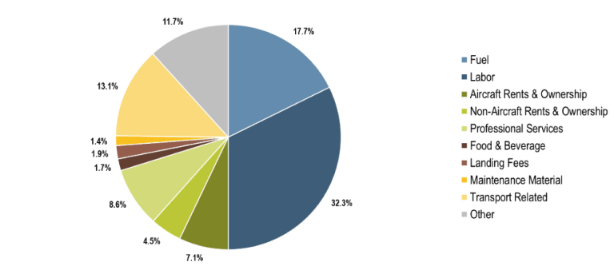
Business question
Passenger Airlines Operating Costs, United States, 2019
Source: Airlines for America.
(https://www.airlines.org/data/)

Slide 5
Data Quick Facts
US domestic flights for 2018 and 2019
11 marketing carriers / 28 operating carriers
6,487 Aircrafts
376 Airports
3,496 Return routes
15,927,485 flights
19 % delayed arrival
1,7 % canceled

Slide 6
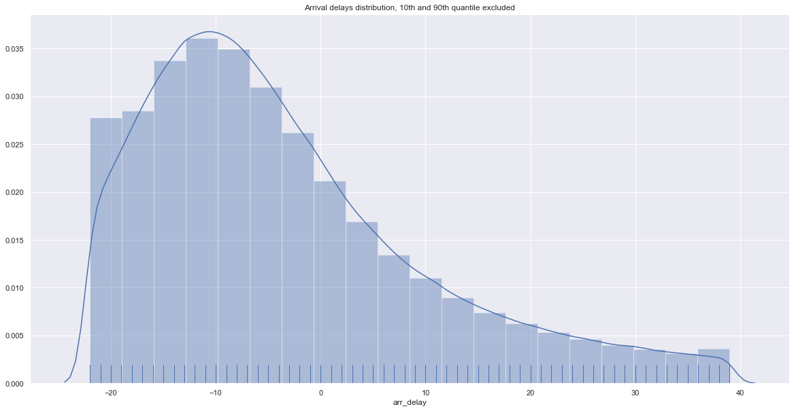
Exploratory analysis – Q.1
Null Hypothesis : Delay is normal distribution and mean is 0 : Rejected
Most planes
arrive early.
When they’re late,
they’re really late.

Slide 7
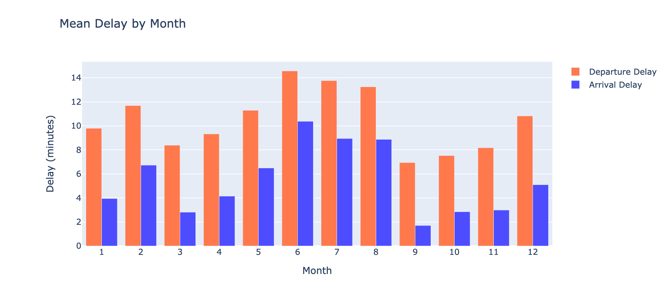
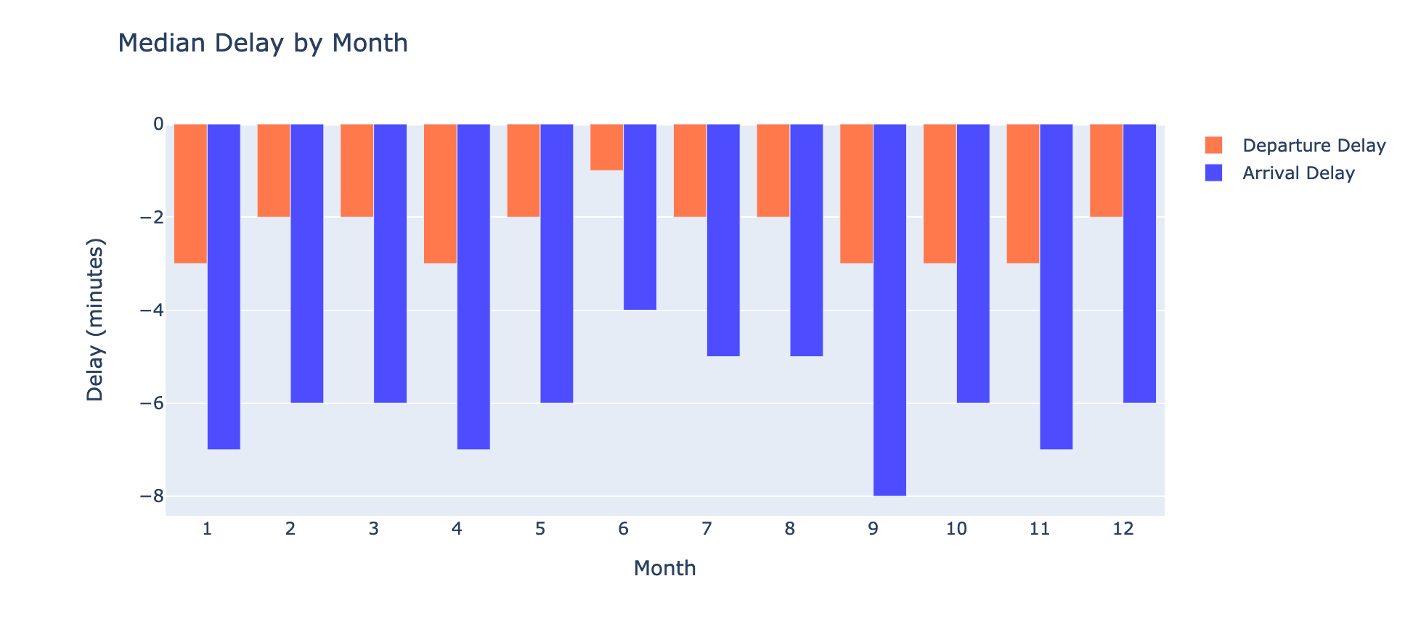
Exploratory analysis – Q.2
Mean and median
delay per month
Seasons where you’ll wait:
Summer and winter.

Slide 8
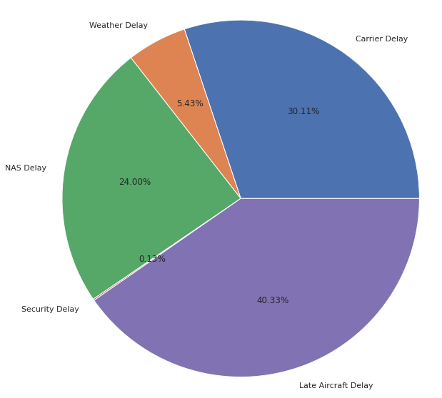
Exploratory analysis – Q.3
Weather related delays
Arrival delays breakdown:
Late Aircraft : 40%
Carrier : 30%
National Air System: 24%
Weather : 6%
Security : <1%

Slide 9
Exploratory analysis – Q.3
Understanding delay types
Air Carrier: maintenance or crew problems, aircraft cleaning, baggage loading, fueling, etc.
Extreme Weather: Significant meteorological conditions (actual or forecasted) such as tornado, blizzard or hurricane.
National Aviation System (NAS): non-extreme weather conditions, airport operations, heavy traffic volume, and air traffic control.
Late-arriving aircraft: A previous flight with same aircraft arrived late, causing the present flight to depart late.
Security: Evacuation of a terminal or concourse, re-boarding of aircraft because of security breach, inoperative screening equipment and/or long lines in excess of 29 minutes at screening areas.
https://www.bts.gov/topics/airlines-and-airports/understanding-reporting-causes-flight-delays-and-cancellations

Slide 10
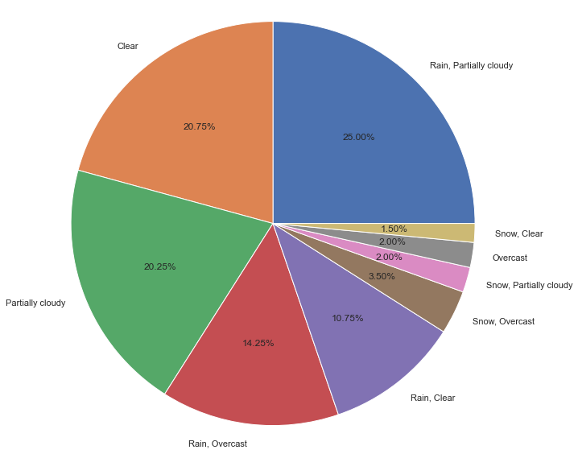
Exploratory analysis – Q.3
Weather related delays.
2 challenges with the weather data :
- Weather is split in two categories.
- No mention of origin or destination.
What we did :
200 random sample of extreme weather delays > 10 mins
Used Visual Crossing API to obtain both airport weather conditions.
Results :
Clear : 33%
Cloudy and Overcast : 67%
Rain: 50%
Snow: 7 %

Slide 11
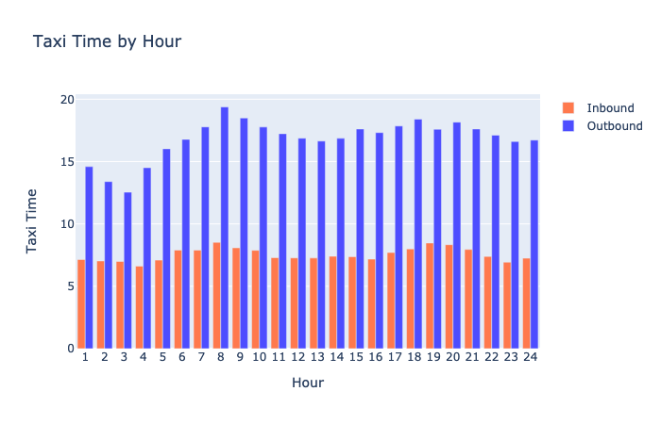
Exploratory analysis – Q.4a
Taxi time fluctuation throughout the day.
Planes are like cars.
Morning and
evening rush hours.

Slide 12
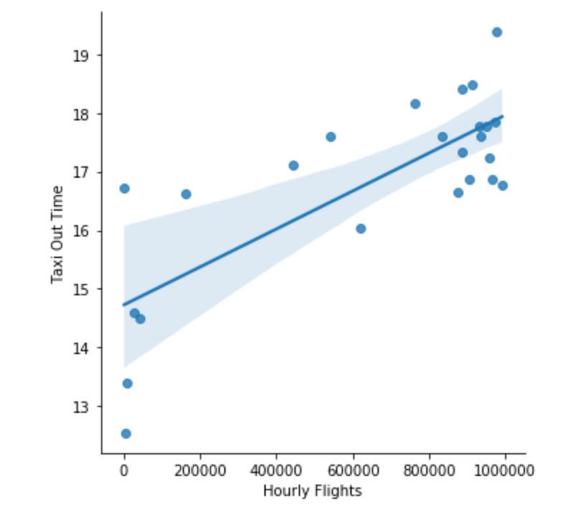
Exploratory analysis – Q.4b
Taxi time fluctuation throughout the day.
The more flights per hour,
the more taxi time.

Slide 13
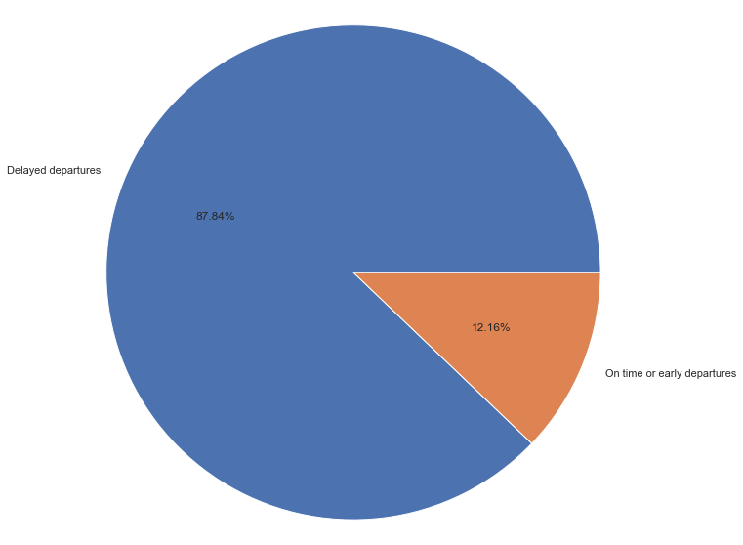
Exploratory analysis – Q.5a
Percentage of delays that is already created before departure ?
88% of delayed arrivals
started with a delayed departure.

Slide 14
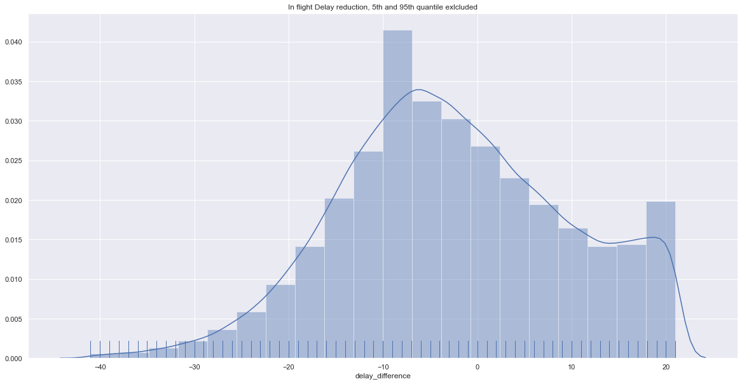
Exploratory analysis – Q.5b
Are airlines able to lower the delay during the flights?
Yes, by 6 mins.
(Mode)

Slide 15
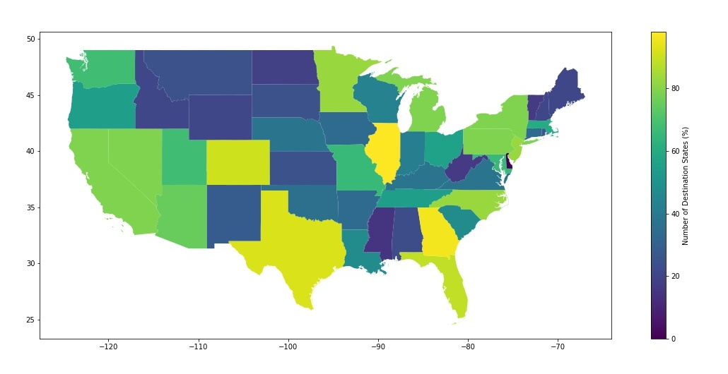
Exploratory analysis – Q.6
How many states cover 50% of US air traffic ?
23 states reach
more than
25 other states

Slide 16
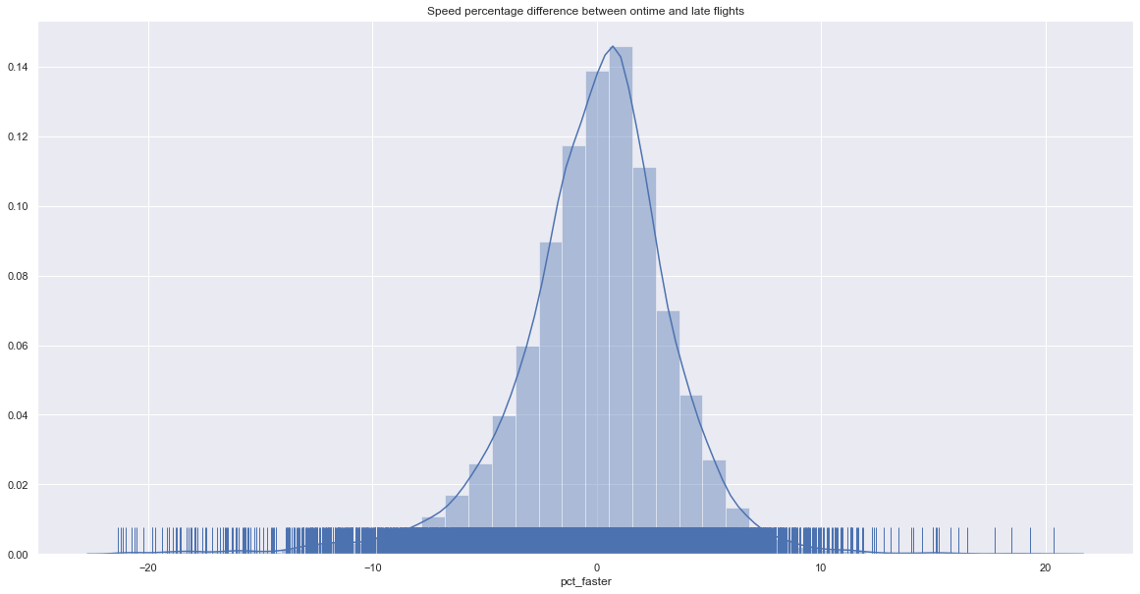
Exploratory analysis – Q.7a
Do planes fly faster when they depart late ?
Half the time.

Slide 17
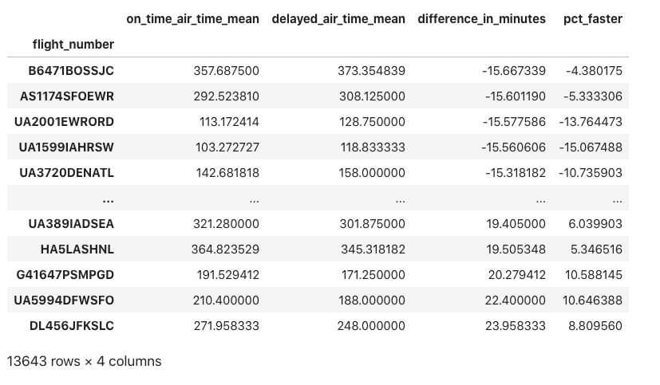
Exploratory analysis – Q.7b
Do planes fly faster when they depart late ?
How we got there.

Slide 18
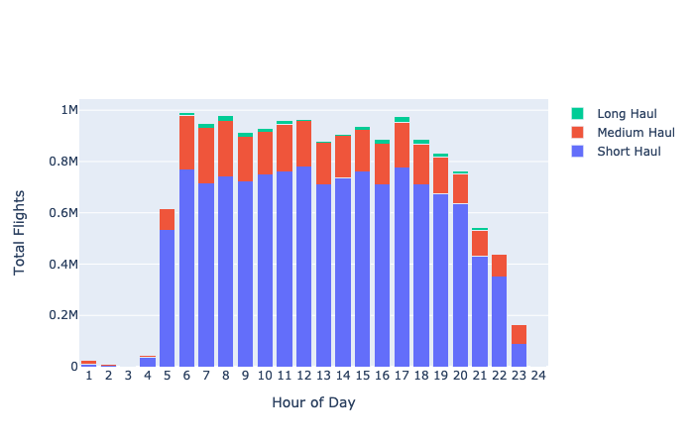
Exploratory analysis – Q.8a
Flight take-off time by flight length.
Short haul : ≤ 3h
Medium haul : 3h-6h
Long haul : ≥ 6h
Short : even during daytime

Slide 19
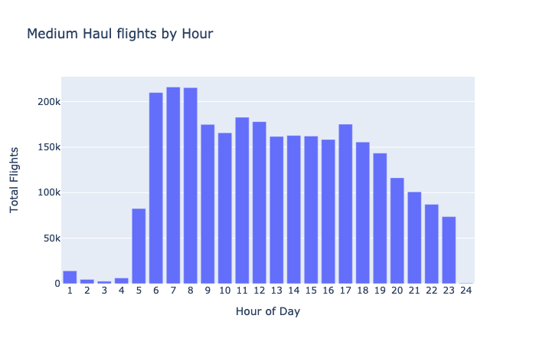
Exploratory analysis – Q.8b
Flight take-off time by flight length.
Medium haul : morning peak

Slide 20
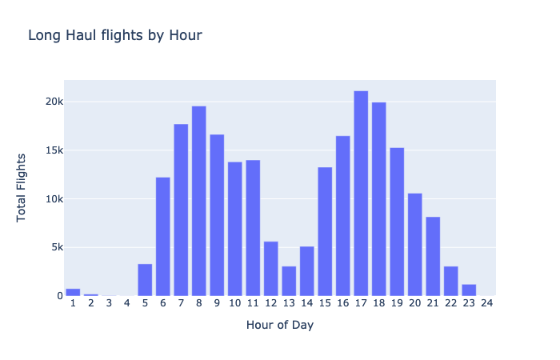
Exploratory analysis – Q.8c
Flight take-off time by flight length.
Long haul :
morning and evening peak

Slide 21
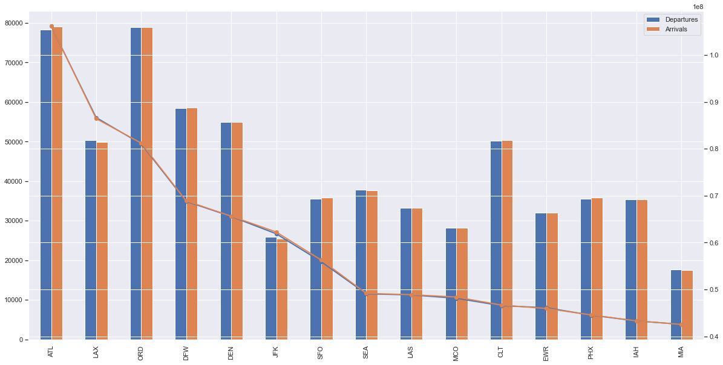
Exploratory analysis – Q.9
Busiest airports by flights (bar) and passengers (line) for 2018/2019
Atlanta
Los Angeles
Chicago
Dallas
Denver
New York
San Francisco
Seattle
Las Vegas
Orlando
International hubs =
bigger planes

Slide 22
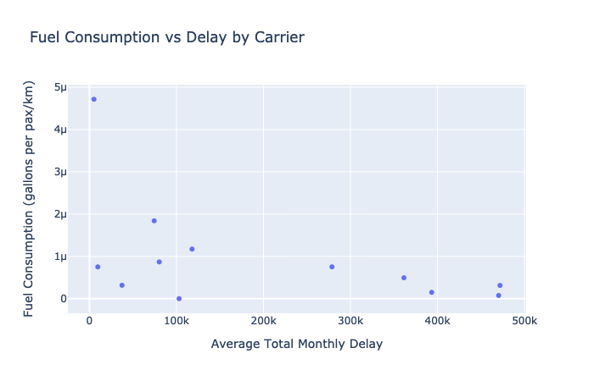
Exploratory analysis – Q.10
Do bigger delays lead to bigger fuel consumption per passenger?
No.
We hypothesise that
they save fuel by letting
themselves be late.

Slide 23
Modeling – Q.1 – Regression
Predicting Arrival Delays in minutes
Feature engineering
Breakdown date and time into simple columns and bins.
Get multiple aggregate historical statistics based on time, carrier and locations.
Mostly Mean and median dep and arr delays for example :
mean arr delay for : Carrier/Route/Month/DOW/Daysection
SelectKBest
RandomForestRegressor
R^2 score : 0,72

Slide 24
Modeling – Q.2 – Multiclass
Predicting the type of arrival delays
Feature engineering
Get multiple aggregate historical statistics based on per type of delay.
For example :
% Probability that a route will have weather delay, per month.
% Probability that an airport will have a NAS delay per day of the week
SelectKBest
RandomForestClassificator
Accuracy : 0,78

Slide 25
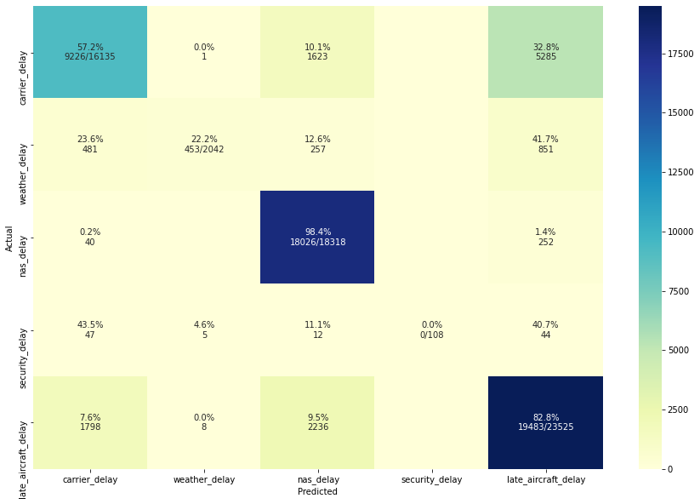
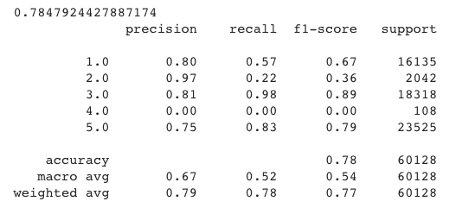
Modeling – Q.2 – Multiclass
Predicting the type of arrival delays

Slide 26
Modeling – Q.3 – Binary Class.
Predicting cancellations
Create a 50/50 train set.
Feature engineering
For example :
% cancellation by carrier
% cancellation per route / per month
SelectKBest
RandomForestClassificator
Accuracy:
On our 5050 test data : 0,82
On our full dataframe : 0,70

Slide 27
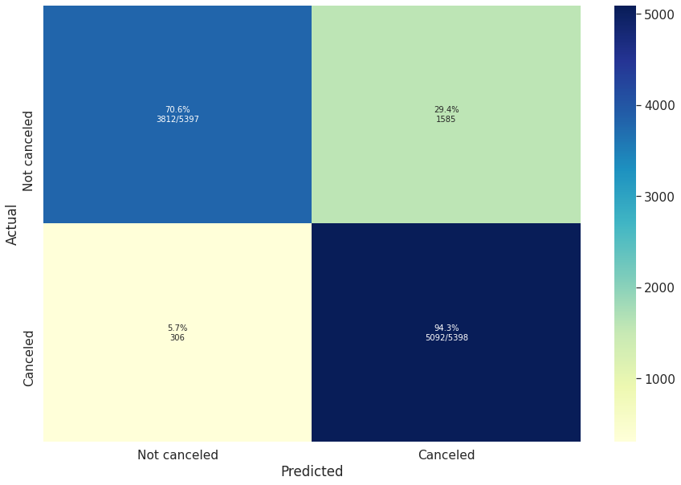
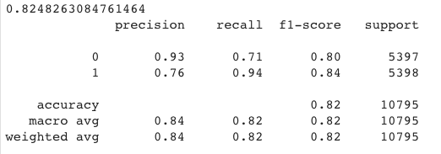
Modeling – Q.3 – Binary Class.
Predicting cancellations

Slide 28
Conclusion
What’s next :
Optimization phase :
Try more algorithms
Hyperparameter tuning.
Other ideas
For Q1 – train model on January 2018-2019 data only.
Bring in more info from passenger and fuel table (passenger volume, plane type)
Apply unsupervised learning to create airport clusters.

Slide 29



Contact us
Full project available at :
https://github.com/kyletsang0/midterm-project
Kyle Tsang
kyletsang0
Julien Tremblay
julien-tr

