Slide 1
Adaptive Influence Balancing
Preserving Correct Minority Hypotheses in Multi-Agent LLM Debates
Advisor: Dr. Feng Chen
Weekly Update 07/23/2026
Building on: A Diagnostic Study of Multi-Agent LLMs (ICML 2026)

Slide 2
The Problem: Multi-Agent Debates Can Fail Silently
What We Expect
Real Example (MMLU-Pro Q42, Correct = A)
✓ Agents debate, challenge each other
✓ Best argument wins
✓ Consensus = correct answer
Rd 1
Agent1: B
Agent2: B
Agent3: A ✓
Rd 2
Agent1: B
Agent2: B
Agent3: A ✓
What Actually Happens
Rd 3
Agent1: B
Agent2: B
Agent3: B ✗
✗ Majority pressure silences minority
✗ Correct hypothesis eliminated early
✗ Agents converge on wrong answer
✗ Consensus looks confident but is wrong
Rd 4
Agent1: B
Agent2: B
Agent3: B ✗
Rd 5
→ Consensus: B ✗ WRONG
8.2% of correct hypotheses are eliminated before the final round

Slide 3
What Our Experiments Already Show (Exp1 – 3b, 200 MMLU-Pro Questions)
Method
Accuracy
Δ Acc
PER
Consensus Reliability
Baseline (Exp1)
54.5%
—
8.20%
57.1%
Loser Resist.–Support (2a)
55.5%
+1.0 pp
9.02%
56.3%
Loser Resist.–Metric (2b)
58.0%
+3.5 pp
7.81%
58.3%
Static Protection (3a)
57.5%
+3.0 pp
6.20%
58.1%
Diag. Protection (3b) ★
60.0%
+5.5 pp
3.17%
60.6%
Exp3b: diagnostic-triggered minority protection is best so far +5.5 pp accuracy | −61% PER | +3.5 pp consensus reliability
Key gap: Exp3b uses FIXED thresholds — not responsive to reasoning quality

Slide 4
New Baseline Design: Multi-Seed, Multi-Dataset
Why I need a new baseline:
→ Current baseline: 200 questions × 1 seed = only 88 minority situations
→ Only 24 correct minorities, only 3 that disappeared next round
→ Too few examples to train a reliable learned predictor
New design:
MMLU-Pro 200q × 3 seeds
GPQA 100q × 3 seeds
~455 minority obs
Breadth Knowledge + reasoning
More difficult questions; Depth Grad-level science
5× more training data
Key addition: Round State saved in DETAIL — per-round, per-agent diagnostics saved during debate
Process diagnostics: "Prefix" = Only the Rounds You've Seen So Far
Minority features
Labels
• prefix_influence_asymmetry
• support_share
• is_correct
• prefix_balance
• support_delta
• is_correct_minority
• prefix_engagement
• minority_quality_mean
• drops_next_round
• prefix_responsiveness
• minority_conf_mean
• correct_drops_next
• prefix_dispersion
• was_majority_before
• answer_survives_to_final

Slide 5
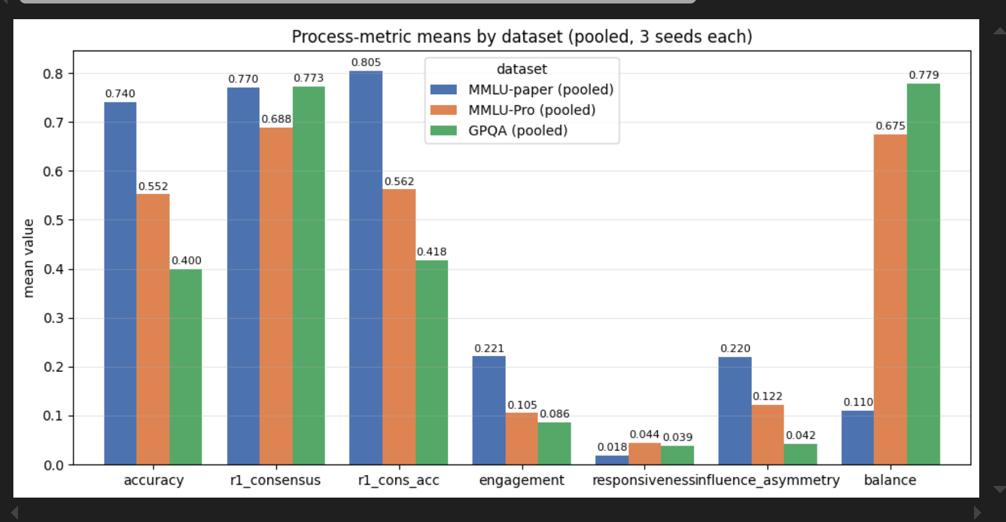
Process Metrics Distribution by Datasets (Diff Difficulty)
1. Difficulty: MMLU < MMLU-PRO < GPQA
2. Although the first-round consensus rates are similar, the first-round consensus accuracy differs significantly. i.e GPQA consensus formed without sufficient correct knowledge
3. Engagement mean, influence asymmetry mean and balance mean show correlation with difficulty

Slide 6
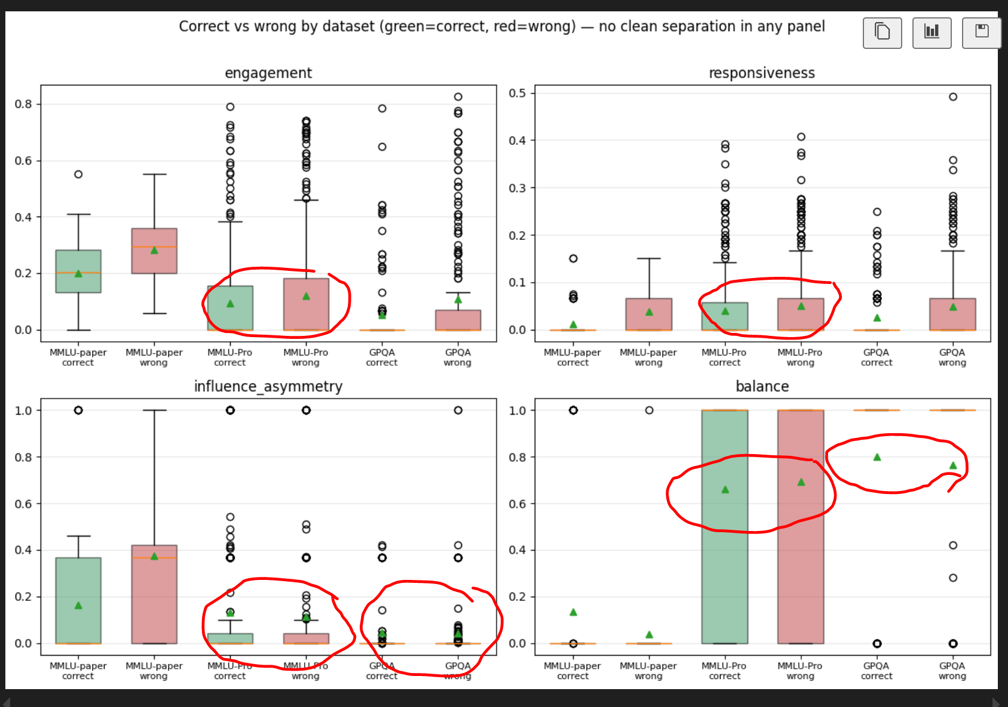
Process Metrics Distribution by Correctness by Question Difficulty
Process metrics and accuracy are effectively decoupled - No significant separation between correct and incorrect debates, for MMLU-PRO and GPQA debates

Slide 7
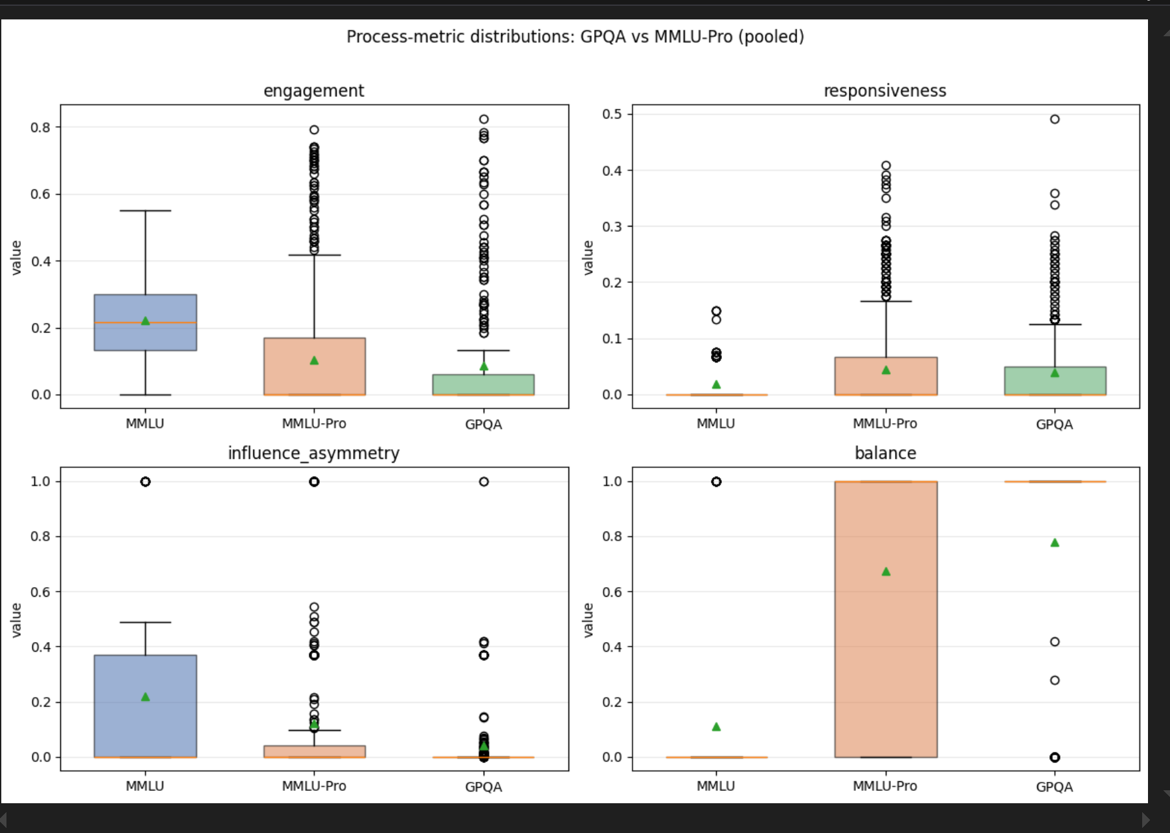
Process Metrics Distribution by Question Difficulty

Slide 8
Next Steps
Faithfully reproduce the baseline described in the paper.
Assign a different sampling temperature to each debate agent
Assign a distinct persona to each debate agent
Use a question set with a difficulty level similar to that used in the paper
Redesign the debate inference balancing controller using debate diagnostics

Slide 9
Adaptive Controller: Closing the Observe → Control Loop
1 OBSERVE
2 PREDICT RISK
3 ACT
Estimate p_truth × p_drop (Is h correct? Will h disappear?)
Protect potentially correct hypotheses that might otherwise be eliminated in the next round.
Compute prefix-safe process diagnostics after each round
Allocate protection tokens proportional to risk score
→
→
Risk(h, t) = p_truth(h, t) × p_drop(h, t)
Quality Gate (prevents protecting noise)
Adaptive Token Budget
• minority_quality_mean ≥ 0.30
• Risk(h, t) ≥ threshold τ
• Both required to trigger
→ Incorrect minorities not protected
extra_tokens = 150 × min(Risk, 0.9)
Risk = 0.40 → +60 tokens
Risk = 0.70 → +105 tokens
Risk = 0.90 → +135 tokens
Key research question: "Can learned process diagnostics guide within-trajectory minority protection?

Slide 10
Two-Head Predictor: p_truth and p_drop
Head 1: p_truth
Head 2: p_drop
P(minority is correct | features at round t)
P(hypothesis disappears at t+1 | features at round t)
Top features (need re-evaluate):
Key features (need re-evaluate):
• minority_quality_mean
β = +0.245 ← #1 signal
• support_delta (losing agents this round)
• support_delta
β = +0.179 ← losing support?
• num_defectors (agents already leaving)
• num_defectors
β = −0.121 ← being abandoned?
• rounds_remaining (urgency)
• was_majority_before
β = −0.107 ← social pressure?
• prefix_balance (rapid convergence?)
• prefix_influence_asymmetry
β = +0.077 ← suppression?
• minority_size (1 agent vs 2 agents)
• prefix_balance
β = +0.091 ← convergence risk?
• prefix_influence_asymmetry
Model: Logistic Regression + Isotonic Calibration Grouped CV by (dataset, question_no)
Status: 25–30 positive events expected from new baseline

Slide 11
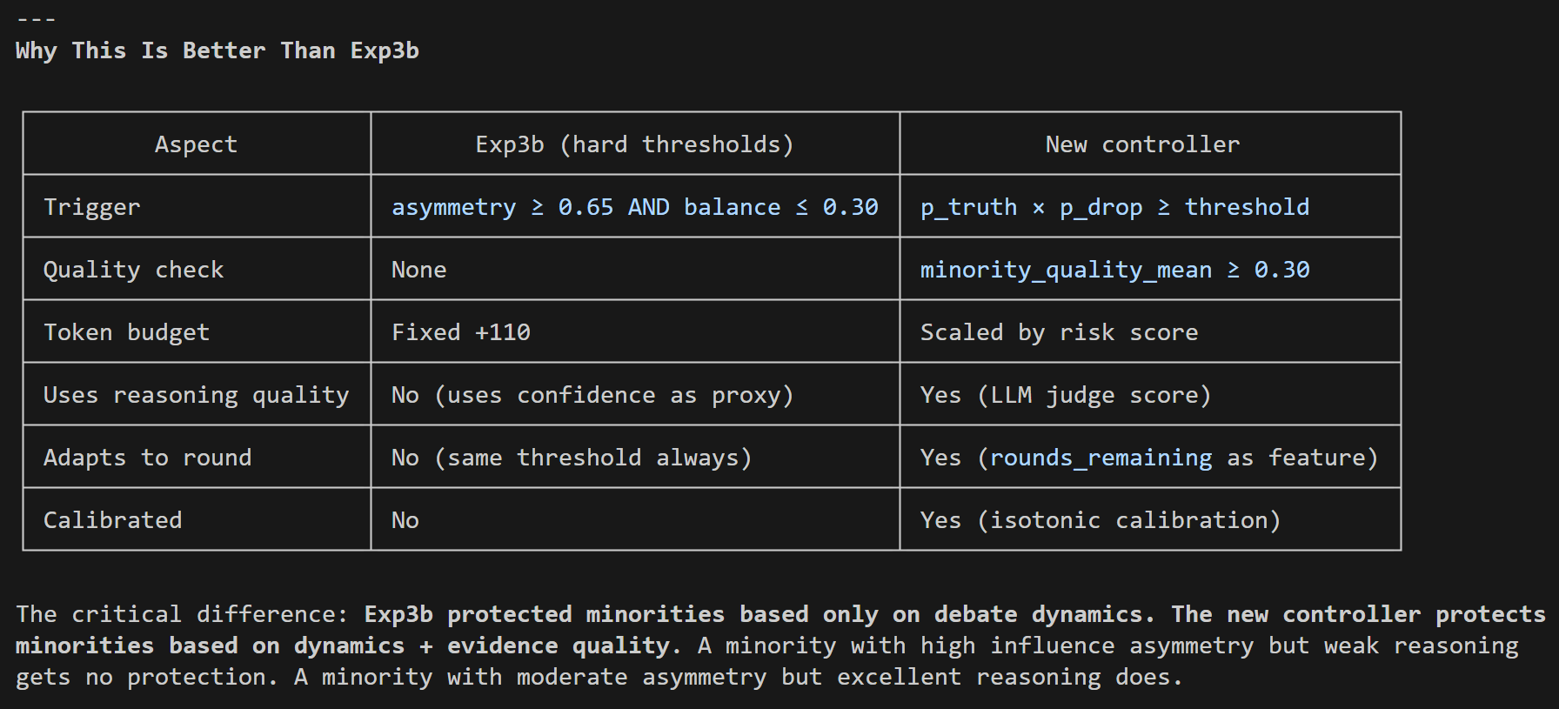
Why This is Better Than Exp3b

Slide 12
Training Pipeline: From Round_State to Controller
1
2
3
4
New Baseline (generate_baseline_v2.py)
Feature Extraction (extract_features_prefix.py)
Train Two-Head Predictor (train_two_head_predictor.py)
Deploy: Exp5 (generate_exp5_controller.py)
→
→
→
200 MMLU-Pro × 3 seeds 100 GPQA × 3 seeds Round_State: ~13,500 rows
~455 minority situations Prefix-safe features only No future leakage
Logistic regression Grouped CV by question_no Calibrated probabilities
Same 200 MMLU-Pro questions Compare vs Exp1 & Exp3b Measure: Acc, PER, CR
Critical design choices:
✓ Train on baseline only
No data from intervention experiments → no circular reasoning
✓ Prefix-safe features
Only rounds 1..t used → valid for real-time deployment
✓ Grouped CV by question
All seeds of same question in same fold → no question leakage
✓ Constrained threshold
Maximize minority recovery s.t. majority corruption ≤ 5%

Slide 13
Expected Results: Adaptive Controller vs Prior Methods
Method
Accuracy
PER
Cons. Reliability
Key Advantage
Baseline (Exp1)
54.5%
8.2%
57.1%
Reference
Diag. Protection (3b)
60.0%
3.2%
60.6%
Best hard-threshold
Adaptive Controller
61–63%
2–3%
61–63%
Quality-aware + calibrated
Why the adaptive controller should outperform Exp3b:
Reasoning quality gated
Risk-scaled tokens
p_drop signal
Exp3b protects ALL minorities under high asymmetry → some of those are wrong New controller: only protects high-quality reasoning
Exp3b: fixed +110 tokens always New: +60 to +135 scaled by p_truth × p_drop → more budget to highest-risk situations
Exp3b doesn't know if elimination is imminent New: directly predicts whether hypothesis will disappear next round → timely intervention

Slide 14
Summary
Three things no prior work has combined:
Process diagnostics as control signals
Reasoning quality in the trigger
Calibrated risk = p_truth × p_drop
Prior work measures engagement, asymmetry, balance We use them to DECIDE when to intervene
Exp3b triggers on dynamics alone We add LLM quality score to gate out bad minorities
Novel formulation: protect only when both correct AND at imminent risk
"First work to use calibrated process diagnostics for within-trajectory minority protection in multi-agent LLM debates" per Codex
Due to compute constraints, experiments use Qwen2.5-14B. Model generalization is left for future work, as our intervention mechanism operates on behavioral patterns (answer changes, support dynamics) rather than model-specific features.
Future work: Run same experiments using GPT-4, Llama, Gemini etc.

