Slide 1

Outline
What is network security?
Principles of cryptography
Message integrity, authentication
Securing e-mail
Operational security: firewalls and IDS

Slide 2
What is network security?
confidentiality: only sender, intended receiver should “understand” message contents
  sender encrypts message
  receiver decrypts message
authentication: sender, receiver want to confirm identity of each other
message integrity: sender, receiver want to ensure message not altered (in transit, or afterwards) without detection
access and availability: services must be accessible and available to users

Slide 3



Friends and enemies: Alice, Bob, Trudy
well-known in network security world
Bob, Alice (lovers!) want to communicate “securely”
Trudy (intruder) may intercept, delete, add messages
Alice
channel
data, control messages
Bob
secure
sender
secure
receiver
data
data
Trudy

Slide 4
Friends and enemies: Alice, Bob, Trudy
Who might Bob and Alice be?
… well, real-life Bobs and Alices!
Web browser/server for electronic transactions (e.g., on-line purchases)
on-line banking client/server
DNS servers
BGP routers exchanging routing table updates
other examples?

Slide 5
There are bad guys (and girls) out there!
Q: What can a “bad guy” do?
A: A lot! (see section 1.6)
  eavesdrop: intercept messages
  actively insert messages into connection
  impersonation: can fake (spoof) source address in packet (or any field in packet)
  hijacking: “take over” ongoing connection by removing sender or receiver, inserting himself in place
  denial of service: prevent service from being used by others (e.g., by overloading resources)

Slide 6
The language of cryptography
Alice’s
encryption
key
Bob’s
decryption
key
K
A
K
B
plaintext
encryption
algorithm
ciphertext
decryption
algorithm
plaintext
m: plaintext message
K_{A}(m): ciphertext, encrypted with key K_{A}
m = K_{B}(K_{A}(m))

Slide 7
Cryptograhic Building Blocks
Principles of Ciphers
  Most ciphers are block ciphers: they are defined to take as input a plaintext block of a certain fixed size, typically 64 to 128 bits.
  Using a block cipher to encrypt each block independently—known as electronic codebook (ECB) mode encryption—has the weakness that a given plaintext block value will always result in the same ciphertext block.
  Hence recurring block values in the plaintext are recognizable as such in the ciphertext, making it much easier for a cryptanalyst to break the cipher.

Slide 8
Cryptograhic Building Blocks
Block Ciphers
  A common mode of operation is cipher block chaining (CBC), in which each plaintext block is XORed with the previous block’s ciphertext before being encrypted.
    The result is that each block’s ciphertext depends in part on the preceding blocks, i.e. on its context. Since the first plaintext block has no preceding block, it is XORed with a random number.
      That random number, called an initialization vector (IV), is included with the series of ciphertext blocks so that the first ciphertext block can be decrypted.

Slide 9
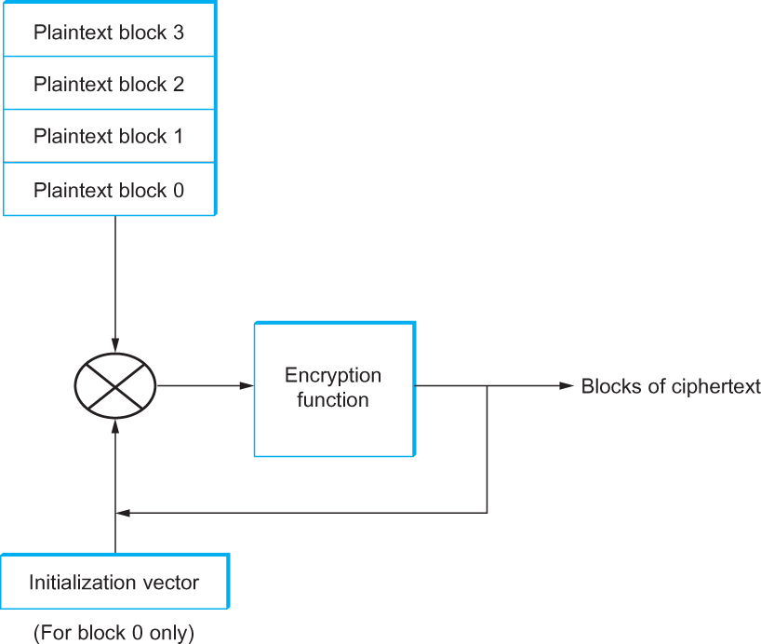
Cryptograhic Building Blocks
Cipher block chaining (CBC).

Slide 10
Symmetric key cryptography
K
K
S
S
plaintext
encryption
algorithm
ciphertext
decryption
algorithm
plaintext
K (m)
S
symmetric key crypto: Bob and Alice share same (symmetric) key: K
e.g., key is knowing substitution pattern in mono alphabetic substitution cipher
Q: how do Bob and Alice agree on key value?

Slide 11
Simple encryption scheme
substitution cipher: substituting one thing for another
  monoalphabetic cipher: substitute one letter for another
plaintext: abcdefghijklmnopqrstuvwxyz
ciphertext: mnbvcxzasdfghjklpoiuytrewq
e.g.:
Plaintext: bob. i love you. alice
ciphertext: nkn. s gktc wky. mgsbc
Encryption key: mapping from set of 26 letters
to set of 26 letters

Slide 12
A more sophisticated encryption approach
n substitution ciphers, M₁,M₂,…,M_{n}
cycling pattern:
  e.g., n=4: M₁,M₃,M₄,M₃,M₂; M₁,M₃,M₄,M₃,M₂; ..
for each new plaintext symbol, use subsequent substitution pattern in cyclic pattern
  dog: d from M₁, o from M₃, g from M₄
  Encryption key: n substitution ciphers, and cyclic pattern
  key need not be just n-bit pattern

Slide 13
Key Management is Key!
Kerckhoffs’s Principle:
  a cryptosystem should be secure even if everything about the system, except the key, is public knowledge.
Shannon's Maxim: "the enemy knows the system,”
  meaning security should not rely on secrecy of the algorithm, but on the secrecy of the key

Slide 14
Symmetric key crypto: DES
DES: Data Encryption Standard
US encryption standard [NIST 1993]
56-bit symmetric key, 64-bit plaintext input
block cipher with cipher block chaining
how secure is DES?
  DES Challenge: 56-bit-key-encrypted phrase decrypted (brute force) in less than a day
  no known good analytic attack
making DES more secure:
  3DES: encrypt 3 times with 3 different keys
Notes:
National Institute of Standards and Technology (NIST)

Slide 15
AES: Advanced Encryption Standard
symmetric-key NIST standard, replaced DES (Nov 2001)
processes data in 128 bit blocks
128, 192, or 256 bit keys
brute force decryption (try each key) taking 1 sec on DES, takes 149 trillion years for AES
Notes:
AES uses a different encryption structure (Substitution-Permutation Network vs. Feistel Network)

Slide 16

Public Key Cryptography
symmetric key crypto:
requires sender, receiver know shared secret key
Q: how to agree on key in first place (particularly if never “met”)?
public key crypto
radically different approach [Diffie-Hellman76, RSA78]
sender, receiver do not share secret key
public encryption key known to all
private decryption key known only to receiver

Slide 17
Public Key Cryptography
+
Bob’s public key
K
B
-
Bob’s private key
K
B
plaintext
message, m
encryption
algorithm
ciphertext
decryption
algorithm
plaintext
+
-
+
K (m)
m = K (K (m))
B
B
B
Wow - public key cryptography revolutionized 2000-year-old (previously only symmetric key) cryptography!
similar ideas emerged at roughly same time, independently in US and UK (classified)

Slide 18
Public key encryption algorithms
requirements:
+
.
-
.
1
need K ( ) and K ( ) such that
B
B
-
+
K (K (m)) = m
B
B
+
2
given public key K , it should be impossible to compute private key K
B
-
B
RSA: Rivest, Shamir, Adelson algorithm
Notes:
RSA (Rivest–Shamir–Adleman) is a widely used public-key cryptosystem employing an asymmetric encryption algorithm, relying on a pair of keys – a public key for encryption and a private key for decryption, crucial for secure data transmission and digital signatures

Slide 19
RSA in practice: session keys
Session Keys
Authentication, Digital Signatures

Slide 20
RSA in practice: session keys
exponentiation in RSA is computationally intensive
DES is at least 100 times faster than RSA
use public key crypto to establish secure connection, then establish second key – symmetric session key – for encrypting data
session key, K_{S}
Bob and Alice use RSA to exchange a symmetric session key K_{S}
once both have K_{S}, they use symmetric key cryptography

Slide 21
Authentication:
Goal: avoid playback attack
nonce: number (R) used only once-in-a-lifetime
protocol ap4.0: to prove Alice “live”, Bob sends Alice nonce, R
Alice must return R, encrypted with shared secret key
“I am Alice”
R
K (R)
Bob know Alice is live, and only Alice knows key to encrypt nonce, so it must be Alice!
A-B
Failures, drawbacks?

Slide 22
Authentication: ap5.0
ap4.0 requires shared symmetric key - can we authenticate using public key techniques?
ap5.0: use nonce, public key cryptography
“I am Alice”
R
Bob computes
+
-
-
K
(K (R)) = R
K (R)
A
A
A
and knows only Alice could have the private key, that encrypted R such that
Send me your public key
+
K (R)
+
-
A
K
A
(K (R)) = R
A

Slide 23

Digital signatures
cryptographic technique analogous to hand-written signatures:
sender (Bob) digitally signs document: he is document owner/creator.
verifiable, nonforgeable: recipient (Alice) can prove to someone that Bob, and no one else (including Alice), must have signed document
simple digital signature for message m:
  Bob signs m by encrypting with his private key K_{B}, creating “signed” message, K_{B}⁻(m)
-
Bob’s private
key
-
Bob’s message, m
K
m,K
(m)
B
B
Dear Alice
Oh, how I have missed you. I think of you all the time! …(blah blah blah)
Bob
Dear Alice
Oh, how I have missed you. I think of you all the time! …(blah blah blah)
Bob
Public key
encryption
algorithm
-
K
(m)
B

Slide 24
Digital signatures
-
suppose Alice receives msg m, with signature: m, K_{B}(m)
Alice verifies m signed by Bob by applying Bob’s public key K_{B} to K_{B}(m) then checks K_{B}(K_{B}(m) ) = m.
If K_{B}(K_{B}(m) ) = m, whoever signed m must have used Bob’s private key
+
-
+
-
+
-
Alice thus verifies that:
  Bob signed m
  no one else signed m
  Bob signed m and not m’
non-repudiation:
  Alice can take m, and signature K_{B}(m) to court and prove that Bob signed m
-

Slide 25
Message digests
Problem: computationally expensive to public-key-encrypt long messages
goal: fixed-length, easy- to-compute digital “fingerprint”
apply hash function H to m, get fixed size message digest, H(m)
large
message
m
H: Hash
Function
H(m)
Hash function properties:
many-to-1
produces fixed-size msg digest (fingerprint)
given message digest x, computationally infeasible to find m such that x = H(m)

Slide 26
Digital signature = signed message digest
Bob sends digitally signed message:
Alice verifies signature, integrity of digitally signed message:
large
message
m
H: Hash
Function
H(m)
encrypted
message digest
-
K_{B}(H(m))
digital
signature
(encrypt)
Bob’s
private
key
large
message
m
-
K
B
digital
signature
(decrypt)
Bob’s
public
key
+
encrypted
message digest
H: Hash
function
K
B
+
-
K_{B}(H(m))
H(m)
H(m)
?
equal

Slide 27
Public key Certification Authorities (CA)
certification authority (CA): binds public key to particular entity, E
entity (person, website, router) registers its public key with CA provides “proof of identity” to CA
  CA creates certificate binding identity E to E’s public key
  certificate containing E’s public key digitally signed by CA: CA says “this is E’s public key”
Bob’s
public
key
digital
signature
(encrypt)
+
+
K
K
B
B
CA’s
private
key
-
certificate for Bob’s public key, signed by CA
Bob’s
identifying information
K
CA
Notes:
Use cases for digital signatures…

Slide 28
Public key Certification Authorities (CA)
when Alice wants Bob’s public key:
  gets Bob’s certificate (Bob or elsewhere)
  apply CA’s public key to Bob’s certificate, get Bob’s public key
+
digital
signature
(decrypt)
Bob’s
public
key
K
+
B
K
B
CA’s
public
key
+
K
CA

Slide 29
Secure e-mail: confidentiality
Alice wants to send confidential e-mail, m, to Bob.
K_{S}
.
K_{S}(m )
K_{S}(m )
.
m
K_{S}( )
K_{S}( )
m
+
-
Internet
K_{S}
.
-
.
+
K_{S}
K_{B}( )
+
+
K_{B}( )
K_{B}(K_{S} )
K_{B}(K_{S} )
+
-
K_{B}
K_{B}
Alice:
generates random symmetric private key, K_{S}
encrypts message with K_{S} (for efficiency)
also encrypts K_{S} with Bob’s public key
sends both K_{S}(m) and K⁺_{B}(K_{S}) to Bob

Slide 30
Secure e-mail: confidentiality (more)
Alice wants to send confidential e-mail, m, to Bob.
K_{S}
.
K_{S}(m )
K_{S}(m )
.
m
K_{S}( )
K_{S}( )
m
+
-
Internet
K_{S}
.
-
.
+
K_{S}
K_{B}( )
+
+
K_{B}( )
K_{B}(K_{S} )
K_{B}(K_{S} )
+
-
K_{B}
K_{B}
Bob:
uses his private key to decrypt and recover K_{S}
uses K_{S} to decrypt K_{S}(m) to recover m

Slide 31
Secure e-mail: integrity, authentication
Alice wants to send m to Bob, with message integrity, authentication
-
+
K_{A}
K_{A}
.
.
-
-
.
-
K_{A}(H(m))
K_{A}(H(m))
+
H(m )
m
H( )
K_{A}( )
K_{A}( )
+
-
compare
Internet
.
m
H( )
H(m )
m
Alice digitally signs hash of her message with her private key, providing integrity and authentication
sends both message (in the clear) and digital signature

Slide 32
Secure e-mail: integrity, authentication
Alice sends m to Bob, with confidentiality, message integrity, authentication
-
K_{A}
-
confidentiality
.
.
K_{A}(H(m))
m
-
K_{S}
H( )
K_{A}( )
.
K_{S}(m )
+
K_{S}( )
m
+
Internet
message integrity, authentication
.
K_{S}
+
K_{B}( )
+
K_{B}(K_{S} )
+
K_{B}
Alice uses three keys: her private key, Bob’s public key, new symmetric key
What are Bob’s complementary actions?

Slide 33
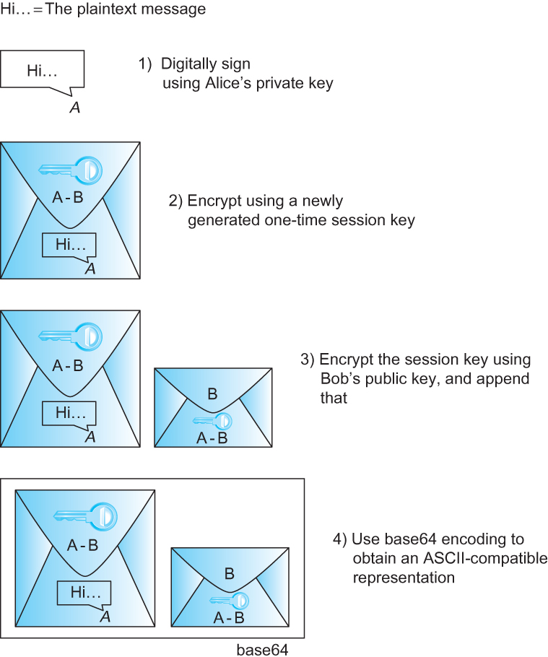
Example Systems - Pretty Good Privacy (PGP)
PGP’s steps to prepare a message for emailing from Alice to Bob

Slide 34
Transport-layer security (TLS)
widely deployed security protocol above the transport layer
  supported by almost all browsers, web servers: https (port 443)
provides:
  confidentiality: via symmetric encryption
  integrity: via cryptographic hashing
  authentication: via public key cryptography
all techniques we have studied!
history:
  early research, implementation: secure network programming, secure sockets
  secure socket layer (SSL) deprecated [2015]
  TLS 1.3: RFC 8846 [2018]

Slide 35
Transport-layer security (TLS)
TLS provides an API that any application can use
an HTTP view of TLS:
HTTP 1.0
HTTP/2
HTTP/2 (slimmed)
Application
HTTP/3
TLS
QUIC
Transport
TCP
TCP
UDP
Network
IP
IP
IP
HTTP/2 over TCP
HTTP/2 over TCP
HTTP/2 over QUIC
(which incorporates TLS)
over UDP

Slide 36
TLS: 1.3 cipher suite
“cipher suite”: algorithms that can be used for key generation, encryption, MAC, digital signature
TLS: 1.3 (2018): more limited cipher suite choice than TLS 1.2 (2008)
  only 5 choices, rather than 37 choices
  requires Diffie-Hellman (DH) for key exchange, rather than DH or RSA
  combined encryption and authentication algorithm (“authenticated encryption”) for data rather than serial encryption, authentication
    4 based on AES
  HMAC uses SHA (256 or 284) cryptographic hash function

Slide 37

TLS 1.3 handshake: 1 RTT
1
client TLS hello msg:
guesses key agreement protocol, parameters
indicates cipher suites it supports
client hello:
supported cipher suites
DH key agreement protocol, parameters
1
2
server TLS hello msg chooses
key agreement protocol, parameters
cipher suite
server-signed certificate
server hello:
selected cipher suite
DH key agreement protocol, parameters
2
3
3
client:
checks server certificate
generates key
can now make application request (e.g.., HTTPS GET)
client
server

Slide 38
TLS 1.3 handshake: 0 RTT
initial hello message contains encrypted application data!
“resuming” earlier connection between client and server
application data encrypted using “resumption master secret” from earlier connection
vulnerable to replay attacks!
maybe OK for get HTTP GET or client requests not modifying server state
client hello:
supported cipher suites
DH key agreement protocol, parameters
application data
server hello:
selected cipher suite
DH key agreement protocol, parameters
application data (reply)
client
server

Slide 39

Firewalls
firewall
isolates organization’s internal network from larger Internet, allowing some packets to pass, blocking others
administered
network
public
Internet
trusted “good guys”
untrusted “bad guys”
firewall

Slide 40
Firewalls: why
prevent denial of service attacks:
  SYN flooding: attacker establishes many bogus TCP connections, no resources left for “real” connections
prevent illegal modification/access of internal data
  e.g., attacker replaces CIA’s homepage with something else
allow only authorized access to inside network
  set of authenticated users/hosts
three types of firewalls:
  stateless packet filters
  stateful packet filters
  application gateways

Slide 41
Stateless packet filtering
Should arriving packet be allowed in? Departing packet let out?
internal network connected to Internet via router firewall
filters packet-by-packet, decision to forward/drop packet based on:
  source IP address, destination IP address
  TCP/UDP source, destination port numbers
  ICMP message type
  TCP SYN, ACK bits

Slide 42
Stateless packet filtering: example
Should arriving packet be allowed in? Departing packet let out?
example 1: block incoming and outgoing datagrams with IP protocol field = 17 and with either source or dest port = 23
  result: all incoming, outgoing UDP flows and telnet connections are blocked
example 2: block inbound TCP segments with ACK=0
  result: prevents external clients from making TCP connections with internal clients, but allows internal clients to connect to outside

Slide 43
Stateless packet filtering: more examples
Policy | Firewall Setting
no outside Web access | drop all outgoing packets to any IP address, port 80
no incoming TCP connections, except those for institution’s public Web server only. | drop all incoming TCP SYN packets to any IP except 130.207.244.203, port 80
prevent Web-radios from eating up the available bandwidth. | drop all incoming UDP packets - except DNS and router broadcasts.
prevent your network from being used for a smurf DoS attack. | drop all ICMP packets going to a “broadcast” address (e.g. 130.207.255.255)
prevent your network from being tracerouted | drop all outgoing ICMP TTL expired traffic

Slide 44
Access Control Lists
ACL: table of rules, applied top to bottom to incoming packets: (action, condition) pairs: looks like OpenFlow forwarding (Ch. 4)!
action | source address | dest address | protocol | source port | dest port | flag bit
allow | 222.22/16 | outside of 222.22/16 | TCP | > 1023 | 80 | any
allow | outside of 222.22/16 | 222.22/16 | TCP | 80 | > 1023 | ACK
allow | 222.22/16 | outside of 222.22/16 | UDP | > 1023 | 53 | ---
allow | outside of 222.22/16 | 222.22/16 | UDP | 53 | > 1023 | ----
deny | all | all | all | all | all | all

Slide 45
Stateful packet filtering
stateless packet filter: heavy handed tool
  admits packets that “make no sense,” e.g., dest port = 80, ACK bit set, even though no TCP connection established:
action | source address | dest address | protocol | source port | dest port | flag bit
allow | outside of 222.22/16 | 222.22/16 | TCP | 80 | > 1023 | ACK
stateful packet filter: track status of every TCP connection
  track connection setup (SYN), teardown (FIN): determine whether incoming, outgoing packets “makes sense”
  timeout inactive connections at firewall: no longer admit packets

Slide 46
Stateful packet filtering
ACL augmented to indicate need to check connection state table before admitting packet
action | source address | dest address | proto | source port | dest port | flag bit | check connection
allow | 222.22/16 | outside of 222.22/16 | TCP | > 1023 | 80 | any
allow | outside of 222.22/16 | 222.22/16 | TCP | 80 | > 1023 | ACK | x
allow | 222.22/16 | outside of 222.22/16 | UDP | > 1023 | 53 | ---
allow | outside of 222.22/16 | 222.22/16 | UDP | 53 | > 1023 | ---- | x
deny | all | all | all | all | all | all

Slide 47
Intrusion detection systems
packet firewall/filtering:
  operates on TCP/IP headers only
  no correlation check among sessions
IDS: intrusion detection system
  deep packet inspection: look at packet contents (e.g., check character strings in packet against database of known virus, attack strings)
  examine correlation among multiple packets
    port scanning
    network mapping
    DoS attack

Slide 48
Intrusion detection systems
multiple IDSs: different types of checking at different locations
firewall
internal
network
Internet
IDS
sensors
Web
server
demilitarized
zone
DNS
server
FTP
server

Slide 49
Network Security (summary)
basic techniques…...
  cryptography (symmetric and public key)
  message integrity
  end-point authentication
…. used in many different security scenarios
  secure email
  secure transport (TLS)
operational security: firewalls and IDS

