Slide 1
What we’d like to know
If we have a polynomial time algorithm to solve a problem is it the best possible algorithm for that problem?
If we don’t have a polynomial time algorithm: is it unsolvable ?
is it intractable ?
or are we just not clever enough ?
10

Slide 2
Problem Reduction
Common technique to find lower bound for problem P
Idea: take another problem Q with known lower bound &
find a way of solving Q by reducing Q to our problem P
Use: we know the lower bound for Q
⇒ just showed Q solvable using P
⇒ P has at least the same complexity as Q
⇒ P is at least as hard as Q
⇒ So lower bound of Q is also a lower bound for P

Slide 3
Problem Reduction
To prove that problem P is at least as hard as
another problem Q, reduce Q to P.
11

Slide 4
Problems Used for Reduction
Problem | Lower Bound | Tightness
Sorting | Ω(n log n) | yes
Searching in sorted array | Ω(log n) | yes
Element uniqueness problem | Ω(n log n) | yes
Multiplication of n-digit integers | Ω(n) | unknown
Multiplication of square matrices | Ω(n²) | ¹² unknown

Slide 5
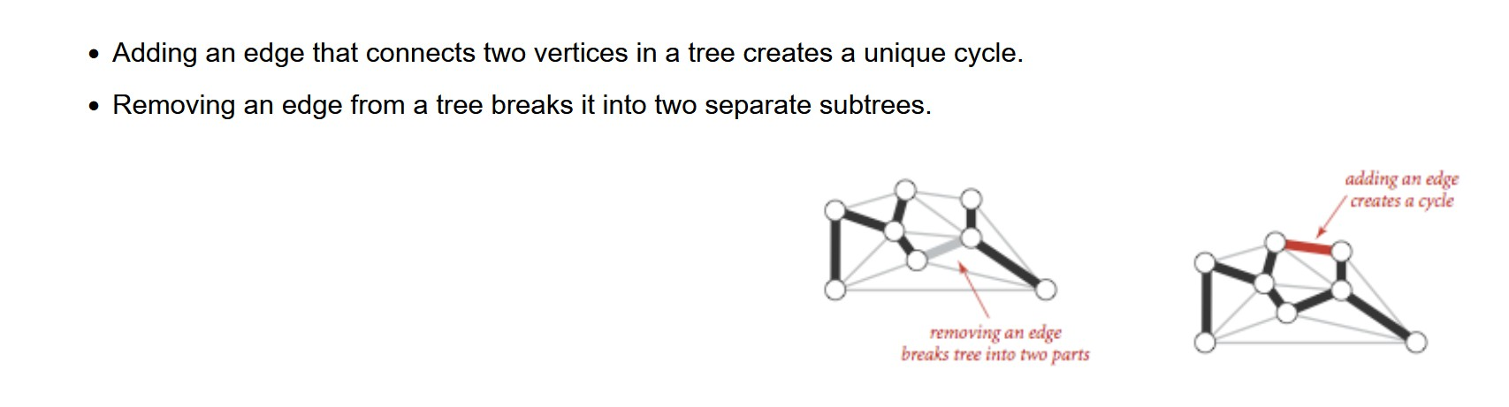
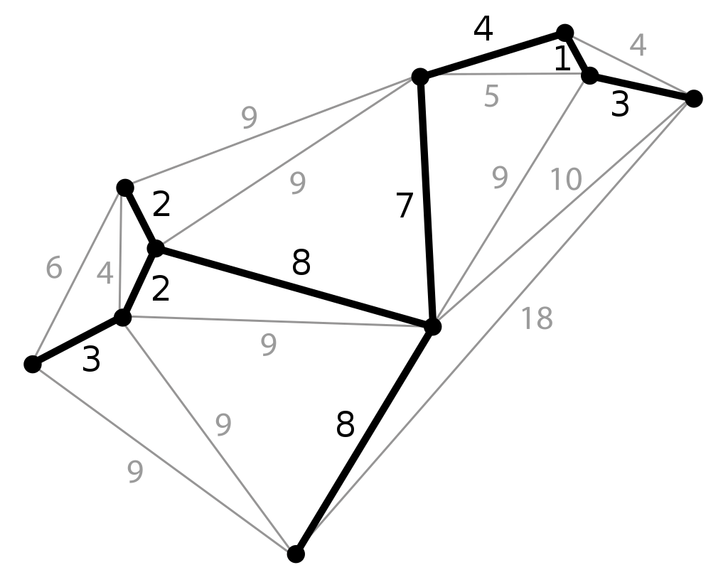
Example: Lower Bound via Reduction
Euclidean minimum spanning tree problem:
find the cheapest way to connect all nodes in a weighted graph

Slide 6
Example: Lower Bound via Reduction
Euclidean minimum spanning tree problem is at least Ω(n log n)
Consider element uniqueness, with input set x₁, x₂, …, x_{n}
transform to (x₁, 0), ..., (x_{n},0)
then build a minimum spanning tree T
T must contain a shortest edge
if it contains zero length edge ⇔ element uniqueness
⇒ this does at least as much work as element uniqueness
⇒ Ω(n log n) lower bound

Slide 7
Euclidean minimum spanning tree problem has to find the cheapest way to connect all nodes in a weighted graph
Notes:
Maybe the solution included that zero-weight edge but it could have been left out? No, because if you did that to a minimum spanning tree it is no longer a tree. Adding 0 to a minimum means it is still a minimum. So maybe the solution added that zero-weight edge because it cost nothing but in fact it wasn’t needed in the solution? No, because if you did that to a minimum spanning tree it is no longer a tree.

Slide 8
Is squaring a number harder than multiplying two numbers?
(x*y) = ( (x + y)² – (x – y)² ) /4
So we can reduce multiplication to squaring!
So squaring a number is not harder than multiplying
Check: RHS is (x² + 2xy + y² – x² +2xy – y²)/4

Slide 9
Decision Trees
Many algorithms (sorting, searching, …) work by comparing their input items
use decision trees to determine their efficiency
How much work to find a solution?
yes a < b no
a < c b < c
no yes
yes
no
a
c
b
c
1
6

Slide 10
Decision Trees
How much work (#comparisons) to find the minimum of 3 values?
What’s the least number of leaves its binary tree decision tree can have?
How high must such a tree be?
yes a < b no
a < c b < c
no yes
yes
no
a
c
b
c
1
7
For a binary tree with n leaves and height h:
h ≥ ⎡log₂ n⎤

Slide 11
Decision Trees
The algorithm’s work can be traced by a path from the root to a leaf in its decision tree
So the number of comparisons in the worst case is the same as the height of a tree
1
8

Slide 12
Decision Trees
For a binary tree with l leaves and height h:
h ≥ ⎡log₂ l⎤⎤
The number of leaves must be equal to or greater than the number of possible results
A tree must be high enough to have all leaves for the
number of possible results
We look at decision trees for sorting algorithms and
decision trees for searching a sorted array
1
9

Slide 13
Decision Trees and Sorting Algorithms
Any comparison-based sorting algorithm can
be represented by a decision tree
Exercise: How many leaves?
Number of leaves (outcomes) ≥ n!
Exercise: Height of the corresponding Binary Tree?
Height of binary tree with n! leaves ≥ ⎡log₂n!⎤
Exercise: Minimum number of comparisons in the worst case?
Minimum number of comparisons in the worst case ≥
⎡log₂n!⎤ for any comparison-based sorting algorithm
Which is???
2
0

Slide 14
Worst Case Complexity of Sorting
Number of possible ways of sorting n elements is n! Worst case number of comparisons, C_{worst} is:
C_{worst} (n) ≥ ⎡log₂ n!⎤
n
≥ log ⎛⎮^{⎛n ⎞}⎮
² ⎛ ^{e} ⎠
Using Stirling’s Formula
≥ n log₂ n − n log₂ e
≈ Ω(n log n)
This lower bound is tight (mergesort)
2
1

Slide 15
Three-Element Insertion Sort
Exercise: What is the average case complexity of the three-element insertion sort?
yes a < b no
abc
standard assumption: all cases equally likely
b < c
a < c
yes
no
yes
no
a<b<c
b<a<c
a < c
b < c
yes
no
yes
no
a<c<b
c<a<b
b<c<a
c<b<a
2
2

Slide 16
Three-Element Insertion Sort: Average Case Complexity
Average case ⇔ average height
In this tree there are 6 leaves and the average height is (2+3+3+2+3+3)/6
= 2 ²₃
yes a < b no
ab c
b < c
a < c
yes
no
yes
no
a<b<c
b<a<c
a < c
b < c
yes
no
yes
no
a<c<b
c<a<b
b<c<a
c<b<a
9

Slide 17
Decision Trees for Searching a
Sorted Array
Principal algorithm: binary search
The number of comparisons needed by binary
search in worst case from Section 4.3:
C_{worst} (n) = ⎡log₂ (n + 1)⎤
Use ternary tree, as three different possible results per
comparison:
k < A[i], k = A[i], k > A[i]
2n+1 leaves (n for successful searches, n+1 for unsuccessful)
24

Slide 18
Decision Tree for Binary Search:
four-element array
<
A[1]
>
A[0]
A[2]
<
>
<
>
< A[0]
(A[0],A[1])
(A[1],A[2])
A[3]
<
>
Minimum height of a ternary tree with l leaves:
⎡log₃ l⎤
(A[2],A[3])
>A[3]

Slide 19
Reminder: Meaning of Intractable
If an algorithm exists that can solve a problem in
polynomial time, then we can hope to get answers
If it cannot be solved in polynomial time, then we cannot really hope to get answers in our lifetime for reasonable sized problems.
26
But – computers are getting faster all the time ????

Slide 20
Largest Problem Solvable in Unit Time
time complexity | current computer | 1000 times faster | 1 000 000 times faster | 1 000 000 000 times faster
n | 100 | 100 000 | 100 000 000 | 100 000 000 000
_{n}2 | 10 | 316 | 10 000 | 316 227
_{n}3 | 4.6 | 46 | 464 | 4 641
_{n}5 | 2.5 | 10 | 39.8 | 158
₂n | 6.6 | 16 | 26 | 36.5
₃n | 4.2 | 10.5 | 16.8 | 28 23.0

Slide 21
Polynomial time algorithms are useful,
superpolynomial time algorithms are not.
The idea of classifying problems according to polynomial and superpolynomial time profoundly changed the way people thought about computational problems.
27

Slide 22
Provably Intractable Problems
Intractable problems are problems with an exponential lower bound.
Very few problems have been proved intractable
100’s are suspected of being intractable
Some problems proved intractable, e.g.:
Towers of Hanoi – exponential output (2^{n} – 1)
generalized checkers chess and go (N x N board)
  Given a board position, can the first player force a win? Here N is the size of the board, and the running time is exponential in N.
29
roadblock

