Slide 1
Estimating Serial Intervals from Outbreak Symptom Onset Data
An Extension of the Vink et al. Transmission-Path Framework
Supervisors: Kylie Ainslie, David Price
Panyuan (Terry) Xue
Master of Biostatistics (Enhanced)

Slide 2
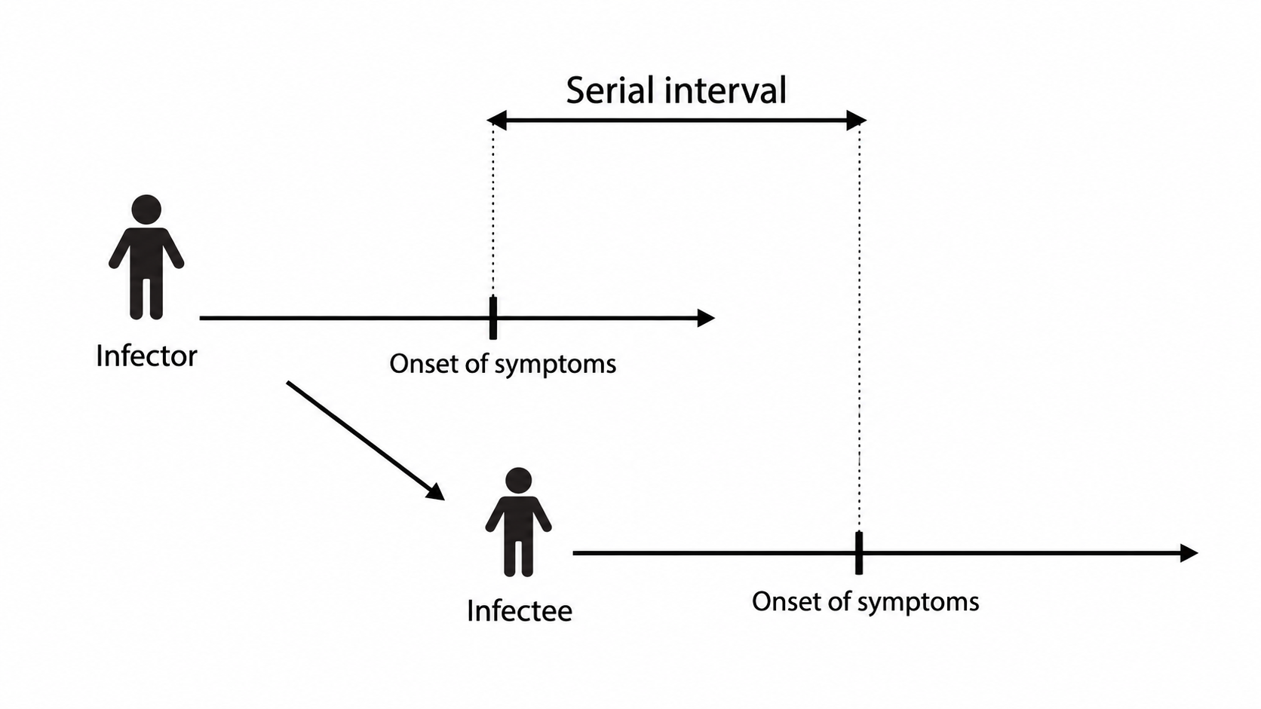
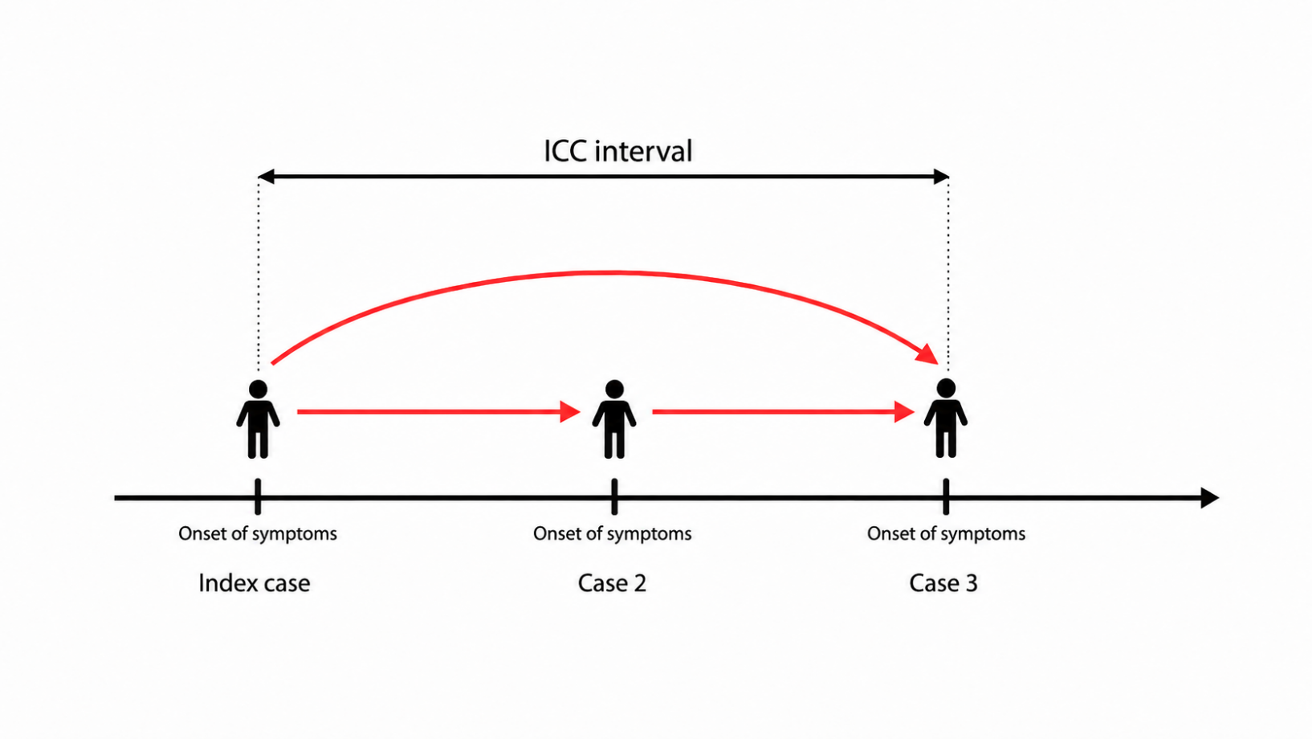
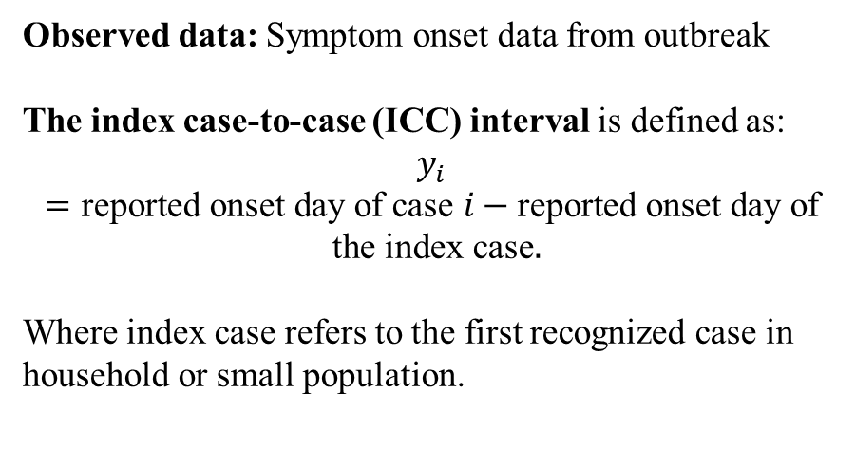
Introduction
Serial interval (SI): the time duration between symptom onsets of a primary case (infector) and its secondary case (infectee).
Observed data: Symptom onset data from outbreak
The index case-to-case (ICC) interval is defined as:
$$y_{i}=\text{reported onset day of case }i−\text{reported onset day of the index case}.$$
Where index case refers to the first recognized case in household or small population.

Slide 3
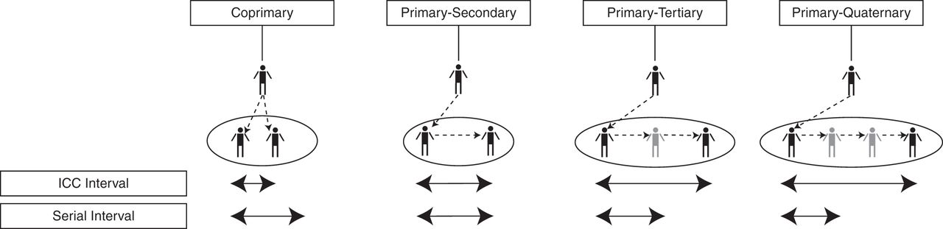
Existing Framework (Vink et al.)
What latent transmission path structure lies behind an observed ICC interval?
Quantity of interest: the mean and standard deviation of the underlying SI distribution, represented by the Primary–Secondary transmission path.
Figure source: Vink et al. (2014)

Slide 4
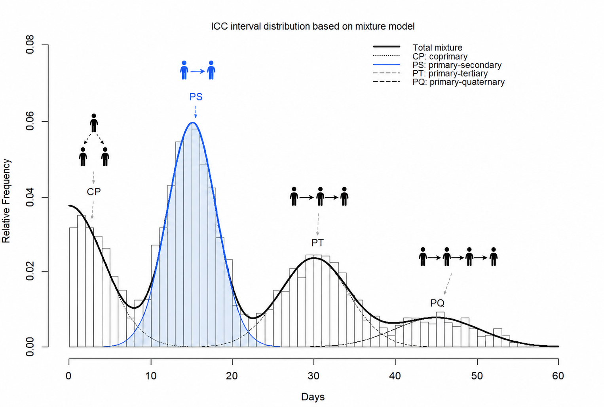
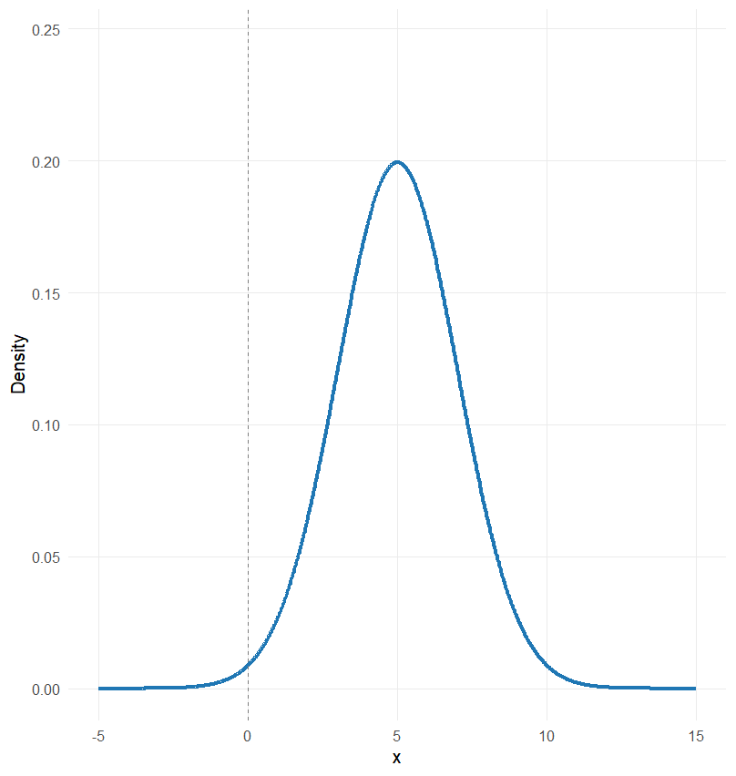
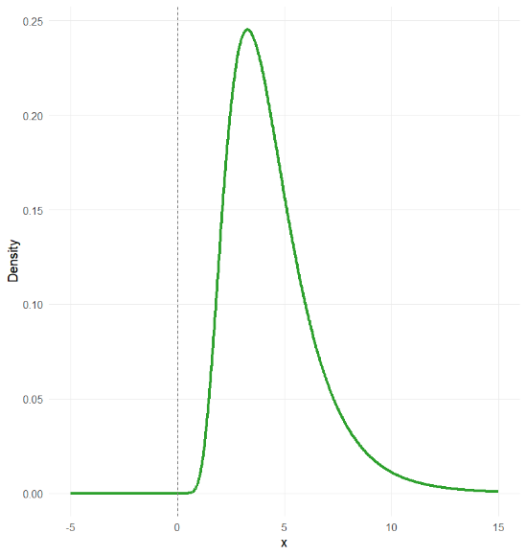
Lognormal Extension & Path update in Mixture model
Normal
Lognormal
Transmission path | Co-primary (CP) | Primary-secondary (PS) | Primary-tertiary (PT) | Primary-quaternary (PQ)
Ideal construction | ∣X₁ − X₂∣ | X₁ | X₁ + X₂ | X₁ + X₂ + X₃
Working formulation | Half-Normal approximation | Exact Log-Normal | Fenton–Wilkinson approximation | Fenton–Wilkinson approximation
Working distribution | ∣N(0, 2σ²)∣ | Lognormal(μ, σ²) | Lognormal(2μ, 2σ²) | Lognormal(3μ, 3σ²)

Slide 5
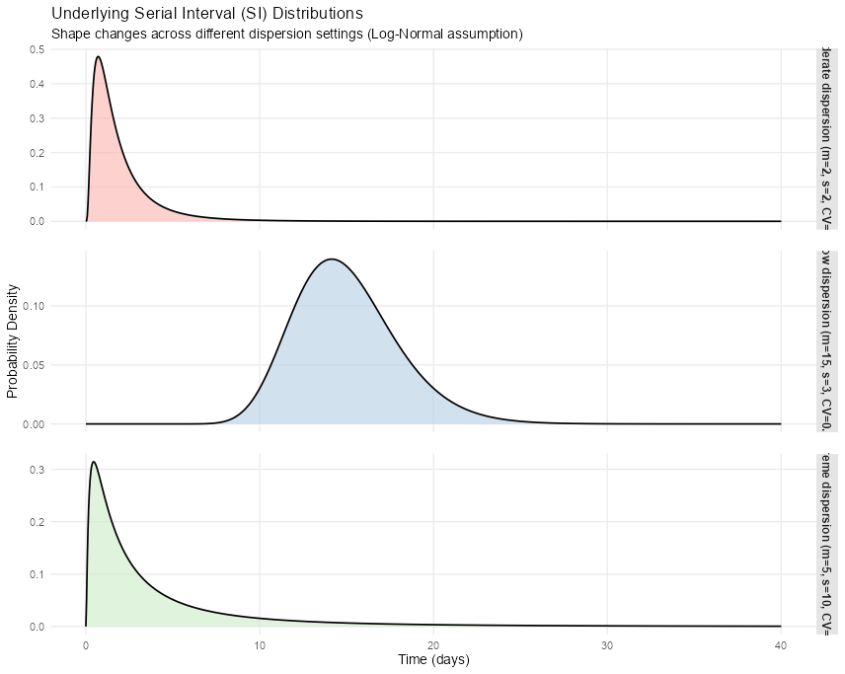
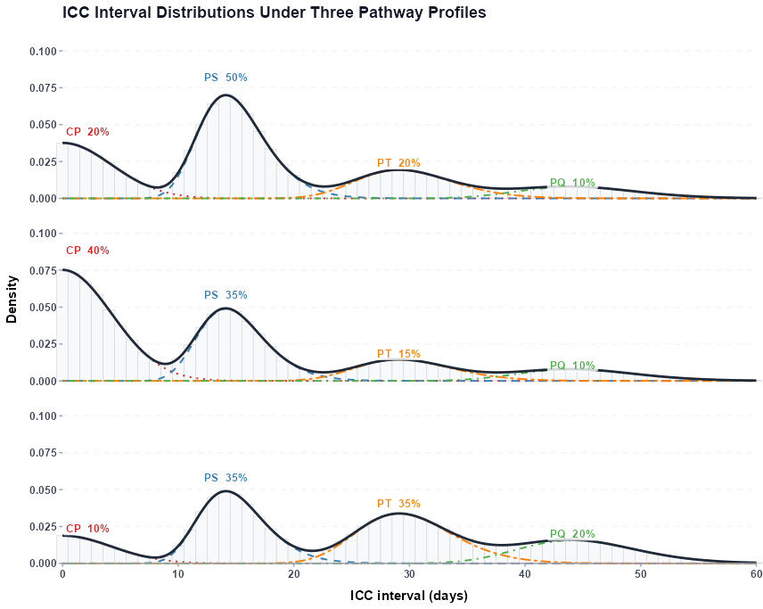
Simulation design
SI distribution
Path weights for Mixture Model
Baseline (PS dominant)
High -dispersion
3×3
scenarios
CP-heavy
Low-dispersion
Higher-generation heavy
Moderate dispersion

Slide 6
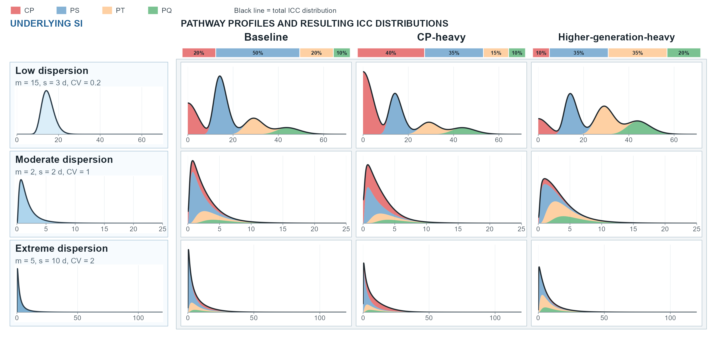
Simulation design (9 scenarios)

Slide 7
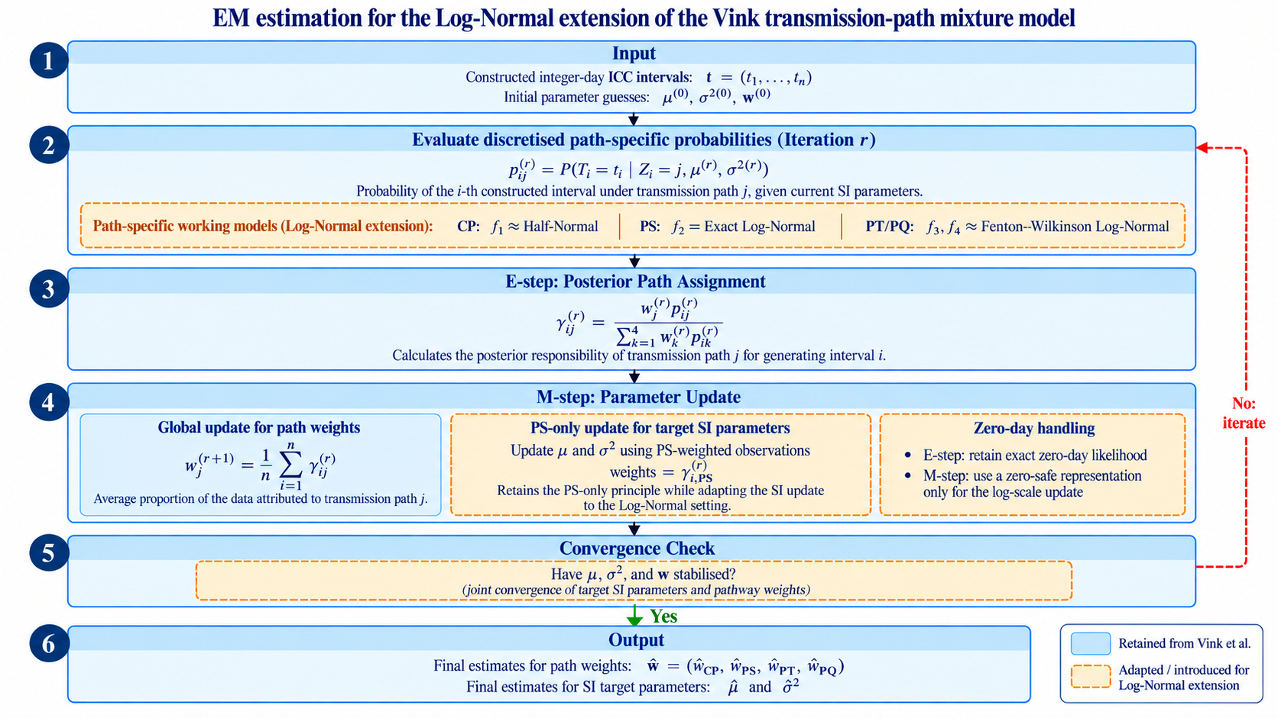
EM algorithm (computational optimization)

Slide 8
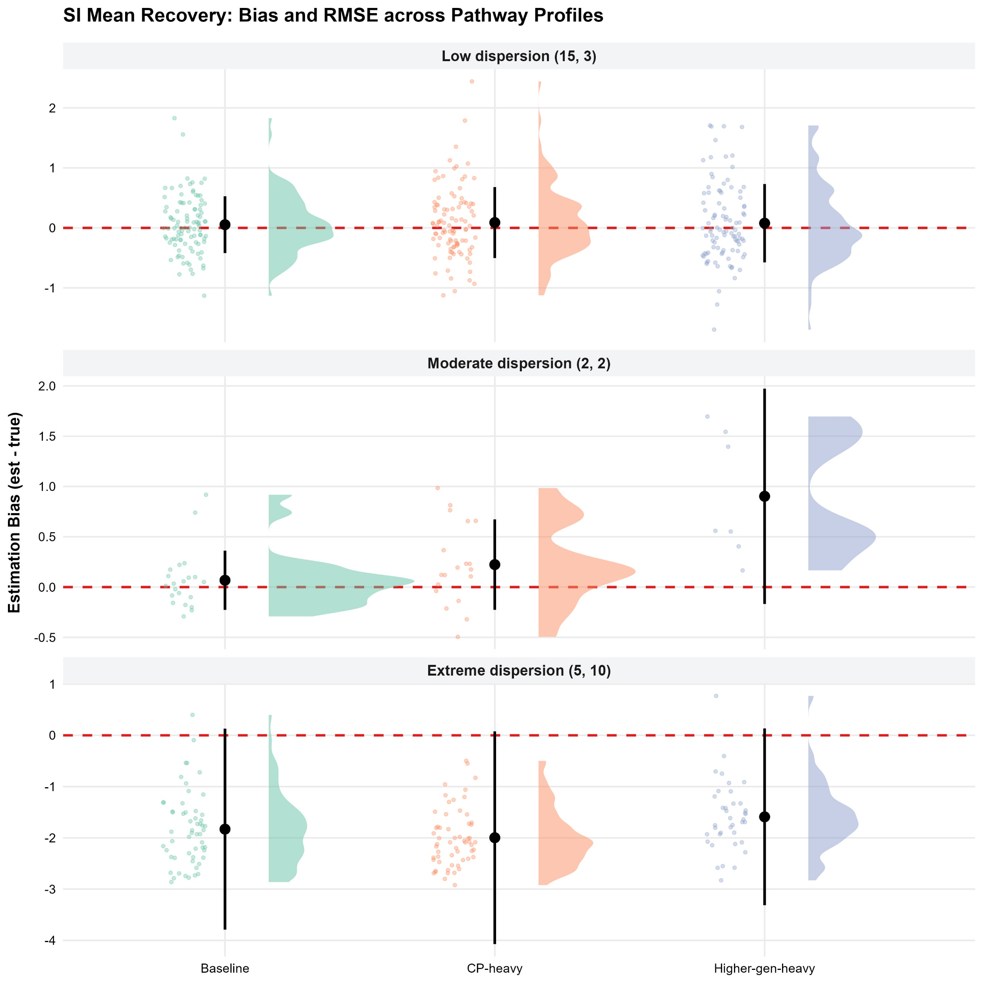
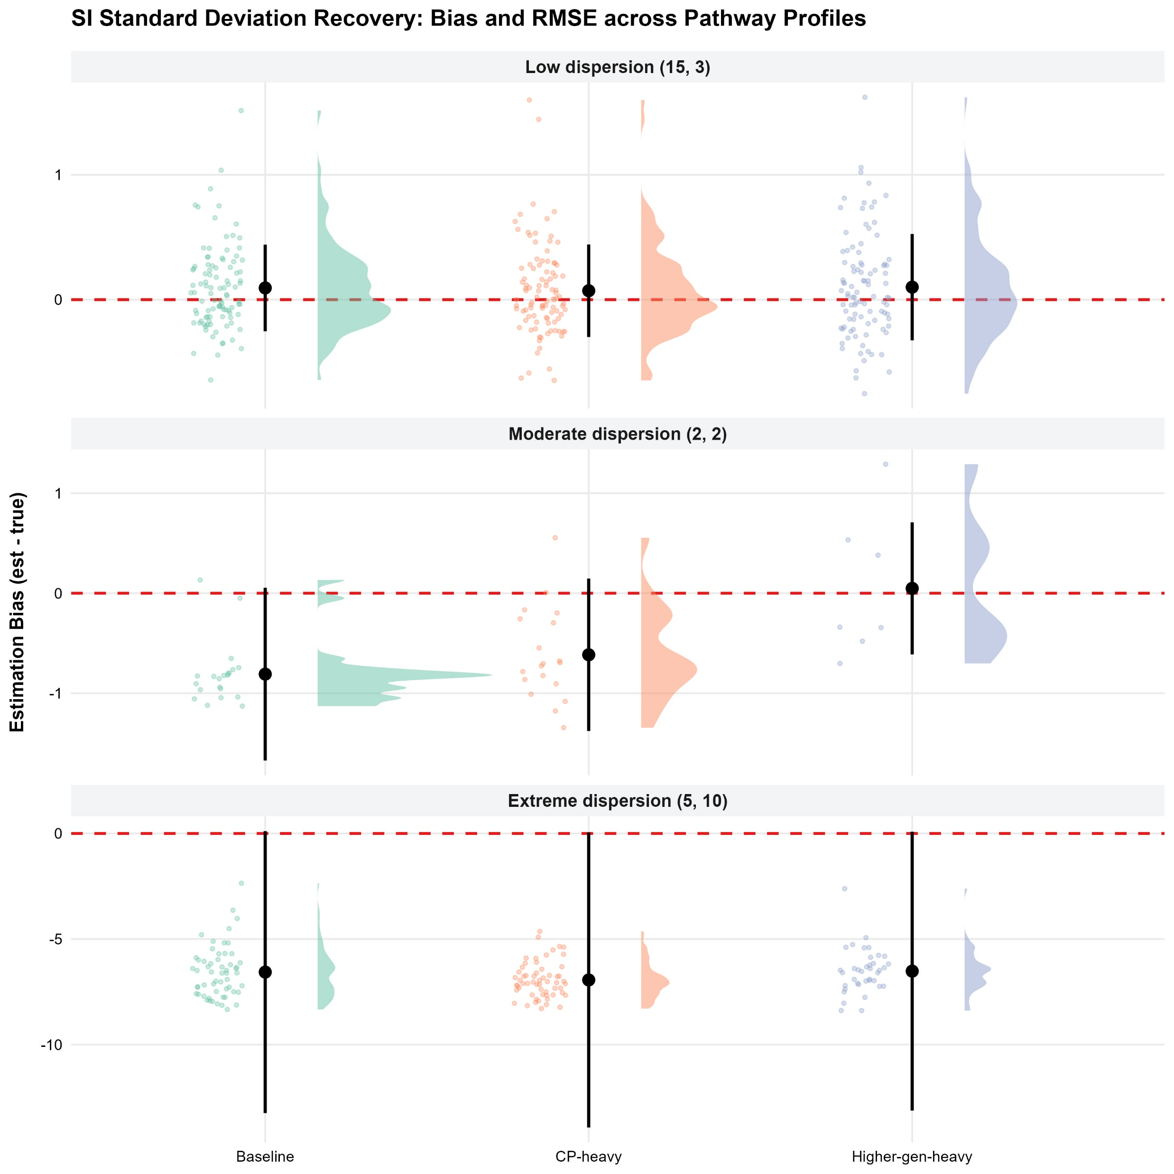
Simulation result

Slide 9
Simulation result
True SI Mean=15 and SD =3 (N=200; 100 repetitions; 50 iterations)
Scenario | Profile | Parameter | Avg. estimate | Bias | RMSE | Convergence (%)
1 | Baseline | Mean | 15.06 | 0.06 | 0.49 | 99
1 | Baseline | SD | 3.1 | 0.1 | 0.36 | 99
2 | CP-heavy | Mean | 15.11 | 0.11 | 0.61 | 98
2 | CP-heavy | SD | 3.09 | 0.09 | 0.39 | 98
3 | Higher-generation-heavy | Mean | 15.14 | 0.14 | 0.72 | 96
3 | Higher-generation-heavy | SD | 3.16 | 0.16 | 0.52 | 96
True SI Mean=2 and SD =2 (N=200; 100 repetitions; 300 iterations)
Scenario | Profile | Parameter | Avg. estimate | Bias | RMSE | Convergence (%)
4 | Baseline | Mean | 2.3 | 0.3 | 0.48 | 21
4 | Baseline | SD | 1.46 | -0.54 | 0.67 | 21
5 | CP-heavy | Mean | 2.38 | 0.38 | 0.54 | 19
5 | CP-heavy | SD | 1.53 | -0.47 | 0.61 | 19
6 | Higher-generation-heavy | Mean | 2.77 | 0.77 | 0.92 | 7
6 | Higher-generation-heavy | SD | 1.93 | -0.07 | 0.54 | 7
True SI Mean=5 and SD =10 (N=200; 100 repetitions; 300 iterations)
Scenario | Profile | Parameter | Avg. estimate | Bias | RMSE | Convergence (%)
7 | Baseline | Mean | 3.47 | -1.53 | 2.03 | 56
7 | Baseline | SD | 3.89 | -6.11 | 6.58 | 56
8 | CP-heavy | Mean | 3.42 | -1.58 | 2.28 | 58
8 | CP-heavy | SD | 3.7 | -6.3 | 6.92 | 58
9 | Higher-generation-heavy | Mean | 4.99 | -0.01 | 2.34 | 38
9 | Higher-generation-heavy | SD | 6.21 | -3.79 | 5.63 | 38

Slide 10
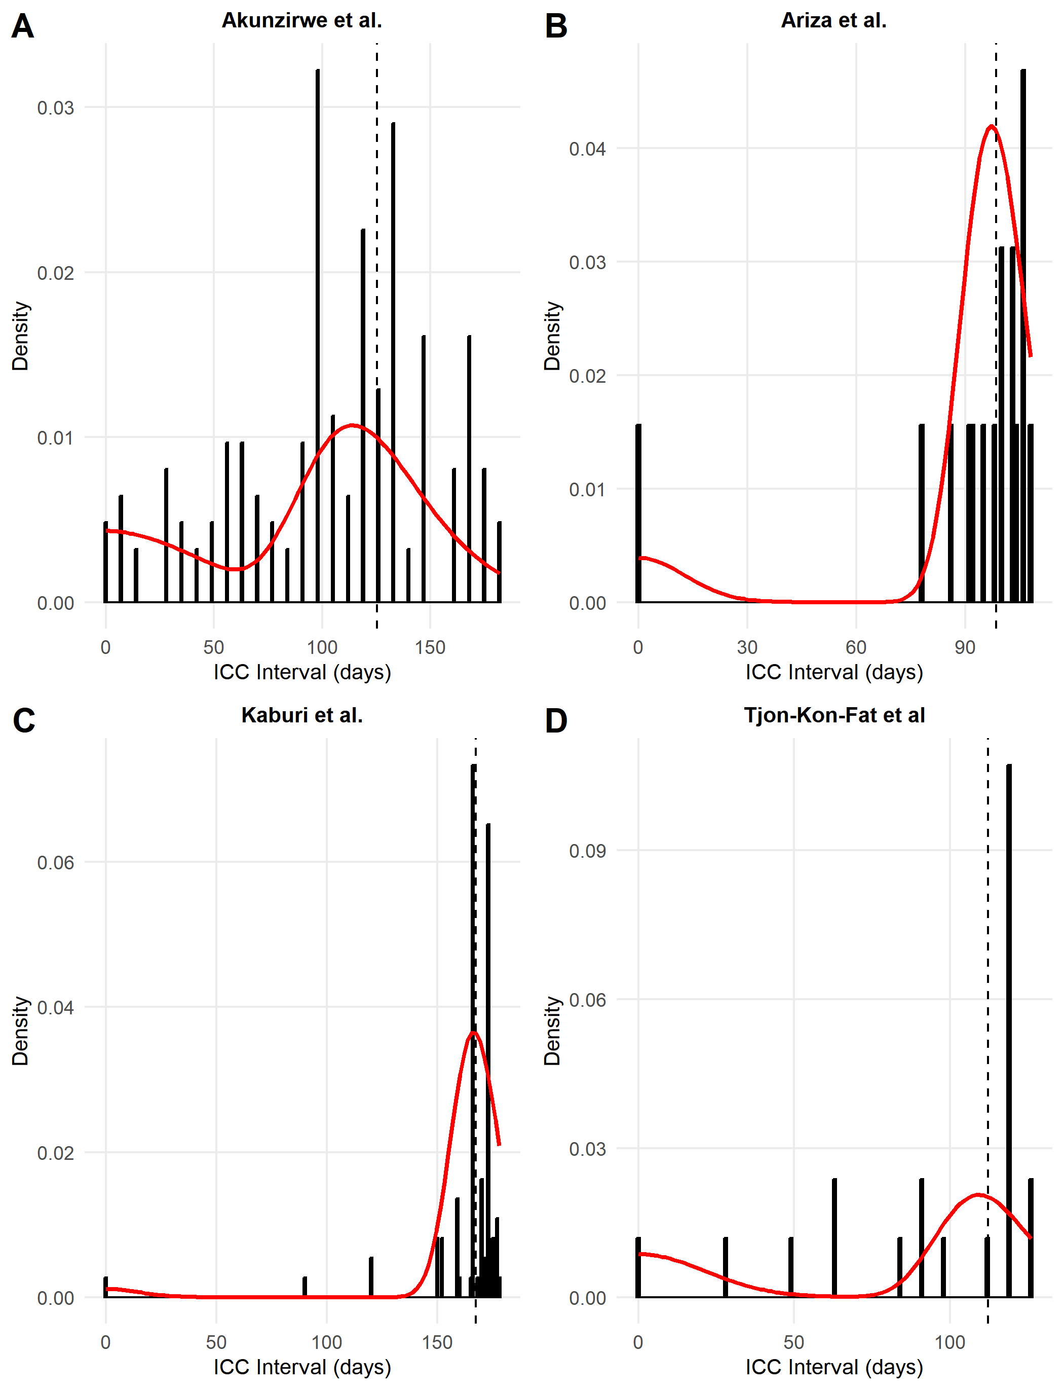
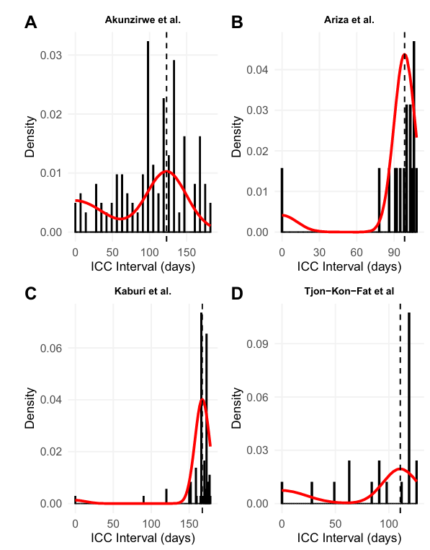
Data analysis (Scabies dataset)
Study | Normal mean | Lognormal mean | Normal SD | Lognormal SD
Akunzirwe | 122.9 | 125.438 | 26.9 | 30.989
Ariza | 98.4 | 98.440 | 8.5 | 9.011
Kaburi | 167.3 | 167.370 | 9.7 | 10.731
Tjon-Kon-Fat | 110.7 | 112.321 | 16.1 | 15.165
Model fits of lognormal SI to ICC data
Model fits of normal SI to ICC data
Figure source: Ainslie et al. (2025)

Slide 11
Code Implementation (mitey package)

Slide 12
Limitations
Approximation error: FW underestimates higher-order skewness..
Convergence: High dispersion increases pathway overlap and weakens identifiability.
Structure: Four pathways and independence assumptions may not capture complex outbreaks.
Future work
Develop SI distribution selection criteria: Evaluate methods such as smooth goodness-of-fit tests to help {mitey} users choose an appropriate Normal, Gamma, or Log-Normal SI model.
Extend the pathway structure: Determine when higher-generation transmission paths are warranted and how to add them while preserving epidemiological plausibility and model identifiability.

