Slide 1
The Foundations: Logic and Proofs
Chapter 1, Part I: Propositional Logic
Edited by Shih-Tsung Liang

Slide 2
Chapter Summary
Propositional Logic ( 命題邏輯)
The Language of Propositions
Applications
Logical Equivalences
Predicate Logic (述詞邏輯)
Predicates(述詞) and Quantifiers(量詞)
Logical Equivalences (等價)
Nested Quantifiers
Proofs
Rules of Inference
Proof Methods
Proof Strategy

Slide 3
Propositional Logic (命題邏輯)
Section 1.1

Slide 4
Propositions
A proposition(命題) is a declarative sentence (陳述句) that is either true or false.
Examples of propositions:
The Moon is made of green cheese.
Trenton is the capital of New Jersey.
Toronto is the capital of Canada.
1 + 0 = 1
0 + 0 = 2
Examples that are not propositions.
Sit down!
What time is it?
x + 1 = 2
x + y = z

Slide 5
Constructing Propositions
Propositional Variables: p, q, r, s, …
The proposition that is always true is denoted by T and the proposition that is always false is denoted by F.
Compound Propositions; constructed from logical connectives and other propositions
Negation (否定) ¬
Conjunction (合取) ∧
Disjunction (分取) ∨
Implication (蘊涵) →
Biconditional (雙條件；若且唯若) ↔

Slide 6
Compound Propositions: Negation
The negation (否定) of a proposition p is denoted by ¬p and has this truth table:
Example: If p denotes “The earth is round.”, then ¬p denotes “It is not the case that the earth is round,” or more simply “The earth is not round.”
p | ¬p
T | F
F | T

Slide 7
Conjunction (合取)
The conjunction of propositions p and q is denoted by p ∧ q and has this truth table:
Example: If p denotes “I am at home.” and q denotes “It is raining.” then p ∧q denotes “I am at home and it is raining.”
p | q | p ∧ q
T | T | T
T | F | F
F | T | F
F | F | F

Slide 8
Disjunction(分取)
The disjunction of propositions p and q is denoted by p ∨q and has this truth table:
Example: If p denotes “I am at home.” and q denotes “It is raining.” then p ∨q denotes “I am at home or it is raining.”
p | q | p ∨q
T | T | T
T | F | T
F | T | T
F | F | F

Slide 9
The Connective Or in English
In English “or” has two distinct meanings.
“Inclusive Or” - In the sentence “Students who have taken CS202 or Math120 may take this class,” we assume that students need to have taken one of the prerequisites, but may have taken both. This is the meaning of disjunction. For p ∨q to be true, either one or both of p and q must be true.
“Exclusive Or” (互斥或) - When reading the sentence “Soup or salad comes with this entrée,” we do not expect to be able to get both soup and salad. This is the meaning of Exclusive Or (Xor).
The exclusive or of p and q, denoted by p ⊕ q , is the proposion that is true when exactly one of p and q is true and is false otherwise.. The truth table for ⊕ is:
p | q | p ⊕q
T | T | F
T | F | T
F | T | T
F | F | F

Slide 10
Implication(蘊涵)
If p and q are propositions, then p →q is a conditional statement or implication which is read as “if p, then q ” and has this truth table:
Example: If p denotes “I am at home.” and q denotes “It is raining.” then p →q denotes “If I am at home then it is raining.”
In p →q , p is the hypothesis (antecedent or premise) and q is the conclusion (or consequence).
p | q | p →q
T | T | T
T | F | F
F | T | T
F | F | T

Slide 11
Understanding Implication
In p →q there does not need to be any connection between the antecedent or the consequent. The “meaning” of p →q depends only on the truth values of p and q.
These implications are perfectly fine, but would not be used in ordinary English.
“If the moon is made of green cheese, then I have more money than Bill Gates. ”
“If the moon is made of green cheese then I’m on welfare.”
“If 1 + 1 = 3, then your grandma wears combat boots.”

Slide 12
Understanding Implication (cont)
One way to view the logical conditional is to think of an obligation or contract.
“If I am elected, then I will lower taxes.”
“If you get 100% on the final, then you will get an A.”
If the politician is elected and does not lower taxes, then the voters can say that he or she has broken the campaign pledge. Something similar holds for the professor. This corresponds to the case where p is true and q is false.

Slide 13
Different Ways of Expressing p →q
if p, then q p implies q
if p, q p only if q
q unless ¬p q when p
q if p q when p
q whenever p p is sufficient for q
q follows from p q is necessary for p
a necessary condition for p is q
a sufficient condition for q is p
Notes:
In logic, necessity and sufficiency are terms used to describe a conditional or implicational relationship between statements. For example, in the conditional statement: "If P then Q", Q is necessary for P" because P cannot be true unless Q is true. Similarly, "P is sufficient for Q" because P being true always implies that Q is true, but P not being true does not always imply that Q is not true.

Slide 14
Converse (逆命題), Contrapositive(對位命題), and Inverse(反命題)
From p →q we can form new conditional statements .
q →p is the converse of p →q
¬q → ¬ p is the contrapositive of p →q
¬ p → ¬ q is the inverse of p →q
Example: Find the converse, inverse, and contrapositive of “It raining is a sufficient condition for my not going to town.”
Solution:
converse: If I do not go to town, then it is raining.
inverse: If it is not raining, then I will go to town.
contrapositive: If I go to town, then it is not raining.

Slide 15
Biconditional (若且唯若)
If p and q are propositions, then we can form the biconditional proposition p ↔q , read as “p if and only if q .” The biconditional p ↔q denotes the proposition with this truth table:
If p denotes “I am at home.” and q denotes “It is raining.” then p ↔q denotes “I am at home if and only if it is raining.”
p | q | p ↔q
T | T | T
T | F | F
F | T | F
F | F | T

Slide 16
Expressing the Biconditional
Some alternative ways “p if and only if q” is expressed in English:
p is necessary and sufficient for q
if p then q , and conversely
p iff q

Slide 17
Truth Tables For Compound Propositions
Construction of a truth table:
Rows
Need a row for every possible combination of values for the atomic propositions.
Columns
Need a column for the compound proposition (usually at far right)
Need a column for the truth value of each expression that occurs in the compound proposition as it is built up.
This includes the atomic propositions

Slide 18
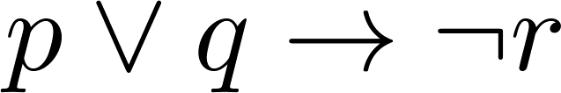
Example Truth Table
Construct a truth table for
p | q | r | ¬r | p ∨ q | p ∨ q → ¬r
T | T | T | F | T | F
T | T | F | T | T | T
T | F | T | F | T | F
T | F | F | T | T | T
F | T | T | F | T | F
F | T | F | T | T | T
F | F | T | F | F | T
F | F | F | T | F | T

Slide 19
Equivalent (等價)Propositions
Two propositions are equivalent if they always have the same truth value.
Example: Show using a truth table that the implication is equivalent to its contrapositive.
Solution:
p | q | ¬ p | ¬ q | p →q | ¬q → ¬ p
T | T | F | F | T | T
T | F | F | T | F | F
F | T | T | F | T | T
F | F | T | T | T | T

Slide 20
Using a Truth Table to Show Non-Equivalence
Example: Show using truth tables that neither the converse nor inverse of an implication are not equivalent to the implication.
Solution:
p | q | ¬ p | ¬ q | p →q | ¬ p →¬ q | q → p
T | T | F | F | T | T | T
T | F | F | T | F | T | T
F | T | T | F | T | F | F
F | F | T | T | F | T | T

Slide 21
Problem
How many rows are there in a truth table with n propositional variables?
Solution: 2^{n} We will see how to do this in Chapter 6.
Note that this means that with n propositional variables, we can construct 2^{n} distinct (i.e., not equivalent) propositions.

Slide 22
Precedence(優先順序) of Logical Operators
Operator | Precedence
¬ | 1
∧ ∨ | 2 3
→ ↔ | 4 5
p ∨q → ¬r is equivalent to (p ∨q) → ¬r
If the intended meaning is p ∨(q → ¬r )
then parentheses must be used.

Slide 23
Applications of Propositional Logic
Section 1.2

Slide 24
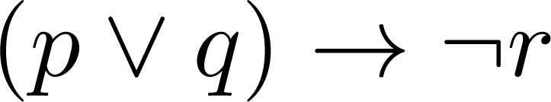
Translating English Sentences
Steps to convert an English sentence to a statement in propositional logic
Identify atomic propositions and represent using propositional variables.
Determine appropriate logical connectives
“If I go to Harry’s or to the country, I will not go shopping.”
p: I go to Harry’s
q: I go to the country.
r: I will go shopping.
If p or q then not r.

Slide 25
Example
Problem: Translate the following sentence into propositional logic:
“You can access the Internet from campus only if you are a computer science major or you are not a freshman.”
One Solution: Let a, c, and f be propositions
a: “You can access the internet from campus,”
c: “You are a computer science major,” and
f: “You are a freshman.”
=>ans: a→ (c ∨ ¬ f )

Slide 26
System Specifications (規格)
System and Software engineers take requirements in English and express them in a precise specification language based on logic.
Example: Express in propositional logic:
“The automated reply cannot be sent when the file system is full”
Solution: One possible solution: Let p denote “The automated reply can be sent” and q denote “The file system is full.”
q→ ¬ p

Slide 27
Consistent(一致性) System Specifications
Definition: A list of propositions is consistent if it is possible to assign truth values to the proposition variables so that each proposition is true.
Exercise: Are these specifications consistent?
“The diagnostic message is stored in the buffer or it is retransmitted.”
“The diagnostic message is not stored in the buffer.”
“If the diagnostic message is stored in the buffer, then it is retransmitted.”
Solution:
Let p and q be propositions and
p: “The diagnostic message is stored in the buffer.”
q: “The diagnostic message is retransmitted”
The specification can be written as: p ∨ q, p→ q, ¬p.
=>When p is false and q is true all three statements are true. So the specification is consistent.
What if “The diagnostic message is not retransmitted is added.” ?
Solution: Now we are adding ¬q and there is no satisfying assignment. So the specification is not consistent.

Slide 28
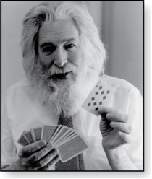
Logic Puzzles
Raymond Smullyan
(Born 1919)
An island has two kinds of inhabitants, knights(武士), who always tell the truth, and knaves(無賴), who always lie.
You go to the island and meet A and B.
A says “B is a knight.”
B says “The two of us are of opposite types.”
Example: What are the types of A and B?
Solution: Let p and q be propositions and
P: “A is a knight”
q: “B is a knight”
=>¬p: “A is a knave” and
¬q: “B is a knave”.
If A is a knight, then p is true. Since knights tell the truth, q must also be true. Then (p ∧ ¬ q)∨ (¬ p ∧ q) would have to be true, but it is not. So, A is not a knight and therefore ¬p must be true.
If A is a knave, then B must not be a knight since knaves always lie. So, then both ¬p and ¬q hold since both are knaves.

Slide 29
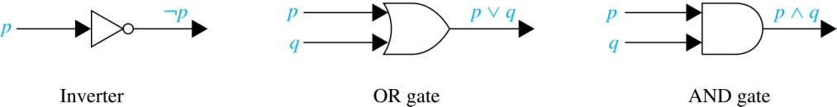
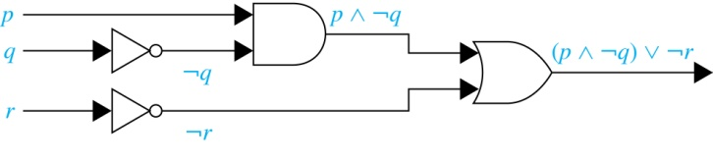
Logic Circuits (Studied in depth in Chapter 12)
Electronic circuits; each input/output signal can be viewed as a 0 or 1.
0 represents False
1 represents True
Complicated circuits are constructed from three basic circuits called gates.
The inverter (NOT gate)takes an input bit and produces the negation of that bit.
The OR gate takes two input bits and produces the value equivalent to the disjunction of the two bits.
The AND gate takes two input bits and produces the value equivalent to the conjunction of the two bits.
More complicated digital circuits can be constructed by combining these basic circuits to produce the desired output given the input signals by building a circuit for each piece of the output expression and then combining them. For example:

Slide 30
Propositional Equivalences
Section 1.3

Slide 31
Tautologies(恆真) , Contradictions(矛盾), and Contingencies(偶發)
A tautologyis a proposition which is always true.
Example: p ∨¬p
A contradiction is a proposition which is always false.
Example: p ∧¬p
A contingency is a proposition which is neither a tautology nor a contradiction, such as p
P | ¬p | p ∨¬p | p ∧¬p
T | F | T | F
F | T | T | F

Slide 32
Logically Equivalent
Two compound propositions p and q are logically equivalent if p↔q is a tautology.
We write this as p⇔q or as p≡q where p and q are compound propositions.
Two compound propositions p and q are equivalent if and only if the columns in a truth table giving their truth values agree.
This truth table show ¬p ∨ q is equivalent to p → q.
p | q | ¬p | ¬p ∨ q | p→ q
T | T | F | T | T
T | F | F | F | F
F | T | T | T | T
F | F | T | T | T

Slide 33
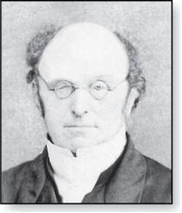
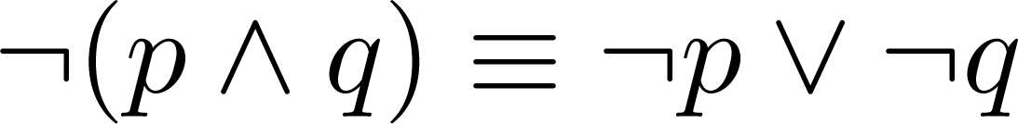
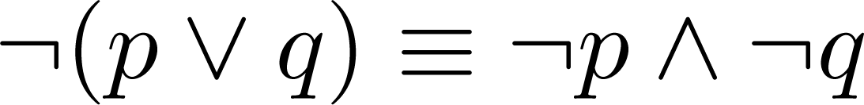
De Morgan’s Laws
De Morgan’s 1ST Laws
Augustus De Morgan
De Morgan’s 2ND Laws
1806-1871
This truth table shows that De Morgan’s 2ND Law holds.
p | q | ¬p | ¬q | (p∨q) | ¬(p∨q) | ¬p∧¬q
T | T | F | F | T | F | F
T | F | F | T | T | F | F
F | T | T | F | T | F | F
F | F | T | T | F | T | T

Slide 34
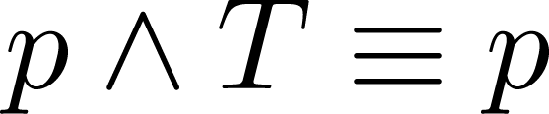
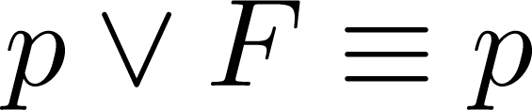
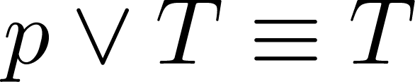
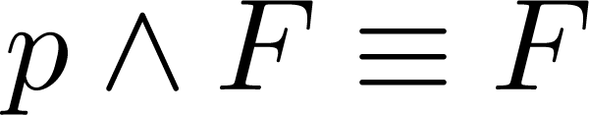
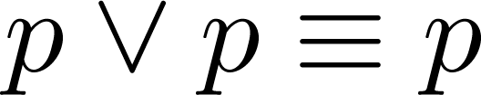
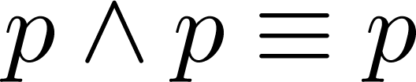
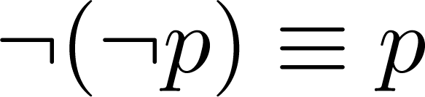
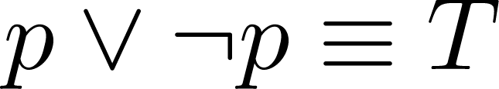
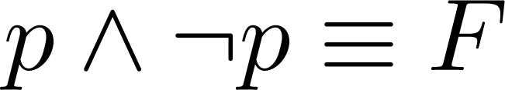
Key Logical Equivalences
Identity Laws: ,
(同一律)
Domination Laws: ,
(支配律)
Idempotent laws: ,
(幂等律)
Double Negation Law:
(雙重否定律)
Negation Laws: ,
(否定律)

Slide 35
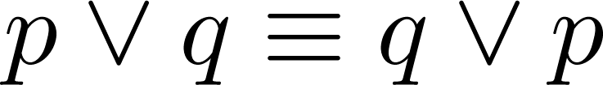
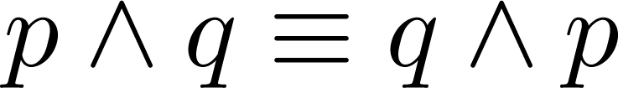
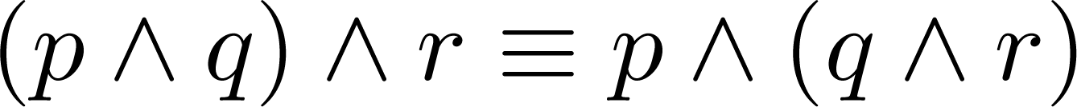
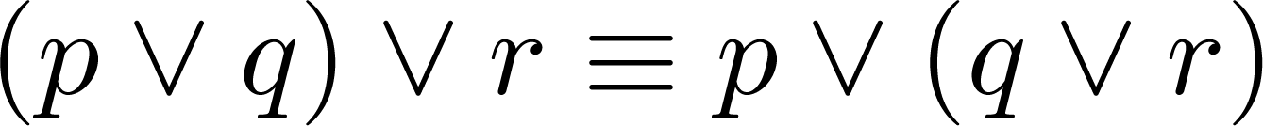
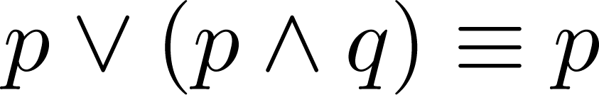
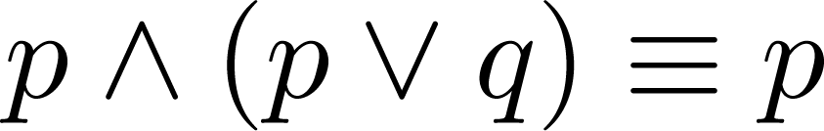
Key Logical Equivalences (cont)
Commutative Laws:
(交換律)
Associative Laws:
(結合律)
Distributive Laws:
(分配律)
Absorption Laws:
(吸收律)

Slide 36
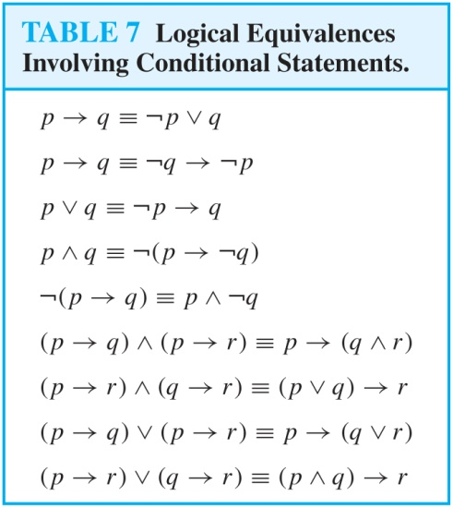
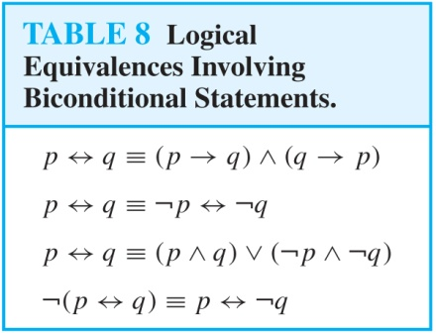
More Logical Equivalences

Slide 37

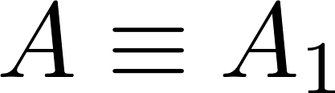
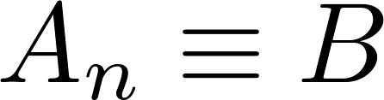
Constructing New Logical Equivalences
We can show that two expressions are logically equivalent by developing a series of logically equivalent statements.
To prove that we produce a series of equivalences beginning with A and ending with B.
Keep in mind that whenever a proposition (represented by a propositional variable) occurs in the equivalences listed earlier, it may be replaced by an arbitrarily complex compound proposition.

Slide 38
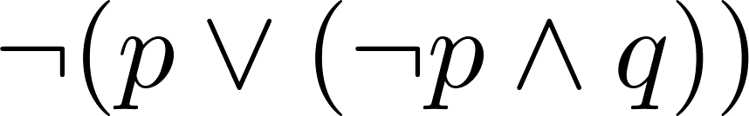
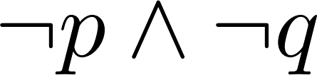
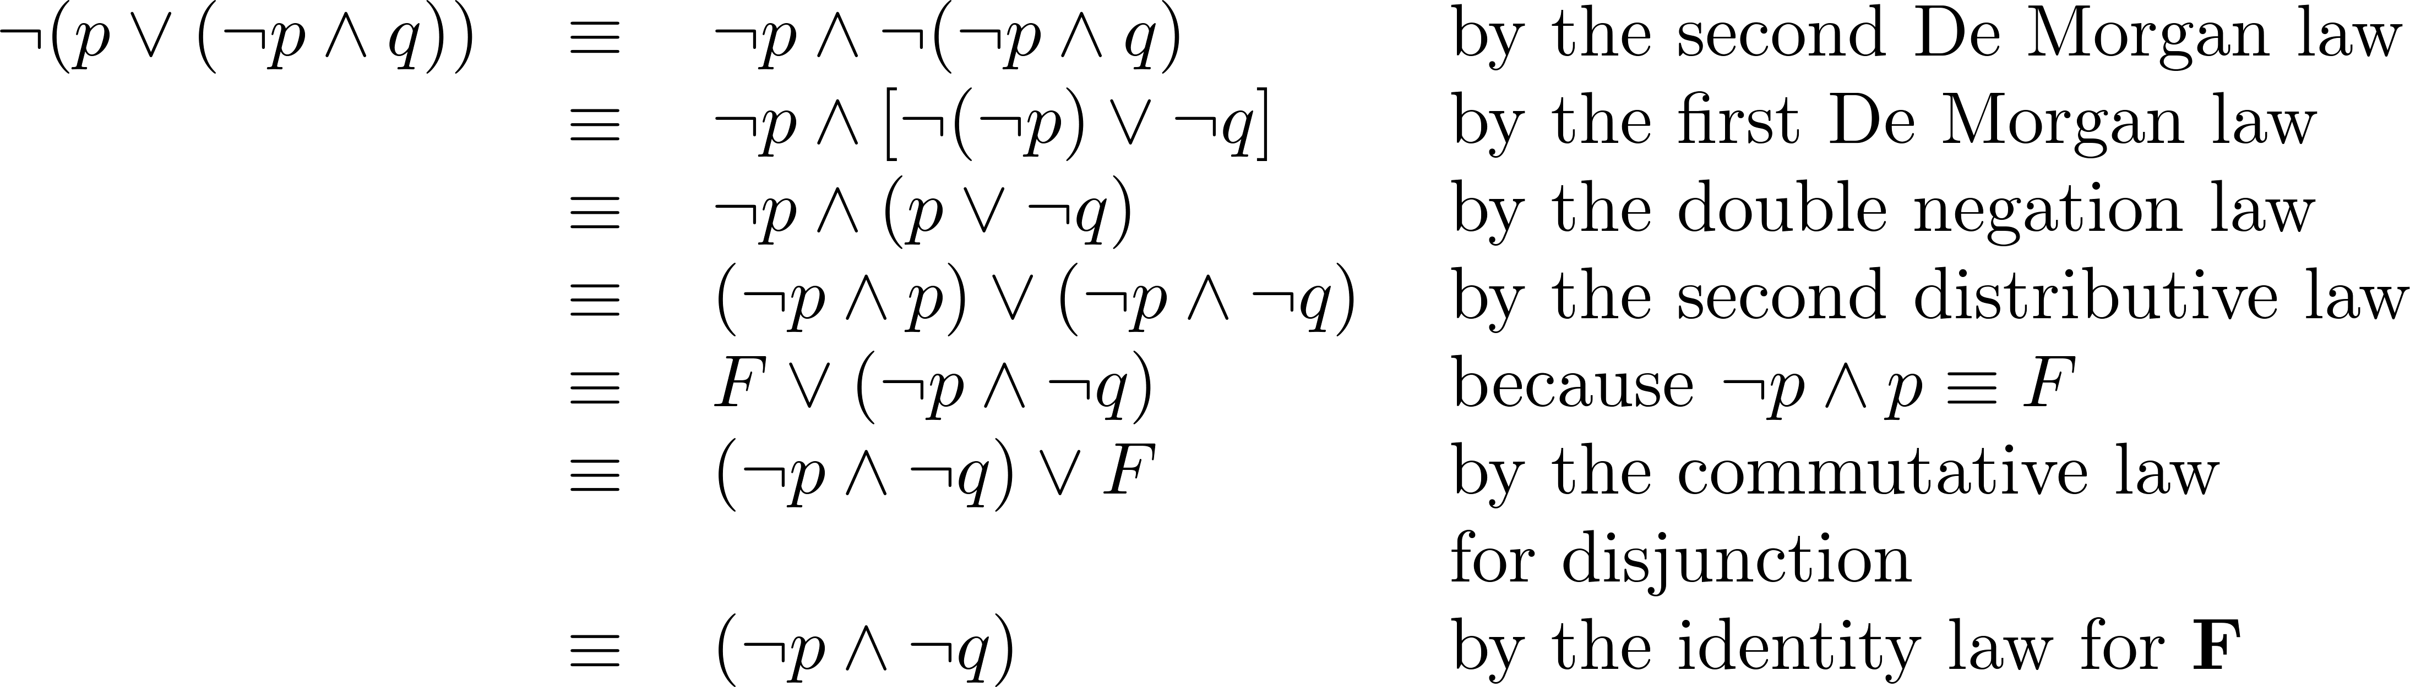
Equivalence Proofs
Example: Show that
is logically equivalent to
Solution:

Slide 39
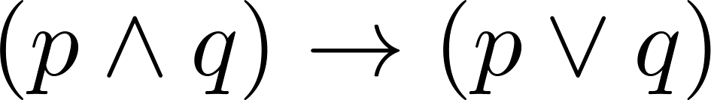
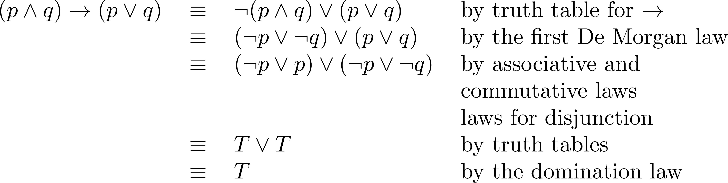
Equivalence Proofs
Example: Show that
is a tautology.
Solution:

Slide 40
The Foundations: Logic and Proofs
Chapter 1, Part II: Predicate Logic (述詞邏輯)
Edited by ShihTsung Liang

Slide 41
Predicates(述詞) and Quantifiers(量詞)
Section 1.4

Slide 42
Propositional Logic Not Enough
If we have:
“All men are mortal.”
“Socrates is a man.”
Does it follow that “Socrates is mortal?”
Can’t be represented in propositional logic. Need a language that talks about objects, their properties, and their relations.
Later we’ll see how to draw inferences.

Slide 43
Introducing Predicate Logic
The atoms of propositional logic are simple statements.
The atoms of predicate logic are statements involving variables (which can be quantified) and predicates
An atomic statement is denoted by a propositional function

Slide 44
Propositional Functions
Propositional functions become propositions (and have truth values) when their variables are each replaced by a value from the domain (or bound by a quantifier, as we will see later).
For example, let P(x) denote “x > 0” and the domain be the integers. Then:
P(-3) is false.
P(0) is false.
P(3) is true.
Often the domain is denoted by U. So in this example U is the integers.

Slide 45
Examples of Propositional Functions
Let “x + y = z” be denoted by R(x, y, z) and U (for all three variables) be the integers. Find these truth values:
R(2,-1,5)
Solution: F
R(3,4,7)
Solution: T
R(x, 3, z)
Solution: Not a Proposition
Now let “x - y = z” be denoted by Q(x, y, z), with U as the integers. Find these truth values:
Q(2,-1,3)
Solution: T
Q(3,4,7)
Solution: F
Q(x, 3, z)
Solution: Not a Proposition

Slide 46
Compound Expressions
Connectives from propositional logic carry over to predicate logic.
If P(x) denotes “x > 0,” find these truth values:
P(3) ∨ P(-1) Solution: T
P(3) ∧ P(-1) Solution: F
P(3) → P(-1) Solution: F
P(-3) → P(-1) Solution: T
Expressions with variables are not propositions and therefore do not have truth values. For example,
P(3) ∧ P(y)
P(x) → P(y)
When used with quantifiers (to be introduced next), these expressions (propositional functions) become propositions.

Slide 47
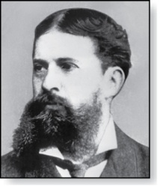
Quantifiers
Charles Peirce (1839-1914)
We need quantifiers to express the meaning of English words including all and some:
“All men are Mortal.”
“Some cats do not have fur.”
The two most important quantifiers are:
Universal Quantifier(全稱量詞), “For all,” symbol: ∀
Existential Quantifier(存在量詞), “There exists,” symbol: ∃
∀x P(x) asserts P(x) is true for every x in the domain.
∃x P(x) asserts P(x) is true for some x in the domain.
The quantifiers are said to bind the variable x in these expressions.

Slide 48
Universal Quantifier (全稱量詞)
∀x P(x) is read as “For all x, P(x)” or “For every x, P(x)”
Examples:
If P(x) denotes “x > 0” and U is the integers, then ∀x P(x) is false.
If P(x) denotes “x > 0” and U is the positive integers, then ∀x P(x) is true.
If P(x) denotes “x is even” and U is the integers, then ∀ x P(x) is false.

Slide 49
Existential Quantifier (存在量詞)
∃x P(x) is read as “For some x, P(x)”, or as “There is an x such that P(x),” or “For at least one x, P(x).”
Examples:
If P(x) denotes “x > 0” and U is the integers, then ∃x P(x) is true. It is also true if U is the positive integers.
If P(x) denotes “x < 0” and U is the positive integers, then ∃x P(x) is false.
If P(x) denotes “x is even” and U is the integers, then ∃x P(x) is true.

Slide 50
Properties of Quantifiers
The truth value of ∃x P(x) and ∀ x P(x) depends both on the propositional function P(x) and on the domain U.
Examples:
If U is the positive integers and P(x) is the statement “x < 2”, then ∃x P(x) is true, but ∀ x P(x) is false.
If U is the negative integers and P(x) is the statement “x < 2”, then both ∃x P(x) and ∀ x P(x) are true.
If U consists of 3, 4, and 5, and P(x) is the statement “x > 2”, then both ∃x P(x) and ∀ x P(x) are true. But if P(x) is the statement “x < 2”, then both ∃x P(x) and ∀ x P(x) are false.

Slide 51
Precedence(優先順序) of Quantifiers
The quantifiers ∀ and ∃ have higher precedence than all the logical operators.
For example, ∀x P(x) ∨ Q(x) means (∀x P(x))∨ Q(x)
∀x (P(x) ∨ Q(x)) means something different.
Unfortunately, often people write ∀x P(x) ∨ Q(x) when they mean ∀ x (P(x) ∨ Q(x)).

Slide 52
Equivalences in Predicate Logic
Statements involving predicates and quantifiers are logically equivalent if and only if they have the same truth value
for every predicate substituted into these statements and
for every domain of discourse used for the variables in the expressions.
The notation S ≡T indicates that S and T are logically equivalent.
Example: ∀x ¬¬S(x) ≡ ∀x S(x)

Slide 53
Thinking about Quantifiers as Conjunctions(合取) and Disjunctions(分取)
If the domain is finite, a universally quantified proposition is equivalent to a conjunction of propositions without quantifiers and an existentially quantified proposition is equivalent to a disjunction of propositions without quantifiers.
If U consists of the integers 1,2, and 3:
Even if the domains are infinite, you can still think of the quantifiers in this fashion, but the equivalent expressions without quantifiers will be infinitely long.

Slide 54
Negating(否定) Quantified Expressions
Consider ∀x J(x)
“Every student in your class has taken a course in calculus.”
Here J(x) is “x has taken a course in calculus” and
the domain is students in your class.
Negating the original statement gives “It is not the case that every student in your class has taken calculus.” This implies that “There is a student in your class who has not taken calculus.”
Symbolically ¬∀x J(x) and ∃x ¬J(x) are equivalent

Slide 55
Negating Quantified Expressions (continued)
Now Consider ∃ x J(x)
“There is a student in this class who has taken a course in Java.”
Where J(x) is “x has taken a course in Java.”
Negating the original statement gives “It is not the case that there is a student in this class who has taken Java.” This implies that “Every student in this class has not taken Java”
Symbolically ¬∃ x J(x) and ∀ x ¬J(x) are equivalent

Slide 56
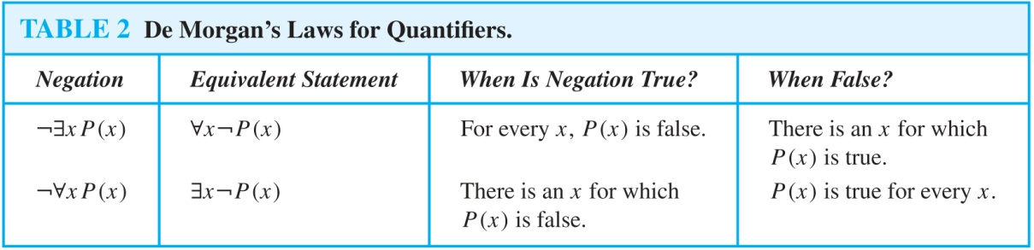
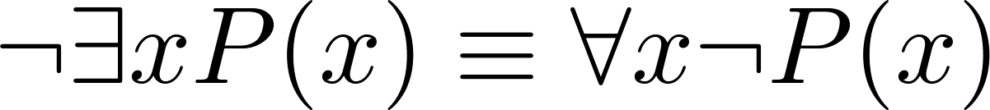
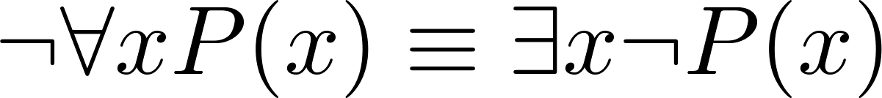
De Morgan’s Laws for Quantifiers
The rules for negating quantifiers are:
Summary:

Slide 57
Translation from English to Logic
Examples:
“Some student in this class has visited Mexico.”
Solution: Let M(x) denote “x has visited Mexico” and S(x) denote “x is a student in this class,” and U be all people.
∃x (S(x) ∧ M(x))
**note: ∃x (S(x)→ M(x)) is incorrect. What does it mean?
“Every student in this class has visited Canada or Mexico.”
Solution: Add C(x) denoting “x has visited Canada.”
∀x (S(x)→ (M(x)∨C(x)))
**note: ∀x (S(x) ∧ (M(x)∨C(x))) is incorrect!!! What does it mean?

Slide 58
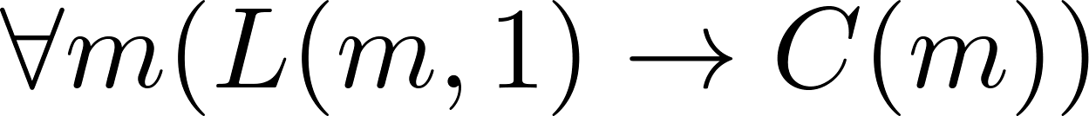
System Specification Example (Reading Exercise)
Predicate logic is used for specifying properties that systems must satisfy.
For example, translate into predicate logic:
“Every mail message larger than one megabyte will be compressed.”
“If a user is active, at least one network link will be available.”
Decide on predicates and domains (left implicit here) for the variables:
Let L(m, y) be “Mail message m is larger than y megabytes.”
Let C(m) denote “Mail message m will be compressed.”
Let A(u) represent “User u is active.”
Let S(n, x) represent “Network link n is state x.
Now we have:

Slide 59
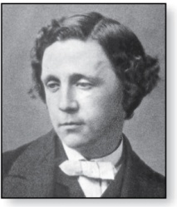
Lewis Carroll Example
Lewis Caroll
(1832-1898)
The first two are called premises and the third is called the conclusion.
“All lions are fierce.”
“Some lions do not drink coffee.”
“Some fierce creatures do not drink coffee.”
Here is one way to translate these statements to predicate logic. Let P(x), Q(x), and R(x) be the propositional functions “x is a lion,” “x is fierce,” and “x drinks coffee,” respectively.
∀x (P(x)→ Q(x))
∃x (P(x) ∧ ¬R(x))
∃x (Q(x) ∧ ¬R(x))
Later we will see how to prove that the conclusion follows from the premises (rule of inferences)

Slide 60
Nested Quantifiers
Section 1.5

Slide 61
Nested Quantifiers
Nested quantifiers are often necessary to express the meaning of sentences in English as well as important concepts in computer science and mathematics.
Example: “Every real number has an inverse” is
∀x ∃y(x + y = 0)
where the domains of x and y are the real numbers.
We can also think of nested propositional functions:
∀x ∃y(x + y = 0) can be viewed as ∀x Q(x) where Q(x) is ∃y P(x, y) where P(x, y) is (x + y = 0)

Slide 62
Order of Quantifiers
Examples:
Let P(x,y) be the statement “x + y = y + x.” Assume that U is the real numbers. Then ∀x ∀yP(x,y) and ∀y ∀xP(x,y) have the same truth value.
Let Q(x,y) be the statement “x + y = 0.” Assume that U is the real numbers. Then ∀x ∃yP(x,y) is true, but ∃y ∀xP(x,y) is false.

Slide 63
Questions on Order of Quantifiers
Example 1: Let U be the real numbers,
Define P(x,y) : x ∙ y = 0
What is the truth value of the following:
∀x∀yP(x,y)
Answer: False
∀x∃yP(x,y)
Answer: True
∃x∀y P(x,y)
Answer: True
∃x ∃ y P(x,y)
Answer: True

Slide 64
Questions on Order of Quantifiers
Example 2: Let U be the real numbers,
Define P(x,y) : x / y = 1
What is the truth value of the following:
∀x∀yP(x,y)
Answer: False
∀x∃yP(x,y)
Answer: True
∃x∀y P(x,y)
Answer: False
∃x ∃ y P(x,y)
Answer: True

Slide 65
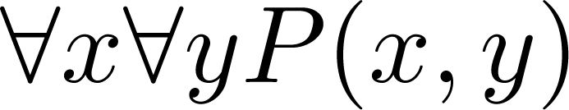
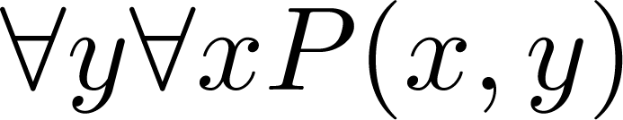
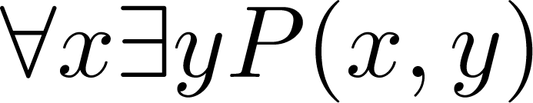
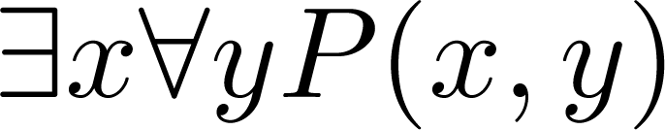
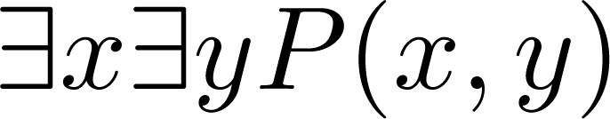
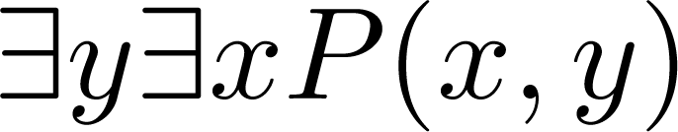
Quantifications of Two Variables (Reading Exercise)
Statement | When True? | When False
 | P(x,y) is true for every pair x,y. | There is a pair x, y for which P(x,y) is false.
 | For every x there is a y for which P(x,y) is true. | There is an x such that P(x,y) is false for every y.
 | There is an x for which P(x,y) is true for every y. | For every x there is a y for which P(x,y) is false.
 | There is a pair x, y for which P(x,y) is true. | P(x,y) is false for every pair x,y

Slide 66
Translating Nested Quantifiers into English
Example 1: Translate the statement
∀x (C(x )∨ ∃y (C(y ) ∧ F(x, y)))
where C(x) is “x has a computer,” and F(x,y) is “x and y are friends,” and the domain for both x and y consists of all students in your school.
Solution: Every student in your school has a computer or has a friend who has a computer.
Example 1: Translate the statement
∃x∀y ∀z ((F(x, y)∧ F(x,z) ∧ (y ≠z))→¬F(y,z))
Solution: There is a student none of whose friends are also friends with each other.

Slide 67
Translating Mathematical Statements into Predicate Logic
Example : Translate “The sum of two positive integers is always positive” into a logical expression.
Solution:
Rewrite the statement to make the implied quantifiers and domains explicit:
“For every two integers, if these integers are both positive, then the sum of these integers is positive.”
Introduce the variables x and y, and specify the domain, to obtain:
“For all positive integers x and y, x + y is positive.”
The result is:
∀x ∀ y ((x > 0)∧ (y > 0)→ (x + y > 0))
where the domain of both variables consists of all integers

Slide 68
Translating English into Logical Expressions Example
Example: Use quantifiers to express the statement “There is a woman who has taken a flight (航班) on every airline(航空公司) in the world.”
Solution:
Let P(w,f) be “w has taken f ” and Q(f,a) be “f is a flight on a .”
The domain of w is all women, the domain of f is all flights, and the domain of a is all airlines.
Then the statement can be expressed as:
∃w ∀a ∃f (P(w,f ) ∧ Q(f,a))

Slide 69
Negating Nested Quantifiers
Example 1: Recall the logical expression developed in the previous slide:
∃w ∀a ∃f (P(w,f ) ∧ Q(f,a))
Part 1: Use quantifiers to express the statement that “There does not exist a woman who has taken a flight on every airline in the world.”
Solution: ¬∃w ∀a ∃f (P(w,f ) ∧ Q(f,a))
Part 2: Now use De Morgan’s Laws to move the negation as far inwards as possible.
Solution:
¬∃w ∀a ∃f (P(w,f ) ∧ Q(f,a))
∀w ¬ ∀a ∃f (P(w,f ) ∧ Q(f,a)) by De Morgan’s for ∃
∀w ∃ a ¬ ∃f (P(w,f ) ∧ Q(f,a)) by De Morgan’s for ∀
∀w ∃ a ∀f ¬ (P(w,f ) ∧ Q(f,a)) by De Morgan’s for ∃
∀w ∃ a ∀f (¬ P(w,f ) ∨ ¬ Q(f,a)) by De Morgan’s for ∧.
Part 3: Can you translate the result back into English?
Solution:
“For every woman there is an airline such that for all flights, this woman has not taken that flight or that flight is not on this airline”

Slide 70
The Foundations: Logic and Proofs
Chapter 1, Part III: Proofs
Edited by Shih-Tsung Liang

Slide 71
Rules of Inference
Section 1.6

Slide 72
Revisiting the Socrates Example
We have the two premises(前提):
“All men are mortal.”
“Socrates is a man.”
And the conclusion(結論):
“Socrates is mortal.”
How do we get the conclusion from the premises?

Slide 73
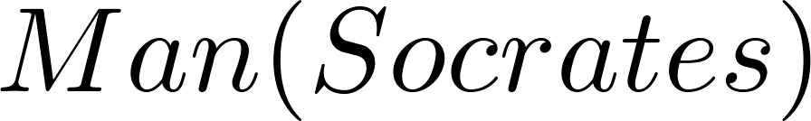
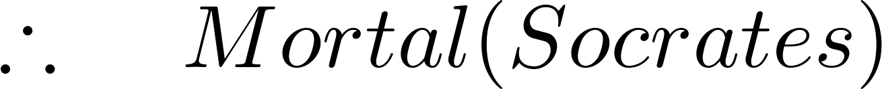
The Argument (論證)
We can express the premises (above the line) and the conclusion (below the line) in predicate logic as an argument:
We will see shortly that this is a valid(有效的) argument.

Slide 74
Arguments in Propositional Logic
An argument in propositional logic is a sequence of propositions. All but the final proposition are called premises. The final proposition is the conclusion.
An argument is valid if the truth of all its premises imply that the conclusion is true.
The argument with premises p₁ ,p₂, …,p_{n} and the conclusion q is valid if
(p₁ ∧ p₂ ∧ … ∧ p_{n} ) → q is a tautology.

Slide 75
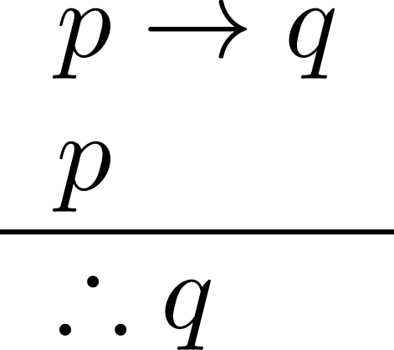
Rules of Inference for Propositional Logic: Modus Ponens (離斷律)
Corresponding Tautology:
(p ∧ (p →q)) → q
Example:
Let p be “It is snowing.”
Let q be “I will study discrete math.”
“If it is snowing, then I will study discrete math.”
“It is snowing.”
“Therefore , I will study discrete math.”

Slide 76
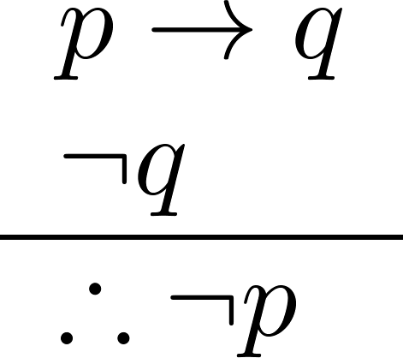
Modus Tollens (逆斷律)
Corresponding Tautology:
(¬p∧(p →q))→¬q
Example:
Let p be “it is snowing.”
Let q be “I will study discrete math.”
“If it is snowing, then I will study discrete math.”
“I will not study discrete math.”
“Therefore , it is not snowing.”

Slide 77
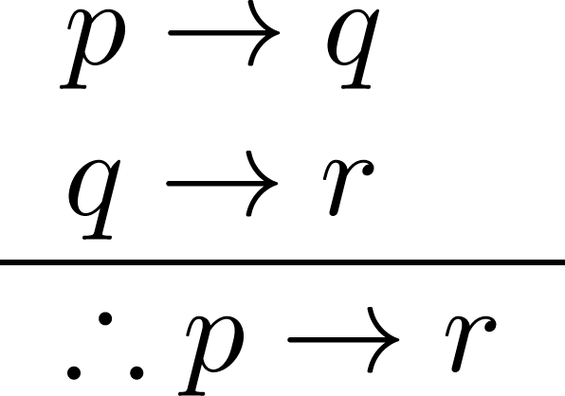
Hypothetical Syllogism (假設三段論)
Corresponding Tautology:
((p →q) ∧ (q→r))→(p→ r)
Example:
Let p be “it snows.”
Let q be “I will study discrete math.”
Let r be “I will get an A.”
“If it snows, then I will study discrete math.”
“If I study discrete math, I will get an A.”
“Therefore , If it snows, I will get an A.”

Slide 78
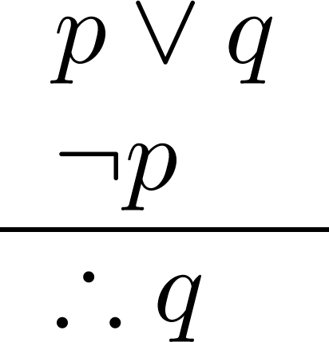
Disjunctive Syllogism(分取三段論)
Corresponding Tautology:
(¬p∧(p ∨q))→q
Example:
Let p be “I will study discrete math.”
Let q be “I will study English literature.”
“I will study discrete math or I will study English literature.”
“I will not study discrete math.”
“Therefore , I will study English literature.”

Slide 79

Addition (添加律)
Corresponding Tautology:
p →(p ∨q)
Example:
Let p be “I will study discrete math.”
Let q be “I will visit Las Vegas.”
“I will study discrete math.”
“Therefore, I will study discrete math or I will visit
Las Vegas.”

Slide 80

Simplification (簡化律)
Corresponding Tautology:
(p∧q) →p
Example:
Let p be “I will study discrete math.”
Let q be “I will study English literature.”
“I will study discrete math and English literature”
“Therefore, I will study discrete math.”

Slide 81

Conjunction (合取律)
Corresponding Tautology:
((p) ∧ (q)) →(p ∧ q)
Example:
Let p be “I will study discrete math.”
Let q be “I will study English literature.”
“I will study discrete math.”
“I will study English literature.”
“Therefore, I will study discrete math and I will study English literature.”

Slide 82

Resolution (預解律)
Resolution plays an important role in AI and is used in Prolog.
Corresponding Tautology:
((¬p ∨ r ) ∧ (p ∨ q)) →(q ∨ r)
Example:
Let p be “I will study discrete math.”
Let r be “I will study English literature.”
Let q be “I will study databases.”
“I will not study discrete math or I will study English literature.”
“I will study discrete math or I will study databases.”
“Therefore, I will study databases or I will English literature.”

Slide 83


Using the Rules of Inference to Build Valid Arguments (有效論證)
A valid argument is a sequence of statements. Each statement is either a premise or follows from previous statements by rules of inference. The last statement is called conclusion.
Example 1: From the single proposition
Show that q is a conclusion.
Solution:
Simplication
Simplication

Slide 84

Valid Arguments
Example 2:
With these hypotheses:
“It is not sunny this afternoon and it is colder than yesterday.”
“We will go swimming only if it is sunny.”
“If we do not go swimming, then we will take a canoe (獨木舟) trip.”
“If we take a canoe trip, then we will be home by sunset.”
Using the inference rules, construct a valid argument for the conclusion:
“We will be home by sunset.”
Solution:
Choose propositional variables:
p : “It is sunny this afternoon.”
r : “We will go swimming.”
t : “We will be home by sunset.”
q : “It is colder than yesterday.”
s : “We will take a canoe trip.”
Translation into propositional logic:
Continued on next slide →

Slide 85

Valid Arguments
3. Construct the Valid Argument
Notes:
Note that a truth table would have 32 rows since we have 5 propositional variables.

Slide 86

Handling Quantified Statements
Rules of Inference for Quantified Statements
Example:
Our domain consists of all dogs and Fido is a dog.
“All dogs are cuddly.”
“Therefore, Fido is cuddly.”
(全稱個例化;UI)
Used often implicitly in Mathematical Proofs.
(全稱通則化;UG)
“Someone got an A in the course.”
“Let’s call her a and say that a got an A”
(存在個例化;EI)
“Michelle got an A in the class.”
“Therefore, someone got an A in the class.”
(存在通則化;EG)

Slide 87

Using Rules of Inference
Example 1: Using the rules of inference, construct a valid argument to show that
“John Smith has two legs”
is a consequence of the premises:
“Every man has two legs.” “John Smith is a man.”
Solution: Let M(x) denote “x is a man” and
L(x) “ x has two legs” and
John Smith be a member of the domain.
Valid Argument:

Slide 88

Using Rules of Inference (Reading Exersise)
Example 2: Use the rules of inference to construct a valid argument showing that the conclusion
“Someone who passed the first exam has not read the book.”
follows from the premises
“A student in this class has not read the book.”
“Everyone in this class passed the first exam.”
Solution: Let C(x) denote “x is in this class,”
B(x) denote “ x has read the book,” and
P(x) denote “x passed the first exam.”
First we translate the
premises and conclusion
into symbolic form.
Continued on next slide →

Slide 89

Using Rules of Inference (Reading Exersise)
Construct the Valid Argument:

Slide 90
Returning to the Socrates Example

Slide 91

Solution for Socrates Example
Valid Argument

Slide 92

Universal Modus Ponens (全稱離斷律)
Universal Modus Ponens combines universal instantiation and modus ponens into one rule.
This rule could be used in the Socrates example.

Slide 93
Introduction to Proofs
Section 1.7

Slide 94
Proofs of Mathematical Statements
A proof is a valid argument (有效論證) that establishes the truth of a statement.
In math, CS, and other disciplines, informal proofs which are generally shorter, are generally used.
More than one rule of inference are often used in a step.
Steps may be skipped.
The rules of inference used are not explicitly stated.
for to understand and to explain to people (not computer).
But it is also easier to introduce errors.

Slide 95
Definitions
A theorem (定理) is a statement that can be shown to be true using:
definitions
other theorems
Axioms (公理) (statements which are given as true)
rules of inference
A lemma (輔助定理) is a ‘helping theorem’ or a result which is needed to prove a theorem.
A corollary (推論) is a result which follows directly from a theorem.
A conjecture (猜想)is a statement that is being proposed to be true. Once a proof of a conjecture is found, it becomes a theorem. It may turn out to be false.

Slide 96
How Theorems are Stated
Often the universal quantifier (needed for a precise statement of a theorem) is omitted by standard mathematical convention.
For example, the statement:
“If x > y, where x and y are positive real numbers, then x² > y² ”
really means
“For all positive real numbers x and y, if x > y, then x² > y² .”

Slide 97



Methods of Proving Theorems
Many theorems have the form:
To prove them, we show that where c is an arbitrary element of the domain,
By universal generalization the truth of the original formula follows.
So, we must prove something of the form:

Slide 98
Proving Conditional Statements: p → q
Direct Proof: Assume that p is true. Use rules of inference, axioms, and logical equivalences to show that q must also be true.
Example: Give a direct proof of the theorem “If n is an odd integer, then n² is odd.”
Solution: Assume that n is odd. Then n = 2k + 1 for an integer k. Squaring both sides of the equation, we get:
n² = (2k + 1)² = 4k² + 4k +1 = 2(2k² + 2k) + 1= 2r + 1,
where r = 2k² + 2k , an integer.
We have proved that if n is an odd integer, then n² is an odd integer.
( marks the end of the proof. Sometimes QED is used instead. )
Notes:
QED, Quod Erat Demonstrandum (Latin: Which Was to Be Demonstrated)

Slide 99

Proving Conditional Statements: p → q
Definition: The real number r is rational if there exist integers p and q where q≠0 such that r = p/q
Example: Prove that the sum of two rational numbers is rational.
Solution: Assume r and s are two rational numbers. Then there must be integers p, q and also t, u such that
Thus the sum is rational.
where v = pu + qt
w = qu ≠ 0

Slide 100
Proving Conditional Statements: p → q
Proof by Contraposition(對位): Assume ¬q and show ¬p is true also. This is sometimes called an indirect proof method. If we give a direct proof of ¬q → ¬p then we have a proof of p → q.
Why does this work? (Recall text p.8, or Lecture p.14 )
Example: Prove that if n is an integer and 3n + 2 is odd, then n is odd.
Solution: Assume n is even. So, n = 2k for some integer k. Thus
3n + 2 = 3(2k) + 2 =6k +2 = 2(3k + 1) = 2j for j = 3k +1
Therefore 3n + 2 is even. Since we have shown ¬q → ¬p , p → q must hold as well. If n is an integer and 3n + 2 is odd (not even) , then n is odd (not even).

Slide 101
Proving Conditional Statements: p → q (Reading Exercise)
Example: Prove that for an integer n, if n² is odd, then n is odd.
Solution: Use proof by contraposition. Assume n is even (i.e., not odd). Therefore, there exists an integer k such that n = 2k. Hence,
n² = 4k² = 2 (2k²)
and n² is even(i.e., not odd).
We have shown that if n is an even integer, then n² is even. Therefore by contraposition, for an integer n, if n² is odd, then n is odd.

Slide 102




Proof by Contradiction
Example: Use a proof by contradiction to give a proof that √2 is irrational.
Solution: Suppose √2 is rational. Then there exists integers a and b with √2 = a/b, where b≠ 0 and a and b have no common factors Then
Therefore a² must be even. If a² is even then a must be even (an exercise). Since a is even, a = 2c for some integer c. Thus,
Therefore b² is even. Again then b must be even as well.
But then 2 must divide both a and b. This contradicts our assumption that a and b have no common factors.
We have proved by contradiction that our initial assumption must be false and therefore √2 is irrational .

Slide 103
Proof by Contradiction (Reading Exercise)
Proof by Contradiction(矛盾):
To prove p, assume ¬p and derive a contradiction such as r∧¬r (an indirect form of proof). Since we have shown that ¬p →F is true , it follows that the contrapositive(對位命題) T→p also holds.
Example: Show that at least 4 of any 22 days must fall on the same day of the week.
Solution: Let p be the proposition “at least 4 of any 22 days must fall on the same day of the week“ and r be the proposition “22 days are chosen”
Suppose that ¬p is True . This means that no more than 3 of the 22 days fall on the same day of the week. Because there are 7 days of the week, we could only have picked 21 days. This contradicts the assumption that we have picked 22 days.

Slide 104
Theorems that are Biconditional Statements
To prove a theorem that is a biconditional statement, that is, a statement of the form p ↔ q, we show that p → q and q →p are both true.
Example: Prove the theorem: “If n is an integer, then n is odd if and only if n² is odd.”
Solution: We have already shown (Lecture P98 & P101) that both p →q and q →p. Therefore we can conclude p ↔ q.
Sometimes iff is used as an abbreviation for “if an only if,” as in
“If n is an integer, then n is odd iff n² is odd.”

Slide 105
Looking Ahead
If direct methods of proof do not work:
We may need a clever use of a proof by contraposition.
Or a proof by contradiction.
In the next section, we will see strategies that can be used when straightforward approaches do not work.
In Chapter 5, we will see mathematical induction and related techniques.
In Chapter 6, we will see combinatorial proofs

Slide 106
Proof Methods and Strategy
Section 1.8

Slide 107


Proof by Cases
To prove a conditional statement of the form:
Use the tautology
Each of the implications is a case.

Slide 108
Proof by Cases
Example: Let a @ b = max{a, b} = a if a ≥ b, otherwise a @ b = max{a, b} = b.
Show that for all real numbers a, b, c
(a @b) @ c = a @ (b @ c)
(This means the operation @ is associative.)
Proof: Let a, b, and c be arbitrary real numbers.
Then one of the following 6 cases must hold.
a ≥ b ≥ c
a ≥ c ≥ b
b ≥ a ≥c
b ≥ c ≥a
c ≥ a ≥ b
c ≥ b ≥ a
Continued on next slide →

Slide 109
Proof by Cases
Case 1: a ≥ b ≥ c
(a @ b) = a, a @ c = a, b @ c = b
Hence (a @ b) @ c = a = a @ (b @ c)
Therefore the equality holds for the first case.
A complete proof requires that the equality be shown to hold for all 6 cases. But the proofs of the remaining cases are similar. Try them.

Slide 110
Without Loss of Generality
Example: Show that if x and y are integers and both x∙y and x+y are even, then both x and y are even.
Proof: Use a proof by contraposition(對位). Suppose x and y are not both even. Then, one or both are odd. Without loss of generality, assume that x is odd. Then x = 2m + 1 for some integer k.
Case 1: y is even. Then y = 2n for some integer n, so x + y = (2m + 1) + 2n = 2(m + n) + 1 is odd.
Case 2: y is odd. Then y = 2n + 1 for some integer n, so x ∙ y = (2m + 1) (2n + 1) = 2(2m ∙ n +m + n) + 1 is odd.
We only cover the case where x is odd because the case where y is odd is similar. The use phrase without loss of generality (WLOG) indicates this.

Slide 111



Existence Proofs
Srinivasa Ramanujan
(1887-1920)
Proof of theorems of the form .
Constructive existence proof:
Find an explicit value of c, for which P(c) is true.
Then is true by Existential Generalization (EG).
Example: Show that there is a positive integer that can be written as the sum of cubes of positive integers in two different ways:
Proof: 1729 is such a number since
1729 = 10³ + 9³ = 12³ + 1³
Godfrey Harold Hardy
(1877-1947)

Slide 112
Nonconstructive Existence Proofs
In a nonconstructive existence proof, we assume no c exists which makes P(c) true and derive a contradiction.
Example: Show that there exist irrational numbers x and y such that x^{y} is rational.
Proof: We know that √2 is irrational. Consider the number √2 ^{√2} .
If it is rational, we have two irrational numbers x and y with x^{y} rational, namely x = √2 and y = √2.
But if √2 ^{√2} is irrational, then we can let x = √2 ^{√2} and y = √2 so x^{y} = (√2 ^{√2} )^{√2} = √2 ^{(√2 √2)} = √2 ² = 2.

Slide 113
Uniqueness Proofs
Some theorems asset the existence of a unique element with a particular property, ∃!x P(x). The two parts of a uniqueness proof are
Existence: We show that an element x with the property exists.
Uniqueness: We show that if y≠x, then y does not have the property.
Example: Show that if a and b are real numbers and a ≠0, then there is a unique real number r such that ar + b = 0.
Solution:
Existence: The real number r = −b/a is a solution of ar + b = 0 because a(−b/a) + b = −b + b =0.
Uniqueness: Suppose that s is a real number such that as + b = 0. Then ar + b = as + b, where r = −b/a. Subtracting b from both sides and dividing by a shows that r = s.

Slide 114



Counterexamples (反例)
Recall .
To establish that is false (or is true) find a c such that ¬P(c) is true (or P(c) is false).
In this case c is called a counterexample to the assertion .
Example: “Every positive integer is the sum of the squares of 3 integers.” The integer 7 is a counterexample. So the claim is false.

Slide 115
Proof Strategies for proving p → q
Choose a method.
First try a direct method of proof.
If this does not work, try an indirect method (e.g., try to prove the contrapositive).
For whichever method you are trying, choose a strategy.
First try forward reasoning. Start with the axioms and known theorems and construct a sequence of steps that end in the conclusion. Start with p and prove q, or start with ¬q and prove ¬p.
If this doesn’t work, try backward reasoning. When trying to prove q, find a statement p that we can prove with the property p → q.

Slide 116
Backward Reasoning
Example: Suppose that two people play a game taking turns removing, 1, 2, or 3 stones at a time from a pile that begins with 15 stones. The person who removes the last stone wins the game. Show that the first player can win the game no matter what the second player does.
Proof: Let n be the last step of the game.
Step n: Player₁ can win if the pile contains 1,2, or 3 stones.
Step n-1: Player₂ will have to leave such a pile if the pile that he/she is faced with has 4 stones.
Step n-2: Player₁ can leave 4 stones when there are 5,6, or 7 stones left at the beginning of his/her turn.
Step n-3: Player₂ must leave such a pile, if there are 8 stones .
Step n-4: Player₁ has to have a pile with 9,10, or 11 stones to ensure that there are 8 left.
Step n-5: Player₂ needs to be faced with 12 stones to be forced to leave 9,10, or 11.
Step n-6: Player₁ can leave 12 stones by removing 3 stones.
Now reasoning forward, the first player can ensure a win by removing 3 stones and leaving 12.

Slide 117



Proof and Disproof: Tilings
Example 1: Can we tile the standard checkerboard using dominos?
Solution: Yes! One example provides a constructive existence proof.
Two Dominoes
The Standard Checkerboard
One Possible Solution

Slide 118
Tilings
Example 2: Can we tile a checkerboard obtained by removing one of the four corner squares of a standard checkerboard?
Solution:
Our checkerboard has 64 − 1 = 63 squares.
Since each domino has two squares, a board with a tiling must have an even number of squares.
The number 63 is not even.
We have a contradiction.

Slide 119

Tilings
Example 3: Can we tile a board obtained by removing both the upper left and the lower right squares of a standard checkerboard?
Nonstandard Checkerboard
Dominoes
Continued on next slide →

Slide 120
Tilings
Solution:
There are 62 squares in this board.
To tile it we need 31 dominos.
Key fact: Each domino covers one black and one white square.
Therefore the tiling covers 31 black squares and 31 white squares.
Our board has either 30 black squares and 32 white squares or 32 black squares and 30 white squares.
Contradiction!

Slide 121
The Role of Open Problems
Unsolved problems have motivated much work in mathematics. Fermat’s Last Theorem was conjectured more than 300 years ago. It has only recently been finally solved.
Fermat’s Last Theorem: The equation x^{n} + y^{n} = z^{n}
has no solutions in integers x, y, and z, with xyz≠0 whenever n is an integer with n > 2.
A proof was found by Andrew Wiles in the 1990s.

Slide 122
An Open Problem
The 3x + 1 Conjecture: Let T be the transformation that sends an even integer x to x/2 and an odd integer x to 3x + 1. For all positive integers x, when we repeatedly apply the transformation T, we will eventually reach the integer 1.
For example, starting with x = 13:
T(13) = 3∙13 + 1 = 40, T(40) = 40/2 = 20, T(20) = 20/2 = 10,
T(10) = 10/2 = 5, T(5) = 3∙5 + 1 = 16,T(16) = 16/2 = 8,
T(8) = 8/2 = 4, T(4) = 4/2 = 2, T(2) = 2/2 = 1
The conjecture has been verified using computers up to 5.6 ∙ 10¹³ .

Slide 123
Additional Proof Methods
Later we will see many other proof methods:
Mathematical induction (數學歸納法), which is a useful method for proving statements of the form ∀n P(n), where the domain consists of all positive integers.
Structural induction(結構歸納法), which can be used to prove such results about recursively defined sets.
Cantor diagonalization (Cantor對角法) is used to prove results about the size of infinite sets.
Combinatorial proofs (組合證明法)use counting arguments.

