Slide 1
Counting
Chapter 6
Edited by Shih-Tsung Liang

Slide 2
Chapter Summary
The Basics of Counting
The Pigeonhole Principle (鴿籠原理)
Permutations(排列) and Combinations(組合)
Binomial Coefficients(二項式係數)and Identities (等式)
Generalized Permutations and Combinations
Generating Permutations and Combinations

Slide 3
The Basics of Counting
Section 6.1

Slide 4
Basic Counting Principles: The Product Rule
The Product Rule: A procedure can be broken down into a sequence of two tasks. There are n₁ ways to do the first task and n₂ ways to do the second task. Then there are n₁∙n₂ ways to do the procedure.
Example: How many bit strings of length seven are there?
Solution: Since each of the seven bits is either a 0 or a 1, the answer is 2⁷ = 128.

Slide 5
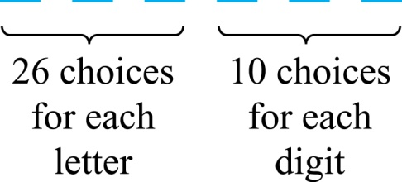
The Product Rule
Example: How many different license plates can be made if each plate contains a sequence of 3 uppercase English letters followed by 3 digits?
Solution: By the product rule,
there are 26 ∙ 26 ∙ 26 ∙ 10 ∙ 10 ∙ 10 = 17,576,000
different possible license plates.

Slide 6
Counting Functions
Counting Functions: How many functions are there from a set with m elements to a set with n elements?
Solution: Since a function represents a choice of one of the n elements of the codomain for each of the m elements in the domain, the product rule tells us that there are n ∙ n ∙ ∙ ∙ n = n^{m} such functions.
Counting One-to-One Functions: How many one-to-one functions are there from a set with m elements to one with n elements?
Solution: Suppose the elements in the domain are a₁, a₂,…, a_{m}. There are n ways to choose the value of a₁ and n−1 ways to choose a₂, etc. The product rule tells us that there are n(n−1) (n−2)∙∙∙(n−m +1) such functions.

Slide 7
Telephone Numbering Plan (Reading Exercise)
Example: The North American numbering plan (NANP) specifies that a telephone number consists of 10 digits, consisting of a 3-digit area code, a 3-digit office code, and a 4-digit station code. There are some restrictions on the digits.
Let X denote a digit from 0 through 9.
Let N denote a digit from 2 through 9.
Let Y denote a digit that is 0 or 1.
In the old plan (in use in the 1960s) the format was NYX-NNX-XXX.
In the new plan, the format is NXX-NXX-XXX.
How many different telephone numbers are possible under the old plan and the new plan?
Solution: Use the Product Rule.
There are 8 ∙2 ∙10 = 160 area codes with the format NYX.
There are 8 ∙10 ∙10 = 800 area codes with the format NXX.
There are 8 ∙8 ∙10 = 640 office codes with the format NNX.
There are 10 ∙10 ∙10 ∙10 = 10,000 station codes with the format XXXX.
Number of old plan telephone numbers: 160 ∙640 ∙10,000 = 1,024,000,000.
Number of new plan telephone numbers: 800 ∙800 ∙10,000 = 6,400,000,000.

Slide 8
Counting Subsets of a Finite Set
Counting Subsets of a Finite Set: Use the product rule to show that the number of different subsets of a finite set S is 2^{|S|}. (In Section 5.1 Ex10, mathematical induction was used to prove this same result.)
Solution: When the elements of S are listed in an arbitrary order, there is a one-to-one correspondence between subsets of S and bit strings of length |S|. When the ith element is in the subset, the bit string has a 1 in the ith position and a 0 otherwise.
By the product rule, there are 2^{|S|} such bit strings, and therefore 2^{|S|} subsets.

Slide 9
Product Rule in Terms of Sets
If A₁, A₂, … , A_{m} are finite sets, then the number of elements in the Cartesian product (see p.123) of these sets is the product of the number of elements of each set.
The task of choosing an element in the Cartesian product A₁ ⨉ A₂ ⨉ ∙∙∙ ⨉ A_{m} is done by choosing an element in A₁, an element in A₂ , …, and an element in A_{m}.
By the product rule, it follows that:
|A₁ ⨉ A₂ ⨉ ∙∙∙ ⨉ A_{m} |= |A₁| ∙ |A₂| ∙ ∙∙∙ ∙ |A_{m}|.

Slide 10
Basic Counting Principles: The Sum Rule
The Sum Rule: If a task can be done either in one of n₁ ways or in one of n₂ ways, where none of the set of n₁ ways is the same as any of the n₂ ways, then there are n₁ + n₂ ways to do the task.
Example: The mathematics department must choose either a student or a faculty member as a representative for a university committee. How many choices are there for this representative if there are 37 members of the mathematics faculty and 83 mathematics majors and no one is both a faculty member and a student.
Solution: By the sum rule it follows that there are 37 + 83 = 120 possible ways to pick a representative.

Slide 11
The Sum Rule in terms of sets.
The sum rule can be expressed in terms of sets.
|A ∪ B|= |A| + |B|
as long as A and B are disjoint sets.
Or more generally,
|A₁ ∪ A₂ ∪ ∙∙∙ ∪ A_{m} |= |A₁| + |A₂| + ∙∙∙ + |A_{m}|
when A_{i} ∩ A_{j} = ∅ for all i, j.

Slide 12
Combining the Sum and Product Rule
Example: Suppose statement labels in a programming language can be either a single letter or a letter followed by a digit. Find the number of possible labels.
Solution: Use the product rule.
26 + 26 ∙ 10 = 286

Slide 13
Counting Passwords (Reading Exercise)
Combining the sum and product rule allows us to solve more complex problems.
Example: Each user on a computer system has a password, which is six to eight characters long, where each character is an uppercase letter or a digit. Each password must contain at least one digit. How many possible passwords are there?
Solution: Let P be the total number of passwords, and let P₆, P₇, and P₈ be the passwords of length 6, 7, and 8.
By the sum rule P = P₆ + P₇ +P₈.
To find each of P₆, P₇, and P₈ , we find the number of passwords of the specified length composed of letters and digits and subtract the number composed only of letters. We find that:
P₆ = 36⁶ − 26⁶ =2,176,782,336 − 308,915,776 =1,867,866,560.
P₇ = 36⁷ − 26⁷ =78,364,164,096 − 8,031,810,176 = 70,332,353,920.
P₈ = 36⁸ − 26⁸ =2,821,109,907,456 − 208,827,064,576 =2,612,282,842,880.
Consequently, P = P₆ + P₇ +P₈ = 2,684,483,063,360.

Slide 14
Basic Counting Principles: Subtraction Rule
Subtraction Rule: If a task can be done either in one of n₁ ways or in one of n₂ ways, then the total number of ways to do the task is n₁ + n₂ minus the number of ways to do the task that are common to the two different ways.
Also known as, the principle of inclusion-exclusion(排容原理):

Slide 15
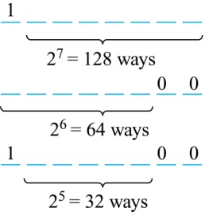
Counting Bit Strings
Example: How many bit strings of length eight either start with a 1 bit or end with the two bits 00?
Solution: Use the subtraction rule.
Number of bit strings of length eight that start with a 1 bit: 2⁷ = 128
Number of bit strings of length eight that start with bits 00: 2⁶ = 64
Number of bit strings of length eight that start with a 1 bit and end with bits 00 : 2⁵ = 32
Hence, the number is 128 + 64 − 32 = 160.

Slide 16
Basic Counting Principles: Division Rule
Division Rule: There are n/d ways to do a task if it can be done using a procedure that can be carried out in n ways, and for every way w, exactly d of the n ways correspond to way w.
(e.g., task:數人頭; procedure:數耳朵; 每1人頭=2耳朵)
Restated in terms of sets: If the finite set A (with |A|=n) is the union of r pairwise disjoint subsets each with d elements, then r = n/d.
In terms of functions: If f is a function from A to B, where both are finite sets, and for every value y ∈ B there are exactly d values x ∈ A such that f(x) = y, then |B| = |A|/d.
x₁
y
...
x_{d}

Slide 17
Basic Counting Principles: Division Rule
Example: How many ways are there to seat 4 people around a circular table, where two seatings are considered the same when each person has the same left and right neighbor?
Solution: Number the seats around the table from 1 to 4 proceeding clockwise. There are 4 ways to select the person for seat 1, 3 for seat 2, 2 for seat 3, and 1 way for seat 4. Thus there are 4! = 24 ways to order the four people. But since two seatings are the same when each person has the same left and right neighbor, for every choice for seat 1, we get the 4 same seating arrangements.
Therefore, by the division rule, there are 24/4 = 6 different seating arrangements.

Slide 18
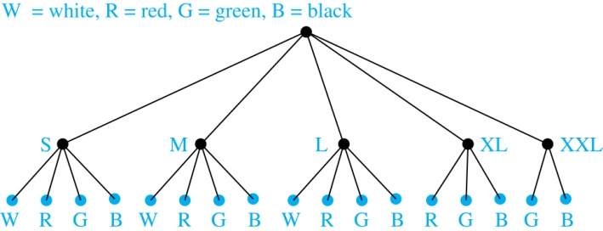
Tree Diagrams
Tree Diagrams: We can solve many counting problems through the use of tree diagrams, where a branch (分枝) represents a possible choice and the leaves (樹葉) represent possible outcomes.
Example: Suppose that “I Love Discrete Math” T-shirts come in five different sizes: S,M,L,XL, and XXL. Each size comes in four colors (white, red, green, and black), except XL, which comes only in red, green, and black, and XXL, which comes only in green and black. What is the minimum number of stores that the campus book store needs to stock to have one of each size and color available?
Solution: Draw the tree diagram.
The store must stock 17 T-shirts.

Slide 19
The Pigeonhole Principle
Section 6.2

Slide 20
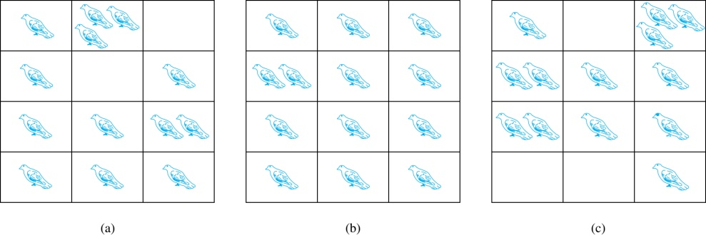
The Pigeonhole Principle(鴿籠原理)
If a flock of 13 pigeons roosts in a set of 12 pigeonholes, one of the pigeonholes must have more than 1 pigeon.
Pigeonhole Principle: If k ∈ Z⁺ and k + 1 objects are placed into k boxes, then at least one box contains two or more objects.
Proof: We use a proof by contraposition. Suppose none of the k boxes has more than one object. Then the total number of objects would be at most k. This contradicts the statement that we have k + 1 objects.

Slide 21
The Pigeonhole Principle
Corollary 1: A function f from a set with k + 1 elements to a set with k elements is not one-to-one.
Proof: Use the pigeonhole principle.
Create a box for each element y in the codomain of f .
Put in the box for y all of the elements x from the domain such that f(x) = y.
Because there are k + 1 elements and only k boxes, at least one box has two or more elements.
Hence, f can’t be one-to-one.

Slide 22
Pigeonhole Principle
Example: Among any group of 367 people, there must be at least two with the same birthday, because there are only 366 possible birthdays.
Example: Show that for every integer n there is a positive multiple of n (n的倍數) that has only 0s and 1s in its decimal expansion.
Solution: Let n be a positive integer. Consider the n + 1 integers
1, 11, 111, …., 11…1
There are n possible remainders when an integer is divided by n.
By the pigeonhole principle, when each of the n + 1 integers is divided by n, at least two must have the same remainder.
Subtract the smaller from the larger and the result is a multiple of n that has only 0s and 1s in its decimal expansion.
n+1個1

Slide 23
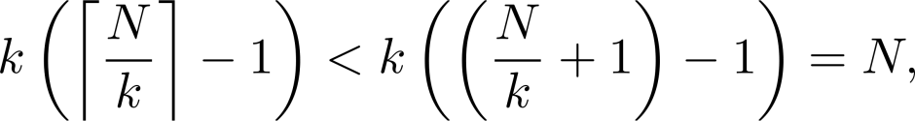
The Generalized Pigeonhole Principle
The Generalized Pigeonhole Principle: If N objects are placed into k boxes, then there is at least one box containing ≥⌈N/k⌉ objects.
Proof: We use a proof by contraposition. Suppose that none of the boxes contains more than ⌈N/k⌉ − 1 objects. Then the total number of objects (N) is at most
where the inequality ⌈N/k⌉ < (N/k) + 1 has been used. That is N<N (contradiction!)
Example: Among 100 people there are at least ⌈100/12⌉ = 9 who were born in the same month.

Slide 24
The Generalized Pigeonhole Principle
Example: a) How many cards must be selected from a standard deck of 52 cards to guarantee that at least 3 cards of the same suit (花色) are chosen?
b) How many must be selected to guarantee that at least 3 hearts (紅心) are selected?
Solution:
a) We assume four boxes; one for each suit. Using the generalized pigeonhole principle, at least one box contains at least ⌈N/4⌉ cards. At least three cards of one suit are selected if ⌈N/4⌉ ≥3. The smallest integer N such that ⌈N/4⌉ ≥3 is N = 2 ∙ 4 + 1 = 9.
b) A deck contains 13 hearts and 39 cards which are not hearts. So, if we select 41 cards, we may have 39 cards which are not hearts along with 2 hearts. However, when we select 42 cards, we must have at least three hearts. (Note that the generalized pigeonhole principle is not used here.)

Slide 25
Permutations and Combinations (排列組合)
Section 6.3

Slide 26
Permutations
Definition: A permutation of a set of distinct objects is an ordered arrangement of these objects.
An ordered arrangement of r elements of a set is called an r-permutation.
Example: Let S = {1,2,3}.
The ordered arrangement 3,1,2 is a permutation of S.
The ordered arrangement 3,2 is a 2-permutation of S.
The number of r-permuatations of a set with n elements is denoted by P(n,r).
The 2-permutations of S = {1,2,3} are 1,2; 1,3; 2,1; 2,3; 3,1; and 3,2. Hence, P(3,2) = 6.

Slide 27
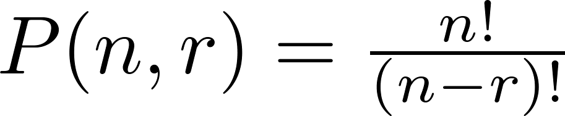
A Formula for the Number of Permutations
Theorem 1: If n is a positive integer and r is an integer with 1 ≤ r ≤ n, then there are
P(n, r) = n(n − 1)(n − 2) ∙∙∙ (n − r + 1)
r-permutations of a set with n distinct elements.
Proof: Use the product rule. The first element can be chosen in n ways. The second in n − 1 ways, and so on until there are (n − ( r − 1)) ways to choose the last element.
Note that P(n,0) = 1, since there is only one way to order zero elements.
Corollary 1: If n and r are integers with 1 ≤ r ≤ n, then

Slide 28
Solving Counting Problems by Counting Permutations
Example: How many ways are there to select a first-prize winner, a second prize winner, and a third-prize winner from 100 different people who have entered a contest?
Solution:
P(100,3) = 100 ∙ 99 ∙ 98 = 970,200

Slide 29
Solving Counting Problems by Counting Permutations (continued)
Example: How many permutations of the letters ABCDEFGH contain the string ABC ?
Solution: We solve this problem by counting the permutations of six objects, ABC, D, E, F, G, and H.
6! = 6 ∙ 5 ∙ 4 ∙ 3 ∙ 2 ∙ 1 = 720

Slide 30

Combinations
Definition: An r-combination of elements of a set is an unordered selection of r elements from the set. Thus, an r-combination is simply a subset of the set with r elements.
The number of r-combinations of a set with n distinct elements is denoted by C(n, r). The notation is also used and is called a binomial coefficient. (We will see the notation again in the binomial theorem in Section 6.4.)
Example: Let S be the set {a, b, c, d}. Then {a, c, d} is a 3-combination from S. It is the same as {d, c, a} since the order listed does not matter.
C(4,2) = 6 because the 2-combinations of {a, b, c, d} are the six subsets {a, b}, {a, c}, {a, d}, {b, c}, {b, d}, and {c, d}.

Slide 31
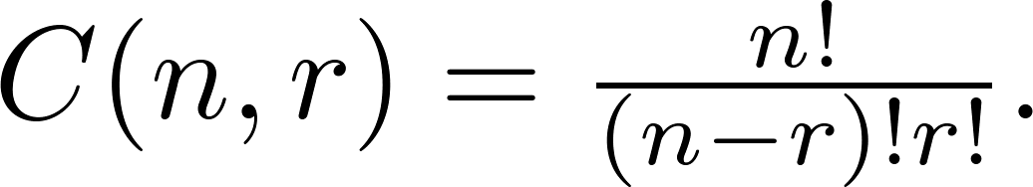
Combinations
Theorem 2: The number of r-combinations of a set with n elements, where n ≥ r ≥ 0, equals
Proof: By the product rule P(n, r) = C(n,r) ∙ P(r,r). Therefore,

Slide 32
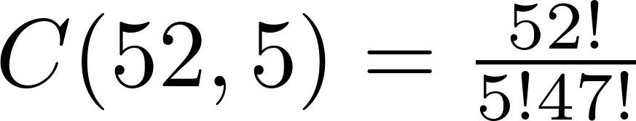
Combinations
Example: How many poker hands of five cards can be dealt from a standard deck of 52 cards? Also, how many ways are there to select 47 cards from a deck of 52 cards?
Solution: Since the order in which the cards are dealt does not matter, the number of five card hands is:
The different ways to select 47 cards from 52 is
This is a special case of a general result. →

Slide 33
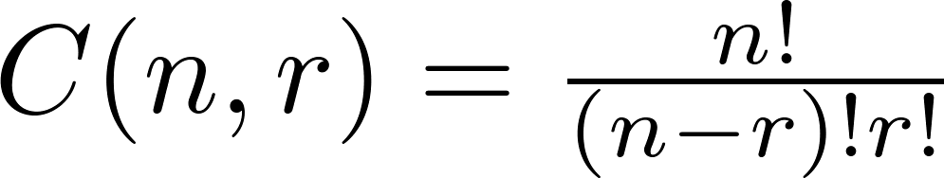
Combinations
Corollary 2: Let n and r be nonnegative integers with r ≤ n. Then C(n, r) = C(n, n − r).
Proof: From Theorem 2, it follows that
and
Hence, C(n, r) = C(n, n − r).
This result can be proved without using algebraic manipulation. →

Slide 34
Combinatorial Proofs
Definition 1: A combinatorial proof of an identity is a proof that uses one of the following methods.
A double counting proof uses counting arguments to prove that both sides of an identity count the same objects, but in different ways.(等式兩邊要算的東西是一樣的只是方法不同)
A bijective proof shows that there is a bijection between the sets of objects counted by the two sides of the identity. (等式兩邊要算的東西雖不一樣，但兩者間存在一對一且映成的函數)
*註: combinatorial proof （組合證明），也就是靠計算數量而得的證明。

Slide 35

Combinatorial Proofs
Here are two combinatorial proofs that
C(n, r) = C(n, n − r)
when r and n are nonnegative integers with r < n:
Proof:
Suppose that S is a set with n elements.
By definition the number of subsets of S with r elements is C(n, r).
Bijective Proof:
The function that maps a subset A of S to is a bijection between the subsets of S with r elements and the subsets with n − r elements.
By definition the number of subsets of S with n-r elements is C(n, n-r). Since there is a bijection between the two sets, they must have the same number of elements.
Double Counting Proof: Each subset A of S can also be described by specifying which elements are not in A, i.e., those which are in . Since the complement of a subset of S with r elements has n − r elements, there are also C(n, n − r) subsets of S with r elements.

Slide 36
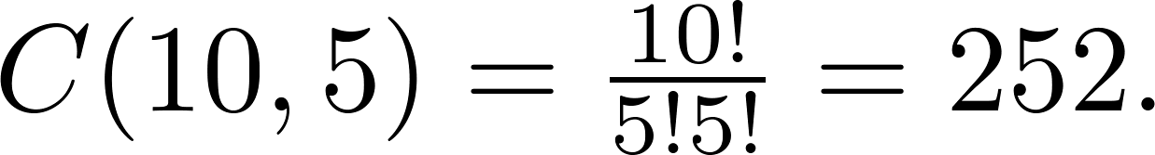
Combinations
Example: How many ways are there to select 5 players from a 10-member tennis team to make a trip to a match at another school.
Solution: By Theorem 2, the number of combinations is
Example: A group of 30 people have been trained as astronauts to go on the first mission to Mars. How many ways are there to select a crew of six people to go on this mission?
Solution: By Theorem 2, the number of possible crews is

Slide 37
Binomial Coefficients and Identities
Section 6.4

Slide 38


Powers of Binomial Expressions
Definition: A binomial expression is the sum of two terms, such as x + y.
We can use counting principles to find the coefficients (係數) in the expansion (展開式)of (x + y)^{n} where n is a positive integer.
To illustrate this idea, we first look at the process of expanding (x + y)³.
(x + y) (x + y) (x + y) expands into a sum of terms that are the product of a term from each of the three sums.
Terms of the form x³, x²y, x y², y³ arise. The question is what are the coefficients?
To obtain x³ , an x must be chosen from each of the sums. There is only one way to do this. So, the coefficient of x³ is 1.
To obtain x²y, an x must be chosen from two of the sums and a y from the other. There are ways to do this and so the coefficient of x²y is 3.
To obtain xy², an x must be chosen from of the sums and a y from the other two . There are ways to do this and so the coefficient of xy² is 3.
To obtain y³ , a y must be chosen from each of the sums. There is only one way to do this. So, the coefficient of y³ is 1.
We have used a counting argument to show that (x + y)³ = x³ + 3x²y + 3x y² + y³ .
Next we present the binomial theorem gives the coefficients of the terms in the expansion of (x + y)^{n} .

Slide 39


Binomial Theorem
Binomial Theorem: Let x and y be variables, and n a nonnegative integer. Then:
Proof: We use combinatorial reasoning .
The terms in the expansion of (x + y)^{n} are of the form x^{n−j}y^{j} for j = 0,1,2,…,n.
To form the term x^{n−j}y^{j}, it is necessary to choose n−j xs from the n sums. Therefore, the coefficient of x^{n−j}y^{j} is which equals .

Slide 40
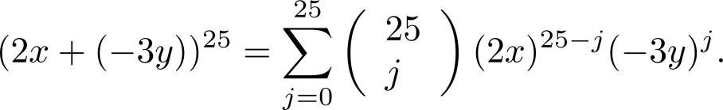
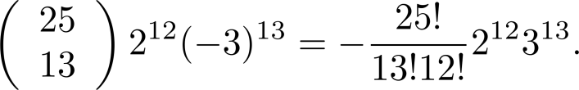
Using the Binomial Theorem
Example: What is the coefficient of x¹²y¹³ in the expansion of (2x − 3y)²⁵?
Solution: We view the expression as (2x +(−3y))²⁵. By the binomial theorem
Consequently, the coefficient of x¹²y¹³ in the expansion is obtained when j = 13. That is

Slide 41
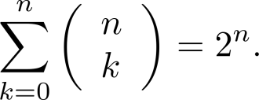
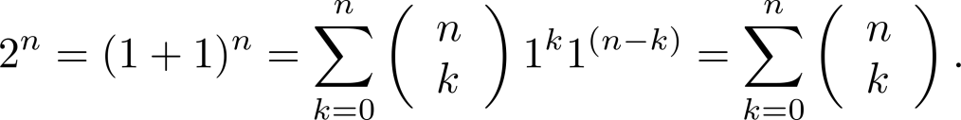




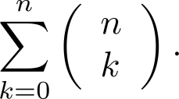
A Useful Identity
Corollary 1: With n ≥0,
Proof (using binomial theorem): With x = 1 and y = 1, from the binomial theorem we see that:
Proof (combinatorial): Consider the subsets of a set with n elements. There are subsets with zero elements, with one element, with two elements, …, and with n elements. Therefore the total is
Since, we know that a set with n elements has 2^{n} subsets,
we conclude:

Slide 42
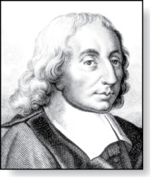
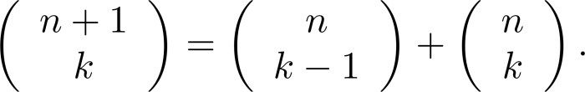



Pascal’s Identity
Blaise Pascal
(1623-1662)
Pascal’s Identity: If n and k are integers with n ≥ k ≥ 0, then
Proof (combinatorial): Let T be a set where |T| = n + 1, a ∊T, and S = T − {a}. There are subsets of T containing k elements. Each of these subsets either:
contains a together with k − 1 other elements of S, or
contains k elements of S and not contain a.
There are
subsets of k elements that contain a, since there are subsets of k − 1 elements of S,
subsets of k elements of T that do not contain a, because there are subsets of k elements of S.
Hence,

Slide 43
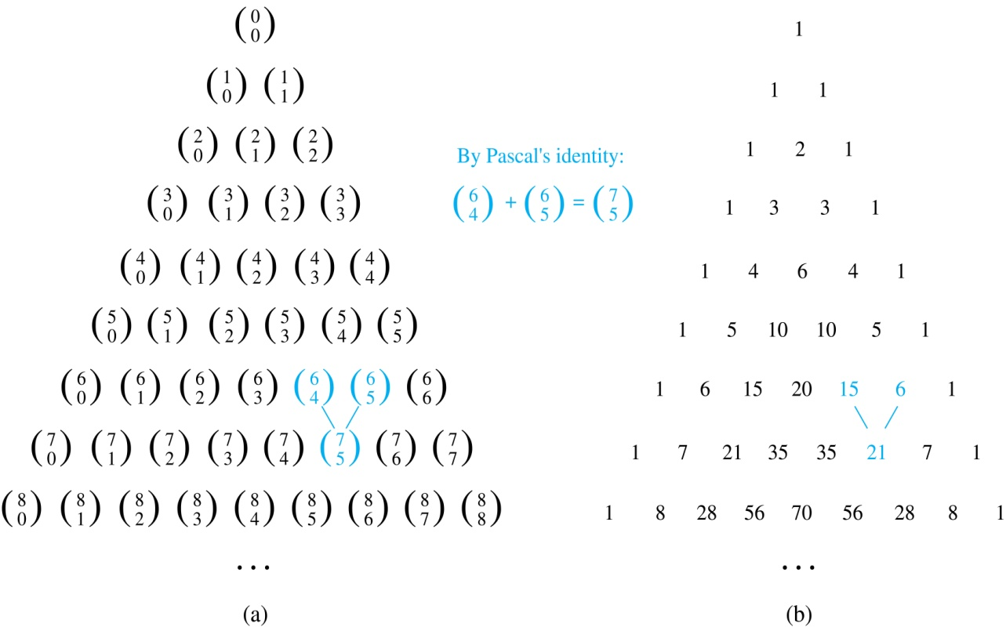
Pascal’s Triangle
The nth row in the triangle consists of the binomial coefficients , k = 0,1,….,n.
By Pascal’s identity, adding two adjacent bionomial coefficients results is the binomial coefficient in the next row between these two coefficients.

Slide 44
Generalized Permutations and Combinations
Section 6.5

Slide 45
Permutations with Repetition
Theorem 1: The number of r-permutations of a set of n objects with repetition allowed is n^{r}.
Proof: There are n ways to select an element of the set for each of the r positions in the r-permutation when repetition is allowed. Hence, by the product rule there are n^{r} r-permutations with repetition.
Example: How many strings of length r can be formed from the uppercase letters of the English alphabet?
Solution: The number of such strings is 26^{r}, which is the number of r-permutations of a set with 26 elements.

Slide 46
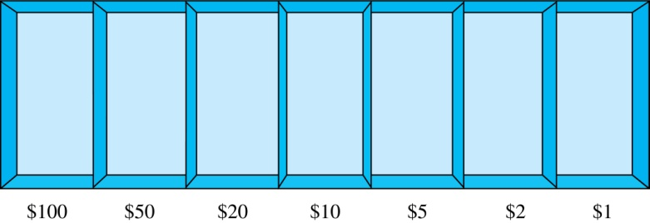
Combinations with Repetition
Example: How many ways are there to select five bills from a box containing at least five of each of the following denominations: $1, $2, $5, $10, $20, $50, and $100?
Solution: Place the selected bills in the appropriate position of a cash box illustrated below:
continued →

Slide 47
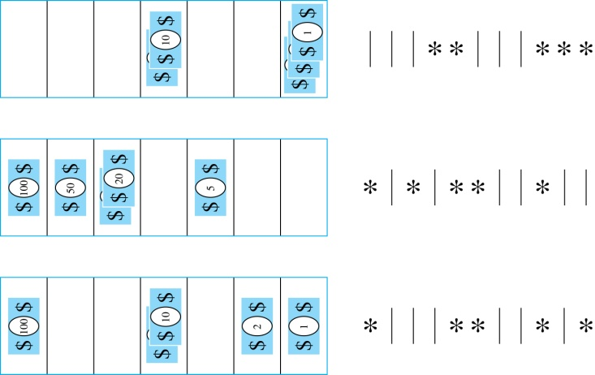

Combinations with Repetition
Some possible ways of
placing the five bills:
The number of ways to select five bills corresponds to the number of ways to arrange six bars and five stars in a row.
This is the number of unordered selections of 5 objects from a set of 11. Hence, there are
ways to choose five bills with seven types of bills.

Slide 48
Combinations with Repetition
Theorem 2: The number 0f r-combinations from a set with n elements when repetition of elements is allowed is
C(n + r – 1,r) = C(n + r – 1, n –1).
Proof: Each r-combination of a set with n elements with repetition allowed can be represented by a list of n –1 bars and r stars. The bars mark the n cells containing a star for each time the ith element of the set occurs in the combination.
The number of such lists is C(n + r – 1, r), because each list is a choice of the r positions to place the stars, from the total of n + r – 1 positions to place the stars and the bars. This is also equal to C(n + r – 1, n –1), which is the number of ways to place the n –1 bars.

Slide 49
Combinations with Repetition
Example: How many solutions does the equation
x₁ + x₂ + x₃ = 11
have, where x₁ , x₂ and x₃ are nonnegative integers?
Solution: Each solution corresponds to a way to select 11 items from a set with three elements; x₁ elements of type one, x₂ of type two, and x₃ of type three.
By Theorem 2 it follows that there are
solutions.

Slide 50
Combinations with Repetition
Example: Suppose that a cookie shop has 4 different kinds of cookies. How many different ways can 6 cookies be chosen?
Solution: The number of ways to choose six cookies is the number of 6-combinations of a set with four elements. By Theorem 2
is the number of ways to choose six cookies from the four kinds.

Slide 51
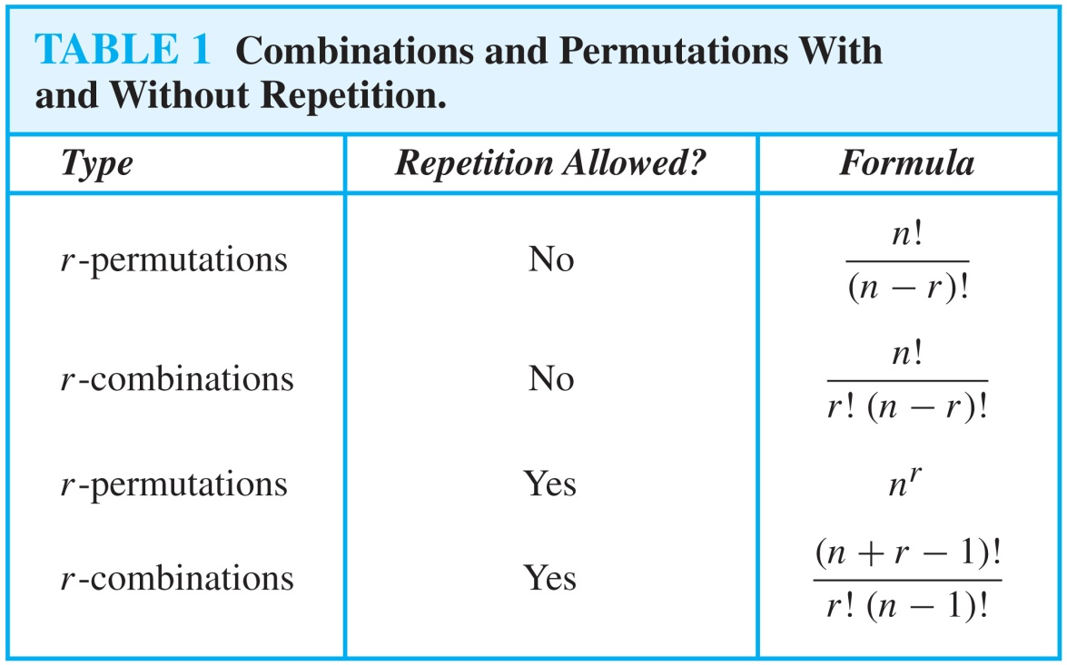
Summarizing the Formulas for Counting Permutations and Combinations with and without Repetition

Slide 52
Permutations with Indistinguishable Objects
Example: How many different strings can be made by reordering the letters of the word SUCCESS.
Solution: There are seven possible positions for the three Ss, two Cs, one U, and one E.
The three Ss can be placed in C(7,3) different ways, leaving four positions free.
The two Cs can be placed in C(4,2) different ways, leaving two positions free.
The U can be placed in C(2,1) different ways, leaving one position free.
The E can be placed in C(1,1) way.
By the product rule, the number of different strings is:
The reasoning can be generalized to the following theorem. →

Slide 53
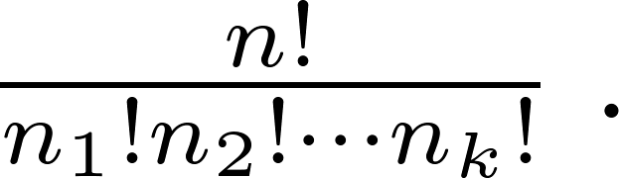
Permutations with Indistinguishable Objects
Theorem 3: The number of different permutations of n objects, where there are n₁ indistinguishable objects of type 1, n₂ indistinguishable objects of type 2, …., and n_{k} indistinguishable objects of type k, is:
Proof: By the product rule the total number of permutations is:
C(n, n₁ ) C(n − n₁, n₂ ) ∙∙∙ C(n − n₁ − n₂ − ∙∙∙ − n_{k}, n_{k}) since:
The n₁ objects of type one can be placed in the n positions in C(n, n₁ ) ways, leaving n − n₁ positions.
Then the n₂ objects of type two can be placed in the n − n₁ positions in C(n − n₁, n₂ ) ways, leaving n − n₁ − n₂ positions.
Continue in this fashion, until n_{k} objects of type k are placed in C(n − n₁ − n₂ − ∙∙∙ − n_{k}, n_{k}) ways.
The product can be manipulated into the desired result as follows:

Slide 54
Distributing Objects into Boxes
Many counting problems can be solved by counting the ways objects can be placed into boxes.
We can consider two types of objects:
1. Distinguishable objects (e.g., “Julie, Vivian, and Wilson”)
2. Indistinguishable objects (e.g., “three students”)
We can also consider two types of “boxes”
1. Distinguishable boxes (e.g., “room G313 and room G508”)
2. Indistinguishable boxes (e.g., “two homerooms”)
G313
G508

Slide 55
Distributing Objects into Boxes
Distinguishable objects / distinguishable boxes
Example: How many ways are there to deal 5-card poker hands from a 52-card deck to each of four players?
Solutions:
Player 1: C(52,5) ways to deal
Player 2: C(47,5) ways to deal
Player 3: C(42,5) ways to deal
Player 4: C(37,5) ways to deal
Theorem 4: The number of ways to distribute n distinguishable objects into k distinguishable boxes so that n_{i} objects are placed into box i, i=1,2,…,k, equals
(See Exercises 47 and 48 for two different proofs.)
Based on the product rule, there are C(52,5)×C(47,5)×C(42,5)×C(37,5)
=52!/(5!5!5!5!32!)
ways to distribute hands of 5 cards to each 4 players.

Slide 56
Distributing Objects into Boxes
Indistinguishable objects / distinguishable boxes
This turns out to be the same as counting the n-combinations for a set with k elements when repetition is allowed!(ppt.p50)
Recall: We solved the above problem by arranging placeholders (*) and dividers (|).
To place n indistinguishable items into k distinguishable bins:
1. Treat our indistinguishable items as *s
2. Use | to divide our distinguishable bins
3. Count the ways to arrange n placeholders and k-1 dividers
Result: There are C(n + k – 1, n) ways to place n indistinguishable objects into k distinguishable boxes
Example: How many ways are there to place 10 indistinguishable balls into 8 distinguishable bins?
Observation:
1. Treat balls as *s
2. Use 8-1 = 7 dividers to separate bins
3. Pick 10 positions out of a total 17 to place balls (all remaining positions will be bin dividers)
Solution: We have C(8 + 10 − 1, 10) = C(17,10) = 19,448 ways to place 10 indistinguishable objects into 8 distinguishable boxes.
1
2
3
4
5
6
7
8

Slide 57


Distributing Objects into Boxes
Distinguishable objects and indistinguishable boxes.
Example: How many ways are there to put 4 different employees into 3 indistinguishable offices, when each office can contain any number of employees?
Solution:
Let’s call the 4 employees A, B, C, and D
Goal: Partition A, B, C, and D into at most 3 disjoint subsets
One way to put everyone in the same office
 {{A, B, C, D}}
Seven ways to put everyone in 2 offices
 {{A, B, C}, {D}}, {{A, B, D}, {C}}, {{A, C, D}, {B}}, {{B, C, D}, {A}}
 {{A, B}, {C, D}}, {{A, C}, {B, D}}, {{A, D}, {B, C}}
Six ways to put everyone into 3 offices
{{A, B}, {C}, {D}}, {{A, C}, {B}, {D}}, {{A, D}, {B}, {C}}
{{B, C}, {A}, {D}}, {{B, D}, {A}, {C}}, {{C, D}, {A}, {B}}
Total: 14 ways to assign 4 different employees to 3 indistinguishable offices
Is there a simple closed formula for the number of ways to distribute n distinguishable objects into k indistinguishable boxes?
No! but there is a complicated one
S(n,j) is a Stirling number of the second kind that tells us the number of ways that a set of n items can be partitioned into j non-empty subsets.
S(n, j) is defined as follows:
Result: The number of ways to distribute n distinguishable objects into k indistinguishable boxes is:

Slide 58
Distributing Objects into Boxes
Indistinguishable objects / indistinguishable boxes.
Example: How many ways can six copies of the same book be packed in at most four boxes, if each box can hold up to six books?
Solution:
Total: There are 9 ways to pack 6 identical books into at most 4 indistinguishable boxes.
better way to do this? Unfortunately no!
Here’s why: Placing n indistinguishable objects into k indistinguishable boxes is the same as writing n as the sum of at most k positive integers arranged in non-increasing order.
i.e., n = a₁ + a₂ + … + a_{j}, where a₁ ≥ a₂ ≥ … ≥ a_{j}, and j ≤ k
We say that a₁, a₂, …, a_{j} is a partition of n into j integers
There is no simple closed formula for counting the partitions of an integer, thus there is no solution for placing n indistinguishable items into k indistinguishable boxes.
6
5
1
4
2
3
3
4
1
1
3
2
1
2
2
2
3
1
1
1
2
2
1
1

Slide 59
Generating Permutations and Combinations
Sometimes permutations and combinations need to be generated, not just being counted!
Ex1: [salesman problems]
visiting 6 cities without duplication with minimal instances.
==> try all possible permutations of the cities and find one with minimal instances.
Ex2: S={x₁,...,x₆}, find a subset {y₁,..,y_{j}} of S s.t. Σy_{k} = 100.
Sol: find each subset (combination) T of S and check their sum.

Slide 60
Generating Permutations and Combinations
Generating permutations based on lexicographic ordering of the set of permutation of {1,2,3,…,n}
a₁a₂…a_{n} precedes b₁b₂…b_{n} if ∃k, 1≤k≤n s.t. a₁=b₁, a₂=b₂, …, a_{k-1}=b_{k-1} ,and a_{k}<b_{k.}
E.g., 23415 precedes 23514;
41523 precedes 52143
Sketch of the algorithm to generate the next permutation:
Given a permutation
Choose the right-most pair a_{j},a_{j+1} where a_{j}<a_{j+1}
Choose the least items to the right of a_{j} greater than a_{j}
Swap this item and a_{j}
Arrange the remaining (to the right) items in order
E.g., Generate the permutation of the integers 1, 2, 3 in lexicographic order.
Sol: 1 2 3→1 3 2→2 1 3→2 3 1→3 1 2→3 2 1
3 6 2 5 4 1
3 6 2<5>4>1
3 6 2<5>4>1
3 6 4<5>2>1
3 6 4 1 2 5
<
<
<
<
<

Slide 61
Generating Permutations and Combinations
Generating communications
Generate all the combinations of the elements of a finite set:
{a₁, a₂,…, a_{k}, …, a_{n-1}, a_{n}}
0 0 … 0 … 0 0 φ
0 0 … 0 … 0 1 {a_{n}}
0 0 … 0 … 1 0 {a_{n-1}}
… … … …
1 1 … 1 … 1 1 {a₁, a₂,…, a_{k}, …, a_{n-1}, a_{n}}
Generate the r-combination of the set {1,2,3,…,n}
Start with {1,…,r}
To find the next combination of a₁a₂…a_{r},
Locate the last element a_{i} such that a_{i} ≠ n-r+i
Replace a_{i} with a_{i}+1
Replace a_{j} with a_{i}+j-i for j=i+1, i+2,…,r
4-combination of {1,2,3,4,5,6}
{1,2,3,4}
…
{1,2,5,6}
{1,3,5,6}
{1,3,4,5}

