Slide 1
Advanced Counting Techniques
Chapter 8
Edited by Shih-Tsung Liang

Slide 2
Chapter Summary
Applications of Recurrence Relations
Solving Linear Recurrence Relations
Homogeneous Recurrence Relations
Nonhomogeneous Recurrence Relations
Divide-and-Conquer Algorithms and Recurrence Relations
Generating Functions
Inclusion-Exclusion
Applications of Inclusion-Exclusion

Slide 3
Applications of Recurrence Relations
Section 8.1

Slide 4
Recurrence Relations (recalling definitions from Chapter 2)
Definition: A recurrence relation for the sequence {a_{n}} is an equation that expresses a_{n} in terms of one or more of the previous terms of the sequence, namely, a₀, a₁, …, a_{n-1}, for all integers n with n ≥ n₀, where n₀ is a nonnegative integer.
A sequence is called a solution of a recurrence relation if its terms satisfy the recurrence relation.
The initial conditions for a sequence specify the terms that precede the first term where the recurrence relation takes effect.

Slide 5
Rabbits and the Fibonacci Numbers
Example: A young pair of rabbits (one of each gender) is placed on an island. A pair of rabbits does not breed until they are 2 months old. After they are 2 months old, each pair of rabbits produces another pair each month. Find a recurrence relation for the number of pairs of rabbits on the island at the n-th months, assuming that rabbits never die.
This is the original problem considered by Leonardo Pisano (Fibonacci) in the thirteenth century.

Slide 6
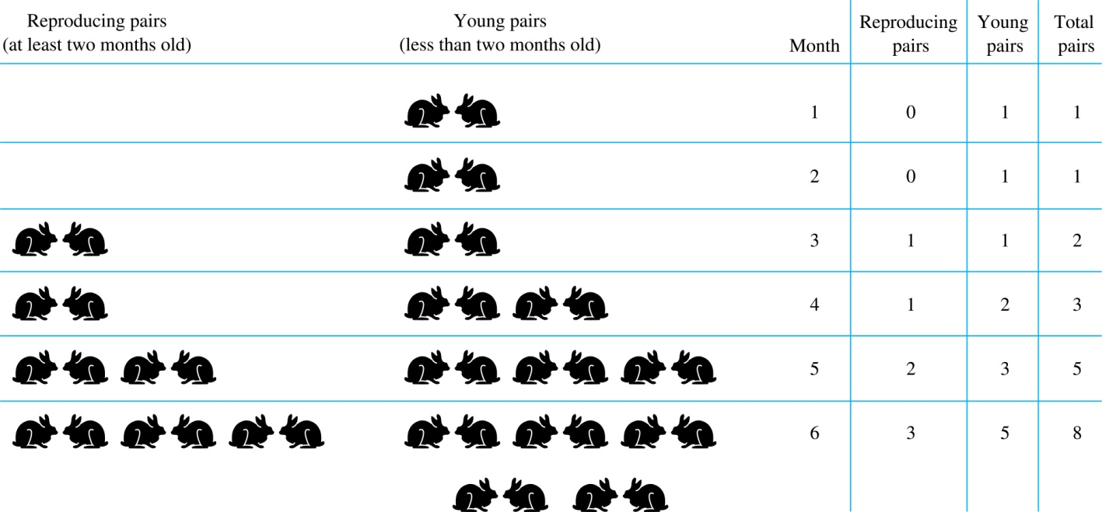
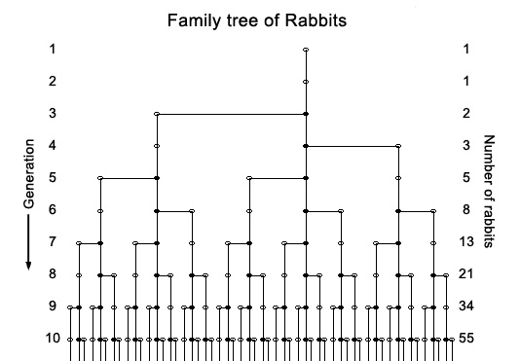
Rabbits and the Fiobonacci Numbers (cont.)
Modeling the Population Growth of Rabbits on an Island

Slide 7
Rabbits and the Fibonacci Numbers (cont.)
Solution: Let f_{n} be the number of pairs of rabbits after n months.
There are is f₁ = 1 pairs of rabbits on the island at the end of the first month.
We also have f₂ = 1 because the pair does not breed during the first month.
To find the number of pairs on the island after n months, add the number on the island after the previous month, f_{n-1}, and the number of newborn pairs, which equals f_{n-2}, because each newborn pair comes from a pair at least two months old.
Consequently the sequence {f_{n} } satisfies the recurrence relation f_{n} = f_{n-1} + f_{n-2} for n ≥ 3 with the initial conditions f₁ = 1 and f₂ = 1.
The number of pairs of rabbits on the island after n months is given by the nth Fibonacci number.

Slide 8
The Tower of Hanoi
In the late 19th century, the French mathematician Édouard Lucas invented a puzzle consisting of three pegs on a board with disks of different sizes. Initially all of the disks are on the first peg in order of size, with the largest on the bottom.
Rules: You are allowed to move the disks one at a time from one peg to another as long as a larger disk is never placed on a smaller.
Goal: Using allowable moves, end up with all the disks on the second peg in order of size with largest on the bottom.
Demo: http://towersofhanoi.info/Animate.aspx

Slide 9
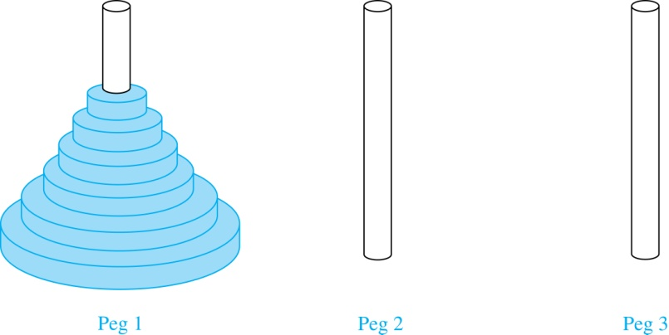
The Tower of Hanoi (continued)
The Initial Position in the Tower of Hanoi Puzzle

Slide 10
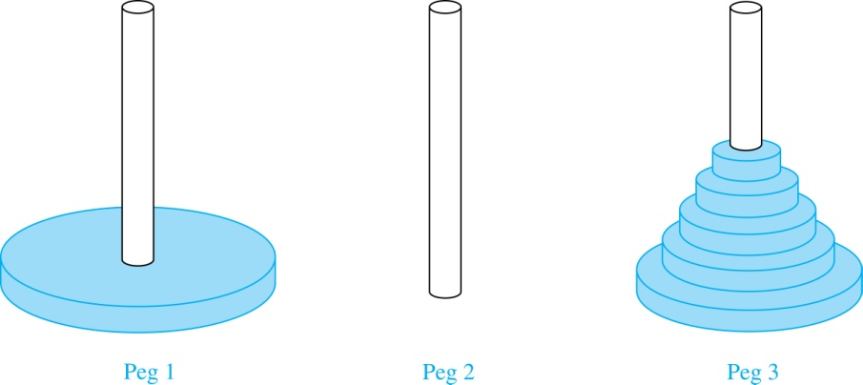
The Tower of Hanoi (continued)
Solution: Let {H_{n}} denote the number of moves needed to solve the Tower of Hanoi Puzzle with n disks. Set up a recurrence relation for the sequence {H_{n}}. Begin with n disks on peg 1. We can transfer the top n −1 disks, following the rules of the puzzle, to peg 3 using H_{n−1} moves.
First, we use 1 move to transfer the largest disk to the second peg. Then we transfer the n −1 disks from peg 3 to peg 2 using H_{n−1} additional moves. This can not be done in fewer steps. Hence,
H_{n} = 2H_{n−1} + 1.
The initial condition is H₁= 1 since a single disk can be transferred from peg 1 to peg 2 in one move.

Slide 11
The Tower of Hanoi (continued)
We can use an iterative approach to solve this recurrence relation by repeatedly expressing H_{n} in terms of the previous terms of the sequence.
H_{n} = 2H_{n−1} + 1
= 2(2H_{n−2} + 1) + 1 = 2² H_{n−2} +2 + 1
= 2²(2H_{n−3} + 1) + 2 + 1 = 2³ H_{n−3} +2² + 2 + 1
⋮
= 2^{n-1}H₁ + 2^{n−2} + 2^{n−3} + …. + 2 + 1
= 2^{n−1} + 2^{n−2} + 2^{n−3} + …. + 2 + 1 because H₁= 1
= 2^{n} − 1 using the formula for the sum of the terms of a geometric series
There was a myth created with the puzzle. Monks in a tower in Hanoi are transferring 64 gold disks from one peg to another following the rules of the puzzle. They move one disk each day. When the puzzle is finished, the world will end.
Using this formula for the 64 gold disks of the myth,
2⁶⁴ −1 = 18,446, 744,073, 709,551,615
days are needed to solve the puzzle, which is more than 500 billion years.

Slide 12
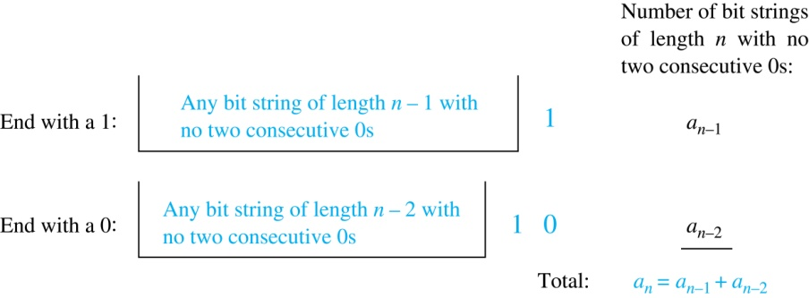
Counting Bit Strings
Example 3: Find a recurrence relation and give initial conditions for the number of bit strings of length n without two consecutive 0s. How many such bit strings are there of length 5?
Solution:
Let a_{n} denote the number of bit strings of length n without two consecutive 0s.
To obtain a recurrence relation for {a_{n} } note by the sum rule that a_{n} is equal to the number of such bit strings ending with a 0 plus the number of such bit strings ending with a 1.
Now assume that n ≥ 3.
The bit strings of length n ending with 1 without two consecutive 0s are the bit strings of length n −1 with no two consecutive 0s with a 1 added at the end. Hence, there are a_{n−1} such bit strings.
The bit strings of length n ending with 0 without two consecutive 0s are the bit strings of length n −2 with no two consecutive 0s with 10 at the end. Hence, there are a_{n−2} such bit strings.
We conclude that a_{n} = a_{n−1} + a_{n−2} for n ≥ 3.

Slide 13
Bit Strings (continued)
The initial conditions are:
a₁ = 2, since both the bit strings 0 and 1 do not have consecutive 0s.
a₂ = 3, since the bit strings 01, 10, and 11 do not have consecutive 0s, while 00 does.
To obtain a₅ , we use the recurrence relation three times to find that:
a₃ = a₂ + a₁ = 3 + 2 = 5
a₄ = a₃ + a₂ = 5+ 3 = 8
a₅ = a₄ + a₃ = 8+ 5 = 13
Note that {a_{n} } satisfies the same recurrence relation as the Fibonacci sequence. Since a₁ = f₃ and a₂ = f₄ , we conclude that a_{n} = f_{n+2} .

Slide 14
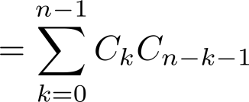
Counting the Ways to Parenthesize a Product
Example: Find a recurrence relation for C_{n} , the number of ways to parenthesize the product of n + 1 numbers, x₀ ∙ x₁ ∙ x₂ ∙ ⋯ ∙ x_{n}, to specify the order of multiplication.
For example, C₃ = 5, since all the possible ways to parenthesize 4 numbers are
((x₀∙x₁)∙x₂)∙x₃, (x₀∙(x₁∙x₂ ))∙x₃, (x₀∙x₁)∙(x₂∙x₃), x₀∙((x₁∙x₂)∙x₃), x₀∙(x₁∙(x₂∙x₃))
Solution:
Note that however parentheses are inserted in x₀ ∙ x₁ ∙ x₂ ∙ ⋯ ∙ x_{n}, one “∙” operator remains outside all parentheses.
This final operator appears between two of the n + 1 numbers, say x_{k} and x_{k+1}.
Since there are C_{k} ways to insert parentheses in the product x₀ ∙ x₁ ∙ x₂ ∙ ⋯ ∙ x_{k} and C_{n−k−1} ways to insert parentheses in the product x_{k+1} ∙ x_{k+2} ∙ ⋯ ∙ x_{n}, we have
The initial conditions are C₀ = 1 and C₁ = 1.
The sequence {C_{n} } is the sequence of Catalan Numbers. This recurrence relation can be solved using the method of generating functions (will be introduced in Section 8.4)

Slide 15
Solving Linear Recurrence Relations
Section 8.2

Slide 16
Linear Homogeneous Recurrence Relations
Definition: A linear(線性) homogeneous(齊次) recurrence relation of degree k with constant coefficients is a recurrence relation of the form a_{n} = c₁a_{n−1} + c₂a_{n−2} + ….. + c_{k} a_{n−k ,} where c₁, c₂, ….,c_{k} are real numbers, and c_{k} ≠ 0
it is linear because the right-hand side is a sum of the previous terms of the sequence each multiplied by a constant.
it is homogeneous because no terms occur that are not multiples of the a_{j}s. Each coefficient is a constant.
the degree is k because a_{n} is expressed in terms of the previous k terms of the sequence.
*Note: A sequence satisfying such a recurrence relation is uniquely determined by the recurrence relation and the k initial conditions a₀ = C₁, a₀ = C₁ ,… , a_{k−1} = C_{k−1}.

Slide 17
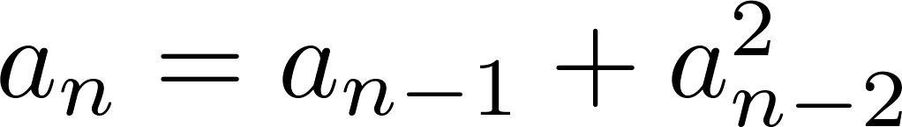
Examples of Linear Homogeneous Recurrence Relations
P_{n} = (1.11)P_{n-1} linear homogeneous recurrence relation of degree one
f_{n} = f_{n-1} + f_{n-2} linear homogeneous recurrence relation of degree two
not linear
H_{n} = 2H_{n−1} + 1 not homogeneous
B_{n} = nB_{n−1} coefficients are not constants

Slide 18
Solving Linear Homogeneous Recurrence Relations
The basic approach is to look for solutions of the form
a_{n} = r^{n}, where r is a constant.
Note that a_{n} = r^{n} is a solution to the recurrence relation
a_{n} = c₁a_{n−1} + c₂a_{n−2} + ⋯ + c_{k} a_{n−k} iff r^{n} = c₁r^{n−1} + c₂r^{n−2} + ⋯ + c_{k} r^{n−k} .
Algebraic manipulation yields the characteristic equation (特徵方程式): r^{k} − c₁r^{k−1} − c₂r^{k−2} − ⋯ − c_{k−1}r − c_{k} = 0
The sequence {a_{n}} with a_{n} = r^{n} is a solution iff r is a solution to the characteristic equation.
The solutions to the characteristic equation are called the characteristic roots(特徵根) of the recurrence relation. The roots are used to give an explicit formula for all the solutions of the recurrence relation.

Slide 19
Solving Linear Homogeneous Recurrence Relations of Degree Two
Recall: Linear Homogeneous R.R. of Degree Two: a_{n} = c₁a_{n−1} + c₂a_{n−2}
Theorem 1: Let c₁ and c₂ be real numbers. Suppose that r²–c₁r–c₂=0 has two distinct roots r₁ and r₂. Then the sequence {a_{n}} is a solution to the recurrence relation a_{n}= c₁a_{n−1}+ c₂a_{n−2} if and only if a_{n} = α₁r₁^{n} + α₂r₂^{n}, for n = 0,1,2,…, where α₁ and α₂ are constants.
Proof:
(←) ( i.e., a_{n} = α₁r₁^{n} + α₂r₂^{n} → a_{n}= c₁a_{n−1}+ c₂a_{n−2} )
c₁a_{n−1}+c₂a_{n−2} =c₁(α₁r₁^{n-1} + α₂r₂^{n-1})+c₂(α₁r₁^{n-2} + α₂r₂^{n-2})
=α₁r₁^{n-2}(c₁r₁+c₂)+ α₂r₂^{n-2}(c₁r₂+c₂)=α₁r₁^{n}+α₂r₂^{n}=a_{n}
(→) ( i.e., a_{n}= c₁a_{n−1}+ c₂a_{n−2} with a₀=K₀ and a₁=K₁ → a_{n} = α₁r₁^{n} + α₂r₂^{n} )
We will prove this by using strong induction:
Basis Step:
a₀ =K₀=α₁r₁⁰ + α₂r₂⁰ = α₁+ α₂ ;
a₁ =K₁=α₁r₁ + α₂r₂ (since r₁ ≠ r₂, (α₁, α₂) must exist!) ,
Induction Step:
Inductive hypothesis: a_{j} = α₁r₁^{j} + α₂r₂^{j} , for 1≤j≤k
a_{k+1} = c₁a_{k} + c₂a_{k-1}
= (by ind.hyp.) c₁(α₁r₁^{k}+ α₂r₂^{k}) + c₂ (α₁r₁^{k-1} + α₂r₂^{k-1})
= α₁(c₁r₁^{k}+c₂r₁^{k-1}) + α₂(c₁r₂^{k}+c₂r₂^{k-1})
= α₁r₁^{k-1}(c₁r₁+c₂) + α₂r₂^{k-1} (c₁r₂+c₂) = α₁r₁^{k+1} + α₂r₂^{k+1}
based on mathematical induction have shown that a_{n} = α₁r₁^{n} + α₂r₂^{n} , for n = 0,1,2,…

Slide 20
Using Theorem 1
Example: What is the solution to the recurrence relation
a_{n} = a_{n−1} + 2a_{n−2} with a₀ = 2 and a₁ = 7?
Solution: The characteristic equation is r² − r − 2 = 0.
Its roots are r = 2 and r = −1 . Therefore, {a_{n}} is a solution to the recurrence relation if and only if a_{n} = α₁2^{n} + α₂(−1)^{n}, for some constants α₁ and α₂.
To find the constants α₁ and α₂, note that
a₀ = 2 = α₁ + α₂ and a₁ = 7 = α₁2 + α₂(−1).
Solving these equations, we find that α₁ = 3 and α₂ = −1.
Hence, the solution is the sequence {a_{n}} with a_{n} = 3∙2^{n}−(−1)^{n}.

Slide 21
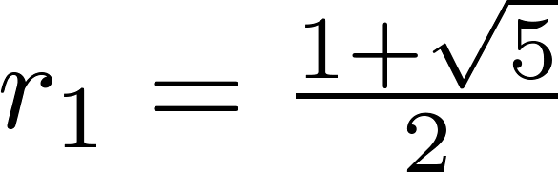
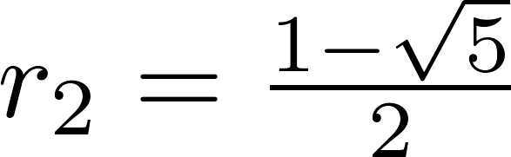
An Explicit Formula for the Fibonacci Numbers
We can use Theorem 1 to find an explicit formula for the Fibonacci numbers. The sequence of Fibonacci numbers satisfies the recurrence relation f_{n} = f_{n−1} + f_{n−2} with the initial conditions: f₀ = 0 and f₁ = 1.
Solution: The roots of the characteristic equation r² – r – 1 = 0 are

Slide 22
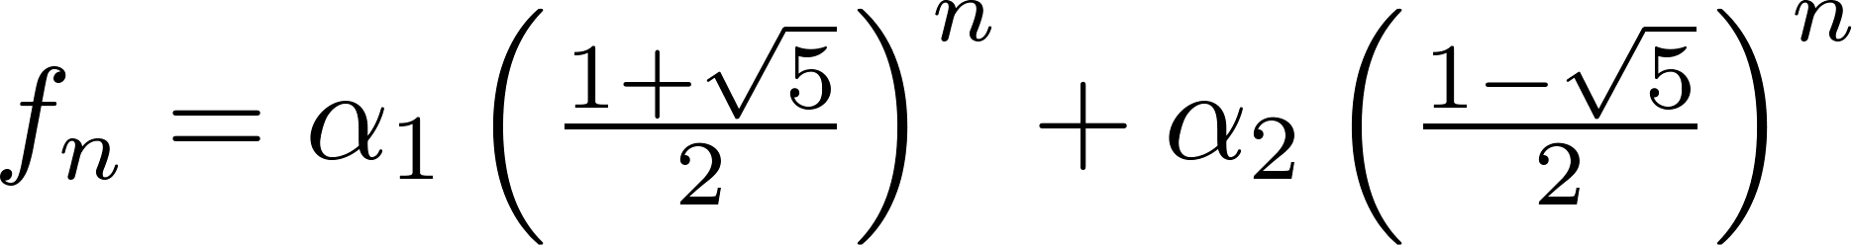
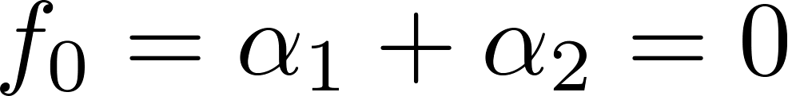
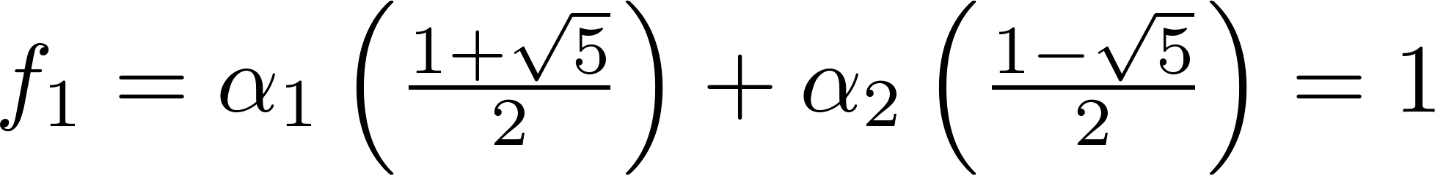
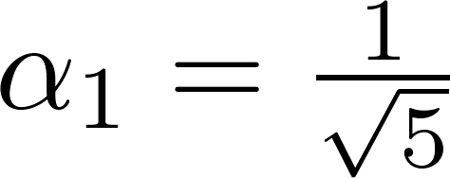
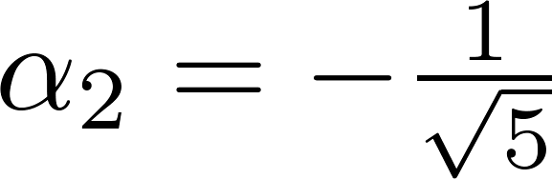
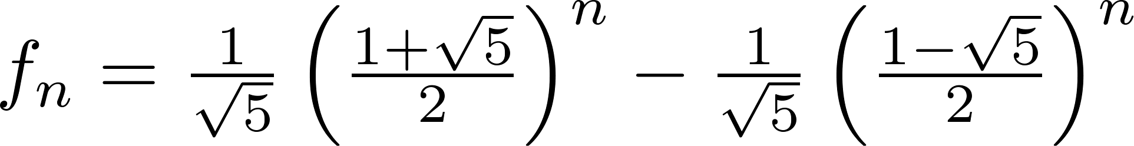
Fibonacci Numbers (continued)
Therefore by Theorem 1
for some constants α₁ and α₂.
Using the initial conditions f₀ = 0 and f₁ = 1 , we have
Solving, we obtain .
Hence,
.
,

Slide 23
The Solution when there is a Repeated Root(重根)
Theorem 2: Let c₁ and c₂ be real numbers with c₂ ≠ 0. Suppose that r²–c₁r–c₂=0 has only one root r₀. Then the sequence {a_{n}} is a solution to the recurrence relation a_{n} = c₁a_{n−1} + c₂a_{n−2} if and only if a_{n} = α₁r₀^{n} + α₂nr₀^{n}, for n = 0,1,2,… , where α₁ and α₂ are constants.
Proof: => (Similar to Theorem 1; Reading Exercise! )
(←) : ( i.e., a_{n} = α₁r₀^{n} + α₂nr₀^{n} → a_{n}= c₁a_{n−1}+ c₂a_{n−2} )
c₁a_{n-1} +c₂a_{n−2}= c₁(α₁r₀^{n-1} + α₂(n-1) r₀^{n-1} )+c₂(α₁r₀^{n-2} + α₂(n-2) r₀^{n-2})
= α₁r₀^{n-2} (c₁r₀+c₂)+ α₂r₀^{n-2}((n-1)(c₁r₀+c₂)-c₂)
= α₁r₀^{n} + α₂r₀^{n-2}((n-1) r₀² + r₀²) = α₁r₀^{n} + α₂nr₀^{n} =a_{n}
(→) :( i.e., a_{n}= c₁a_{n−1}+ c₂a_{n−2} with a₀=C₀ and a₁=C₁ →a_{n} = α₁r₀^{n} + α₂nr₀^{n} )
We will prove this by using strong induction:
Basis Step:
a₀ =C₀=α₁r₀⁰ + α₂⋅0⋅r₀⁰ = α₁ ;
a₁ =C₁=α₁r₀ + α₂⋅1⋅r₀ (such (α₁, α₂) exist! (α₁, α₂)=(C₀, -C₀+C₁/r₀))
Induction Step:
Inductive hypothesis: a_{j} = α₁r₀^{j} + α₂jr₀^{j} , for 1≤j≤k
a_{n}=c₁a_{n-1}+c₂a_{n-2}=(by ind.hyp.) c₁(α₁ r₀^{n-1} + α₂ (n-1) r₀^{n-1})+c₂(α₁r₀^{n-2} + α₂(n-2)r₀^{n-2})
= α₁(c₁ r₀^{n-1} + c₂r₀^{n-2}) + α₂(c₁(n-1)r₀^{n-1} + c₂(n-2)r₀^{n-2})
= α₁r₀^{n-2}(c₁ r_{o} + c₂) + α₂r₀^{n-2}( (n-1)(c₁r_{o}+c₂) - c₂)= α₁r₀^{n} + α₂r₀^{n-2}((n-1) r₀² + r₀²)
= α₁r₀^{n} + α₂nr₀^{n}
based on mathematical induction have shown that a_{n} = α₁r₀^{n} + α₂nr₀^{n} , for n=0,1,2,…
∵ r²- c₁r -c₂ = (r-r₀)²
= r² - 2 r₀ r + r₀²; ⇒-c₂ = r₀²

Slide 24
Using Theorem 2
Example: What is the solution to the recurrence relation a_{n}=6a_{n−1}−9a_{n−2} with a₀ = 1 and a₁ = 6?
Solution: The characteristic equation is r² − 6r + 9 = 0.
The only root is r = 3. Therefore, {a_{n}} is a solution to the recurrence relation if and only if
a_{n} = α₁3^{n} + α₂n(3)^{n}
where α₁ and α₂ are constants.
To find the constants α₁ and α₂, note that
a₀ = 1 = α₁ and a₁ = 6 = α₁ ∙ 3 + α₂ ∙3.
Solving, we find that α₁ = 1 and α₂ = 1 .
Hence,
a_{n} = 3^{n} + n3^{n} .

Slide 25
Solving Linear Homogeneous Recurrence Relations of Arbitrary Degree
Theorem 3: Let c₁, c₂ ,…, c_{k} be real numbers. Suppose that the characteristic equation r^{k} –c₁r^{k−1} –⋯ – c_{k}=0 has k distinct roots r₁, r₂, …, r_{k}. Then a sequence {a_{n}} is a solution of the recurrence relation a_{n} = c₁a_{n−1} + c₂a_{n−2} + ….. + c_{k} a_{n−k} if and only if a_{n} = α₁r₁^{n} + α₂r₂^{n} + …+α_{k}r_{k}^{n}, for n = 0, 1, 2, …, where α₁, α₂,…, α_{k} are constants.
Example 6: Find the solution to the recurrence relation
a_{n} = 6a_{n-1} - 11a_{n-2} + 6a_{n-3}
with the initial conditions a₀=2 and a₁=5, and a₂=15.
Solution: (show time)

Slide 26
The General Case with Repeated Roots Allowed
Theorem 4: Let c₁, c₂ ,…, c_{k} be real numbers. Suppose that the characteristic equation r^{k} –c₁r^{k−1} –⋯– c_{k}=0 has t distinct roots r₁, r₂, …, r_{t} with multiplicities m₁, m₂, …, m_{t}, respectively so that m_{i} ≥ 1 for i = 1, 2, …,t and m₁ + m₂ + … + m_{t} = k. Then a sequence {a_{n}} is a solution of the recurrence relation a_{n} = c₁a_{n−1} + c₂a_{n−2} + ….. + c_{k} a_{n−k} if and only if
for n = 0, 1, 2, …, where α_{i,j} are constants for 1≤ i ≤ t and 0≤ j ≤ m_{i}-1.
Example 8: Find the solution to the recurrence relation
a_{n} = -3a_{n-1} - 3a_{n-2} - a_{n-3}
with the initial conditions a₀=1 and a₁=-2, and a₂=-1.
Solution: (show time)

Slide 27
Linear Nonhomogeneous Recurrence Relations with Constant Coefficients
Definition: A linear nonhomogeneous recurrence relation with constant coefficients is a recurrence relation of the form:
a_{n} = c₁a_{n−1} + c₂a_{n−2} + ….. + c_{k} a_{n−k} + F(n) ,
where c₁, c₂, ….,c_{k} are real numbers, and F(n) is a function not identically zero depending only on n.
The recurrence relation
a_{n} = c₁a_{n−1} + c₂a_{n−2} + ….. + c_{k} a_{n−k ,}
is called the associated homogeneous recurrence relation.

Slide 28
Linear Nonhomogeneous Recurrence Relations with Constant Coefficients (cont.)
The following are linear nonhomogeneous recurrence relations with constant coefficients:
a_{n} = a_{n−1} + 2^{n} ,
a_{n} = a_{n−1} + a_{n−2} + n² + n + 1,
a_{n} = 3a_{n−1} + n3^{n} ,
a_{n} = a_{n−1} + a_{n−2} + a_{n−3} + n!
where the following are the associated linear homogeneous recurrence relations, respectively:
a_{n} = a_{n−1 ,}
a_{n} = a_{n−1} + a_{n−2},
a_{n} = 3a_{n−1} ,
a_{n} = a_{n−1} + a_{n−2} + a_{n−3}

Slide 29
Solving Linear Nonhomogeneous Recurrence Relations with Constant Coefficients
Theorem 5: If {a_{n}^{(p)}} is a particular solution of the nonhomogeneous linear recurrence relation with constant coefficients a_{n}=c₁a_{n−1}+c₂a_{n−2}+⋯+c_{k}a_{n−k}+F(n) ,
then every solution is of the form {a_{n}^{(p)} + a_{n}^{(h)}}, where {a_{n}^{(h)}} is a solution of the associated homogeneous recurrence relation a_{n}=c₁a_{n−1}+c₂a_{n−2}+⋯+c_{k}a_{n−k .}
Example: Find all solutions of the recurrence relation a_{n} = 3 a_{n-1} + 2n, and what is the solution with a₁ = 3 ?
Sol: The key to the problem is to find a particular solution a_{n}^{(p)}.
We first guess that p_{n} is in linear form, i.e., a_{n}^{(p)} = cn + d for some constants c and d.
We then have cn+d = 3 (c(n-1) + d) + 2n = (3c + 2) n + (3d – 3c).
As a result (2c+2) n + (2d – 3c) = 0. Hence c = -1 and d =-3/2. => a_{n}^{(p)} = -n – 3/2
Next Find general solution of the associated lhrr: a_{n}^{(h)} = 3 a_{n-1} .
Which we know is of the form α 3^{n}. (特徵方程式:r-3=0)
Hence by Theorem 5, all solutions are of the form: a_{n}=α3^{n}-n-3/2.
If a₁ = 3, then 3 = α3¹ - 1 -3/2 and α=11/6.
Hence a_{n} = 11/6 x 3^{n} - n-3/2.

Slide 30
Solving Linear Nonhomogeneous Recurrence Relations with Constant Coefficients
The key to the problem is to find a particular solution p_{n}! How?
Theorem 6: Suppose {a_{n}} satisfies the linear nonhomogeneous recurrence relation
a_{n} = c₁a_{n-1} + c₂a_{n-2} +. . . + c_{k}a_{n-k} + F(n)
where c₁ , c₂ ,. . ., c_{k} be real numbers and
F(n) = (b_{t}n^{t} + b_{t-1}n^{t-1} +. . .+ b₁n + b₀ )*s^{n}
where b₁ , b₂ ,. . ., b_{t} and s are real numbers.
(1) When s is not a root of the characteristic equation of the associated linear homogeneous recurrence relation, there is a particular solution of the form
(p₁n^{t} + p_{t-1}n^{t-1} +. . .+ p₁n + p₀ )*s^{n}
(2) When s is a root of this characteristic equation and its multiplicity is m, there is a particular solution of the form
n^{m} (p₁n^{t} + p_{t-1}n^{t-1} +. . .+ p₁n + p₀ )*s^{n}
以前頁Example為例
a_{n} = 3 a_{n-1} + 2n
F(n) =(b₁n+b₀)*s^{n}
2
0
1
Lhrr: a_{n} = 3 a_{n-1}
特徵根: r=3
s=1不是特徵根
a_{n}^{(p)} =(p₁n+ p₀)*1^{n}
Recall:
前頁Example我們猜
a_{n}^{(p)} = cn + d

Slide 31
Generating Functions
Section 8.4

Slide 32
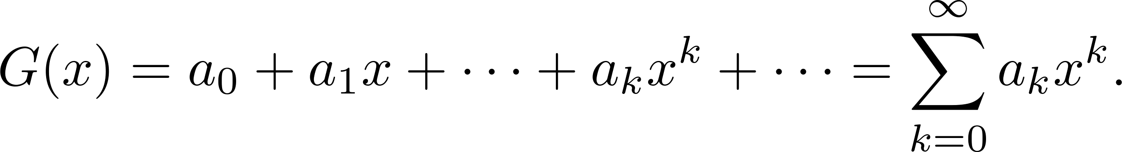
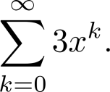
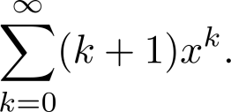
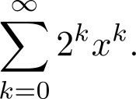
Generating Functions
Definition: The generating function for the sequence a₀, a₁,…, a_{k}, … of real numbers is the infinite series
Examples:
The sequence {a_{k}} with a_{k} = 3 has the generating function
The sequence {a_{k}} with a_{k} = k + 1 has the generating function has the generating function
The sequence {a_{k}} with a_{k} = 2^{k} has the generating function has the generating function

Slide 33
Generating Functions for Finite Sequences
Generating functions for finite sequences of real numbers can be defined by extending a finite sequence a₀,a₁, … , a_{n} into an infinite sequence by setting a_{n+1}=0, a_{n+2}=0, and so on.
The generating function G(x) of this finite sequence {a_{n}} is a polynomial of degree n because no terms of the form a_{j}x^{j} with j > n occur, that is,
G(x) = a₀ + a₁x + ⋯ + a_{n} x^{n}.
Example: What is the generating function for the sequence 1,1,1,1,1,1?
Solution: The generating function of 1,1,1,1,1,1 is
1 + x + x² + x³ + x⁴ + x⁵.
By Theorem 1 of Section 2.4 (等比級數), we have
(x⁶ − 1)/(x −1) = 1 + x + x² + x³ + x⁴ + x⁵ when x ≠ 1.
Consequently G(x) = (x⁶ − 1)/(x −1) is the generating function of the sequence.

Slide 34
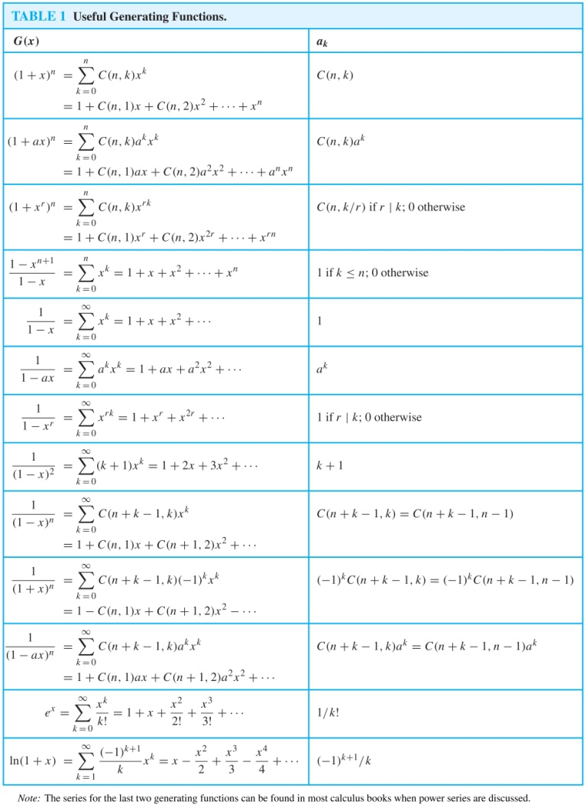
Useful Generating Functions

Slide 35
Useful Generating Functions
Reading Exercise: The EXTENDED BINOMIAL THEOREM (Text Book p.566-567)

Slide 36
Counting Problems and Generating Functions
Example: Find the number of solutions of
e₁ + e₂ + e₃ = 17,
where e₁, e₂, and e₃ are nonnegative integers with 2 ≤ e₁≤ 5, 3 ≤ e₂ ≤ 6, and 4 ≤ e₃ ≤ 7.
Solution: The number of solutions is the coefficient of x¹⁷ in the expansion of
(x² + x³ + x⁴ + x⁵) (x³ + x⁴ + x⁵ + x⁶) (x⁴ + x⁵ + x⁶ + x⁷).
This follows because a term equal to is obtained in the product by picking a term in the first sum x^{e1}, a term in the second sum x^{e2}, and a term in the third sum x^{e3}, where e₁ + e₂ + e₃ = 17.
There are three solutions since the coefficient of x¹⁷ in the product is 3.

Slide 37

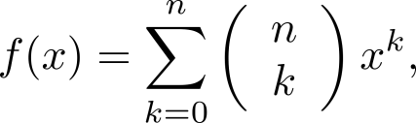
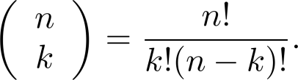
Counting Problems and Generating Functions (continued)
Example: Use generating functions to find the number of k-combinations of a set with n elements, i.e., C(n,k).
Solution:
Each of the n elements in the set contributes the term (1+ x) to the generating function = (x⁰+x¹) (x⁰+x¹) … (x⁰+x¹) = (1+x)^{n .}
solu: = coefficient of x^{k} in the generating function
By Binominal theorem :
where
Hence #k-combinations =

Slide 38
Using Generating Functions to Solve Recurrent Relations
Example: Suppose that a valid codeword is an n-digit number in decimal notation containing an even number of 0s. Let a_{n} denote the number of valid codewords of length n. It follows from Example 4 of Section 8.1 that
a_{n}=8a_{n-1}+10^{n-1} and the initial condition a₁=9.
Use generating function to find an explicit formula for a_{n} .
Solution: For simplicity, we extend this sequence by setting a₀=1.
a_{n}=8a_{n-1}+10^{n-1} ⇒a_{n} x^{n} = 8a_{n-1} x^{n} + 10^{n-1} x^{n}
Let G(x) =
G(x)–1 = =
G(x) (1-8x) = 1+ x/(1-10x)
Hence a_{n} = ½ (8^{n} + 10^{n}).
Note: Using the method introduced in 8.2 is easier than using generating function.

Slide 39
Inclusion-Exclusion
Section 8.5

Slide 40
Principle of Inclusion-Exclusion
In Section 2.2, we developed the following formula for the number of elements in the union of two finite sets:
We will generalize this formula to finite sets of any size.

Slide 41
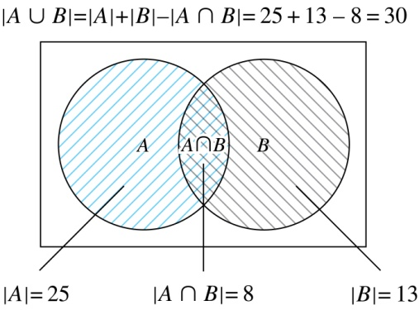
Two Finite Sets
Example: In a discrete mathematics class every student is a major in computer science or mathematics or both. The number of students having computer science as a major (possibly along with mathematics) is 25; the number of students having mathematics as a major (possibly along with computer science) is 13; and the number of students majoring in both computer science and mathematics is 8. How many students are in the class?
Solution: |A∪B| = |A| + |B| −|A∩B|
= 25 + 13 −8 = 30

Slide 42
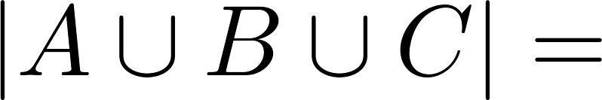
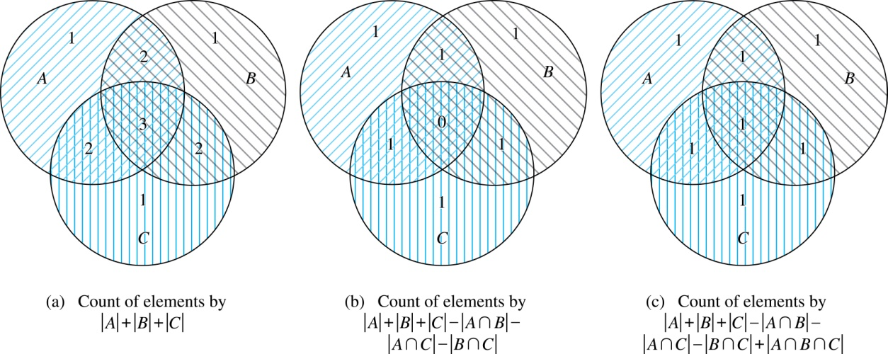
Three Finite Sets

Slide 43
Three Finite Sets Continued
Example: A total of 1232 students have taken a course in Spanish, 879 have taken a course in French, and 114 have taken a course in Russian. Further, 103 have taken courses in both Spanish and French, 23 have taken courses in both Spanish and Russian, and 14 have taken courses in both French and Russian. If 2092 students have taken a course in at least one of Spanish French and Russian, how many students have taken a course in all 3 languages.
Solution: Let S be the set of students who have taken a course in Spanish, F the set of students who have taken a course in French, and R the set of students who have taken a course in Russian. Then, we have
|S| = 1232, |F| = 879, |R| = 114, |S∩F| = 103, |S∩R| = 23, |F∩R| = 14, and |S∪F∪R| = 23.
Using the equation
|S∪F∪R| = |S|+ |F|+ |R| − |S∩F| − |S∩R| − |F∩R| + |S∩F∩R|,
we obtain 2092 = 1232 + 879 + 114 −103 −23 −14 + |S∩F∩R|.
Solving for |S∩F∩R| yields 7.

Slide 44
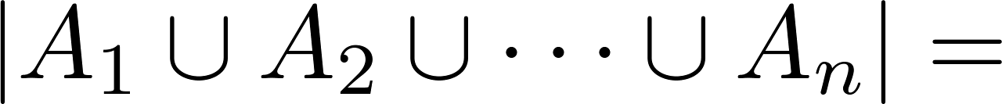
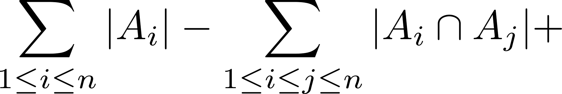
The Principle of Inclusion-Exclusion
Theorem 1. The Principle of Inclusion-Exclusion: Let A₁, A₂, …, A_{n} be finite sets. Then:

Slide 45
Applications of Inclusion-Exclusion
Section 8.6

Slide 46
The Number of Onto Functions
Example: How many onto functions are there from a set with 6 elements to a set with 3 elements?
Solution: Suppose that the elements in the codomain are b₁, b₂, and b₃. Let P₁, P₂, and P₃ be the properties that b₁, b₂, and b₃ are not in the range of the function, respectively. The function is onto if none of the properties P₁, P₂, and P₃ hold.
By the inclusion-exclusion principle the number of onto functions from a set with 6 elements to a set with 3 elements is
N − [N(P₁) + N(P₂) + N(P₃)] + [N(P₁P₂) + N(P₁P₃) + N(P₂P₃)] − N(P₁P₂P₃)
Here the total number of functions from a set with six elements to one with three elements is N = 3⁶.
The number of functions that do not have in the range is N(P₁) = 2⁶. Similarly, N(P₂) = N(3₁) = 2⁶ .
Note that N(P₁P₂) = N(P₁P₃) = N(P₂P₃) = 1 and N(P₁P₂P₃)= 0.
Hence, the number of onto functions from a set with six elements to a set with three elements is:
3⁶ − 3∙ 2⁶ + 3 = 729 − 192 + 3 = 540

Slide 47
The Number of Onto Functions (continued)
Theorem 1: Let m and n be positive integers with m ≥ n.
Then there are
onto functions from a set with m elements to a set with n elements.
Proof follows from the principle of inclusion-exclusion

Slide 48
Derangements (錯位)
Definition: A derangement is a permutation of objects that leaves no object in the original position.
Example: The permutation of 21453 is a derangement of 12345 because no number is left in its original position. But 21543 is not a derangement of 12345, because 4 is in its original position.

Slide 49
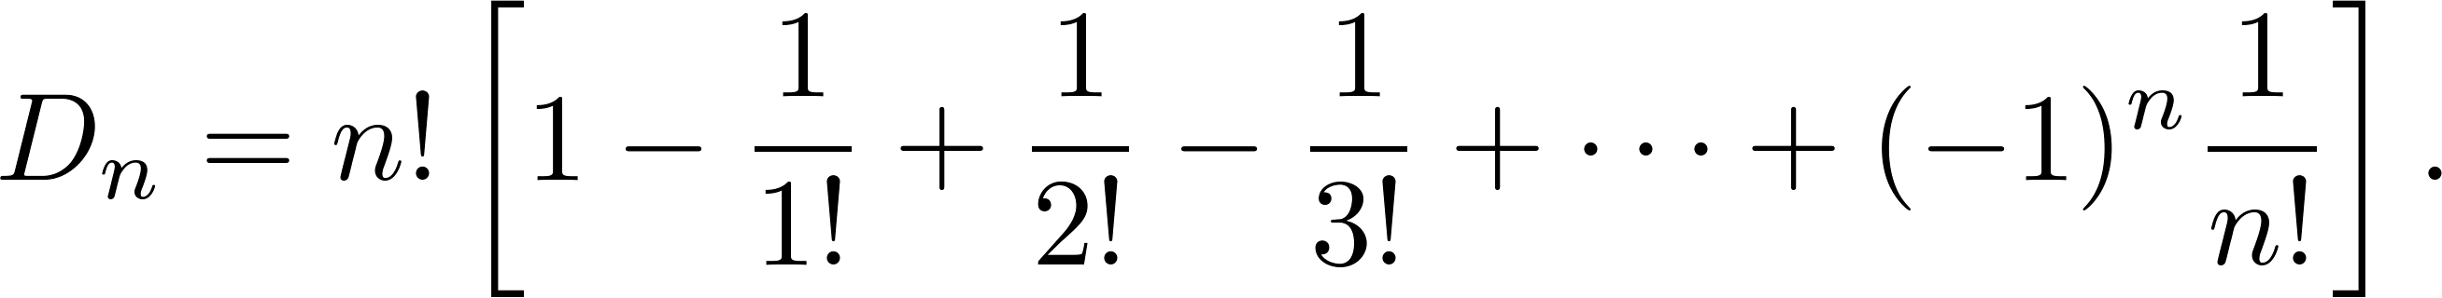
Derangements (continued)
Theorem 2: The number of derangements of a set with n elements is
Proof follows from the principle of inclusion-exclusion (see text ).

Slide 50
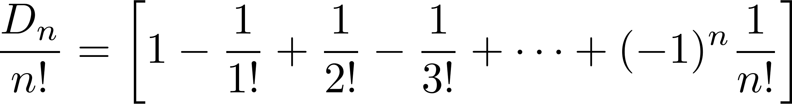
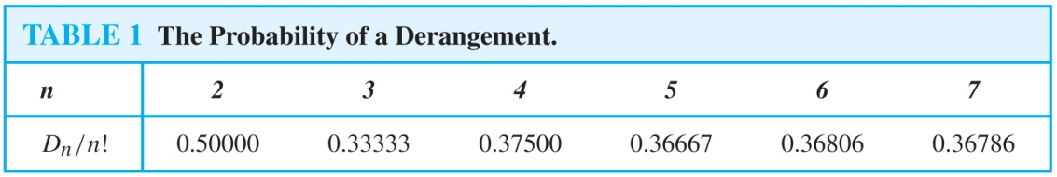
Derangements (continued)
The Hatcheck Problem: A new employee checks the hats of n people at restaurant, forgetting to put claim check numbers on the hats. When customers return for their hats, the checker gives them back hats chosen at random from the remaining hats. What is the probability that no one receives the correct hat.
Solution: The answer is the number of ways the hats can be arranged so that there is no hat in its original position divided by n!, the number of permutations of n hats.
Remark: It can be shown that the probability of a derangement approaches 1/e as n grows without bound.

