Slide 1
Relations
Chapter 9

Slide 2
Chapter Summary
Relations and Their Properties
n-ary Relations and Their Applications (not currently included in overheads)
Representing Relations
Closures of Relations
Equivalence Relations
Partial Orderings

Slide 3
Relations and Their Properties
Section 9.1

Slide 4
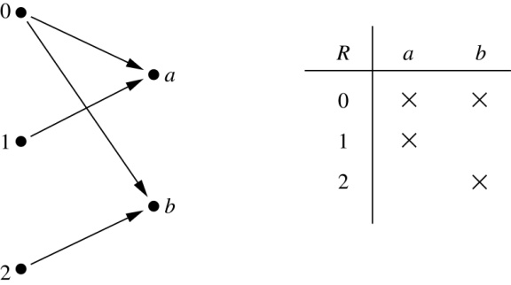
Binary Relations (二元關係)
Definition: A binary relation R from a set A to a set B is a subset R ⊆ A ×B.
Example:
Let A = {0,1,2} and B = {a,b}
{(0, a), (0, b), (1,a) , (2, b)} is a relation from A to B.
We can represent relations from a set A to a set B graphically or using a table:
Relations are more general than functions. A function is a relation where exactly one element of B is related to each element of A.

Slide 5
Binary Relation on a Set
Definition: A binary relation R on a set A is a subset of A × A or a relation from A to A.
Example:
Suppose that A = {a,b,c}. Then R = {(a,a),(a,b), (a,c)} is a relation on A.
Let A = {1, 2, 3, 4}. The ordered pairs in the relation
R = {(a,b) | a divides b} are
R={(1,1), (1, 2), (1,3), (1,4), (2,2), (2,4), (3,3), (4,4)}.

Slide 6
Binary Relation on a Set (cont.)
Question: How many relations are there on a set with n elements?
Solution:
Because a relation on A is a subset of A ⨉ A, we count the subsets of A × A.
Since A × A has n² elements when A has n elements, and a set with m elements has 2^{m} subsets, there are subsets of A × A. Therefore, there are relations on a set A.

Slide 7
Binary Relations on a Set (cont.)
Example: Consider these relations on the set of integers:
R₁ = {(a,b) | a ≤ b}, R₄ = {(a,b) | a = b},
R₂ = {(a,b) | a > b}, R₅ = {(a,b) | a = b + 1},
R₃ = {(a,b) | a = b or a = −b}, R₆ = {(a,b) | a + b ≤ 3}.
Which of these relations contain each of the pairs?
(1,1), (1, 2), (2, 1), (1, −1), and (2, 2)?
Solution:
(1,1) is in R₁, R₃, R₄ , and R₆
(1,2) is in R₁ and R₆
(2,1) is in R₂, R₅, and R₆
(1, −1) is in R₂, R₃, and R₆
(2,2) is in R₁, R₃, and R₄
Note that these relations are on an infinite set and each of these relations is an infinite set.

Slide 8
Reflexive Relations
Definition: R is reflexive iff (a,a) ∊ R for every element a ∊ A. Written symbolically, R is reflexive if and only if
∀x[x∊U ⟶ (x,x) ∊ R]
Example: The following relations on the integers are reflexive:
R₁ = {(a,b) | a ≤ b},
R₃ = {(a,b) | a = b or a =−b},
R₄ = {(a,b) | a = b}.
The following relations are not reflexive:
R₂ = {(a,b) | a > b} (note that 3 ≯ 3),
R₅ = {(a,b) | a = b + 1} (note that 3 ≠3 + 1),
R₆ = {(a,b) | a + b ≤ 3} (note that 4 + 4 ≰ 3).
If A = ∅ then the empty relation is reflexive vacuously. That is the empty relation on an empty set is reflexive!

Slide 9
Symmetric Relations
Definition: R is symmetric iff (b,a) ∊ R whenever (a,b) ∊ R for all a,b ∊ A. Written symbolically, R is symmetric if and only if
∀x∀y [(x,y) ∊R ⟶ (y,x) ∊ R]
Example: The following relations on the integers are symmetric:
R₃ = {(a,b) | a = b or a = −b},
R₄ = {(a,b) | a = b},
R₆ = {(a,b) | a + b ≤ 3}.
The following are not symmetric:
R₁ = {(a,b) | a ≤ b} (note that 3 ≤ 4, but 4 ≰ 3),
R₂ = {(a,b) | a > b} (note that 4 > 3, but 3 ≯ 4),
R₅ = {(a,b) | a = b + 1} (note that 4 = 3 + 1, but 3 ≠4 + 1).

Slide 10
Antisymmetric Relations
Definition:A relation R on a set A such that for all a,b ∊ A if (a,b) ∊ R and (b,a) ∊ R, then a = b is called antisymmetric. Written symbolically, R is antisymmetric if and only if
∀x∀y [(x,y) ∊R ∧ (y,x) ∊ R ⟶ x = y]
Example: The following relations on the integers are antisymmetric:
R₁ = {(a,b) | a ≤ b},
R₂ = {(a,b) | a > b},
R₄ = {(a,b) | a = b},
R₅ = {(a,b) | a = b + 1}.
The following relations are not antisymmetric:
R₃ = {(a,b) | a = b or a = −b}
(note that both (1,−1) and (−1,1) belong to R₃),
R₆ = {(a,b) | a + b ≤ 3} (note that both (1,2) and (2,1) belong to R₆).
For any integer, if a a ≤ b and b ≤ a, then a = b.

Slide 11
Transitive Relations
Definition: A relation R on a set A is called transitive if whenever (a,b) ∊ R and (b,c) ∊ R, then (a,c) ∊ R, for all a,b,c ∊ A. Written symbolically, R is transitive if and only if
∀x∀y ∀z[(x,y) ∊R ∧ (y,z) ∊ R ⟶ (x,z) ∊ R ]
Example: The following relations on the integers are transitive:
R₁ = {(a,b) | a ≤ b},
R₂ = {(a,b) | a > b},
R₃ = {(a,b) | a = b or a = −b},
R₄ = {(a,b) | a = b}.
The following are not transitive:
R₅ = {(a,b) | a = b + 1} (note that both (3,2) and (4,3) belong to R₅, but not (3,3)),
R₆ = {(a,b) | a + b ≤ 3} (note that both (2,1) and (1,2) belong to R₆, but not (2,2)).
For every integer, a ≤ b and b ≤ c, then b ≤ c.

Slide 12
Combining Relations
Given two relations R₁ and R₂, we can combine them using basic set operations to form new relations such as
R₁ ∪ R₂, R₁ ∩ R₂, R₁ − R₂, and R₂ − R₁.
Example: Let A = {1,2,3} and B = {1,2,3,4}. The relations
R₁ = {(1,1),(2,2),(3,3)} and R₂ = {(1,1),(1,2),(1,3),(1,4)} can be combined using basic set operations to form new relations:
R₁ ∪ R₂ ={(1,1),(1,2),(1,3),(1,4),(2,2),(3,3)}
R₁ ∩ R₂ ={(1,1)}
R₁ − R₂ ={(2,2),(3,3)}
R₂ − R₁ ={(1,2),(1,3),(1,4)}

Slide 13
Composition
Definition: Suppose
R₁ is a relation from a set A to a set B.
R₂ is a relation from B to a set C.
Then the composition (or composite) of R₂ and R₁, denoted as R₂∘ R₁, is a relation from A to C where
if (x,y) is a member of R₁ and (y,z) is a member of R₂, then (x,z) is a member of R₂∘ R₁.

Slide 14
Representing the Composition of a Relation
R₂
R₁
w
m
a
x
n
b
y
o
c
p
z
R₁∘ R₂ = {(b,x),(b,z)}

Slide 15
Powers of a Relation
Definition: Let R be a binary relation on A. Then the powers R^{n} of the relation R can be defined recursively by:
R¹ = R
R^{n+1} = R^{n} ∘ R
Theorem 1: The relation R on a set A is transitive iff R^{n} ⊆ R for n = 1,2,3 ….
Proof:
(1) ←(if)
R^{n} ⊆ R ⇒ R² ⊆ R ⇒ Based on the definition of R∘R, ∀ (a,b)∈R and (b,c)∈R →(a,c)∈R²⊆R, i.e., R is transitive.
(2) →(only if)
We use mathematical induction to prove: R is transitive → R^{n} ⊆ R for n = 1,2,3,…
Basis Step: R¹ ⊆ R
Inductive Step: (Inductive Hypothesis: R^{n} ⊆ R, n∈N )
∀ (a,b)∈R^{n+1} , (R^{n+1} = R^{n} ∘ R ), ∃ x∈A such that (a,x) ∈R and (x,b) ∈R^{n}
Since R^{n} ⊆ R , (x,b) ∈R
Since R is transitive : (a,x) ∈R and (x,b) ∈R → (a,b) ∈R
Now we have ∀(a,b)∈R^{n+1} → (a,b) ∈R , that is R^{n+1} ⊆ R
It follows from the mathematical induction that R is transitive → R^{n} ⊆ R for n = 1,2,3,…

Slide 16
Representing Relations
Section 9.3

Slide 17
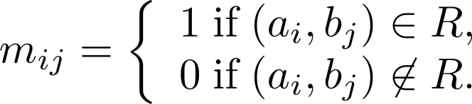
Representing Relations Using Matrices
A relation between finite sets can be represented using a zero-one matrix (零壹矩陣).
Suppose R is a relation from A = {a₁, a₂, …, a_{m}} to B = {b₁, b₂, …, b_{n}}.
The elements of the two sets can be listed in any particular arbitrary order. When A = B, we use the same ordering.
The relation R is represented by the matrix M_{R} = [m_{ij}], where
The matrix representing R has a 1 as its (i,j) entry when a_{i} is related to b_{j} and a 0 if a_{i} is not related to b_{j}.

Slide 18
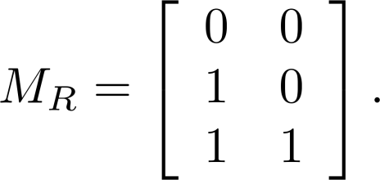
Examples of Representing Relations Using Matrices
Example 1: Suppose that A = {1,2,3} and B = {1,2}. Let R be the relation from A to B containing (a,b) if a∈A, b∈B, and a > b. What is the matrix representing R (assuming a₁=1, a₂=2, a₃=3, and b₁=1, b₂=2)?
Solution: Because R = {(2,1), (3,1),(3,2)}, the matrix is

Slide 19
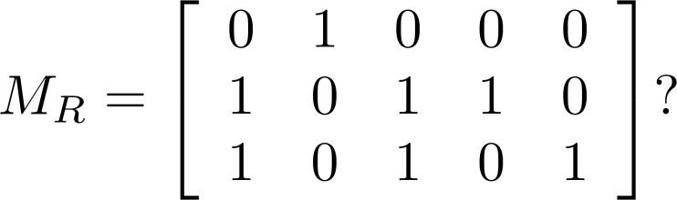
Examples of Representing Relations Using Matrices (cont.)
Example 2: Let A = {a₁,a₂, a₃} and B = {b₁,b₂, b₃,b₄, b₅}. Which ordered pairs are in the relation R represented by the matrix
Solution: Because R consists of those ordered pairs (a_{i},b_{j}) with m_{ij} = 1, it follows that:
R = {(a₁, b₂), (a₂, b₁),(a₂, b₃), (a₂, b₄),(a₃, b₁), {(a₃, b₃), (a₃, b₅)}.

Slide 20
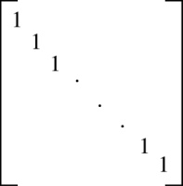
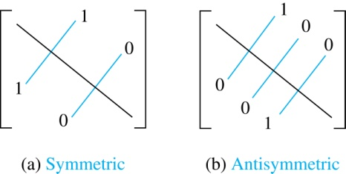
Matrices of Relations on a Set
A square matrix
If R is a reflexive relation, all the elements on the main diagonal of M_{R} are equal to 1.
R is a symmetric relation, if and only if m_{ij} = 1 whenever m_{ji} = 1. R is an antisymmetric relation, if and only if m_{ij} = 0 or m_{ji} = 0 when i≠ j.

Slide 21
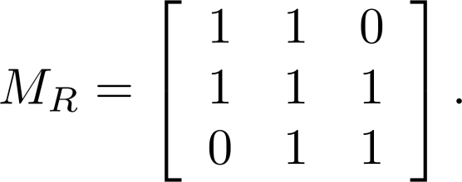
Example of a Relation on a Set
Example 3: Suppose that the relation R on a set is represented by the matrix
Is R reflexive, symmetric, and/or antisymmetric?
Solution: Because all the diagonal elements are equal to 1, R is reflexive. Because M_{R} is symmetric, R is symmetric and not antisymmetric because both m_{1,2} and m_{2,1} are 1.

Slide 22
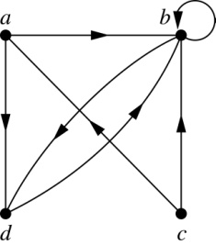
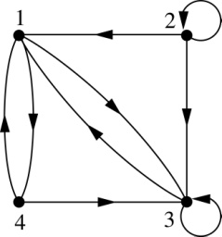
Representing Relations Using Digraphs
Definition: A directed graph (有向圖), or digraph, consists of a set V of vertices (or nodes) together with a set E of ordered pairs of elements of V called edges (or arcs). The vertex a is called the initial vertex (起點)of the edge (a,b), and the vertex b is called the terminal vertex (終點)of this edge.
An edge of the form (a,a) is called a loop (迴圈).
Example 7: A drawing of the directed graph with vertices
a, b, c, and d, and edges (a, b), (a, d), (b, b), (b, d), (c, a),
(c, b), and (d, b) is shown here.
Example 8: What are the ordered pairs in the relation
represented by this directed graph?
Solution: The ordered pairs in the relation are
(1,3), (1,4), (2,1), (2,2), (2,3), (3,1), (3,3),(4,1), and (4, 3)

Slide 23
Determining which Properties a Relation has from its Digraph
Reflexivity: A loop must be present at all vertices in the graph.
Symmetry: If (x,y) is an edge, then so is (y,x).
Antisymmetry: If (x,y) with x ≠ y is an edge, then (y,x) is not an edge.
Transitivity: If (x,y) and (y,z) are edges, then so is (x,z).

Slide 24
Determining which Properties a Relation has from its Digraph – Example 1
a
b
c
d
Reflexive? No, not every vertex has a loop
Symmetric? Yes (trivially), there is no edge from one vertex to another
Antisymmetric? Yes (trivially), there is no edge from one vertex to another
Transitive? Yes, (trivially) since there is no edge from one vertex to another

Slide 25
Determining which Properties a Relation has from its Digraph – Example 2
a
b
c
d
Reflexive? No, there are no loops
Symmetric? No, there is an edge from a to b, but not from b to a
Antisymmetric? No, there is an edge from d to b and b to d
Transitive? No, there are edges from a to c and from c to b, but there is no edge from a to d

Slide 26
Determining which Properties a Relation has from its Digraph – Example 3
a
b
c
d
Reflexive? No, there are no loops
Symmetric? No, for example, there is no edge from c to a
Antisymmetric? Yes, whenever there is an edge from one vertex to another, there is not one going back
Transitive? No, there is no edge from a to b

Slide 27
Determining which Properties a Relation has from its Digraph – Example 4
b
a
c
d
Reflexive? No, there are no loops
Symmetric? No, for example, there is no edge from d to a
Antisymmetric? Yes, whenever there is an edge from one vertex to another, there is not one going back
Transitive? Yes (trivially), there are no two edges where the first edge ends at the vertex where the second edge begins

Slide 28
Closures of Relations
Section 9.4

Slide 29
Closures of Relations
For any property P, the “P closure” of relation R on a set A is defined as the “smallest” superset of R that has property P.
The reflexive closure of a relation R on A is obtained by adding (a,a) to R for each a∈A. i.e., it is R ∪ Δ, Δ={(a,a)|a∈A}
The symmetric closure of R is obtained by adding (b,a) to R for each (a,b) in R. I.e., it is R ∪ R⁻¹
The transitive closure or connectivity relation of R is obtained by repeatedly adding (a,c) to R for each (a,b),(b,c) in R.
I.e., it is

Slide 30
Paths in Digraphs/Binary Relations
A path of length n from node a to b in the directed graph G (or the binary relation R) is a sequence (a,x₁), (x₁,x₂), …, (x_{n−1},b) of n ordered pairs in E_{G} (or R).
An empty sequence of edges is considered a path of length 0 from a to a.
If any path from a to b exists, then we say that a is connected to b. (“You can get there from here.”)
A path of length n≥1 from a to a is called a circuit or a cycle.
Note that there exists a path of length n from a to b in R if and only if (a,b)∈R^{n}.

Slide 31
Simple Transitive Closure Alg.
A procedure to compute R* with 0-1 matrices.
procedure transClosure(M_{R}:rank-n 0-1 mat.)
A := B := M_{R};
for i := 2 to n begin A := A⊙M_{R}; B := B ∨ A {boolean product; join} end return B {Alg. takes Θ(n⁴) time}
{note A represents R^{i}}

Slide 32
Roy-Warshall’s Transitive closure Alg.
Main idea: a path exists between two vertices i, j, iff
there is an edge from i to j; or
there is a path from i to j going through vertex 1; or
there is a path from i to j going through vertex 1 and/or 2; or
there is a path from i to j going through vertex 1, 2, and/or 3; or
…
there is a path from i to j going through any of the other vertices

Slide 33
Roy-Warshall Algorithm
Uses only Θ(n³) operations!
Procedure Warshall(M_{R} : rank-n 0-1 matrix)
W := M_{R}
for k := 1 to n for i := 1 to n for j := 1 to n w_{ij} := w_{ij} ∨ (w_{ik} ∧ w_{kj}) return W {this represents R*}
path from i to k and from k to j using just 1 ,…,k-1
k
(kth iteration)
i
j
path using just 1 ,…,k-1
w_{ij} = 1 means there is a path from i to j going only through nodes ≤k

Slide 34
Equivalence Relations
Section 9.5

Slide 35
Equivalence Relations
Definition 1: A relation on a set A is called an equivalence relation if it is reflexive, symmetric, and transitive.
Definition 2: Two elements a, and b that are related by an equivalence relation are called equivalent. The notation a ∼ b is often used to denote that a and b are equivalent elements with respect to a particular equivalence relation.

Slide 36
Strings
Example: Suppose that R is the relation on the set of strings of English letters such that aRb if and only if l(a) = l(b), where l(x) is the length of the string x. Is R an equivalence relation?
Solution: Show that all of the properties of an equivalence relation hold.
Reflexivity: Because l(a) = l(a), it follows that aRa for all strings a.
Symmetry: Suppose that aRb. Since l(a) = l(b), l(b) = l(a) also holds and bRa.
Transitivity: Suppose that aRb and bRc. Since l(a) = l(b),and l(b) = l(c), l(a) = l(a) also holds and aRc.

Slide 37
Congruence Modulo m (模m同餘)
Example: Let m be an integer with m > 1. Show that the relation
R = {(a,b) | a ≡ b (mod m)}
is an equivalence relation on the set of integers.
Solution: Note that a ≡ b (mod m) if and only if m divides a − b.
Reflexivity: a ≡ a (mod m) since a−a = 0 is divisible by m since 0 = 0 ∙ m.
Symmetry: Suppose that a ≡ b (mod m). Then a − b is divisible by m, and so a − b = km, where k is an integer. It follows that b − a = (− k) m, so b ≡ a (mod m).
Transitivity: Suppose that a ≡ b (mod m) and b ≡ c (mod m). Then m divides both a − b and b − c. Hence, there are integers k and l with a − b = km and b − c = lm. We obtain by adding the equations:
a − c = (a − b) + (b − c) = km + lm = (k + l) m.
Therefore, a ≡ c (mod m).

Slide 38
Divides
Example: Show that the “divides” relation on the set of positive integers is not an equivalence relation.
Solution: The properties of reflexivity, and transitivity do hold, but the relation is not symmetric. Hence, “divides” is not an equivalence relation.
Reflexivity: a ∣ a for all a.
Not Symmetric: For example, 2 ∣ 4, but 4 ∤ 2. Hence, the relation is not symmetric.
Transitivity: Suppose that a divides b and b divides c. Then there are positive integers k and l such that b = ak and c = bl. Hence, c = a(kl), so a divides c. Therefore, the relation is transitive.

Slide 39
Equivalence Classes
Definition 3: Let R be an equivalence relation on a set A. The set of all elements that are related to an element a of A is called the equivalence class of a. The equivalence class of a with respect to R is denoted by [a]_{R}.
When only one relation is under consideration, we can write [a], without the subscript R, for this equivalence class.
Note that [a]_{R} = {s|(a,s) ∈ R}.
If b ∈ [a]_{R}, then b is called a representative of this equivalence class. Any element of a class can be used as a representative of the class.
The equivalence classes of the relation congruence modulo m are called the congruence classes modulo m. The congruence class of an integer a modulo m is denoted by [a]_{m}, so [a]_{m} = {…, a−2m, a−m, a+2m, a+2m, … }. For example,
[0]₄ = {…, −8, −4 , 0, 4 , 8 , …}
[1]₄ = {…, −7, −3 , 1, 5 , 9 , …}
[2]₄ = {…, −6, −2 , 2, 6 , 10 , …}
[3]₄ = {…, −5, −1 , 3, 7 , 11 , …}

Slide 40
Equivalence Classes and Partitions
Theorem 1: let R be an equivalence relation on a set A. These statements for elements a and b of A are equivalent:
(i) aRb
(ii) [a] = [b]
(iii) [a] ∩ [b] ≠ ∅
Proof: We show that (i) implies (ii).
Assume that aRb. ∀c ∈ [a], aRc.
Because aRb and R is symmetric, bRa.
Because R is transitive: bRa and aRc→bRc. Hence, c ∈ [b]. Therefore, [a]⊆ [b].
A similar argument (omitted here) shows that [b]⊆[a].
Since [a]⊆ [b] and [b]⊆ [a], we have shown that [a] = [b].
(see text for proof that (ii) implies (iii) and (iii) implies (i))

Slide 41
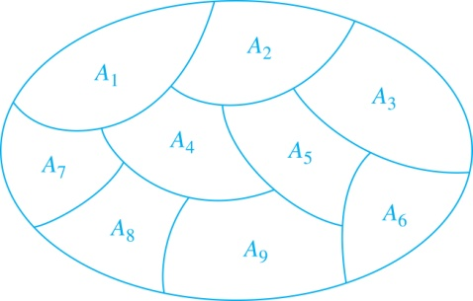
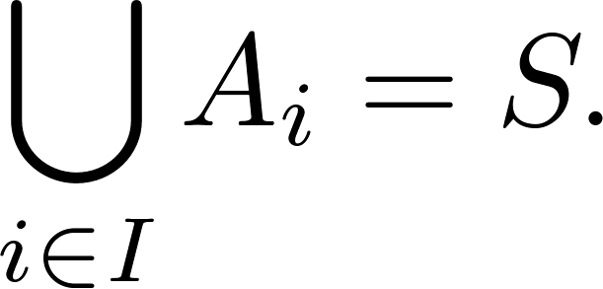
Partition of a Set
Definition: A partition (分割) of a set S is a collection of disjoint nonempty subsets of S that have S as their union. In other words, the collection of subsets A_{i}, where i ∈ I (where I is an index set), forms a partition of S if and only if
A_{i} ≠ ∅ for i ∈ I,
A_{i} ∩ A_{j}=∅ when i ≠ j,
and
A Partition of a Set

Slide 42
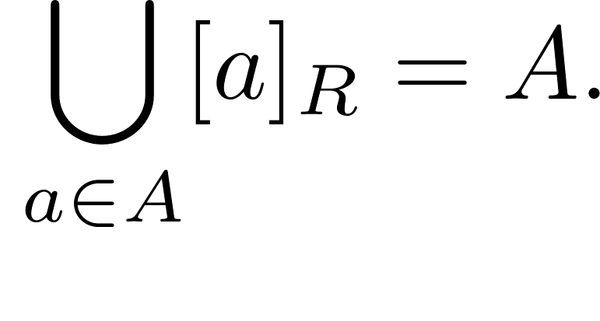
An Equivalence Relation Partitions a Set
Let R be an equivalence relation on a set A. The union of all the equivalence classes of R is all of A, since an element a of A is in its own equivalence class [a]_{R}. In other words,
From Theorem 1, [a]_{R} ∩ [b]_{R} ≠ ∅→[a]_{R} = [b]_{R}
it follows that [a]_{R} ≠ [b]_{R}→[a]_{R} ∩[b]_{R}=∅ , i.e.,
these equivalence classes are either equal or disjoint
Therefore, different equivalence classes form a partition of A, because they split A into disjoint subsets.

Slide 43
An Equivalence Relation Partitions a Set (continued)
Theorem 2: Let R be an equivalence relation on a set S. Then the equivalence classes of R form a partition of S. Conversely, given a partition {A_{i} | i ∈ I} of the set S, there is an equivalence relation R that has the sets A_{i}, i ∈ I, as its equivalence classes.
Proof: We have already shown the first part of the theorem
For the second part, assume that {A_{i} | i ∈ I} is a partition of S.
Let R be the relation on S consisting of the pairs (x, y) where x and y belong to the same subset A_{i} in the partition. We must show that R satisfies the properties of an equivalence relation.
Reflexivity: For every a ∈ S, (a,a) ∈ R, because a is in the same subset as itself.
Symmetry: If (a,b) ∈ R, then b and a are in the same subset of the partition, so (b,a) ∈ R.
Transitivity: If (a,b) ∈ R and (b,c) ∈ R, then a and b are in the same subset of the partition, as are b and c. Since the subsets are disjoint and b belongs to both, the two subsets of the partition must be identical. Therefore, (a,c) ∈ R since a and c belong to the same subset of the partition.

Slide 44
Partial Orderings
Section 9.6

Slide 45
Partial Orderings
Definition 1: A relation R on a set S is called a partial ordering (偏序), or partial order, if it is reflexive, antisymmetric, and transitive.
A set S together with a partial ordering R is called a partially ordered set, or poset(偏序集), and is denoted by (S, R).
Members of S are called elements of the poset.

Slide 46
Partial Orderings (continued)
Example 1: Show that the “greater than or equal” relation (≥) is a partial ordering on the set of integers.
Reflexivity: a ≥ a for every integer a.
Antisymmetry: If a ≥ b and b ≥ a , then a = b.
Transitivity: If a ≥ b and b ≥ c , then a ≥ c.

Slide 47
Partial Orderings (continued)
Example 2: Show that the divisibility relation (∣) is a partial ordering on the set of positive integers.
Reflexivity: a ∣ a for all integers a.
Antisymmetry: If a and b are positive integers with a | b and b | a, then a = b.
Transitivity: Suppose that a divides b and b divides c. Then there are positive integers k and l such that b = ak and c = bl. Hence, c = a(kl), so a divides c. Therefore, the relation is transitive.
(Z⁺, ∣) is a poset.

Slide 48
Partial Orderings (continued)
Example 3: Show that the inclusion relation (⊆) is a partial ordering on the power set of a set S.
Reflexivity: A ⊆ A whenever A is a subset of S .
Antisymmetry: If A and B are two subsets of S with A ⊆ B and B ⊆ A, then A = B.
Transitivity: If A ⊆ B and B ⊆ C, then A ⊆ C.
(P(S), ⊆ ) is a poset

Slide 49
Comparability (可比較性)
Definition 2: The elements a and b of a poset (S,≼ ) are comparable if either a ≼ b or b ≼ a. When a and b are elements of S so that neither a ≼ b nor b ≼ a, then a and b are called incomparable.
Definition 3: If (S,≼ ) is a poset and every two elements of S are comparable, S is called a totally ordered set or linearly ordered set, and ≼ is called a total order (全序) or a linear order.
A totally ordered set is also called a chain(鏈).
Definition 4: (S,≼ ) is a well-ordered set if it is a poset such that ≼ is a total ordering and every nonempty subset of S has a least element.
The symbol ≼ is used to denote the relation in any poset.

Slide 50
Lexicographic Order
Definition: Given two posets (A₁,≼₁) and (A₂,≼₂), the lexicographic ordering on A₁ ⨉ A₂ is defined by specifying that (a₁, a₂) is less than (b₁,b₂), that is,
(a₁, a₂) ≺ (b₁,b₂), either if a₁ ≺₁ b₁ or if a₁ = b₁ and a₂ ≺₂ b₂.
The lexicographic order (with the equality being added) is a partial ordering on the Cartesian product of two posets
Example: Consider strings of lowercase English letters. A lexicographic ordering can be defined using the ordering of the letters in the alphabet. This is the same ordering as that used in dictionaries.
discreet ≺ discrete, because these strings differ in the seventh position and e ≺ t.
discreet ≺ discreetness, because the first eight letters agree, but the second string is longer.

Slide 51
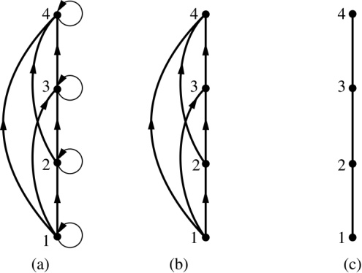
Hasse Diagrams
Definition: A Hasse diagram(哈斯圖) is a visual representation of a partial ordering that remove edges that must be present because of the reflexive and transitive properties.
A partial ordering is shown in (a) of the figure above.
The loops due to the reflexive property are deleted in (b).
The edges that must be present due to the transitive property are deleted in (c).
The Hasse diagram for the partial ordering (a), is depicted in (c).

Slide 52
Procedure for Constructing a Hasse Diagram
To represent a finite poset (S,≼ ) using a Hasse diagram, start with the directed graph of the relation:
Remove the loops (a, a) present at every vertex due to the reflexive property.
Remove all edges (x, y) for which there is an element z ∈ S such that x ≺ z and z ≺ y. These are the edges that must be present due to the transitive property.
Arrange each edge so that its initial vertex is below the terminal vertex.
Remove all the arrows, because all edges point upwards toward their terminal vertex.

Slide 53
Example
Let A = {1, 2, 3, 9, 19} and consider the “divides” relation on A:
For all
18
9
2
3
1

Slide 54
Example
Eliminate the loops at all the vertices.
Eliminate all arrows whose existence is implied by the transitive property.
Eliminate the direction indicators on the arrows.
18
9
2
3
1

Slide 56
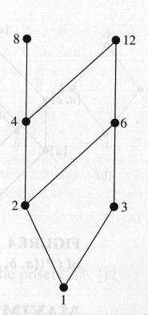
Maximal and Minimal Elements
a is a maximal in the poset (S, ≼) if there is no element b∈S such that a ≼b.
Similarly, an element of a poset is called minimal if it is not greater than any element of the poset. That is, a is minimal if there is no element b∈S such that b≼a.
It is possible to have multiple minimals and maximals.

Slide 57
Greatest Element Least Element
a is the greatest element in the poset (S,≼) if b≼a for all b∈S.
Similarly, an element of a poset is called the least element if it is less or equal than all other elements in the poset. That is, a is the least element if a≼b for all b∈S.

Slide 58
Upper bound, Lower bound
Sometimes it is possible to find (an) element(s) that is greater than all the elements in a subset A of a poset (S,≼).
If u is an element of S such that a≼u for all elements a∈A, then u is called an upper bound of A.
Likewise, there may be (an) element(s) less than all the elements in A. If l is an element of S such that l≼a for all elements a∈A, then l is called a lower bound of A.

Slide 59
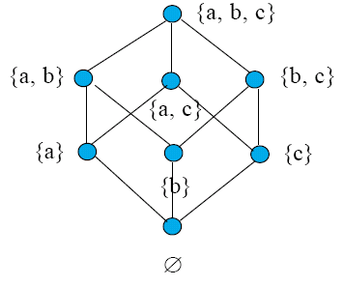
Least Upper Bound, Greatest Lower Bound
The element x is called the least upper bound (lub) of the subset A if x is an upper bound that is less than every other upper bound of A.
The element y is called the greatest lower bound (glb) of A if y is a lower bound of A and z≼y whenever z is a lower bound of A.

Slide 60
Lattices
A partially ordered set in which every pair of elements has both a least upper bound and a greatest lower bound is called a lattice.

Slide 61
Lattices
For the poset represented by the Hasse diagram
Consider element 1 and 3
Upper bound of {1} is 1,2,4,5
Upper bound of {3} is 3,2,4,5
Upper bound of {1,3} is 2,4,5
There is no lub of {1,3}
There is no glb of {1,3} either
The poset is not a lattice

Slide 62
Topological Sorting
A total ordering ≼ is said to be compatible with the partial ordering R if a≼b whenever a R b.
Constructing a compatible total ordering from a partial ordering is called topological sorting. (not unique)
An Algorithm: To sort a poset (S, R)
Selected a (any) minimal element and put it in the list. Delete it from S
Continue until all elements appear in the list (and S is void)

Slide 63
Example
Consider the set A = {2, 3, 4, 6, 18, 24} ordered by the “divides” relation. The Hasse diagram follows:
24
18
4
6
2
3
The ordinary “less than or equal to” relation ≤ on this set is a topological sorting for it since for positive integers a and b, if a|b then a≤ b.

