Slide 1
[TRAINING TITLE]
[Feature Name] | [Version/Date]
[AUDIENCE: Developers / Partners / Champions]
Notes:
PRESENTER NOTES — TITLE SLIDE ------------------------------- Welcome & Introduction: - Greet the audience and introduce yourself - State the training topic and which Claude feature this covers - Mention the target audience (developers, partners, or champions) - Set expectations for duration and format - Mention any prerequisites or prior knowledge needed Key Setup: - Ensure demo environment is ready - Confirm audience has necessary access/credentials - Share any links or resources in chat

Slide 2
Agenda
01
[Topic 1]
[Brief description of first section]
02
[Topic 2]
[Brief description of second section]
03
[Topic 3]
[Brief description of third section]
04
[Topic 4 / Knowledge Check]
[Brief description of assessment]
Notes:
PRESENTER NOTES — AGENDA ------------------------------- Walk Through the Agenda: - Briefly describe each section and what attendees will learn - Highlight the knowledge checks and when they occur - Mention approximate time for each section - Ask if there are any specific topics the audience wants to focus on Logistics: - Explain how questions will be handled (live Q&A, chat, hold until end) - Mention any breaks for longer sessions - Point out supplementary resources that will be shared

Slide 3




Today you’ll learn...
By the end of this training, you will be able to:
[Objective 1: Use action verb — e.g., Explain, Implement, Configure, Demonstrate]
[Objective 2: Use action verb — e.g., Identify, Analyze, Compare, Evaluate]
[Objective 3: Use action verb — e.g., Build, Integrate, Deploy, Troubleshoot]
[Objective 4: Use action verb — e.g., Apply, Design, Optimize, Customize]
Notes:
PRESENTER NOTES — LEARNING OBJECTIVES ------------------------------- Present Each Objective: - Read each learning objective aloud - Briefly explain what 'success' looks like for each objective - Connect objectives to real-world use cases the audience cares about - Mention which knowledge checks will assess each objective Engagement: - Ask audience to identify which objective is most relevant to them - This helps you tailor emphasis throughout the session Bloom's Taxonomy Reminder: - Use action verbs that match the desired cognitive level - Remember/Understand: define, describe, explain, identify - Apply/Analyze: implement, configure, compare, troubleshoot - Evaluate/Create: design, build, optimize, architect

Slide 4
[Chapter N]
[Section title]
[Brief description of what this section covers and why it matters]
[~X minutes]
Notes:
PRESENTER NOTES — SECTION DIVIDER ------------------------------- Transition: - Briefly recap what was covered in the previous section (if applicable) - Introduce the new section topic and its relevance - State what the audience will learn in this section - Mention estimated duration Pacing: - Check time against your schedule - Ask if there are questions from the previous section before moving on

Slide 5




[Concept title]
[Concept A]
[Concept B]
[Explain the concept clearly. Keep to 2-3 sentences maximum.]
[Explain the concept clearly. Keep to 2-3 sentences maximum.]
[Concept C]
[Concept D]
[Explain the concept clearly. Keep to 2-3 sentences maximum.]
[Explain the concept clearly. Keep to 2-3 sentences maximum.]
Notes:
PRESENTER NOTES — KEY CONCEPTS ------------------------------- Teaching Approach: - Walk through each concept card one at a time - Use real-world examples or analogies for each concept - Ask the audience for their experience with each concept - Highlight connections between concepts Tips: - Don't read the card text verbatim — expand on it - Use the demo environment to show each concept in action - Pause for questions after every 2 concepts

Slide 6
FULL-SCREEN IMAGE
[Replace this slide with a full-screen image]
[Image Caption] — [additional context]
Notes:
PRESENTER NOTES - FULL-SCREEN IMAGE
-------------------------------
Usage: Replace this placeholder with a full-bleed image (screenshot, diagram, photo, or infographic).
Image Guidelines: Use high-resolution images (minimum 1920x1080). Ensure text in the caption bar remains readable against the image.
Caption Bar: The semi-transparent dark bar at the bottom provides space for a caption and source attribution. Update both placeholders.
Delivery: Pause briefly to let participants absorb the visual before discussing. Use the image to reinforce the preceding content.
Accessibility: Describe the image verbally for participants who may have visual impairments.

Slide 7
[Process / How-To Title]
1
[Step Title]
[What to do and why]
2
[Step Title]
[What to do and why]
3
[Step Title]
[What to do and why]
4
[Step Title]
[What to do and why]
Notes:
PRESENTER NOTES — STEP-BY-STEP PROCESS ------------------------------- Delivery: - Walk through each step sequentially - DEMO each step live if possible - Pause between steps for audience to follow along - Highlight common mistakes or gotchas at each step Hands-On: - Consider having the audience follow along in their own environment - Provide code snippets or commands in chat for copy-paste - Check in with audience after each step to ensure they're keeping up

Slide 8
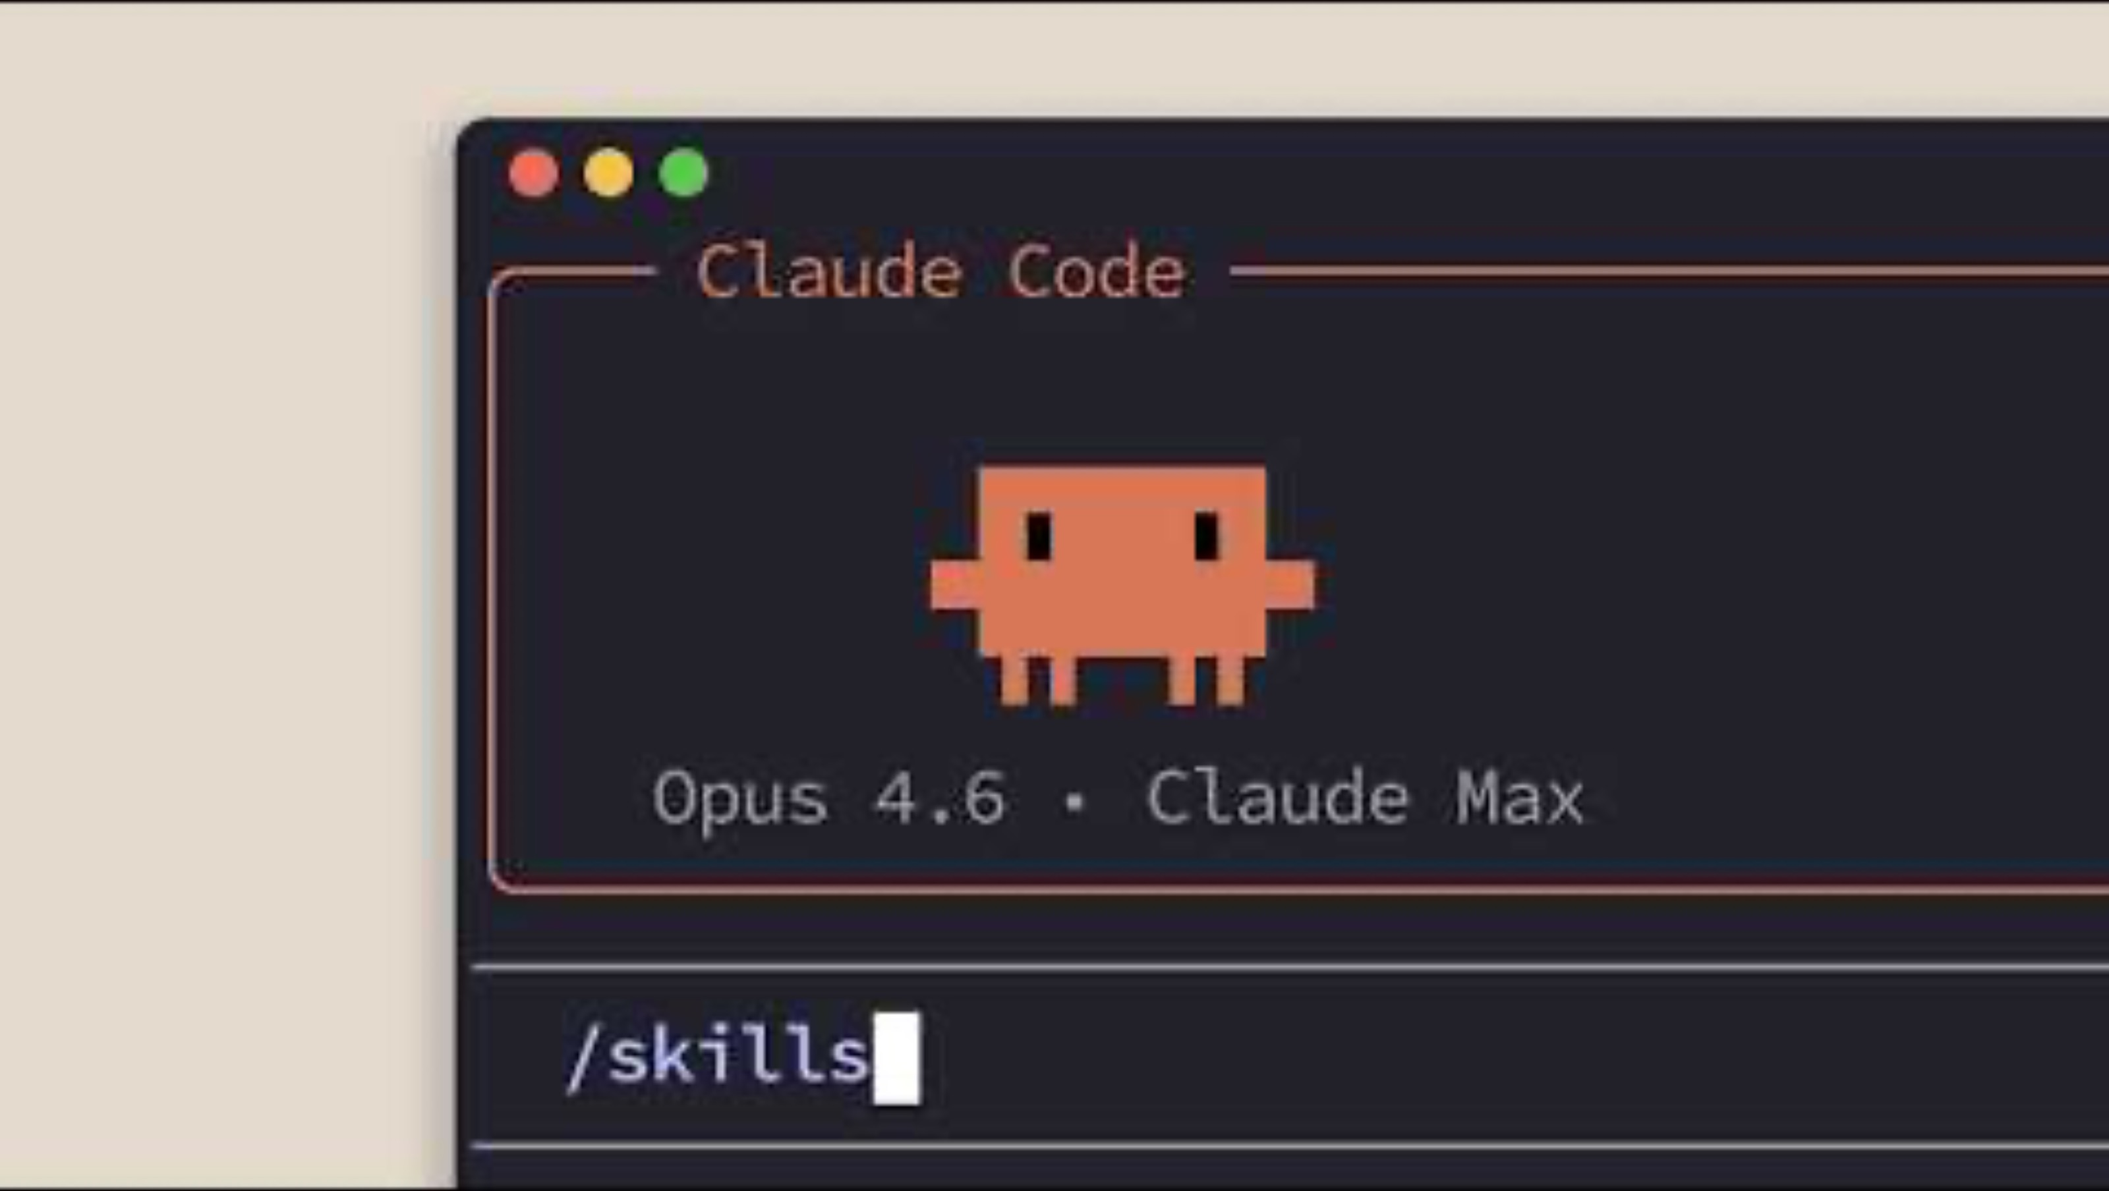
Notes:
PRESENTER NOTES - VIDEO TUTORIAL
-------------------------------
Source: Select a relevant tutorial video from https://www.anthropic.com/learn or https://www.youtube.com/@claude
Setup: Test the video link before the session. Ensure audio works and the video is accessible to participants.
During Playback: Pause at key moments to highlight concepts. Ask participants to note observations.
After Video: Facilitate a brief discussion connecting the video content to the training objectives.
Fallback: If video cannot play, describe the key concepts shown and move to the next slide.

Slide 9
[Code example / Demo title]
[filename.py / terminal]
[Paste code example here]
[Use monospace font — Consolas or Courier New]
[Keep to 12-15 lines maximum]
[Highlight key lines with comments]
[Key takeaway or important note about this code example]
Notes:
PRESENTER NOTES — CODE / DEMO ------------------------------- Demo Preparation: - Have the code pre-loaded in your IDE or terminal - Test the demo before the session to ensure it works - Have a backup plan (screenshots/recording) if live demo fails Delivery: - Walk through the code line by line for key sections - Explain WHY, not just WHAT the code does - Show the output/result after running the code - Point out best practices and anti-patterns Audience Engagement: - Ask audience to predict output before running - Share the code snippet so audience can try it themselves - Ask if anyone has questions about specific lines

Slide 10
[Comparison Title]
[Before / Option A / Without]
[After / Option B / With]
[Point 1 for this side]
[Point 2 for this side]
[Point 3 for this side]
[Point 1 for this side]
[Point 2 for this side]
[Point 3 for this side]
Notes:
PRESENTER NOTES — COMPARISON ------------------------------- Teaching Strategy: - Start with the 'before' / 'without' side to establish baseline - Then reveal the 'after' / 'with' side to show improvement - Emphasize the delta — what changes and why it matters - Use concrete metrics or examples where possible Discussion: - Ask audience about their current approach (left side) - Discuss transition path from left to right - Address potential concerns or tradeoffs

Slide 11
FULL-SCREEN IMAGE
[Replace this slide with a full-screen image]
[Image Caption] — [Source or additional context]
Notes:
PRESENTER NOTES - FULL-SCREEN IMAGE
-------------------------------
Usage: Replace this placeholder with a full-bleed image (screenshot, diagram, photo, or infographic).
Image Guidelines: Use high-resolution images (minimum 1920x1080). Ensure text in the caption bar remains readable against the image.
Caption Bar: The semi-transparent dark bar at the bottom provides space for a caption and source attribution. Update both placeholders.
Delivery: Pause briefly to let participants absorb the visual before discussing. Use the image to reinforce the preceding content.
Accessibility: Describe the image verbally for participants who may have visual impairments.

Slide 12
[Video Title]
[Brief description of what participants will learn from this video]
VIDEO TUTORIAL
[Video URL from anthropic.com/learn or youtube.com/@claude]
Notes:
PRESENTER NOTES - VIDEO TUTORIAL
-------------------------------
Source: Select a relevant tutorial video from https://www.anthropic.com/learn or https://www.youtube.com/@claude
Setup: Test the video link before the session. Ensure audio works and the video is accessible to participants.
During Playback: Pause at key moments to highlight concepts. Ask participants to note observations.
After Video: Facilitate a brief discussion connecting the video content to the training objectives.
Fallback: If video cannot play, describe the key concepts shown and move to the next slide.

Slide 13
Knowledge check
MULTIPLE CHOICE
[Question text goes here? Make it scenario-based when possible.]
A
[Answer option A]
B
[Answer option B]
C
[Answer option C]
D
[Answer option D]
Notes:
PRESENTER NOTES — KNOWLEDGE CHECK (MULTIPLE CHOICE) ------------------------------- Correct Answer: [LETTER] — [Brief explanation] Facilitation: - Read the question aloud and give 30-60 seconds to think - Use polls if available (Zoom poll, Slido, raise hands) - Ask a volunteer to explain their answer before revealing - Explain WHY the correct answer is right - Explain WHY each distractor is wrong — this deepens understanding If Most Get It Wrong: - Don't rush past — this signals a gap - Re-explain the concept using a different example - Ask what was confusing

Slide 14

Knowledge check
TRUE / FALSE
[Statement to evaluate — make it specific and unambiguous]
X
TRUE
FALSE
[Why this would be true]
[Why this would be false]
Notes:
PRESENTER NOTES — KNOWLEDGE CHECK (TRUE/FALSE) ------------------------------- Correct Answer: [TRUE/FALSE] Explanation: [Why this is the correct answer] Facilitation: - Read the statement clearly - Give 15-30 seconds for audience to decide - Use thumbs up/down or polls for response - Reveal the answer and explain the reasoning - Connect back to the specific concept being tested Common Misconception: - [Note any common misconception this question addresses]

Slide 15
Discussion
[Open-ended question or scenario for discussion]
Discussion Guide:
[Guiding question 1 to steer discussion]
[Guiding question 2 to deepen thinking]
[Guiding question 3 to connect to practice]
Notes:
PRESENTER NOTES — DISCUSSION / OPEN-ENDED ------------------------------- Facilitation Strategy: - Pose the question and give 1-2 minutes of silent thinking time - For virtual: use breakout rooms (3-4 people, 5 min) - For in-person: pair-share then group discussion - Use the guiding questions to redirect if discussion stalls Expected Responses: - [List 2-3 strong responses you'd hope to hear] - [Note any responses that indicate misconceptions] Wrap-Up: - Synthesize key themes from the discussion - Connect insights back to learning objectives - Transition to next section or summary

Slide 16
Hands-on exercise
[Exercise Title]
[Describe what participants will build, configure, or implement]
Task 1:
[First task description]
Time
[X min]
Task 2:
[Second task description]
Success Criteria
[What 'done' looks like]
Task 3:
[Third task description]
Notes:
PRESENTER NOTES — HANDS-ON EXERCISE ------------------------------- Setup: - Ensure all participants have access to the required environment - Share starter code or boilerplate if needed - Set a visible timer for the exercise duration During Exercise: - Walk around (in-person) or monitor chat (virtual) for questions - Provide hints for those who are stuck — don't give answers directly - Check in at the halfway point After Exercise: - Ask 1-2 volunteers to share their solution - Show the reference solution and explain key decisions - Discuss alternative approaches - Connect back to learning objectives

Slide 17
REFLECTION
Reflect and apply
Take a moment to consider how you will apply what you've learned
WHAT I LEARNED
[What was the most important concept or skill you gained from this training?]
HOW I'LL USE IT
[How will you apply what you learned in your day-to-day work within the next week?]
WHAT SURPRISED ME
[Was there anything unexpected or that changed the way you think about this topic?]
QUESTIONS I STILL HAVE
[What areas do you want to explore further or need more clarity on?]
Notes:
PRESENTER NOTES - REFLECTION
-------------------------------
Purpose: Give learners a structured pause to internalize what they learned and plan how to apply it. This bridges the gap between learning and doing.
Format: Allow 3-5 minutes of quiet individual reflection, then optionally invite 2-3 volunteers to share one response. Can also be done in pairs or small groups.
Customization: Replace the four prompt questions with prompts specific to your training topic. Keep them open-ended and action-oriented.
Tip: Consider providing sticky notes or a digital whiteboard for participants to capture their reflections. These can inform follow-up actions or coaching.

Slide 18
Key takeaways
[First key takeaway — what should they remember?]
1
[Second key takeaway — what should they be able to do?]
2
[Third key takeaway — what should they apply?]
3
Notes:
PRESENTER NOTES — KEY TAKEAWAYS ------------------------------- Summary: - Recap each takeaway and connect it to a learning objective - Ask participants to share which takeaway resonates most - Reinforce the practical application of each point Next Steps: - Mention what participants should do after the training - Provide links to documentation, sandbox environments, or follow-up materials - Set expectations for follow-up sessions or office hours

Slide 19
Resources and next steps
Documentation
Recommended Next Steps
[Resource 1: API Documentation]
[Resource 2: Getting Started Guide]
[Resource 3: Code Examples Repository]
[Resource 4: Community Forum / Support]
[Action item 1 with timeline]
[Action item 2 with timeline]
[Action item 3 with timeline]
Questions or need help?
[support-channel@anthropic.com] | [Slack #channel-name] | [Office hours schedule]
Notes:
PRESENTER NOTES — RESOURCES & NEXT STEPS ------------------------------- Share Resources: - Paste all links in the chat so participants can click directly - Briefly describe each resource and when to use it - Mention which resources are most important for immediate use Next Steps: - Be specific about what participants should do within 24-48 hours - Mention any follow-up training or advanced sessions available - Explain how to get support if they get stuck Feedback: - Share the training feedback form link - Ask for verbal feedback on what went well and what could improve

Slide 20
Questions?
[Presenter Name] | [Email] | [Slack Handle]
[Training Feedback Form URL]
Notes:
PRESENTER NOTES — CLOSING / Q&A ------------------------------- Q&A Session: - Open the floor for questions - If no questions, prompt with: 'A common question I get is...' - For questions you can't answer, note them and follow up later Closing: - Thank the audience for their time and participation - Remind them of the feedback form - Reiterate the key contact channels for support - Share any recording/slides access information Post-Session: - Send follow-up email with slides, recording link, and resources - Review feedback form responses - Note any content updates needed for future sessions

Slide 21
[Chapter 2]
[Section title]
[Brief description of what this section covers and why it matters]
[~X minutes]

Slide 22
[Chapter 3]
[Section title]
[Brief description of what this section covers and why it matters]
[~X minutes]

Slide 23
[Chapter 4]
[Section title]
[Brief description of what this section covers and why it matters]
[~X minutes]

Slide 24
[Chapter 5]
[Section title]
[Brief description of what this section covers and why it matters]
[~X minutes]

Slide 25
[Chapter 6]
[Section title]
[Brief description of what this section covers and why it matters]
[~X minutes]

