Slide 1


Slide 2
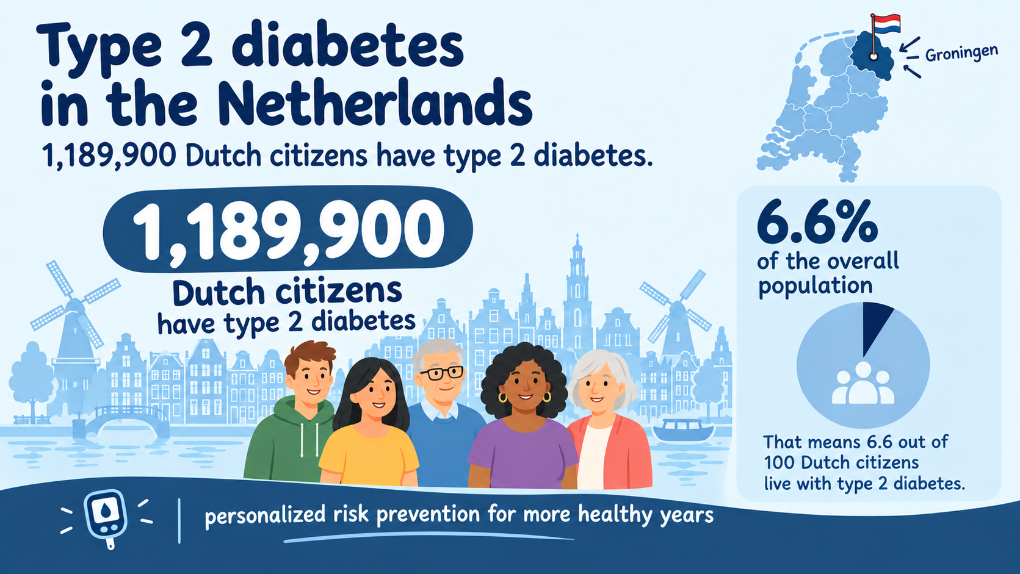

Slide 3


Slide 4
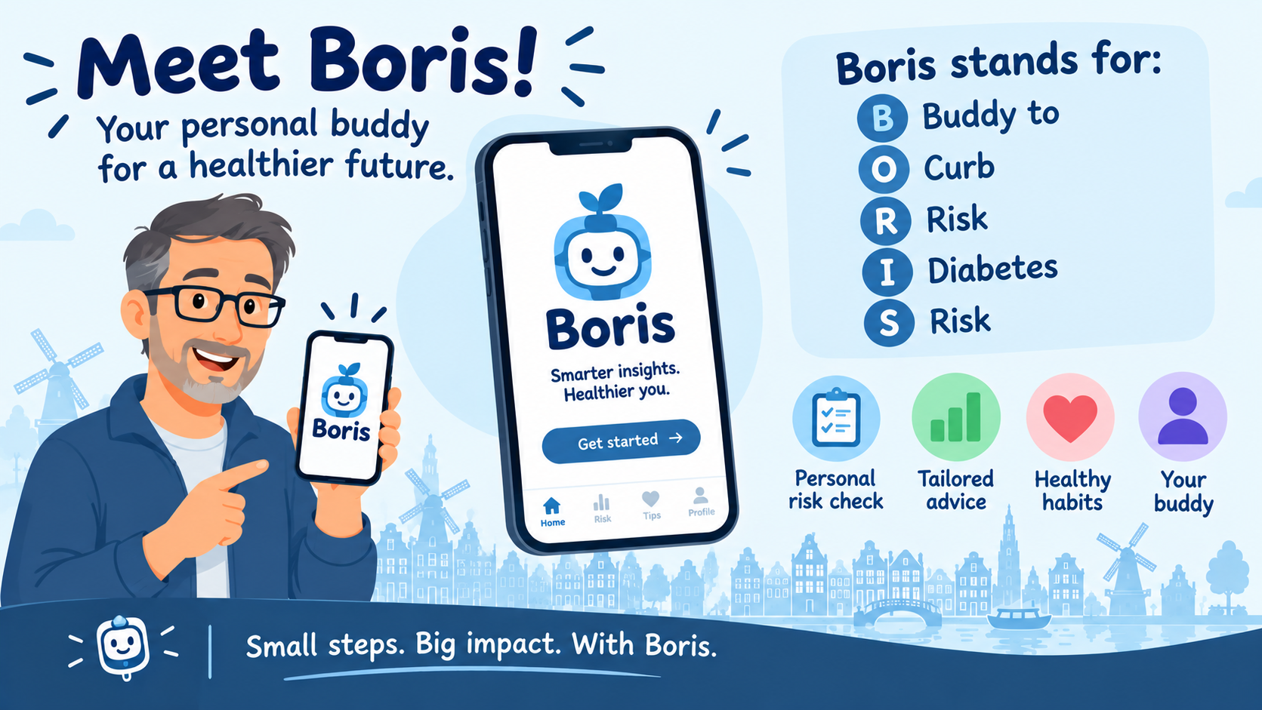



buddy
to
curb
diabetes
risk

Slide 5
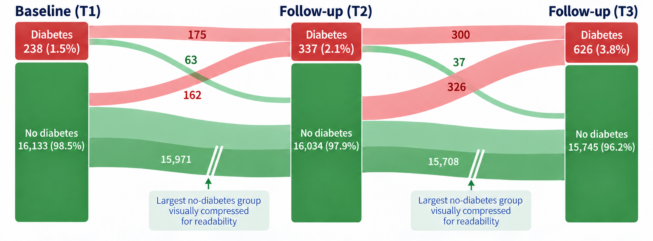
short term risk
long term risk

Slide 6
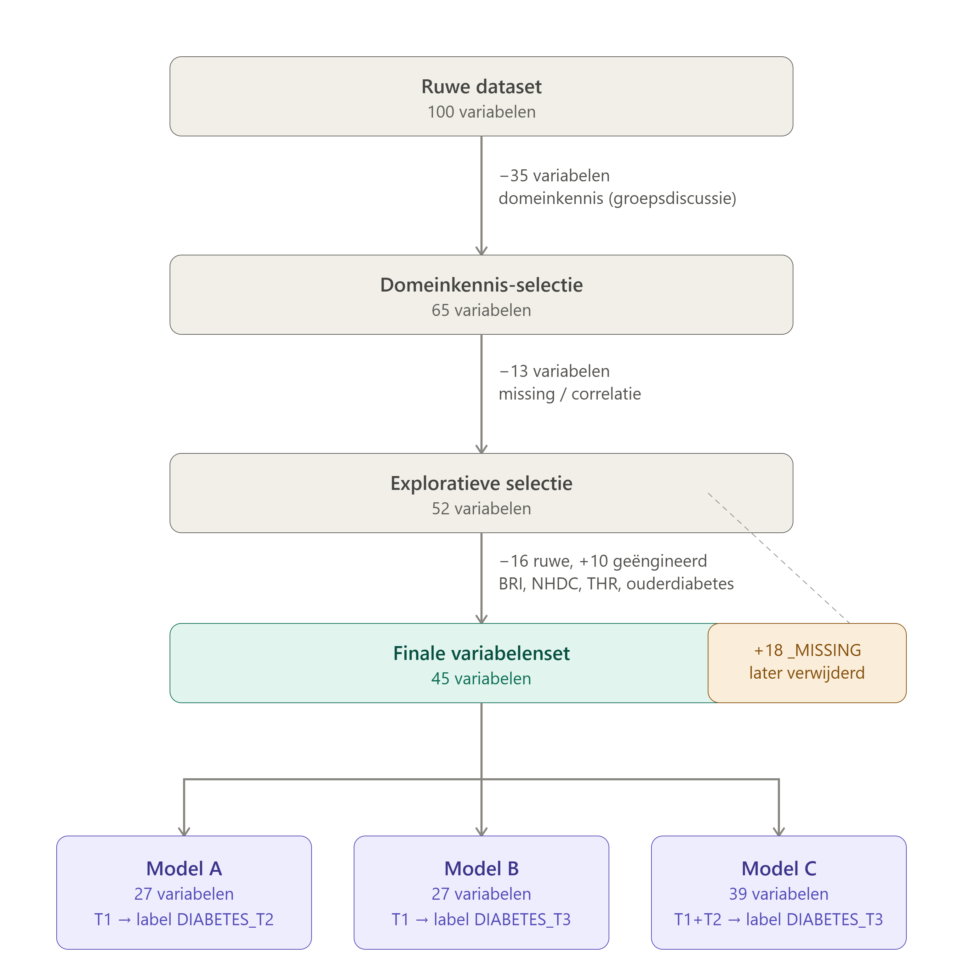
Feature selection

Slide 7
Managing data and code in GitHub repository
Preprocessing
(Frederike)
get_data() → 6 datasets: normaal + geschaald, y_train/y_test
Modelling 1
(Martijn)
3 model options
App development (Tim & Erik)
Meeting
Data decisions after EDA — What does it mean for the preprocessing and modelling?
Meeting
Modelling outcome and input for app
Exploratory Data Analysis (opsplitsbaar)
target • features • samenhang
Modelling 2
(Kylie)
Exploratory deep learning
Final Presentation (Erik & Tim)
Parallel
Parallel
Parallel
Notes:
Horizontaal overzicht, links naar rechts. Overleg 1 is de startpoort met de afspraken (contracten). Daarna lopen preprocessing (teal) en EDA (blauw) simultaan. Bij Overleg 2 komen ze samen in een beslismoment. Daarna modelleren B en C parallel op respectievelijk geschaalde en ongeschaalde data. Overleg 3 checkt de vergelijkbaarheid, waarna het team samen afrondt.

Slide 8
Machine learning pipeline
1. Cohort
All participants with documented NO diabetes at baseline
2. Outcome label
Newly developed diabetes based on HbA1c >6.5%
3. Input
23 features
(only at baseline to prevent leakage)
4. Models
LogReg elastic net
RandomForest
XGBoost +SMOTE
5. Performance evaluation
Optuna · AU-PRC
Testset apart
→
→
→
→
Model A — short term risk
T1 → T2 · ~1% newly developed diabetes
Model B — long term risk
T1 → T3 · ~2,7% newly developed diabetes
• Data: df_trainA/B & df_testA/B · Methode: Methods.docx op kyliekeijzer/exquairo-apex-lifelines.

Slide 9
Results model A ‘short term risk’
Train set
model | threshold | % Abnormal | AUROC | AUPRC | Precision | Recall
logreg_elasticnet | 889 | 1.01% | 0.94 [0.91, 0.96] | 0.29 [0.21, 0.38] | 0.31 [0.24, 0.38] | 0.52 [0.44, 0.60]
random_forest | 684 | 1.01% | 0.99 [0.98, 0.99] | 0.61 [0.53, 0.68] | 0.61 [0.51, 0.69] | 0.55 [0.46, 0.63]
xgboost | 771 | 1.01% | 0.95 [0.93, 0.97] | 0.33 [0.25, 0.42] | 0.37 [0.30, 0.46] | 0.42 [0.33, 0.50]
Test set
model | threshold | % Abnormal | AUROC | AUPRC | Precision | Recall
logreg_elasticnet | 889 | 0.99% | 0.97 [0.94, 0.99] | 0.60 [0.44, 0.76] | 0.38 [0.24, 0.51] | 0.66 [0.49, 0.82]
random_forest | 684 | 0.99% | 0.95 [0.91, 0.98] | 0.33 [0.21, 0.53] | 0.43 [0.25, 0.62] | 0.38 [0.23, 0.57]
xgboost | 771 | 0.99% | 0.96 [0.92, 0.98] | 0.37 [0.22, 0.59] | 0.39 [0.23, 0.54] | 0.47 [0.30, 0.65]

Slide 10
Results model B ‘long term risk’
Train set
model | threshold | % Abnormal | AUROC | AUPRC | Precision | Recall
logreg_elasticnet | 883 | 2.71% | 0.883 [0.864, 0.900] | 0.283 [0.239, 0.339] | 0.367 [0.318, 0.415] | 0.366 [0.318, 0.415]
random_forest | 431 | 2.71% | 0.962 [0.956, 0.967] | 0.515 [0.463, 0.562] | 0.432 [0.379, 0.475] | 0.491 [0.438, 0.538]
xgboost | 0.53 | 2.71% | 0.911 [0.896, 0.924] | 0.371 [0.320, 0.421] | 0.387 [0.339, 0.432] | 0.380 [0.328, 0.427]
Test set
model | threshold | % Abnormal | AUROC | AUPRC | Precision | Recall
logreg_elasticnet | 883 | 2.73% | 0.883 [0.840, 0.919] | 0.279 [0.205, 0.389] | 0.360 [0.253, 0.471] | 0.352 [0.257, 0.448]
random_forest | 431 | 2.73% | 0.869 [0.831, 0.905] | 0.266 [0.186, 0.367] | 0.303 [0.209, 0.411] | 0.307 [0.214, 0.406]
xgboost | 0.53 | 2.73% | 0.878 [0.841, 0.911] | 0.293 [0.199, 0.398] | 0.341 [0.243, 0.454] | 0.318 [0.226, 0.417]

Slide 11
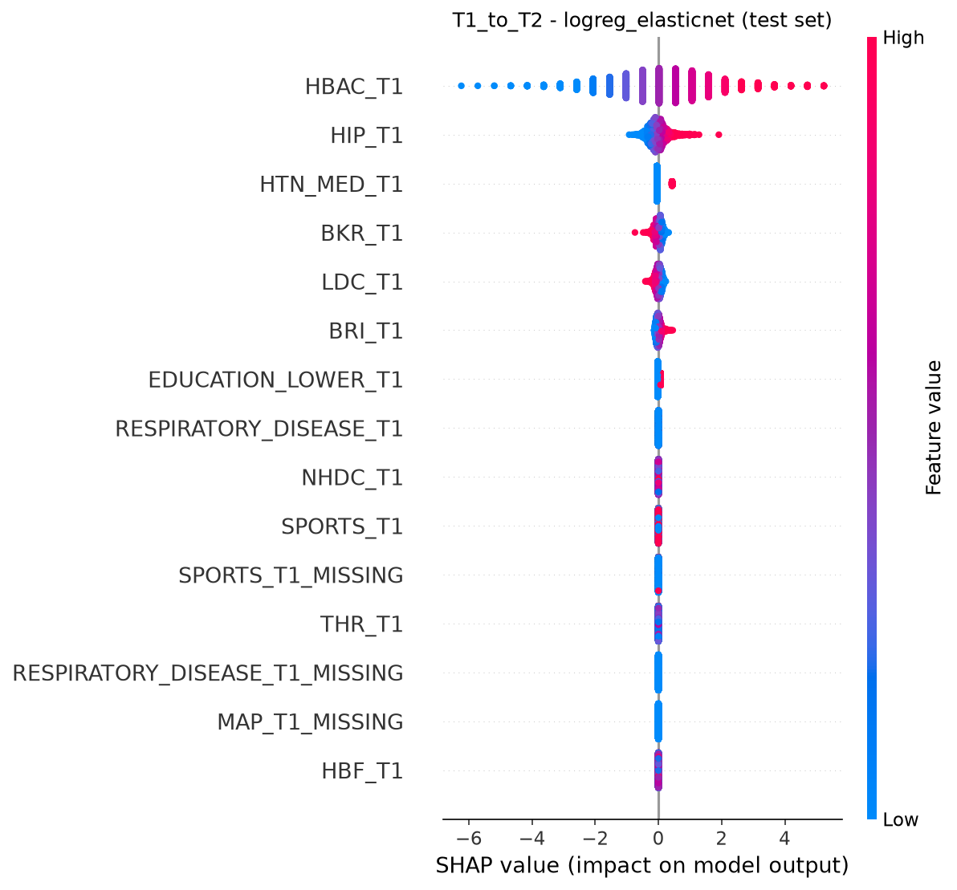
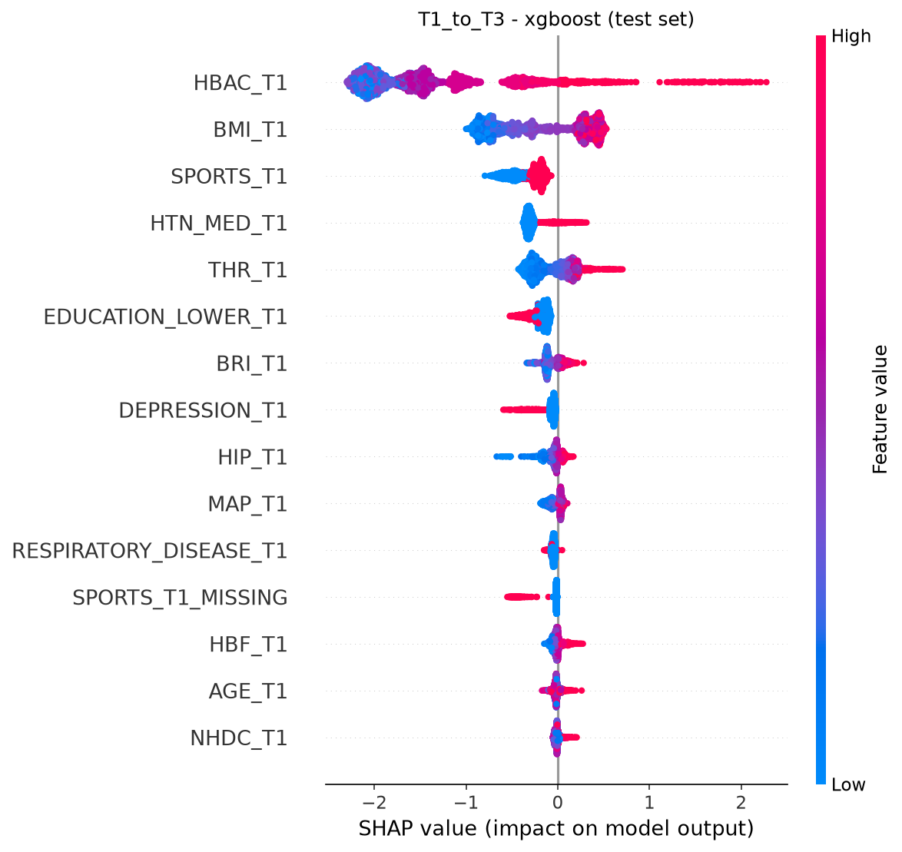
model results

Slide 12
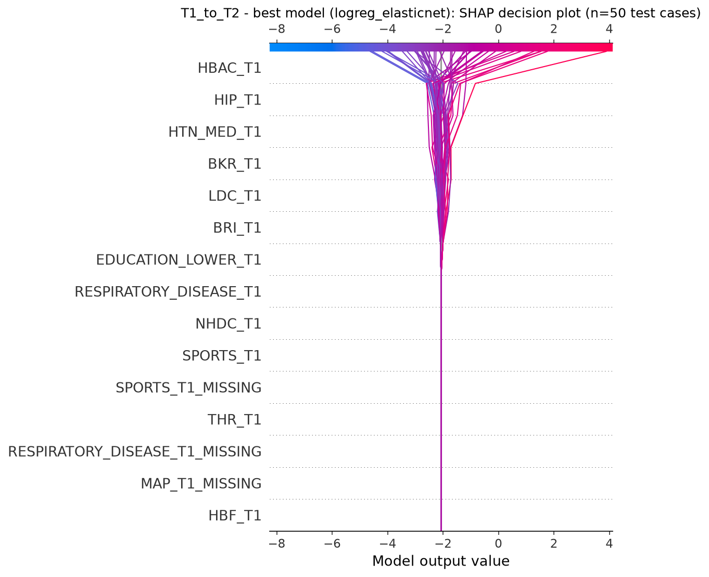
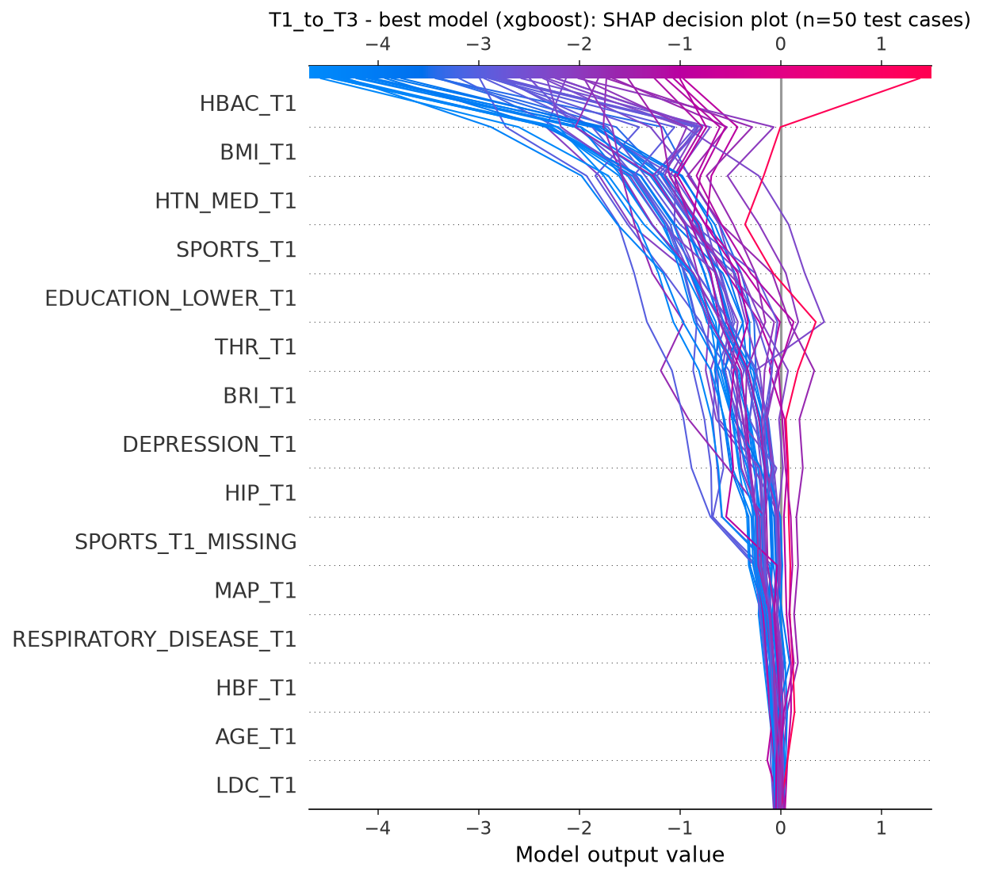
model results
SHAP decision plot ‘short term’
SHAP decision plot ‘long term’

Slide 13
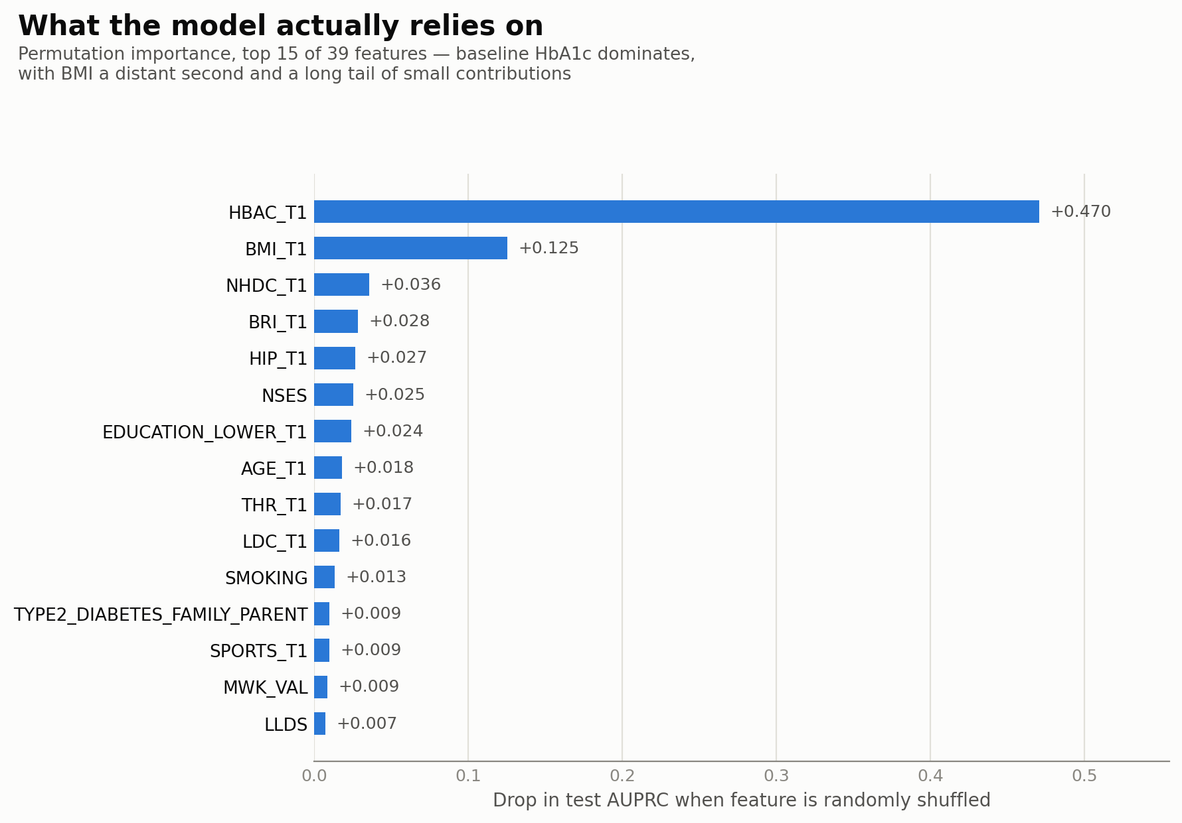
Predicting Diabetes with Deep Learning
A feedforward neural network (MLP) using only baseline (T1) clinical, anthropometric, and lifestyle features to predict new diabetes cases by the T2 follow-up visit.
AUC
AUPRC
0.95
0.51
95% CI: 0.90 – 0.99
95% CI: 0.35 – 0.67 • ~50× the 1% base rate
Bottom line: Baseline labs and lifestyle data predict incident diabetes well, but most of that power comes from a single variable (baseline HbA1c) with the network adding a modest, real improvement on top of it.
Notes:
A small, regularized multilayer perceptron trained on baseline (T1) clinical, anthropometric, and lifestyle measurements predicts diabetes by the T2 visit with an AUROC of 0.95 (95% CI: 0.90–0.99) and AUPRC of 0.51 (95% CI: 0.35–0.67), a roughly 50-fold improvement over the 1% base rate. Permutation importance shows this performance is driven predominantly by baseline HbA1c, with BMI contributing a smaller but meaningful secondary signal and the remaining 37 features each adding marginal information; a single-variable HbA1c model alone already achieves an AUPRC of 0.41, indicating that the network's added value over a simple clinical threshold rule is real but modest. Given only 32 incident cases in the test set, these estimates carry substantial sampling uncertainty, and any comparison to classical machine learning approaches trained on the same split should be interpreted with that uncertainty in mind rather than as a precise ranking.

Slide 14
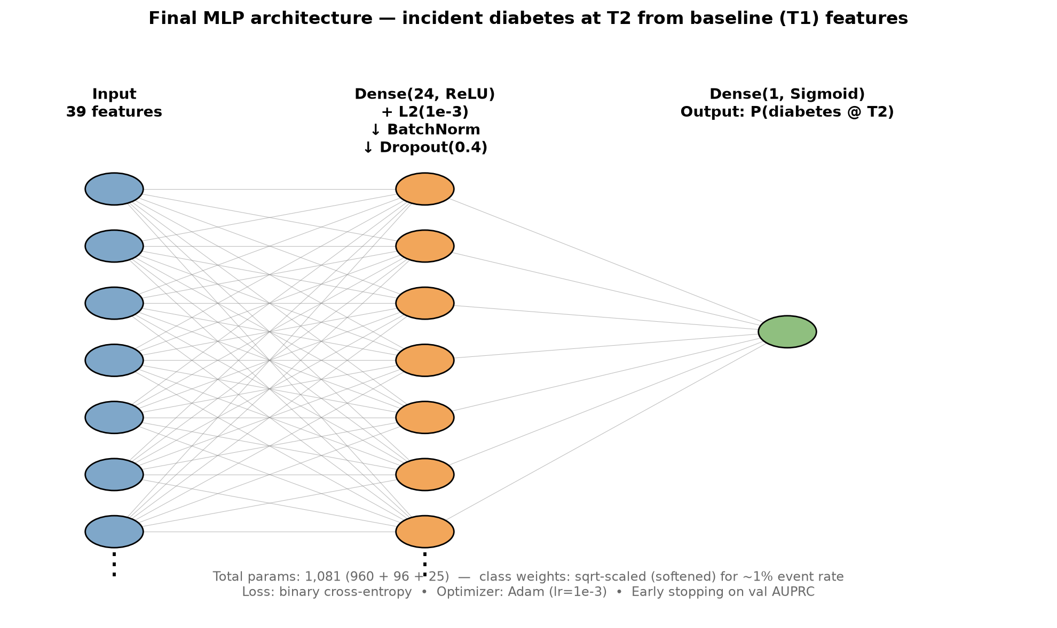

Slide 15
Translating into actionable personal advice
empowering style, monitor activities
chatbot function
push messages:
  suggest activities; runs, sports
  suggest recipes; discounts etc
  …

Slide 16
app demo

Slide 17
future perspectives
focus on curbing costs: adapt to predict complications
  uncomplicated T2D €2,600 per year
  stroke €54,678 per event
  AMI/revasularization €27,038 / €37,071 per event
  heart failure €16,561 per event
  renal failure €91,503 per event

Slide 19
future perspectives
even more personalized: link to wearables, location tracking
even more personalized: adapt to personality characteristics

