Slide 1
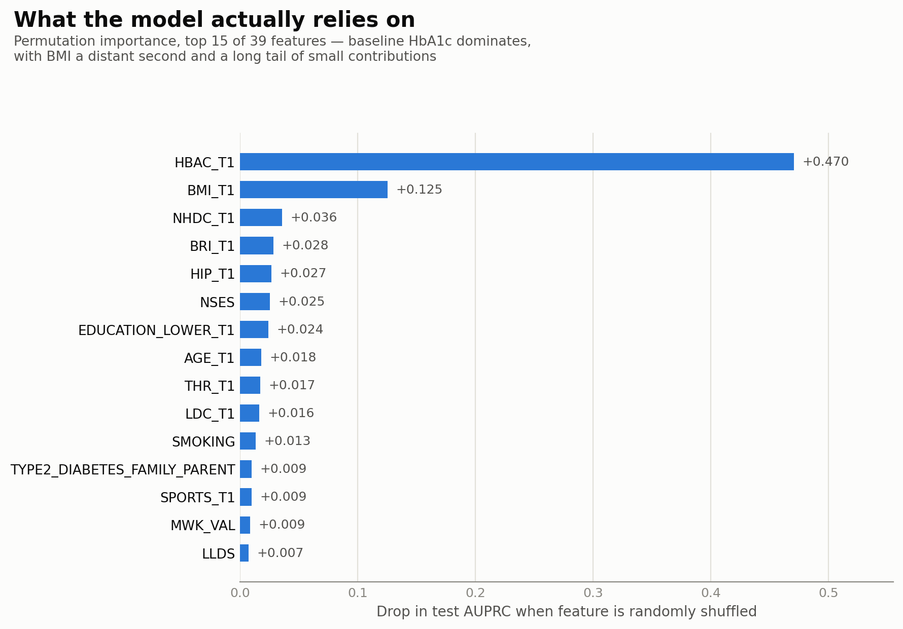
Predicting Diabetes with Deep Learning
A feedforward neural network (MLP) using only baseline (T1) clinical, anthropometric, and lifestyle features to predict new diabetes cases by the T2 follow-up visit.
AUC
AUPRC
0.95
0.51
95% CI: 0.90 – 0.99
95% CI: 0.35 – 0.67 • ~50× the 1% base rate
Bottom line: Baseline labs and lifestyle data predict incident diabetes well, but most of that power comes from a single variable (baseline HbA1c) with the network adding a modest, real improvement on top of it.
HbA1c — dominant predictor (+0.47 AUPRC when removed)
BMI — secondary signal (+0.13)
Remaining 37 features — small individual contributions each
Notes:
A small, regularized multilayer perceptron trained on baseline (T1) clinical, anthropometric, and lifestyle measurements predicts diabetes by the T2 visit with an AUROC of 0.95 (95% CI: 0.90–0.99) and AUPRC of 0.51 (95% CI: 0.35–0.67), a roughly 50-fold improvement over the 1% base rate. Permutation importance shows this performance is driven predominantly by baseline HbA1c, with BMI contributing a smaller but meaningful secondary signal and the remaining 37 features each adding marginal information; a single-variable HbA1c model alone already achieves an AUPRC of 0.41, indicating that the network's added value over a simple clinical threshold rule is real but modest. Given only 32 incident cases in the test set, these estimates carry substantial sampling uncertainty, and any comparison to classical machine learning approaches trained on the same split should be interpreted with that uncertainty in mind rather than as a precise ranking.

Slide 2
