Slide 1
Water Supply App
A tool to assist the Division of Water Rights’ water availability analysis
esri ArcGIS JavaScript API v3.18
USGS StreamStats
USGS Streamer

Slide 2
Steps
List water right holders downstream of proposed diversion
Delineate watershed of each water right diversion point
Sum all diversions within each watershed
Find streamflow data
Notes:
Problem: permitting and licensing has to collect streamflow and water right data for each proposed new appropriative water right. The data are housed in different places, and it is time consuming to collect and arrange all the necessary data.
There is an online mapping tool that shows water rights by stream (http://www.waterboards.ca.gov/waterrights/water_issues/programs/ewrims/terms.shtml?from=http://www.waterboards.ca.gov/waterrights/water_issues/programs/ewrims/&to=g),
Which is useful for seeing what water rights exist downstream of a proposed diversion, but this is just the first step in the process.
From there, the user needs to go through these steps. Once the water supply information has been assembled, streamflow data are collected and the water availability analysis can be performed.
Because the required water right and streamflow data are both publically available, I built a tool that goes through each of these steps in one place, reducing the amount of time that the user must spend preparing a water supply report.

Slide 3
My Water Supply Report Map
User clicks on proposed point of diversion
Flowline is traced downstream to Pacific Ocean
User selects water right holders to include
Watershed built from each diversion point
All diversions within each watershed are summed

Slide 4
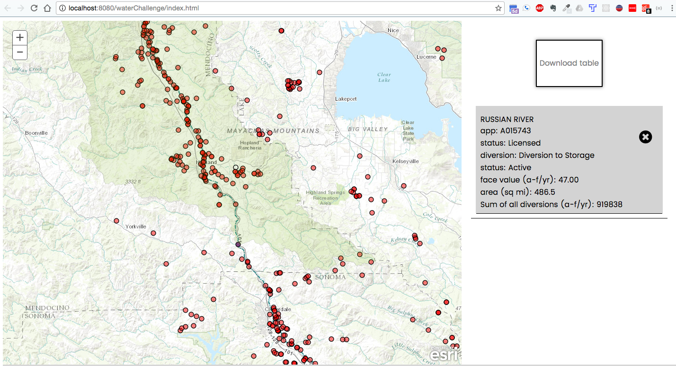
Notes:
Screen shot showing a selected water right diversion (purple dot) and its delineated watershed (light green polygon). Table to the right shows area of delineated watershed and the sum of all face value diversions of active appropriative rights within the delineated watershed

Slide 5
Ideas for Improvement
publish water rights data as an arcGIS feature service
Make diversion points snap to flowline
make water rights data available through data.ca.gov
Use USGS StreamStats api to show nearest active stream gages

