Slide 1
Red Hat Consulting Presentation Guide
Template and primer
This is the “Title Slide” layout. Use it to open and close your presentation.

Slide 2

Agenda
Know the Slide Layouts
Understand what’s available and when to use it
Be Brand Compliant
Get to know Red Hat Brand colors and icons
Fine Tuning
Tips & tricks to make you more proficient

Slide 3
Know the Slide Layouts
This is the Section Header layout.
Us it only when changing major topics.
Don’t go overboard.

Slide 4
Title and Content
This slide layout is best used with a good deal of text
Content area attributes (set in the slide Master):
Auto-size Text – reduces text sizes to fit the content area
Font color – Dark Gray (RGB: 64, 64, 64) to reduce contrast on white
Line spacing – set to .9 lines to tighten text within paragraphs
Paragraph spacing – 8pt for bullet 1, reduces 1pt for each sub-level
Avoid blank lines as spacers
Although tempting at times, this approach is non-standard
Consider a two-column layout with a filler graphic (see Agenda slide)
Avoid resizing content areas or inserting floating text boxes
Complicates re-use of slides between masters
Complicates sharing between LibreOffice / OpenOffice / MS Office

Slide 5
Title and Content with Standard Table
Table Attributes | Recommended Setting | This Table’s Setting | Illustrative Data
Header Row | Enabled | Enabled | $25,000
Total Row | As Needed | Enabled | $50,000
Banded Rows | Enabled | Enabled | $70,000
First Column | As Needed | Disabled | $10,000
Last Column | As Needed | Disabled | $10,000
Banded Columns | Enabled | Enabled | $40,000
Header Row Color | Red Hat Red (Accent 1 in MS Office) | Red Hat Red (Accent 1 in MS Office) | $25,000
Banded Row Color | Light Gray | Light Gray | $40,000
Total |  |  | $270,000
Notes:
This is the preferred table appearance for presentations.
In the “Table” formatting ribbon, enable “Header Row” and “Banded Rows”
This style will then show in the “Table Styles” browser under the “Medium” group.

Slide 6

Title Only Need a Big Impact, Use a Big Graphic
WORLDWIDE PAID & NON-PAID SERVER OS
SHIPMENTS, SUBSCRIPTIONS, DEPLOYMENTS
12 M
10 M
8 M
6 M
LINUX
4 M
WINDOWS
2 M
UNIX
OTHER
2000
2002
2004
2006
2008
2010
2012
2014
Worldwide Client and Server Operating Environments
2011-2015 Forecast: The Perfect Storm of Disruption (May 2011, #228201)
Notes:
Center and Resize multiple objects consistently and easily by using Arrange > Group to group them
Footer area should be reserved for attribution, citing, and footnotes only!

Slide 7
Two Column 45 / 45
Good for limited text plus a graphic to provide impact
Also works well with table and text mix if table has minimal text
If a table is more than 70% of the height of the content frame, resize the table to the same height as the text frame
Use this with any two content types
Risk | Likelihood | Impact | Mitigation Strategy
Training budget low | High | High | Virtual training greatly reduces cost and allows staff to schedule at their own pace
Provisioning Skill Gaps | High | Medium | A consultant works with staff to develop and deploy a Standard Operating Environment (SOE) managed with skills gained via on-site or virtual training
Custom application porting difficulty | High | High | Effective use of software porting tools and resources by Red Hat simplifies the process of custom app porting.
IT staff unable to fully support new projects in the near term | Medium | Medium | Red Hat on-site consultants can provide support and assistance to ensure project goals and timelines are met
Unsupported tools in use | Low | Medium | Enterprise Standard Build ensures supported tools are in place across the environment, and RHN Satellite used to deploy additional tools to address need for consistency

Slide 8

Two Column 55 / 35
When you need a little more room for one portion of the slide than the other
Note that either side can be whatever kind of content you need:
Text and Graphic
Graphic and Table
Chart and Text
Text and Smart Art

Slide 9
Two Column Comparison
Red Hat Enterprise Linux Version 6
Competitor Linux 3
Comparison point 1
Comparison point 2
Comparison point 3
Comparison point 4
Comparison point 4a
Comparison point 4b
Comparison point 5
Comparison point 1
Comparison point 2
Comparison point 3
Comparison point 4
Comparison point 4a
Comparison point 4b
Comparison point 5

Slide 10
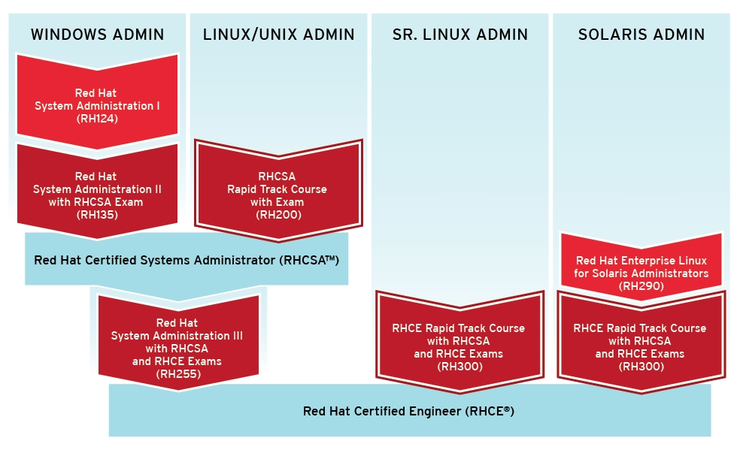
Small Title and Content Layout
Notes:
This is handy when you have lots of data to convey and you need it sized to be readable

Slide 11
Small Title Two Column 55 / 35
When you need a little more room for one portion of the slide than the other
Note either side can be whatever kind of content you need:
Text and Graphic
Graphic and Table
Chart and Text
Text and Smart Art
Back-and-forth between title sizes
Visually distracting during preso
Ok where needed
Try to minimize!

Slide 12
Be Brand Compliant
Understand Red Hat Brand constraints and guidelines

Slide 13
Use Brand Colors
START WITH RED |  |  | SECONDARY COLORS
 | For Red RGB: 204, 0, 0 Theme color*: Accent 1 |  |  | RGB: 191, 220, 232 Theme color*: Text/Background – Light 2 |  |  | RGB: 44, 133, 150
 | For dark Red RGB: 158, 41, 43 |  |  | RGB: 0, 147, 217 Theme color*: Accent 2 |  |  | RGB: 227, 233, 54
 | For darker red RGB: 120, 31,28 Theme color*: Text/Background – Dark 2 |  |  | RGB: 171, 180, 0 Theme color*: Accent 3 |  |  | RGB: 252, 201, 23
 | For black RGB: 0, 0, 0 Theme color*: Text/Background – Dark 1 |  |  | RGB: 255, 141, 0 Theme color*: Accent 4 |  |  | RGB: 220, 159, 46
 | For white RGB: 255, 255, 255 Theme color*: Text/Background – Light 1 |  |  | RGB: 0, 61, 110 Theme color*: Accent 5 |  |  | RGB: 227, 220, 192
 | RGB: 140, 143, 145 |  |  | RGB: 78, 55, 107 Theme color*: Accent 6 |  |  | RGB: 200, 197, 172
Note use of table here to facilitate layout & alignment

Slide 14





Use Brand Presentation Icons
App or Workload
Webpage
Router
Doc
Certified
Server
Small Icons
Hypervisor
Terminal
Router 2
Docs
Gear
Busy
Server Stack
Cancel
Desktop
Satellite
Doc 2
Gears
CD
Workload on Server (group)
download
Laptop
Firewall
Docs 2
Protected
error
Virt. Server
(group)
protected
Data Discs
(group)
Message Queue
security
Internet
Security
signal
verified
Users
Folder
Verified
warning
Server Cluster
Notes:
Where available, .eps files to get the best resolution on various screen sizes. You’ll get better results than using .png, .jpg, or .bmp files.

Slide 15
Fine Tuning
Phase 3

Slide 16

Manual Text-wrap Around Graphics
Sometimes you may want to convey something with a graphic on the same slide where you need significant text space to capture multiple, complex concepts.
In this situation, you are best off using manual line-wraps to wrap your text around the graphic/
This is done as follows:
Start with the Title and Content layout.
Add the text passages you want
Add the graphic and format accordingly
Note: it’s best to right-justify the graphic if you need to do this
Edit the text, using shift-return to force line wraps where needed around the graphics

Slide 17
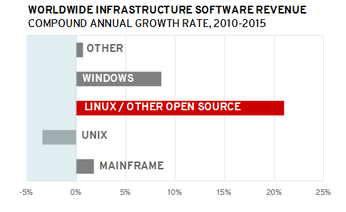
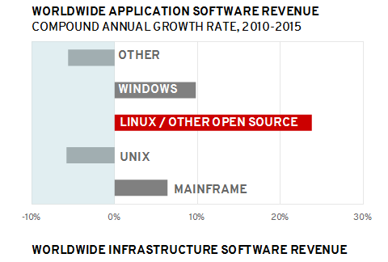
Beware Contiguous White Space
Worldwide Software 2011-2015 Forecast Summary
June 2011, #228658

Slide 18
Break Up White Space - Waterfall Objects from Upper Left
Worldwide Software 2011-2015 Forecast Summary
June 2011, #228658

Slide 19
Smart Art is Helpful, But Watch for Font Readability
This
works
fairly
well
BUT MOST OF THE TEXT
IN THIS ROW IS BARELY
READABLE AND WILL PROBABLY
WASH OUT COMPLETELY ON SCREEN
THIS IS OK, BUT
THIS FONT COLOR WAS CHANGED
WHICH MAKES IT STAND OUT
So 2 and 7 below...
1
2
3
4
5
6
7
8
9
10
Were manually
reformatted to use
darker colors in their
gradient fill colors.
Notes:
Smart Art works well in most cases, but you may need to select and alter individual elements’ fill or font colors.
REMEMBER, light fill colors will wash out on many projectors, so better to use bolder fill colors where possible.

Slide 20





Recolor Graphics but Avoid Pink
Simplified, brand re-colors can help, but use them sparingly.
Detailed graphics look best in gray-scale.
Don’t go Pink!!!

Slide 21
Recolor Icons
Wasted Space
Complexity
Rogue IT
Gridlock
CloudForms
Notes:
Select individual icons and use the Recolor feature to add meaning. You can also set their transparency to aid in getting the point across (e.g. future assets, virtual machines.)

Slide 22
Avoid Wandering Graphics
When using the same graphic(s) between consecutive slides...
Positioning changes distract the eye!
To fix this, do one of the following:
Duplicate the original slide and remove unwanted elements
Copy desired elements, create a new slide, and paste (they’ll show in the same location as their origin slide)
This graphic wandered
This graphic didn’t
CloudForms

Slide 23
Avoid Animation and Rethink Builds
Although animation and builds add flare, they’re have drawbacks
Generally slows down the preso and frustrates the viewer
Poor compatability between Libre Office / Open Office / MS Office
Don’t translate into PDFs or Webinars
Instead...
Don’t hold back text bullets, show them all at once
Use multiple slides for needed builds
As demonstrated on past three slides
Avoid animation!
Simulated build
CloudForms

Slide 24
Artistic License with Tables
 | LOW | MEDIUM | HIGH
ISV SOFTWARE MIGRATION | Third-party application installed on the host is certified on Red Hat Enterprise Linux at the same version levels. Small number of external integration points. | Third-party application installed on the host are certified on Red Hat Enterprise Linux at a different version level. Moderate number of external integration points. | Third-party application installed on the host is not available on Red Hat Enterprise Linux. Large number of external integration points.
APPLICATION PORTING | Highly portable, with well-established porting methods, clean code and few dependencies; e.g. pure Java application which should move over and work with minimal changes. Large percentage of original developers and developers with high level of mindshare are still available. Small number of external integration points. | Generally clean and independent; relies upon a few oddities such as moderate OS-specific calls, libraries to replace. Some amount of mindshare has been lost to departed developers. Moderate number of external integration points. | Large amount of code will need to be rewritten to work or be efficient in the new environment; unavailability of third-party libraries may require custom library building; cost prohibitive and/or impractical for technical or business reasons. Due to the enormous number of issues and lack of resources (person, libraries, hardware) it is highly difficult to perform a port of this application. The cost of porting the existing application is more expensive than writing a new application from scratch. Large number of complex integration points.
Notes:
Feel free to modify tables when it adds to the effect. Here a black header and “Red, Yellow, Green” font colors highlight associated risk levels.

Slide 25
Artistic License With Tables
 | Silo | Integrated | Componentized | Services | Composite Services | Virtualized Services | Dynamically Re-Configurable Services
Business View | Isolated Business Line Driven | Business Process Integration | Componentized Business Functions | Business provides & consumes services | Composed Business Services | Outsourced Services BPM & BAM | Business capabilities via context aware services
Organization & Governance | Ad hoc LOB IT Strategy and Governance | IT Transformation | Common Governance Processes | Emerging SOA governance | SOA and IT Governance Alignment | SOA and IT Infrastructure Governance | Governance via Policy
Methods | Structured Analysis & Design | Object Oriented Modeling | Component Based Development | Service Oriented Modeling | Service Oriented Modeling | Service Oriented Modeling for Infrastructure | Business Process Modeling
Applications | Modules | Objects | Components | Services | Applications comprised of composite services | Process Integration via Service | Dynamic Application Assembly
Architecture | Monolithic Architecture | Layered Architecture | Component Architecture | Emerging SOA | SOA | Grid Enabled SOA | Dynamically Re- Configurable Architecture
Information | Application Specific Data Solution | LOB Specific (Data subject areas established) | Canonical Models. | Information as a Service | Enterprise Business Data Dictionary & Repository | Virtualized Data Services | Semantic Data Vocabularies
Infrastructure & Management | LOB Platform Specific | Enterprise Standards | Common Reusable Infrastructure | Project Based SOA Environment | Common SOA Environment | Virtual SOA Environment: Sense and Respond | Context-aware Event-based: Sense & Respond
Notes:
Brand colors should be used throughout. However, in this case, using the standard Red header table with header and 1st row as Red would be a bit overwhelming, so gray was selected instead.
Note the use of drawn table gridlines in red to highlight the important column.

Slide 26
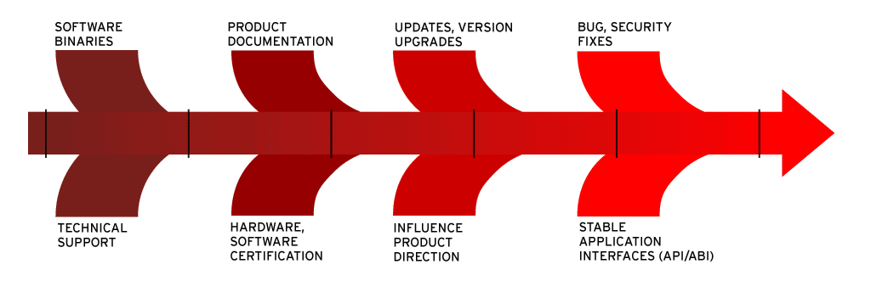
Use Tables for Complex Layouts
Rather than individually align elements, use a table.
Using a no-fill, no-lines table won’t obstruct your graphics
Resize columns and rows to get the alignment you want
Also note the table in the Brand Colors slide
Technical Support | Certified Binaries | Security & Bug Fixes | 10-Year API & ABI Stability
ISV & IHV Engineering Relationships | ISV & IHV Certifications | Enhancements | Knowledgebase
Notes:
There is a broad continuum of openness, ranging from companies who say their cloud is open, but who don't really deliver that. Now that "open source" is cool, even the big proprietary guys like Microsoft and VMWare are trying to use it as a marketing gimmick. Of course, their true intention is to lure the customer in with "open" and then lock them in.
So look carefully, beyond they hype. It is the most important decision an IT professional will make in the next decade.

Slide 27
Tables for Complex Layouts Another Example
Note number bullets have their own column below
 |  | CLOSED NO CHOICE | RESTRICTED INTEROPERABILITY VENDOR CHOOSES YOUR TECHNOLOGIES | OPEN SOURCE CLOUD IN A BOX YOU CAN FIRE YOUR VENDOR | OPEN CLOUD ANYWHERE ON ANYTHING
1 | Align different font sizes |  |  | ✓ | ✓
2 | By vertically centering the paragraphs |  |  | ✓ | ✓
3 | Within adjacent cells. |  |  |  | ✓
4 | Like these larger font |  |  | ✓ | ✓
5 | Numbered bullets and |  | ✓ |  | ✓
6 | The smaller font labels, |  | ✓ | ✓ | ✓
7 | Making layout much easier |  | ✓ |  | ✓

Slide 28
Turn Drab ...
Oracle 11g RAC Node
Red Hat Enterprise Linux 5
Oracle ASM
Veritas NetBackup
Oracle 10g Database Server
Red Hat Enterprise Linux 5
High Availability Add-On
Veritas NetBackup
DB2 Database Server
Red Hat Enterprise Linux 5
High Availability Add-On
Veritas NetBackup
General Purpose Server
RHEV Virtual Machine
Red Hat Enterprise Linux 5
Virtualization Server
Red Hat Enterprise Linux 5
Red Hat Enterprise Virtualization Agent
JavaEE Application Server
RHEV Virtual Machine
Red Hat Enterprise Linux 5
JBoss Enterprise Application Platform
Standard Operating Environment
Systems Management ● Configuration Management ● Identity Management ● Security
Notes:
This slide has a lot of misaligned shapes and lacks punch...

Slide 29
... Into Punch with Quick Styles ...
Oracle 11g RAC Node
Red Hat Enterprise Linux 5
Oracle ASM
Veritas NetBackup
Oracle 10g Database Server
Red Hat Enterprise Linux 5
High Availability Add-On
Veritas NetBackup
DB2 Database Server
Red Hat Enterprise Linux 5
High Availability Add-On
Veritas NetBackup
General Purpose Server
RHEV Virtual Machine
Red Hat Enterprise Linux 5
Virtualization Server
Red Hat Enterprise Linux 5
Red Hat Enterprise Virtualization Agent
JavaEE Application Server
RHEV Virtual Machine
Red Hat Enterprise Linux 5
JBoss Enterprise Application Platform
Standard Operating Environment
Systems Management ● Configuration Management ● Identity Management ● Security
Notes:
Use the Quick Styles to get Brand-consistent punch

Slide 30
... Use Uniform Sizing ...
Oracle 11g RAC Node
Red Hat Enterprise Linux 5
Oracle ASM
Veritas NetBackup
Oracle 10g Database Server
Red Hat Enterprise Linux 5
High Availability Add-On
Veritas NetBackup
DB2 Database Server
Red Hat Enterprise Linux 5
High Availability Add-On
Veritas NetBackup
General Purpose Server
RHEV Virtual Machine
Red Hat Enterprise Linux 5
Virtualization Server
Red Hat Enterprise Linux 5
Red Hat Enterprise Virtualization Agent
JavaEE Application Server
RHEV Virtual Machine
Red Hat Enterprise Linux 5
JBoss Enterprise Application Platform
Standard Operating Environment
Systems Management ● Configuration Management ● Identity Management ● Security
Notes:
Make all vertical blocks uniform size – select them all, then, in the Format ribbon, enter numeric Height and Width values in the Size boxes at far right.

Slide 31
Align, Distribute, Center, and Tweak
Oracle 11g RAC Node
Red Hat Enterprise Linux 5
Oracle ASM
Veritas NetBackup
Oracle 10g Database Server
Red Hat Enterprise Linux 5
High Availability Add-On
Veritas NetBackup
DB2 Database Server
Red Hat Enterprise Linux 5
High Availability Add-On
Veritas NetBackup
Virtualization Server
Red Hat Enterprise Linux 5
Red Hat Enterprise Virtualization Agent
JavaEE Application Server
RHEV Virtual Machine
Red Hat Enterprise Linux 5
JBoss Enterprise Application Platform
General Purpose Server
RHEV Virtual Machine
Red Hat Enterprise Linux 5
Standard Operating Environment
Systems Management ● Configuration Management ● Identity Management ● Security
Notes:
Use Arrange settings to “Align Top” and “Distribute Horizontally”
Center the text in the boxes To rotate gradient 180 degrees in the bars, select all of them, Format > Object... Then select Fill, then Gradient and set the rotation from 90 to 270

Slide 32
Use a Table for Easier Alignment
Oracle 11g RAC Node | Oracle 10g Database Server | DB2 Database Server | Virtualization Server | JavaEE Application Server | General Purpose Server
Red Hat Enterprise Linux 5 | Red Hat Enterprise Linux 5 | Red Hat Enterprise Linux 5 | Red Hat Enterprise Linux 5 | RHEV Virtual Machine | RHEV Virtual Machine
Oracle ASM | High Availability Add-On | High Availability Add-On | Red Hat Enterprise Virtualization Agent | Red Hat Enterprise Linux 5 | Red Hat Enterprise Linux 5
Veritas NetBackup | Veritas NetBackup | Veritas NetBackup |  | JBoss Enterprise Application Platform
Standard Operating Environment
Systems Management ● Configuration Management ● Identity Management ● Security

Slide 33
THANK YOU
Contact your Sales Rep or
email consulting@redhat.com
Notes:
Always end with a Thank You slide. It closes the preso more gracefully than cutting to a black screen or your desktop.

