Slide 1
Verification of task parallel programs using predictive analysis
-Radha Nakade

Slide 2
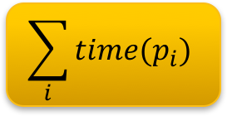
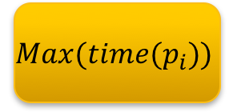
Task Parallel Programs
Reduce processing time by parallelizing the computation
Serial Computation
Proc p (var v) {
Call p1
Call p2
Call p3
Call p4
}
Parallel
Computation
p
p
p1
p1
p4
p2
p2
p3
p3
$$\sum_{i}{time(p_{i})}$$
$$Max(time(p_{i}))$$
p4

Slide 3




Task Parallel Languages
X10
Cilk
Habanero programming model
Chapel

Slide 4
Data Races
Example:
static int x = 0
Task1: int m = x; x = m+1; | Task 2: int n = x; x = n+2;

Slide 5
Data Races
Thread schedule 1
m = x x = m + 1 (x is 1)
n = x
x = n + 2 (x is 3)
Final Value of x = 3

Slide 6
Data Races
Thread schedule 2
m = x x = m + 1 (x is 1)
n = x x = n + 2 (x is 2)
Final Value of x = 1

Slide 7
Data Races
Thread schedule 3
m = x x = m + 1 (x is 1)
n = x
x = n + 2 (x is 2)
Final Value of x = 2

Slide 8
How do we determine if a program is data race free?

Slide 9
Related Work
Dynamic Data Race detectors
Jong-Deok Choi, Keunwoo Lee, Alexey Loginov, Robert O’Callahan, Vivek Sarkar, and Manu Sridharan. Efficient and Precise Datarace Detection for Multithreaded Object-oriented Programs. SIGPLAN Not., 37(5):258–269, May 2002. ISSN 0362-1340.
Tayfun Elmas, Shaz Qadeer, and Serdar Tasiran. Goldilocks: Efficiently computing the happens-before relation using locksets. In Formal Approaches to Software Testing and Runtime Verification, pages 193–208. Springer, 2006.
Leslie Lamport. Time, clocks, and the ordering of events in a distributed system. Communica- tions of the ACM, 21(7):558–565, 1978.
Adrian Nistor, Darko Marinov, and Josep Torrellas. Instantcheck: Checking the determinism of parallel programs using on-the-fly incremental hashing. In Proceedings of the 2010 43rd Annual IEEE/ACM International Symposium on Microarchitecture, pages 251–262. IEEE Computer Society, 2010.
John Mellor-Crummey. On-the-fly detection of data races for programs with nested fork- join parallelism. In Proceedings of the 1991 ACM/IEEE Conference on Supercomputing, Supercomputing ’91
Notes:
The dynamic race detectors use information from the actual program executions for data race detection.
The drawback is that their results can be applied to other thread schedules.

Slide 10
Related Work
Static Data Race Detectors
Martin Abadi, Cormac Flanagan, and Stephen N Freund. Types for safe locking: Static race detection for java. ACM Transactions on Programming Languages and Systems (TOPLAS), 28(2):207–255, 2006.
Jong-Deok Choi, Alexey Loginov, and Vivek Sarkar. Static datarace analysis for multithreaded object-oriented programs. Technical report, Technical Report RC22146, IBM Research, 2001.
Dawson Engler and Ken Ashcraft. RacerX: effective, static detection of race conditions and deadlocks. In ACM SIGOPS Operating Systems Review, volume 37, pages 237–252. ACM, 2003.
Cormac Flanagan, K. Rustan M. Leino, Mark Lillibridge, Greg Nelson, James B. Saxe, and Raymie Stata. Extended Static Checking for Java. Proceedings of the ACM SIGPLAN 2002 conference on Programming language design and implementation (SIGPLAN Not.), 37(5): 234–245, May 2002. ISSN 0362-1340.
Mayur Naik, Alex Aiken, and John Whaley. Effective static race detection for java. 41(6), 2006.
Jan Wen Voung, Ranjit Jhala, and Sorin Lerner. Relay: static race detection on millions of lines of code. In Proceedings of the the 6th joint meeting of the European software engineering conference and the ACM SIGSOFT symposium on The foundations of software engineering, pages 205–214. ACM, 2007.
Notes:
The static race detectors analyze the source code to detect races. They can reason about all possible program runs.
The major drawback of these systems is that they produce a large number of false-positives.

Slide 11
Related Work
Model checking
Patrice Godefroid. Model checking for programming languages using verisoft. In Proceedings of the 24th ACM SIGPLAN-SIGACT Symposium on Principles of Programming Languages, POPL ’97
Sergey Kulikov, Nastaran Shafiei, Franck Van Breugel, and Willem Visser. Detecting data races with java pathfinder, 2010.
Timothy K Zirkel, Stephen F Siegel, and Timothy McClory. Automated Verification of Chapel Programs using Model Checking and Symbolic Execution. NASA Formal Methods, 7871: 198–212, 2013.
Milos Gligoric, Peter C Mehlitz, and Darko Marinov. X10X: Model checking a new programming language with an ”old” model checker. In Software Testing, Verification and Validation (ICST), 2012 IEEE Fifth International Conference on, pages 11–20. IEEE, 2012.
Notes:
Model checking systematically explores the entire state space of the programs to detect concurrency
The major drawback of model checking is the explosion in the state space as the program size increases.

Slide 12
Related Work
Raghavan Raman, Jisheng Zhao, Vivek Sarkar, Martin Vechev, and Eran Yahav. Scalable and Precise dynamic datarace detection for structured parallelism. In ACM SIGPLAN Notices, volume 47, pages 531–542. ACM, 2012.
Surendran Rishi, and Vivek Sarkar. Dynamic determinacy race detection for task parallelism with futures. International Conference on Runtime Verification. Springer International Publishing, 2016.
Notes:
major drawback: Not sound for programs with isolation

Slide 13
Our Approach
Use Dynamic Analysis along with Model Checking

Slide 14
Computation graphs
n₀
n₀’
n₁
n₂
n₀’’
r₁
r₁’

Slide 15
Computation graphs
n₀
n₀’
n₁
n₂
n₀’’
r₁
r₁’

Slide 16
Computation graphs
n₀
n₀’
n₁
n₂
n₀’’
r₁
r₁’

Slide 17
Computation graphs
n₀
n₀’
n₁
n₂
n₀’’
r₁
r₁’

Slide 18
Computation graphs
n₀
n₀’
n₁
n₂
n₀’’
r₁
r₁’

Slide 19
Our Solution
Task Parallel Program
Runtime
Build Computation Graph
Analyze Computation Graph
Program - data race free?

Slide 20
Our Solution
Task Parallel Program
Runtime
Build Computation Graph
Analyze Computation Graph
Program - data race free?

Slide 21

Computation graphs
proc main (var n : int)
l(r₁) := 1;
post r₁ $←$p₁ n ε {r₁} {r₁} λv.n = v;
post r₁ $←$p₂ n ε {r₁} {r₁} λv.n = v;
await r₁
proc p₁ (var n : int)
l(r₁) := l(r₁) + 1;
return 1
proc p₂ (var n : int)
l(r₁) := l(r₁) + 2;
return 1

Slide 22
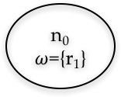
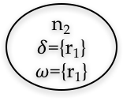
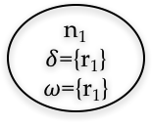
Computation graphs
proc main (var n : int)
l(r₁) := 1;
post r₁ $←$p₁ n ε {r₁} {r₁} λv.n = v;
post r₁ $←$p₂ n ε {r₁} {r₁} λv.n = v;
await r₁
proc p₁ (var n : int)
l(r₁) := l(r₁) + 1;
return 1
proc p₂ (var n : int)
l(r₁) := l(r₁) + 2;
return 1
n₀
$ω$={r₁}
n₀’
n₁
$δ$={r₁}
$ω$={r₁}
n₂
$δ$={r₁}
$ω$={r₁}
n₀’’
r₁
r₁’
Notes:
Simplify

Slide 23
Thesis Statement
A computation graph is a suitable common representation of the execution of any task parallel program. The computation graph is sufficient to determine all relevant schedules over tasks that need to be explored to enumerate all the possible behaviors of the program. Such an exhaustive enumeration is enough for verifying deterministic behavior in task parallel programs.

Slide 24
Thesis Statement
A computation graph is a suitable common representation of the execution of any task parallel program. The computation graph is sufficient to determine all relevant schedules over tasks that need to be explored to enumerate all the possible behaviors of the program. Such an exhaustive enumeration is enough for verifying deterministic behavior in task parallel programs.

Slide 25
Our Solution
Task Parallel Program
Runtime
Build Computation graph
Analyze Computation Graph
Program - data race free?

Slide 26
Our Solution
Task Parallel Program
Runtime
Build Computation graph
Analyze Computation Graph
Program - data race free?

Slide 27
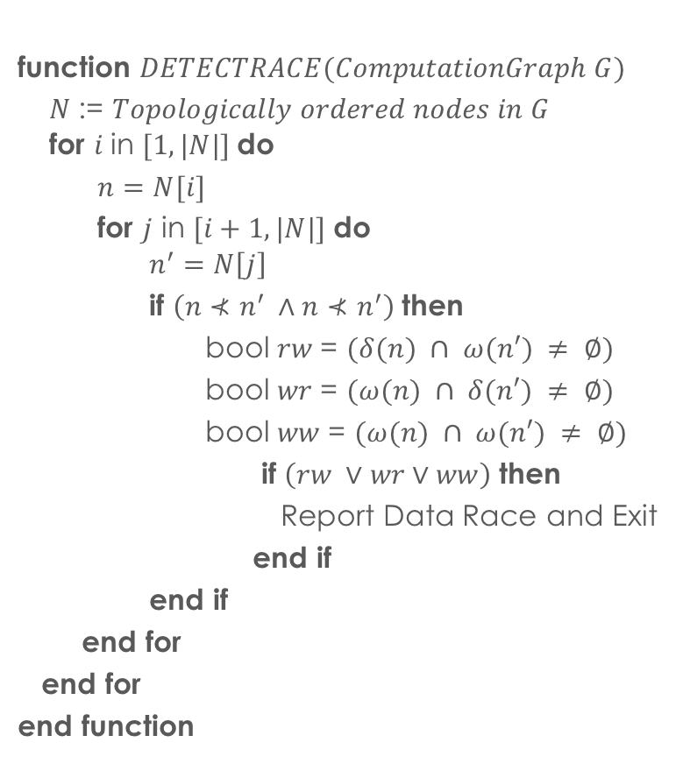
Data Race Detection Algorithm
function $DETECTRACE(ComputationGraph G)$
$N$:= $Topologically ordered nodes in G$ for $i$in $[1, |N|]$do
$n=N[i]$
for $j$ in $[i+1, |N|]$do $n^{′}=N\left[j\right]$
if $\left(n⊀n^{′} ∧n⊀n^{′}\right)$then
bool $rw$= $(δ(n) ∩ ω(n′) ≠ ∅)$
bool $wr$= $(ω(n) ∩ δ(n′) ≠ ∅)$
bool $ww$= $(ω(n) ∩ ω(n′) ≠ ∅)$
if $\left(rw ∨wr∨ww\right)$then
Report Data Race and Exit
end if
end if
end for
end for
end function

Slide 28
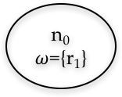
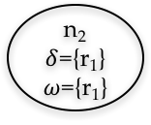
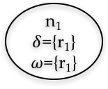
Data Race Detection Algorithm
function $DETECTRACE(ComputationGraph G)$
$N$:= $Topologically ordered nodes in G$ for $i$in $[1, |N|]$do
$n=N[i]$
for $j$ in $[i+1, |N|]$do $n^{′}=N\left[j\right]$
if $\left(n⊀n^{′} ∧n⊀n^{′}\right)$then
bool $rw$= $(δ(n) ∩ ω(n′) ≠ ∅)$
bool $wr$= $(ω(n) ∩ δ(n′) ≠ ∅)$
bool $ww$= $(ω(n) ∩ ω(n′) ≠ ∅)$
if $\left(rw ∨wr∨ww\right)$then
Report Data Race and Exit
end if
end if
end for
end for
end function
n₀
$ω$={r₁}
n₀’
n₁
$δ$={r₁}
$ω$={r₁}
n₂
$δ$={r₁}
$ω$={r₁}
n₀’’
r₁
r₁’

Slide 29
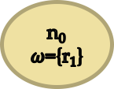
Data Race Detection Algorithm
function $DETECTRACE(ComputationGraph G)$
$N$:= $Topologically ordered nodes in G$ for $i$in $[1, |N|]$do
$n=N[i]$
for $j$ in $[i+1, |N|]$do $n^{′}=N\left[j\right]$
if $\left(n⊀n^{′} ∧n⊀n^{′}\right)$then
bool $rw$= $(δ(n) ∩ ω(n′) ≠ ∅)$
bool $wr$= $(ω(n) ∩ δ(n′) ≠ ∅)$
bool $ww$= $(ω(n) ∩ ω(n′) ≠ ∅)$
if $\left(rw ∨wr∨ww\right)$then
Report Data Race and Exit
end if
end if
end for
end for
end function
n₀
$ω$={r₁}
n₀’
n₁
$δ$={r₁}
$ω$={r₁}
n₂
$δ$={r₁}
$ω$={r₁}
n₀’’
r₁
r₁’

Slide 30
Data Race Detection Algorithm
function $DETECTRACE(ComputationGraph G)$
$N$:= $Topologically ordered nodes in G$ for $i$in $[1, |N|]$do
$n=N[i]$
for $j$ in $[i+1, |N|]$do $n^{′}=N\left[j\right]$
if $\left(n⊀n^{′} ∧n⊀n^{′}\right)$then
bool $rw$= $(δ(n) ∩ ω(n′) ≠ ∅)$
bool $wr$= $(ω(n) ∩ δ(n′) ≠ ∅)$
bool $ww$= $(ω(n) ∩ ω(n′) ≠ ∅)$
if $\left(rw ∨wr∨ww\right)$then
Report Data Race and Exit
end if
end if
end for
end for
end function
n₀’
n₁
$δ$={r₁}
$ω$={r₁}
n₂
$δ$={r₁}
$ω$={r₁}
n₀’’
r₁
r₁’

Slide 31
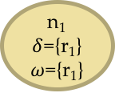
Data Race Detection Algorithm
function $DETECTRACE(ComputationGraph G)$
$N$:= $Topologically ordered nodes in G$ for $i$in $[1, |N|]$do
$n=N[i]$
for $j$ in $[i+1, |N|]$do $n^{′}=N\left[j\right]$
if $\left(n⊀n^{′} ∧n⊀n^{′}\right)$then
bool $rw$= $(δ(n) ∩ ω(n′) ≠ ∅)$
bool $wr$= $(ω(n) ∩ δ(n′) ≠ ∅)$
bool $ww$= $(ω(n) ∩ ω(n′) ≠ ∅)$
if $\left(rw ∨wr∨ww\right)$then
Report Data Race and Exit
end if
end if
end for
end for
end function
n₁
$δ$={r₁}
$ω$={r₁}
n₂
$δ$={r₁}
$ω$={r₁}
n₀’’
r₁
r₁’

Slide 32
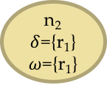
Data Race Detection Algorithm
function $DETECTRACE(ComputationGraph G)$
$N$:= $Topologically ordered nodes in G$ for $i$in $[1, |N|]$do
$n=N[i]$
for $j$ in $[i+1, |N|]$do $n^{′}=N\left[j\right]$
if $\left(n⊀n^{′} ∧n⊀n^{′}\right)$then
bool $rw$= $(δ(n) ∩ ω(n′) ≠ ∅)$
bool $wr$= $(ω(n) ∩ δ(n′) ≠ ∅)$
bool $ww$= $(ω(n) ∩ ω(n′) ≠ ∅)$
if $\left(rw ∨wr∨ww\right)$then
Report Data Race and Exit
end if
end if
end for
end for
end function
n₁
$δ$={r₁}
$ω$={r₁}
n₂
$δ$={r₁}
$ω$={r₁}
n₀’’
r₁
r₁’

Slide 33
Theorem
The data race detection algorithm is complete for a task parallel program with a given input.
Notes:
Complete: A data race detection algorithm is complete if it does not report data races in programs that are data race free.
A complete algorithm may accept programs as data race free when in fact they have data races. It may over-approximate the set of data race free programs.
Sound: A data race detection algorithm is sound if it does not miss any data race in a program for a given input.
If the sound algorithm declares a program to be data race free, no race can exist in execution of the program for the given input on any schedule; although, it may reject programs as having data races when in fact they do not. It may under-approximate the set of data race free programs.

Slide 34
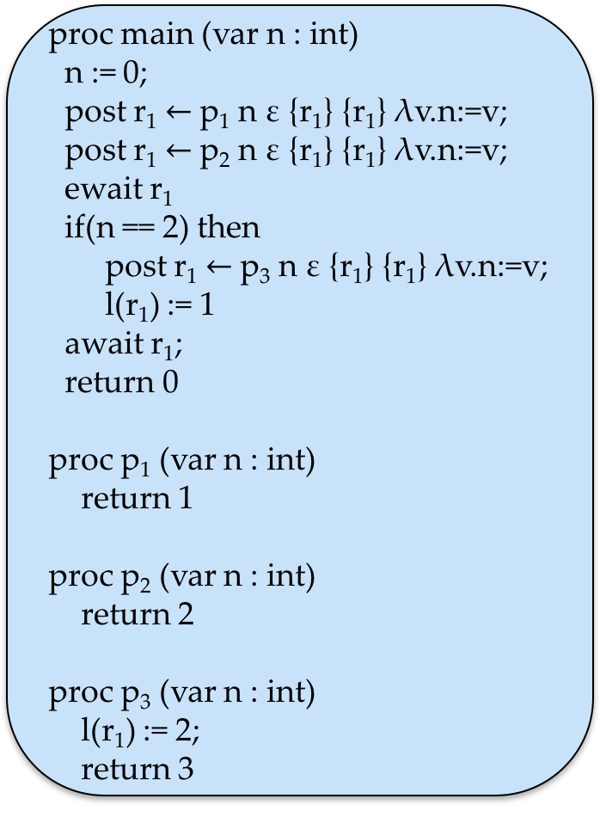
Example
proc main (var n : int)
n := 0;
post r₁ $←$p₁ n ε {r₁} {r₁} λv.n:=v;
post r₁ $←$p₂ n ε {r₁} {r₁} λv.n:=v;
ewait r₁
if(n == 2) then
post r₁ $←$p₃ n ε {r₁} {r₁} λv.n:=v;
l(r₁) := 1
await r₁;
return 0
proc p₁ (var n : int)
return 1
proc p₂ (var n : int)
return 2
proc p₃ (var n : int)
l(r₁) := 2;
return 3

Slide 35
Example
proc main (var n : int)
n := 0;
post r₁ $←$p₁ n ε {r₁} {r₁} λv.n:=v;
post r₁ $←$p₂ n ε {r₁} {r₁} λv.n:=v;
ewait r₁
if(n == 2) then
post r₁ $←$p₃ n ε {r₁} {r₁} λv.n:=v;
l(r₁) := 1
await r₁;
return 0
proc p₁ (var n : int)
return 1
proc p₂ (var n : int)
return 2
proc p₃ (var n : int)
l(r₁) := 2;
return 3
n₀
n₀’
n₁
n₂
n₀’’
r₁
r₁’

Slide 36
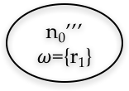
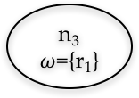
Example
n₀
proc main (var n : int)
n := 0;
post r₁ $←$p₁ n ε {r₁} {r₁} λv.n:=v;
post r₁ $←$p₂ n ε {r₁} {r₁} λv.n:=v;
ewait r₁
if(n == 2) then
post r₁ $←$p₃ n ε {r₁} {r₁} λv.n:=v;
l(r₁) := 1
await r₁;
return 0
proc p₁ (var n : int)
return 1
proc p₂ (var n : int)
return 2
proc p₃ (var n : int)
l(r₁) := 2;
return 3
n₀’
n₁
n₂
n₀’’
r₁
n₀’’’
$ω$={r₁}
n₃
$ω$={r₁}
r₁’
r₁’’

Slide 37


Example
n₀
proc main (var n : int)
n := 0;
post r₁ $←$p₁ n ε {r₁} {r₁} λv.n:=v;
post r₁ $←$p₂ n ε {r₁} {r₁} λv.n:=v;
ewait r₁
if(n == 2) then
post r₁ $←$p₃ n ε {r₁} {r₁} λv.n:=v;
l(r₁) := 1
await r₁;
return 0
proc p₁ (var n : int)
return 1
proc p₂ (var n : int)
return 2
proc p₃ (var n : int)
l(r₁) := 2;
return 3
n₀’
n₁
n₂
n₀’’
r₁
n₀’’’
$ω$={r₁}
n₃
$ω$={r₁}
r₁’
r₁’’

Slide 38
Structured Parallel Languages
Soundness guarantee holds in structured parallel programs
They have a single computation graph for all schedules

Slide 39
Structured Parallel Languages
An ewait statement has to specify the child task that is being synchronized.
Tasks whose return value handlers side effect can be joined only using ewait statements.
All the tasks are joined to the main task at the end of the program execution.
Notes:
A side-effect of a return value handler can be a change in the state of either the local variable or a region variable.

Slide 40
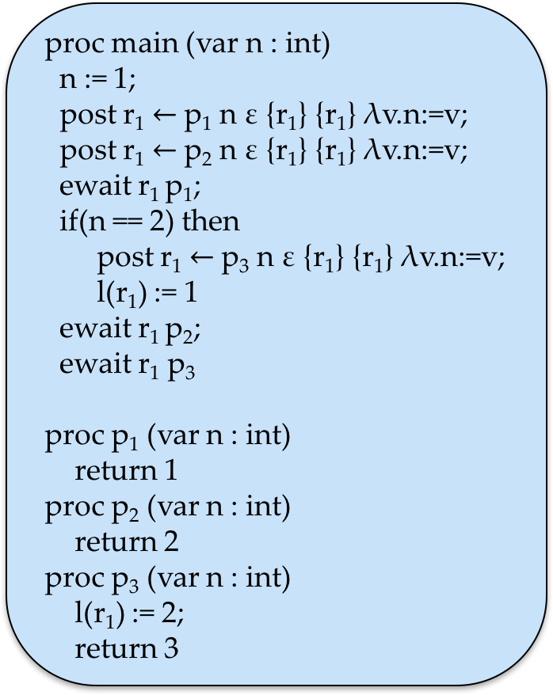
Example
proc main (var n : int)
n := 1;
post r₁ $←$p₁ n ε {r₁} {r₁} λv.n:=v;
post r₁ $←$p₂ n ε {r₁} {r₁} λv.n:=v;
ewait r₁ p₁;
if(n == 2) then
post r₁ $←$p₃ n ε {r₁} {r₁} λv.n:=v;
l(r₁) := 1
ewait r₁ p₂;
ewait r₁ p₃
proc p₁ (var n : int)
return 1
proc p₂ (var n : int)
return 2
proc p₃ (var n : int)
l(r₁) := 2;
return 3
n₀
n₀’
n₁
n₂
n₀’’
r₁
r₁’

Slide 41
Theorem 2
The data race detection algorithm is sound and complete for a structured parallel program with a given input.
Notes:
Task parallel languages are promoting structured parallelism because it provides correctness guarantees such as determinism, deadlock freedom and serializabilty in the absence of data races.

Slide 42
Mutual Exclusion

Slide 43
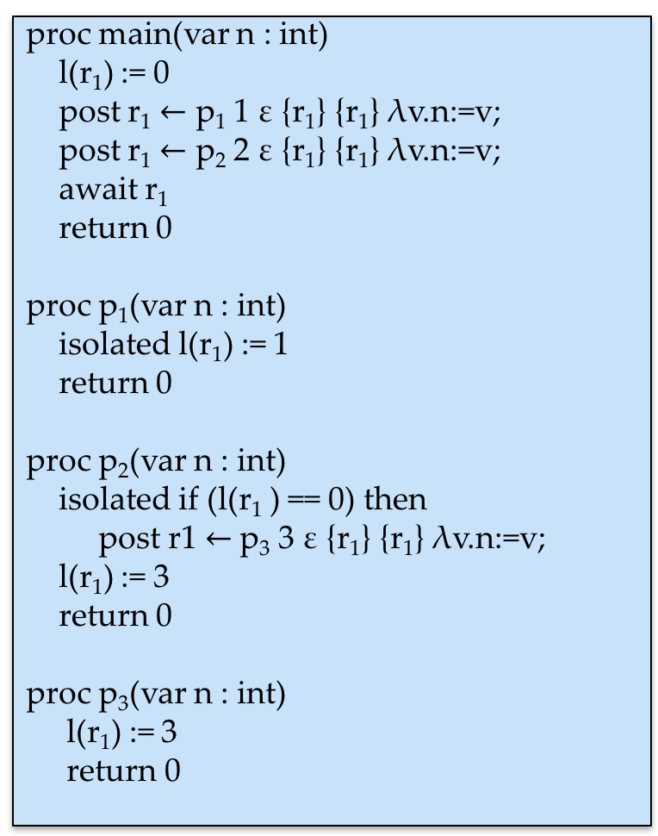
Mutual Exclusion
proc main(var n : int)
l(r₁) := 0
post r₁ $←$ p₁ 1 ε {r₁} {r₁} λv.n:=v;
post r₁ $←$ p₂ 2 ε {r₁} {r₁} λv.n:=v;
await r₁
return 0
proc p₁(var n : int)
isolated l(r₁) := 1
return 0
proc p₂(var n : int)
isolated if (l(r₁ ) == 0) then
post r1 $←$p₃ 3 ε {r₁} {r₁} λv.n:=v;
l(r₁) := 3
return 0
proc p₃(var n : int)
l(r₁) := 3
return 0

Slide 44
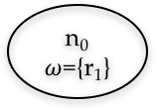
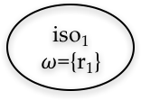
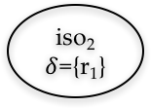
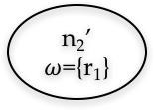
Mutual Exclusion
proc main(var n : int)
l(r₁) := 0
post r₁ $←$ p₁ 1 ε {r₁} {r₁} λv.n:=v;
post r₁ $←$ p₂ 2 ε {r₁} {r₁} λv.n:=v;
await r₁
return 0
proc p₁(var n : int)
isolated l(r₁) := 1
return 0
proc p₂(var n : int)
isolated if (l(r₁ ) == 0) then
post r1 $←$p₃ 3 ε {r₁} {r₁} λv.n:=v;
l(r₁) := 3
return 0
proc p₃(var n : int)
l(r₁) := 3
return 0
n₀
$ω$={r₁}
n₀’
n₁
n₂
n₀’’
iso₁
$ω$={r₁}
iso₂
$δ$={r₁}
n₁’
n₂’
$ω$={r₁}
r₀
r0’

Slide 45
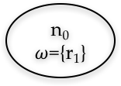
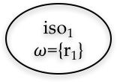
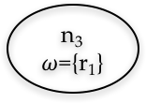
Mutual Exclusion
proc main(var n : int)
l(r₁) := 0
post r₁ $←$ p₁ 1 ε {r₁} {r₁} λv.n:=v;
post r₁ $←$ p₂ 2 ε {r₁} {r₁} λv.n:=v;
await r₁
return 0
proc p₁(var n : int)
isolated l(r₁) := 1
return 0
proc p₂(var n : int)
isolated if (l(r₁ ) == 0) then
post r1 $←$p₃ 3 ε {r₁} {r₁} λv.n:=v;
l(r₁) := 3
return 0
proc p₃(var n : int)
l(r₁) := 3
return 0
n₀
$ω$={r₁}
n₀’
n₂
n₁
n₀’’
iso₂
$δ$={r₁}
iso₁
$ω$={r₁}
r₀
n₂’
$ω$={r₁}
n₃
$ω$={r₁}
r₀’
n₁’
r₀’

Slide 46
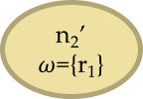

Mutual Exclusion
proc main(var n : int)
l(r₁) := 0
post r₁ $←$ p₁ 1 ε {r₁} {r₁} λv.n:=v;
post r₁ $←$ p₂ 2 ε {r₁} {r₁} λv.n:=v;
await r₁
return 0
proc p₁(var n : int)
isolated l(r₁) := 1
return 0
proc p₂(var n : int)
isolated if (l(r₁ ) == 0) then
post r1 $←$p₃ 3 ε {r₁} {r₁} λv.n:=v;
l(r₁) := 3
return 0
proc p₃(var n : int)
l(r₁) := 3
return 0
n₀
$ω$={r₁}
n₀’
n₂
n₁
n₀’’
iso₂
$δ$={r₁}
iso₁
$ω$={r₁}
r₀
n₂’
$ω$={r₁}
n₃
$ω$={r₁}
r₀’
n₁’
r₀’

Slide 47
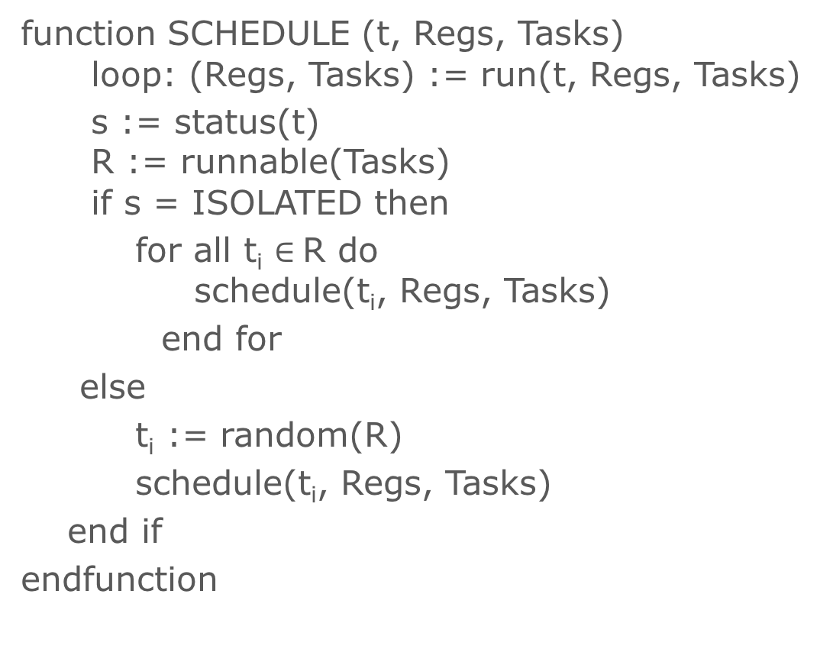
Scheduling Algorithm
function SCHEDULE (t, Regs, Tasks) loop: (Regs, Tasks) := run(t, Regs, Tasks)
s := status(t) R := runnable(Tasks) if s = ISOLATED then
for all t_{i} $∈$R do schedule(t_{i}, Regs, Tasks)
end for
else
t_{i} := random(R)
schedule(t_{i}, Regs, Tasks)
end if
endfunction
Notes:
Line 2 updates the region variables and pool of tasks by running task t until it exits, or reaches an isolated-construct.
The function status on Line 3 returns the status of the task t.
On Line 4, the function runnable is used to obtain a list of all the tasks that can be run from the pool of all tasks. If the status of the currently running task t becomes ISOLATED (i.e., the task encounters an isolated construct), the task is blocked and all the tasks that are runnable are scheduled by the runtime. When the task exits, a task is randomly selected from the set of runnable tasks and scheduled by the runtime.

Slide 48
Theorem 3
The scheduling algorithm finds all unique computation graphs making it sound and complete with the data race detection algorithm.

Slide 49
Thesis Statement
A computation graph is a suitable common representation of the execution of any task parallel program. The computation graph is sufficient to determine all relevant schedules over tasks that need to be explored to enumerate all the possible behaviors of the program. Such an exhaustive enumeration is enough for verifying deterministic behavior in task parallel programs.

Slide 50
Thesis Statement
A computation graph is a suitable common representation of the execution of any task parallel program. The computation graph is sufficient to determine all relevant schedules over tasks that need to be explored to enumerate all the possible behaviors of the program. Such an exhaustive enumeration is enough for verifying deterministic behavior in task parallel programs.

Slide 51


Implementation
Habanero Java
Java PathFinder

Slide 52
Results
Precise race detector
Gradual permission regions based data race detector
Notes:
The Precise race detector inserts choices in the scheduler for all thread actions such as thread creation, synchronizations, locks etc. Therefore, it does not complete execution within the stipulated time or runs out of memory even on smaller programs because of the state space explosion.
The Gradual Permission regions based detector works pretty well compared to precise race detector. The number of states explored and time required for data race analysis by Permission regions and computation graphs is almost the same when the tasks don’t access shared variables outside isolated blocks. When there are accesses to shared variables, the state space of permission regions grows very fast since the shared variable accesses have to annotated with regions and race detector creates scheduling choices at every region boundary.
We used these two because they are sound and complete for all programs in contrast to other solutions present out there.

Slide 53
Results
Test Name | Num of Tasks | Result | Time taken by CG | Time taken by GPR | Time taken by PRD
Primitive Array Race | 3 | Race | 00:01 | 00:01 | 00:01
Vector Add | 3 | No Race | 00:01 | 00:01 | 00:19
Substring search | 60 | Race | 00:03 | 00:01 | N/A
Integer Counter | 10 | Race | 00:01 | 05:53 | N/A
Prime Num Counter | 25 | No Race | 00:03 | 17:37 | N/A
Binary Trees | 625 | No Race | 00:25 | 00:03 | N/A

Slide 54
Conclusion
A computation graph is a suitable representation of the execution of the program
It can be very helpful in developing data race detection algorithms for any task parallel language
Data race detection using computation graphs for structured parallel programs is sound and complete
Data race detection using computation graphs is very efficient compared to model checking

Slide 55
Future Work
Use symbolic execution
Use static analysis
Notes:
Use symbolic execution to detect data races in structured parallel programs for any input.
The computation graphs can be created statically using program instrumentation and analyzed to gain performance improvements.

Slide 56

Questions

