Slide 1
Verification of Task Parallel Programs using Computation graphs
Radha Nakade

Slide 2
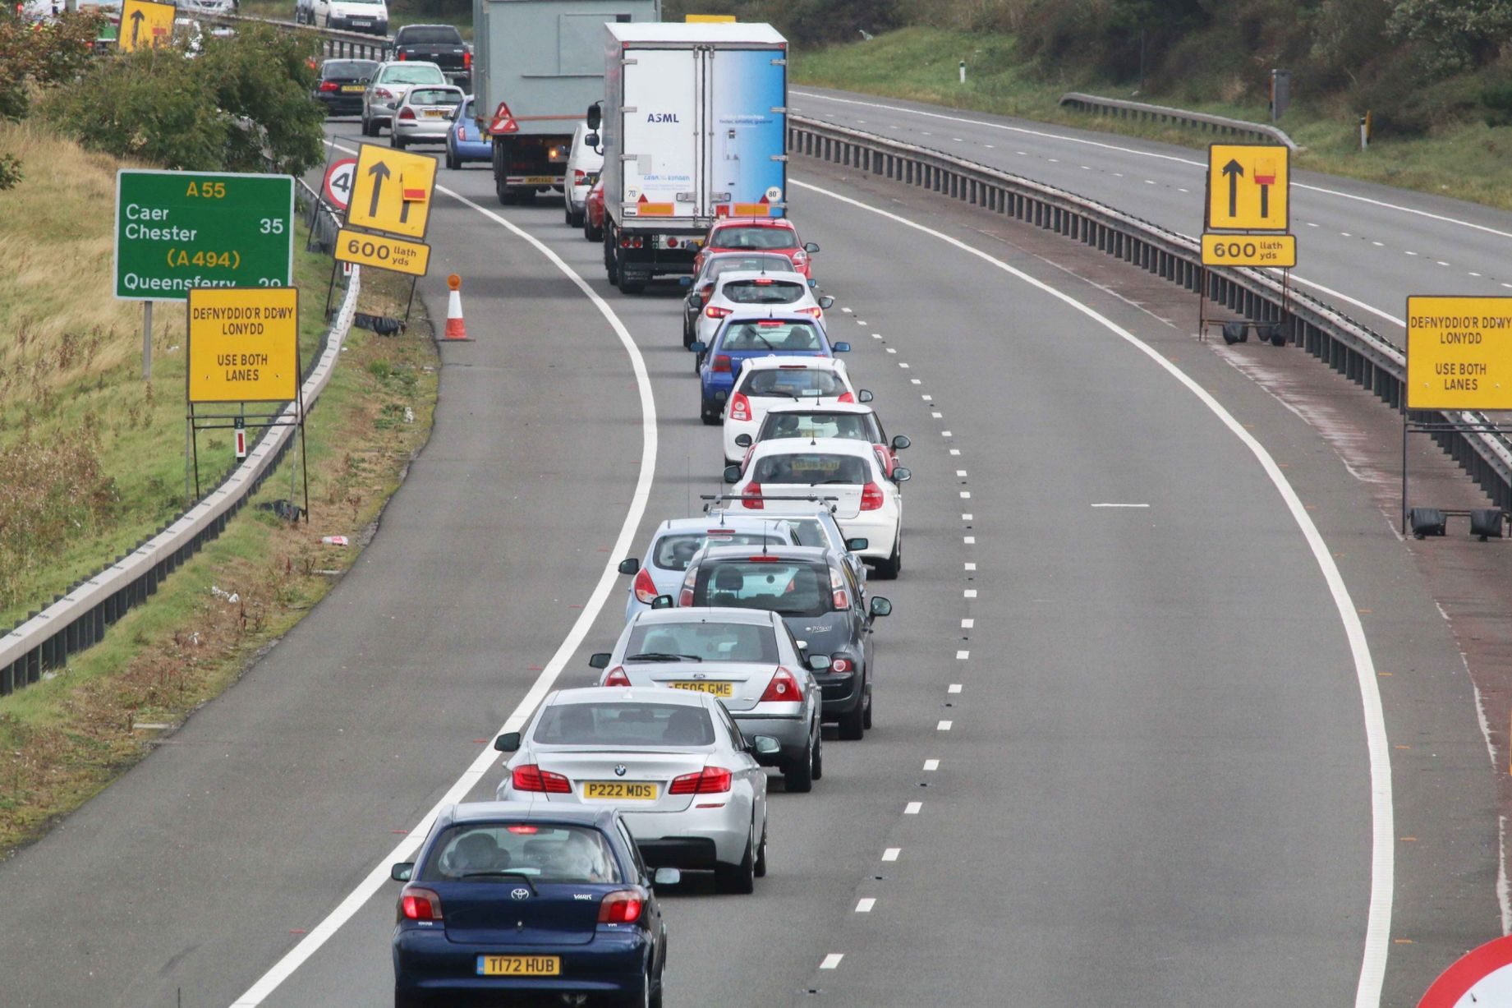
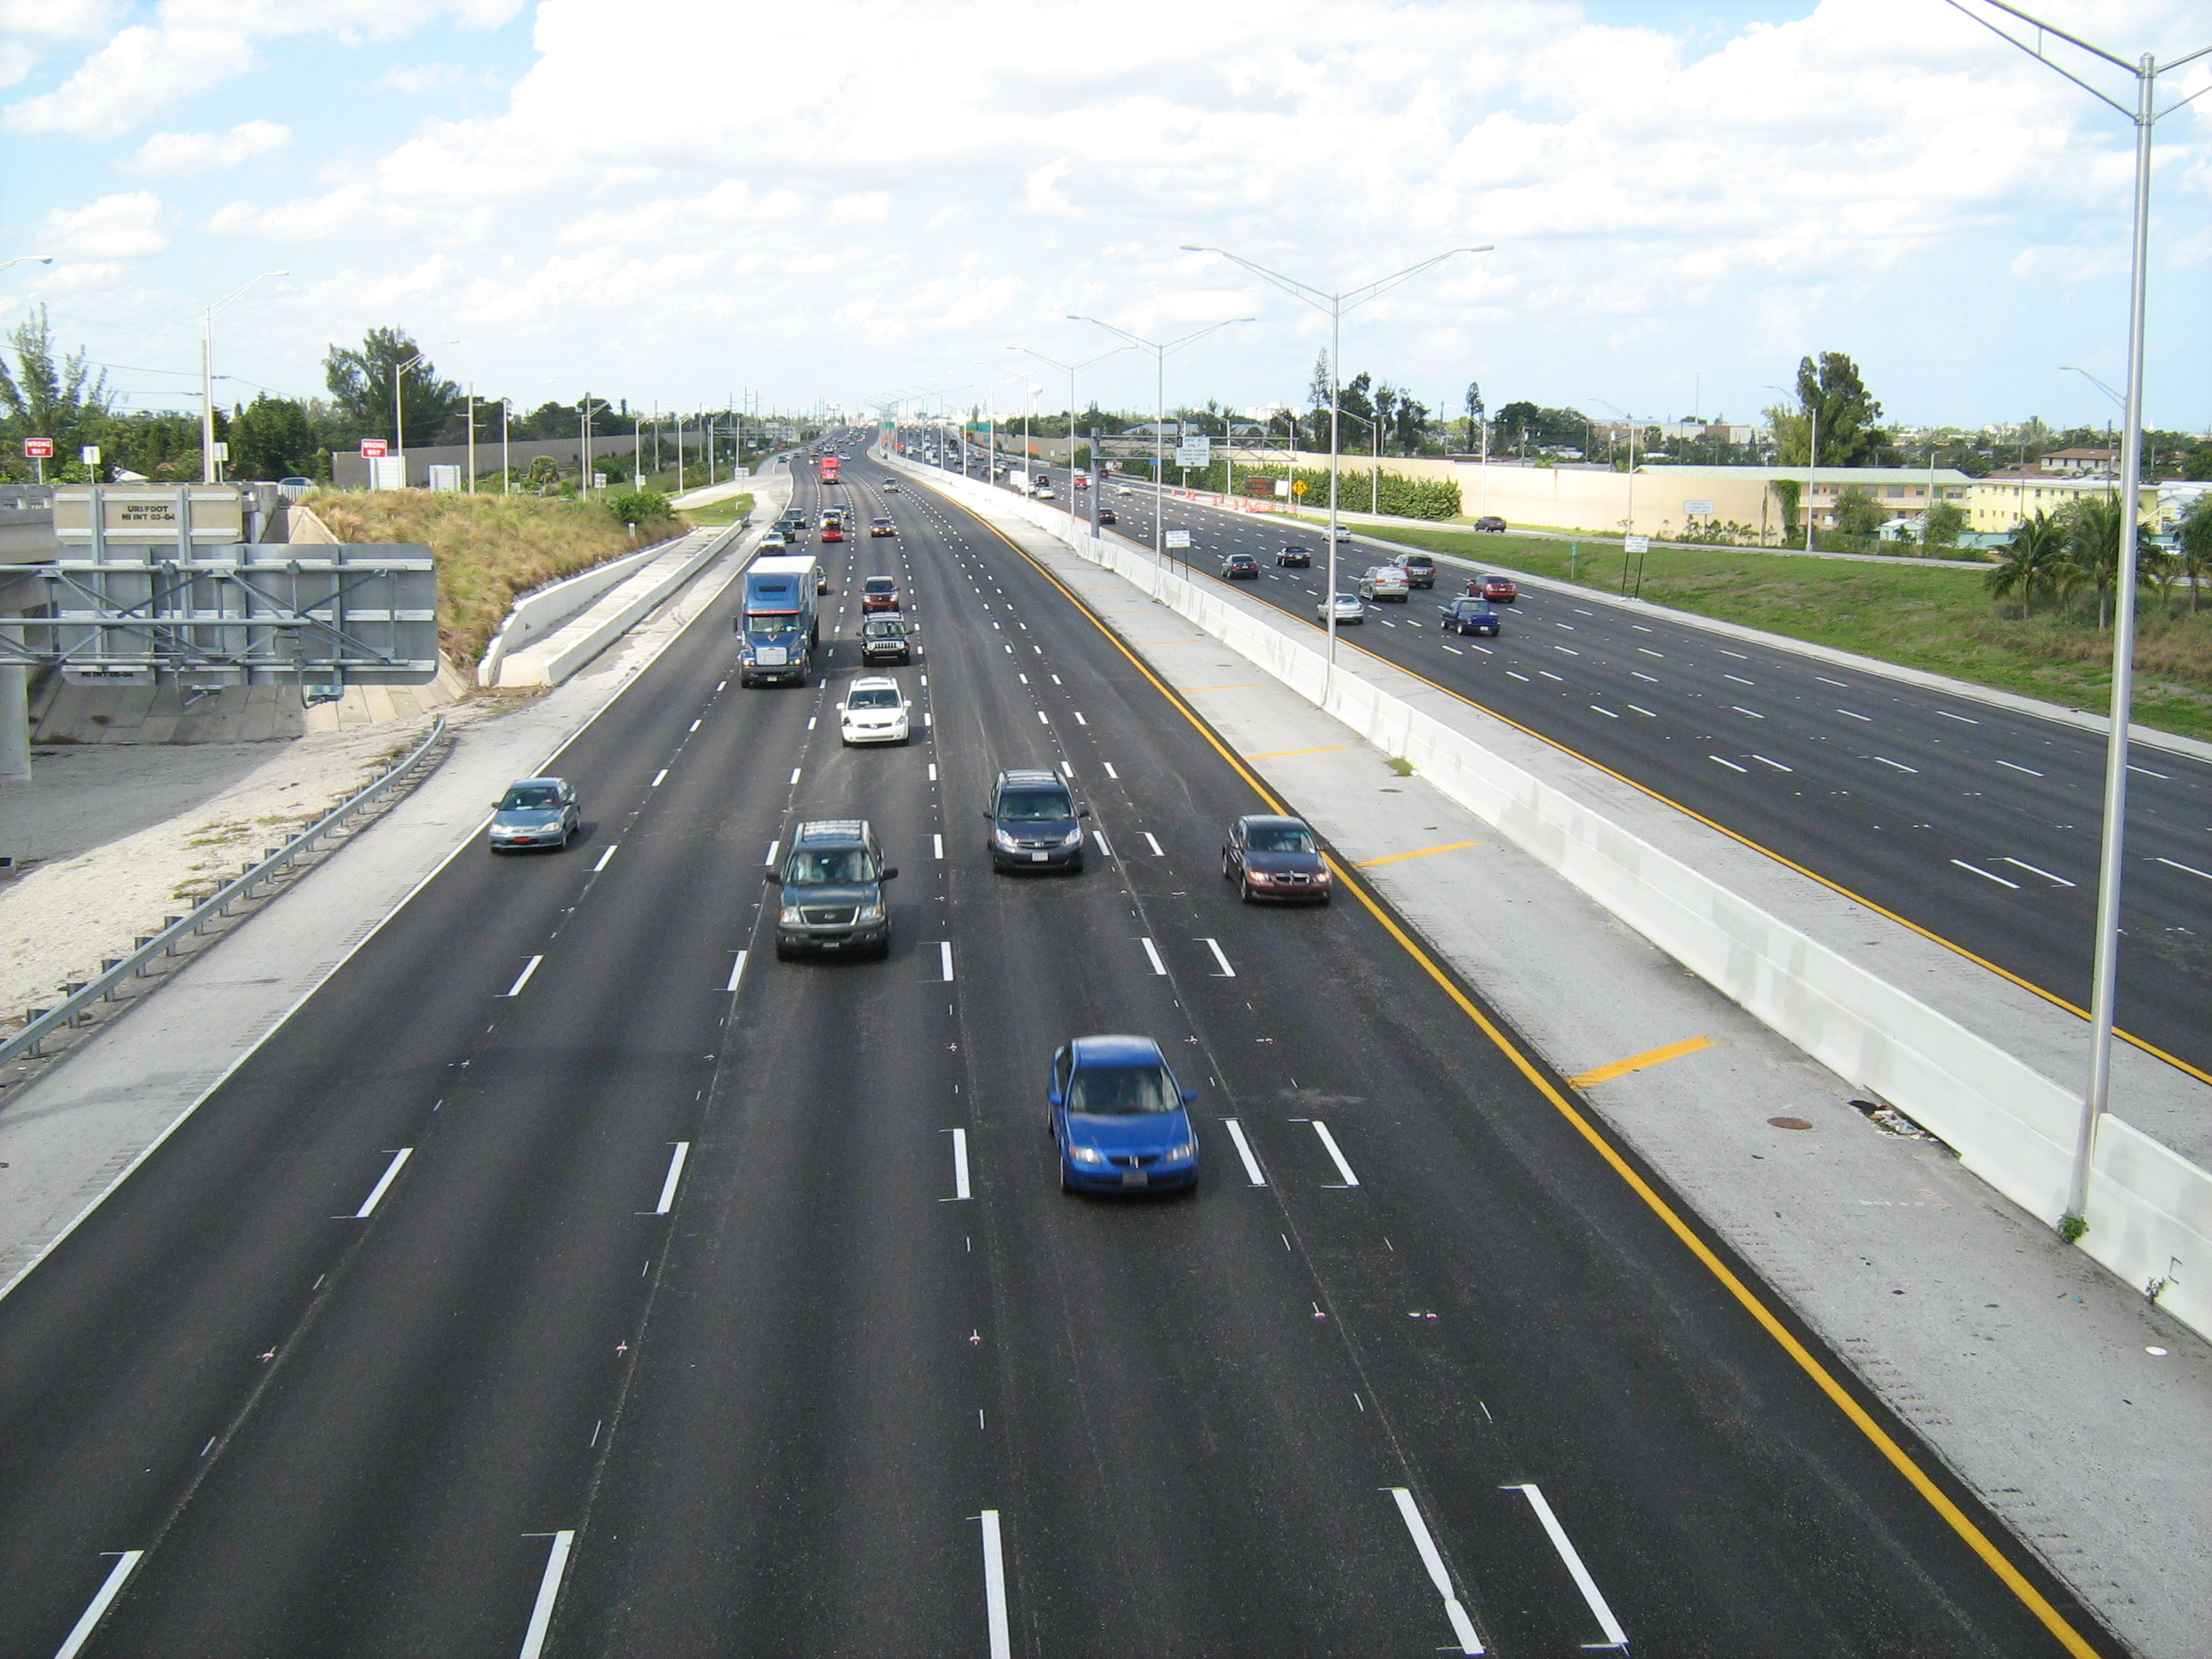
Why Parallel Processing

Slide 3
Habanero Java
Task Creation
Async
Finish
Future
Mutual Exclusion
Isolated
Synchronization
Phasers
Accumulators
Loop parallelism
ForAll
ForAsync

Slide 4
Data Races
Inherent to Parallel Programs
When two or more tasks access a shared variable, at least one tries to modify it
Introduces non-determinism

Slide 5
How do you know if a program is free of any data-race?

Slide 6
Our Solution
HJ Program
Runtime
CG
Analyze CG
output
Program Data race free?

Slide 7
Computation graphs
public class Example {
static int x = 0;
public static void main(String[] args) {
finish{
async{
int t = x;
x = t + 1; }
async{
int u = x;
x = u + 2; }
}
print("Value of x = " + x);
}
}
n₀
n₀’
n₁
R(x),W(x)
n₀’’
_{R(x)}
n₂
R(x),W(x)
join

Slide 8
Computation graphs
public class Example {
static int x = 0;
public static void main(String[] args) {
finish{
async{
int t = x;
x = t + 1; }
async{
int u = x;
x = u + 2; }
}
print("Value of x = " + x);
}
}
n₀
n₀’
n₁
R(x),W(x)
n₀’’
_{R(x)}
n₂
R(x),W(x)
join

Slide 9
Data Race Detection
forAll n ϵ N
forAll n’ϵ N and n≠n’
and n↛n’
if H(n) ∩ W(n’) ≠ ∅ then
report Data Race
end if
end for
end for

Slide 10
On the fly DRD

Slide 11
On the fly DRD
n₀
public class Example {
public static void main(String[] args) {
finish{ //region r0
async{ //Task t1 }
finish{ //region r1
async{ //Task t2 }
async{ //Task t3 }
}
}
}
n₀’
n₀’’
n₂
n₁
n₀’’’
n₃
r₁
r₀

Slide 12
On the fly DRD
n₀
public class Example {
public static void main(String[] args) {
finish{ //region r0
async{ //Task t1 }
finish{ //region r1
async{ //Task t2 }
async{ //Task t3 }
}
}
}
n₀’
n₀’’
n₂
n₁
n₀’’’
n₃
r₁
r₀

Slide 13
On the fly DRD
n₀
public class Example {
public static void main(String[] args) {
finish{ //region r0
async{ //Task t1 }
finish{ //region r1
async{ //Task t2 }
async{ //Task t3 }
}
}
}
n₁
n₀’
r₀

Slide 14
Mutual Exclusion

Slide 15
On the fly DRD
int x = 0;
finish{
async{
isolated {
x = 2; }
}
async{
isolated {
if(x == 0){
async {}
}
}
}
}
n₀
n₀’
n₂
n₁
iso₂
iso₁
n₀’’
n₂’
n₁’
join

Slide 16
On the fly DRD
int x = 0;
finish{
async{
isolated {
x = 2; }
}
async{
isolated {
if(x == 0){
async {}
}
}
}
}
n₀
n₀’
n₂
n₁
iso₂
iso₁
n₀’’
n₂’
n₁’
n₃
join

Slide 17
Implementation and Results
Test Case Name | Tasks | CG Race Detector |  |  | Precise Race Detector
 |  | States | Time | Error Info | States | Time | Error Info
Search Count | 4 | 7 | 0:00:01 | No Race | 145139 | 0:00:45 | No Race
Existence | 4 | 7 | 0:00:01 | Detected Race | 50197 | 0:00:15 | Detected Race
Index | 4 | 7 | 0:00:01 | Detected Race | 68806 | 0:00:29 | Detected Race
Existence - eureka | 2 | 5 | 0:00:01 | Detected Race | 296 | 0:00:00 | Detected Race
Search Index - eureka | 2 | 5 | 0:00:01 | Detected Race | 326 | 0:00:00 | Detected Race

Slide 18
Questions !!

