Slide 1

Verification of Task Parallel Programs with Predictive Analysis
Eric Mercer and Radha Nakade

Slide 2
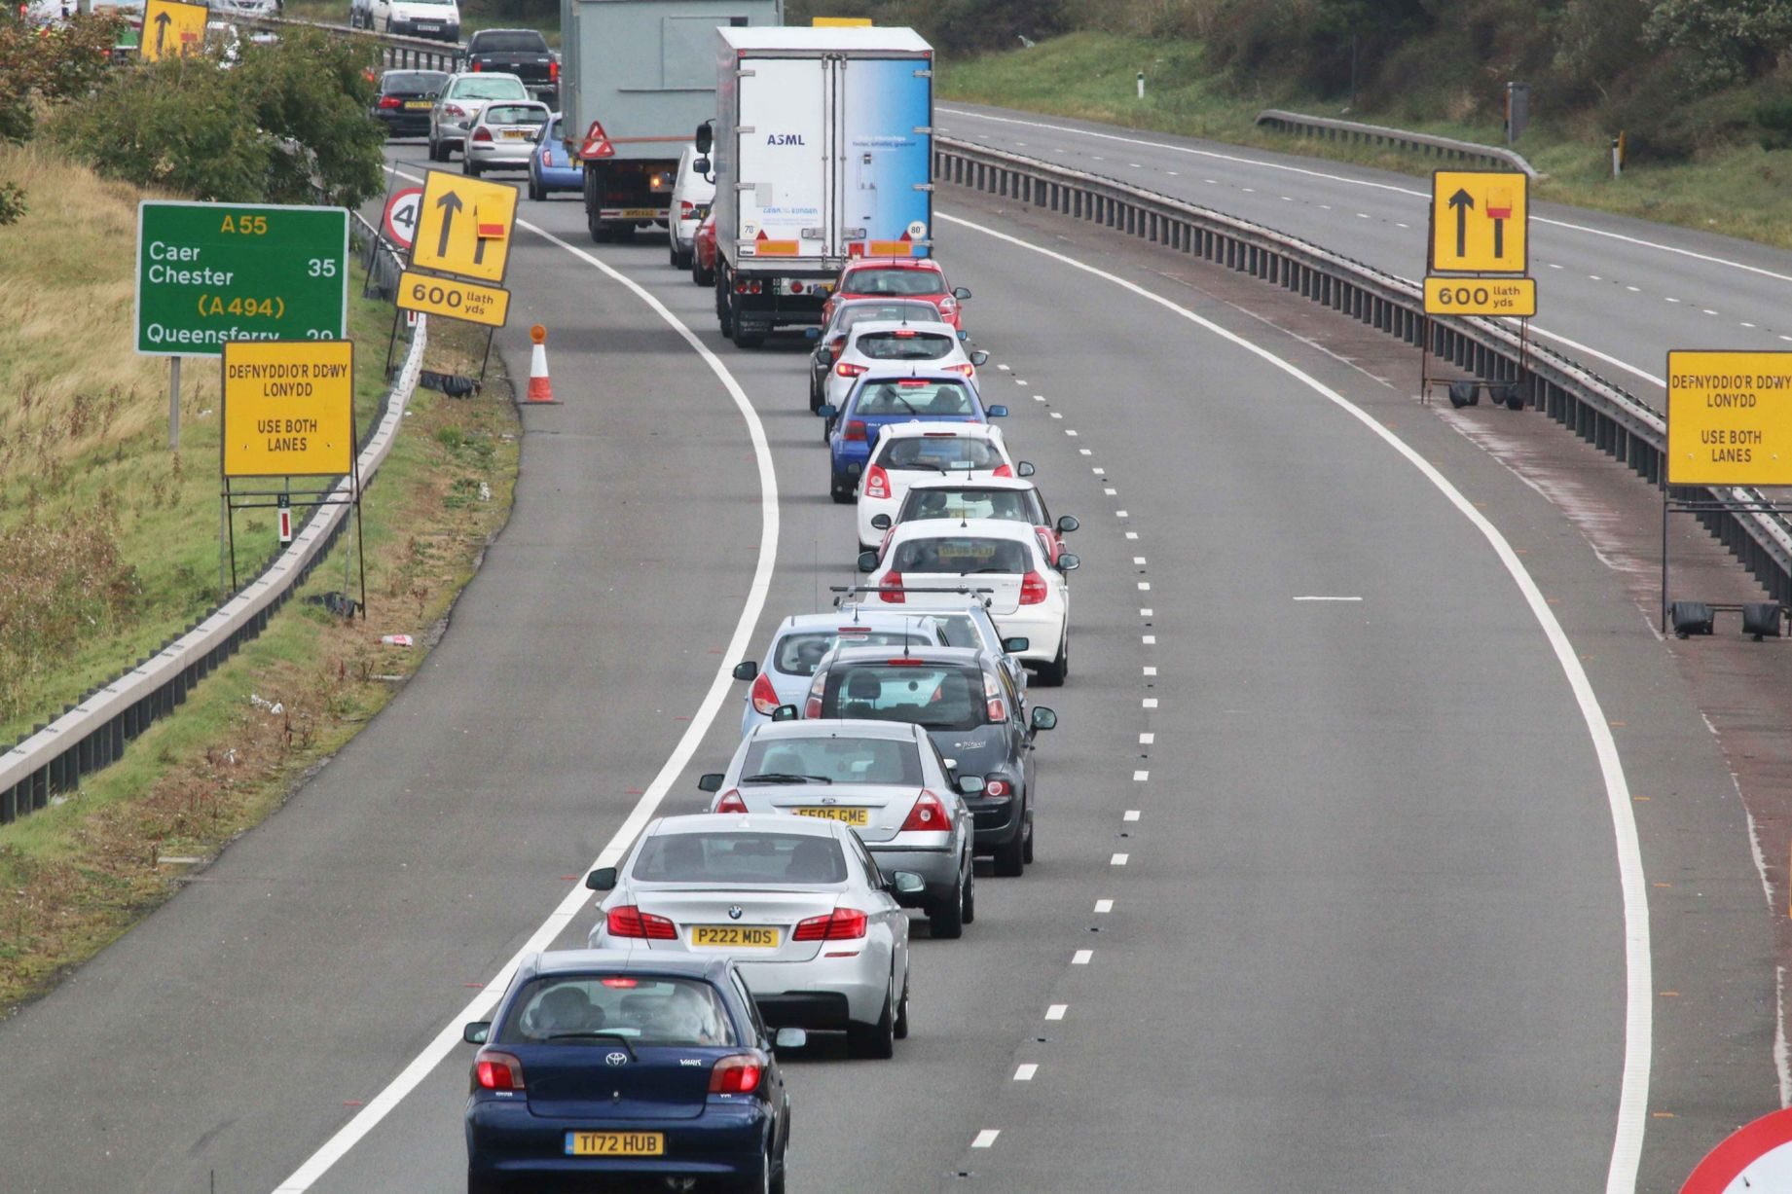
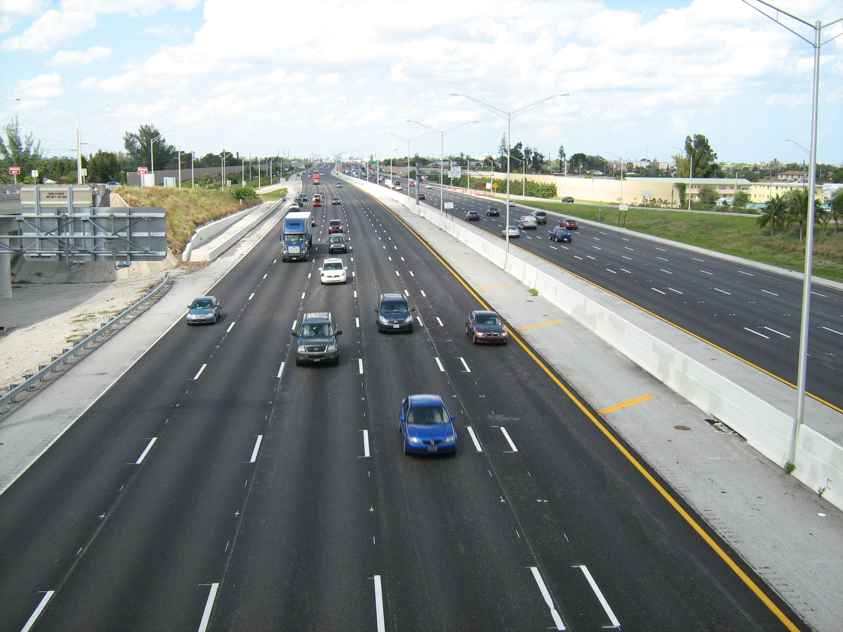
Why Parallel Processing
Parallel Processing
Serial Processing
Notes:
Traditional serial computing has limits:
Physical size of Transistors
Power usage, heating problem
Parallel Processing: Simultaneous use of multiple processors to solve a problem
Saves time
Bigger problems can be solved efficiently
Saves cost

Slide 3
Habanero Java
Lightweight Dynamic Task Creation Async Future Finish forall | Collective and Point-to-Point Synchronization Phasers Barriers Accumulators
Mutual Exclusion and Isolation Isolated | Locality Control Places Hierarchy
Notes:
Programming model compatible with Java with emphasis on safe, efficient, and usable concurrency constructs
Lightweight Tasks – Includes variations on async (future, DDF, etc) that fit more comfortably into different use cases
Collective and PnP Synchronization – Advanced synchronization between tasks
Mutual Exclusion – Creates a region of code that will execute in exclusion with any other conflicting isolated regions
Locality Control – Control over how program runs on a distributed system

Slide 4
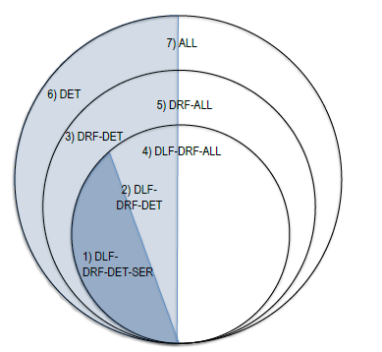
Habanero Java
DLF = DeadLock-Free
DRF = DataRace-Free
SER = Serializable
DET = Deterministic
ALL = Deterministic and nondeterministic
Notes:
Parallel programming model:
Emphasis on the usability and safety of parallel constructs
Lightweight dynamic task creation and termination
Collective and point-to-point synchronization
Mutual exclusion and isolation
Programs with async, finish, futures are DLF-DRF-DET-SER
Programs with async, finish, futures and Isolated are DLF-DRF-ALL (All means deterministic and non-deterministic)

Slide 5
Habanero Java
DLF = DeadLock-Free
DRF = DataRace-Free
SER = Serializable
DET = Deterministic
ALL = Deterministic and nondeterministic
Async
Finish
Future
Notes:
Parallel programming model:
Emphasis on the usability and safety of parallel constructs
Lightweight dynamic task creation and termination
Collective and point-to-point synchronization
Mutual exclusion and isolation
Programs with async, finish, futures are DLF-DRF-DET-SER
Programs with async, finish, futures and Isolated are DLF-DRF-ALL (All means deterministic and non-deterministic)

Slide 6
Habanero Java
Async
Finish
Future
Phasers
DLF = DeadLock-Free
DRF = DataRace-Free
SER = Serializable
DET = Deterministic
ALL = Deterministic and nondeterministic
Notes:
Parallel programming model:
Emphasis on the usability and safety of parallel constructs
Lightweight dynamic task creation and termination
Collective and point-to-point synchronization
Mutual exclusion and isolation
Programs with async, finish, futures are DLF-DRF-DET-SER
Programs with async, finish, futures and Isolated are DLF-DRF-ALL (All means deterministic and non-deterministic)

Slide 7
Habanero Java
Async
Finish
Futures
Phasers
Data Driven Future
DLF = DeadLock-Free
DRF = DataRace-Free
SER = Serializable
DET = Deterministic
ALL = Deterministic and nondeterministic
Notes:
Parallel programming model:
Emphasis on the usability and safety of parallel constructs
Lightweight dynamic task creation and termination
Collective and point-to-point synchronization
Mutual exclusion and isolation
Programs with async, finish, futures are DLF-DRF-DET-SER
Programs with async, finish, futures and Isolated are DLF-DRF-ALL (All means deterministic and non-deterministic)

Slide 8
How do you know if a program is free
of any data-race?

Slide 9
Related Work
Anderson, P., Vrvilo, N., Mercer, E., & Sarkar, V. (2015). Model Checking Task Parallel Programs using Gradual Permissions. Proceedings of 30th IEEE/ACM International Conference on Automated Software Engineering, New ideas category, Lincoln, Nebraska, November, 2015.
Raman, R., Zhao, J., Sarkar, V., Vechev, M., & Yahav, E. (2012). Efficient data race detection for async-finish parallelism. Formal Methods in System Design, 41(3), 321-347.
Raman, R., Zhao, J., Sarkar, V., Vechev, M., & Yahav, E. (2012, June). Scalable and precise dynamic datarace detection for structured parallelism. In ACM SIGPLAN Notices (Vol. 47, No. 6, pp. 531-542). ACM.
Flanagan, C., & Freund, S. N. (2009, June). FastTrack: efficient and precise dynamic race detection. In ACM Sigplan Notices (Vol. 44, No. 6, pp. 121-133). ACM.
Choi, J. D., Lee, K., Loginov, A., O'Callahan, R., Sarkar, V., & Sridharan, M. (2002, June). Efficient and precise datarace detection for multithreaded object-oriented programs. In ACM SIGPLAN Notices (Vol. 37, No. 5, pp. 258-269). ACM.
S. Savage, M. Burrows, G. Nelson, P. Sobalvarro, and T. Anderson. Eraser: A dynamic data race detector for multithreaded programs. ACM Transactions on Computer Systems (TOCS), 15(4):391–411, 1997.
Notes:
Gradual Permission regions
Dynamic analysis algorithm, ESP-bags
checks for the presence of data races (and proves data race freedom) in async-finish style parallel computations
Uses Dynamic Program Structure Tree (DPST) data structure
sound and precise for a given input
Fast Track :

Slide 10
Our Solution
HJ
Runtime
CG Builder
HJ Program
Trace
CG
CG Analyzer
Output
Correct?

Slide 11
Computation Graphs
public class Example {
public static int x = 0;
public static void main(String[] args){
finish{
async{ int t = x;
x = t + 1; }
async{ int u = x;
x = u + 2; }
}
System.out.println("Value of x = " + x); }
}

Slide 12
Computation Graphs
public class Example {
public static int x = 0;
public static void main(String[] args){
finish{
async{ int t = x;
x = t + 1; }
async{ int u = x;
x = u + 2; }
}
System.out.println("Value of x = " + x); }
}
Start
T0
Finish Start
T1
T0
T2
Finish
End
T0
End

Slide 13
Computation graph creation
public class Example {
public static int x = 0;
public static void main(String[] args){
finish{
async{ int t = x;
x = t + 1; }
async{ int u = x;
x = u + 2; }
}
System.out.println("Value of x = " + x); }
}
Start
T0
End

Slide 14
Computation graph creation
public class Example {
public static int x = 0;
public static void main(String[] args){
finish{
async{ int t = x;
x = t + 1; }
async{ int u = x;
x = u + 2; }
}
System.out.println("Value of x = " + x); }
}
Start
T0
Finish
Start
Finish
End
End

Slide 15
Computation graph creation
public class Example {
public static int x = 0;
public static void main(String[] args){
finish{
async{ int t = x;
x = t + 1; }
async{ int u = x;
x = u + 2; }
}
System.out.println("Value of x = " + x); }
}
Start
T0
Finish
Start
T1
T0
Finish
End
End

Slide 16
Computation graph creation
public class Example {
public static int x = 0;
public static void main(String[] args){
finish{
async{ int t = x;
x = t + 1; }
async{ int u = x;
x = u + 2; }
}
System.out.println("Value of x = " + x); }
}
Start
T0
Finish
Start
T1: R(x)
T0
Finish
End
End

Slide 17
Computation graph creation
public class Example {
public static int x = 0;
public static void main(String[] args){
finish{
async{ int t = x;
x = t + 1; }
async{ int u = x;
x = u + 2; }
}
System.out.println("Value of x = " + x); }
}
Start
T0
Finish
Start
T1: W(x)
T0
Finish
End
End

Slide 18
Computation graph creation
public class Example {
public static int x = 0;
public static void main(String[] args){
finish{
async{ int t = x;
x = t + 1; }
async{ int u = x;
x = u + 2; }
}
System.out.println("Value of x = " + x); }
}
Start
T0
Finish
Start
T1
T0
T2
Finish
End
End

Slide 19
Computation graph creation
public class Example {
public static int x = 0;
public static void main(String[] args){
finish{
async{ int t = x;
x = t + 1; }
async{ int u = x;
x = u + 2; }
}
System.out.println("Value of x = " + x); }
}
Start
T0
Finish
Start
T1
T0
T2 : R(x)
Finish
End
End

Slide 20
Computation graph creation
public class Example {
public static int x = 0;
public static void main(String[] args){
finish{
async{ int t = x;
x = t + 1; }
async{ int u = x;
x = u + 2; }
}
System.out.println("Value of x = " + x); }
}
Start
T0
Finish
Start
T1
T0
T2: W(x)
Finish
End
End

Slide 21
Computation graph creation
public class Example {
public static int x = 0;
public static void main(String[] args){
finish{
async{ int t = x;
x = t + 1; }
async{ int u = x;
x = u + 2; }
}
System.out.println("Value of x = " + x); }
}
Start
T0
Finish
Start
T1
T0
T2
Finish
End
T0 : R(x)
End

Slide 22
Start
T0
Finish
Start
T1: R(x), W(x)
T0
T2: R(x), W(x)
Finish
End
T0 : R(x)
End

Slide 23
Data Race Detection
Given a list activity_nodes between a pair of Finish_start and Finish_end nodes
∀nodes n ϵ activity_nodes do
∀nodes n’ ϵ activity_nodes and n≠n’
and n↛n’
if H(n) ∩ W(n’) ≠ ∅ then
report Data Race
end for
end for
Finish
Start
Activity 1
Activity 2
Activity 3
Finish
End

Slide 24
On-the-Fly Data Race Detection

Slide 25
On the Fly DRD
public class Example {
public static void main(String[] args){
finish{
async{ Stmt 1}
finish{
async{ Stmt 2 }
async{ Stmt 3 }
}
}
}
}
FIN-1
FIN-2
T1
T2
T3
FIN-2
END
FIN-1
END
Notes:
Suppose we have two nested finish blocks

Slide 26
On the Fly DRD
public class Example {
public static void main(String[] args){
finish{
async{ Stmt 1}
finish{
async{ Stmt 2 }
async{ Stmt 3 }
}
}
}
}
FIN-1
FIN-2
T1
T2
T3
FIN-2
END
FIN-1
END

Slide 27
On the Fly DRD
public class Example {
public static void main(String[] args){
finish{
async{ Stmt 1}
finish{
async{ Stmt 2 }
async{ Stmt 3 }
}
}
}
}
FIN-1
FIN-2
T1
T2
T3
FIN-2
END
FIN-1
END

Slide 28
On the Fly DRD
public class Example {
public static void main(String[] args){
finish{
async{ Stmt 1}
finish{
async{ Stmt 2 }
async{ Stmt 3 }
}
}
}
}
FIN-1
FIN-2
T1
T2
T3
FIN-2
END
FIN-1
END

Slide 29
On the Fly DRD
public class Example {
public static void main(String[] args){
finish{
async{ Stmt 1}
finish{
async{ Stmt 2 }
async{ Stmt 3 }
}
}
}
}
FIN-1
T1
FIN-2
FIN-1
END

Slide 30
On the Fly DRD
public class Example {
public static void main(String[] args){
finish{
async{ Stmt 1}
finish{
async{ Stmt 2 }
async{ Stmt 3 }
}
}
}
}
FIN-1
T1
FIN-2
FIN-1
END

Slide 31
Mutual Exclusion

Slide 32
Computation graph creation
int x = 0;
finish{
async{
isolated {
x = 2;
}
}
async{
isolated {
if(x == 0)
async {}
}
}
}
Start
T0
Finish
Start
Finish
End
End

Slide 33
Computation graph creation
int x = 0;
finish{
async{
isolated {
x = 2;
}
}
async{
isolated {
if(x == 0)
async {}
}
}
}
Start
T0
Finish
Start
T1
T0
Finish
End
End

Slide 34
Computation graph creation
int x = 0;
finish{
async{
isolated {
x = 2;
}
}
async{
isolated {
if(x == 0)
async {}
}
}
}
Start
T0
Finish
Start
T1
T0
T2
Finish
End
End

Slide 35
Computation graph creation
int x = 0;
finish{
async{
isolated {
x = 2;
}
}
async{
isolated {
if(x == 0)
async {}
}
}
}
Start
T0
Finish
Start
T1
T0
T2
ISO1
T1
Finish
End
End

Slide 36
Computation graph creation
int x = 0;
finish{
async{
isolated {
x = 2;
}
}
async{
isolated {
if(x == 0)
async {}
}
}
}
Start
T0
Finish
Start
T1
T0
T2
ISO1: W(x)
T1
Finish
End
End

Slide 37
Computation graph creation
int x = 0;
finish{
async{
isolated {
x = 2;
}
}
async{
isolated {
if(x == 0)
async {}
}
}
}
Start
T0
Finish
Start
T1
T2
T0
ISO1: W(x)
ISO2: W(x)
T1
T2
Finish
End
End

Slide 38
Computation graph creation
int x = 0;
finish{
async{
isolated {
x = 2;
}
}
async{
isolated {
if(x == 0)
async {}
}
}
}
Start
T0
Finish
Start
T1
T0
T2
ISO1: W(x)
ISO2: W(x)
T1
T2
Finish
End
End
Notes:
If there is a race between two isolated blocks, we report it as a progammer intended race

Slide 39
Computation graph creation
int x = 0;
finish{
async{
isolated {
x = 2;
}
}
async{
isolated {
if(x == 0)
async {}
}
}
}
Start
T0
Finish
Start
T1
T0
T2
ISO1: W(x)
ISO2: W(x)
T1
T2
Finish
End
End
Notes:
If there is a race between two isolated blocks, we report it as a progammer intended race

Slide 40
Computation graph creation
int x = 0;
finish{
async{
isolated {
x = 2;
}
}
async{
isolated {
if(x == 0)
async {}
}
}
}
Start
T0
Finish
Start
T1
T0
T2
Finish
End
End
Notes:
If there is a race between two isolated blocks, we report it as a progammer intended race

Slide 41
Computation graph creation
int x = 0;
finish{
async{
isolated {
x = 2;
}
}
async{
isolated {
if(x == 0)
async {}
}
}
}
Start
T0
Finish
Start
T2
T1
T0
ISO2
T2
T3
Finish
End
End
Notes:
If there is a race between two isolated blocks, we report it as a progammer intended race

Slide 42
Computation graph creation
int x = 0;
finish{
async{
isolated {
x = 2;
}
}
async{
isolated {
if(x == 0)
async {}
}
}
}
Start
T0
Finish
Start
T1
T2
T0
ISO1
ISO2
T2
T1
T3
Finish
End
End
Notes:
If there is a race between two isolated blocks, we report it as a progammer intended race

Slide 43
Implementation
CG Based Race Detector
Sharedness Policy
VMListener
Scheduler
Listener

Slide 44
JPF Scheduler
Sharedness Policy
Shared Class
Shared Object
Shared Array
Notes:
Currently JPF’s default behavior is to insert scheduling points for Thread Synchronization and Shared State
In our scheduler, we have removed choice generators for all shared access to have just one schedule

Slide 45
Our Scheduler
Sharedness Policy
Shared Class
Shared Object
Shared Array
Notes:
Currently JPF’s default behavior is to insert scheduling points for Thread Synchronization and Shared State
In our scheduler, we have removed choice generators for all shared access to have just one schedule

Slide 46
VM Listener configuration
Method | Application
objectCreated | create the different nodes in the graph
objectReleased | assign correct finish scope to tasks
executeInstruction | store heap accesses in the activity nodes

Slide 47
Results
Test Case Name | SLOC | Tasks | CG Race Detector |  |  | Precise Race Detector
 |  |  | States | Time | Error Info | States | Time | Error Info
Search Count | 50 | 4 | 7 | 0:00:00 | No Race | 145139 | 0:00:45 | No Race
Existence | 45 | 4 | 7 | 0:00:00 | Detected Race | 50197 | 0:00:15 | Detected Race
Index | 38 | 4 | 7 | 0:00:00 | Detected Race | 68806 | 0:00:29 | Detected Race
Existence - eureka | 45 | 2 | 5 | 0:00:00 | Detected Race | 296 | 0:00:00 | Detected Race
Search Index - eureka | 48 | 2 | 5 | 0:00:00 | Detected Race | 326 | 0:00:00 | Detected Race
Notes:
Different tests based on a simple Linear search algorithm:

Slide 48
Conclusion and Future Work
Use fewer states to detect data races
On the fly Data race detection implementation
Proof of correctness
Symbolic execution to explore input space
https://jpf.byu.edu/jpf-hj/
Notes:
CG Race detector uses significantly fewer states to detect data races
Can be extended to explore control flow paths for other inputs by using Symbolic Execution

Slide 49

Questions

