Slide 1
Walmart Time-series Weekly Sales forecast
Prepared by: Kevin Ying

Slide 2
Problem / Motivation
The trend of e-commerce blows sky high in the recent years, a lot of mortar retail cooperation turns themselves into the competition of e-commerce (e.g. Walmart , Target etc). The concept of this project is to utilize the dataset provided by Walmart to forecast theirs weekly sales in 45 stores.
Questions to be addressed:
- Discover the sales distribution in Store and individual department
- Discover the correlation of between features and Sales.
- Discover the features contributes differently to the predictive models
- Determine the best model(s) for forecasting the weekly sales (continuous values)?
- How’s the models perform differently in various States?

Slide 3
Methodology / WorkFlow (Python 3.6x)
1. Preliminary Setup: Load Dataset, Libraries
2. Data Exploration
(i.e. Missing Values, Outliers, Categorical Features conversion)
3. Data Analysis
4. Correlation between variables
5. Hypothesis Test between variables
6. Feature engineering
7. Machine learning modelling
8. Prediction measurement
9. Summary

Slide 4
Data Exploration
Missing Values
Drop FIVE features (i.e. MarkDown1, MarkDown2, MarkDown3, MarkDown4, MarkDown5) due to high volume missing ( i.e. about 63%- 80%)
Selected Features for Machine Learning Forecast
isHoliday(bnary)
Temperature(continuous)
Fuel Price(continuous)
Customer Price Index CPI(continuous)
Store Type(Binary)
Unemployment Rate(continuous)
Deal with Categorical Variables
Convert to variables (i.e. IsHoliday and Store_Type ) to Numerical values
Outliers
Independent variables: Outliers are not easily perceived
Dependent variable: Outliers which were found might due to seasonal impact
Since Time-Series Analysis may be affected by seasonal impact, so that none of outliers are dropped or modified before the forecast

Slide 5
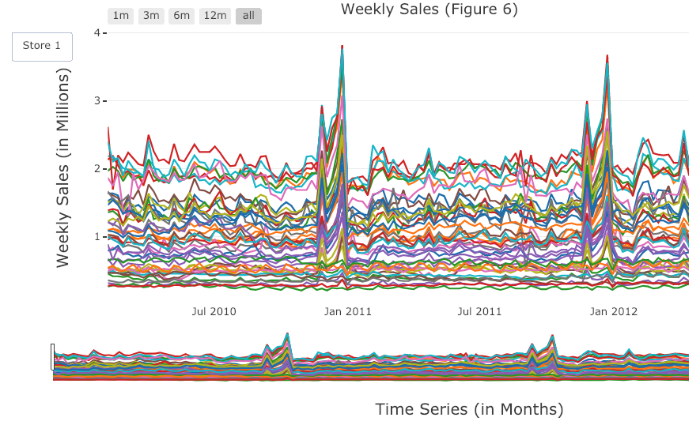
Data Analysis
Overview

Slide 6
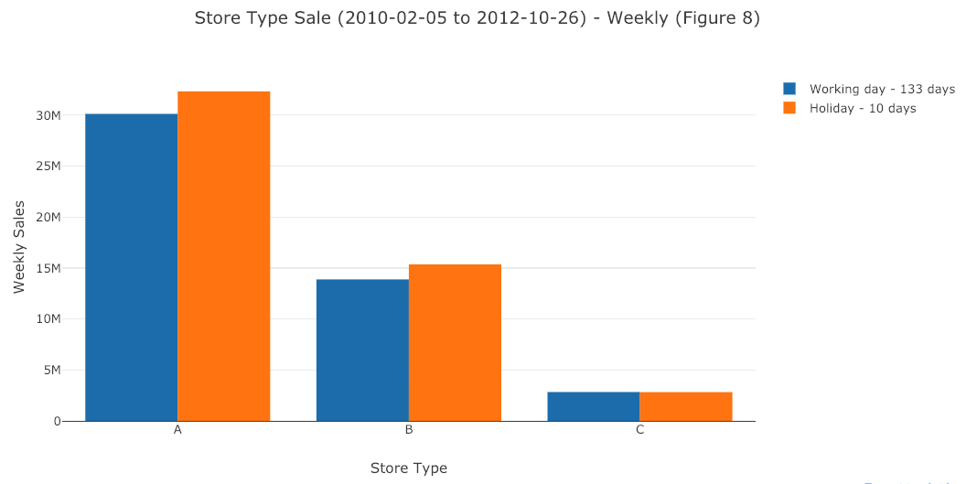
Data Analysis
Weekly Sales in Store_Type

Slide 7
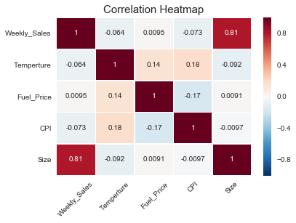
Correlation (Prior Dummy Variables)
Independent vs Dependent
Weekly Sales vs Store_size (+ve)
Dependent vs Dependent
Temperature vs Fuel_Price (+ve)
Temperature vs CPI (+ve)

Slide 8
Hypothesis Test
Dependent (i.e. Weekly_Sales) vs Independent Variables:
Null Hypothesis H0: Features (i.e. Temperature, Fuel_Price, CPI, Store Size) completely NOT correlates with the Store Weekly Sales.
Alt. Hypothesis Ha: Features correlates with the Store Weekly Sales.
Result:
Weekly_Sales is correlated with Temperature, CPI, Store_Size
Weekly_Sales is NOT correlated with Fuel_Price
Further analysis in Machine Learning part

Slide 9
Machine learning
Partition dataset into 64% and 36% proportion (Cutoff date: 2011-11-18)
Utilizes the analyzed features to build predictive model forecasting the Target variable Stores’ Weekly Sales in given Time-step.
Grid search out the best model based on the various measurement metrics: Mean_Square_Error (MSE), Mean_Absolute_Error (MAE).
Proposed Methodologies for modeling:
Baseline model: Linear Regression
Linear models: RidgeCV, LassoCV,
Regressors: XGB Regressor, SGD Regressor, Bayesian Regressor, Random Forest Regressor, Gradient Boosting Regressor, Adaboost Regressor

Slide 10
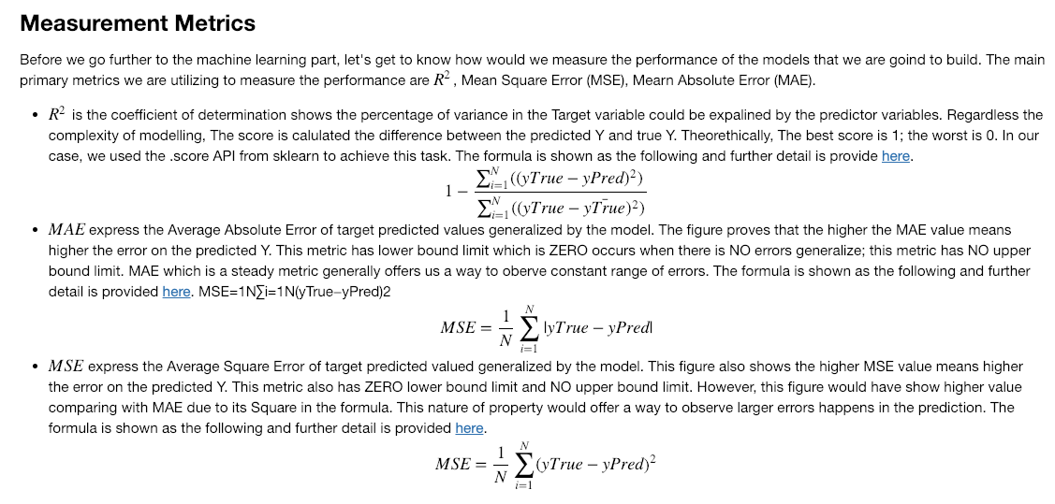
Error Measurement

Slide 11
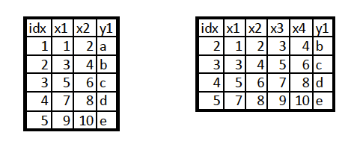
Window Slides / time-step
Example: Window Slide = 2
Original Dataset
Transformed Dataset

Slide 12
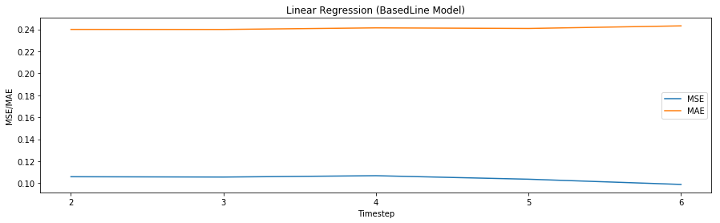
Baseline model – Linear Regression
Original Dataset (Time-step 2-6)
MSE vs MAE
No improvement with increment of timestep

Slide 13
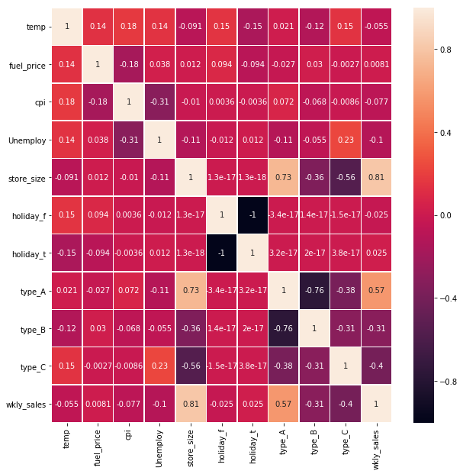
Feature Engineering (Correlation)

Slide 14
Feature Engineering (OLS Stat Model)
Time-Step | Set 1 Original 10 Features | Set 2 5 Features | Set 3 4 Features | Set 4 * 3 Features
Time Step | 2 | 2 | 2 | 2
R-Square | 0.681 | 0.662 | 0.665 | 0.913
F-Statistic | 0.00 | 0.00 | 0.00 | 0.00
P-value (Independent Vars) | Not ALL Vars. are significant | One Var is not significant | All Vars is significant | All Vars are significant
MSE | 0.106 | 0.107 | 0.109 | 0.109
MAE | 0.24 | 0.237 | 0.238 | 0.238
Improvement is not shown with extracted Highly correlated Features!!! Check other Regressor Models!!!
* Set 4 Features: "store_size","type_A", "type_C"

Slide 15
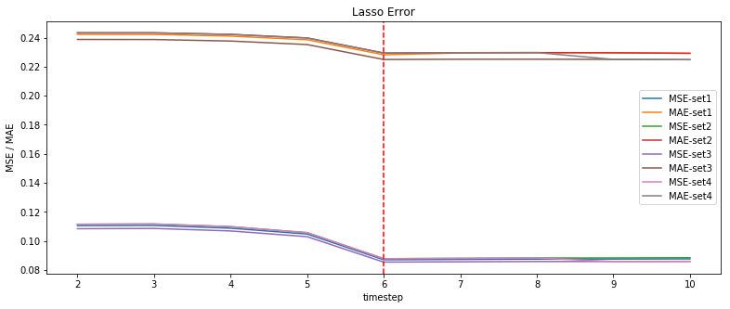
LASSO Regressor
* Set 4 Features: "store_size","type_A", "type_C"

Slide 16
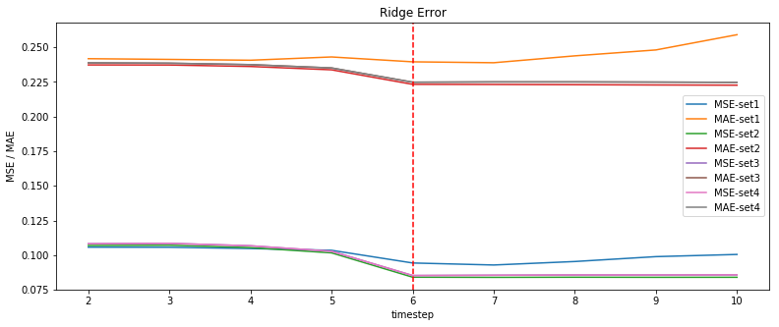
Ridge CV
* Set 4 Features: "store_size","type_A", "type_C"

Slide 17
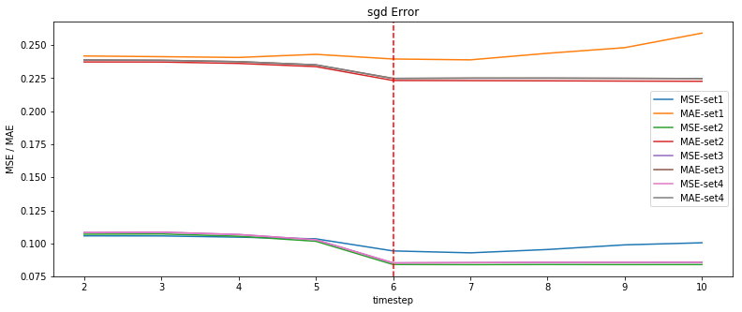
SGD Regressor
* Set 4 Features: "store_size","type_A", "type_C"

Slide 18
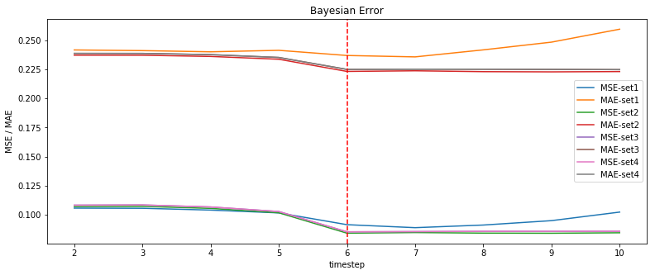
Bayesian Regressor
* Set 4 Features: "store_size","type_A", "type_C"

Slide 19
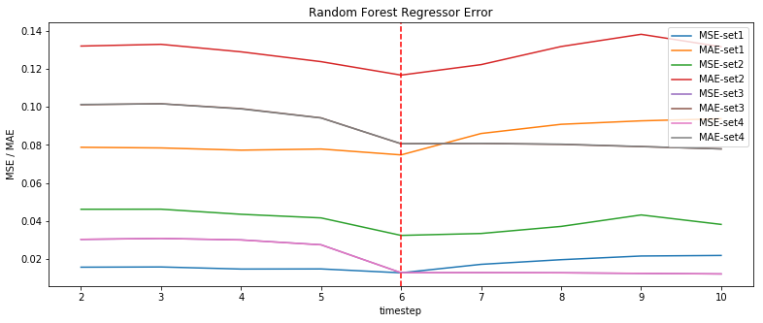
Random Forest Regressor
* Set 4 Features: "store_size","type_A", "type_C"

Slide 20
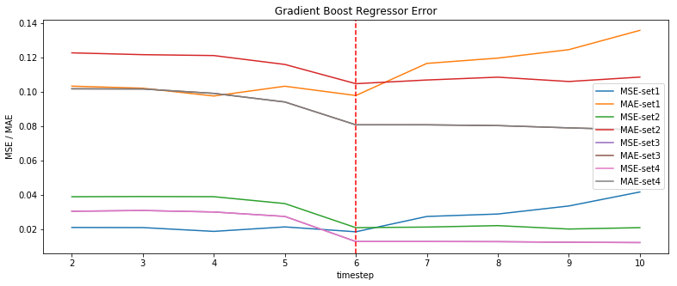
Gradient Boost Regressor
* Set 4 Features: "store_size","type_A", "type_C"

Slide 21
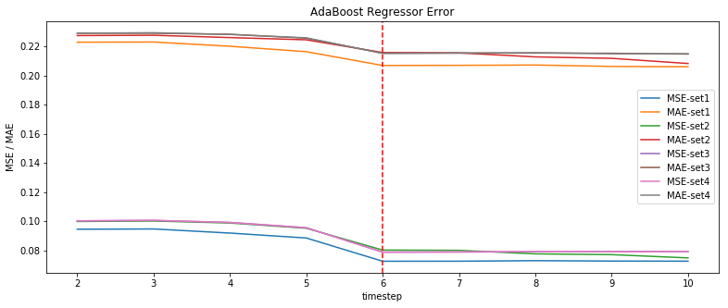
Ada Boost Regressor
* Set 4 Features: "store_size","type_A", "type_C"

Slide 22
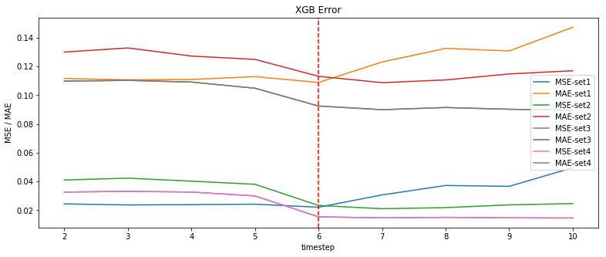
XGB Regressor
* Set 4 Features: "store_size","type_A", "type_C"

Slide 23
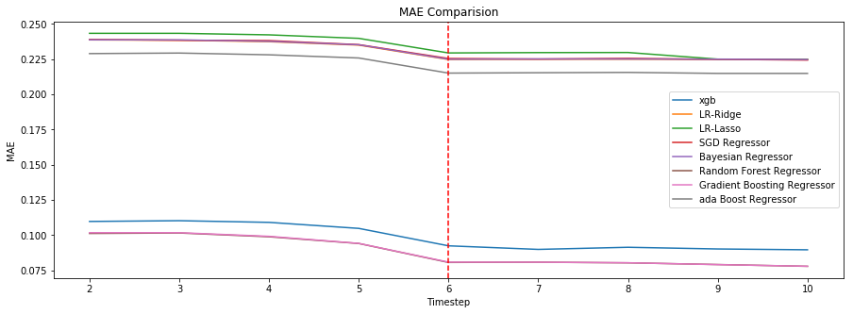
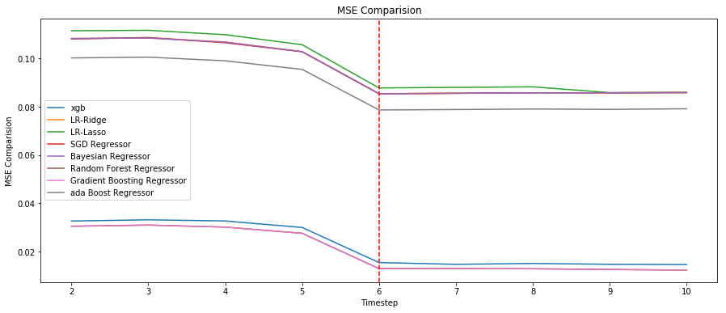
Performance Comparison
Best Time-Step = 6
Best Set of Features: Set 4 ("store_size","type_A", "type_C")
Optimal Model:
-Gradient Boosting Regressor
-XGB Regressor
Metrics improved from Baseline:
MSE: 0.108 → 0.0128
MAE: 0.238 → 0.08

Slide 24
Future Work
Goal
Success to optimize the performance from Baseline model by minimizing the error on target continuous variable (i.e. Weekly Sales)
The best models with time-step = 6:
Gradient Boost Regressor
XGB Regressor
Fine tune the parameters to further optimize the performance
Attempt to utilize Deep Learning method (e.g. LSTM)
Research more representable Feature out of data

