Slide 1
A flexible and easy way to connect and extend enterprise applications in a cloud-native world

Slide 2
This is the divider page

Slide 3
This is the divider page

Slide 4

Kyma mission: Make simple things simple again!
Kyma aims to equip enterprise software users with agile tools to customize, extend, and integrate any API-enabled application and tailor it to their needs.
Kyma makes the development and operation of microservices-based solutions easy by providing consistent service management capabilities and the integration of the existing enterprise software in a service-oriented manner.

Slide 5


What is Kyma?
Kyma is a cloud-native application development framework.
It provides the last mile capabilities that a developer needs to build a cloud-native application using several open-source projects such as Kubernetes, Istio, NATS, Kubeless, and Prometheus, to name a few.
It is designed natively on Kubernetes and, therefore, it is portable to all major cloud providers.

Slide 6
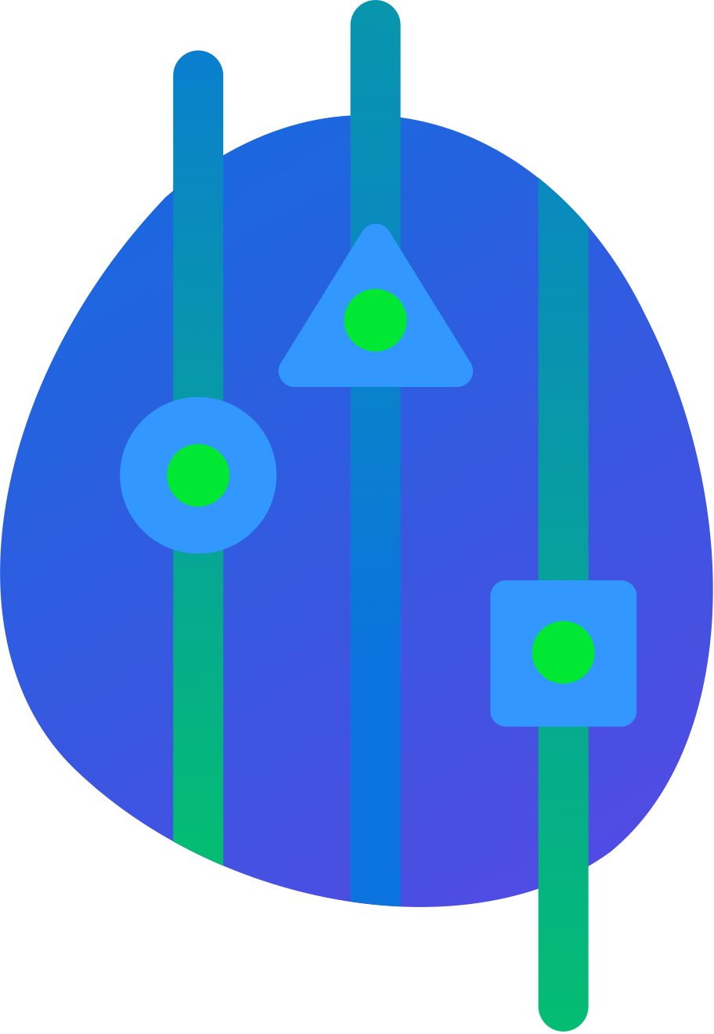
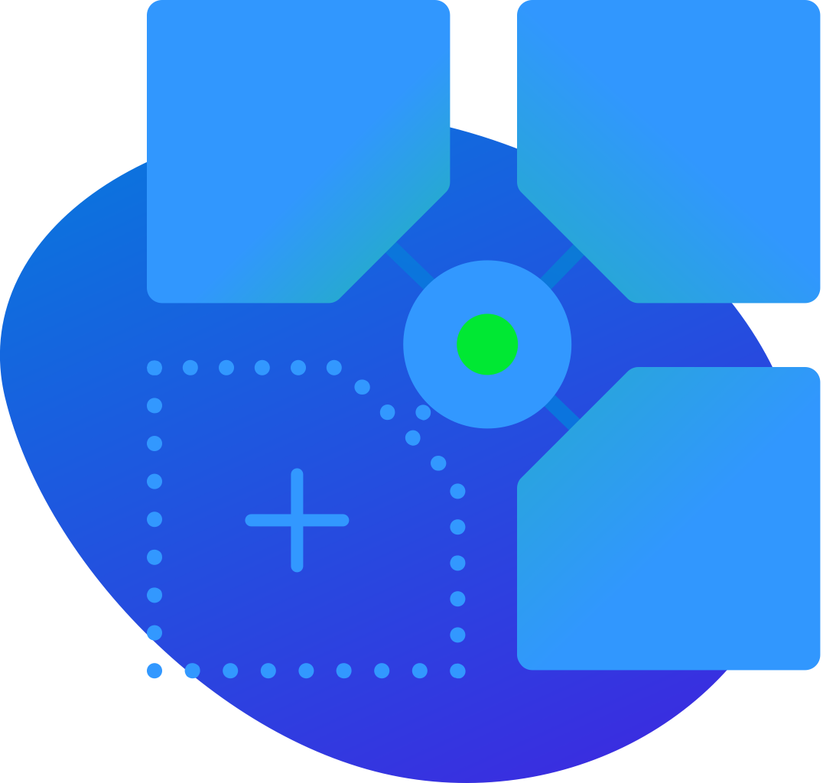
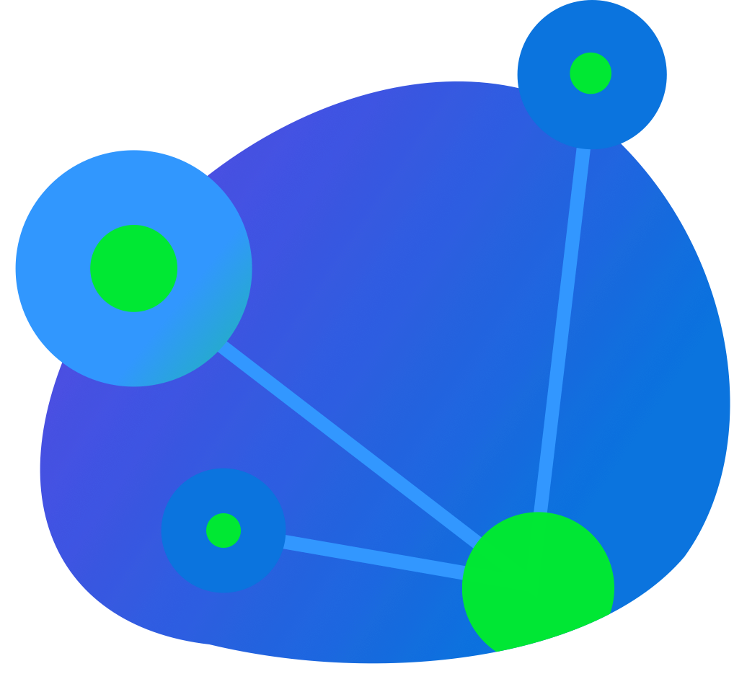
Open and extendable
Seamless connectivity
Coherent and technology-independent
Consume services from different sources.
Unify the consumption of internal and external services through the Open Service Broker standard-compliant Service Catalog.
Leverage HTTP/2 for optimized latency and payload.
Ensure flexible add-on triggers, including Events and HTTP requests.
A programming language-agnostic add-on model that allows you to customize a software solution using the technology stack you are most experienced with.

Slide 7
Thank you
Contact information:
Name Title Address Phone number

