Slide 1
Kyma Companion
History & Current state
Hierarchical Multi-Agent System
April 2026

Slide 2
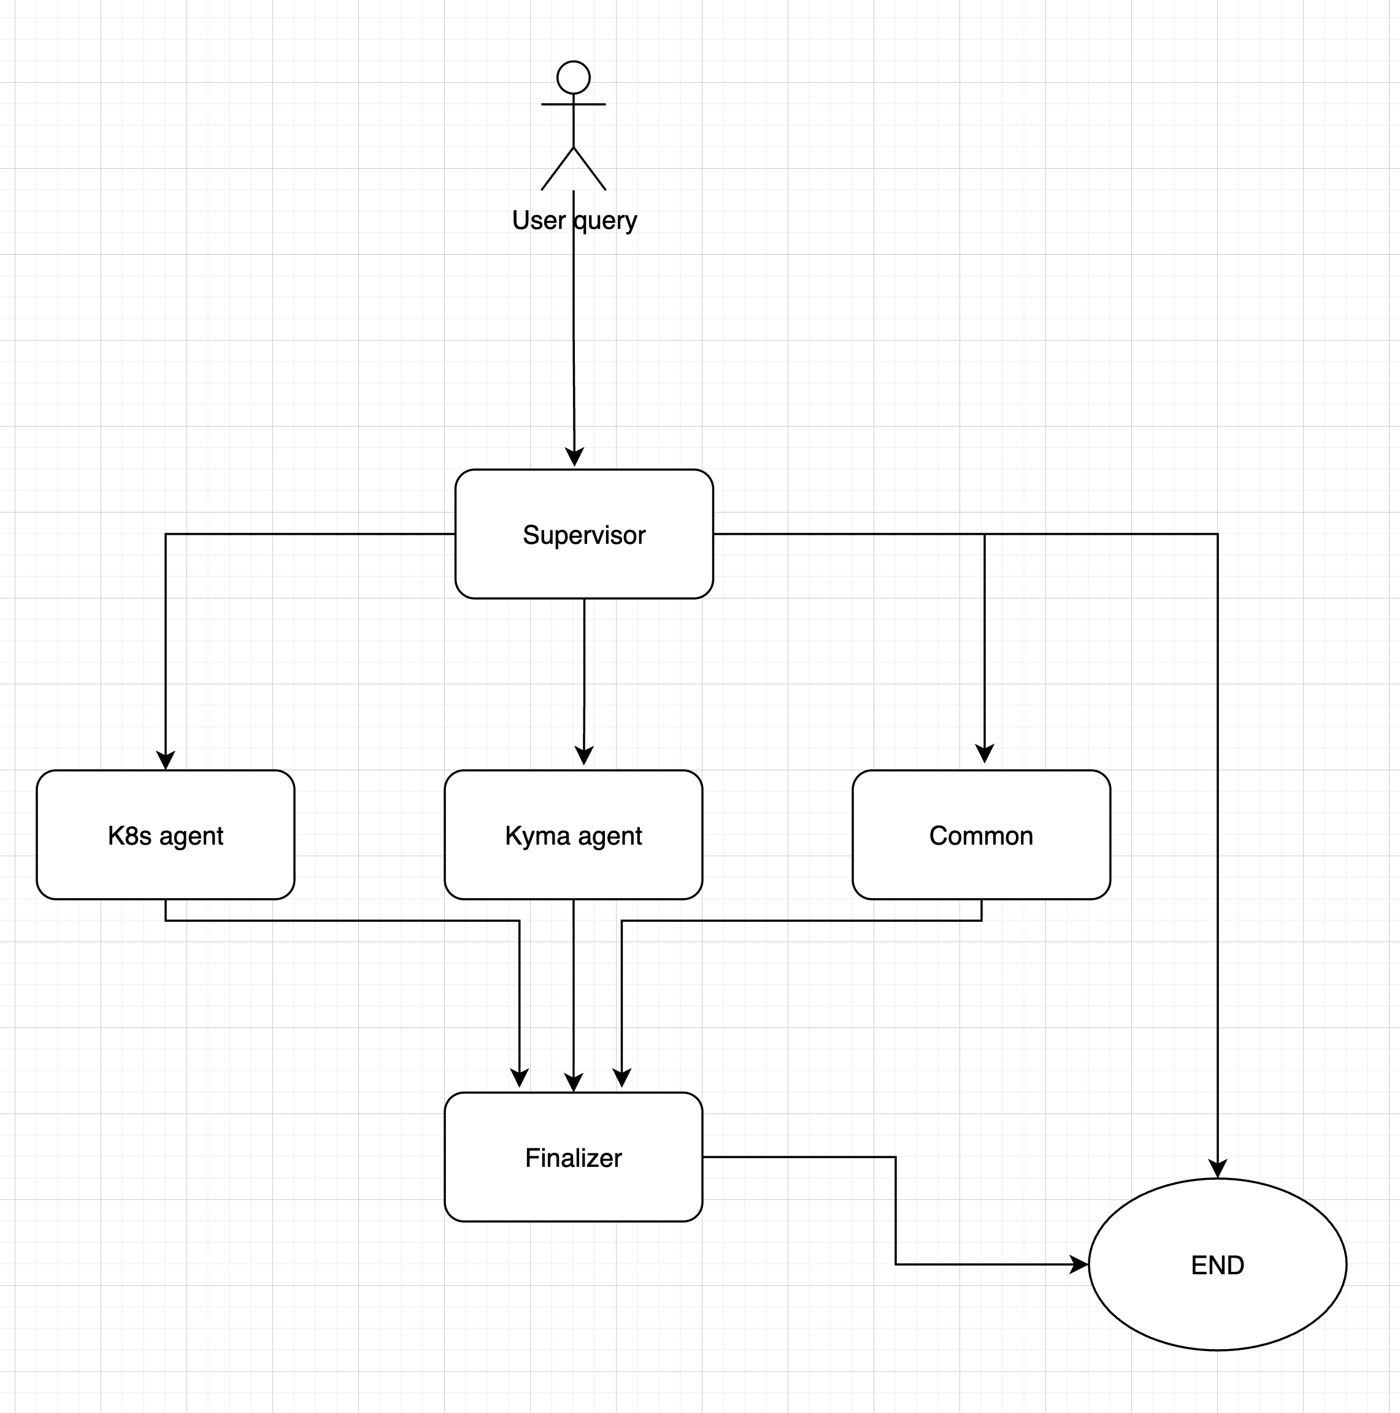
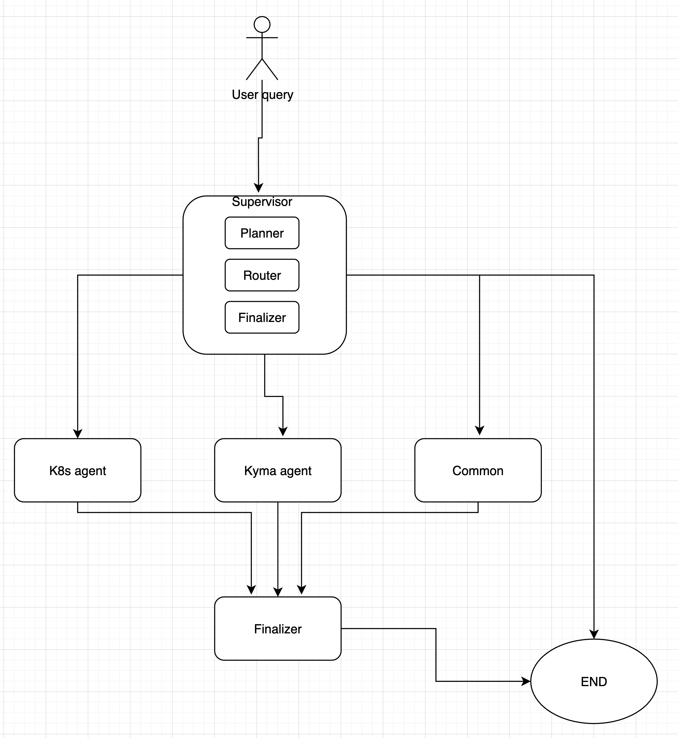
Architecture Overview
Hierarchical multi-agent system built with LangGraph
Iteration 1
Iteration 2
1
Summarize
2
Gatekeeper
3
Supervisor
4
Agents
5
Finalizer

Slide 3
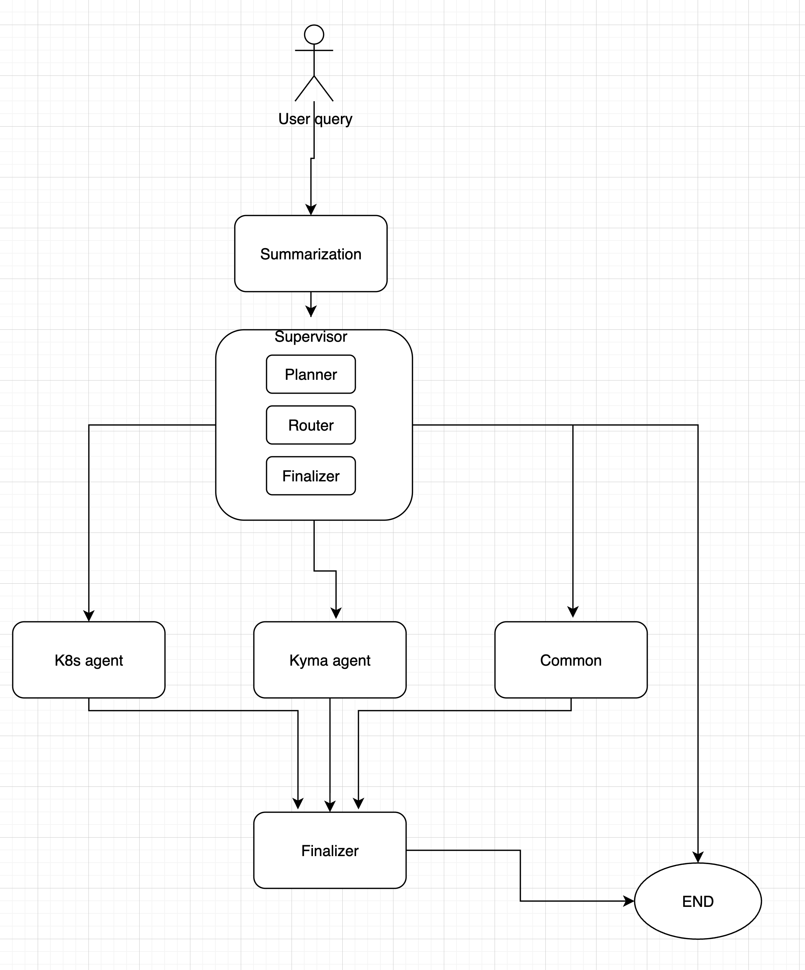
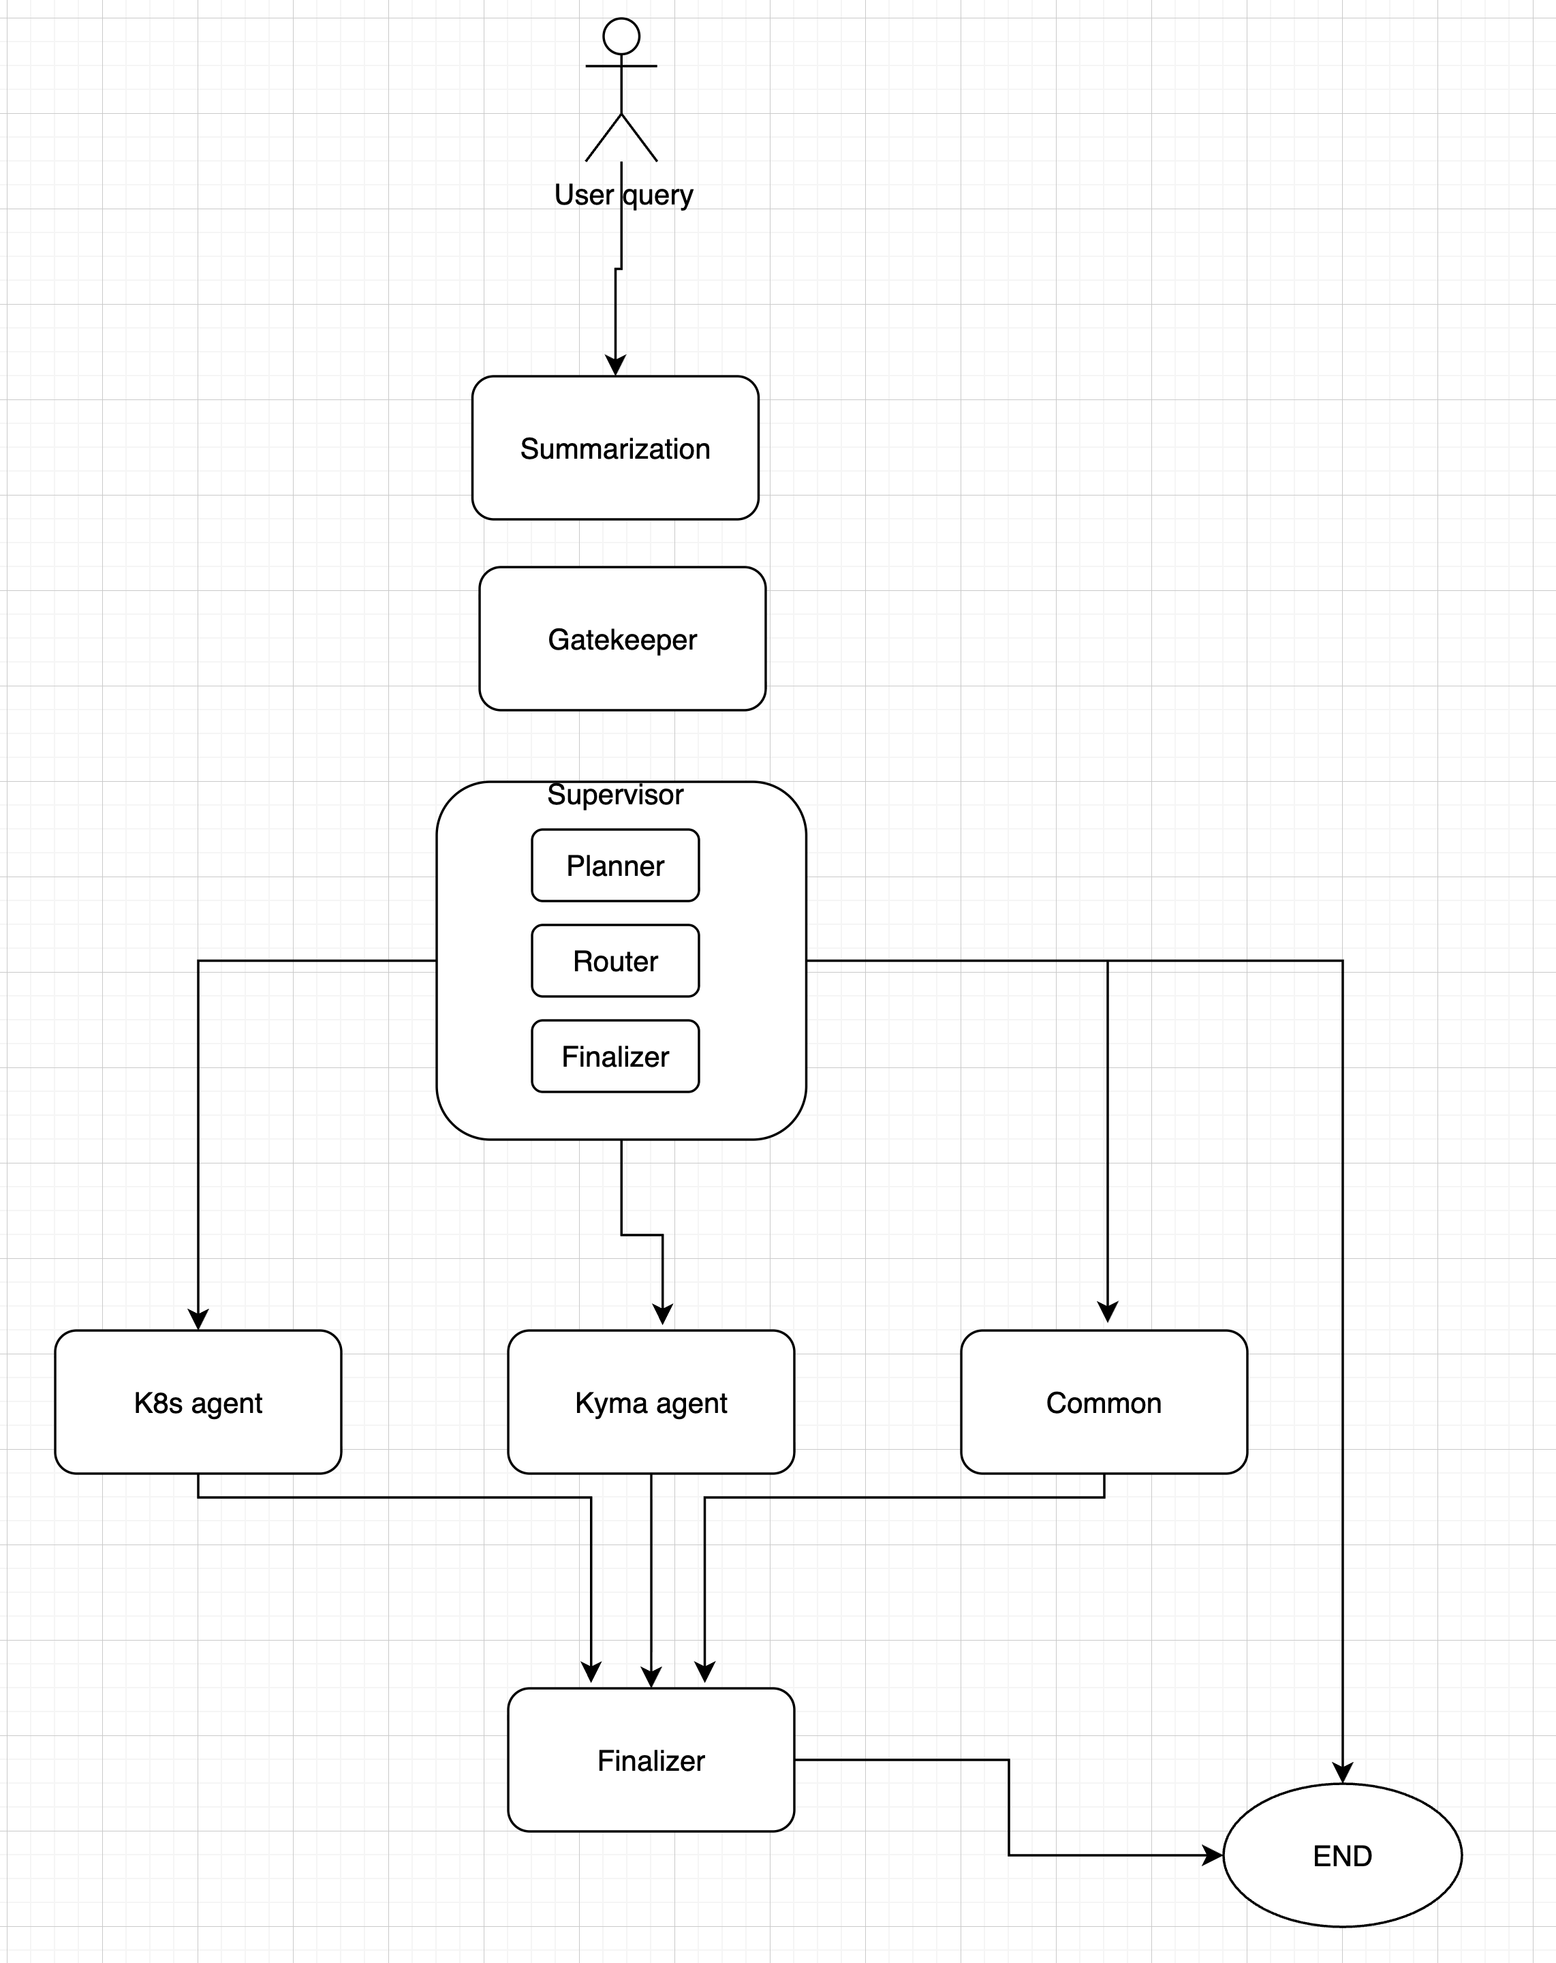
Architecture Overview
Hierarchical multi-agent system built with LangGraph
Iteration 3
Iteration 4

Slide 4
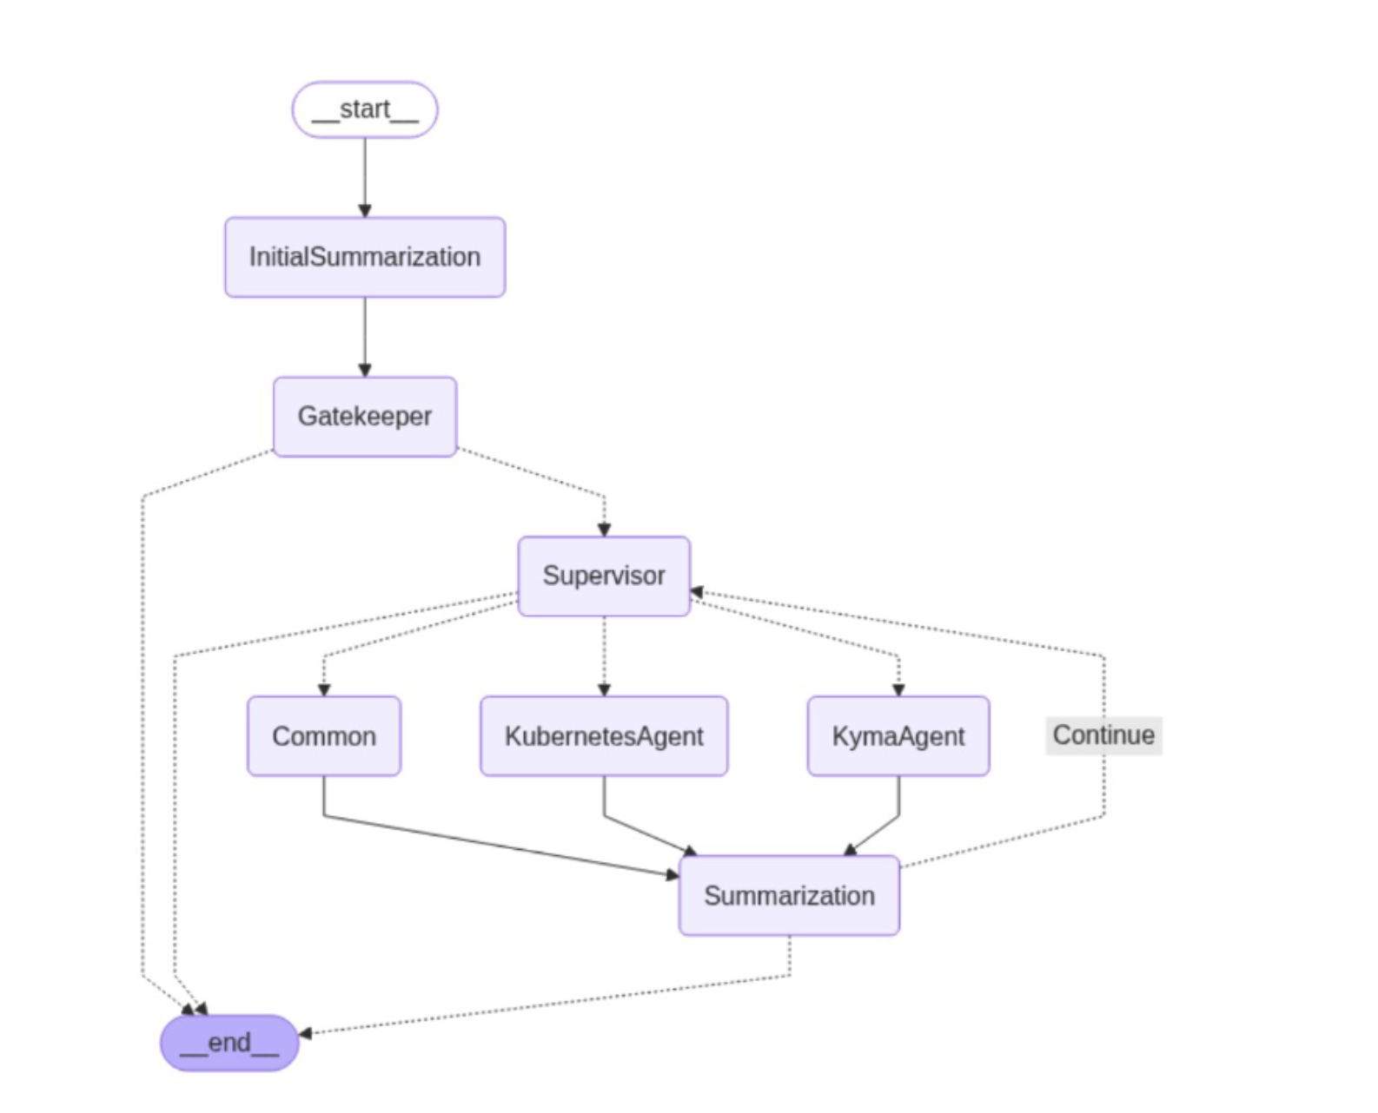
Architecture Overview
Hierarchical multi-agent system built with LangGraph
Current Graph
Query Lifecycle
1
Summarize
Condense old message history.
Condenses messages > 3k tokens on every request. Model: gpt-4o-mini
2
Gatekeeper
Security check + query classification + Direct response from message history. Model: gpt-4.1
3
Supervisor
Plan & dispatch to specialist agents.
Orchestrates agents via Plan → Route → Finalize cycle
4
Agents
Kyma / Kubernetes / Common process tasks
5
Finalizer
Synthesize responses into final answer + filter inappropriate parts

Slide 5
Gatekeeper Node
Security gate and query classifier — Model: gpt-4.1
Responsibilities
Routing Rules
• Detects prompt injection via system fields
• Detects security threats (RCE, SQLi, attack payloads)
• Classifies queries: Kyma, K8s, Programming, Greeting, Irrelevant
• Answers greetings directly (no forwarding)
• Answers Programming / About You queries via LLM
• Resolves past-tense Kyma/K8s queries from history
• Forwards present-tense Kyma/K8s queries to Supervisor
• Rejects out-of-domain queries with fixed message
Prompt Injection detected
Block → outside-domain msg
Security threat detected
Block → outside-domain msg
Category: Irrelevant
Block → outside-domain msg
Category: Greeting
Fixed hello response
Kyma/K8s + past-tense
Answer from history
Kyma/K8s (present)
Forward → Supervisor
Programming / About You
Answer directly via LLM

Slide 6
Supervisor Subgraph
Plans, routes, and finalizes multi-agent responses
Planner
Router
Finalizer
• Breaks query into ordered SubTask list
• Assigns to: KymaAgent, KubernetesAgent, Common
• Cluster-wide → both agents
• Namespace-wide → both (namespace-scoped)
• Mixed-domain → split by domain
• Ambiguous → defaults to KymaAgent
• General/programming → Common
• Model: gpt-4o-mini
• Pure logic node — no LLM
• Scans subtasks for first PENDING item
• Sets 'next' = assigned agent name
• If no PENDING tasks → routes to Finalizer
• Determines which agent runs next
• Synthesizes all agent responses
• Never invents content beyond agent output
• Filters malicious content from responses
• Wraps new YAML in <YAML-NEW> tags
• Wraps update YAML in <YAML-UPDATE> tags
• All agents failed → standard failure msg
• Runs ResponseConverter post-processing
• Model: gpt-4.1

Slide 7
Agent Subgraph (KymaAgent & KubernetesAgent)
Shared architecture — each handles domain-specific subtasks
Execution Loop
Node Descriptions
subtask_selector
Find pending subtask
subtask_selector
Scans state.subtasks for PENDING task assigned to this agent. If none found, routes to finalizer.
agent (LLM + tools)
Run LLM with bound tools
agent
Summarization
Compress messages if needed
Invokes LLM with tools on my_task.description + filtered history. Summarizes oversized tool responses. Stops early if remaining_steps ≤ 3.
tools
Execute tool calls
Summarization
Agent-level token compression scoped to agent_messages / agent_messages_summary. Triggered when agent decides to call tools.
(loop → agent)
Repeat until done
tools
finalizer
Mark COMPLETED, clean up
LangGraph ToolNode executing tool calls from last AIMessage. handle_tool_errors=True — exceptions returned as ToolMessage for agent retry.
finalizer
Marks subtask COMPLETED (or keeps ERROR). Prepends subtask description for traceability. Promotes final result to parent messages list.

Slide 8
Agent Tools
Domain-specific tools available to each agent
KymaAgent Tools
KubernetesAgent Tools
fetch_kyma_resource_version
k8s_query_tool
Discovers API group/version for Kyma resource kinds. Warns on deprecated versions. Uses K8s discovery endpoint.
Raw GET against K8s API server via full URI. Sanitizes sensitive data (e.g. removes Secret.data field).
kyma_query_tool
fetch_pod_logs_tool
Executes raw GET against K8s API server via full URI. Returns Kyma resource JSON.
Fetches last 10 lines of current + previous logs for a pod container. Returns structured diagnostic context if current logs unavailable.
search_kyma_doc
RAG search over official Kyma docs. Returns top-5 relevant chunks (text-embedding-3-large). Filters by relevancy score ≥ 0.5.
Common Node
No tools — answers directly from LLM knowledge and conversation history. Used for: general programming questions, conceptual explanations, anything not requiring cluster access. Model: gpt-4o-mini
KymaAgent Tool Flow
• Resource unknown: fetch_version → query → search_doc
• Resource known: query → search_doc
• On 404: query(err) → fetch_version → query(retry) → search_doc
• Conceptual queries: search_doc only

Slide 9
Configuration & Guardrails
Limits that prevent runaway token usage, infinite loops, and context overload
Summarization & Step Limits
API, RAG & Token Quota
SUMMARIZATION_TOKEN_UPPER_LIMIT
3,000 tokens
Triggers summarization
K8S_API_PAGINATION_LIMIT
40 items
Items per page for K8s API listing
SUMMARIZATION_TOKEN_LOWER_LIMIT
2,000 tokens
Target after trimming
K8S_API_PAGINATION_MAX_PAGE
1 page
Only first page retrieved
TOOL_RESPONSE_TOKEN_COUNT_LIMIT
10,000 tokens
Summarize oversized tool responses
POD_LOGS_TAIL_LINES_LIMIT
10 lines
Log lines per container
TOTAL_CHUNKS_LIMIT
2 chunks
Max chunks; else query rejected as too broad
RAG_RELEVANCY_SCORE_THRESHOLD
0.5
Min cosine similarity for doc chunks
remaining_steps (BaseAgentState)
25 steps
LangGraph-managed recursion counter
DEFAULT_TOP_K
5 chunks
Max doc chunks per search_kyma_doc call
AGENT_STEPS_NUMBER
3 steps
Stop tool calls when ≤3 steps remain
TOKEN_LIMIT_PER_CLUSTER
5,000,000
Aggregate token cap per cluster (Redis-tracked)
GRAPH_STEP_TIMEOUT_SECONDS
180 s
Per-step wall-clock timeout for agents
TOKEN_USAGE_RESET_INTERVAL
86,400 s
Rolling 24h counter reset
RECENT_MESSAGES_LIMIT
10 messages
History window passed to Planner
MAX_TOKEN_LIMIT_INPUT_QUERY
8,000 tokens
Max tokens in single input query

Slide 10
Model Assignment
Each component uses a model appropriate to its complexity and cost requirements
Component → Model Mapping
Component
Model
Rationale
Gatekeeper
gpt-4.1
Security-critical; needs highest accuracy for injection/threat detection
KymaAgent
gpt-4.1
Complex Kyma domain reasoning + multi-step tool use
KubernetesAgent
gpt-4.1
Complex K8s domain reasoning + multi-step tool use
Finalizer
gpt-4.1
Full reasoning required to faithfully synthesize agent responses
Supervisor / Planner
gpt-4o-mini
Task decomposition; fast and cost-efficient
Common node
gpt-4o-mini
General questions; speed over capability
All Summarization nodes
gpt-4o-mini
Cost-efficient; runs frequently on every agent cycle
Strategy: gpt-4.1 for security-critical and response-quality paths; gpt-4o-mini for high-frequency, cost-sensitive nodes

Slide 11
Architecture Summary
Security First
Smart Routing
Resource Control
Cost Efficiency
• Gatekeeper on every query
• Prompt injection detection
• Security threat blocking
• gpt-4.1 on critical paths
• Query classification
• History-aware answering
• Multi-agent task decomposition
• Domain-specific delegation
• Token budgets at every level
• Step limits prevent loops
• Tool response summarization
• Per-cluster usage quotas
• gpt-4o-mini for high-frequency nodes
• RAG for doc retrieval
• Pagination limits on K8s API
• Rolling summarization
Kyma Companion • LangGraph Multi-Agent Architecture • April 2026

