Slide 1
Instructions
Follow the learner instructions in the grey text boxes for each slide.
Delete the text box and instructions when complete.
Instructions for learner:
Action 1
Action 2
Action 3

Slide 2
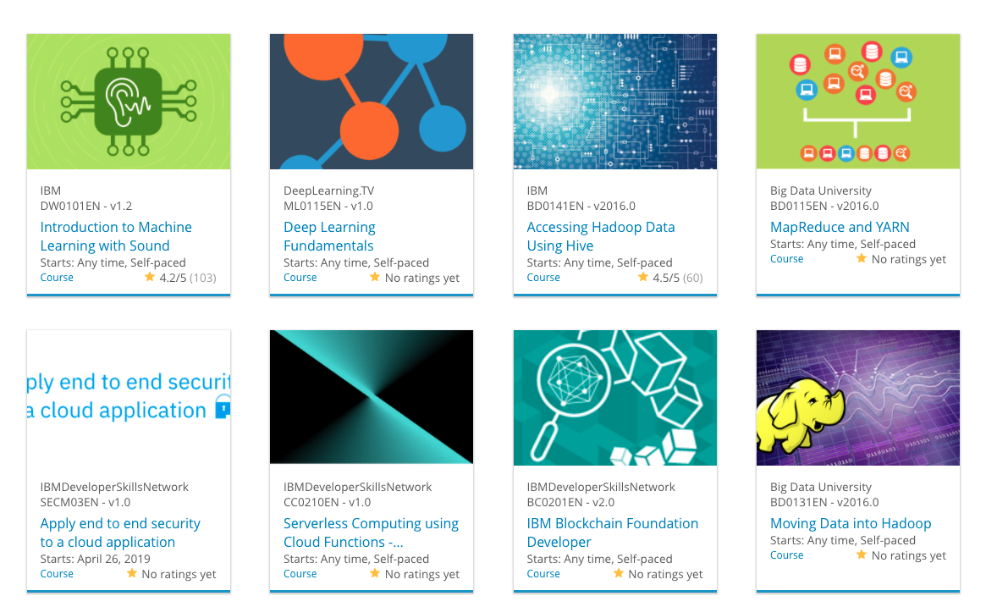

Build a Personalized Online Course Recommender System with Machine Learning
Kymberly Ayodeji
December 31, 2023

Slide 3

Outline
Introduction and Background
Exploratory Data Analysis
Content-based Recommender System using Unsupervised Learning
Collaborative-filtering based Recommender System using Supervised learning
Conclusion
Appendix

Slide 4
Introduction
As people new to machine learning have a strong desire to upskill to the necessary information to further their interest and possible career through Massive Open Online Courses (MOOC), they would benefit from a resource that recommends appropriate courses based on their previous learning history.
Our goal is to improve the learning experience by helping students quickly find new courses better aligned to their learning history via a course recommender application.

Slide 5
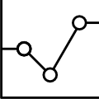
Exploratory Data Analysis

Slide 6
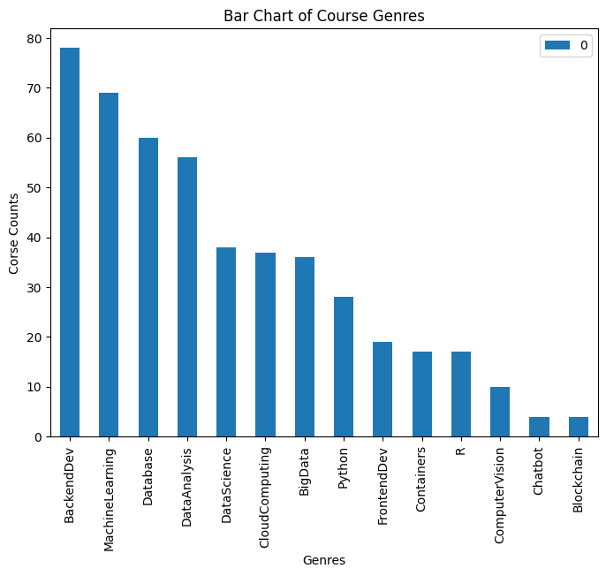
Course counts per genre
Notes:
A sorted bar chart of the total course offerings based on genre. The genres with the most courses (55-80) are related to Backend Development, Machine Learning. Database and Data Analysis. The genres with the least amount of courses (under 10) are Chatbot and Blockchain. Note: Some course fit into multiple genres.

Slide 7
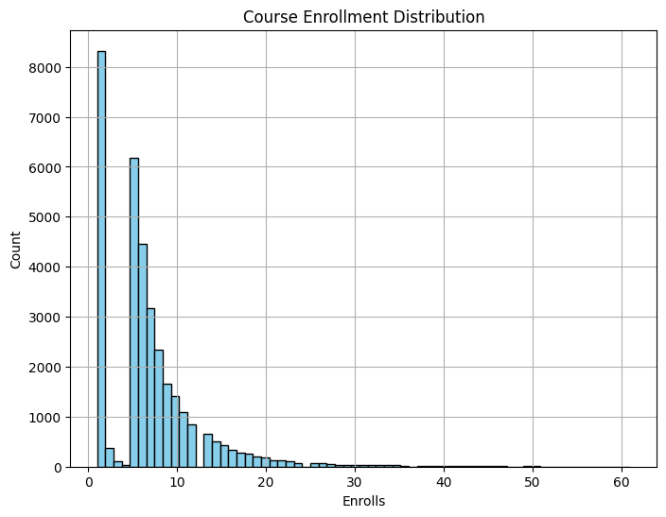
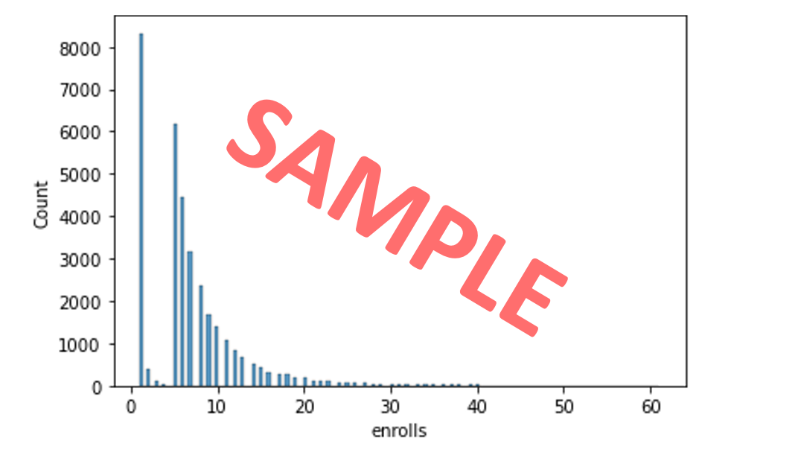
Course enrollment distribution
Notes:
From the histogram, where each bar at a tick number ,x, represents the number of users enrolled in a total of x courses. Shows that by far, over eight thousand users enrolled in only one course. In fact, the majority of users enrolled in under 10 courses. Interesting to note is that the second highest number of courses enrolled in is five and the number of courses after that have only a decreasing number of users.

Slide 8
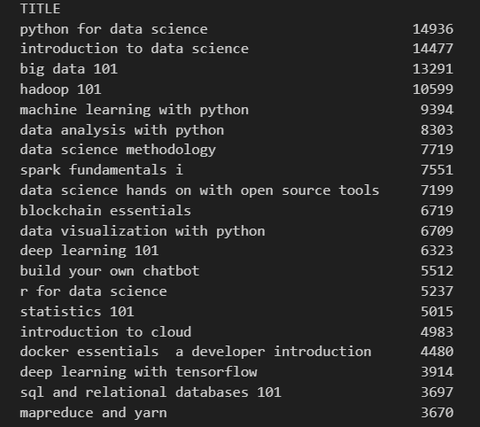
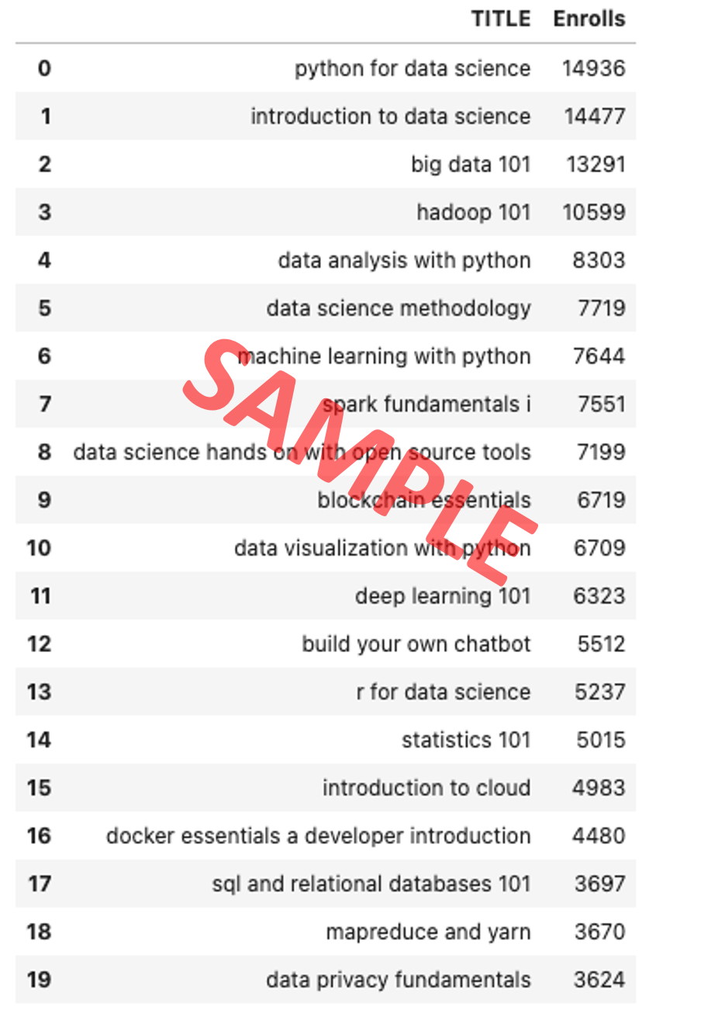
20 most popular courses
Notes:
The 20 most popular courses and their respective number of enrolled students is above. As you can see most popular course is Python for Data Science with almost 15,000 enrolled students. The next most popular course is Introduction to Data Science, which indicates that Data Science courses are in high demand. Interestingly enough, the top 20 most popular courses range from 3600 to 14,000 enrollments which indicates a heavily right skewed distribution.

Slide 9
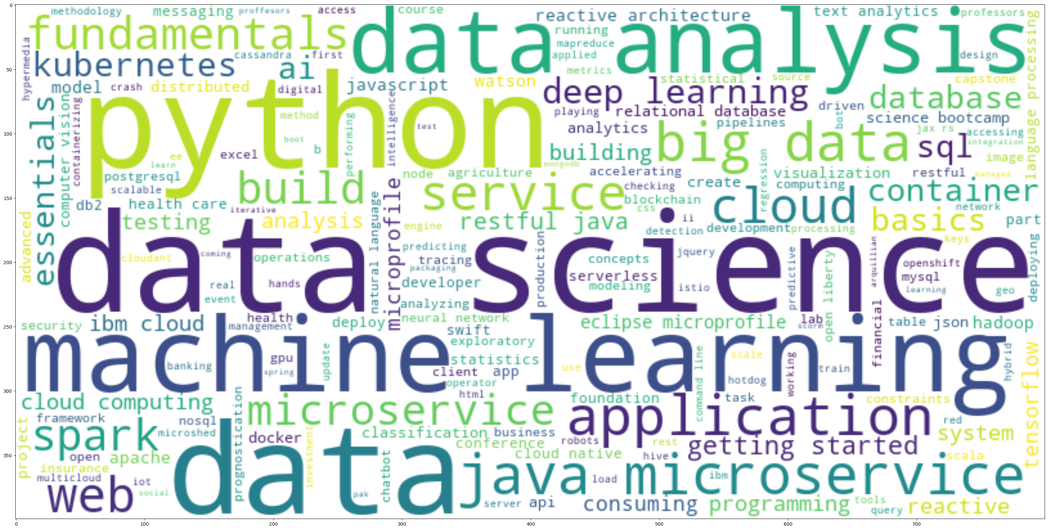
Word cloud of course titles
Notes:
The Word cloud was generated form the words from the course titles in the course_df dataframe from the course_genre.csv file. As we can see from the largest font-size words of “python”, “data science”, “data”, and “machine learning”, many of the course titles involved those words/phrases.

Slide 10
Content-based Recommender System using Unsupervised Learning
Cluster2
Cluster1

Slide 11
Flowchart of content-based recommender system using user profile and course genres
- Plot a flowchart which should clearly illustrate how you implemented the content-based recommender system using user profile vectors and course genre vectors
Briefly explain the flowchart in the slide note
An example flowchart may look like the following:
Raw data
Data processing
Cleaned datasets
Feature engineering
Features

Slide 12
Evaluation results of user profile-based recommender system
Place your hyper-parameter settings, such as recommendation score or course similarity thresholds, etc.
Note: if you have tried multiple hyper-parameters, you may group and show all results in a grouped bar chart
On average, how many new/unseen courses have been recommended per user (in the test user dataset)
What are the most frequently recommended courses? Return the top-10 commonly recommended courses across all users

Slide 13
Flowchart of content-based recommender system using course similarity
- Plot a flowchart which should clearly illustrate how you implemented the course similarity based recommender system
- Briefly explain the flowchart in the slide note
An example flowchart may look like the following:
Raw data
Data processing
Cleaned datasets
Feature engineering
Features

Slide 14
Evaluation results of course similarity based recommender system
Your hyper-parameter settings, such as a score or similarity threshold
Note if you have tried multiple hyper-parameters, you may show your results in a grouped bar chart
On average, how many new/unseen courses have been recommended per user (in the test user dataset)
What are the most frequently recommended courses? Return the top-10 commonly recommended courses

Slide 15
Flowchart of clustering-based recommender system
Plot a flowchart which should clearly illustrate how you performed user profile clustering based recommender system
- Briefly explain the flowchart in the slide note
An example flowchart may look like the following:
Raw data
Data processing
Cleaned datasets
Feature engineering
Features

Slide 16
Evaluation results of clustering-based recommender system
Your hyper-parameter settings, such as a score or similarity threshold
Note if you have tried multiple hyper-parameters, you may show your results in a grouped bar chart
On average, how many new/unseen courses have been recommended per user (in the test user dataset)
What are the most frequently recommended courses? Return the top-10 commonly recommended courses

Slide 17
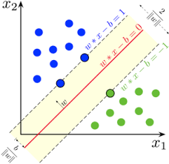
Collaborative-filtering Recommender System using Supervised Learning

Slide 18
Flowchart of KNN based recommender system
Plot a flowchart which should clearly illustrate how you performed KNN based recommender system using course enrollments history
- Briefly explain the flowchart in the slide note
An example flowchart may look like the following:
Raw data
Data processing
Cleaned datasets
Feature engineering
Features

Slide 19
Flowchart of NMF based recommender system
- Plot a flowchart which should clearly illustrate how you performed NMF based recommender system
- Briefly explain the flowchart in the slide note
An example flowchart may look like the following:
Raw data
Data processing
Cleaned datasets
Feature engineering
Features

Slide 20
Flowchart of Neural Network Embedding based recommender system
- Plot a flowchart which should clearly illustrate how you performed Neural Network Embedding based recommender system
- Briefly explain the flowchart in the slide note
An example flowchart may look like the following:
Raw data
Data processing
Cleaned datasets
Feature engineering
Features

Slide 21
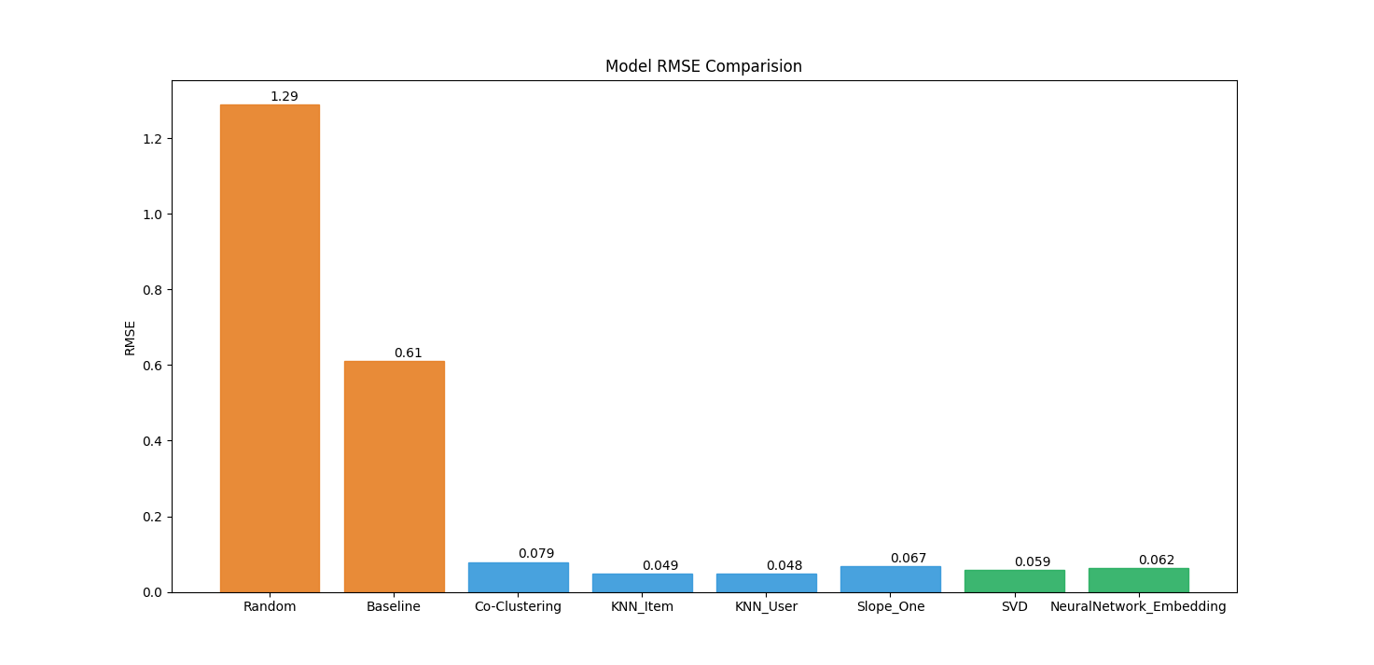
Compare the performance of collaborative-filtering models
Plot a barchart visualizing the performance metric (such as RMSE) of different collaborative-filtering models you have built so far
Briefly explain the barchart in the slide note
A sample barchart may look like the following

Slide 22
Optional: Build a course recommender system app with Streamlit
Streamlit app screenshot1
Streamlit app screenshot2
A published Streamlit App URL for a live demo

Slide 23
Conclusions
Point 1
Point 2
Point 3
Point 4
…

Slide 24
Appendix
Instructions for learner:
Include any relevant assets like a GitHub repo, key Python code snippets, charts, notebook outputs, or deployed Streamlit app URLs that you may have created during this project
Asset 1
Asset 2
Asset 3
Asset 4
…

